Slide 1

Preston and South Ribble Flood Risk Management Scheme (FRMS)
August 2021
Official
Notes:
Ensure residents are aware of scheme and disruption, check any issues we haven’t thought of.

Slide 2
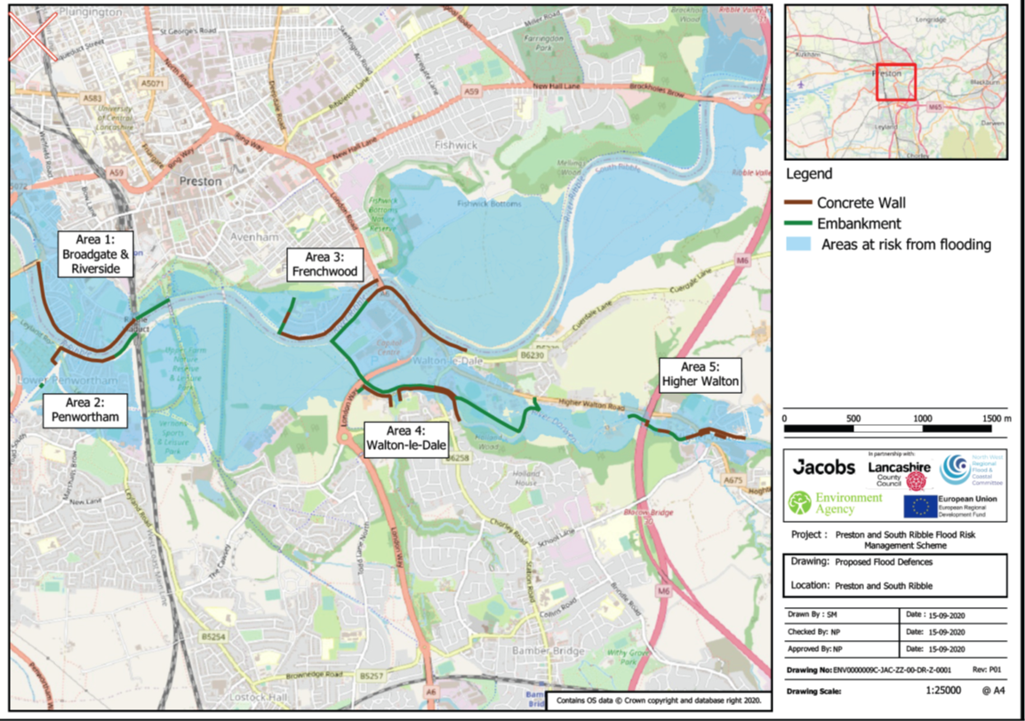
Preston & South Ribble Scheme
The Scheme is divided into 5 areas of work:
● Area 1 –Broadgate and Riversway
● Area 2 – Lower Penwortham
● Area 3 – Frenchwood and Walton-Le-Dale (along the Ribble)
● Area 4 – Walton-Le-Dale (along the Darwen)
● Area 5 – Higher Walton.
Official

Slide 3




Preston & South Ribble Scheme
The original defences were built intermittently from the 1920s to 1980s and are coming to the end of their life, they need repairing or replacing and ideally brought up to a 75 year standard of protection. The aim of the scheme is to improve the protection to over 4800 business and residential properties by raising the existing defences and building new walls to protect properties within the scheme. Over 200 homes and businesses flooded on boxing day, this was a near miss for other properties and businesses as the event only just missed NEAP high tides.
£
£
required
1.33% AEP
~4700
£54.7m
Cost of scheme.
Funding is still required, will continue to be sought.
Scheme will provide a 1.33% (1 in 75) Annual Exceedance Probability
Residential Properties and business properties directly benefiting from the scheme
5:1
Enhancement and mitigation opportunities
9Km
2020-2024
For every tree removed, 5 will be planted
Amount of new and improved defences
Opportunity for habitat, sports and leisure enhancements
Scheme started in 2019 (ground investigation) and constructed by end 2024
Official

Slide 4
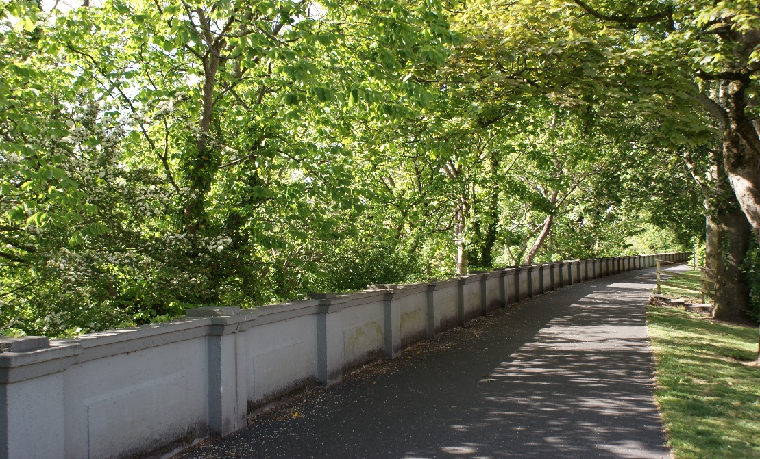
Preston & South Ribble Flood
Risk Management Scheme
Areas to highlight
Tree loss
Diversions and road closures
Extension of the defences into
the river
Miller Park entrance diversion
Work around Penwortham Methodist church
Access
Official

Slide 5
Preston & South Ribble Flood
Risk Management Scheme
Areas to highlight
Works: 100m sections: expect to start at area 2B Riverside Road to End of Riverside (April 22 to end Dec 22),
Access: Will be restricted as result of works. Emergency access.
Surveys: Property surveys to be carried out
Temporary Cycleway
Drop in office: office on site for public to speak to contractors/team
Extension of the defences into the river
Tree planting and Landscaping to take place Inc. 0.35HA at Ribble Sidings.
Official

Slide 6
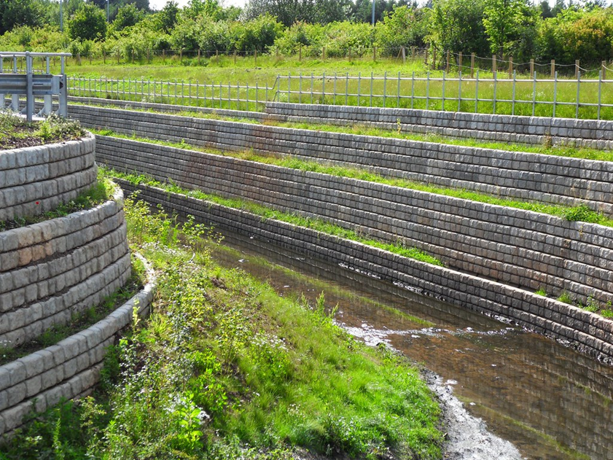
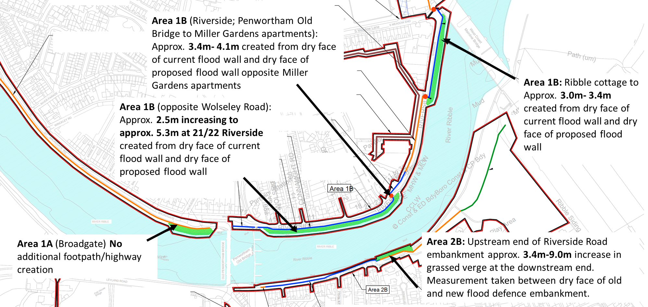
Preston & South Ribble Flood
Risk Management Scheme
Areas to highlight
Official

Slide 7
Preston & South Ribble Flood
Risk Management Scheme
Guild Wheel
Official

Slide 8

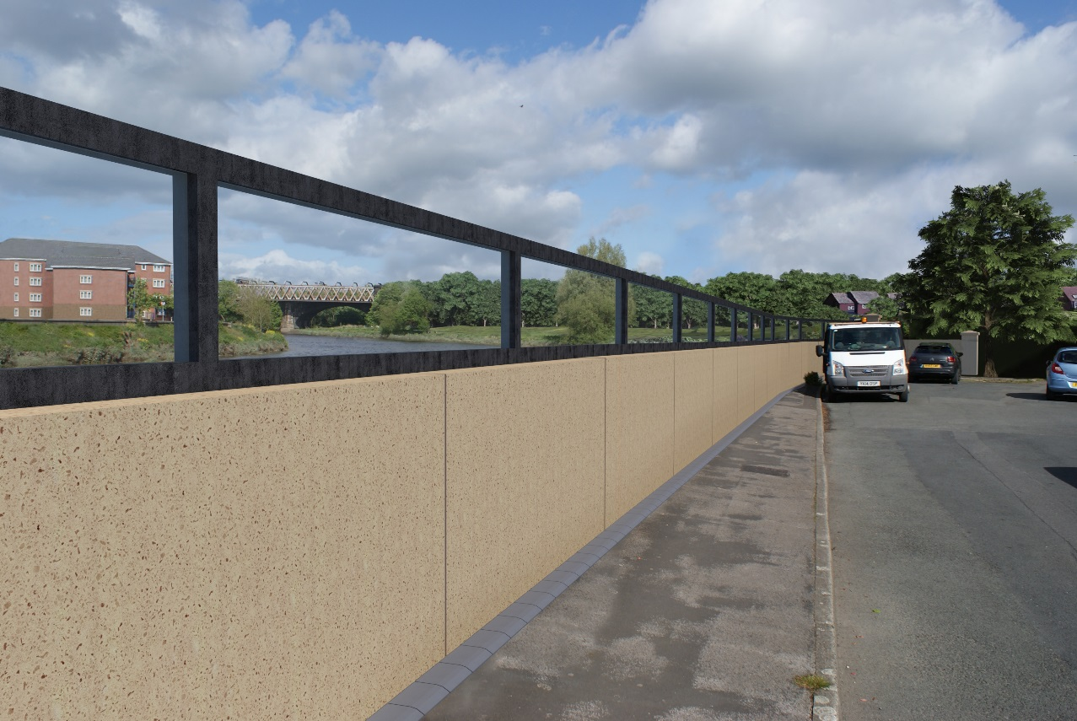
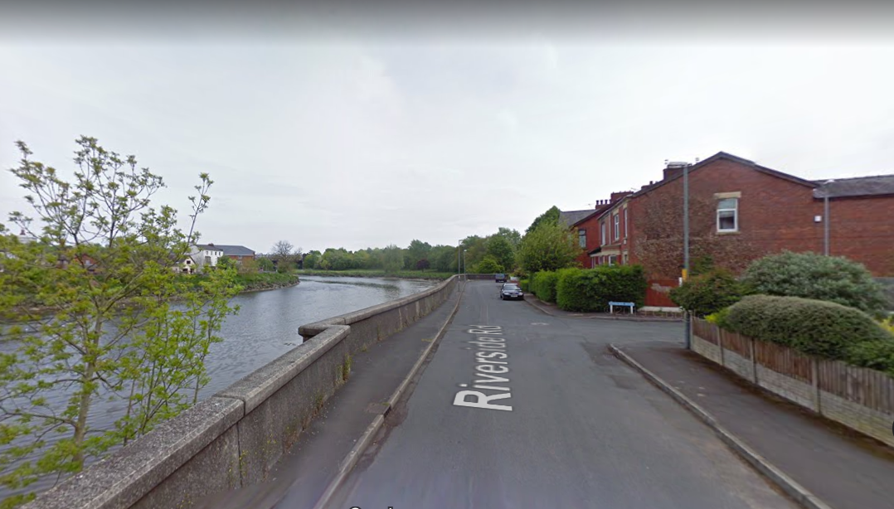
Riverside Road Visualisation
looking upstream from the gas pipe bridge
between Havelock Road and Fairhaven Road
Pillar altered to retain views
Glass panels extended to pillar to retain views.
Redi-Rock revetment to rear of pillar to stabilise bank
Pre-cast flood wall with glass panels on top to retain existing views of the river. Glass panels are typically 800mm high. No copings on top of pre-cast wall where glass panels are used.
Grey stone sett along bottom of wall to provide tidy interface with footpath. Path reinstated with tarmac.
Joints between wall panels to match colour of wall.

Slide 9


Official
Notes:
AMQ:
As part of planning we have been asked to provide further detail on the finishes of the defences. This is what has been accepted by the public. Expect that this will be a planning condition. Needs to be in keeping with existing structures and take into account graffiti. Existing walls not graffiti.
Pre-cast concrete flood walls: Smooth finish concrete walls would be consistent with the existing flood defences found within the area. A pre-cast concrete wall would provide a consistent design theme to the flood defence to complement the diverse mix of architectural styles and materials within the urban area.
Proposed materials are sandstone or yellow cream colour with a smooth finish. Final colour and finish selections to be discussed and agreed by the Environment Agency.
Wall could have an exposed aggregate finish to the top half of the wall with a straight lower edge similar to finish shown in the photo of the Warrington Flood Defence Scheme but with no wavy lower edge.
Working closely with the supplier during the design process to achieve the desired colour and finish. The supplier would produce a trial panel to demonstrate required finish can be achieved to a high standard and consistency
Another option for Broadgate is the red colour imprinted as per the illustrative example to match the colours of London Rd Bridge.
Glass panelled walls
Location: Along Riverside between Penwortham Old Bridge and Miller Park Apartments; in front of the Continental Public House restaurant; and along Riverside Road from the Cadent Gas Pipe Bridge to Stanley Road.
Purpose: to maintain critical views of the river and key landmark buildings from residential properties and identified vantage points.

Slide 10
Preston & South Ribble Scheme
Questions
Official
Notes:
AMQ
Thank you for your participation today, we have recorded the meeting today so we can share this with other elected members who were not here. The information will be available to your constituents from next week. If you have any queries please do get in touch, we value your continued support to deliver this scheme.

