Slide 1
What is Climate Change?
Lesson aim:
To understand what climate change is, the causes of it and why it is happening.
Lesson objectives:
To learn about the greenhouse effect and how it is causing global warming and climate change.
To be aware of how the global temperature has changed over time.
To learn about the human activities that are causing climate change.

Slide 2
Recap
Weather -
Sunshine, rain, thunderstorms, wind and snow are all examples of weather. The weather is described as what is happening outside right now. It is temporary and only lasts a few days and weeks.
Climate -
Climate is a description of the weather conditions in an area over the last 30 years.

Slide 3
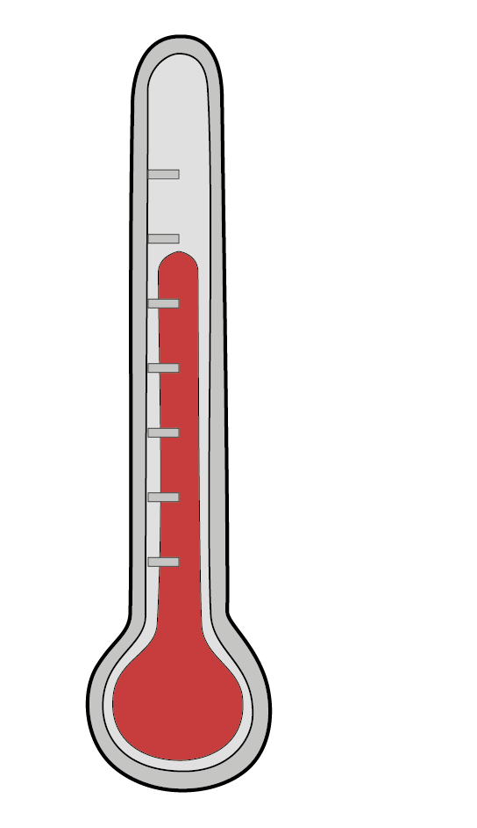
What is Climate Change?
In pairs, discuss what you think climate change is?

Slide 4
Climate Change
Climate change is a change in the Earth’s usual weather conditions over many years.

Slide 5
Definitions Match Up Game
Climate change
- a change in the Earth’s usual weather conditions over many years.
Global warming
- an increase in the Earth’s average temperature.
Greenhouse gases
- gases such as carbon dioxide, water vapour and methane, in Earth’s atmosphere that trap heat.
Greenhouse effect
- process where greenhouse gases in the atmosphere trap the sun’s heat.

Slide 6
Definitions Match Up Game
Climate change
Global warming
Greenhouse gases
Greenhouse effect
- an increase in the Earth’s average temperature.

Slide 7
Definitions Match Up Game
Climate change
Global warming
- an increase in the Earth’s average temperature.
Greenhouse gases
Greenhouse effect
- process where greenhouse gases in the atmosphere trap the sun’s heat.

Slide 8
Definitions Match Up Game
Climate change
Global warming
- an increase in the Earth’s average temperature.
Greenhouse gases
Greenhouse effect
- process where greenhouse gases in the atmosphere trap the sun’s heat.
- a change in the Earth’s usual weather conditions over many years.

Slide 9
Definitions Match Up Game
Climate change
- a change in the Earth’s usual weather conditions over many years.
Global warming
- an increase in the Earth’s average temperature.
Greenhouse gases
Greenhouse effect
- process where greenhouse gases in the atmosphere trap the sun’s heat.
- gases such as carbon dioxide, water vapour and methane, in Earth’s atmosphere that trap heat.

Slide 10
Definitions Match Up Game
Climate change
- a change in the Earth’s usual weather conditions over many years.
Global warming
- an increase in the Earth’s average temperature.
Greenhouse gases
- gases such as carbon dioxide, water vapour and methane, in Earth’s atmosphere that trap heat.
Greenhouse effect
- process where greenhouse gases in the atmosphere trap the sun’s heat.

Slide 11
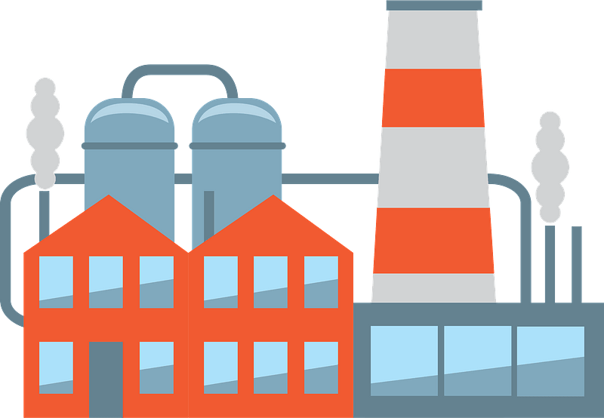
Climate Change and Global Warming
The climate and global temperature has always varied slightly over time. However, since the Industrial Revolution, there has been a sharp increase in temperature.
This is due to global warming caused by human activity. Some human activity creates more greenhouse gases which is causing the greenhouse effect.

Slide 12
The Industrial Revolution
The Industrial Revolution marked a big change in society as lots of large factories began being built in towns and cities. Instead of working in agriculture and products being made by hand in rural homes or small workshops, things began being made in big factories in towns and cities (industrialisation).
As a result, lots of people moved from the countryside to larger towns and cities in order to work and earn money.
Watch the video below about the industrialisation that occurred in Britain as a result of the Industrial Revolution.
Click here to watch a video about “Industrialisation” by BBC Teach.

Slide 13
Greenhouse Gases (GHG) and the Greenhouse Effect (GHE)
Human activity is causing an increase in greenhouse gases being released into our atmosphere. These gases are:
Carbon Dioxide (CO2)
Methane (MH4)
Sulphur Dioxide (SO2)
Water Vapour (H2O)
Nitrous Oxide (N2O)
Chloroflurocarbons (CFCs)
Ozone
Image by Clker-Free-Vector-Images from Pixabay
Greenhouse gases support all life on Earth and without them, the Earth would be on average 18°C cooler.

Slide 14
Global Warming and the Greenhouse Effect (GHE)
Click here to watch a ‘What is Global Warming?’ video by BBC What’s New / Actu Jeunes
Video: BBC What’s New / Actu Jeunes YouTube Video

Slide 15
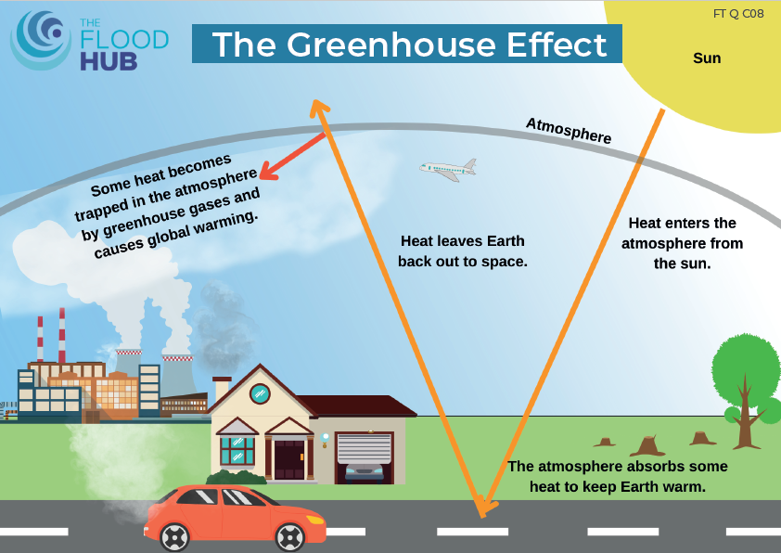
Greenhouse Effect (GHE)
1
2
6
3
5
4

Slide 16
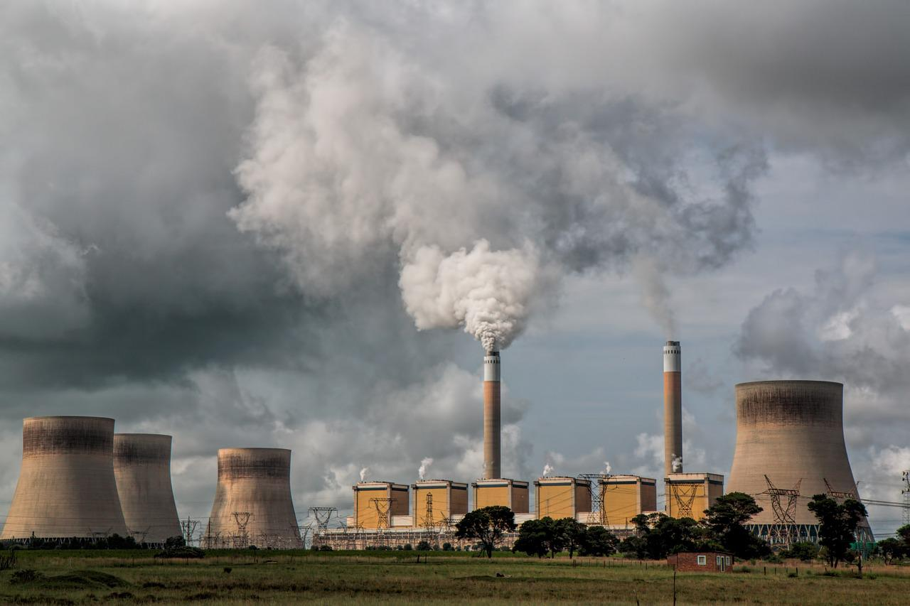
What is Causing Climate Change?
Burning of fossil fuels
Fossil fuels are coal, oil and gas and were formed millions of years ago.
We use them for many things, such as to heat our homes, drive vehicles, fly planes, run factories and power technology.
They are harmful as they release greenhouse gases into the atmosphere.
Photo by Steve Buissinne from Pixabay

Slide 17
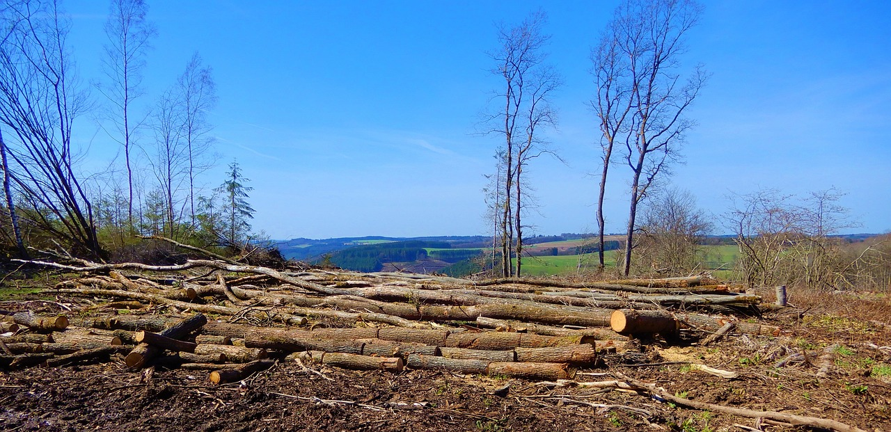
What is Causing Climate Change?
Deforestation
Deforestation is the cutting down of trees, which destroys forests. The wood can be used for buildings, paper and agriculture.
Trees store carbon dioxide and when trees are cut down, the carbon dioxide is released into the atmosphere which contribute to the greenhouse effect and global warming.
Photo by Hans Bijstra from Pixabay

Slide 18
What is Causing Climate Change?
Deforestation
YouTube Video by Christie Todd

Slide 19
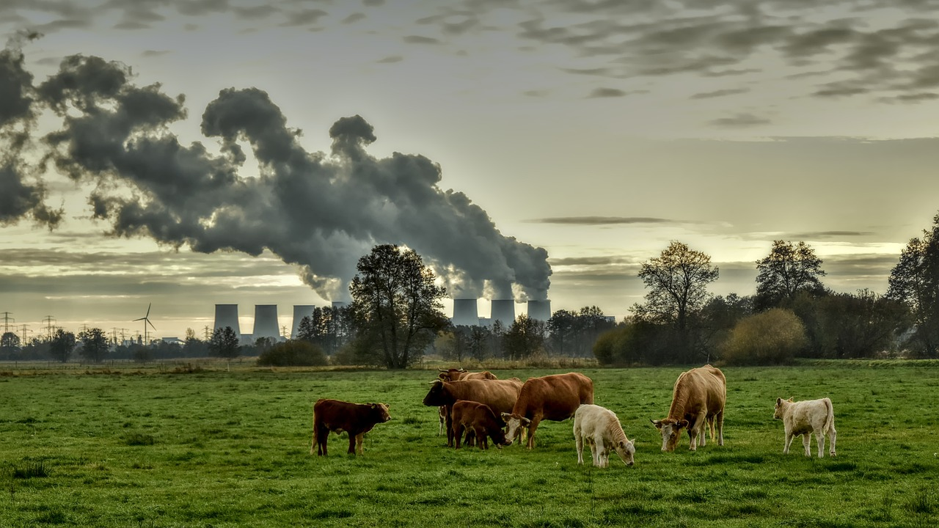
What is Causing Climate Change?
Intensive Farming
In some countries, lots of trees and forests have been cut down and cleared to make way for farmland, so there are less trees to absorb carbon dioxide from the atmosphere.
Also, in order for us to keep eating meat and dairy, humans have been farming more livestock such as cows and sheep and they release methane.
Photo by Peggychoucair from Pixabay

Slide 20
Climate Change Video
Show video for the first three minutes – YouTube video by Matt Miltonberger- https://www.youtube.com/watch?v=-D_Np-3dVBQ&t=359s

Slide 21
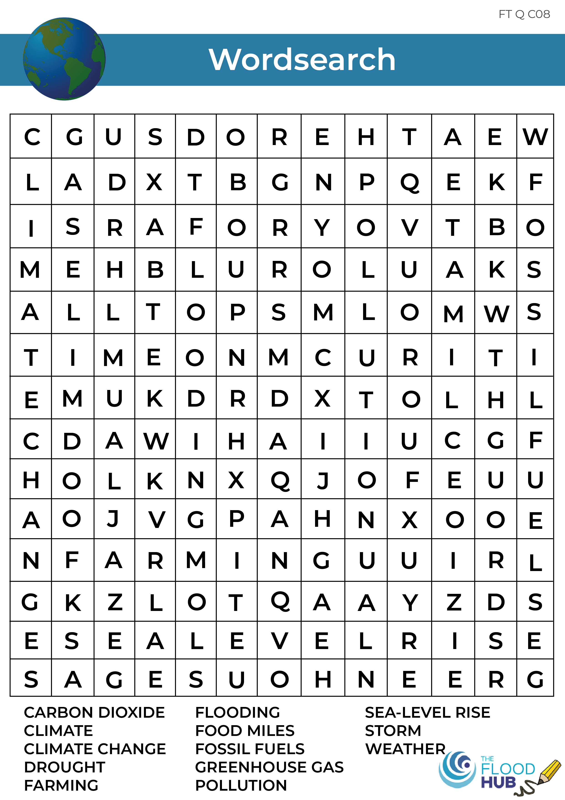
Climate Change Wordsearch

Slide 22
Homework
Choose one of the following topics:
Create a poster about climate change on one of these topics:
Climate change and the greenhouse effect
Causes of climate change
Write a newspaper article about climate change and the causes of it

