Slide 1
What are the Effects of Climate Change?
Lesson aim:
To be able to name the effects that climate change is having on the world.
Lesson objectives:
To be able to name at least three effects of climate change.
To be aware that the effects are becoming increasingly visible each year.

Slide 2
Lesson Recap
Climate change
- a change in the Earth’s usual weather conditions over many years.
Global warming
- an increase in the Earth’s average temperature.
Greenhouse gases
- gases such as carbon dioxide, water vapour and methane, in Earth’s atmosphere that trap heat
Greenhouse effect
- process where greenhouse gases in the atmosphere trap the Earth’s heat.

Slide 3
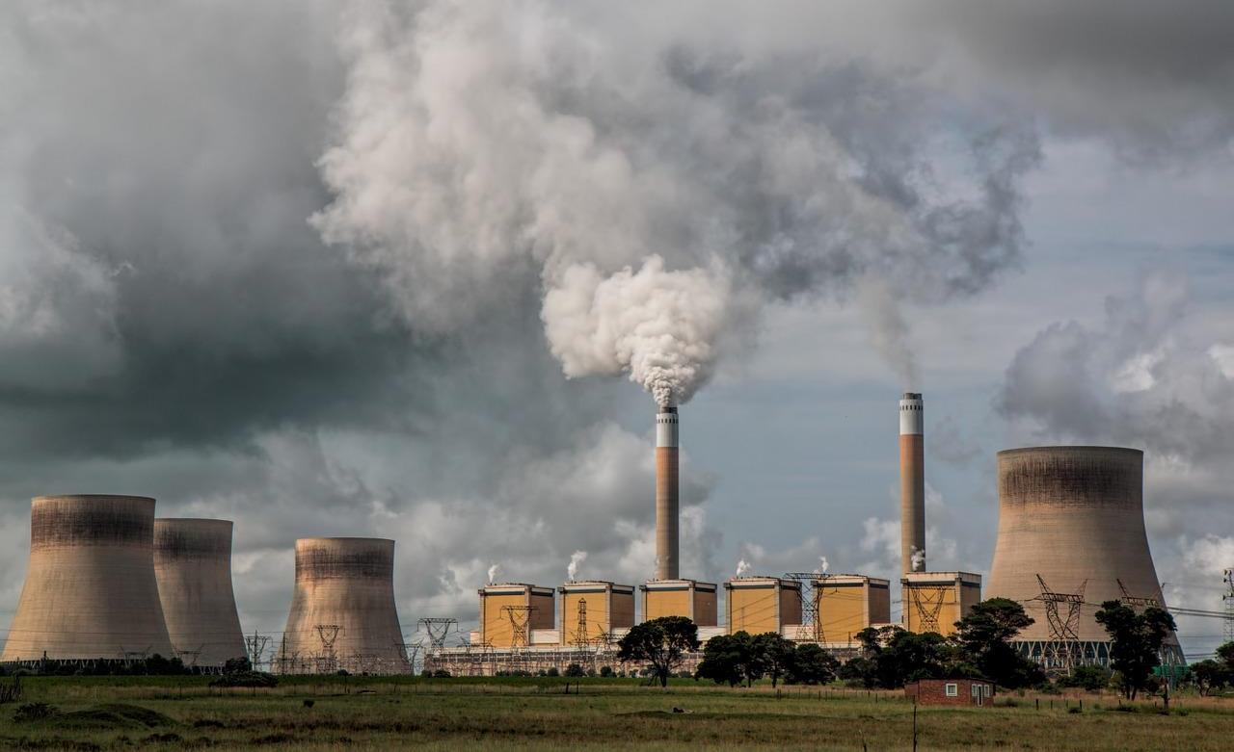
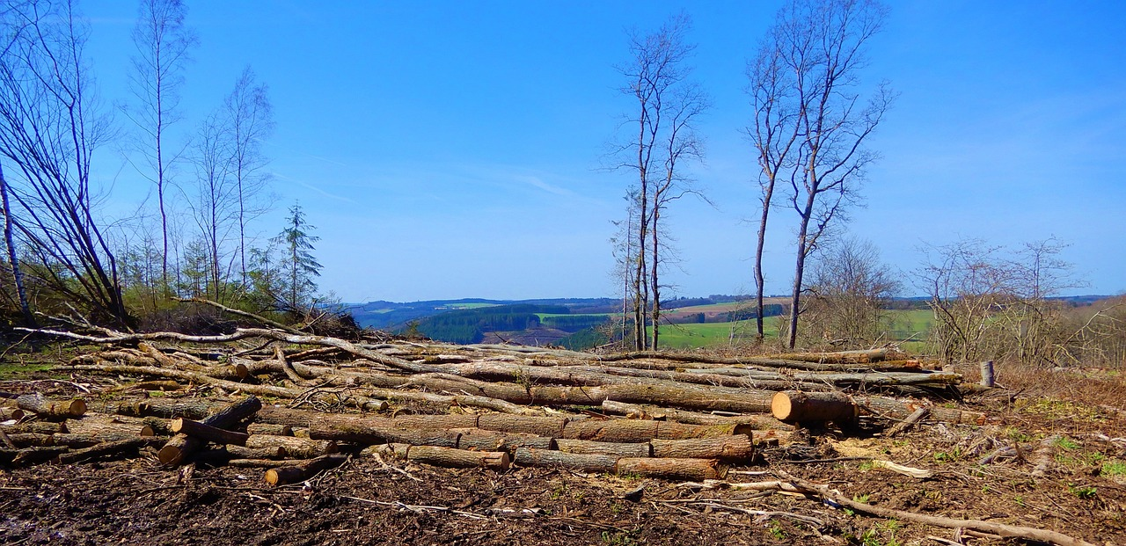
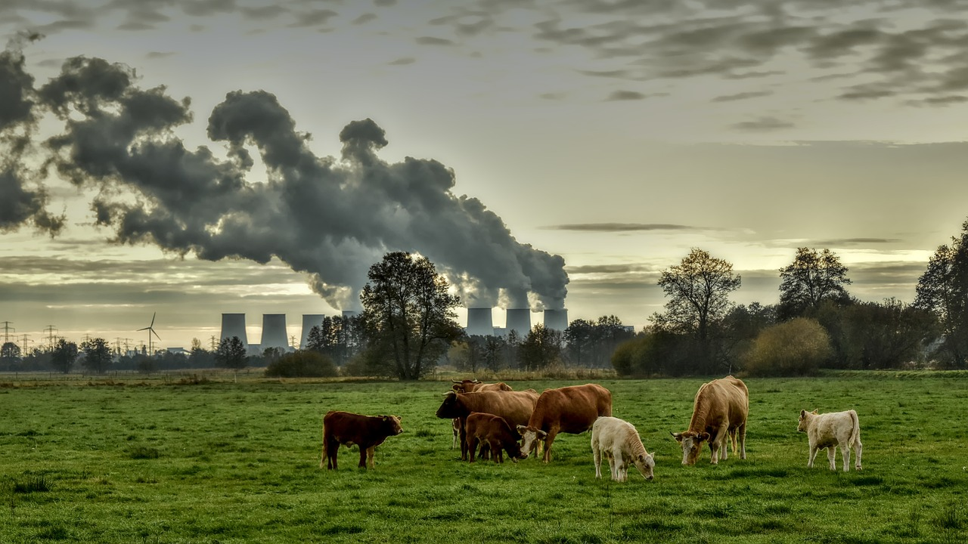
Lesson Recap
The Main Causes of Climate Change
Photo by Steve Buissinne from Pixabay
The burning of fossil fuels
Deforestation
Intensive farming
Fossil fuels are coal, oil and gas and were formed millions of years ago.
We use them for many things, such as to heat our homes, drive vehicles, fly planes, run factories and power technology.
Photo by Hans Bijstra from Pixabay
Photo by Peggychoucair from Pixabay
As population increases across the globe, so are the activities which cause climate change.

Slide 4
The Effects of Climate Change
Do you know any effects of climate change?
If so, write these down in your workbooks.

Slide 5
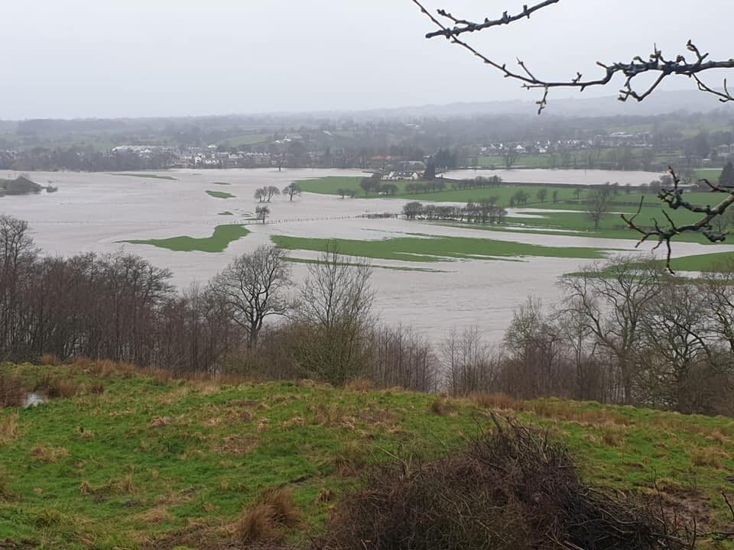
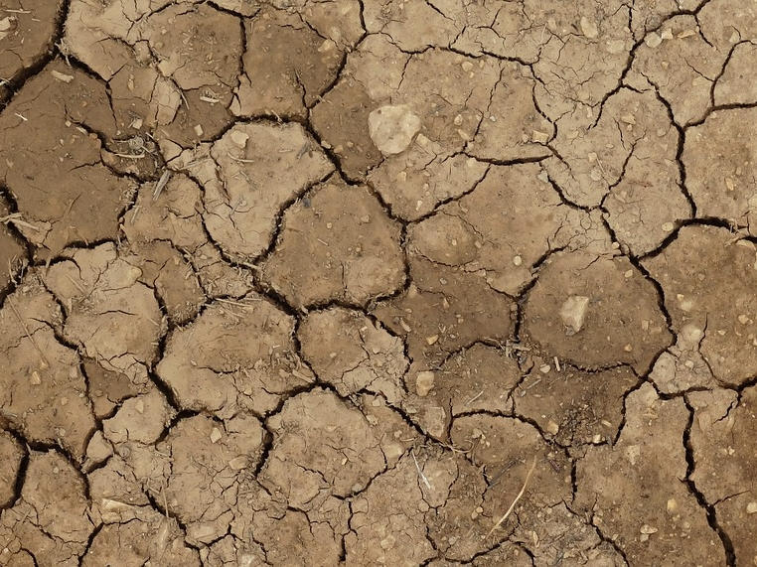
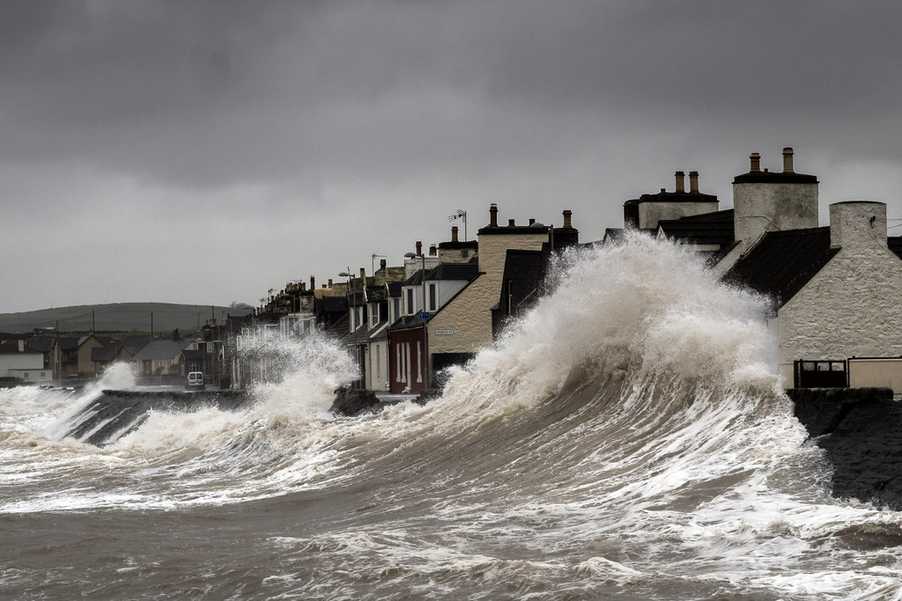
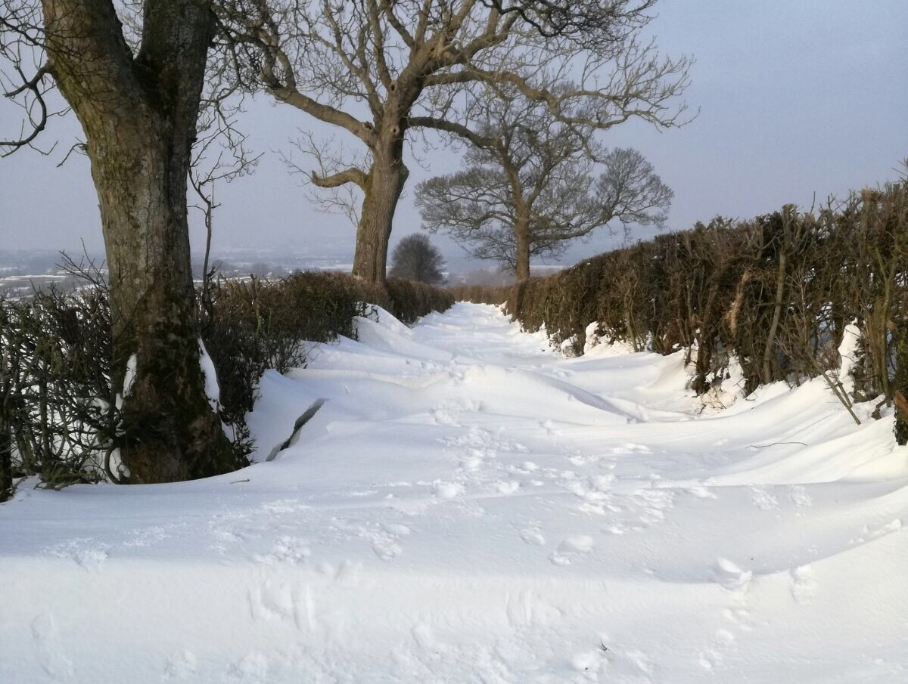
The Effects of Climate Change
Extreme weather
Extreme weather is when the weather is very different from normal. Examples of extreme weather events in the UK are:
Image: The Flood Hub
Storm surge cc-by-sa/2.0 - © David Baird - geograph.org.uk/p/3833138
Image: The Flood Hub
Heavy rain and flooding
Heatwaves and droughts
Strong winds and storms
Heavy snowfall and blizzards
These are becoming more common with climate change.

Slide 6
The Effects of Climate Change
Rising temperatures
The greenhouse effect is causing Earth to heat up. By 2100, the Earth is expected to be between 1.1 and 5.4°C warmer than today.
This will cause more extreme weather events and the melting of the ice caps.
In the UK, our summers will become hotter and drier and winters will become warmer and wetter.

Slide 7
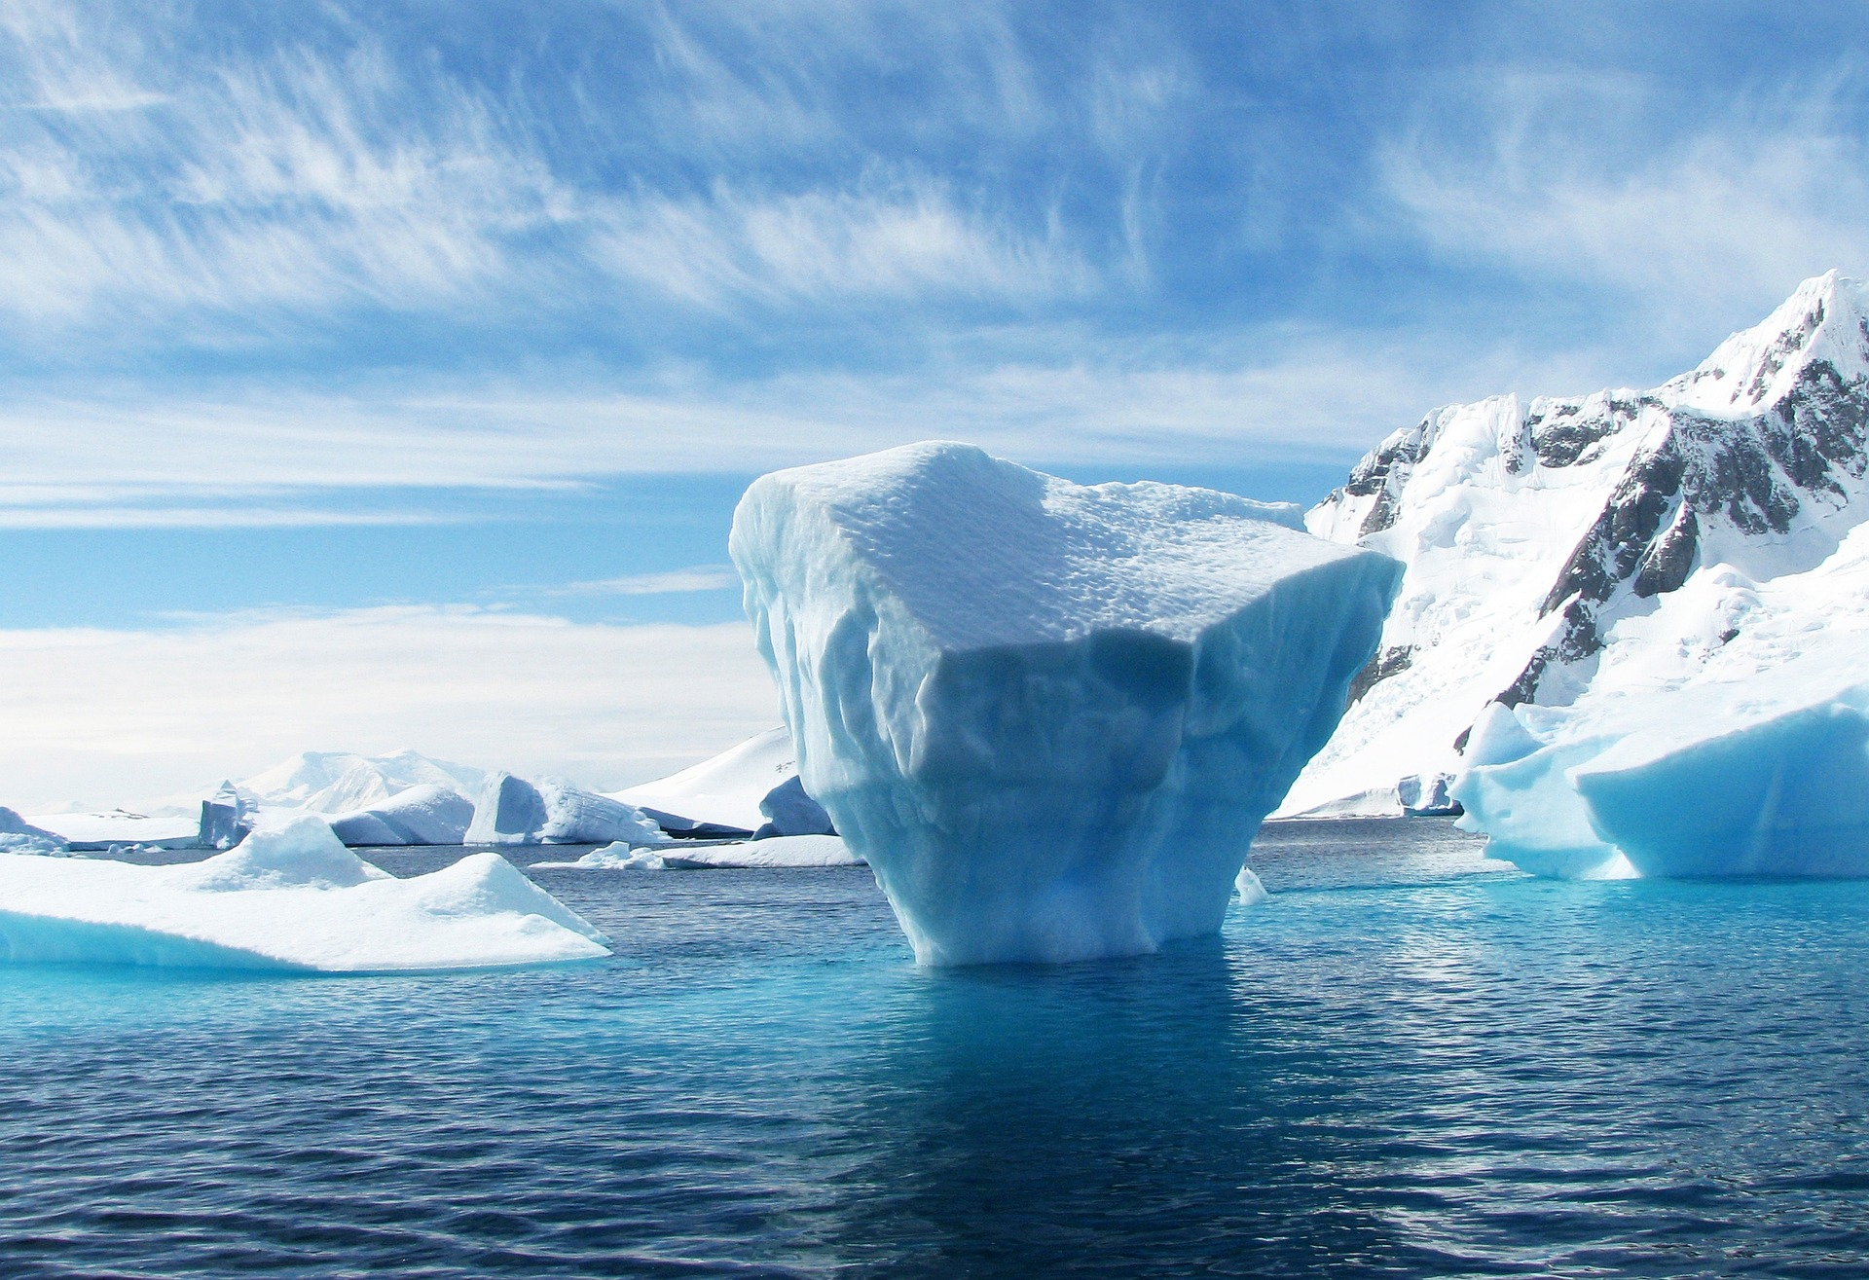
The Effects of Climate Change
Sea-level rise
Due to the Earth heating up, the glaciers and ice caps melt and add more water to our oceans.
This could result in some small islands and coastal areas disappearing underwater.
Image: 358611 from Pixabay
Did you know that sea levels have risen 24cm since 1880?
(BBC Bitesize)

Slide 8
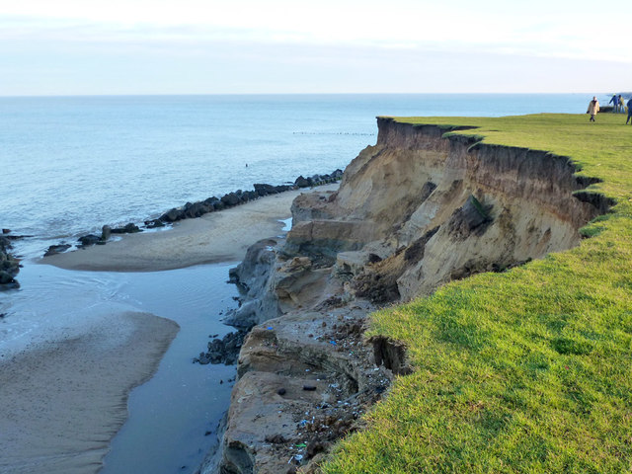
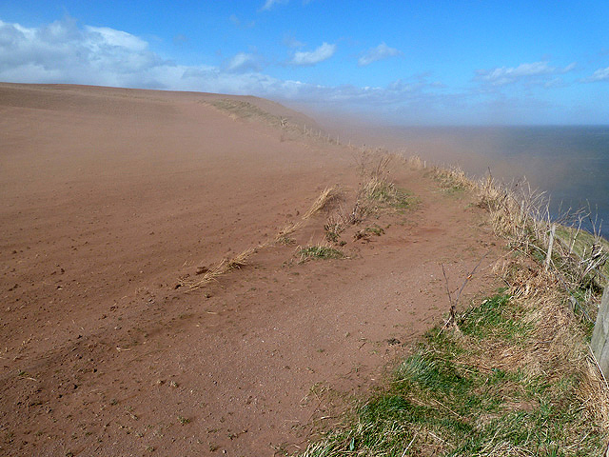
The Effects of Climate Change
Erosion
Erosion is the wearing away of rocks and the Earth’s surface by natural forces such as water, wind and ice.
Image: Cliff, Happisburgh, 2013 cc-by-sa/2.0 - © Robin Webster - geograph.org.uk/p/5885043
Sea-level rise, as well as extreme weather events such as floods, droughts and storms can all increase erosion. Both of which are an effect of climate change.
Image: Wind-blown soil erosion at Bournmouth cc-by-sa/2.0 - © Walter Baxter - geograph.org.uk/p/3420041

Slide 9
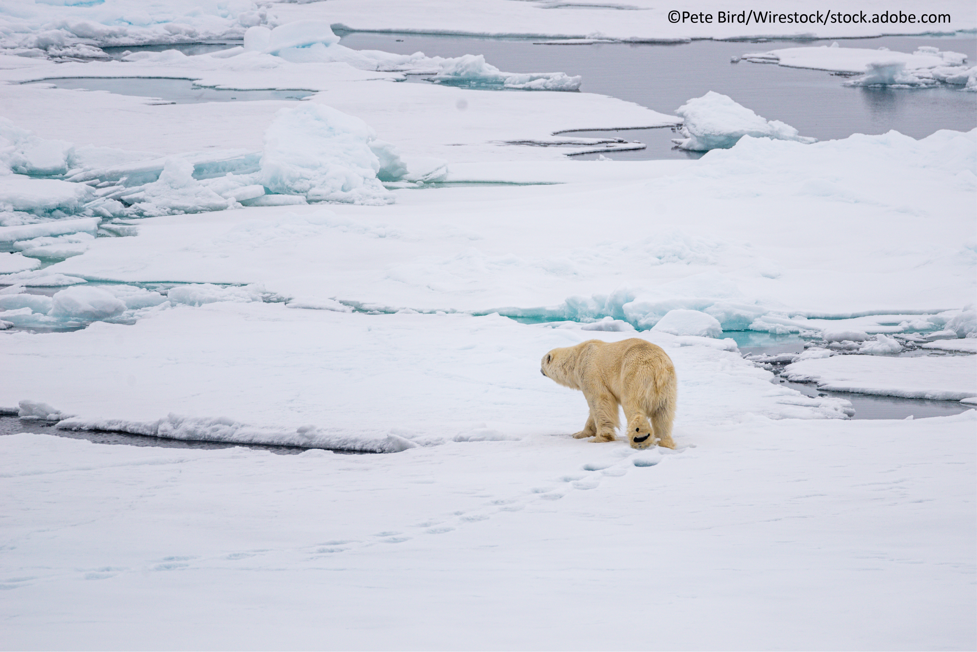
The Effects of Climate Change
Negative effects on ecosystems
Rising temperatures, deforestation, rising sea levels and melting ice caps will have a big impact on plants and animals. Some may be able to adapt to a different habitat, but others may become endangered or even extinct.
For example, polar bears and penguins need ice to survive.

Slide 10
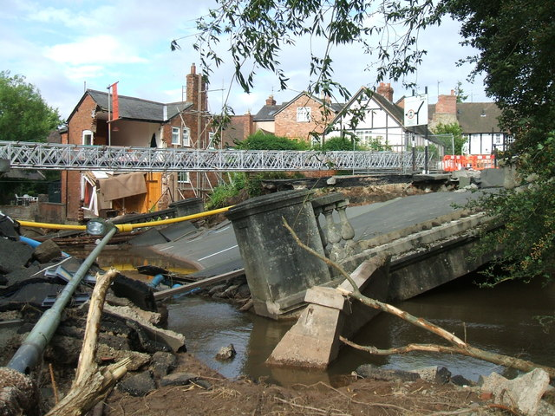
The Effects of Climate Change
Impacts to buildings, roads and railways
Extreme weather events, such as flooding, can cause damage to buildings, roads, railways and power supplies. For example, during a flood, defences, roads and railways can become damaged or overtopped.
Coastal land may also be lost due to flooding, erosion and rising sea levels, which may lead to communities becoming cut off from others.
Flood Damage cc-by-sa/2.0 - © DI Wyman - geograph.org.uk/p/1278873

Slide 11
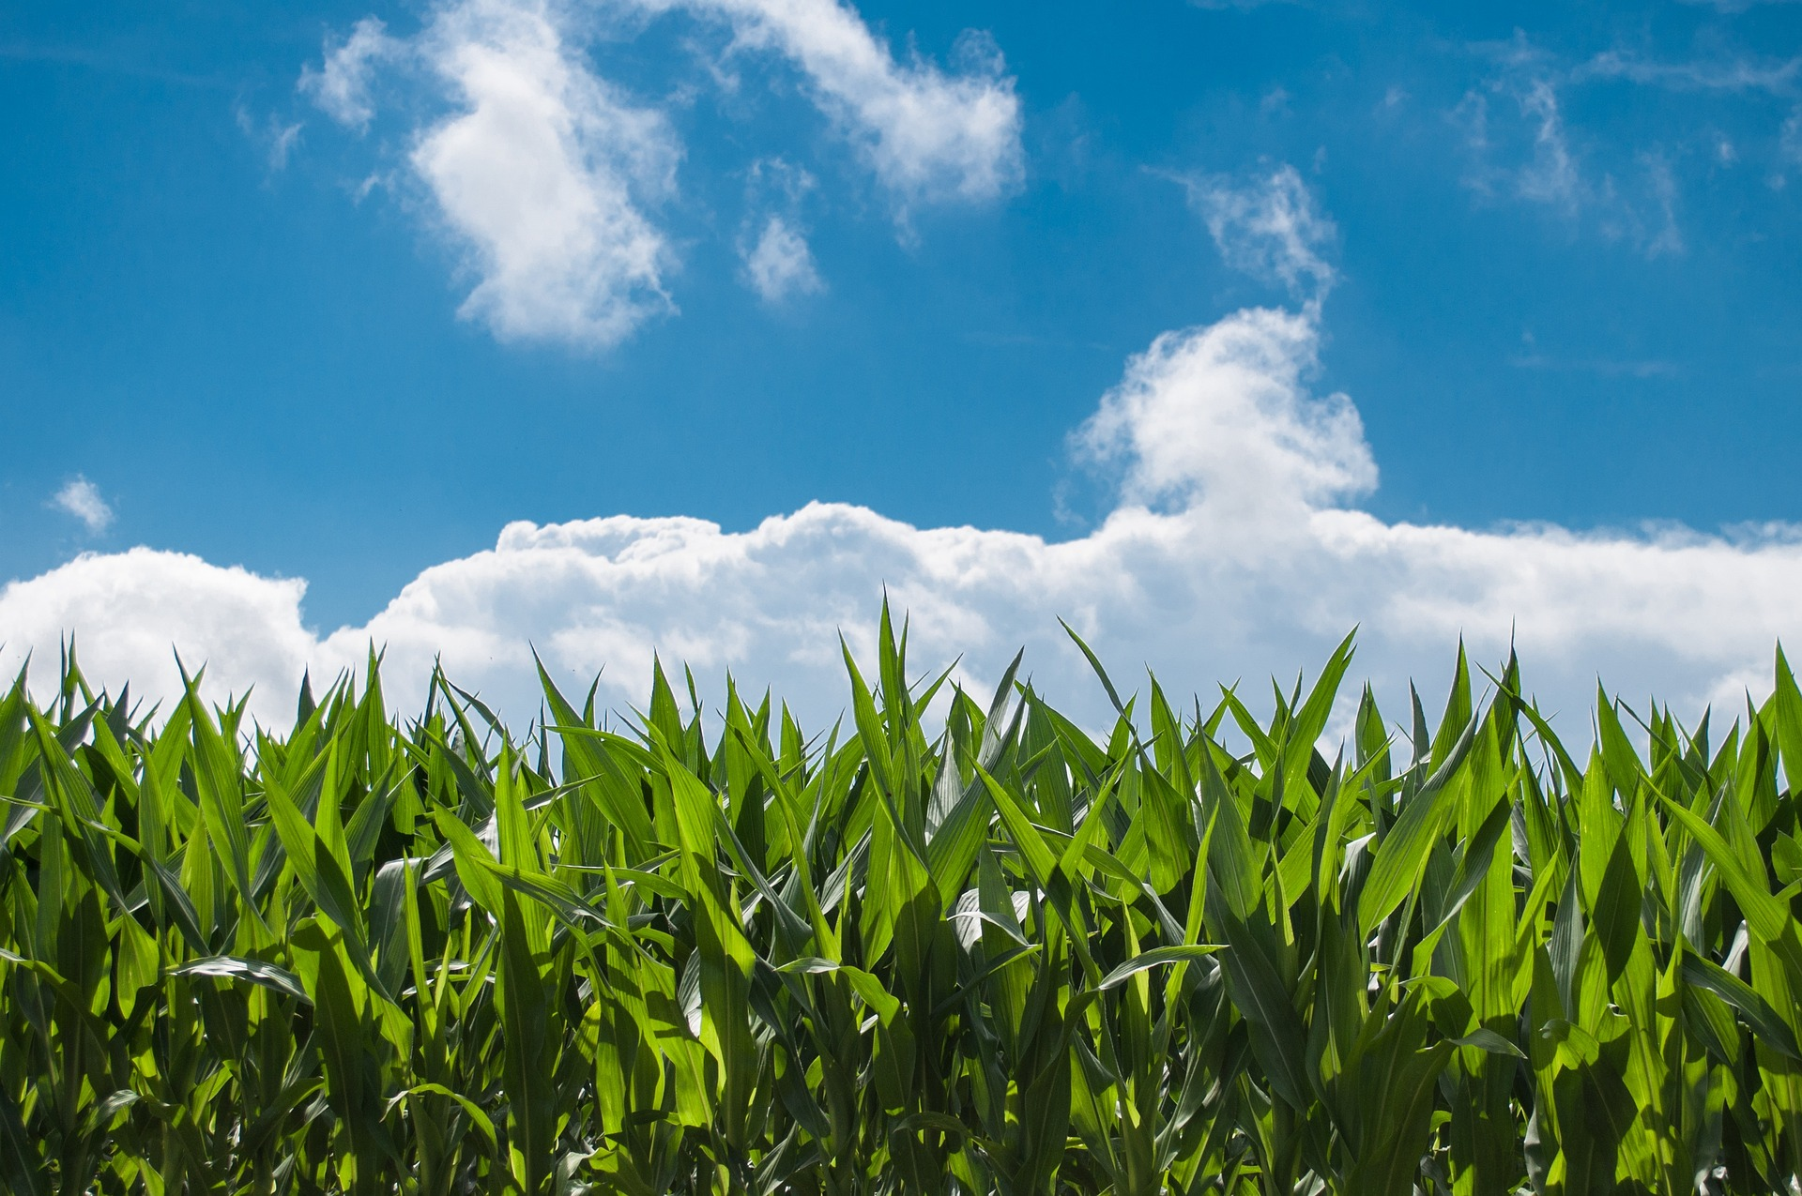
The Effects of Climate Change
Negative effects on food
Changing weather patterns and extreme weather events are putting food production at risk.
Both flooding and drought can destroy crops, both of which will become more common with climate change. This will lead to both food shortages and increased food prices.
Image by Rudy and Peter Skitterians from Pixabay

Slide 12
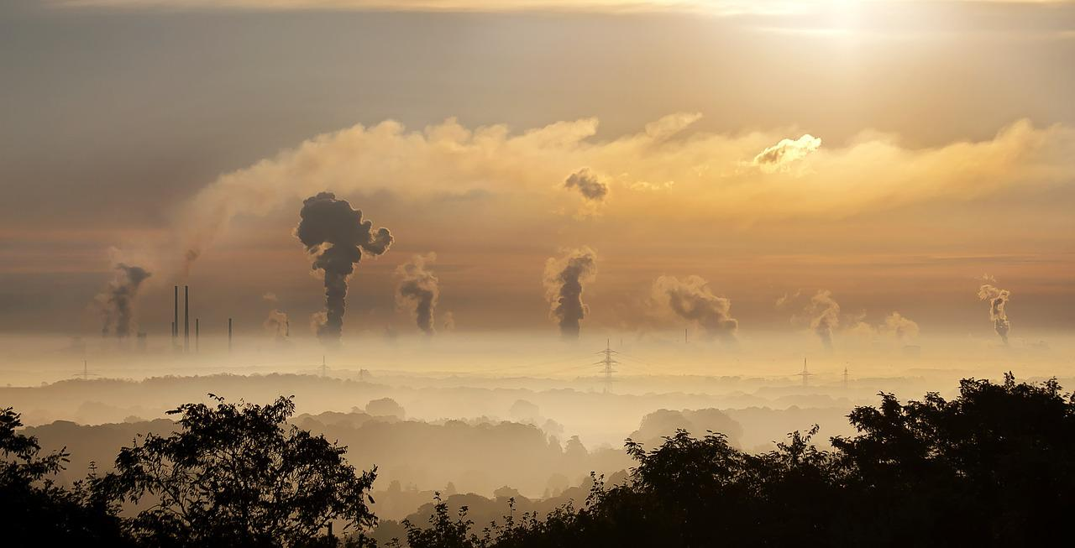
The Effects of Climate Change
Pollution
Burning fossil fuels to power factories, cars and power stations are just some of the ways that harmful greenhouse gases and particles can enter our atmosphere and cause air pollution.
Higher global temperatures can trap the harmful gases and pollutants and cause health problems such as asthma and heart disease.
Image by Foto-RaBe on Pixabay

Slide 13
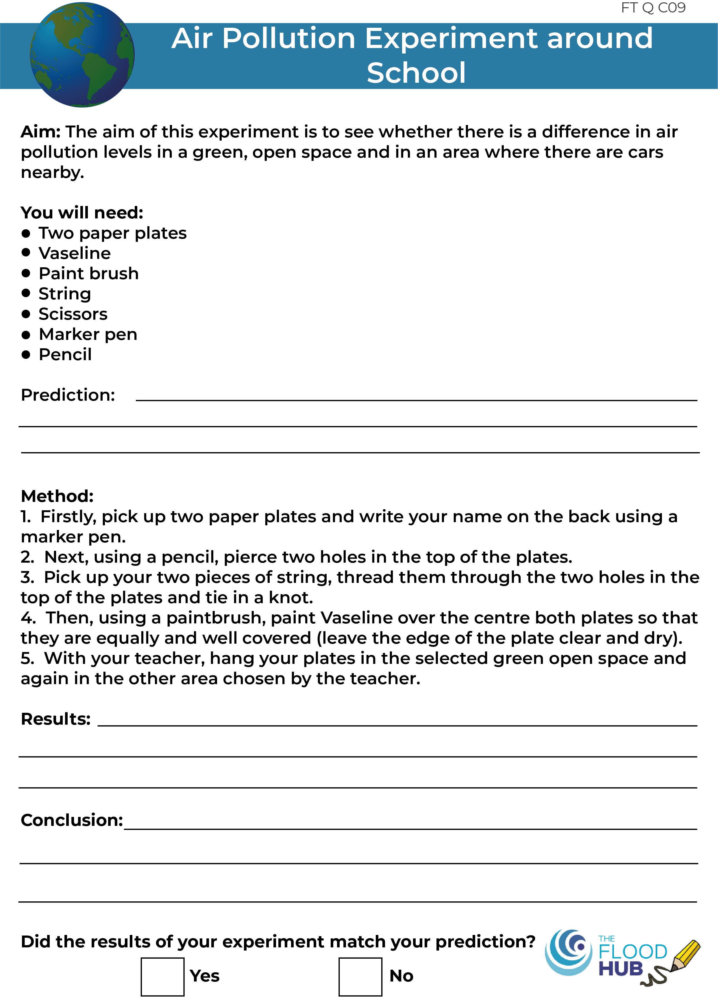
The Effects of Climate Change
Activity – Air pollution science experiment
Image by Foto-RaBe on Pixabay

Slide 14
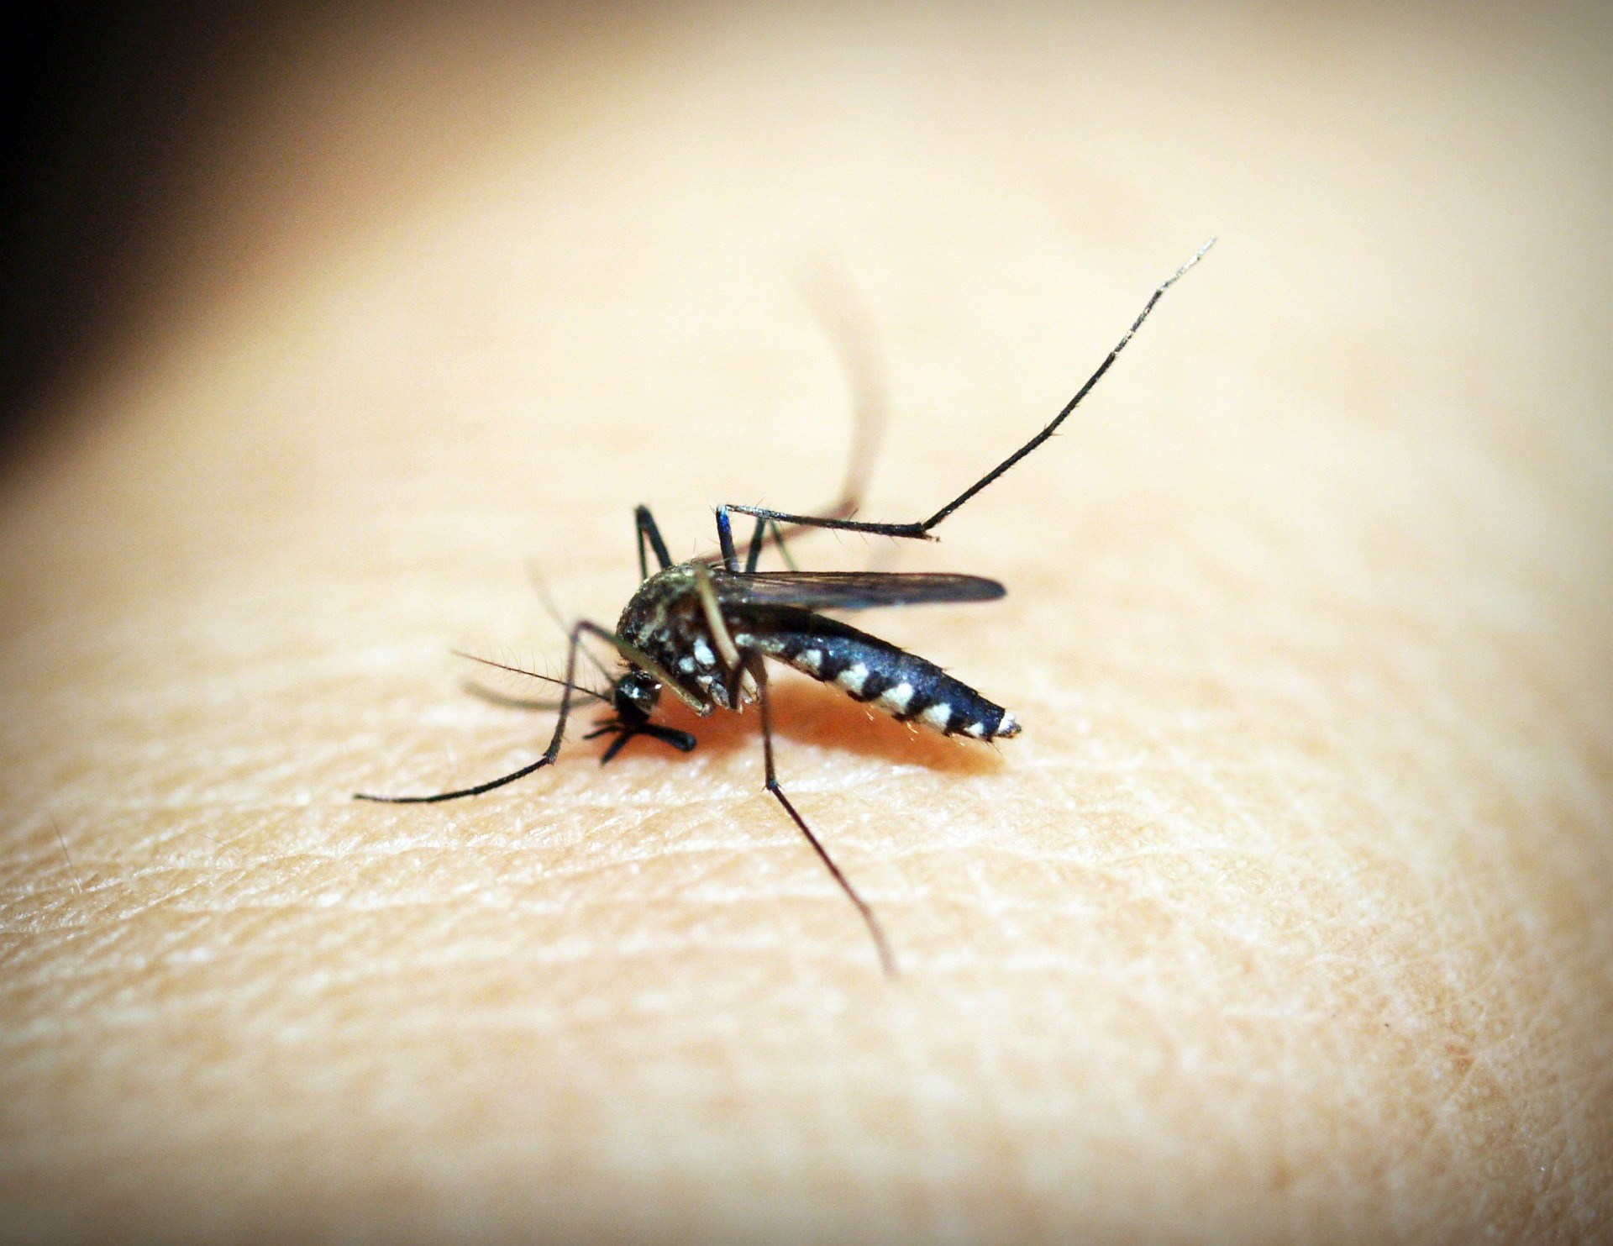
The Effects of Climate Change
Impacts on Human Health
The warmer and wetter weather as a result of climate change causes diseases such as malaria to spread more easily as these weather patterns create the perfect conditions for mosquito habitat.
Increased temperatures and changes in rainfall may cause an increase in wildfires in areas such as California.
Air pollution can also cause breathing issues.
Image by 41330 on Pixabay

Slide 15
The Effects of Climate Change

Slide 16
Activity
Write a poem all about climate change, what is causing it and the effect that it is having on our planet.

Slide 17
Homework
Complete one of the following homework tasks:
Create a poster showing the effects of climate change.
Write a newspaper article or speech about the effects of climate change.

