Slide 1
Reducing Flooding (Part 1)
Lesson aim:
To understand how we can reduce flooding through the catchment using flood schemes
Lesson objectives:
Learn what flood resilience is and the different types
Introduce different types of flood defences
Think of ways we can stop or reduce flooding

Slide 2
Recap…
What is a catchment?
A catchment is an area of land which leads each drop of rain that falls within it, towards the same river.
Can you remember the three ‘courses’ of a river?
1.
2.
3.
Upper course
Middle course
Lower course

Slide 3
Recap…
Who manages the risk of flooding?
Environment Agency –
Water Companies –
Local Council or
County Council –
Main rivers, the sea and reservoirs
Sewer flooding and blockages
Surface water flooding
Now lets take a closer looks at how this is done…

Slide 4
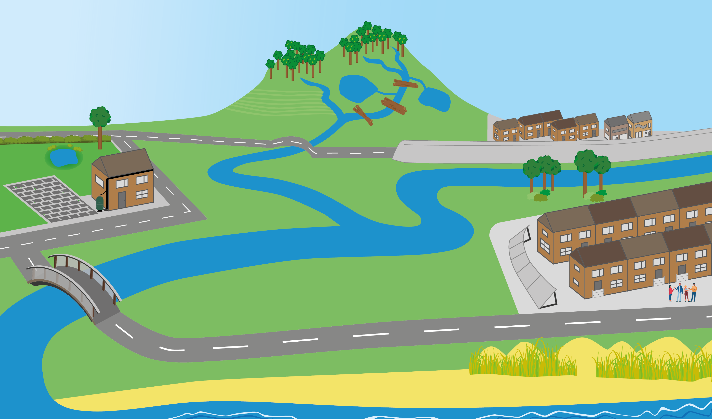
Reducing Flooding
Natural flood management
Do you know any ways we can reduce flooding?
Flood schemes
Only flush the 3 p’s
Sustainable Drainage Systems (SuDS)
Property Flood Resilience (PFR)
Preparing for flooding & creating community groups

Slide 5
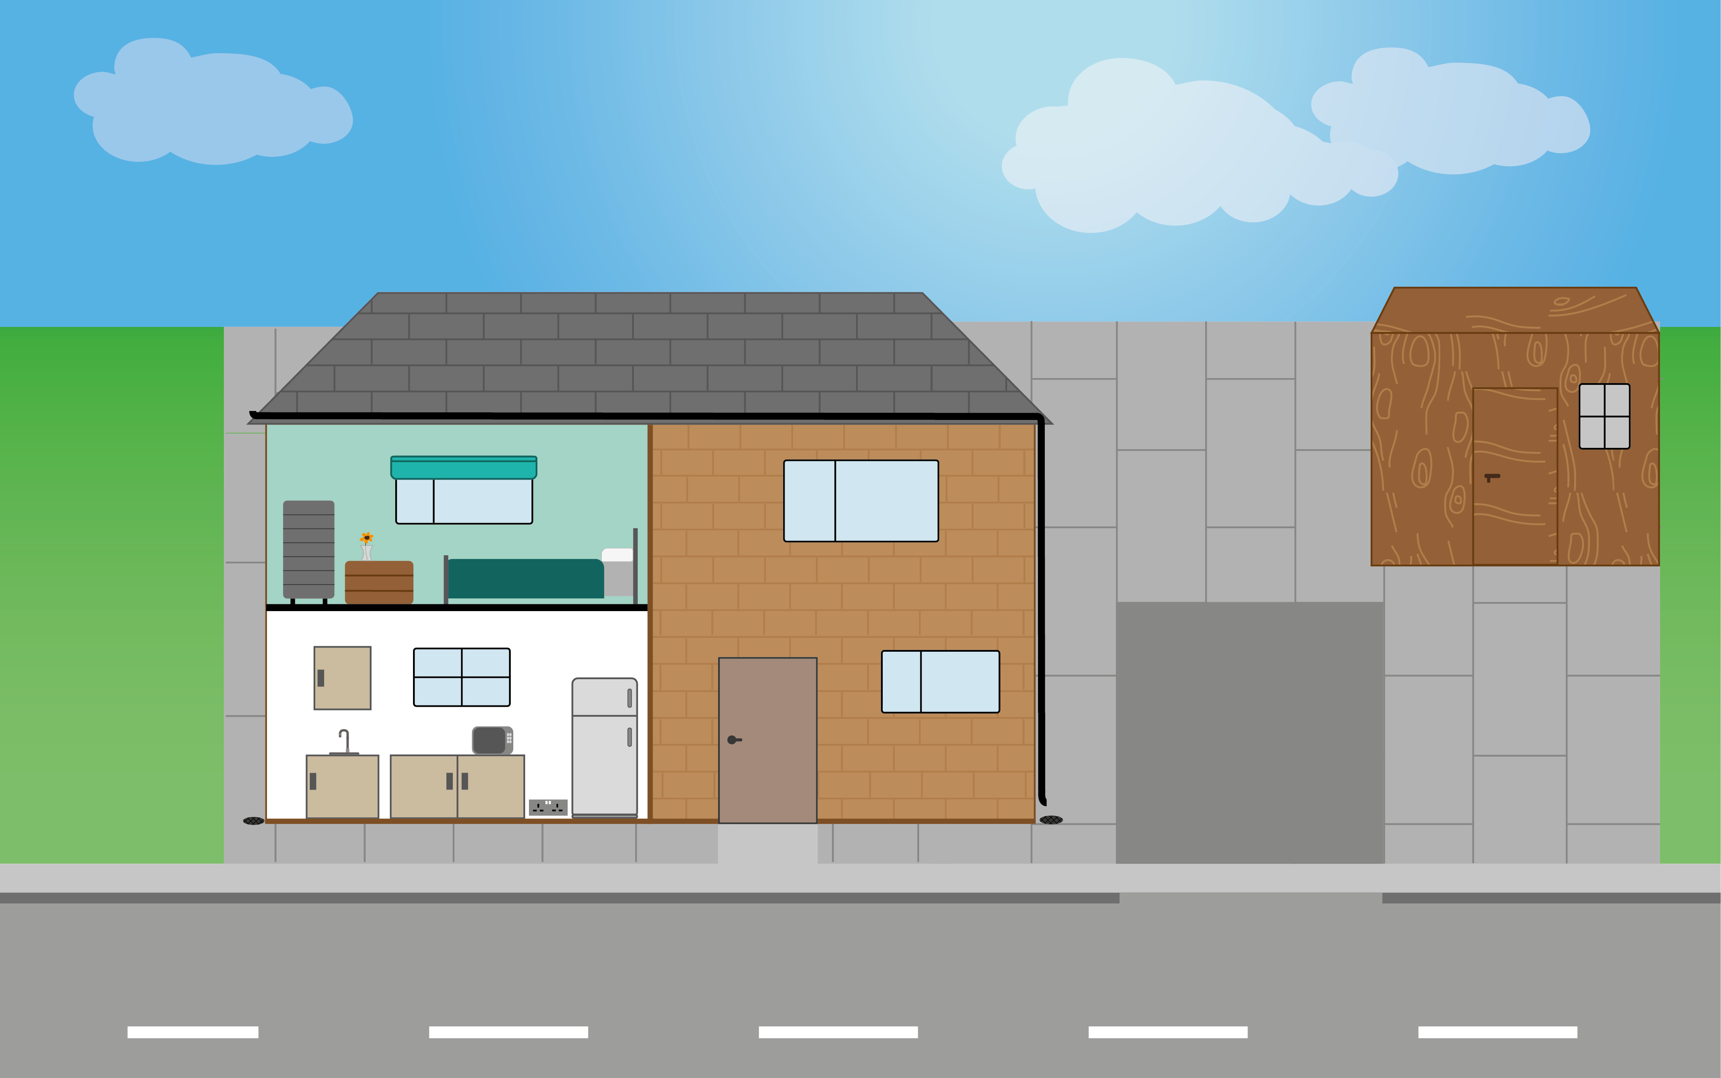
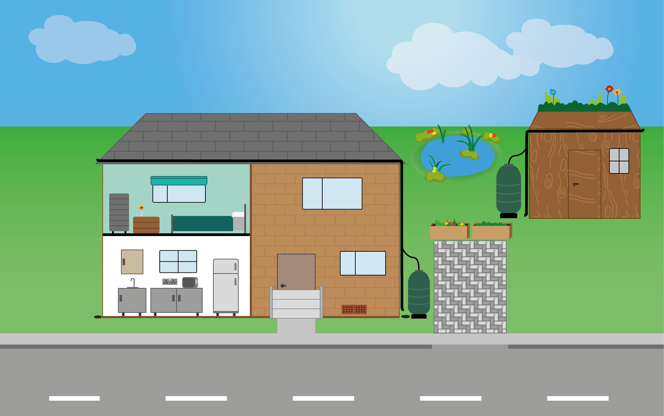
Protecting Your Property
Can you spot the difference between these two houses?
Which one would be more prepared for flooding?

Slide 6
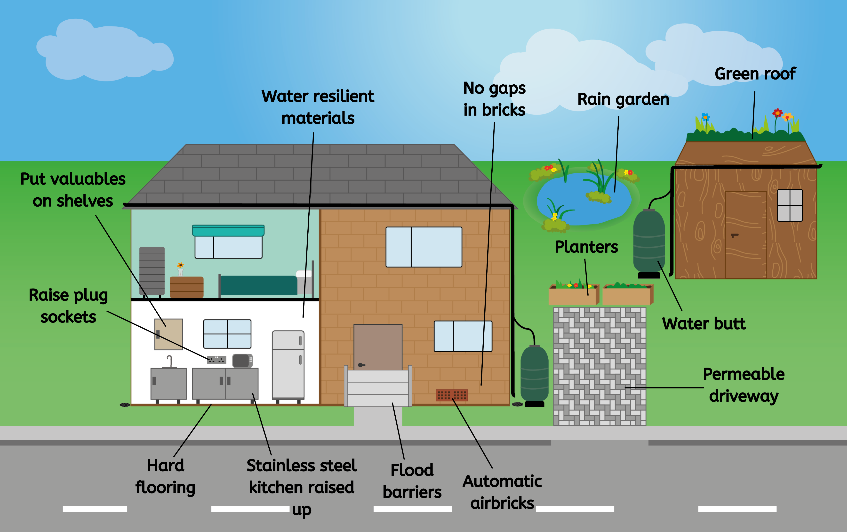
Protecting Your Property

Slide 7
Protecting Your Property
Property Flood Resilience (PFR) = Changes people can make to their property so that it can cope better when it floods
Resistance and Resilience
Resistance = stops water coming in
Resilience = reduces flood damage & makes recovery faster

Slide 8
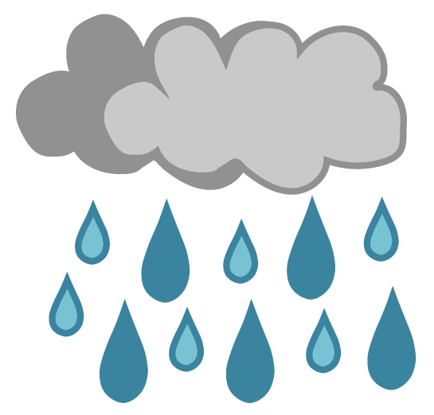
Protecting Your Property
Sustainable Drainage Systems (SuDS)
SuDS catch rain to stop it from adding to surface water, entering drains and adding to the risk of flooding!
As well as reducing flood risk they have lots of other benefits such as creating habitats for wildlife and soaking up carbon dioxide (CO₂).
Image: The Flood Hub

Slide 9
Protecting Your Property
Can you guess which defences are resistance, which are resilience, and which are SuDS?
Resistance = stops water coming in
Resilience = reduces flood damage & makes recovery faster
SuDS = catch and store rainwater

Slide 10
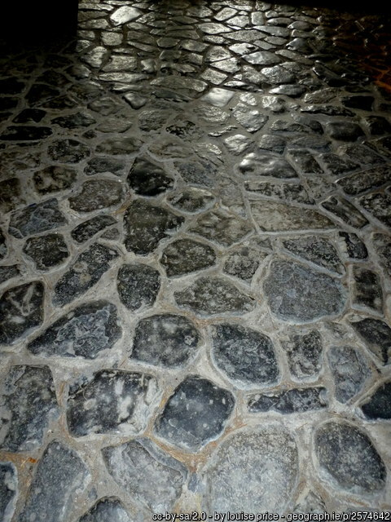
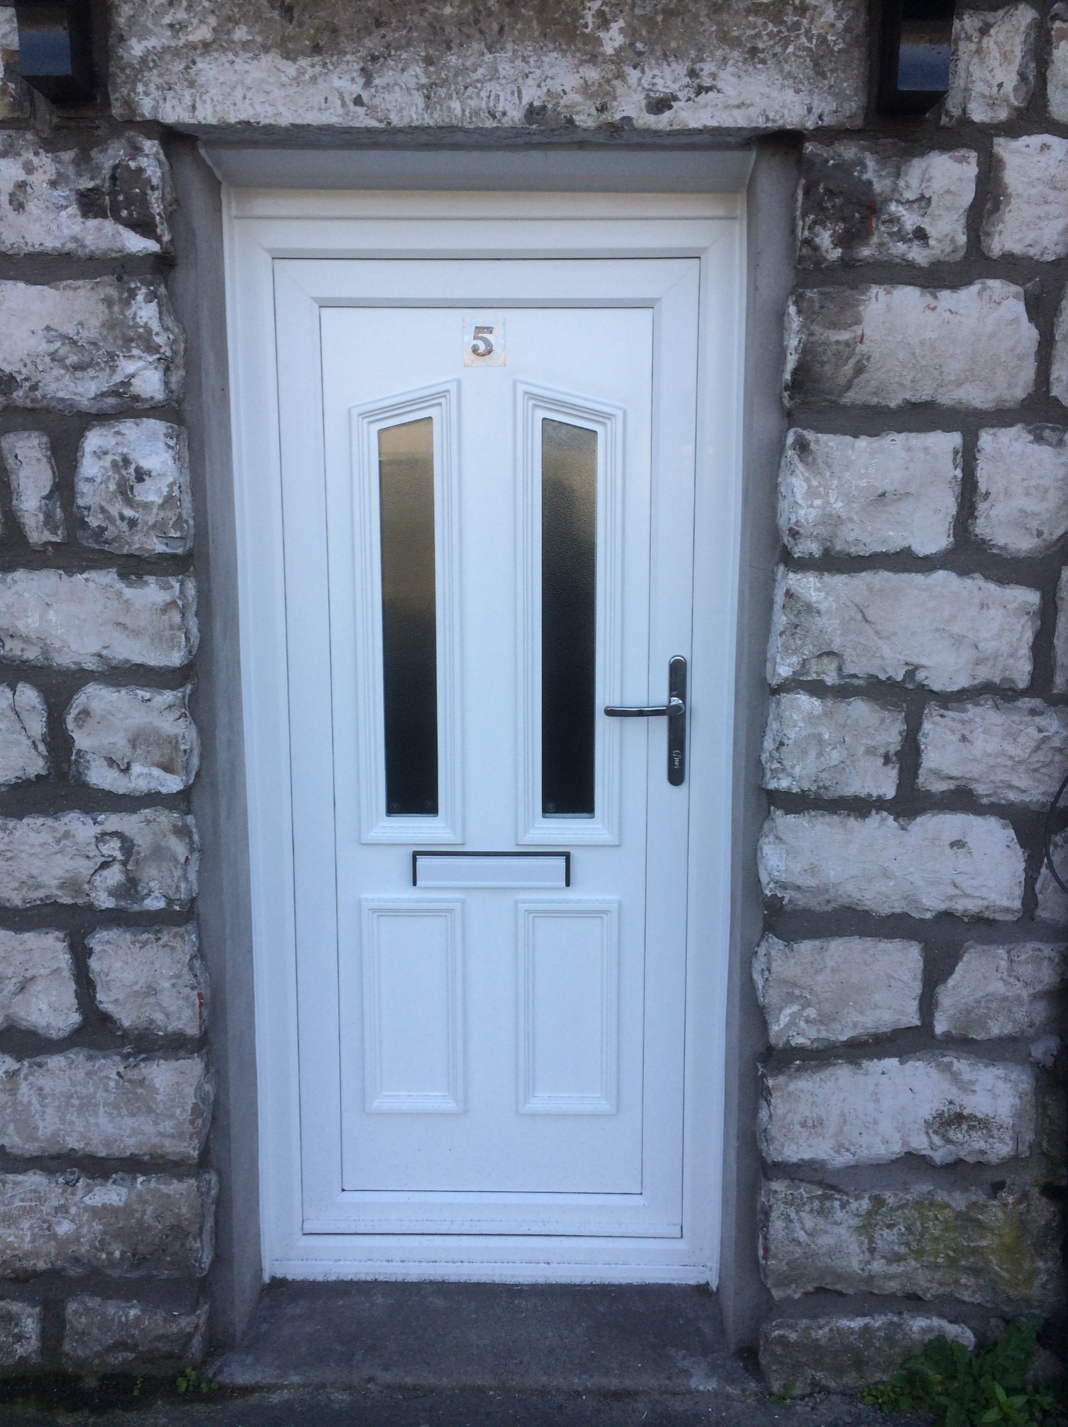
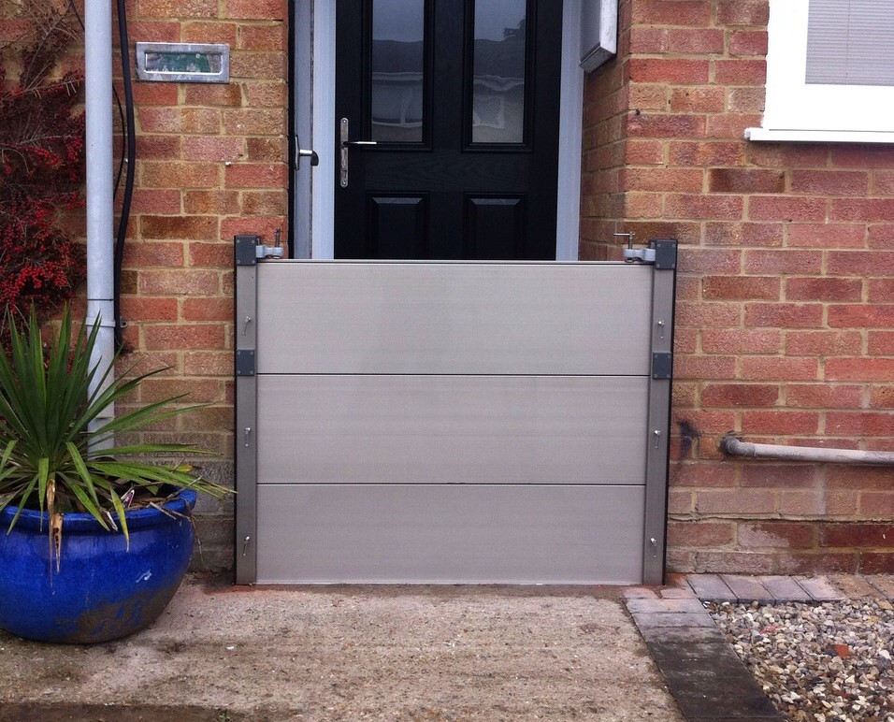
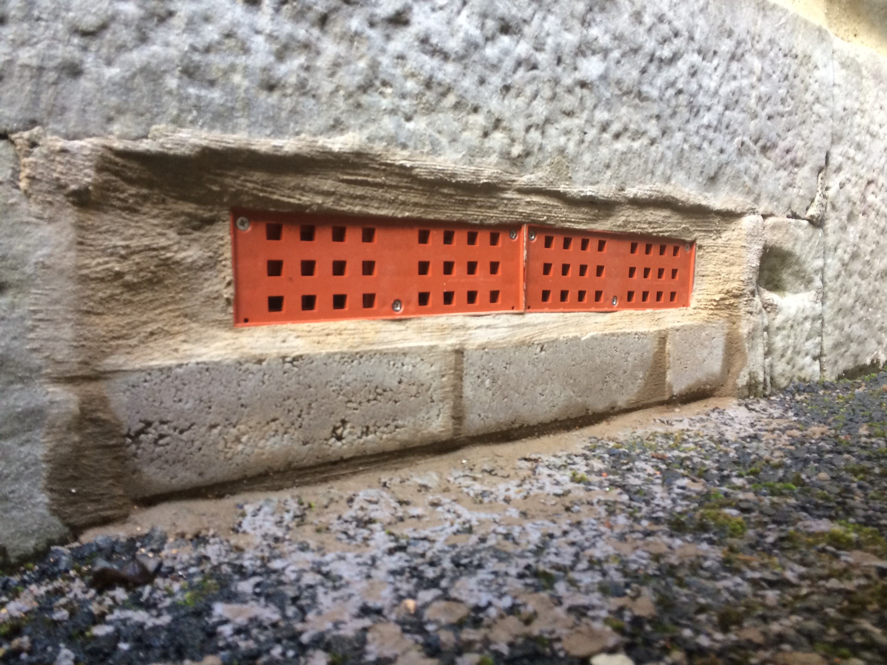
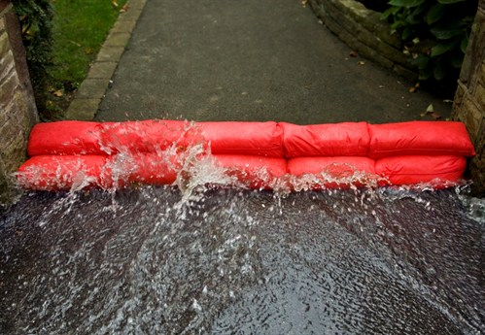
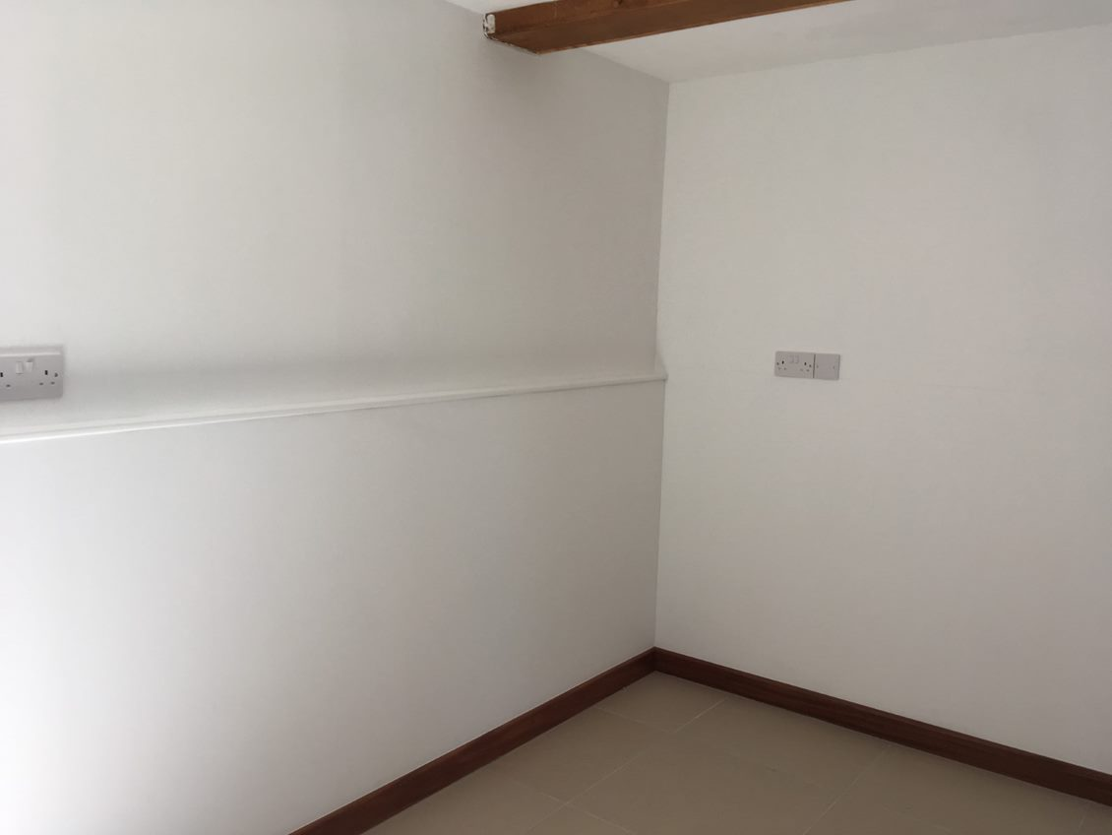
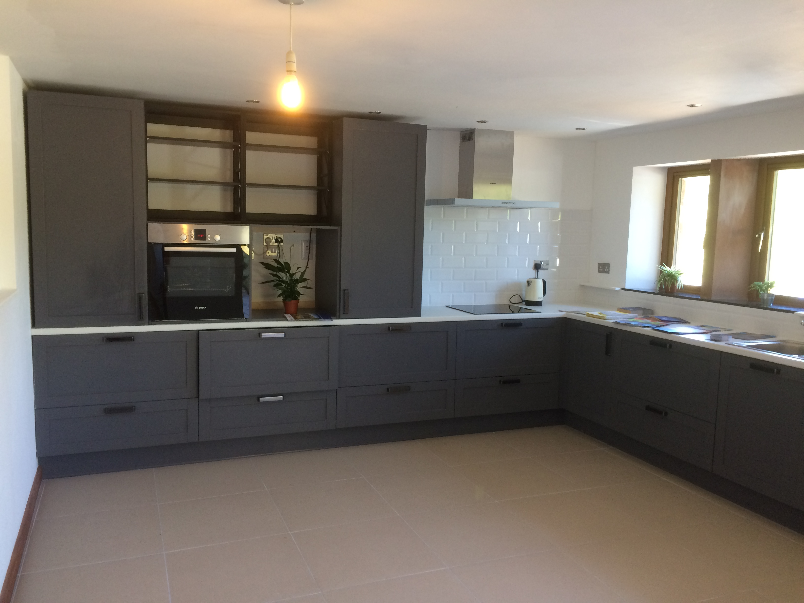
Protecting Your Property
Let’s take a closer look at some defences
Image: The Flood Hub
Image: Lakeside Flood Solutions
Image: The Flood Hub
Flood door
Flood barrier
Automatic airbrick
Hard flooring
Image: Domestic flood control 2011 - water reactive sandbag by Gravitas International Ltd is licenced under CC BY-SA 3.0.
Image: The Flood Hub
Image: The Flood Hub
Kitchen made from resilient materials
Alternative sandbags
Raised electric sockets

Slide 11
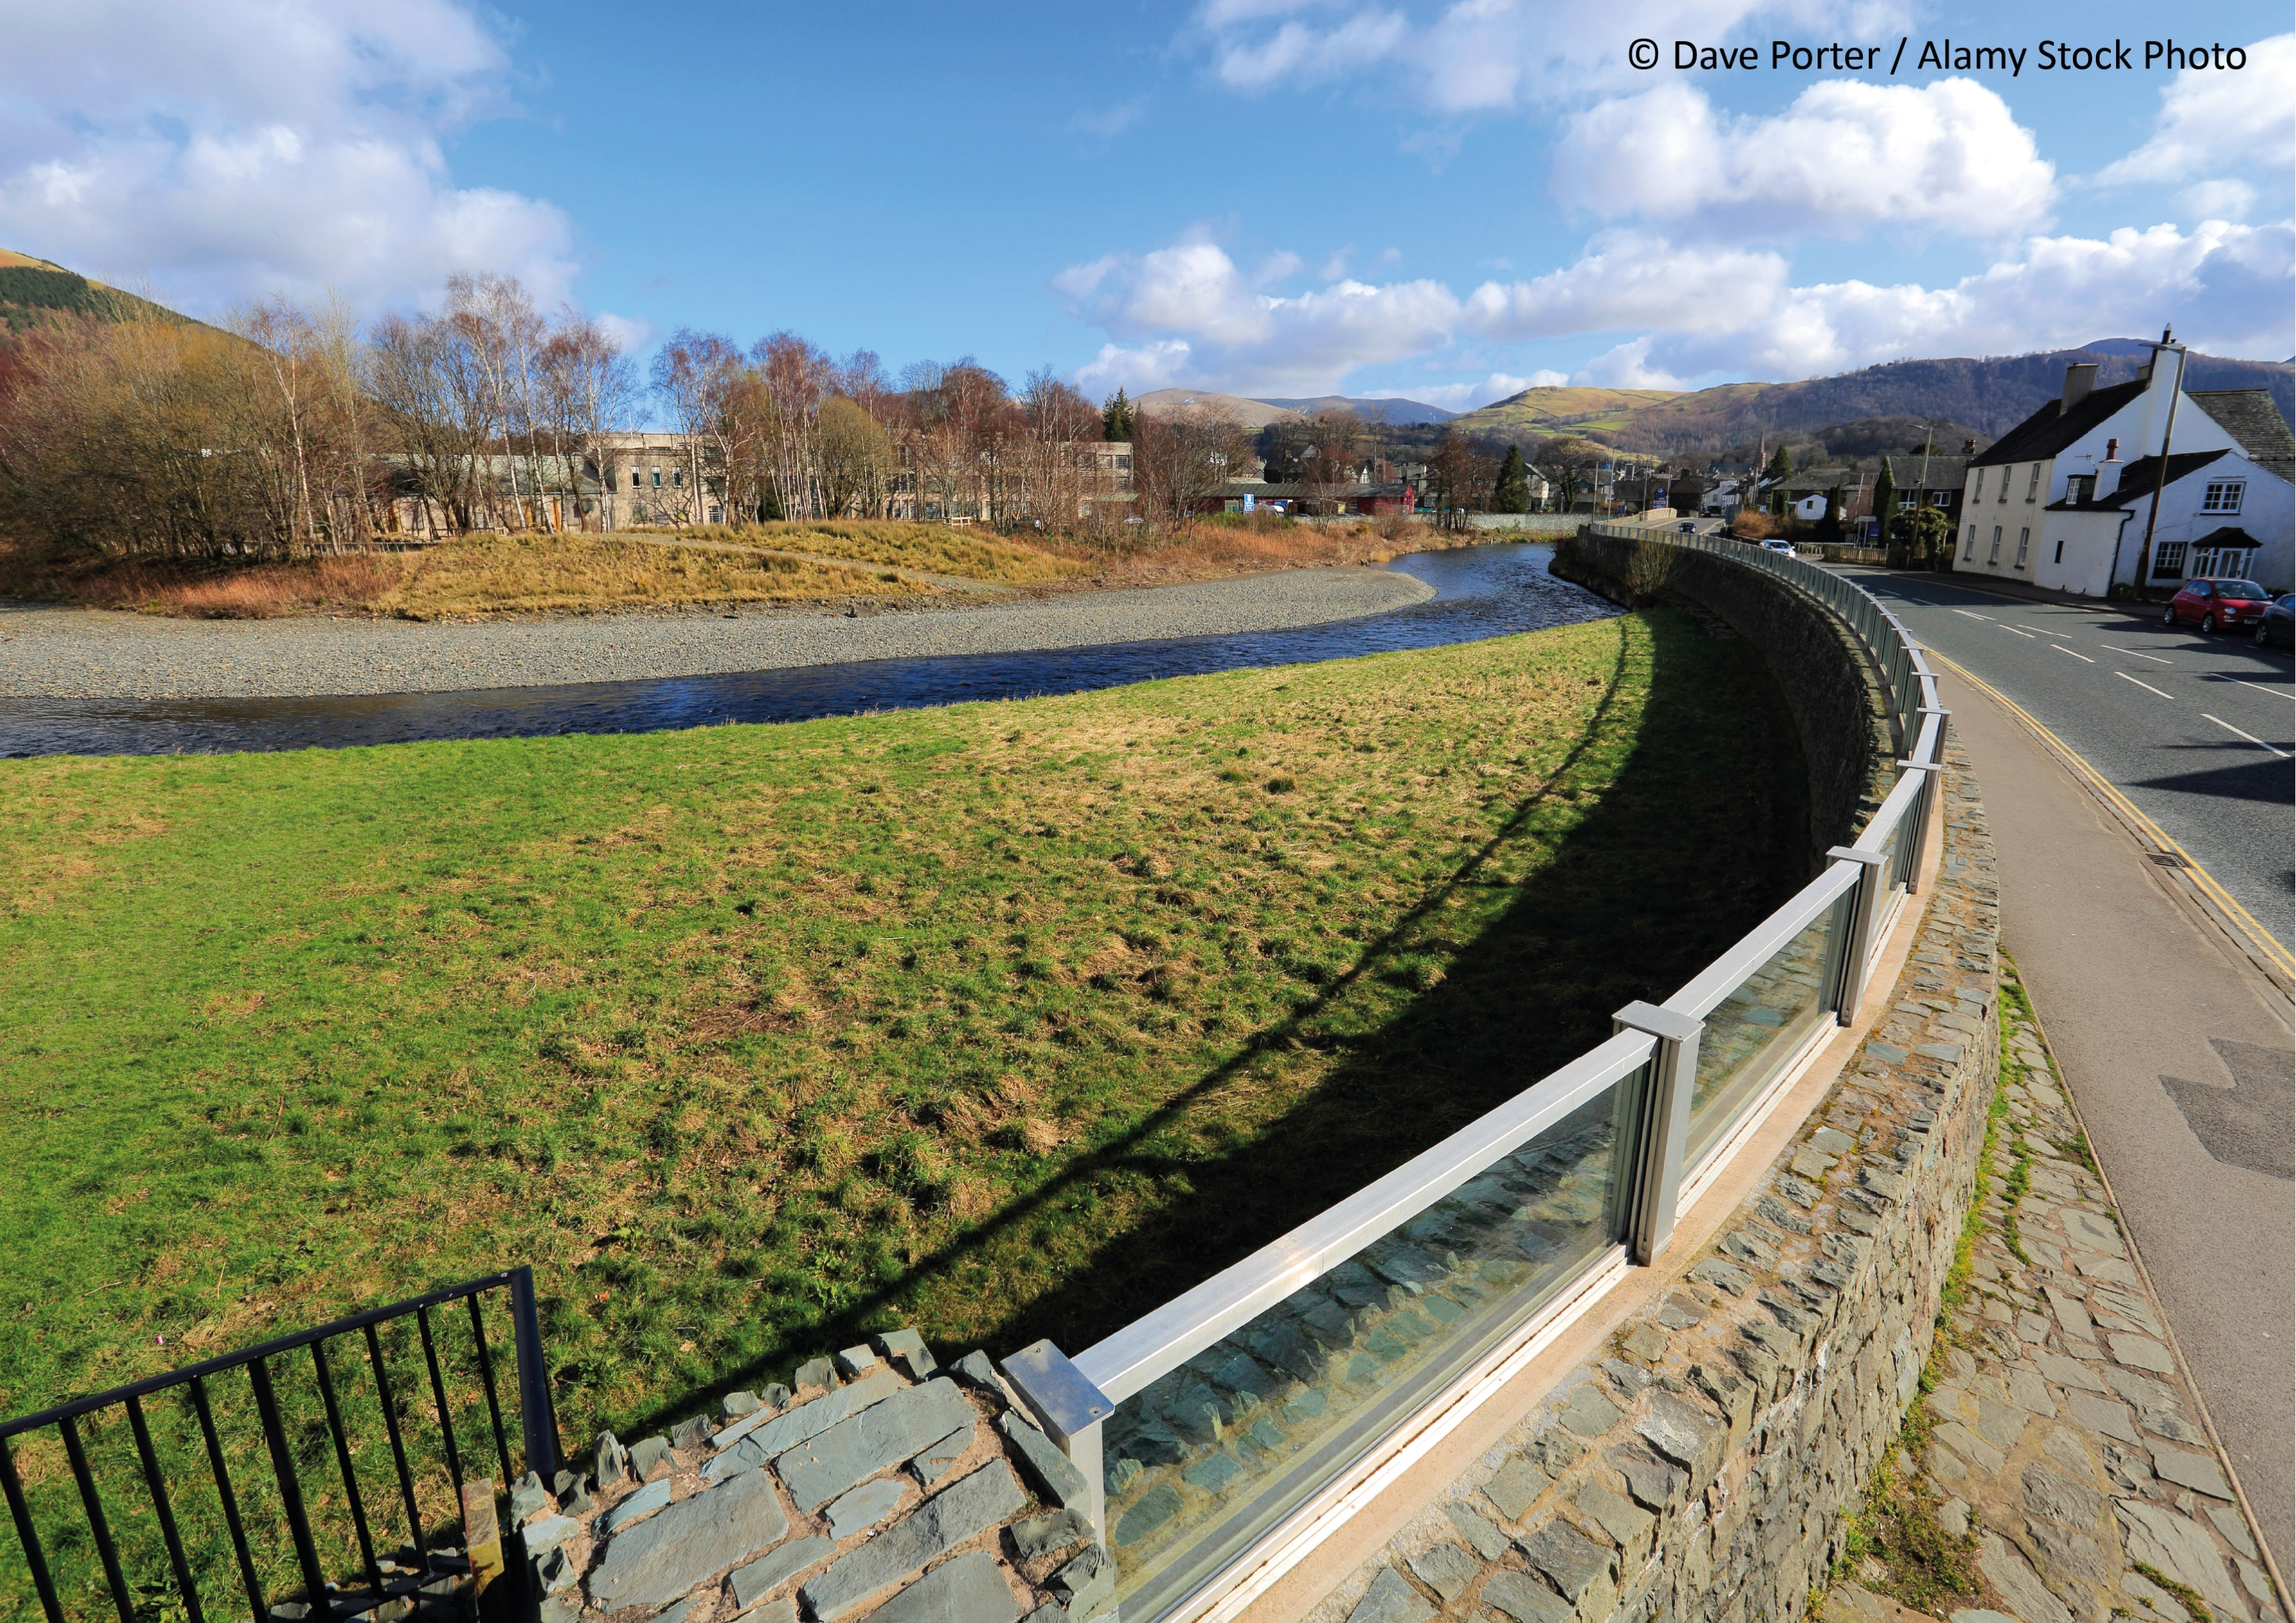
Flood Schemes
What do flood schemes do?
Flood schemes are built to protect big parts of towns and villages from flooding!
They are usually made up of walls, embankments, and flood storage areas.

Slide 12
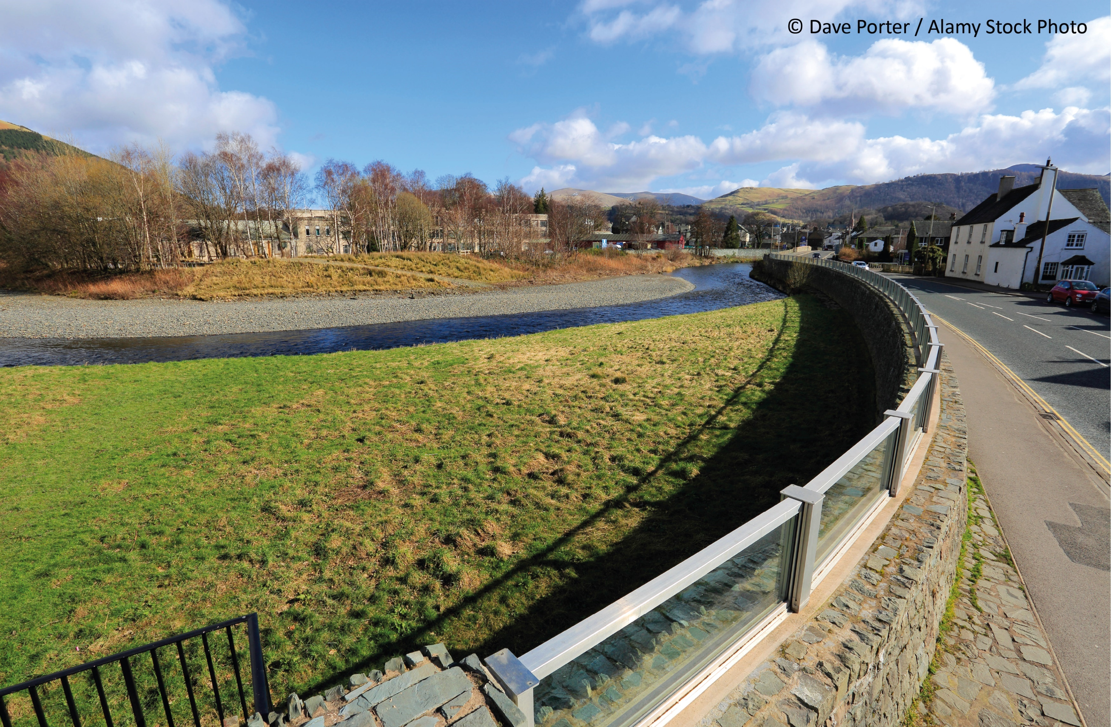
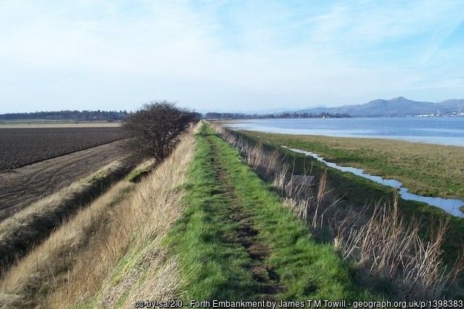
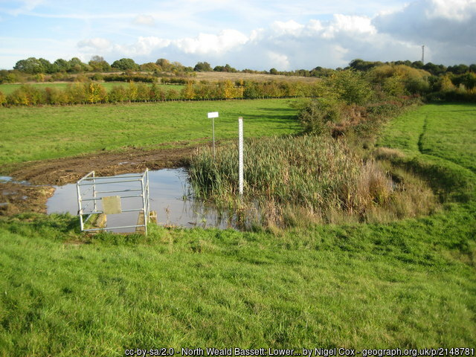
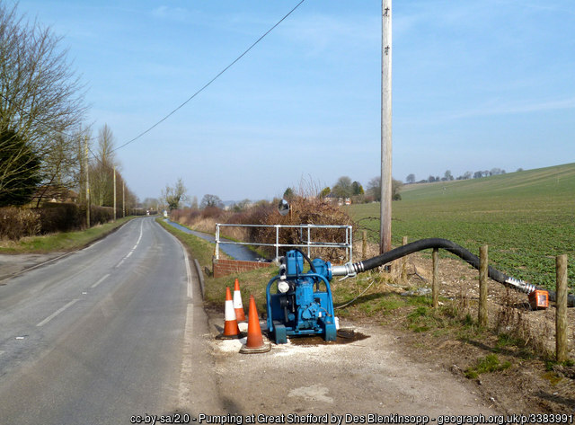
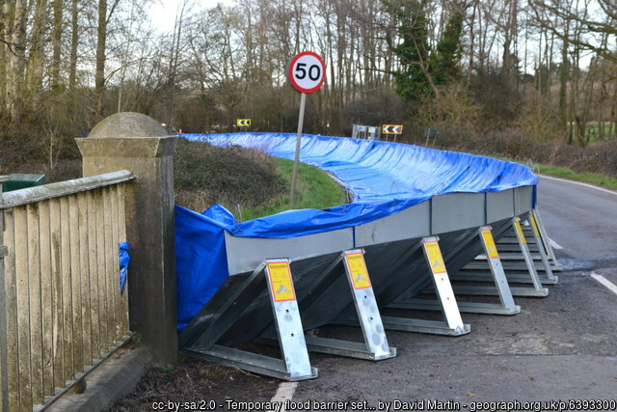
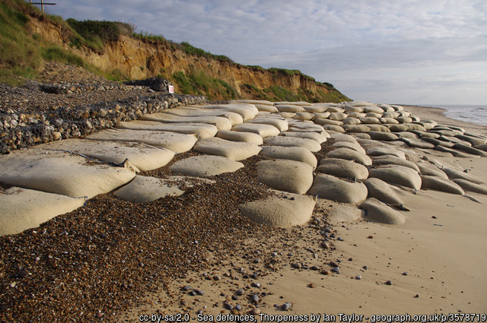
Types of Flood Defences
Flood walls
Embankments
Storage areas
Built along the river to stop floodwater from rivers reaching into towns
Grassy hills or slopes which stop floodwater from rivers reaching houses
Floodwater is directed out of a river onto empty land to be stored
Pumps
Temporary flood barriers
Coastal defences
These take water from a place that is flooding to a different location
Put up in communities before flooding happens to stop floodwater reaching houses
This can be flood walls or changes to the beach to protect it from waves and high tides

Slide 13
Recap of Lesson
What does property flood resilience do?...
What do SuDS do?...
What do flood schemes and defences do?...
Stops or reduces the amount of water getting into your home and damaging things
Catch rainwater and stop it from flowing over roads and into drains
Protect big parts of towns and villages from flooding

Slide 14
Homework
Protect your home from flooding
Using what we’ve learnt in this lesson, have a look around your house and answer the questions on the sheet.
Where could flood water get in?
What defences could you use to stop flood water getting in?
Do you think a flood scheme would help to stop your home from flooding? If so, how?

