Slide 1



Why Rivers Are Important
Lesson aim:
To learn about and understand why rivers are important.
Lesson objectives:
To define a river.
To learn some of the different reasons why rivers are important.
FT Q C38

Slide 2
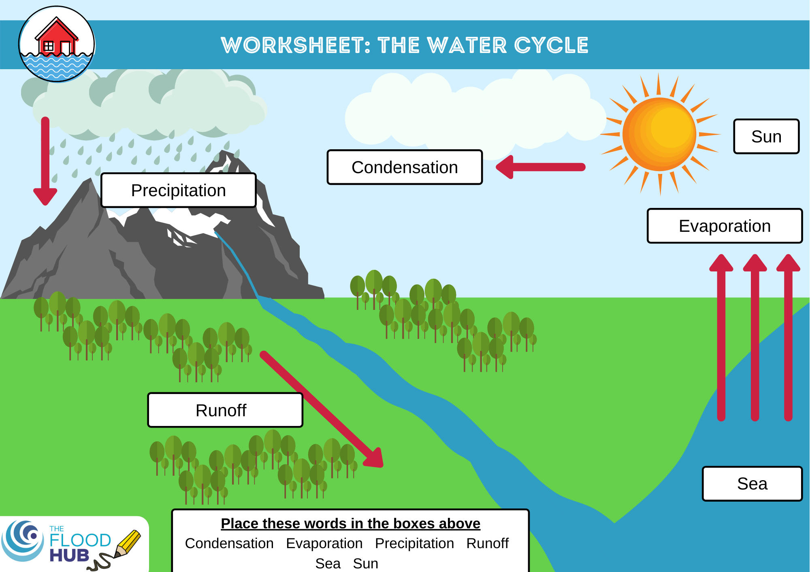
The water cycle
FT Q C38
This is the journey water takes, from land, to the sea, to the sky and back again. The cycle consists of evaporation, condensation, precipitation and collection.
Rivers play an important role in the water cycle because they transport water from the hills back to the sea.
FT Q C38

Slide 3
The water cycle
Evaporation – the sun heats up water in rivers, lakes, the sea and turns it into water vapour (gas) which rises into the air.
Condensation – as the water vapour reaches a certain height in the sky, it cools and condenses to form clouds.
Precipitation – as the clouds get larger, they sink and the warmer temperature turns it back into a liquid, which falls to the ground as rain.
Runoff – the rain runs over the land (runoff) and flows into rivers and lakes which take the water back to the sea. The cycle begins
again.
FT Q C38

Slide 4
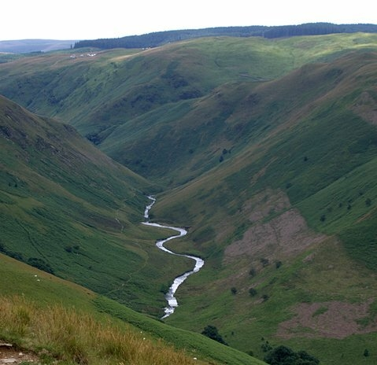
What is a river?
A river is a natural channel down which water flows.
Rivers usually begin as a trickle of water draining from higher ground such as hills or mountains.
They gradually get larger as they make their way across the land where they are joined by other rivers before making their way to lakes or the sea.
cc-by-sa/2.0 - © Rudi Winter -geograph.org.uk/p/910633
FT Q C38

Slide 5
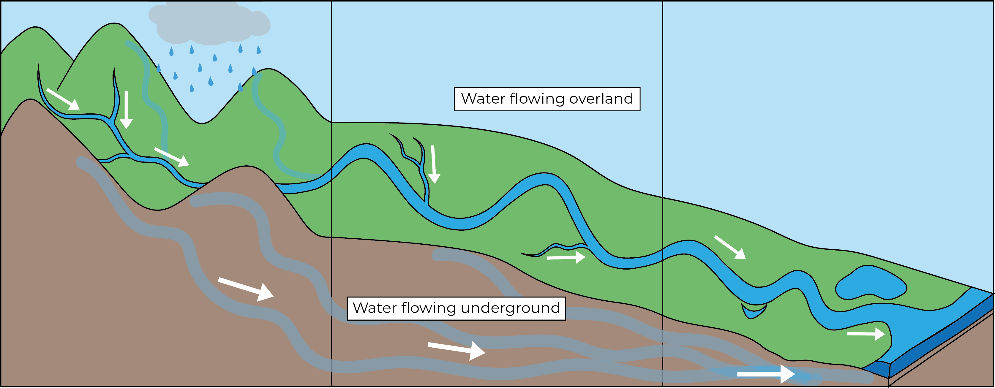
Land drainage (runoff)
Water runs off the hills and collects nutrients and minerals on the way. The water runs down into the rivers and drains the land. The rivers take the water, nutrients and minerals down stream / back to the sea.
FT Q C38

Slide 6
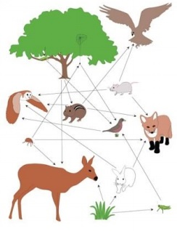
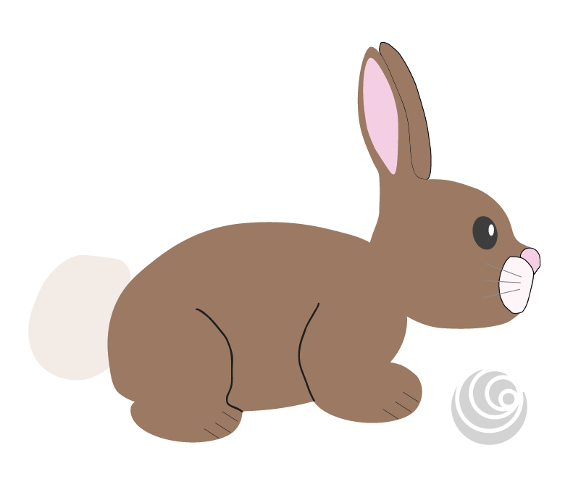
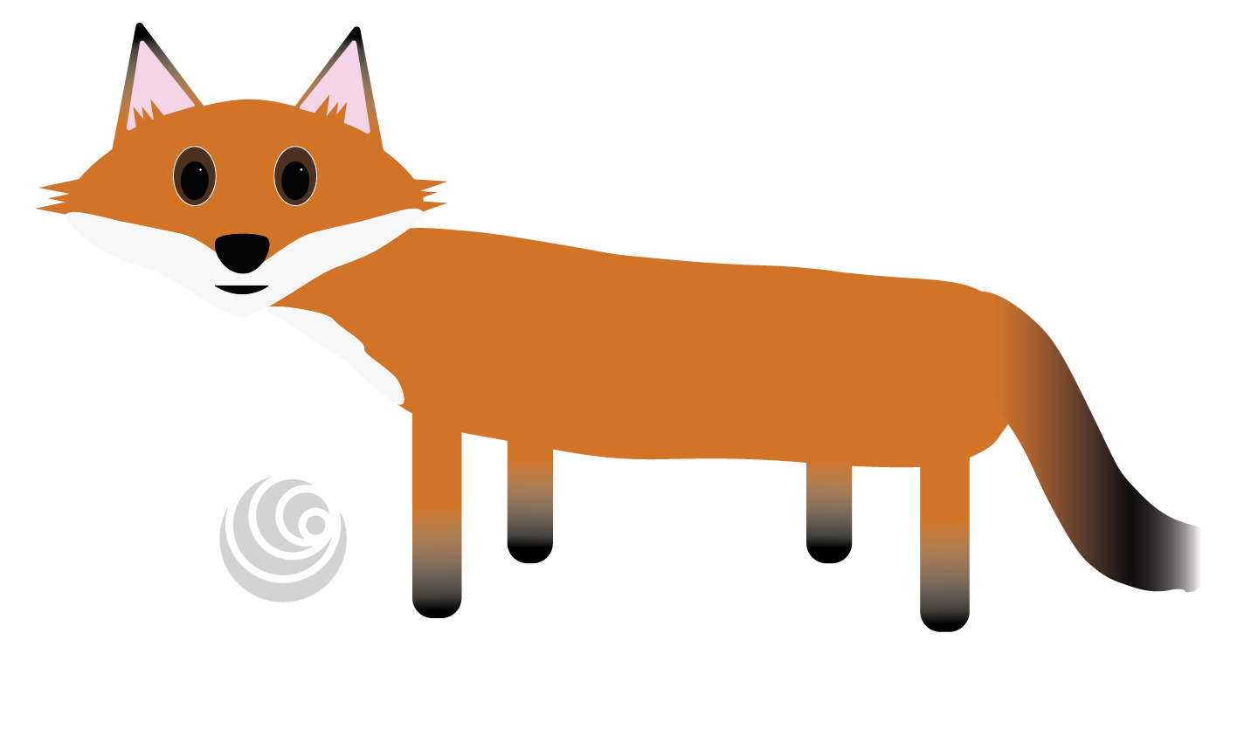
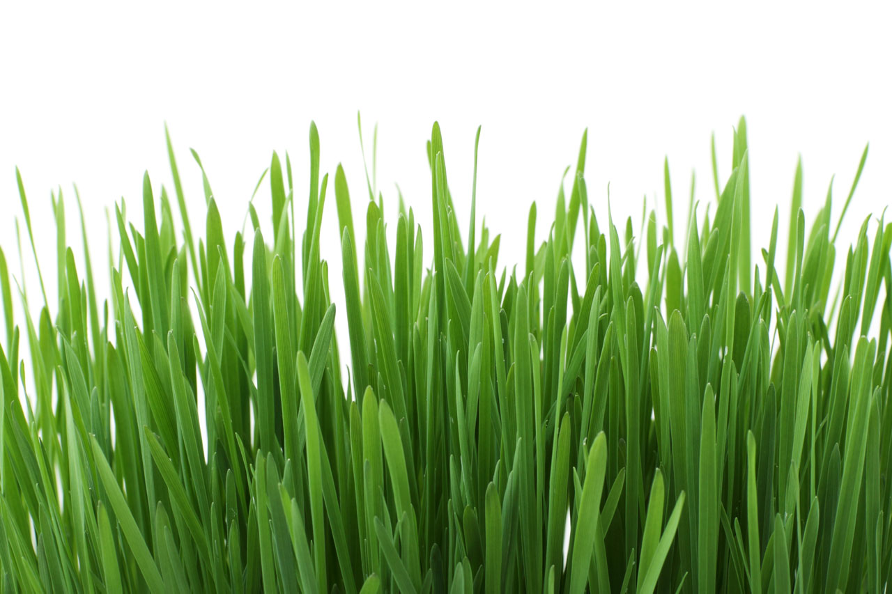
Ecosystems
What is an ecosystem?
A river ecosystem is the environment in which plants and animals all live together and rely on each other in order to survive.
Image: Petr Kratochvil via Public domain pictures.net.
FT Q C38

Slide 7
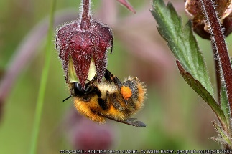
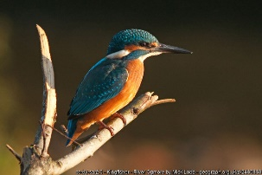
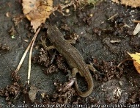
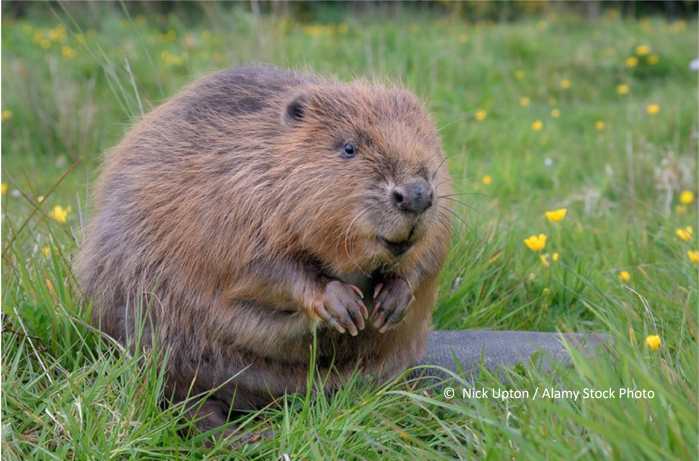
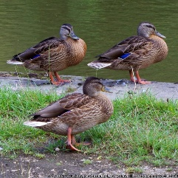
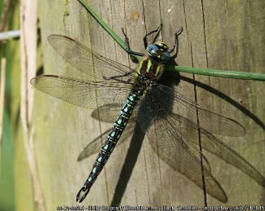
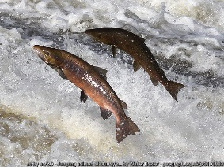
Ecosystems
What kind of animals live in a river ecosystem?
Bumblebees
Kingfishers
Newts
Beavers
Ducks
Dragonflies
Fish
FT Q C38

Slide 8
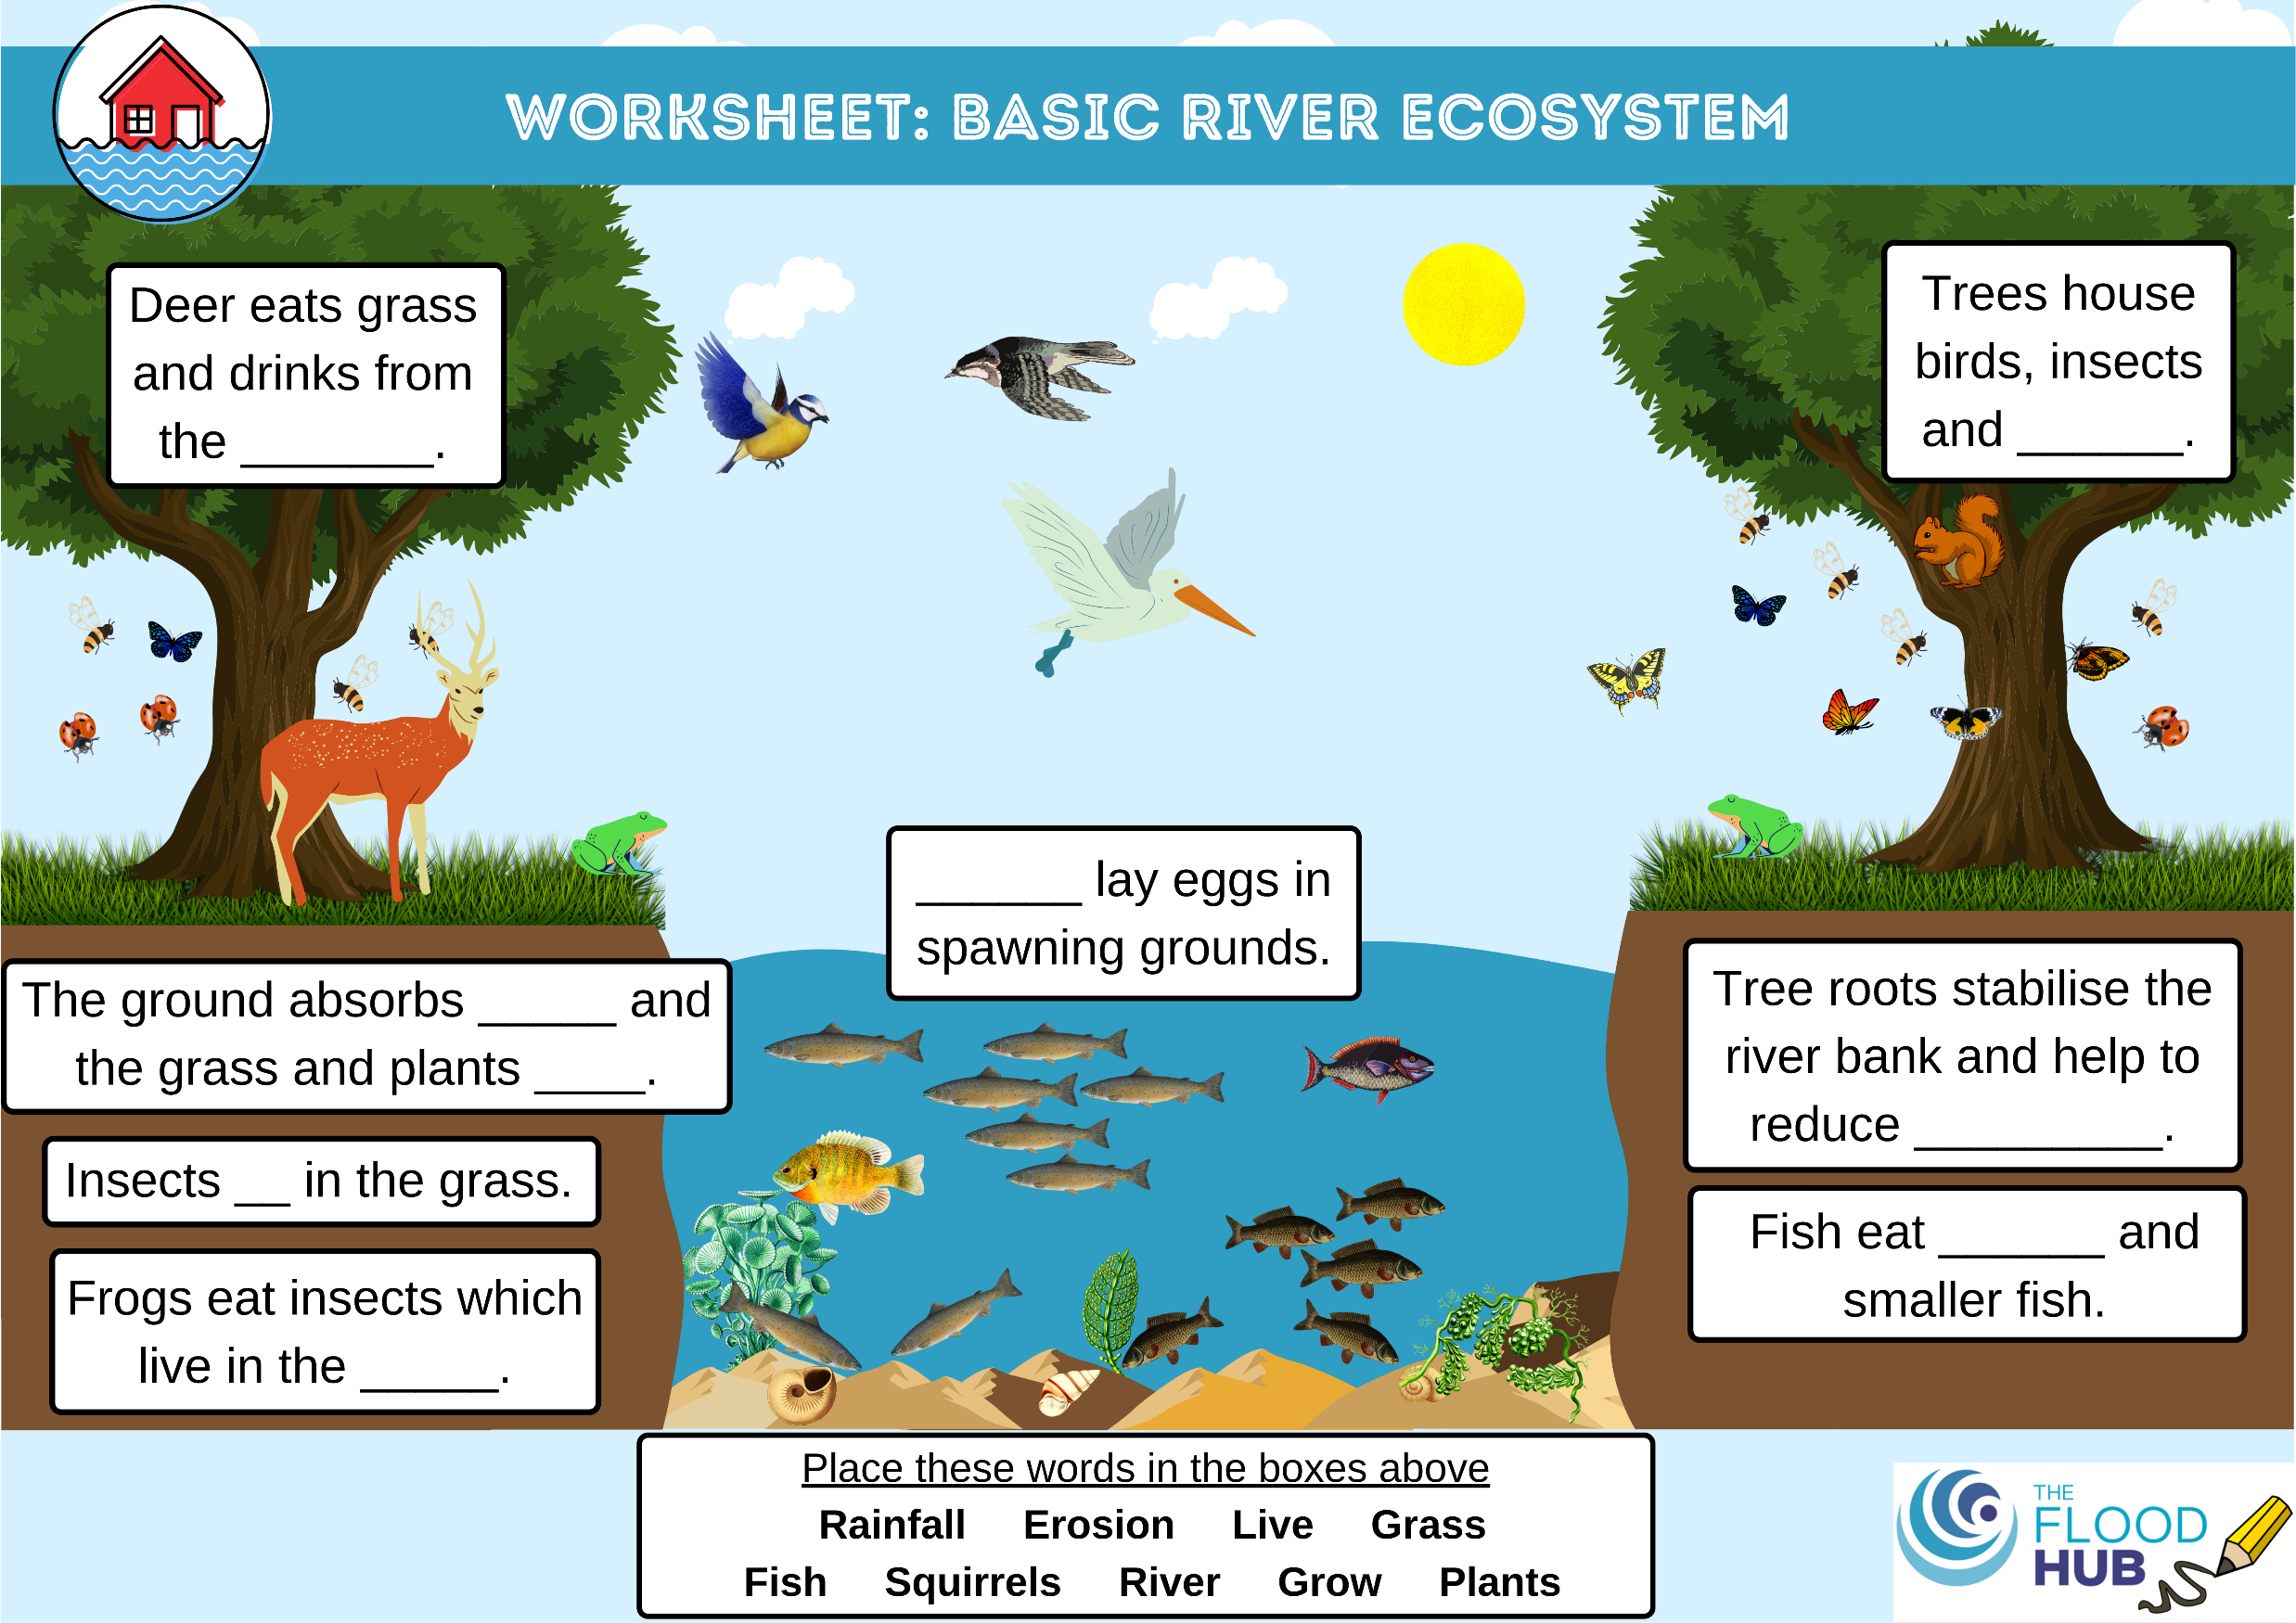

Class exercise
In pairs with the person sitting next to you, complete the worksheet by placing each word into the correct box and space to complete the sentence (5 – 10 minutes)
FT Q C38
FT Q C38

Slide 9
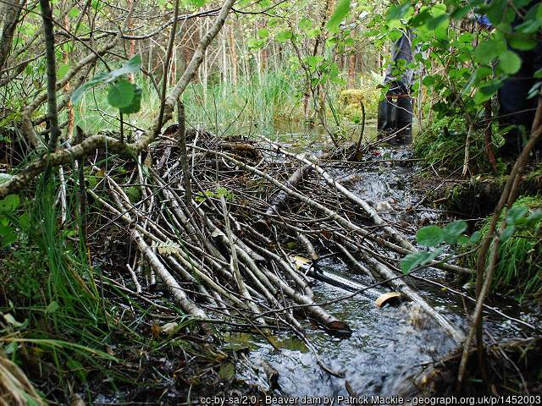
Why rivers are important
Beavers
Beavers play an important role in helping to reduce flood risk, they build beaver dams that hold back water!
FT Q C38

Slide 10
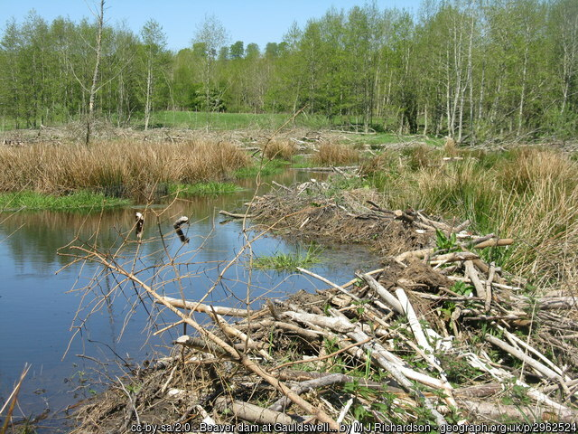
Why rivers are important
Beaver dams!
Beavers dams hold water upstream and release it slowly over time.
In flood risk management, this is known as a natural flood management, because it uses natural materials, such as trees to manage the water naturally.
FT Q C38

Slide 11
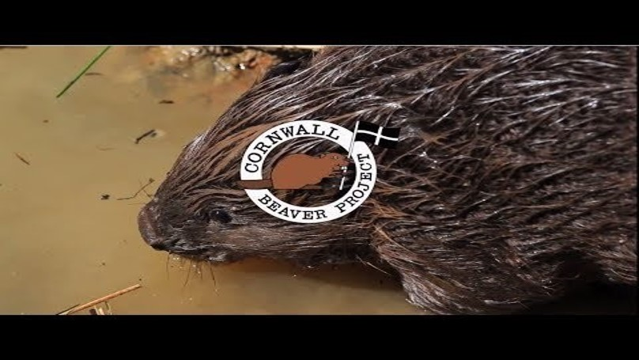
Why rivers are important
Take a look at this video about the Cornwall Beaver Project
https://www.youtube.com/watch?v=LeOmBbLwPm4
FT Q C38

Slide 12
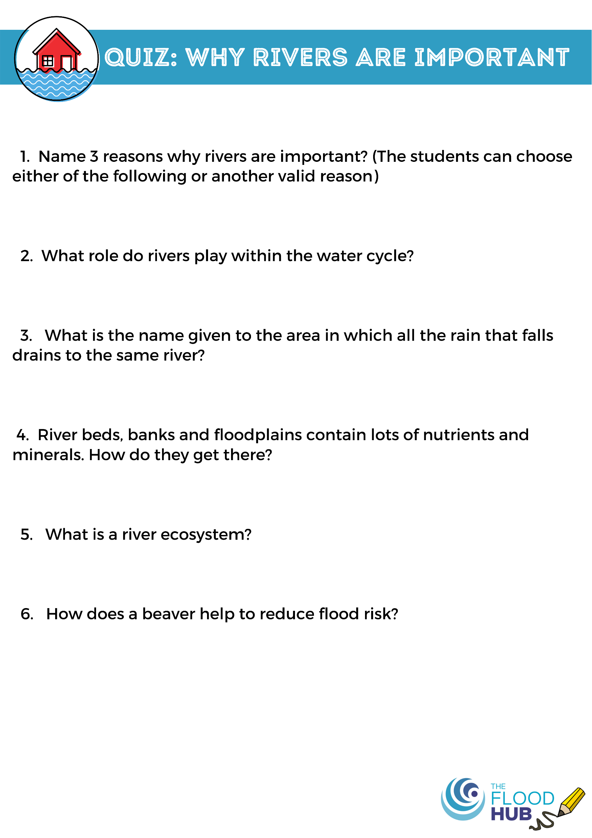
Quiz
Complete the following quiz on your own.
At the end, we will swap sheets and mark them together.
FT Q C38

Slide 13
Recap
The water cycle is….
A river is….
Rivers are important for….
the journey water takes, from land to the sea, to the sky and back again. The cycle consists of evaporation, condensation, precipitation and collection.
a natural channel down which water flows.
land drainage, ecosystems and animals.
FT Q C38

Slide 14

Homework
Choose a river located anywhere in the UK and find out…
Where it starts (the source)?
Where it ends (the mouth)?
How long is it in miles/km?
Write a paragraph about why it is important. This can be about anything on or around the river e.g. a community, textile mill, tourist location, or a historical fact about it.
FT Q C38

Slide 15
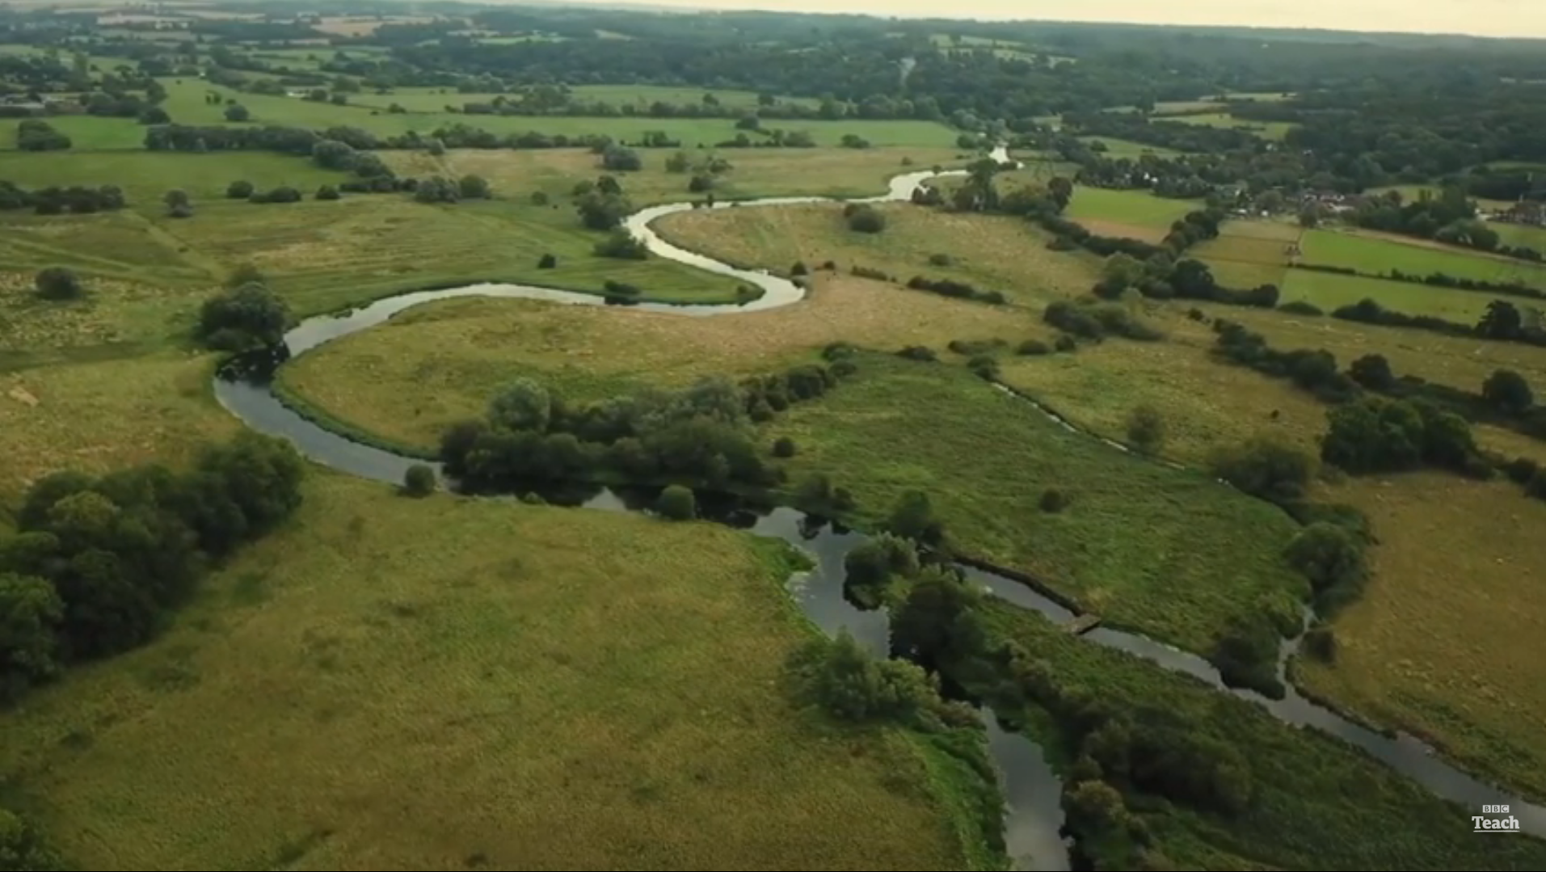
Future learning
Here is a video about what we will be learning about in future lessons…
https://www.youtube.com/watch?v=lIK3bgjiEEk
FT Q C38

