Slide 1



Types of Flooding
Lesson aim:
To learn the different types of flooding and understand that flooding can happen in lots of different ways.
Lesson objectives:
To name and define the different types of flooding.
To understand that flooding can happen in lots of different ways and why.
FT Q C42

Slide 2
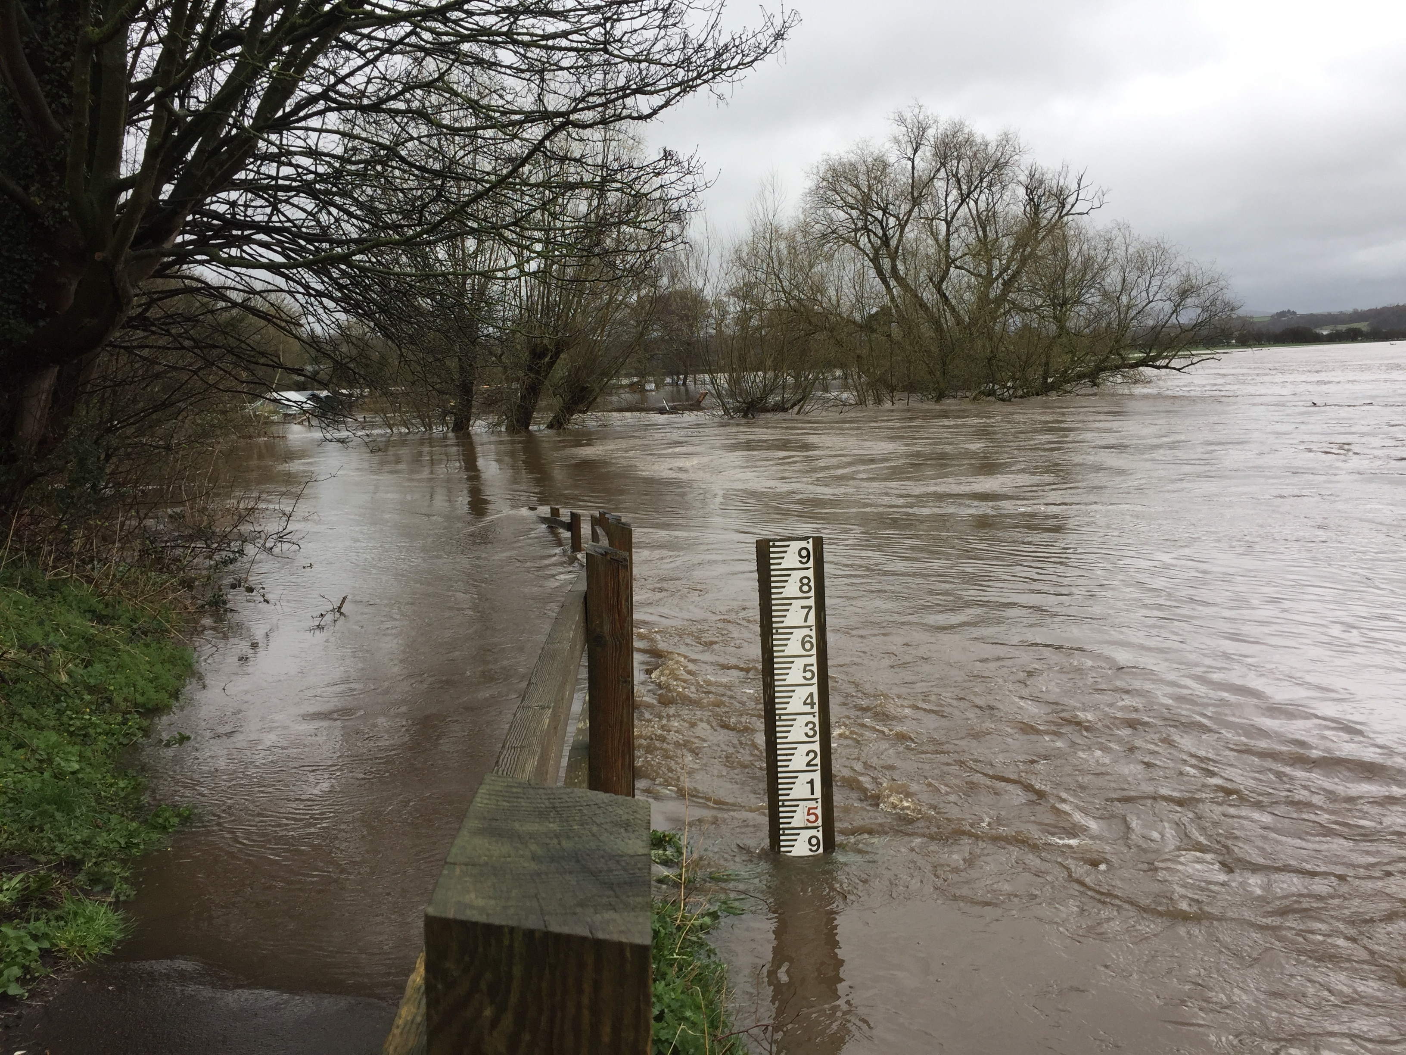
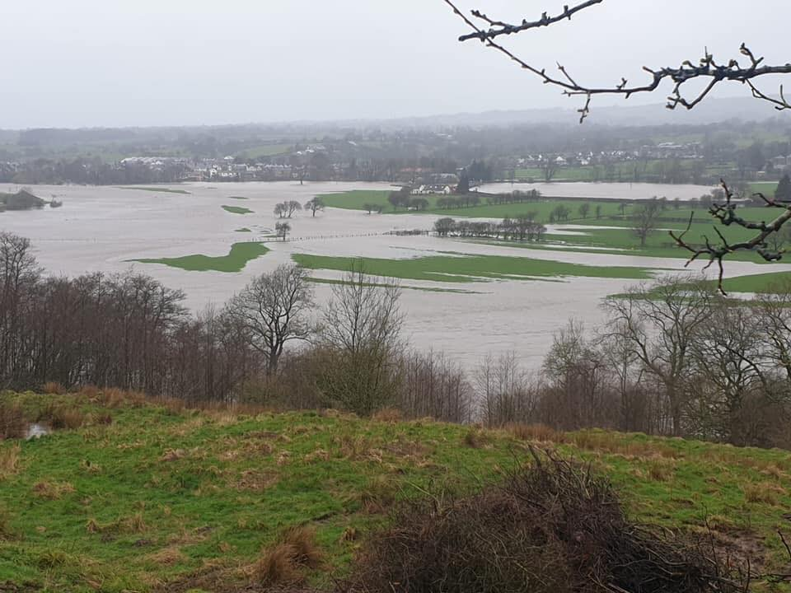
Types of flooding
River flooding
This happens when the water in a river overtops its banks and spills over, covering an area of land next to the river that is usually dry.
FT Q C42
Image: The Flood Hub
Image: The Flood Hub

Slide 3
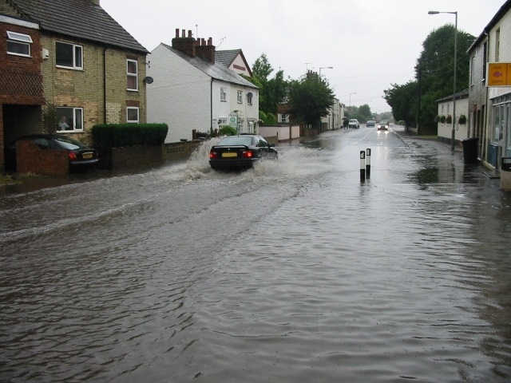
Types of flooding
Surface water flooding
This occurs when rainwater cannot soak into the land or flow into drains so it flows over the surface instead.
Blocked drains and sewers can increase the risk of surface water flooding as the water has nowhere to go.
Flash Flood cc-by-sa/2.0 - © Malcolm Campbell – geograph.org.uk/p/657563
FT Q C42

Slide 4
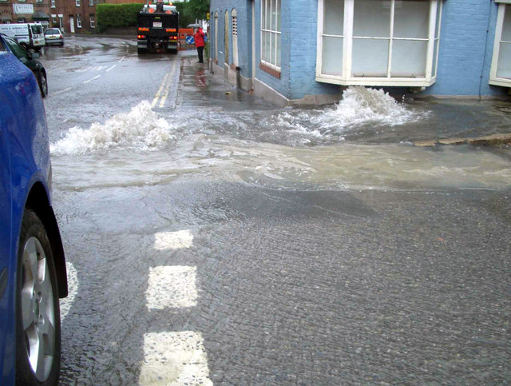
Types of flooding
Flash flooding
Flash flooding usually happens very quickly when there is heavy rainfall and it can happen with little or no warning.
Land that has been dry for a long time, or urban areas with large areas covered by hard surfaces have an increased risk of flash flooding as the land can’t absorb the heavy rainfall.
More drain excitement cc-by-sa/2.0 - © Des Blenkinsopp - geograph.org.uk/p/1638365
FT Q C42

Slide 5
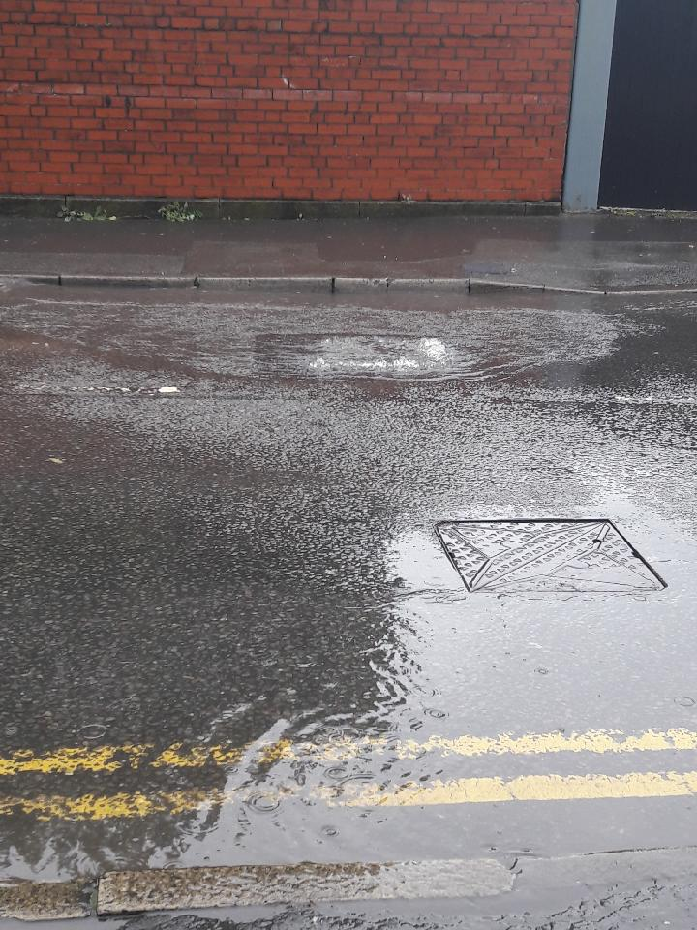
Types of flooding
Flooding from sewers and utility pipes
This happens when sewers have too much water in them after heavy rainfall and become full, or when the sewers are blocked by people flushing the wrong things down the toilet.
FT Q C42

Slide 6
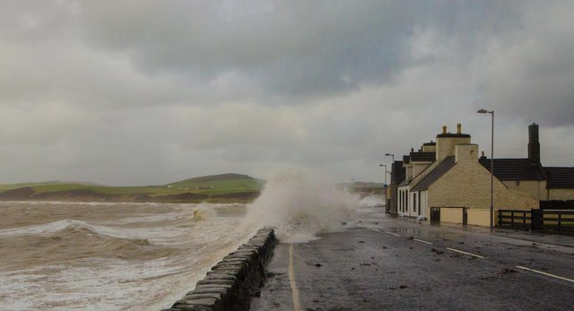
Types of flooding
Coastal flooding
This is when normally dry, low lying flat land at the coast is flooded by the sea.
Flooding at the coast is usually caused by storms, high tides and strong winds.
Port in a Storm cc-by-sa/2.0 - © Andy Farrington - geograph.org.uk/p/3833637
FT Q C42

Slide 7
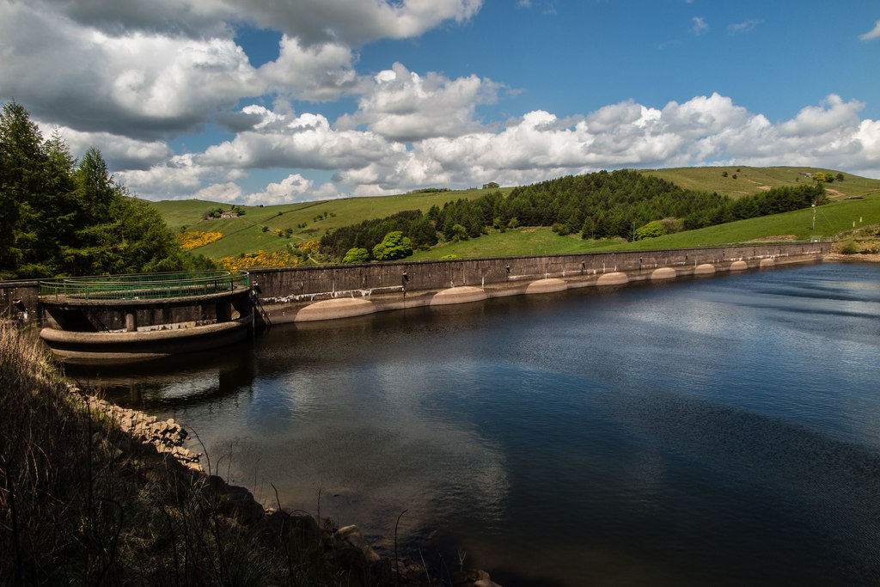
Types of flooding
Reservoir flooding
If the dam or banks of the reservoir fail, millions of gallons of water can be released very quickly which can cause lots of damage.
Of all the types of flooding, reservoir flooding is the least likely to happen.
Lamaload Dam cc-by-sa/2.0 - © Peter McDermott - geograph.org.uk/p/5391438
FT Q C42

Slide 8
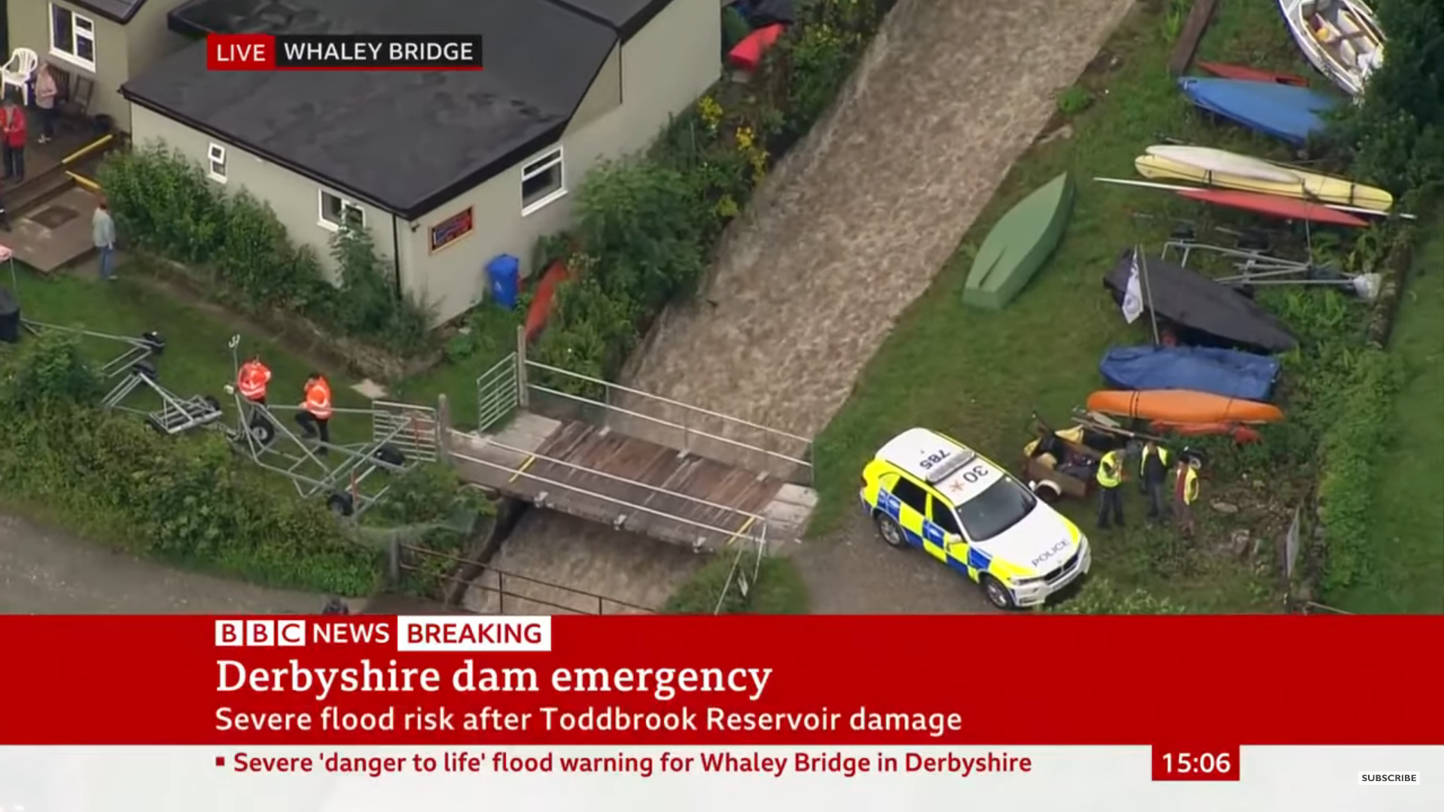
Types of flooding
Reservoir flooding
https://www.youtube.com/watch?v=iRuiD0-FkzU
FT Q C42

Slide 9
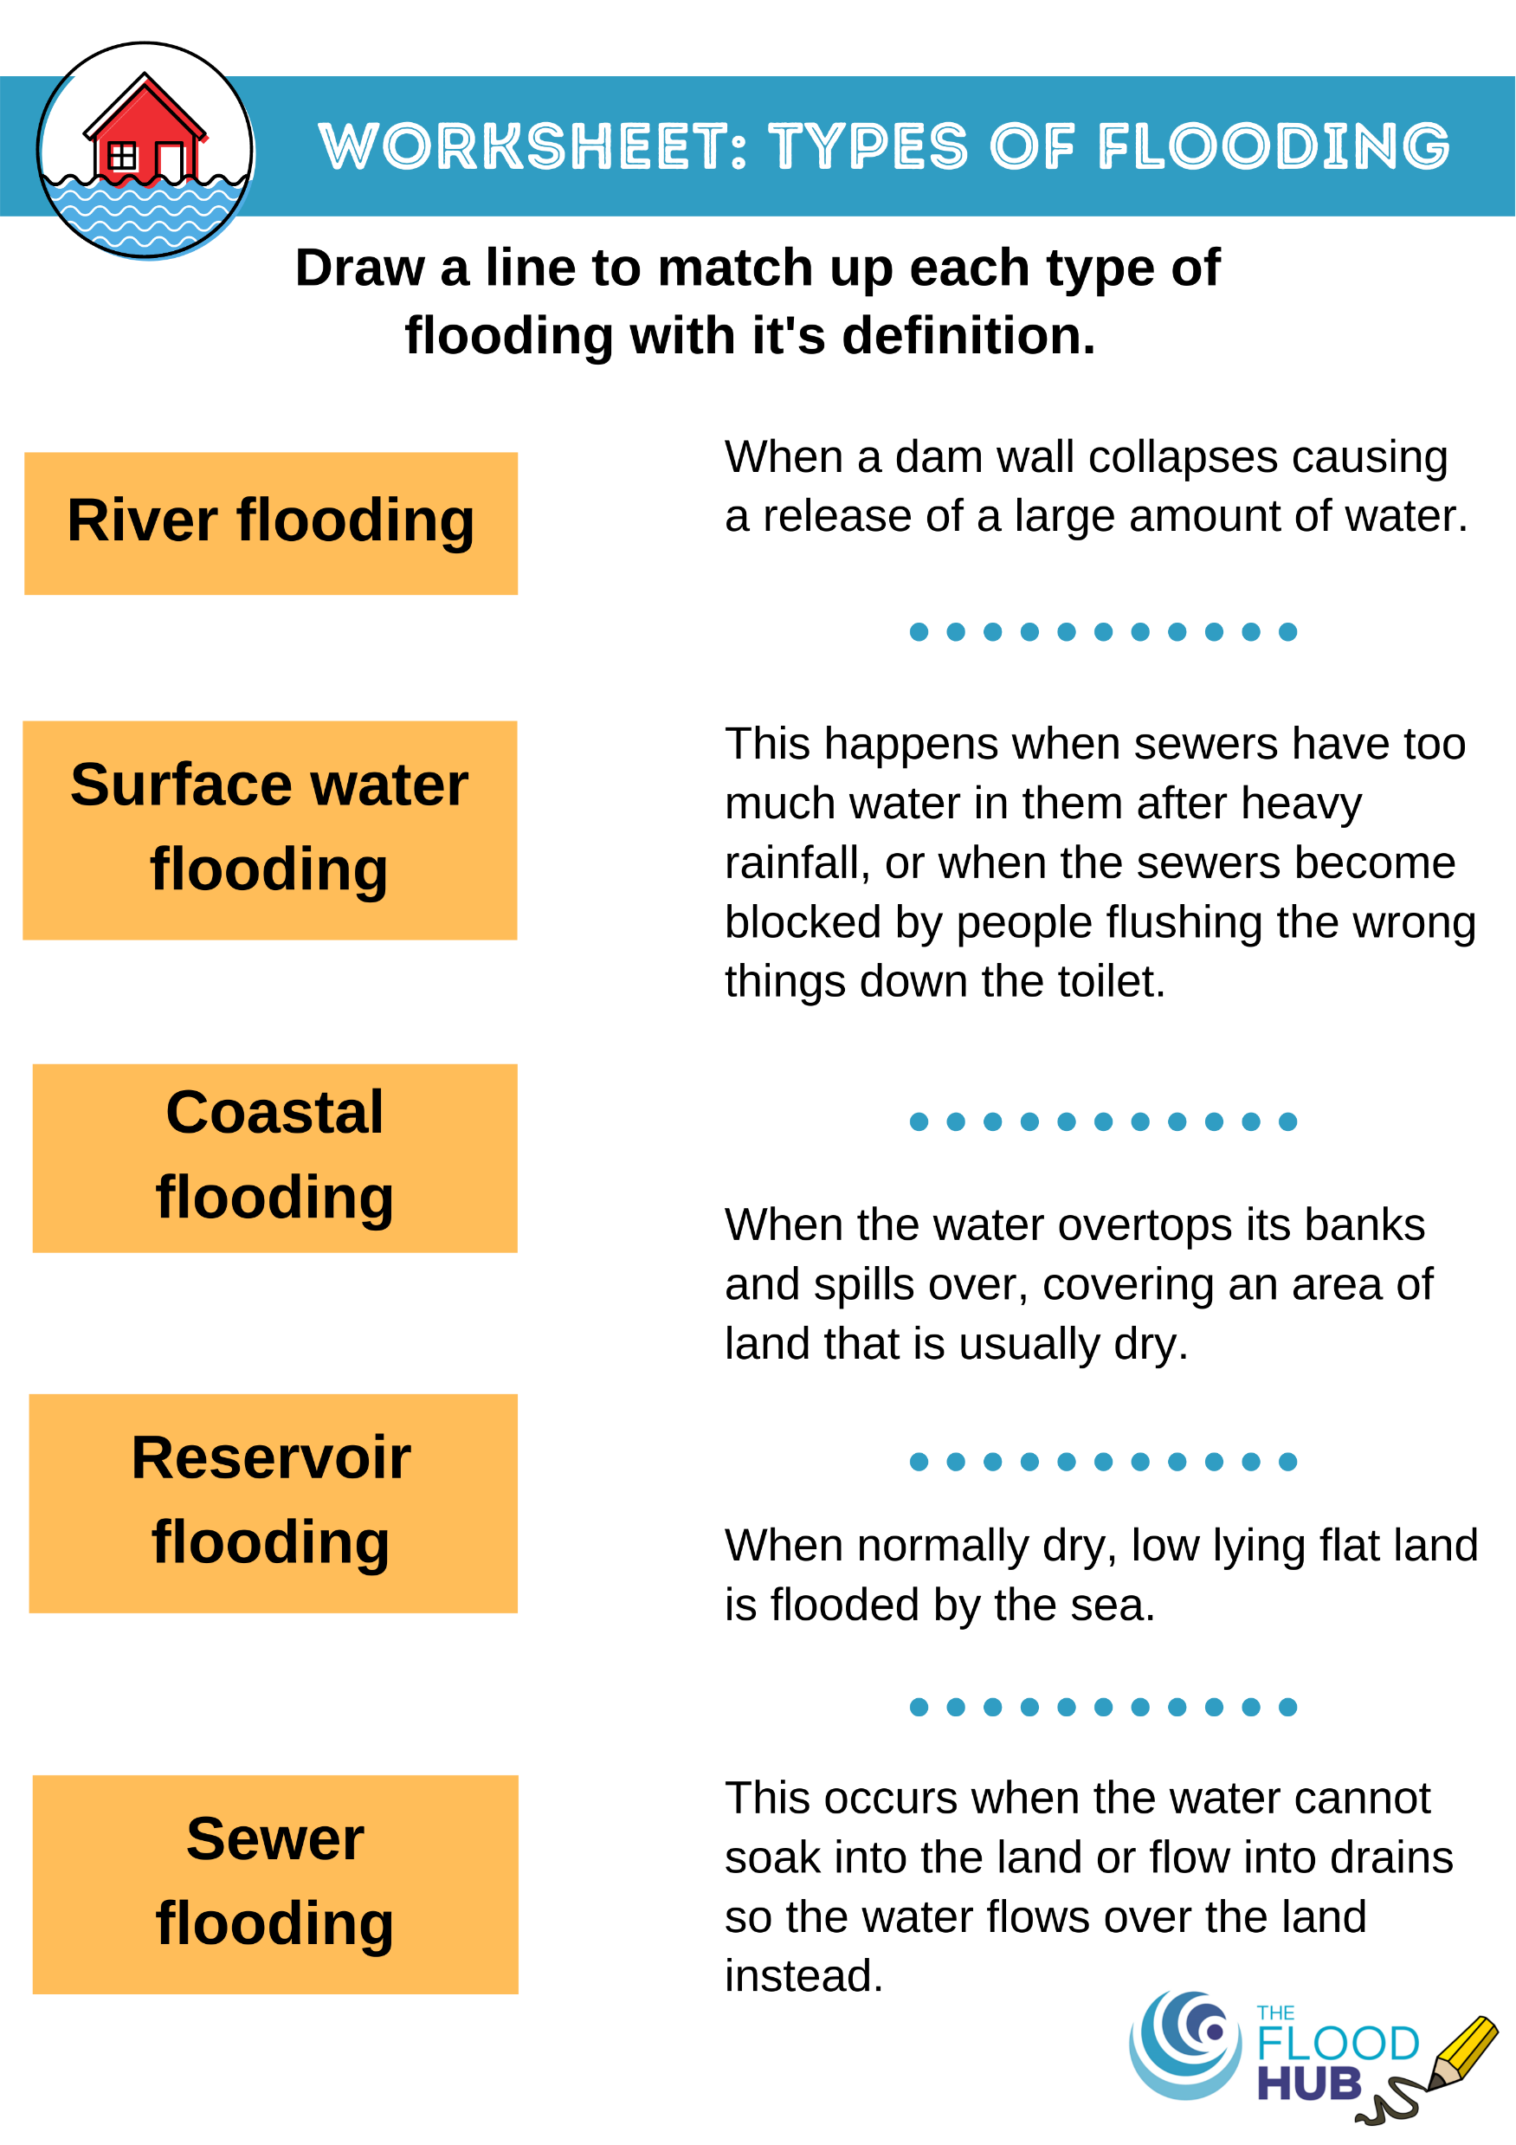
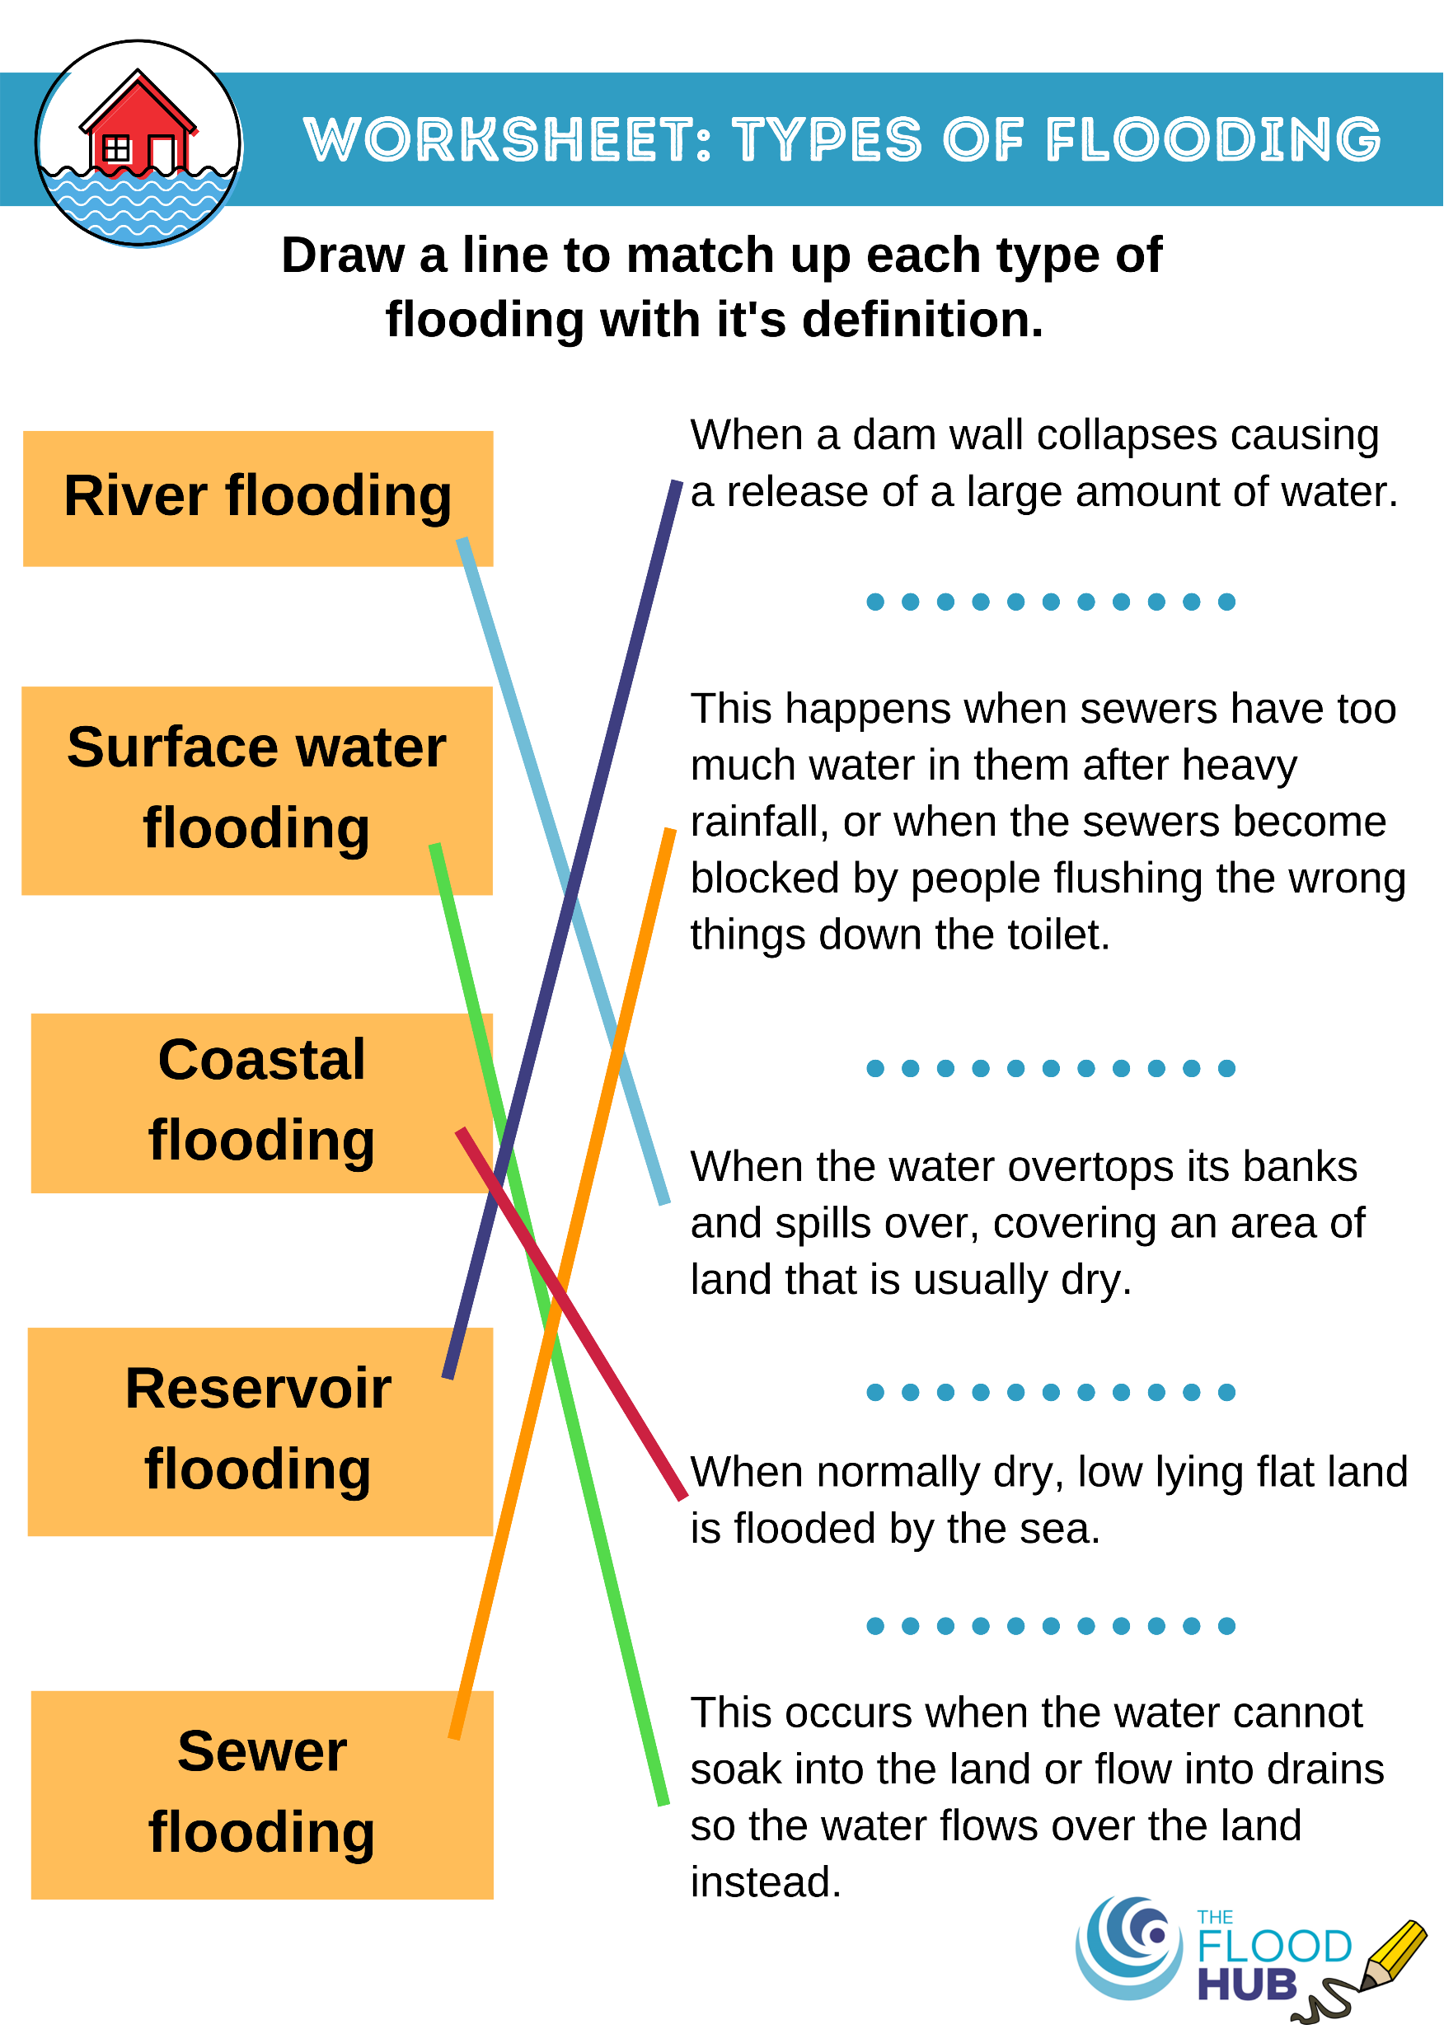
FT Q C42
Types of flooding
Match the type of flooding with the correct definition.
FT Q C42

Slide 10

Who manages the risk of flooding?
Environment Agency –
Water Companies –
Local Council or
County Council –
Main rivers, the sea and reservoirs
Sewer flooding and blockages
Surface water flooding
FT Q C42

Slide 11



True or false?
“Flooding only happens in winter”
FALSE!
Flash flooding can happen in summer as water can’t soak through hard, dry ground so there is more water running across the ground.
FT Q C42

Slide 12
True or false?
Flooding only happens from rivers.
FALSE!
As you have already learnt today, there are many different types of flooding.
FT Q C42

Slide 13


True or false?
⅙ homes and businesses are at risk of flooding from rivers, sea and surface water.
TRUE!
This number is set to increase in the future so it is important to check your flood risk.
FT Q C42

Slide 14
True or false?
“I live on a hill so I won’t flood”
FALSE!
Houses on a hill can suffer flooding from surface water, sewage pipes or even a burst water pipe.
FT Q C42

Slide 15
True or false?
If you have flooded recently, it won’t happen again for many years.
FALSE!
Flooding can happen every year. An area could also be flooded more than once in one year.
FT Q C42

Slide 16
True or false?
More people are at risk of surface water flooding than any other type of flooding.
TRUE!
In England, over 3 million homes and businesses are at risk from surface water flooding, compared to 2.7 million at risk from rivers and the sea.
FT Q C42

Slide 17
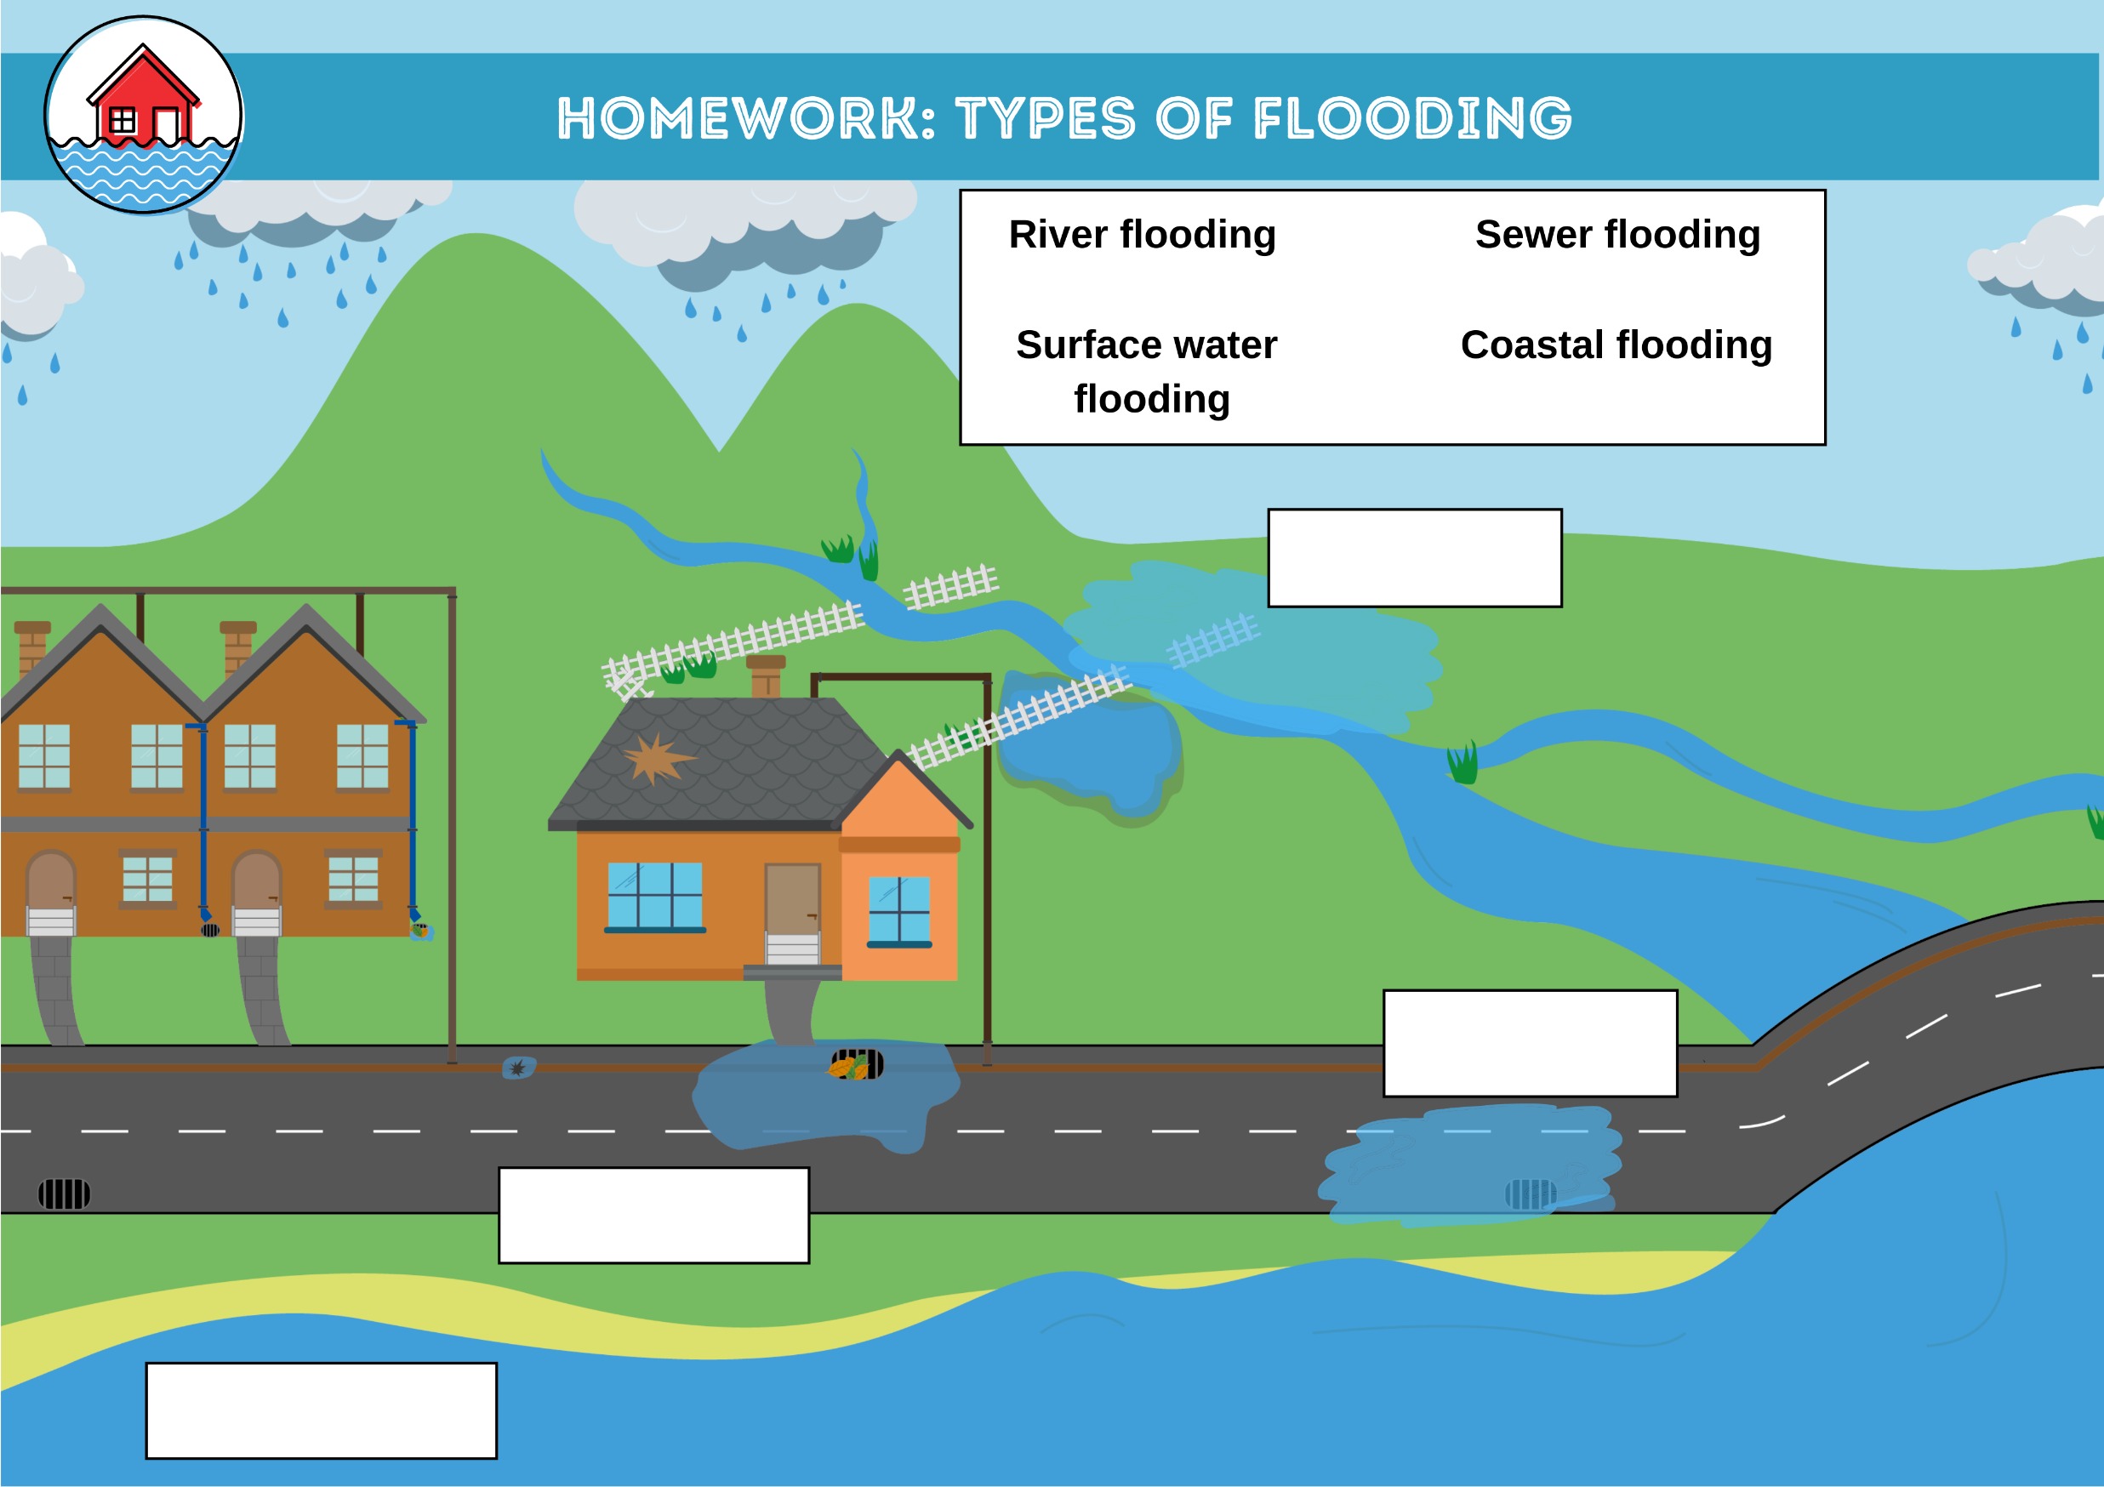
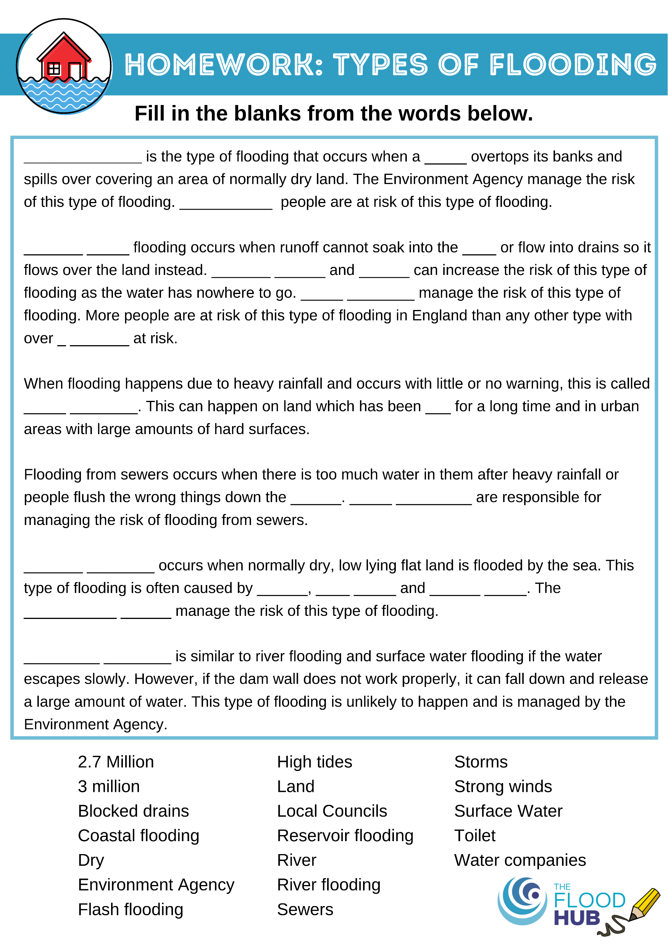

Homework: Types of flooding
Complete the worksheets about the types of flooding you have just learnt about in class. Fill in the gaps using the words provided.
FT Q C42
FT Q C42
FT Q C42

