Slide 1



The Dangers and Impacts of Flooding
Lesson aim:
To understand the dangers, impacts and damages that can be caused by flooding.
Lesson objectives:
To name some of the dangers and impacts that can be caused by flooding.
To learn about the damage caused in a recent UK flood.
To know that flooding can happen all over the world.
FT Q C45

Slide 2
FT Q C45
The Dangers and Impacts of Flooding
Flooding can be very dangerous!
Can you think of any dangers or damages caused by flooding?
!
!
Discuss with the person sitting next to you.

Slide 3
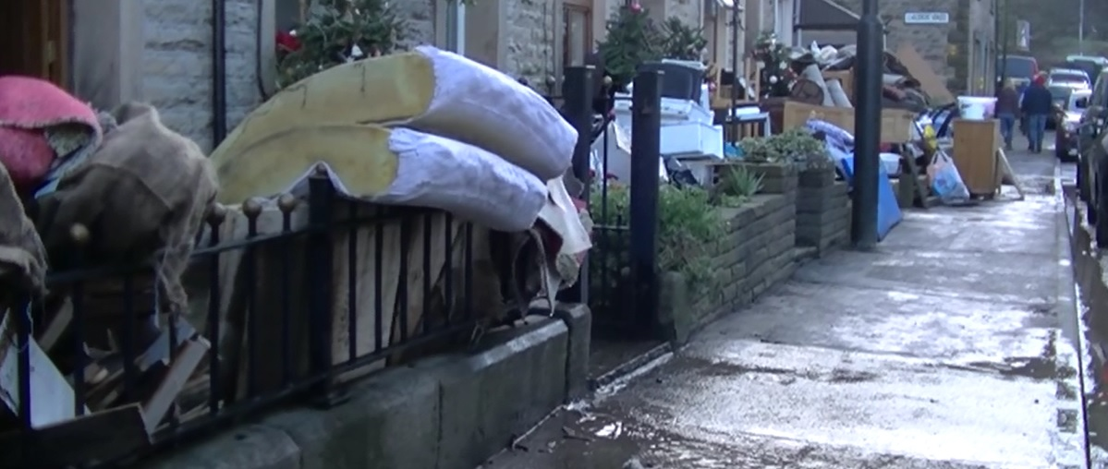
FT Q C45
Damage caused by floodwater
Damage to homes
Floodwater can cause lots of damage to homes and some families have to move out whilst it gets cleaned up. Sometimes, carpets get dirty and need to be ripped out and furniture needs to be thrown away. Some of your personal belongings such as toys can also be damaged.
Image from video by J Whipps / Whalley flooding, Lancashire

Slide 4
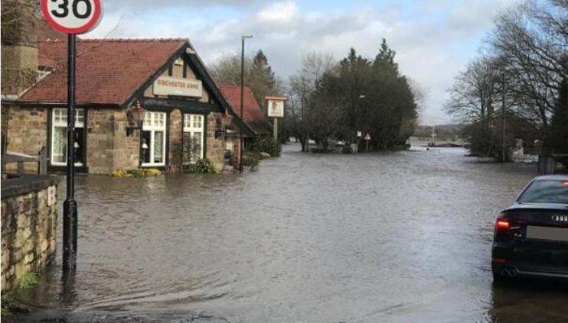
Damage caused by floodwater
Damage to businesses
Businesses may need to close for many months because of the damage caused by floodwater. Expensive equipment and stock may need to be thrown away and there could be thousands of pounds worth of damage. Some businesses have to close forever.
Image: The Flood Hub
FT Q C45

Slide 5
Damage caused by floodwater
Loss of power and disruption to water supply
X
Residents and business owners could be left without gas and electricity if supplies are damaged by floodwater.
If floodwater enters the water supply, it can cause disease or make you ill if you drink it from the tap.
FT Q C45

Slide 6
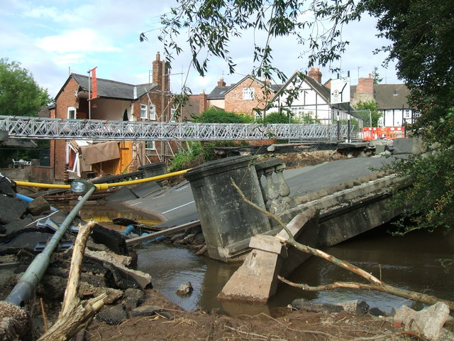
FT Q C45
Damage caused by floodwater
Damage to roads, bridges, railway lines etc.
It may be difficult to travel around your local area if there is a lot of floodwater on the ground. Floodwater can also damage roads, bridges and railway lines.
Flood Damage
cc-by-sa/2.0 - © DI Wyman - geograph.org.uk/p/1278873

Slide 7
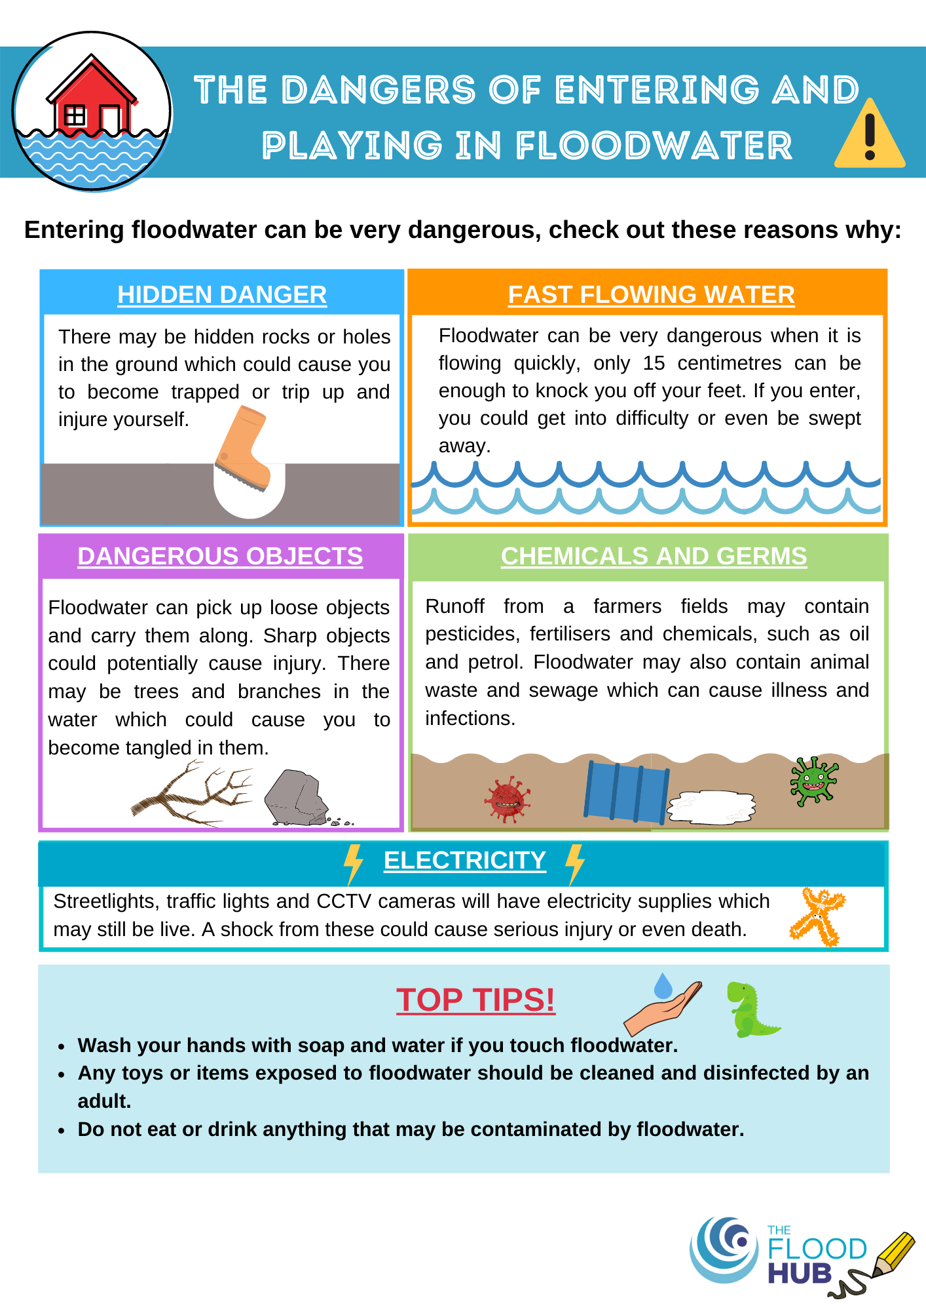
The dangers of entering and playing in floodwater
RISK OF FALLING OVER
FAST FLOWING WATER
DANGEROUS OBJECTS
CHEMICALS AND GERMS
ELECTROCUTION
FT Q C45

Slide 8
Storm Desmond, December 2015
Check out this BBC video showing a helicopter journey over a flooded Cumbria as a result of Storm Desmond
https://www.youtube.com/watch?v=aV_V_4bMwPI
FT Q C45

Slide 9

Case Study: Storm Desmond, 2015
When:
5-6th December 2015
Where:
Northern England, Wales, Scotland and Northern Ireland – severe gusts of up to 81mph were recorded in Cumbria.
Impacts:
Disruption to rail services
x
Schools and a university closed
~100,000 homes left without power in the North
5200 homes flooded
Many roads flooded
X
FT Q C45

Slide 10

Flooding in other parts of the world
Flooding and storms can happen all over the world, not just in the United Kingdom.
Storms may be called typhoons, hurricanes and cyclones in other parts of the world and they cause a lot of damage.
Some of the wettest weather occurs in the poorest parts of the world where they may not be able to recover as quickly.
FT Q C45

Slide 11
Group exercise: News report following a flood
In groups of three, choose a UK storm of your choice.
Research when and where it happened, why it happened and the damage and dangers caused by the flood water.
One of you will be the reporter and interview the other two, who will be a homeowner and a business owner.
As a group, decide up to ten questions and answers related to your flood event.
You will then act out your interview in front of the class to educate them about your chosen flood.
FT Q C45

Slide 12
Lesson recap
Flooding can have an impact on:
The dangers of entering and playing in floodwater are:
Storms that cause flooding in other countries can be called:
Homes
Businesses
Travel
Power
Water supply
Risk of falling over
Fast flowing water
Dangerous objects
Chemicals and germs
Electrocution
Typhoons
Hurricanes
Cyclones
FT Q C45

Slide 13

Homework – choose a task
1. Write a newspaper article with information on the damages caused by Storm Desmond, Eva, Frank, Ciara or Dennis. Name the storm, where it happened, when it happened and what damage it caused.
2. Research a flood event that happened in another country. Name the storm, where it happened, when it happened and what damage it caused. Are there any differences to the UK and why?
3. Create a poster which show the dangers and impacts that flood water can cause.
FT Q C45

