Slide 1



Flood Recovery
Lesson aim:
To understand how to recover from flooding.
Lesson objectives:
To understand the different stages of recovering from a flood.
Be aware that recovering from flooding can take a long time.
FT Q C46

Slide 2
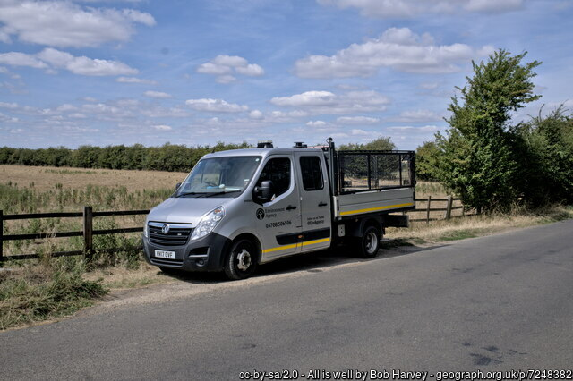

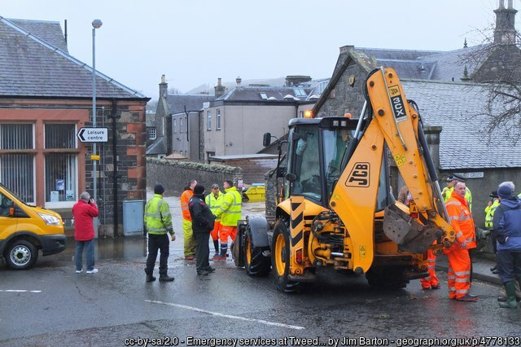
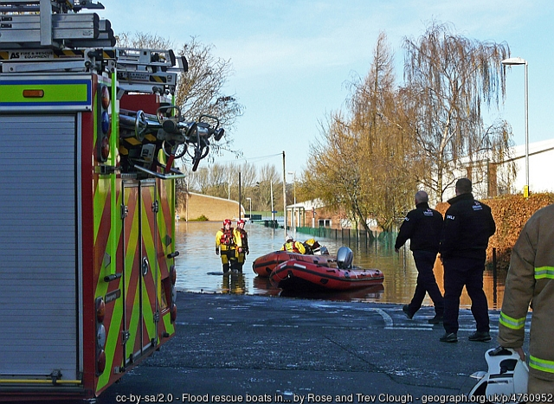
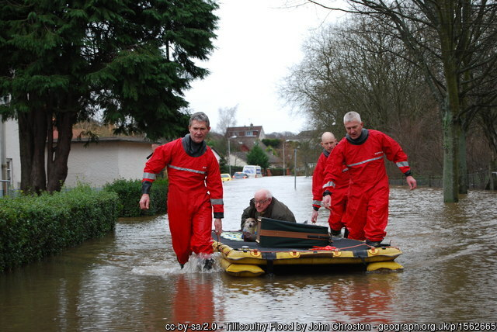

FT Q C46
Flood Recovery
When flooding occurs, who do you think will come to help?
Environment
Agency
Council
Police
Fire and Rescue Services
Water
companies
Voluntary
Groups
Image United Utilities
Flooding can be dangerous, so there will be a plan for how all those coming to help can work together.
FT Q C46

Slide 3
Flood Recovery
During a flood
It may be too dangerous to stay at home and you may have to leave or even be rescued.
FT Q C46

Slide 4
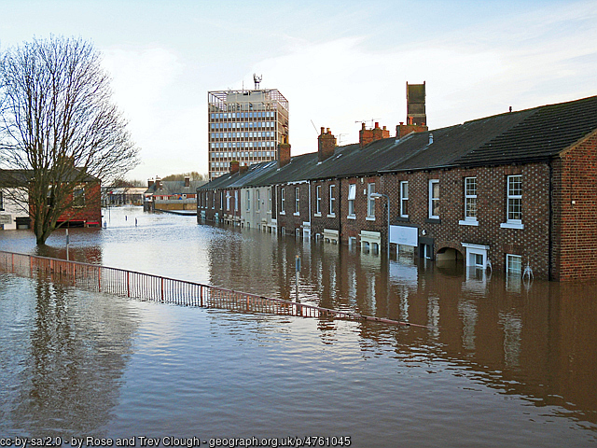
Flood Recovery
During a flood
The floodwater could be in your home for hours or even days, so you may have to move out until it’s safe to go back. This could be for a few nights, or maybe much longer.
FT Q C46

Slide 5
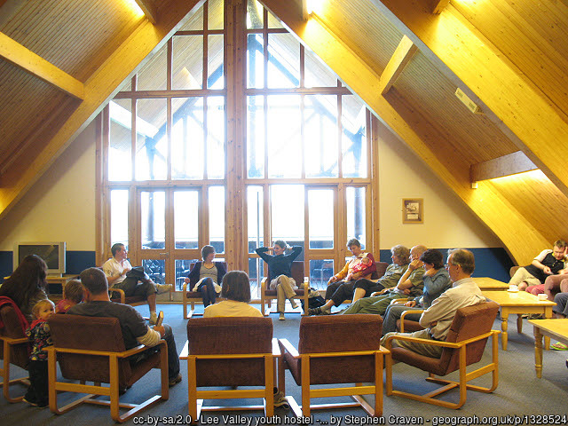
Flood Recovery
During a flood
Emergency recovery centres may be set up where people can stay to be safe, warm and dry. This may be at the local community centre or village hall, somewhere that isn’t at risk of flooding where people can go.
FT Q C46

Slide 6
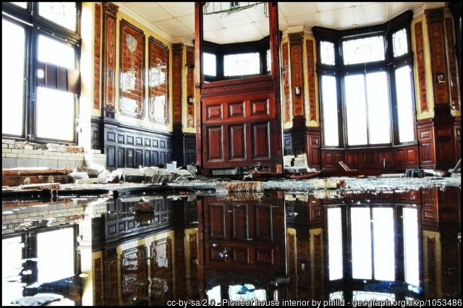
FT Q C46
Flood Recovery
Cleaning up
When the floodwater has gone down it will be time to start thinking about cleaning up.
There may be poisonous substances, human and animal waste, silt, germs and bacteria carried into your home by the floodwater, so deep cleaning will be required.

Slide 7
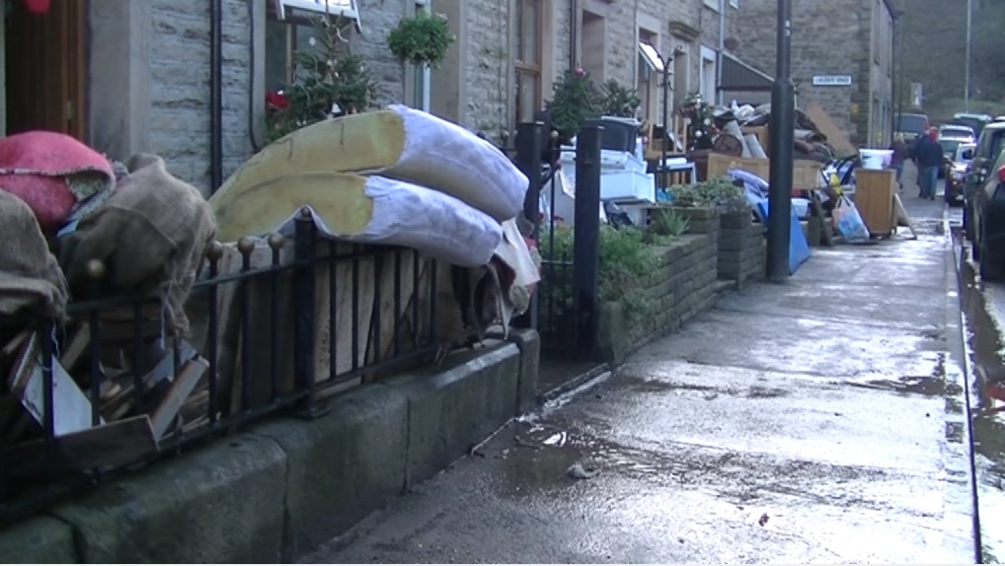
Flood Recovery
Cleaning up
Some things such as pots, pans, cutlery and solid tables and chairs can be cleaned by an adult with detergent or disinfectant and will be okay to use again.
Other things that may have been soaked in floodwater such as armchairs, beds, mattresses, couches and carpets usually need to be thrown away.
Image from video by J Whipps / Whalley flooding, Lancashire
FT Q C46

Slide 8
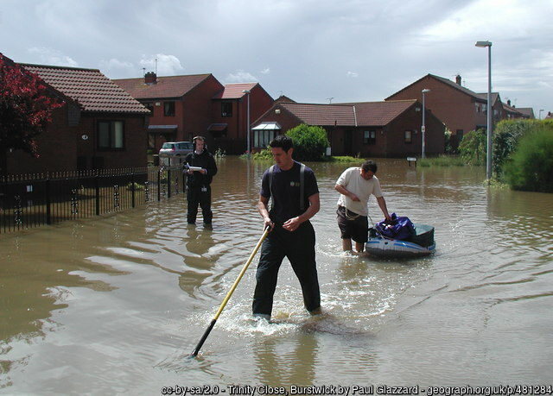
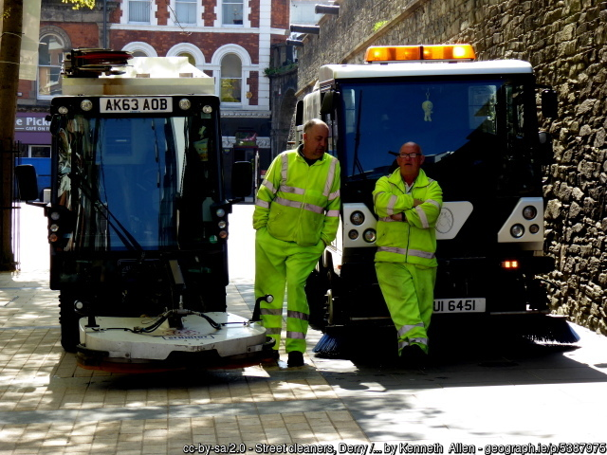
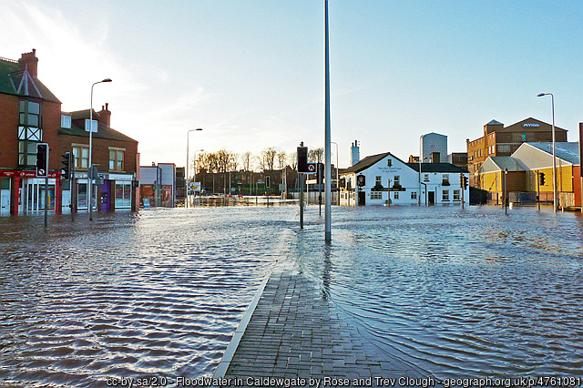
Flood Recovery
Cleaning up
There will also be a clean up required in the streets and surrounding areas near to where you live.
FT Q C46

Slide 9
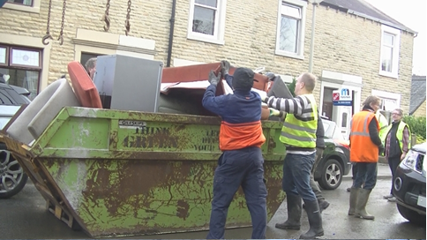
Flood Recovery
Cleaning up
The council may provide skips so people can throw away their flood damaged items and volunteer groups may come to offer help and support.
FT Q C46
Image from video by J Whipps / Whalley flooding, Lancashire

Slide 10
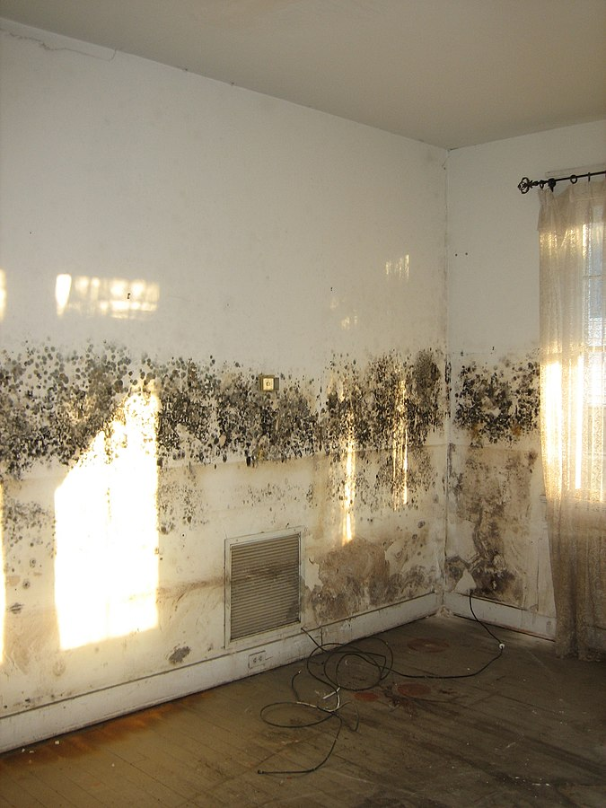
Flood Recovery
Cleaning up
Floodwater can soak into the plaster and bricks of the walls of your home and this will cause mould to grow. The walls must be thoroughly dried out or the mould will come back, even if you clean it off.
Image: New Orleans after Hurricane Katrina: Mold in flood damaged home by Infrogmation in licensed under CC BY-SA 2.5 - Wikimedia Commons
FT Q C46

Slide 11
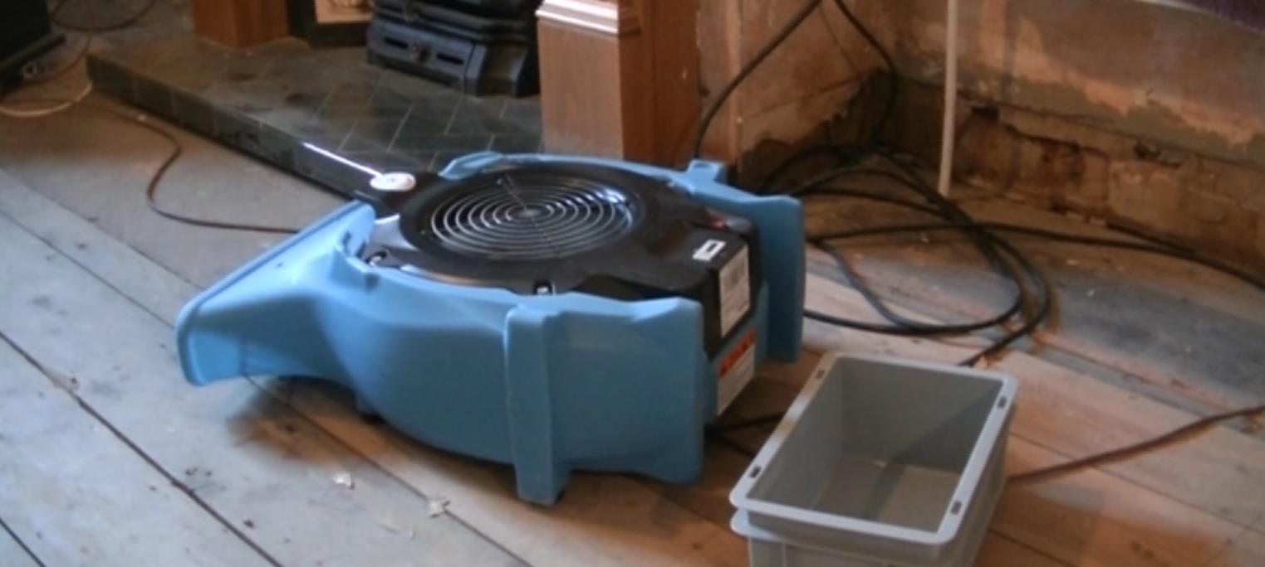
Flood Recovery
Drying out
Drying out your house can take days or weeks using large blowers that work like big hair dryers! When the drying out is finished, you can get a certificate to prove it is properly dried out, and then the repairs to your home can begin.
FT Q C46

Slide 12
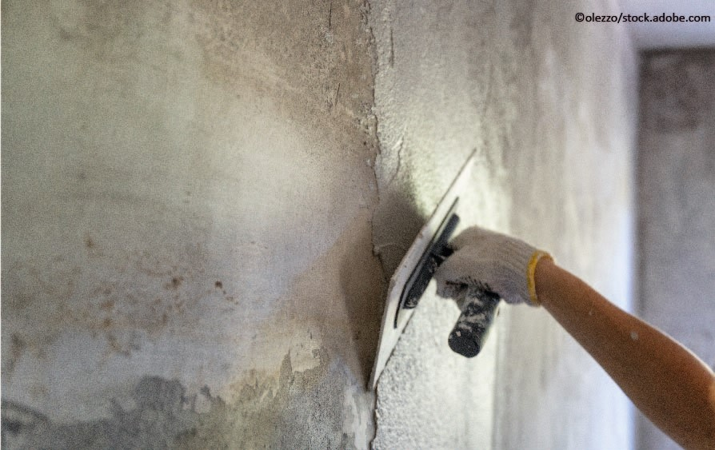
Flood Recovery
Repair work
Repairs can include replacing plaster on the walls, new floor coverings, replacing electrics, new kitchen units and re-decorating.
FT Q C46

Slide 13
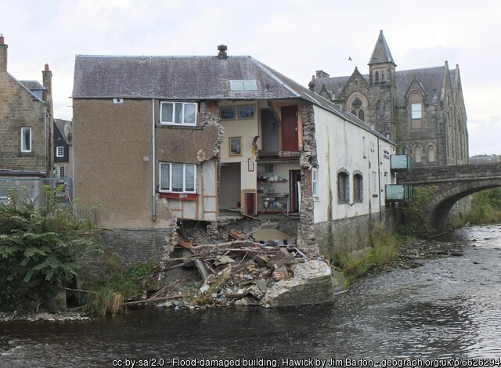
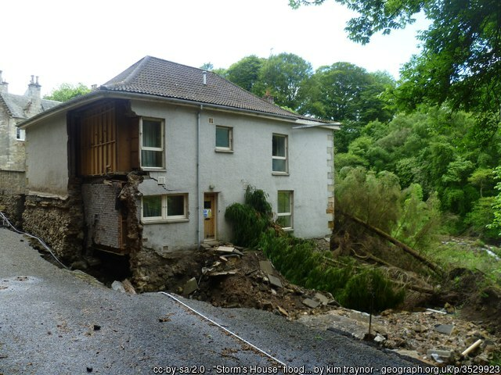
Flood Recovery
Damages
It could be too dangerous to return to your home as it may have been badly damaged by the flooding and be unsafe.
FT Q C46

Slide 14
Flood Recovery
Damages
If the flood event was particularly severe, you might have to stay with friends, family, or even go to a hotel. When lots of properties are flooded in one area, repair work can take a long time to complete as there can be a shortage of skilled workers such as builders, plasterers or joiners who can carry out the repairs.
FT Q C46

Slide 15
Flood Recovery
Other effects of flooding
There is something else which can be affected by flooding and all the disruption it causes.
This effect can take much longer to recover than the time it takes to get back into your home.
Do you know what it might be?
Mental health and well-being
FT Q C46

Slide 16
Flood Recovery
Being flooded can affect people differently and there are lots of reasons for this:
It can be a dangerous and scary situation.
It can make people sad when they lose their personal possessions.
You might not know what’s happening or when things will be back to ‘normal’.
You might have to move out of your home for a long time
You might not be able to go back to school as it may also have flooded.
You might feel lonely as you may not be able to see your friends as much.
Recovering from the effects of flooding can be a very stressful time for you and your family.
You might feel nervous whenever it rains or whenever there is a flood warning.
It is important to remember that recovering from flooding doesn’t only mean fixing the damage to your home.
FT Q C46

Slide 17
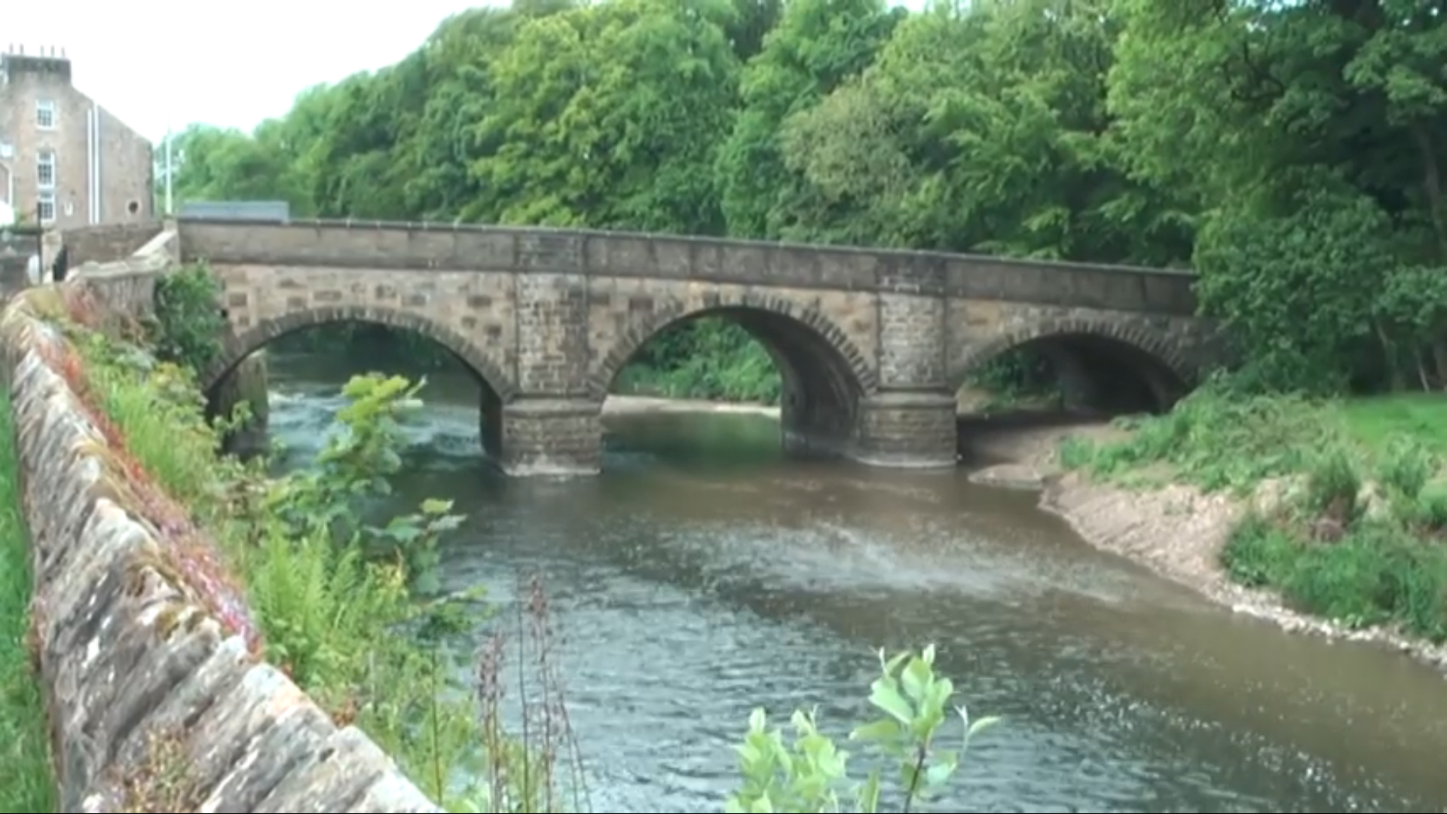
Flood Recovery
Let’s watch this film about flooding in Whalley, Lancashire, to see how people recovered.
https://www.youtube.com/watch?v=P7TvtgH7dWc&feature=youtu.be
FT Q C46

Slide 18
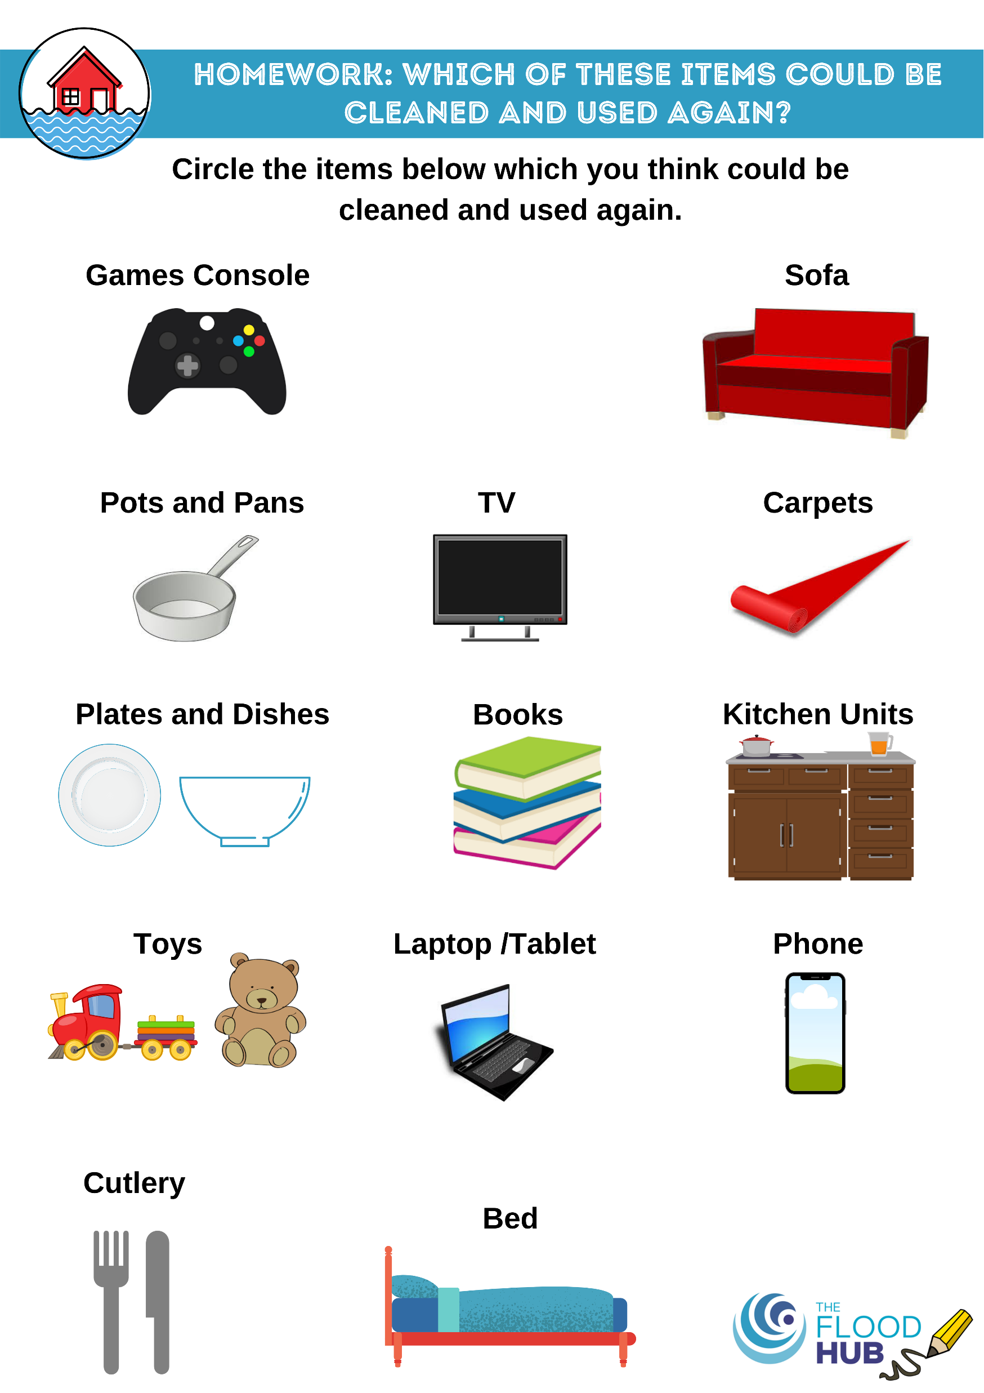
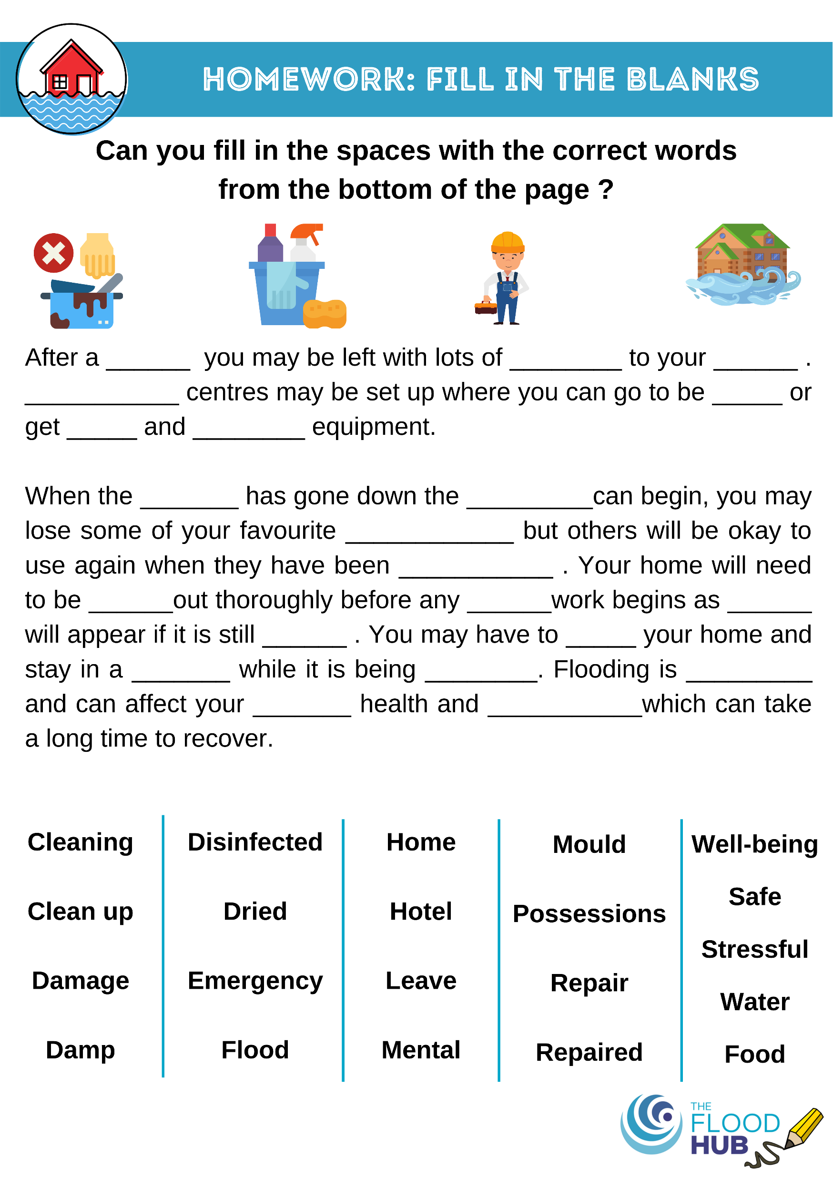
Homework
FT Q C46
FT Q C46
FT Q C46

