Slide 1



FT Q C50
Extreme Weather in the UK
Learning Objectives:
  Understand the concept of extreme weather and identify various types of extreme weather events in the UK.
  Identify the different types of flood warnings issued by the Environment Agency and their significance.
  Analyse the impacts and characteristics of the storms during the 2023-24 season, including how they relate to the wider context of extreme weather in the UK.

Slide 2

FT Q C50
Extreme Weather in the UK
Starter:
Discuss with your neighbour...
Any extreme weather events you've heard about or experienced in the UK.
How do these events differ from regular weather, and what impact do they have on people and communities?

Slide 3

FT Q C50
Extreme Weather in the UK
WEATHER IN THE UK
TASK: Fill the blanks on your worksheet with the words below.
The weather in the UK is characterised by______ , ______ summers and ______ , ______ winters. However, there are__________ differences. The_______, influenced by the Atlantic Ocean, is ________and windier, especially in the northwest. In contrast, the_________ is _________and more sheltered, with less rainfall. The_______ is cooler than the_______, experiencing colder winters and cooler summers. These variations are due to geographical factors like latitude, proximity to the ocean and prevailing wind patterns.
wet, north, wetter, regional, warm, west, mild, drier, east, wet, south

Slide 4
FT Q C50
Extreme Weather in the UK
WEATHER IN THE UK
TASK: Fill the blanks on your worksheet with the words below.
wet
warm
The weather in the UK is characterised by______ , ______ summers and ______ , ______ winters. However, there are__________ differences. The_______, influenced by the Atlantic Ocean, is ________and windier, especially in the northwest. In contrast, the_________ is _________and more sheltered, with less rainfall. The_______ is cooler than the_______, experiencing colder winters and cooler summers. These variations are due to geographical factors like latitude, proximity to the ocean and prevailing wind patterns.
wet
mild
regional
north
wetter
south
drier
west
east

Slide 5

FT Q C50
Extreme Weather in the UK
EXTREME WEATHER
Extreme weather is any weather that is unusual or unexpected. This can include severe or unseasonal weather. In the UK, warnings are issued if extreme weather is expected to help people prepare and stay safe.

Slide 6
FT Q C50
Extreme Weather in the UK
TASK:
Copy this definition onto your worksheets
EXTREME WEATHER
Extreme weather is any weather that is unusual or unexpected. This can include severe or unseasonal weather. In the UK, warnings are issued if extreme weather is expected to help people prepare and stay safe.

Slide 7
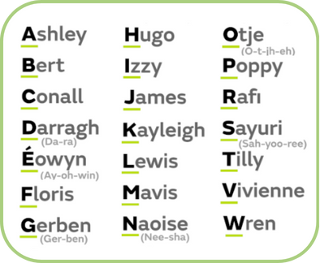
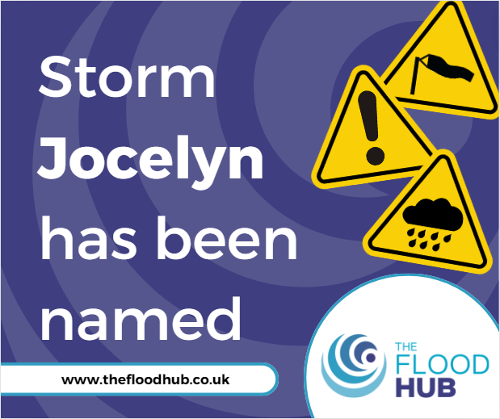
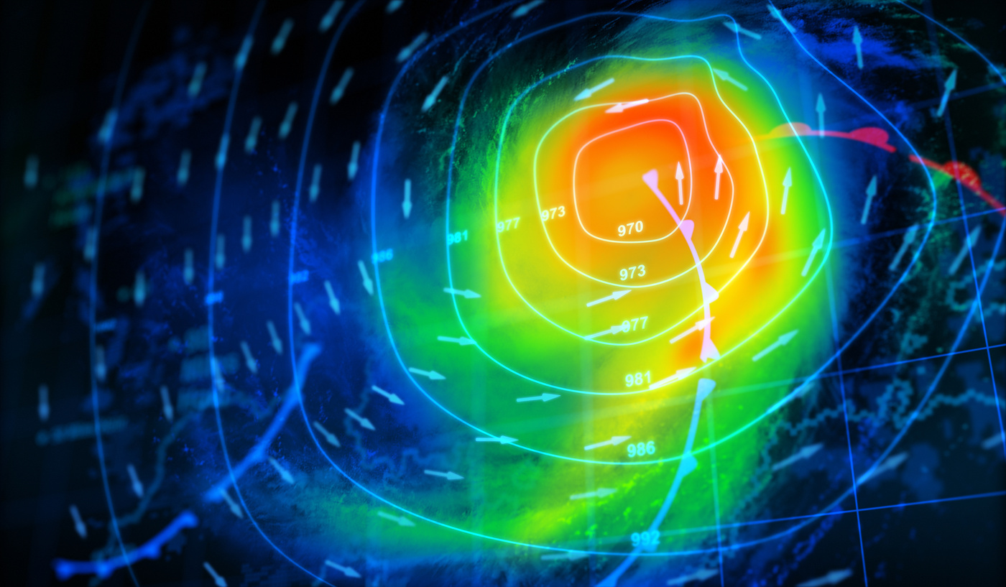
FT Q C50
Extreme Weather in the UK
STORMS
Since 2015, the Met Office has named severe storms in the UK. This helps meteorologists at the Met Office monitor the progression of each storm over time and provide accurate forecasts to the public.
Weather Map View more by Petrovich9 from Getty Images Pro
2024/25 Storm Names

Slide 8

FT Q C50
Extreme Weather in the UK
SUMMER STORMS VS WINTER STORMS
Summer storms are often marked by thunderstorms, which can bring heavy rainfall, lightning, and hail. They typically occur when warm, moist air rises quickly, leading to intense weather events such as flash floods, especially during hot summer months.
In contrast, winter storms are characterised by cold temperatures, snow, and strong winds, often leading to blizzards and ice conditions.

Slide 9
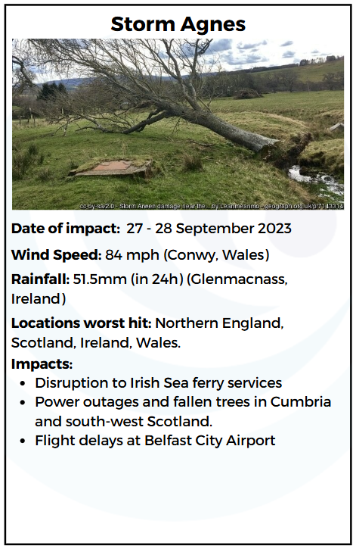
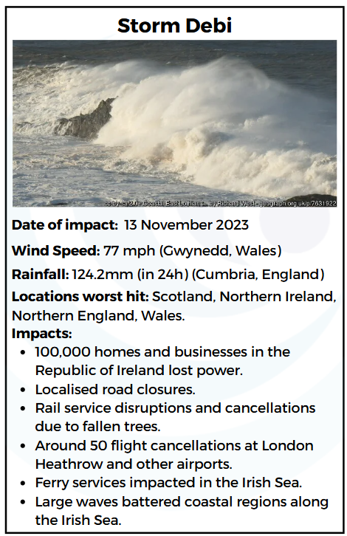
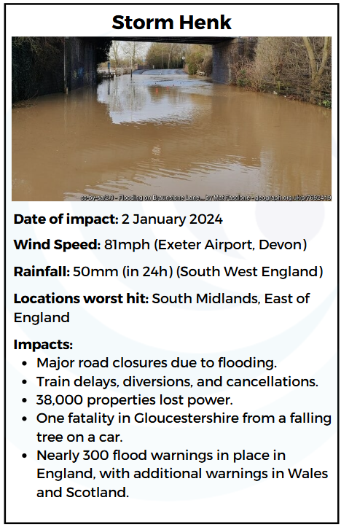
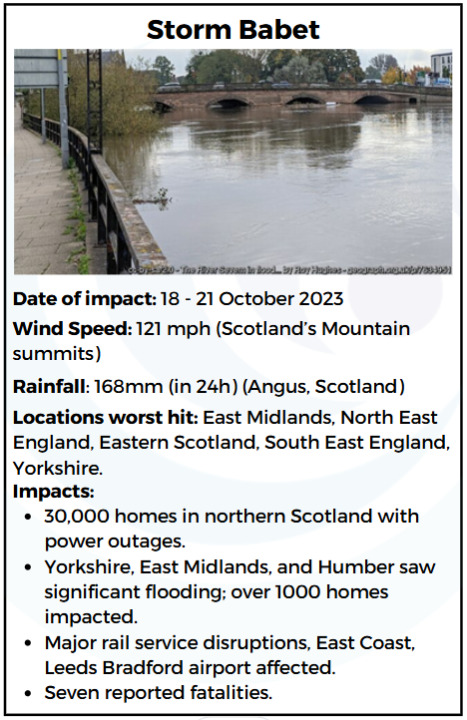
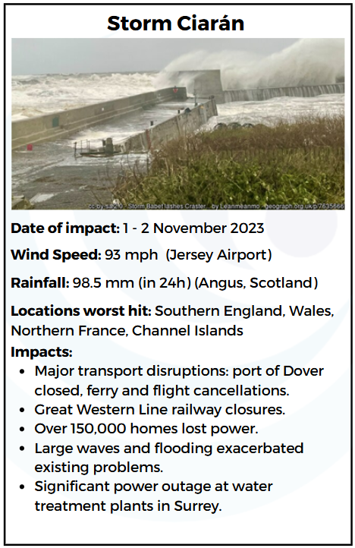
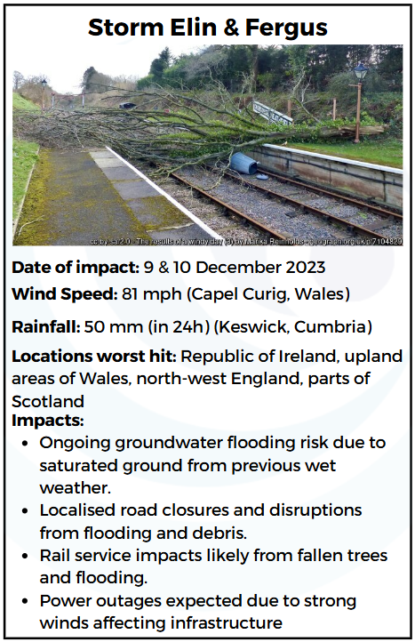
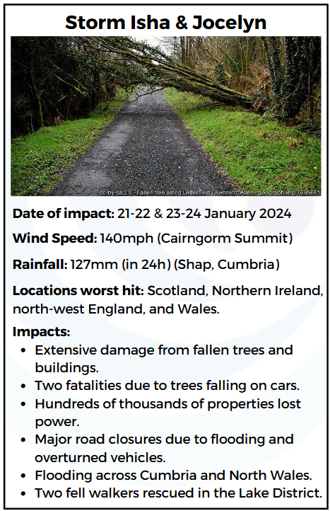
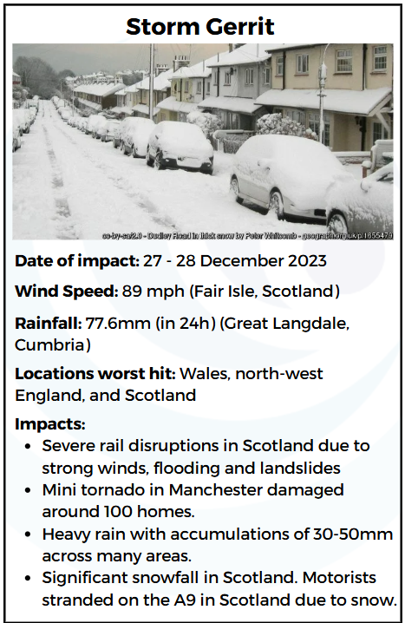
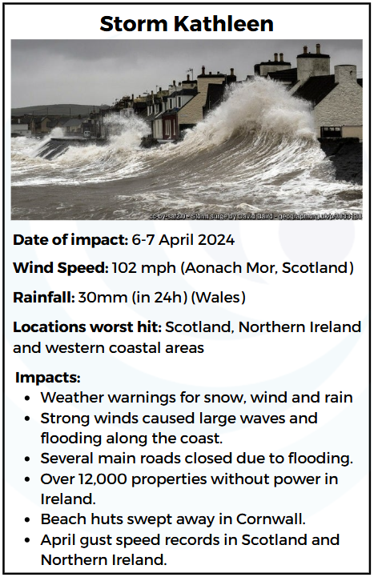
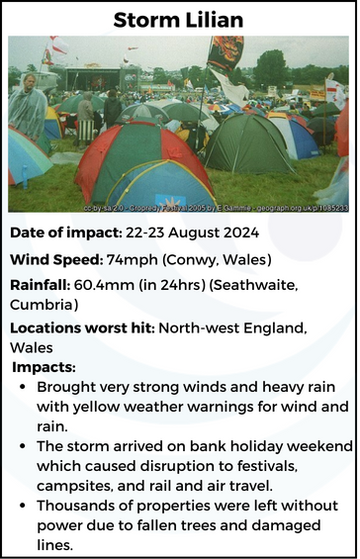

FT Q C50
Extreme Weather in the UK
STORMS
The 2023-24 storm season was important because it was the first time storms reached the letter "L" since the naming system started in 2015.

Slide 10

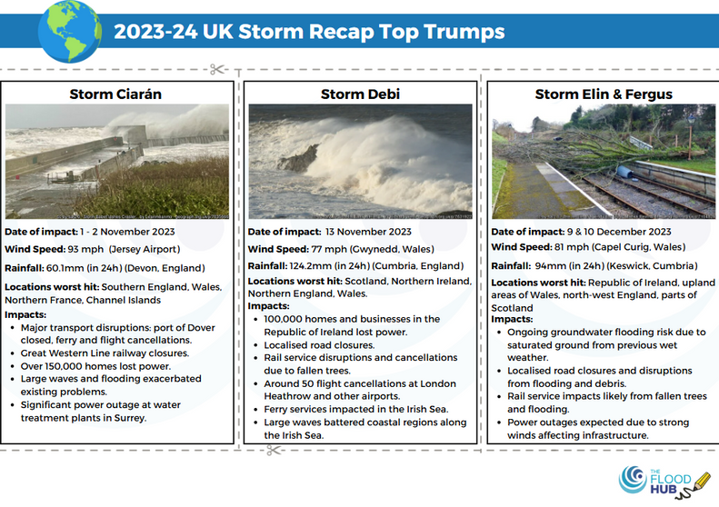

FT Q C50
Extreme Weather in the UK
STORMS
TASK:
Cut out the Top Trumps cards and in pairs or small groups, compare the storms based on their strength, impact, and other key features. Discuss which storm had the most significant effect.

Slide 11
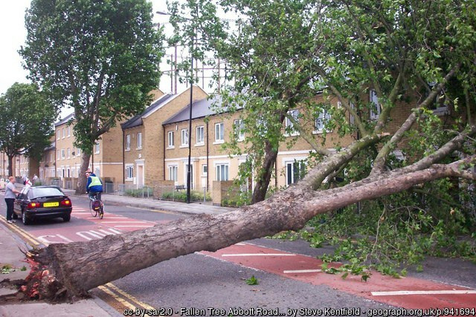
FT Q C50
Extreme Weather in the UK
STRONG WINDS
Strong winds occur due to several atmospheric conditions that create significant pressure differences. They can cause significant damage to buildings, uproot trees, and disrupt power supplies, posing serious risks to public safety.

Slide 12
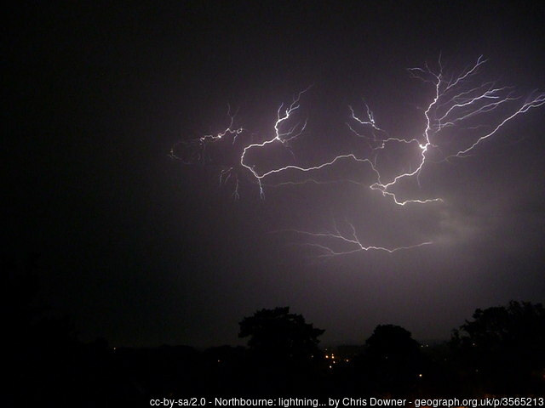
FT Q C50
Extreme Weather in the UK
THUNDERSTORMS
Thunderstorms occur when warm air rises quickly, often due to low pressure.
They are more frequent in the UK during summer when temperatures are high. Thunderstorms feature lightning strikes, which can harm buildings and start fires.
Northbourne: lightning continues. cc-by-sa/2.0 - © Chris Downer - geograph.org.uk/p/3565213

Slide 13
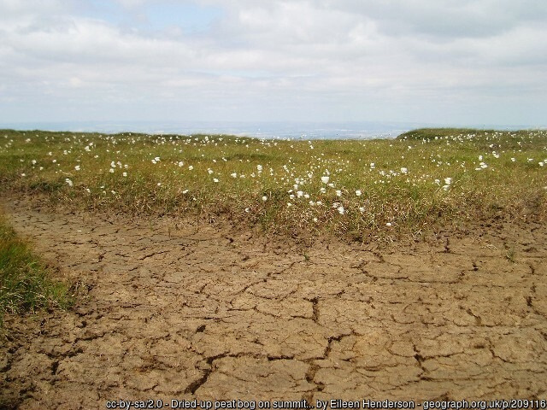
FT Q C50
Extreme Weather in the UK
DROUGHTS
A drought is a very dry period that happens when there is not enough rain for a long time.
Droughts can lead to water shortages and cause problems like crop failures and restrictions on water use. They can also harm the environment by drying up rivers and harming wildlife.
Dried-up peat bog on summit of Cheviot cc-by-sa/2.0 - © Eileen Henderson - geograph.org.uk/p/209116

Slide 14
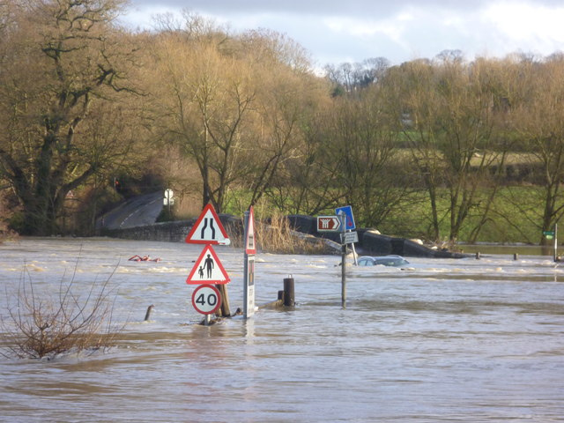
FT Q C50
Extreme Weather in the UK
FLOODS
Floods occur all year round, when water covers land that is usually dry. They happen because of heavy rain, rivers overflowing their banks, or storm surges from the sea.
Floods can damage homes, wash away roads and cars, and sometimes lead to people getting hurt or losing their lives.
Flooding and submerged car at Teston Bridge on Christmas Daycc-by-sa/2.0 - © Marathon - geograph.org.uk/p/3789774

Slide 15
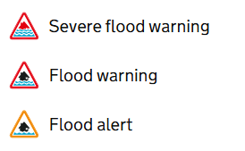
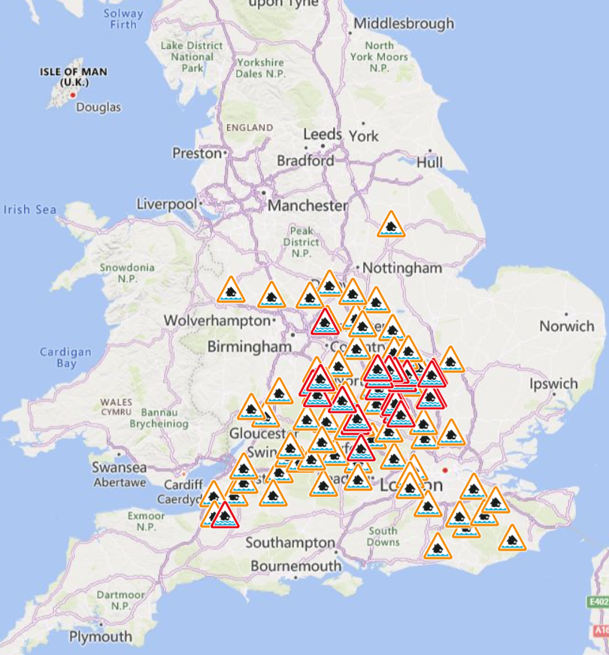
FT Q C50
Extreme Weather in the UK
FLOOD WARNINGS
In England, the Environment Agency provides a Flood Warning Service to help people prepare for potential flooding. These alerts and warnings are issued based on weather forecasts, river levels, and coastal conditions.
By keeping people informed, flood alerts and warnings allow time to prepare, protecting lives and minimising damage to homes and businesses.
© 2025 Microsoft Corporation
© 2025 TomTom

Slide 16



FT Q C50
Extreme Weather in the UK
FLOOD WARNINGS
What the different warnings mean:
Flood Alert
Flood Warning
Severe Flood Warning
Flooding is possible
Flooding is expected
Severe flooding is expected
This means flooding is possible and you need to stay vigilant, making early preparations for a potential flood.
This means flooding is expected and immediate action is required to protect yourself and your property.
This means severe flooding is expected and is likely to cause significant risk to life and destruction of property.
  Monitor the situation through forecasts, the Environment Agency's 'Check for Flooding' service, local radio stations and monitoring stations.
  Check your flood plan is filled and your flood kit is complete and ready if needed.
  Continue to monitor the situation.
  Carry out actions detailed in your flood plan.
  Put any property flood resilience equipment into place.
  Prepare to evacuate and cooperate with the emergency services.
  Get your flood kit before evacuating.
  Turn off utility supplies.

Slide 17
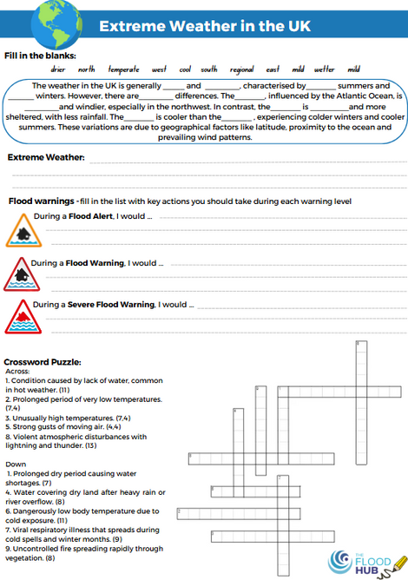
FT Q C50
Extreme Weather in the UK
FLOOD WARNINGS
What the different warnings mean:
TASK:
On your worksheets, fill in what would you do if any of the flood alerts and warnings were issued.
Think about specific actions such as gathering important documents, securing their property, and preparing a flood kit.

Slide 18
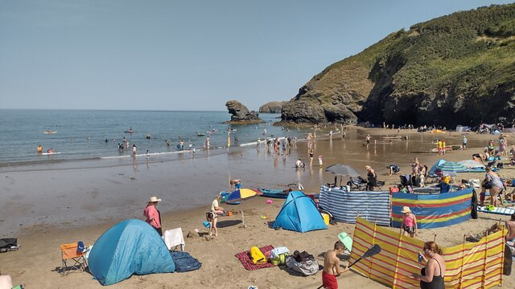
FT Q C50
Extreme Weather in the UK
EXTREME HOT SPELLS
Extreme hot spells are prolonged periods of unusually hot weather, often with high humidity. These hot spells typically occur during the summer and can lead to conditions like droughts and thunderstorms.
High temperatures during these spells can lead to dehydration, heat exhaustion, sunburn, and wildfires due to dry vegetation.
Llangrannog Beach cc-by-sa/2.0 - © Shaun Ferguson - geograph.org.uk/p/7669308

Slide 19
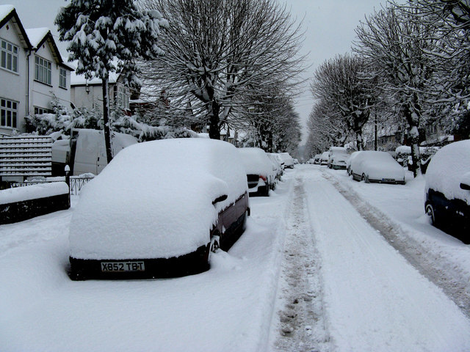
FT Q C50
Extreme Weather in the UK
EXTREME COLD SPELLS
Extreme cold spells are prolonged periods of unusually cold weather, occurring during the UK winter. These spells often bring freezing temperatures, heavy snow and ice, creating hazardous walking and driving conditions. Extreme cold weather can also lead to health issues in people, such as hypothermia and increased risk of influenza (flu).
Windermere Road, Coulsdon in the snowcc-by-sa/2.0 - © Dr Neil Clifton - geograph.org.uk/p/1181176

Slide 20
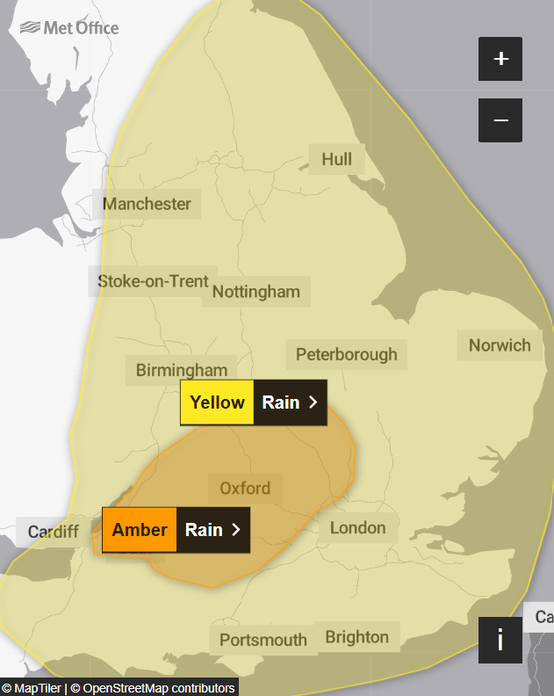
FT Q C50
Extreme Weather in the UK
WEATHER WARNINGS
The Met Office covers a wide range of weather conditions with its warnings to ensure public safety and preparedness.
These include: rain, snow, wind, thunderstorms, fog, ice, extreme heat & cold weather.

Slide 21



FT Q C50
Extreme Weather in the UK
WEATHER WARNINGS
The warnings are categorised into three levels, based on the severity of the weather and its potential impact:
Yellow Warning: This indicates that severe weather is possible. While the risk may be lower, people should be aware of the potential for disruption and stay informed.
Amber Warning: The weather is more severe, with a higher likelihood of disruption to daily life. This could include road closures, public transport delays, power cuts, or property damage. People should take action to prepare and protect themselves.
Red Warning: This is the highest level, indicating dangerous weather that poses a risk to life. Major disruption is expected, and immediate action is needed to protect people and property. People should avoid travelling and follow advice from emergency services.

Slide 22

FT Q C50
Extreme Weather in the UK
TASK:
Complete the crossword puzzle on your worksheets with the extreme weather events in the UK and some of the effects.
﻿﻿Across:
1. Lack of sufficient water in the body. (11)
﻿﻿﻿2. Prolonged period of very low temperatures. (7,4)
﻿﻿﻿3. Unusually high temperatures. (7,4)
5. Strong gusts of moving air. (4,4)
8. Violent atmospheric disturbances with lightning and thunder. (13)
Down
1. Prolonged dry period causing water shortages. (7)
4. Water covering dry land after heavy rain or river overflow. (8)
6. Dangerously low body temperature due to cold exposure. (11)
7. Viral respiratory illness that spreads during cold spells and winter months. (9)
9. Uncontrolled fire spreading rapidly through vegetation. (8)

Slide 23
FT Q C50
Extreme Weather in the UK

Slide 24
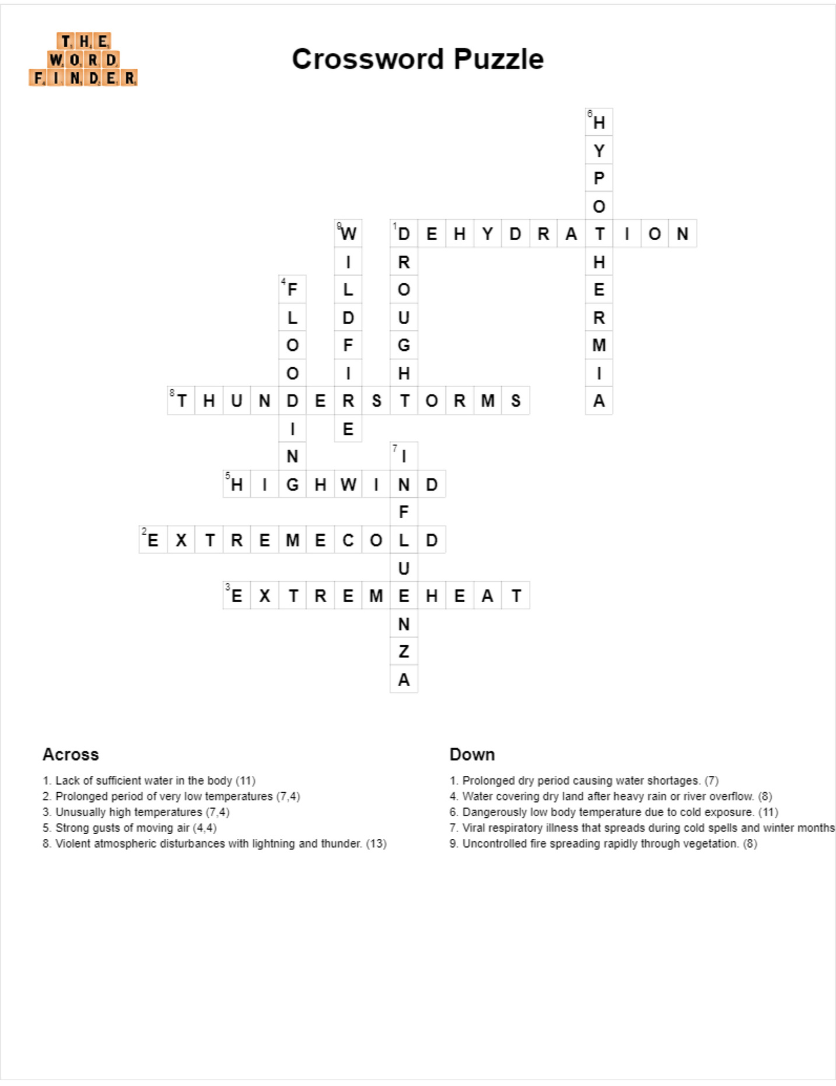
FT Q C50
Extreme Weather in the UK

Slide 25
FT Q C50
Extreme Weather in the UK
PLENARY:
Before next lesson, have a think about...
What types of extreme weather events can lead to flooding?
Can you share any personal experiences or stories you know about flooding or severe weather in your local area or elsewhere? How did these events affect the community?

