Slide 1




FT Q C52
Introduction to Climate
Learning Objectives:
  Explain what climate is and how it differs from weather.
  Explore global climate types, differentiate their characteristics and provide examples of locations where each climate zone can be found.

Slide 2

FT Q C52
Introduction to Climate
Introduction to Climate
Starter:
Discuss with your neighbour...
What makes the climate of the Amazon rainforest different to that of UK?
What do you think climate means? How is it different from weather?

Slide 3
FT Q C52
Introduction to Climate
WEATHER
CLIMATE
Climate refers to the average atmospheric conditions, such as temperature and rainfall, in a specific location. It is determined by observing these conditions over a long period, typically around 30 years. Climate provides us with an understanding of the typical conditions we can expect in that area.
Weather refers to the day-to-day changes in the atmosphere. It is a description of what the conditions are like in a particular place, such as hot or cold, wet or dry, windy or calm, or stormy with thunder and lightning.
We can measure atmospheric conditions, such as air pressure and wind direction, to create weather forecasts.

Slide 4

FT Q C52
Introduction to Climate
TASK:
On your worksheet, complete the climate definition by filling in the blanks:
Climate refers to the , such as temperature and
,in a specific location. It is determined by observing these conditions over a
, typically, around . Climate provides us with an understanding of the we can expect in that area.
rainfall, 30 years, average atmospheric conditions, typical conditions, long period,

Slide 5
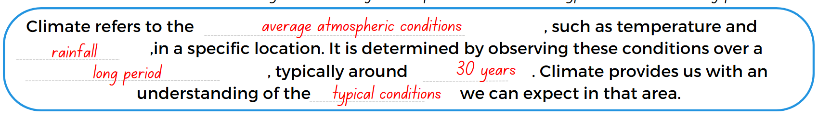
FT Q C52
Introduction to Climate
TASK:
On your worksheet, complete the climate definition by filling in the blanks:

Slide 6
FT Q C52
Introduction to Climate
TASK:
On your worksheet, read each statement carefully and decide whether it describes climate or weather.
Use two different colours to highlight or underline the statements:
Remember, climate refers to long-term patterns, while weather describes short-term conditions or events.
The Sahara Desert is hot and dry, with very little rainfall throughout the year. | It rained all day yesterday, but today it’s sunny and warm. | In the UK, it’s typically mild and wet throughout the year.
There was a sudden thunderstorm this afternoon that lasted an hour. | In Spain, summers are generally warm and dry. | What is happening outside right now. The conditions can differ rom day to day.
The heatwave last week caused temperatures to soar above 35°C for several days. | A description of the typical conditions in an area over a long period of time. | In tropical rainforests, it’s usually hot and humid, with heavy rainfall throughout the year.

Slide 7
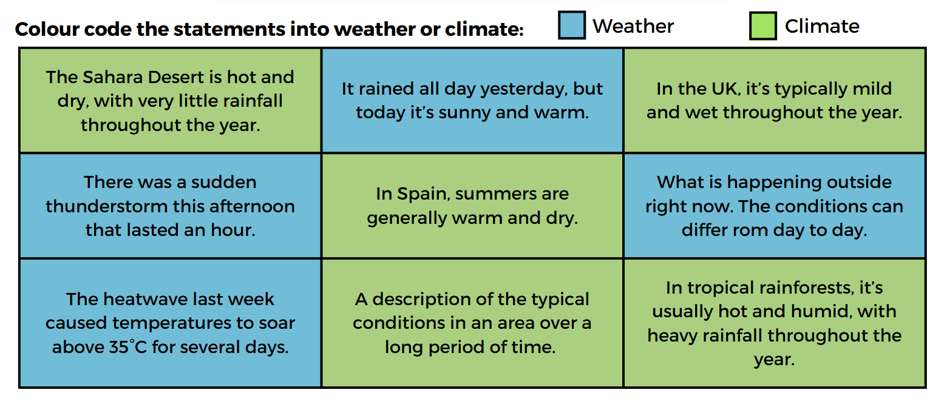
FT Q C52
Introduction to Climate
TASK:
On your worksheet, read each statement carefully and decide whether it describes climate or weather.
Use two different colours to highlight or underline the statements:

Slide 8
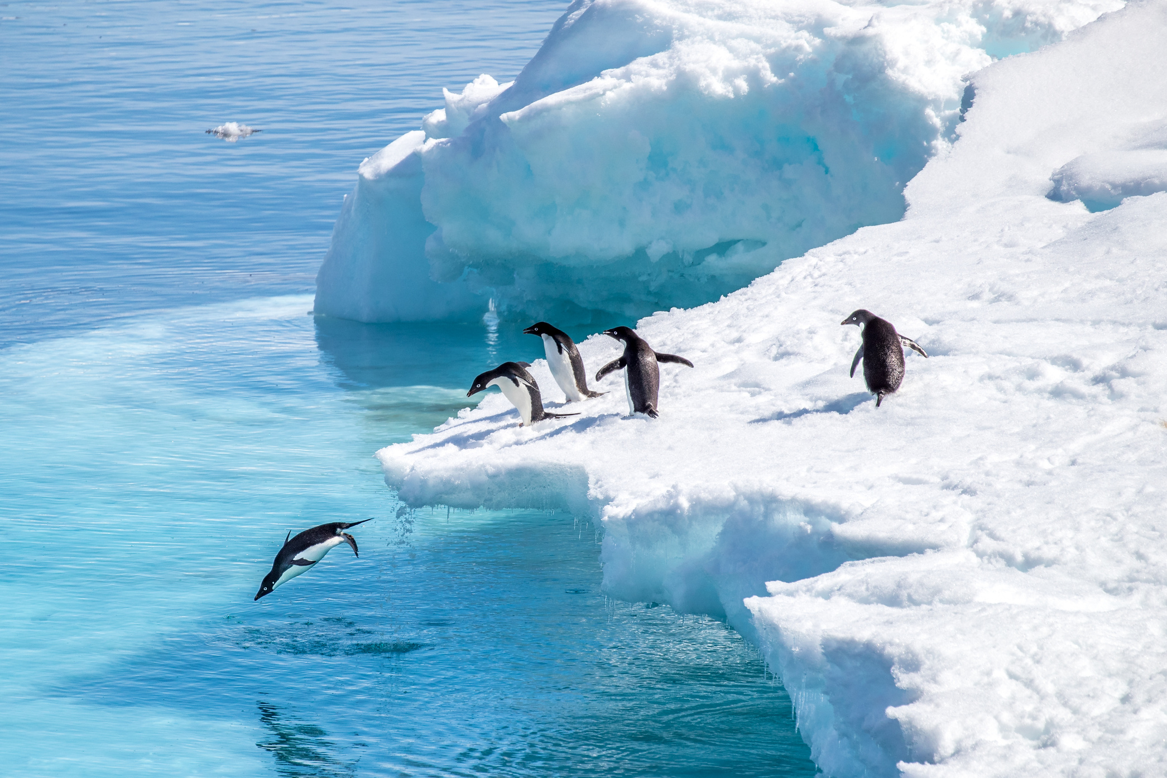
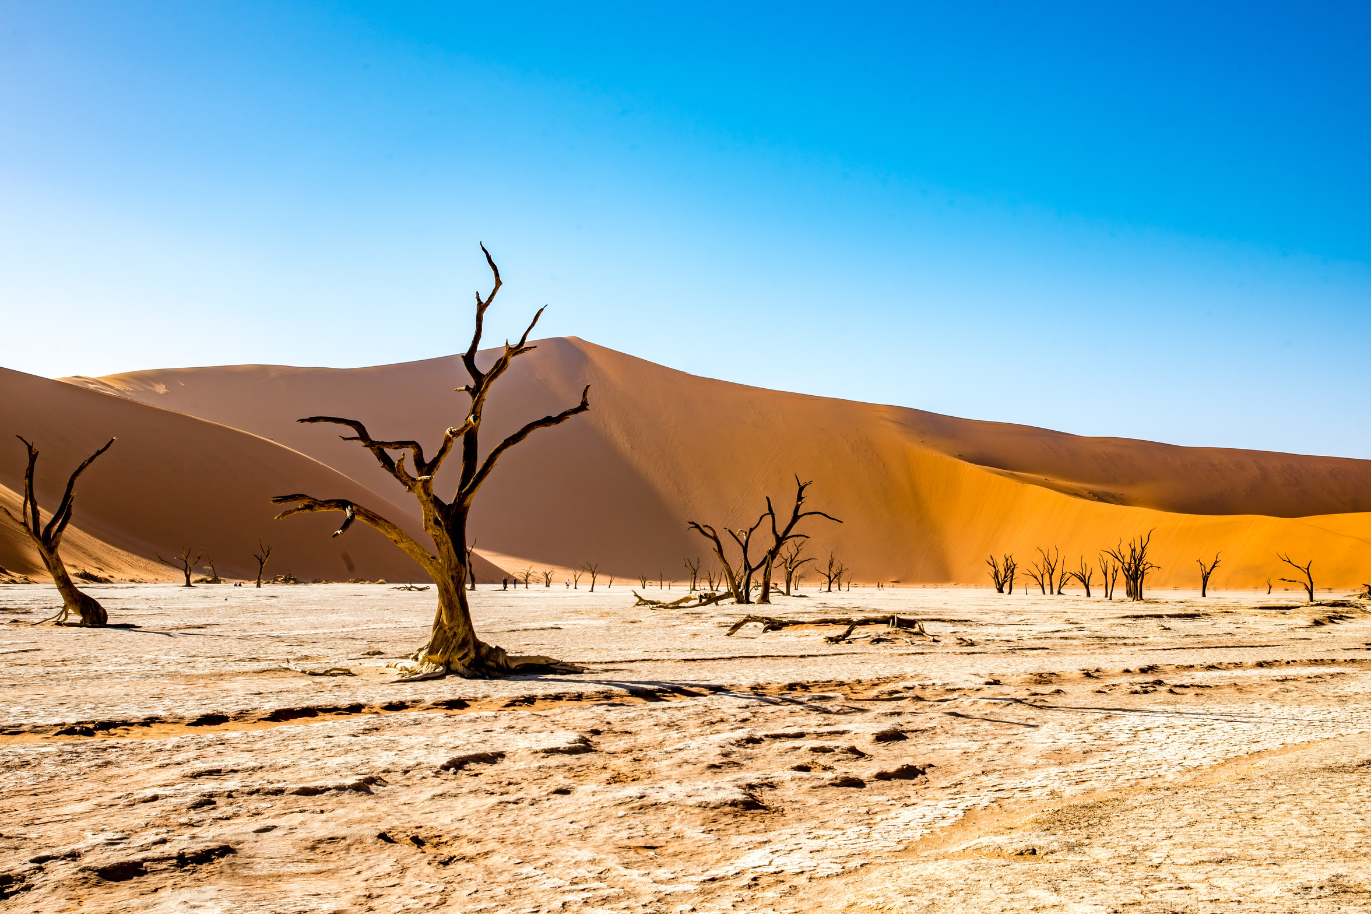
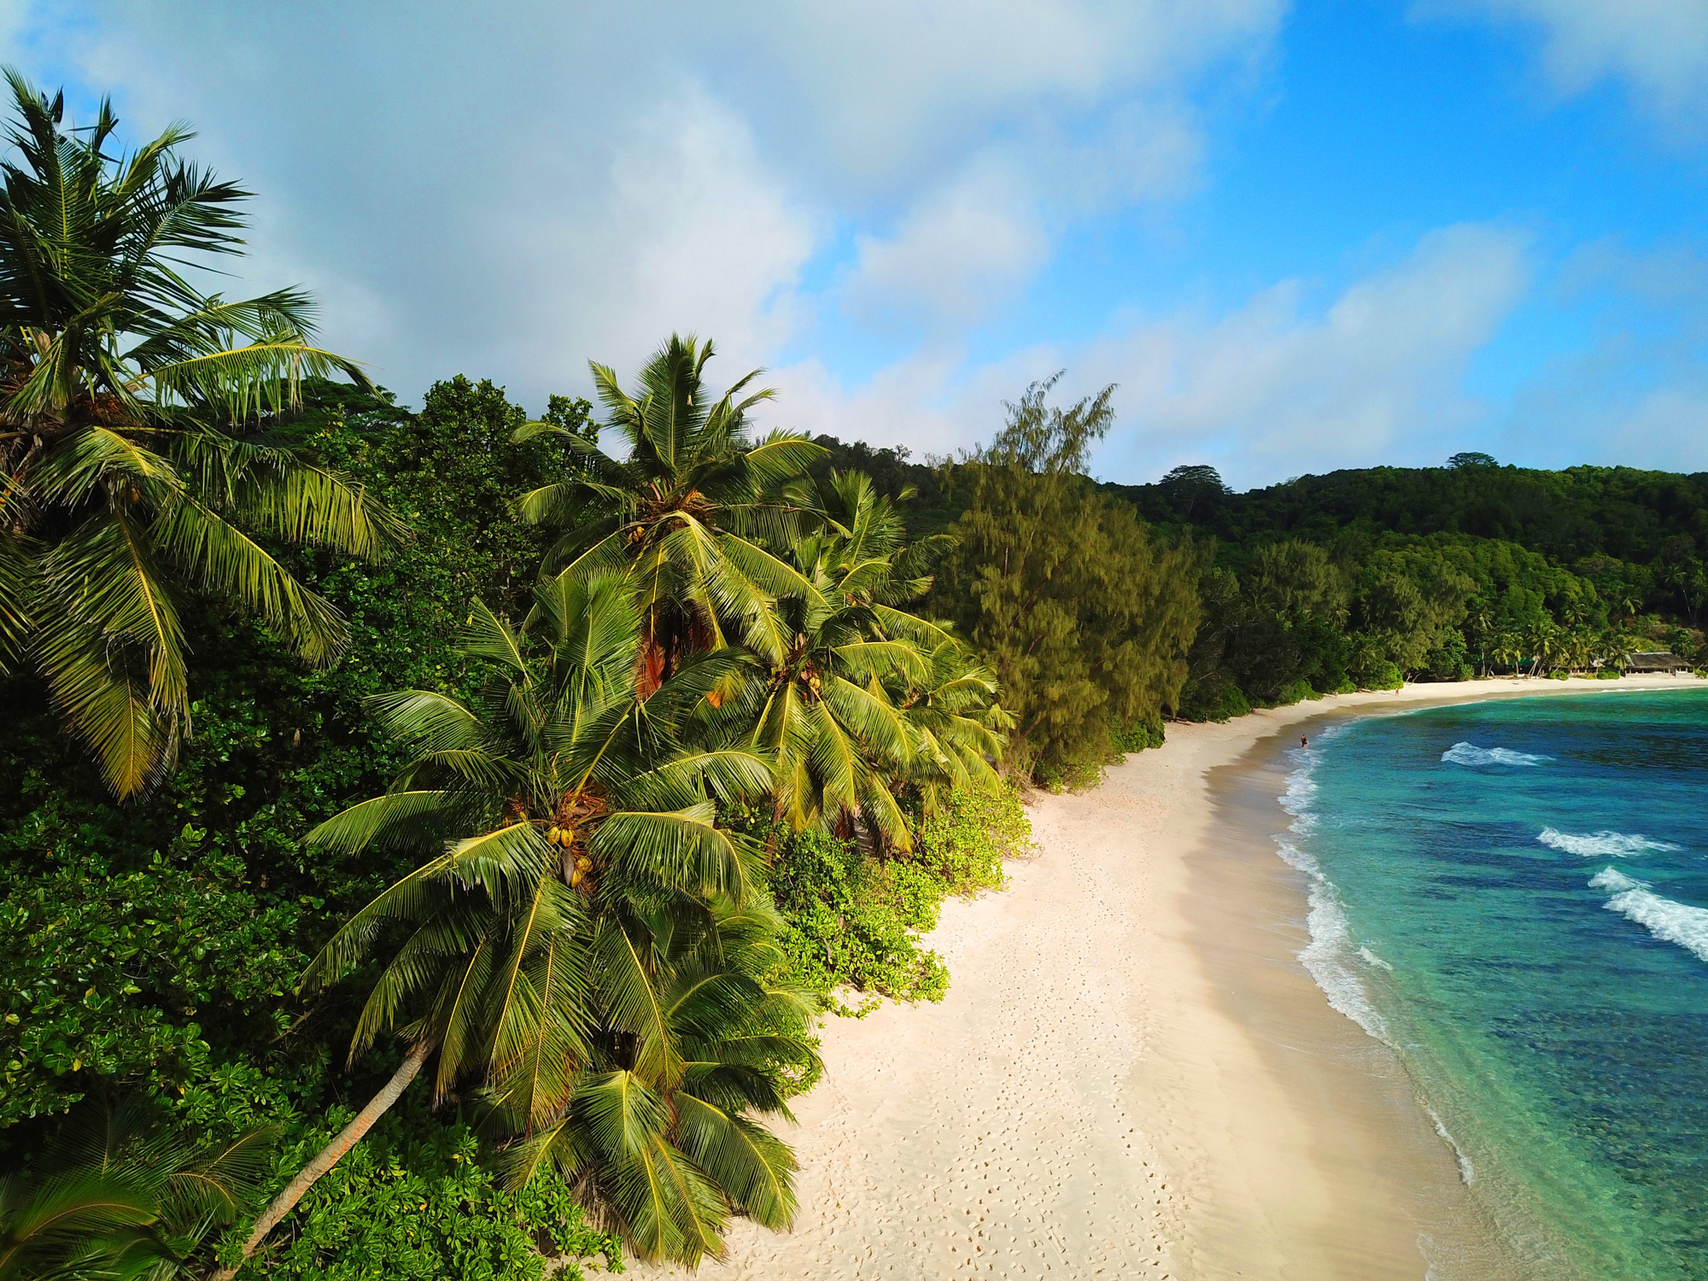
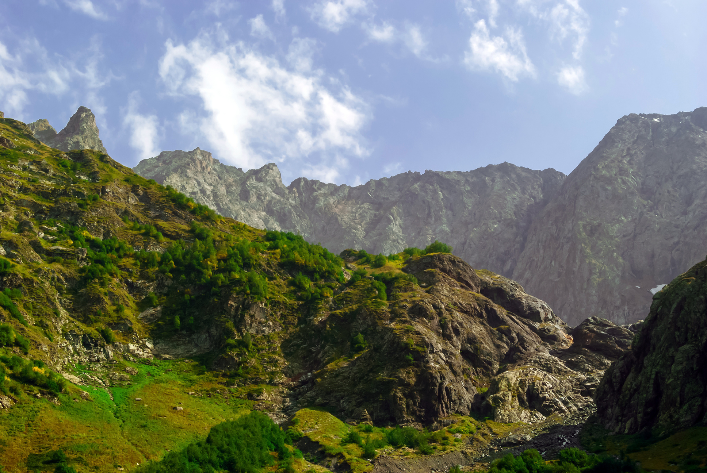
FT Q C52
Introduction to Climate
Global Climate Types
Latitude, altitude, ocean currents, continentality and atmospheric circulation all impact climates, leading to the various climate zones found around the world.
Can you name any climate types?

Slide 9


FT Q C52
Introduction to Climate
Global Climate Types
e.g. Antarctica,
Greenland, Arctic regions of Canada, Northern Alaska, Siberia, Russia, Northern Norway, Iceland...
Polar Climate
Cold, dry climates found in the far north and south of the planet. Some polar regions are covered in ice and others have tundra vegetation.
The Ocean Current World Map with Names by blueringmedia

Slide 10
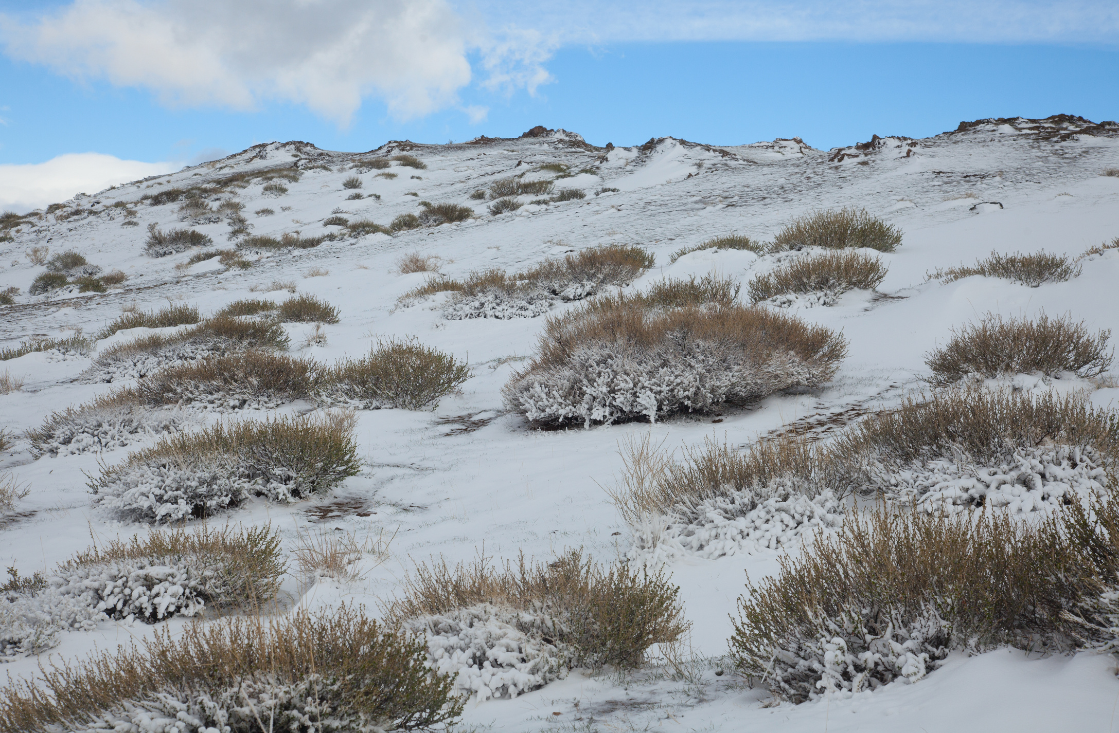

FT Q C52
Introduction to Climate
Tundra vegetation refers to the hardy, low-growing plants, such as mosses, lichens, and dwarf shrubs, that thrive in cold, dry conditions of the tundra biome, characterized by short growing seasons and permafrost.
alpine tundran View more by afhunta from Getty Images

Slide 11
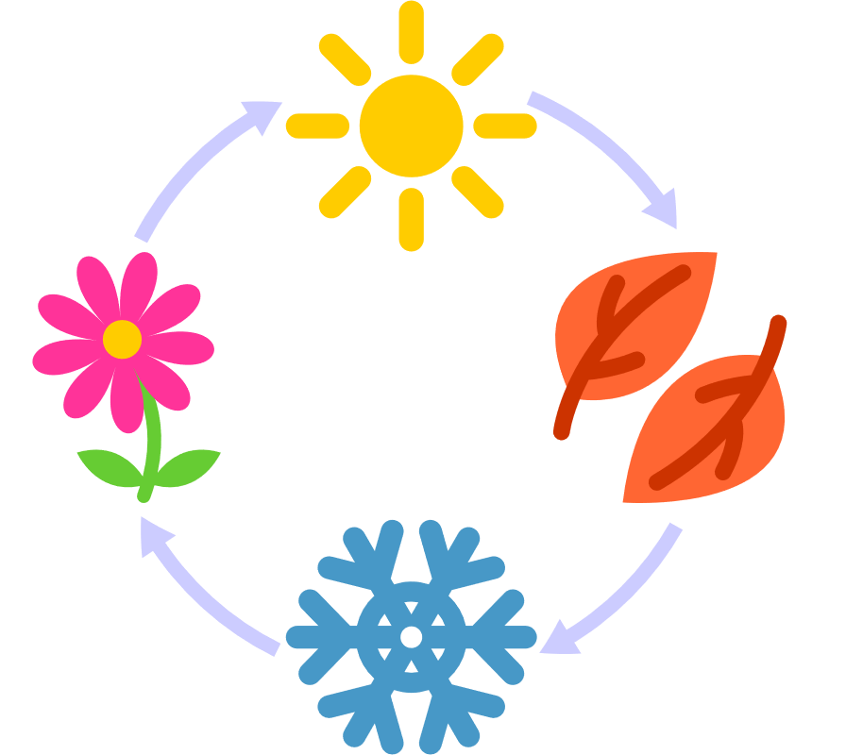
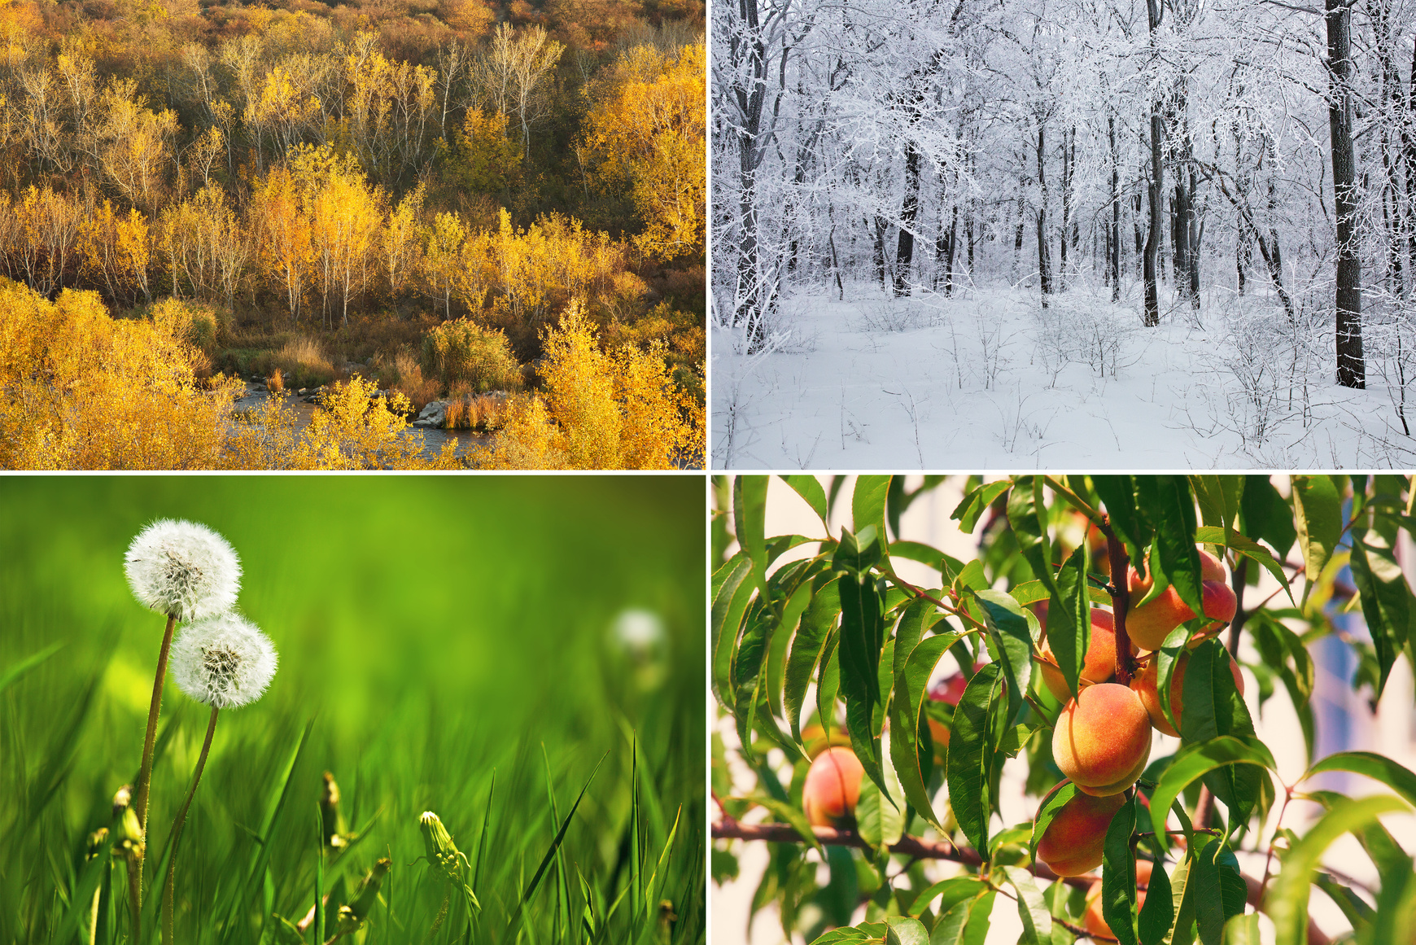
FT Q C52
Introduction to Climate
Global Climate Types
e.g. United Kingdom, Germany, France, Japan, New Zealand....
Temperate Climate
Characterised by moderate temperatures and four distinct seasons—spring, summer, autumn, and winter—typically with mild to warm summers and cool to cold winters with varying amounts of precipitation throughout the year.
alpine tundran View more by afhunta from Getty Images

Slide 12


FT Q C52
Introduction to Climate
Global Climate Types
e.g. Sahara Desert, Atacama Desert, Great Victoria Desert, Kalahari Desert, Gobi Desert, Namib Desert, Chihuahuan Desert,
Thar Desert...
Desert / Arid Climates
These regions receive less than 250 millimeters of rainfall annually, resulting in high daytime temperatures, cooler nights, and limited vegetation. Arid climates often featuring drought-resistant plants like cacti and shrubs.
4790487.jpg by TonW from pixabay

Slide 13

FT Q C52
Introduction to Climate
Global Climate Types
e.g. Amazon Rainforest, Congo Basin, Indonesia, Malaysia, Costa Rica, Panama, Cuba, Jamaica, Northern Australia, Southern Florida, Madagascar, Sri Lanka, Philippines...
Tropical Climates
Typically, hot and often experience high levels of rainfall, particularly in regions near the Equator, like the Amazon Rainforest. In these areas, warm air rises, resulting in significant precipitation. Tropical rainforests thrive in these humid conditions.
5293774.jpg by fleglsebastian7 from pixabay

Slide 14
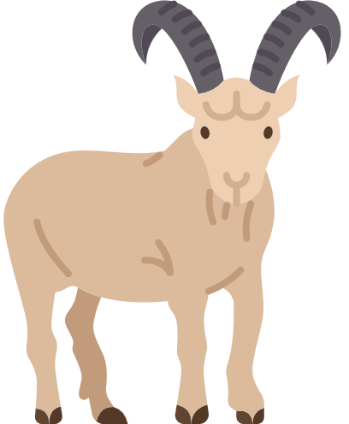
FT Q C52
Introduction to Climate
e.g. The Andes (South America), The Himalayas (Asia), The Rockies (North America), The Alps (Europe), The Atlas Mountains (North Africa), The Pyrenees (Europe)...
Global Climate Types
Mountain Climates
Colder climates at high altitudes, which can be found anywhere on the planet. Only small plants, such as grasses and mosses, can survive above the tree line.
subtropical mountain landscape by Евгений Харитонов from Getty Images

Slide 15
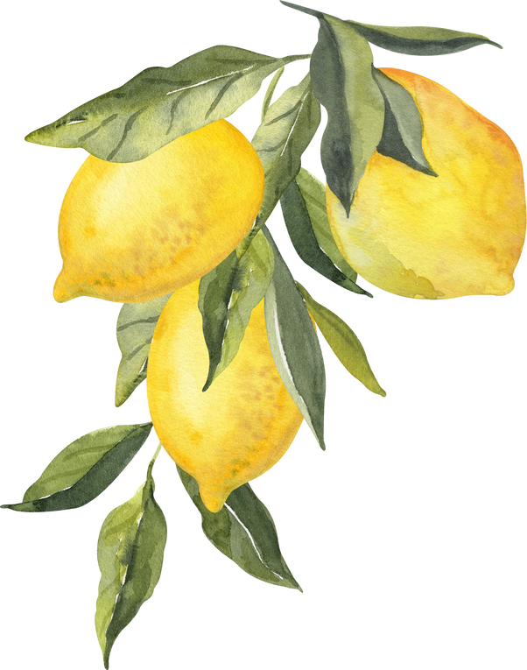
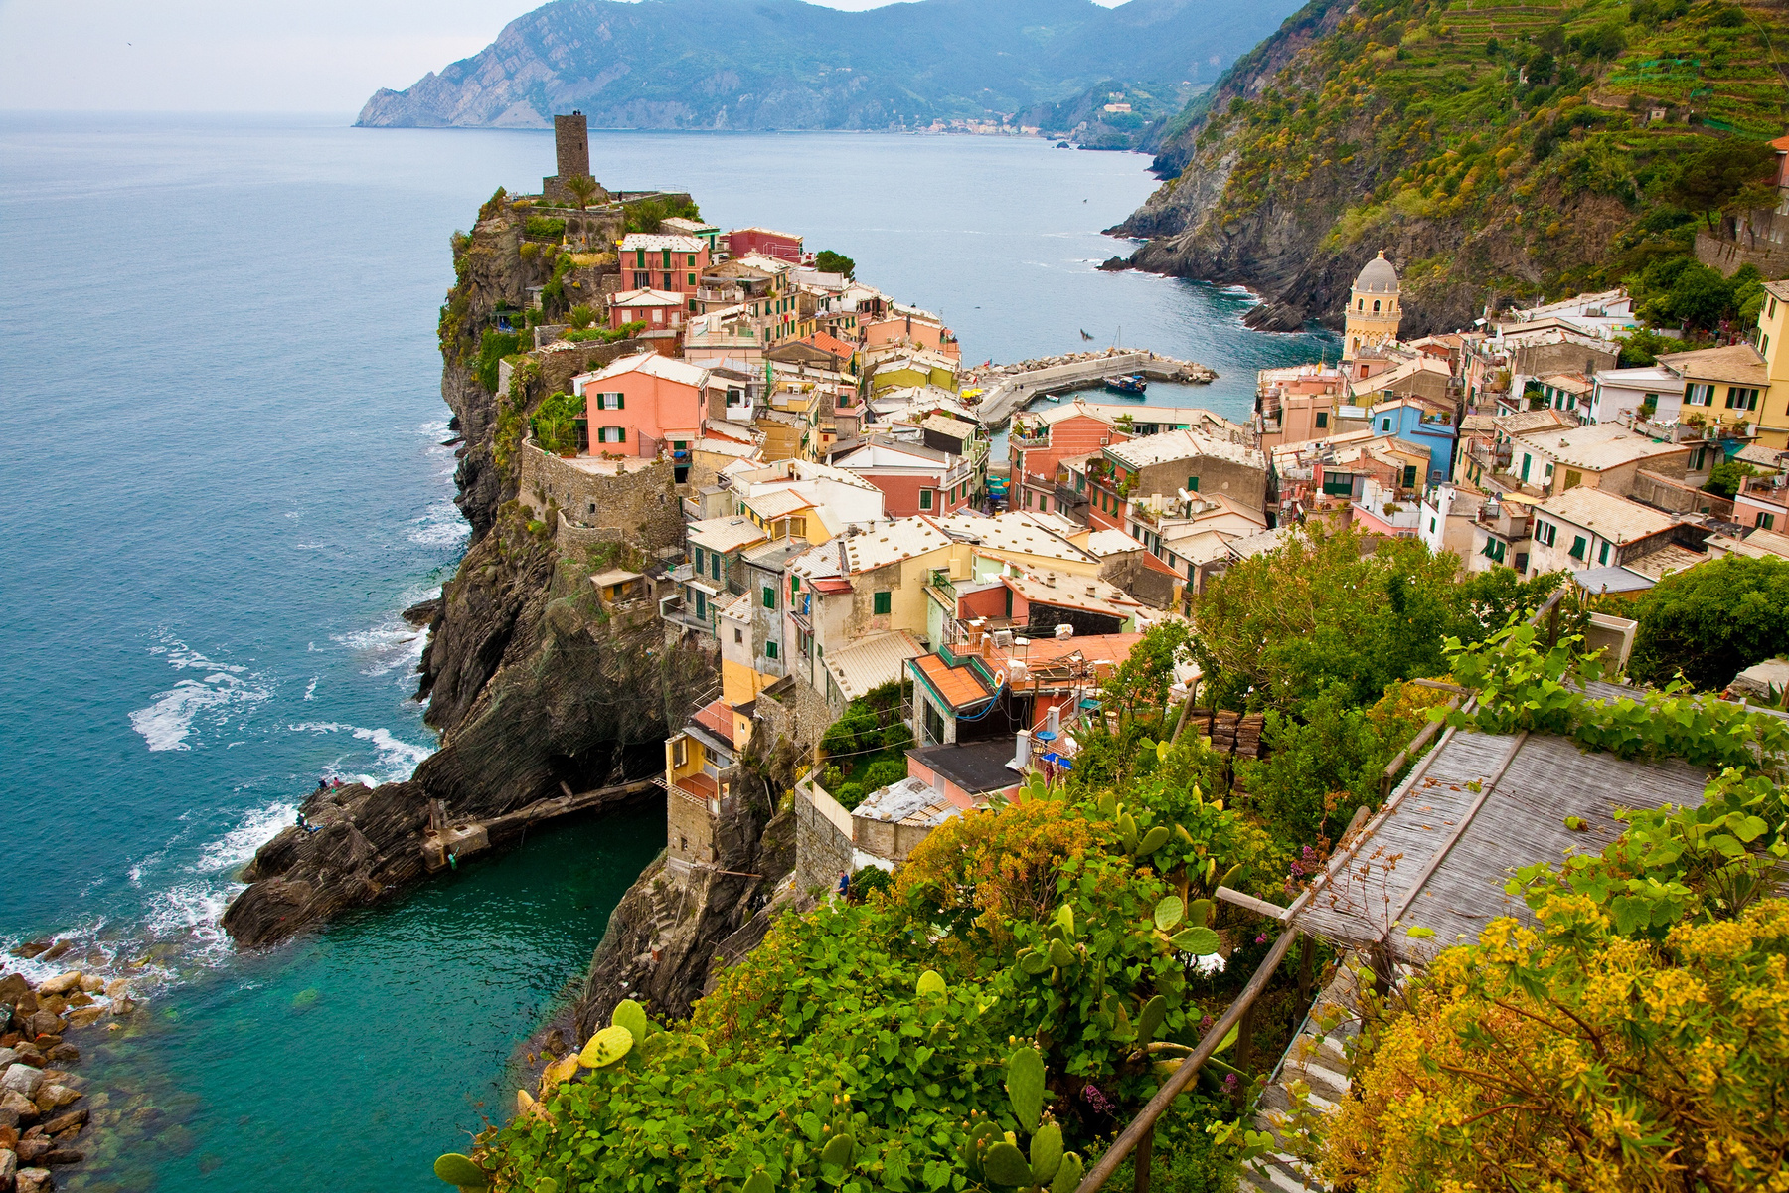
FT Q C52
Introduction to Climate
Global Climate Types
e.g. California, Southern Spain, Italy, Greece, Turkey, South Australia, Chile, Southwest South Africa, Portugal, Algeria....
Mediterranean Climates
Characterised by warm coastal regions located between 30° and 45° north and south of the Equator, featuring hot, dry summers and milder, wetter winters, with moderate rainfall occurring primarily during the winter months. This climate supports a diverse range of vegetation, including shrubs, grasses and drought-resistant trees.
subtropical mountain landscape by Евгений Харитонов from Getty Images

Slide 16
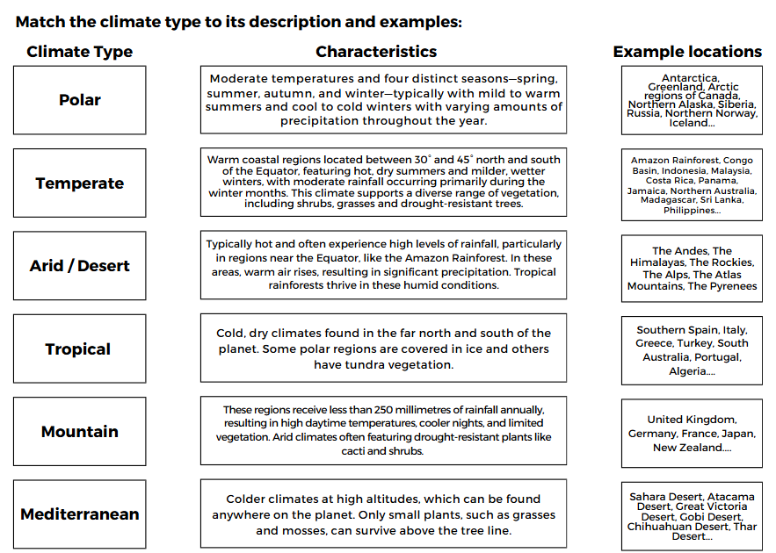
FT Q C52
Introduction to Climate
TASK:
On your worksheet, match up the climate type with its characteristics and example locations

Slide 17
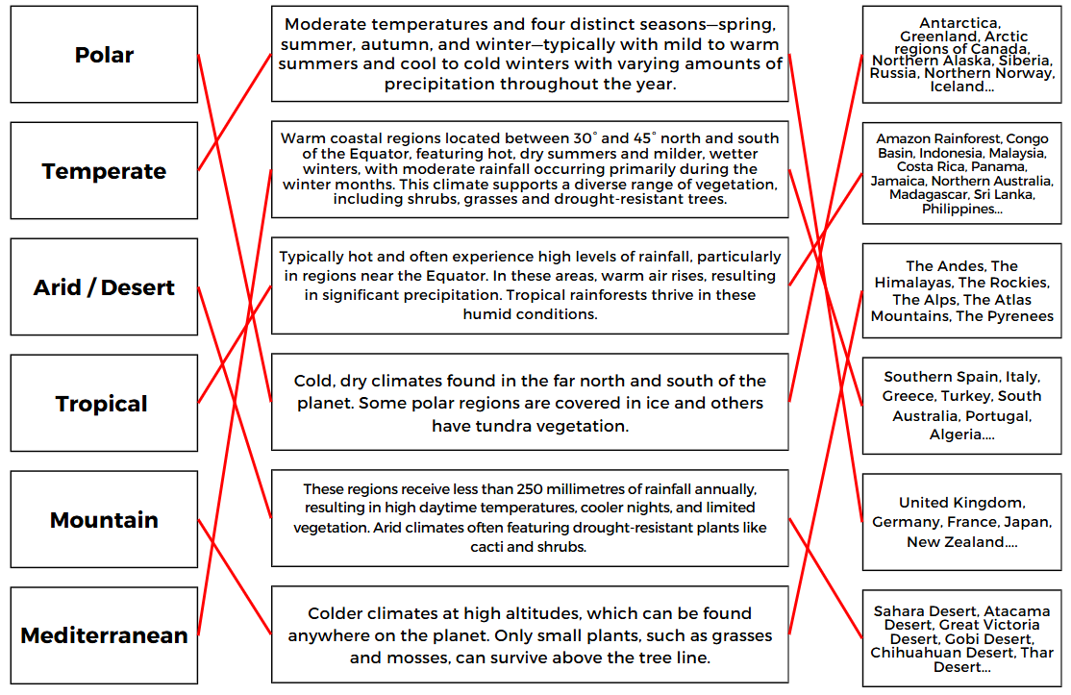
FT Q C52
Introduction to Climate
TASK:

Slide 18
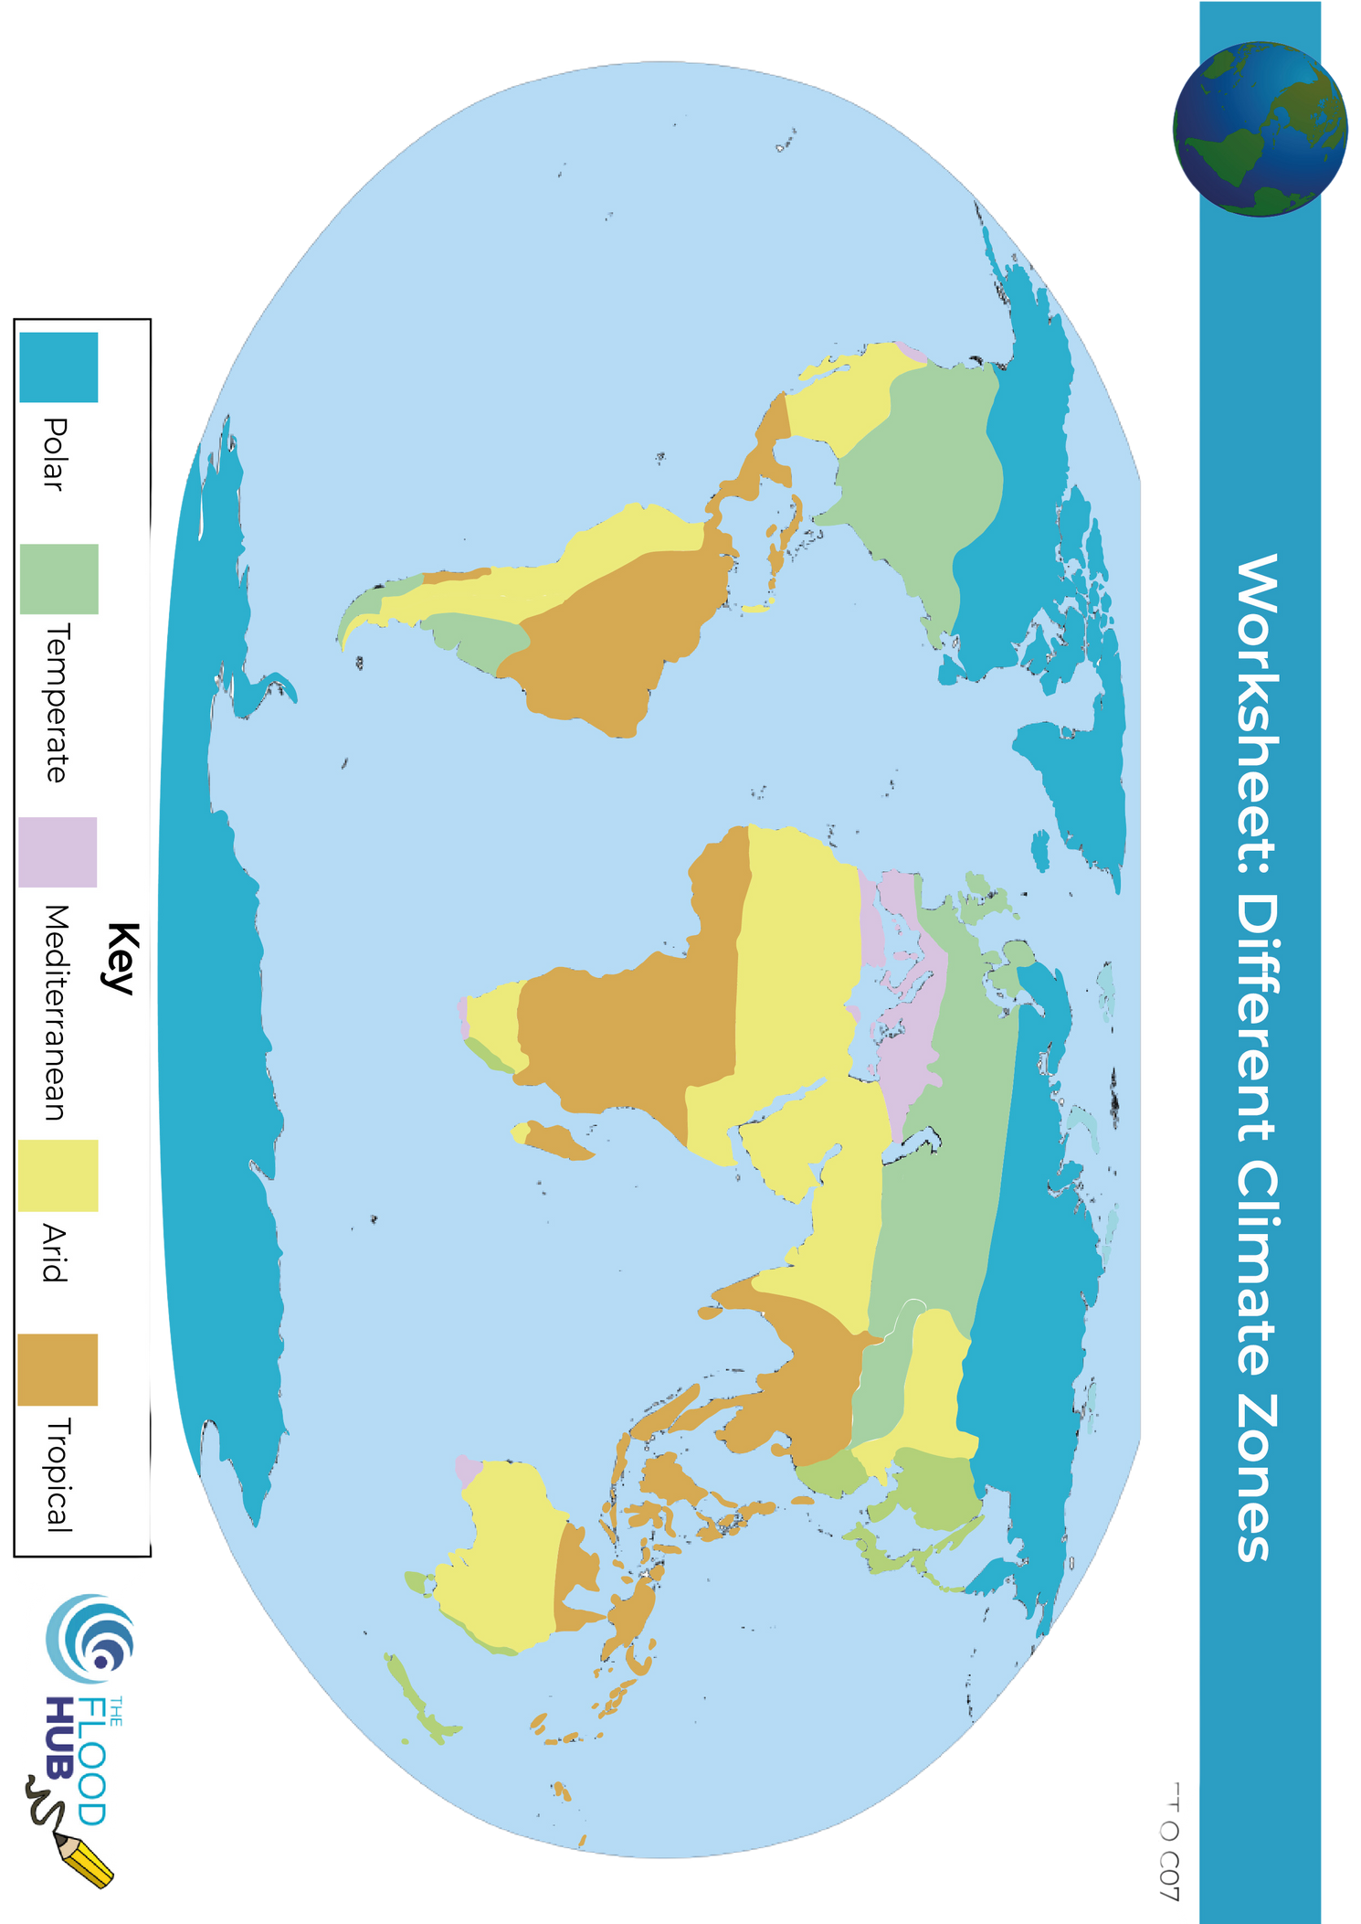


FT Q C52
Introduction to Climate
Global Climate Types
Polar
Temperate
Desert / Arid
Tropical
Mediterranean
Mountain

Slide 19
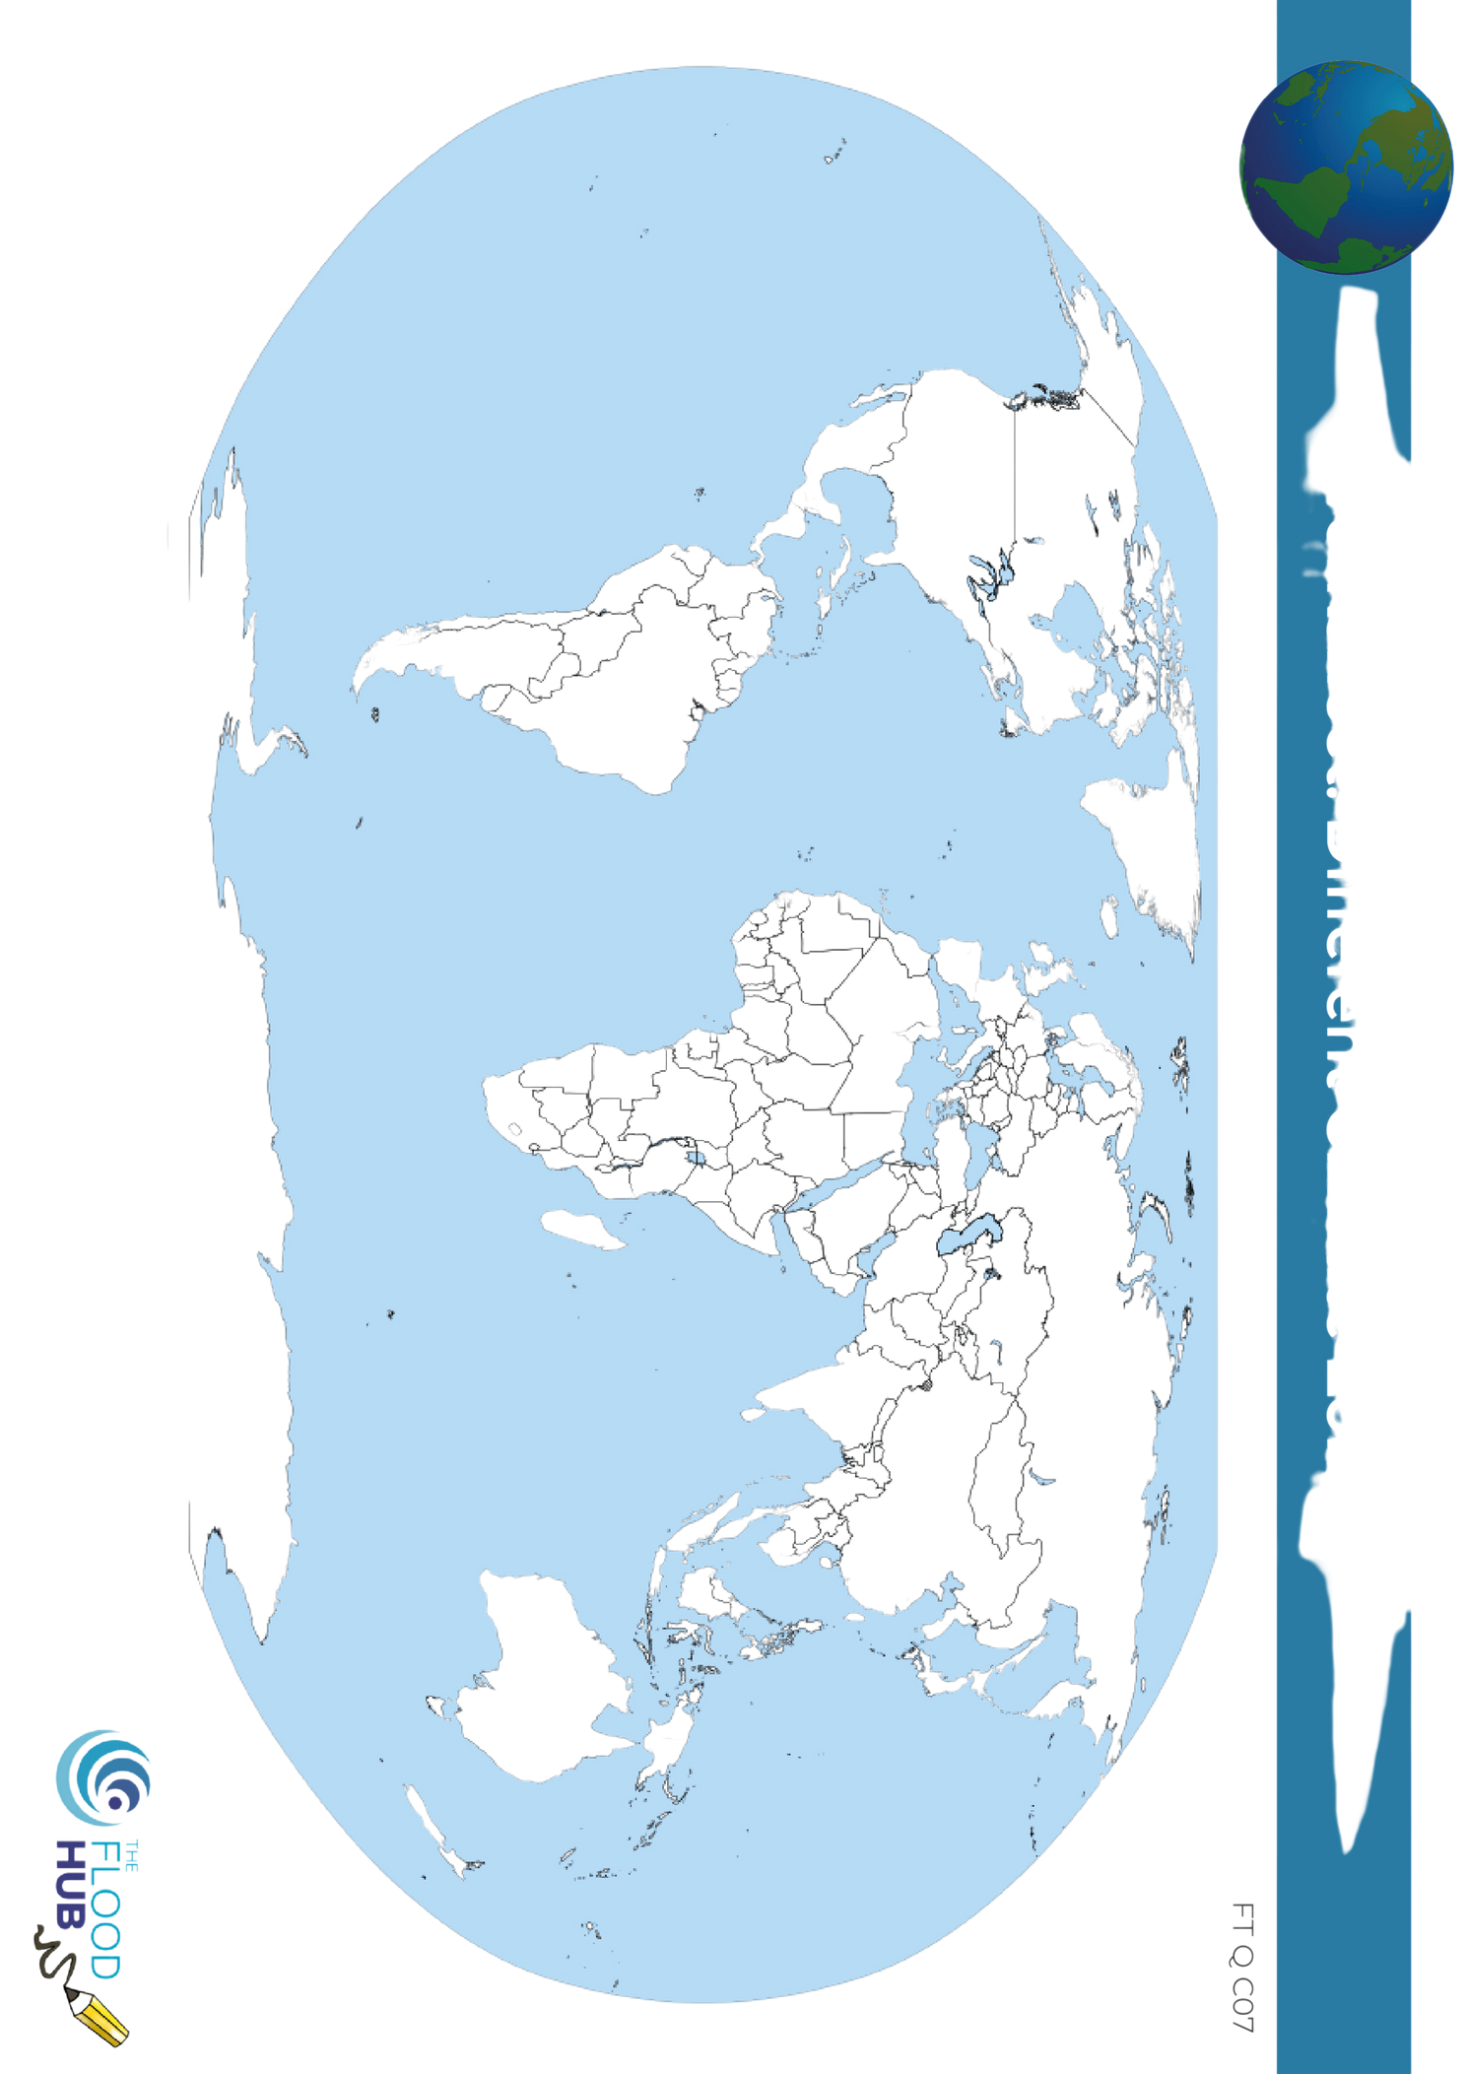
FT Q C52
Introduction to Climate
Homework Task:
Colour in the map according to the climate zones.
Don't forget to colour in the key.
Polar
Temperate
Desert / Arid
Tropical
Mediterranean
Mountain

