Slide 1




FT Q C53
Factors Influencing Climate
Learning Objectives:
  Identify and describe the key factors influencing climate, including latitude, altitude, continentality and ocean currents.

Slide 2

FT Q C53
Introduction to Climate
Factors Influencing Climate
Starter:
Discuss with your neighbour...
Why do places closer to the Equator usually have warmer climates than those further away?
Why do mountain regions tend to be colder than lowland areas, even though they get the same amount of sunlight?

Slide 3
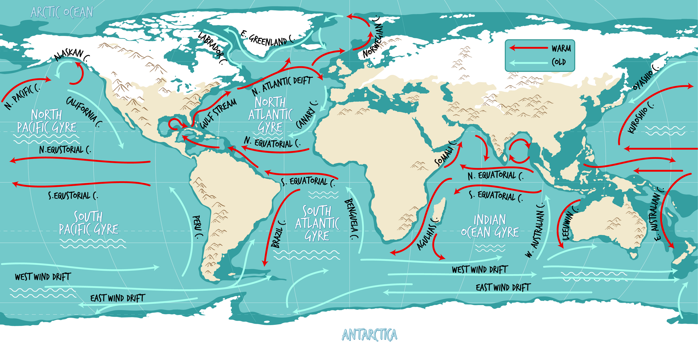







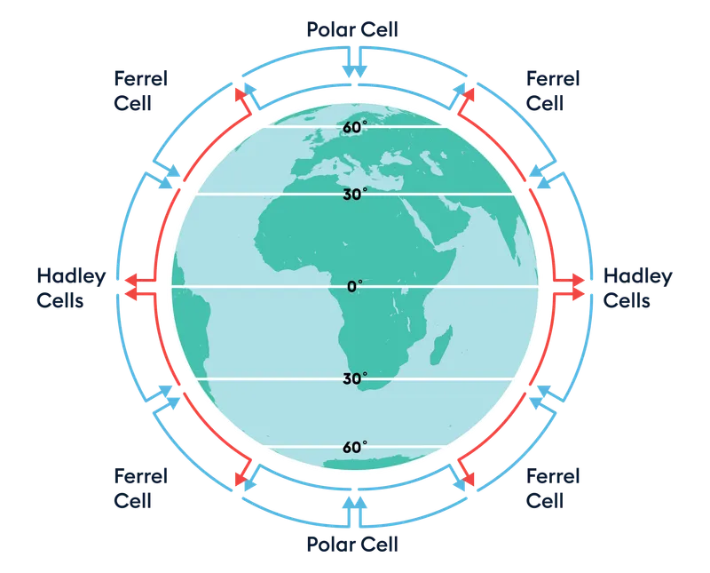


FT Q C53
Factors Influencing Climate
There are many factors that influence climate.
Take a look at the images – can you guess what each one represents?
North Pole
Arctic Circle
Factors Influencing Climate
Equator
Antarctic Circle
3000 meters = 10°C
South Pole
Long Distance
Atmosphere
2000 meters = 17°C
Large Area
1000 meters = 23.5°C
Short Distance
Small Area
0 meters
(sea level) = 30°C

Slide 4
FT Q C53
Factors Influencing Climate
Latitude
Latitude is the measurement of a location's distance north or south of the Equator, expressed in degrees.
  At the poles, the Sun is lower in the sky, meaning its rays hit the Earth at a shallow angle. This angle spreads the sunlight over a larger area, leading to less direct sunlight and cooler temperatures.
Atmosphere
Long Distance
Large Area
  At the Equator, the Sun is directly overhead, resulting in hotter temperatures because its rays are concentrated over a smaller area.
Short Distance
Small Area

Slide 5
FT Q C53
Factors Influencing Climate
Latitude
Winter in the Northern Hemisphere
  In summer, polar regions can have almost 24 hours of daylight, while in winter, they experience long periods of darkness.
North Pole
Arctic Circle
  Locations on the equator have a fairly consistent day length throughout the year, with around 12 hours of daylight.
Equator
Antarctic Circle
This difference in how long the Sun shines on different parts of the Earth helps explain why polar regions have such unique and varied climates compared to places near the Equator.
South Pole

Slide 6

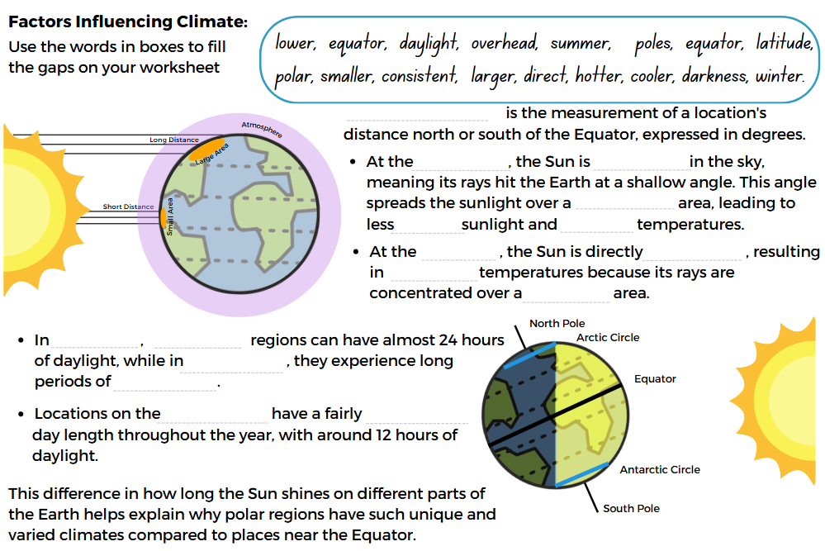
FT Q C53
Factors Influencing Climate
TASK:
On your worksheet, complete the information on latitude by filling in the blanks

Slide 7
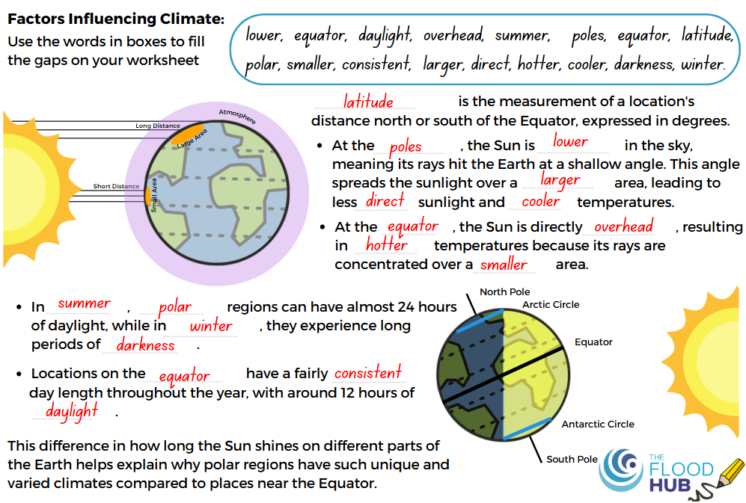
FT Q C53
Factors Influencing Climate

Slide 8
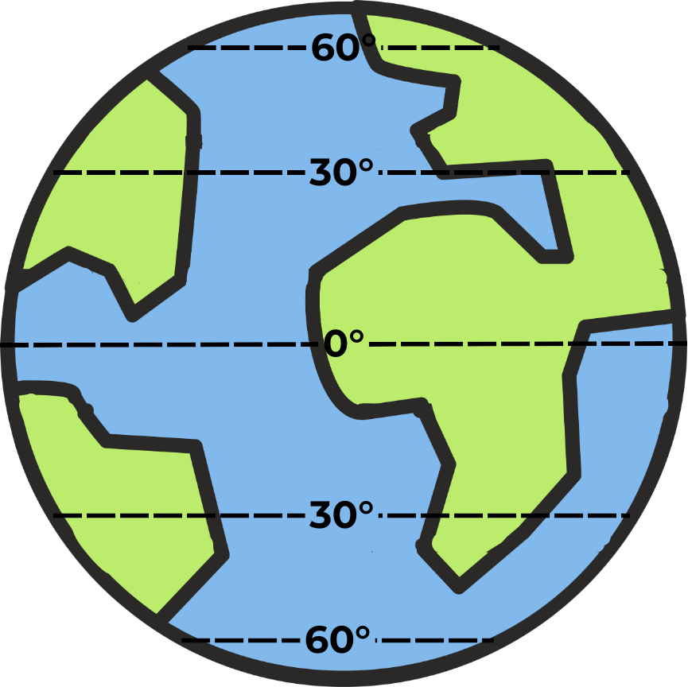



FT Q C53
Factors Influencing Climate
Global Atmospheric Circulation
Global atmospheric circulation is the large-scale movement of air around the Earth, which helps distribute heat from the Equator toward the poles. This movement of air creates different climate zones and weather patterns across the planet.
In the Hadley cell, warm air rises at the Equator, then cools and sinks around 30° north and south, creating deserts like the Sahara. The air then flows back toward
the Equator, completing the loop.
The Ferrel cell, between 30° and 60°, moves in the opposite direction. Air rises at around 60° and sinks at 30°, bringing wet and windy weather to places like the UK.

Slide 9
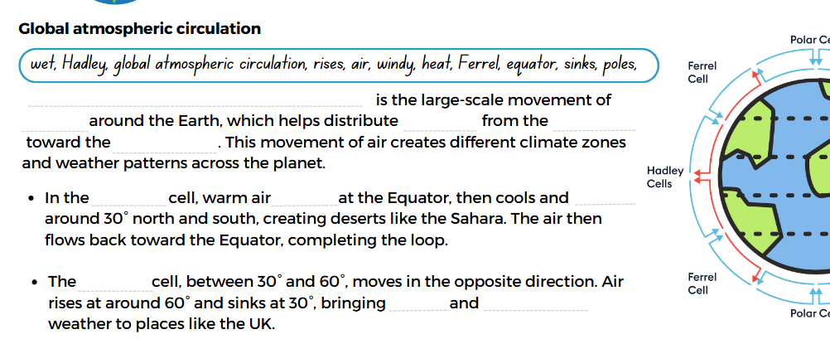
FT Q C53
Factors Influencing Climate
TASK:
On your worksheet, complete the information on Global Atmospheric Circulation by filling in the blanks

Slide 10
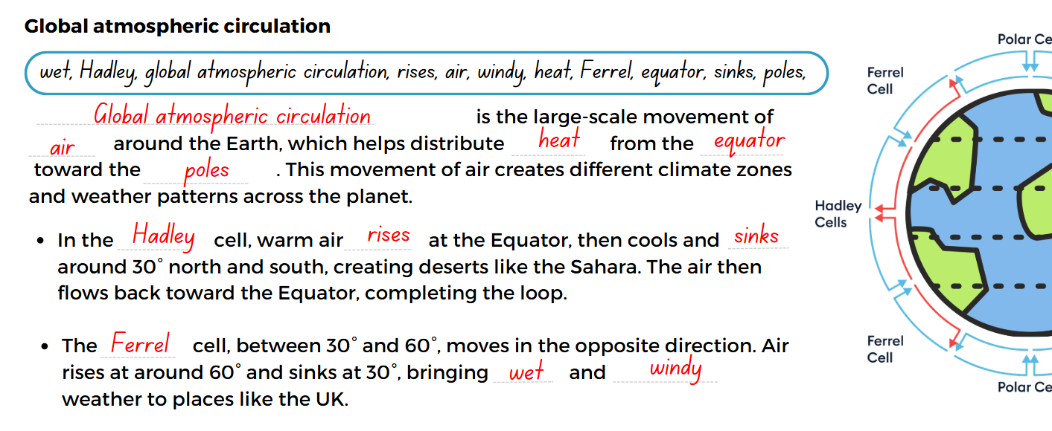
FT Q C53
Factors Influencing Climate
TASK:

Slide 11

FT Q C53
Factors Influencing Climate
The temperature decreases by 1°C for every ~150m climbed
Altitude (height above sea level)
  As you ascend, the air becomes less dense, which means there are fewer molecules to absorb and retain heat, causing temperatures to drop.
3000 meters = 10°C
  Additionally, cooler air holds less moisture, leading to water vapor condensing into clouds. When enough water collects, it falls as precipitation, resulting in relief rainfall.
2000 meters = 17°C
1000 meters = 23.5°C
  This process means that mountainous areas often receive more rain than low-lying regions, creating distinct climates based on height.
0 meters
(sea level) = 30°C

Slide 12
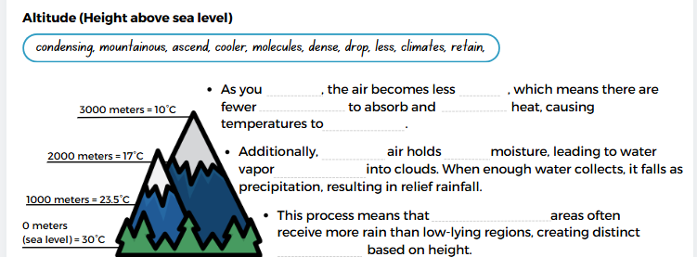
FT Q C53
Factors Influencing Climate
TASK:
On your worksheet, complete the information on altitude by filling in the blanks

Slide 13
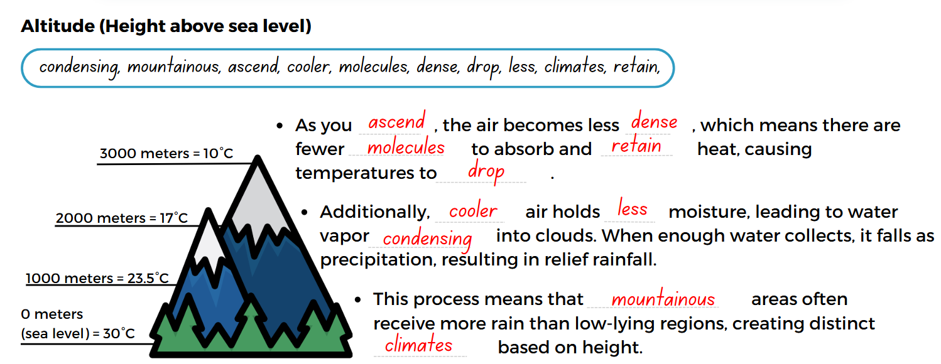
FT Q C53
Factors Influencing Climate
TASK:

Slide 14
FT Q C53
Factors Influencing Climate
Ocean Currents
These play a vital role in shaping climate by redistributing heat across the planet.
Warm currents, like the
Gulf Stream, carry warm water from the equator toward higher latitudes, raising temperatures in coastal regions in the UK.
Cold currents, such as the California Current, bring cooler water from polar regions, resulting in lower temperatures along coastlines.
These currents also affect weather patterns. When warm currents heat the air above them, it can lead to more rainfall in those regions. In contrast, cold currents can create drier conditions.

Slide 15
FT Q C53
Factors Influencing Climate
The Ocean Current World Map with Names by blueringmedia

Slide 16
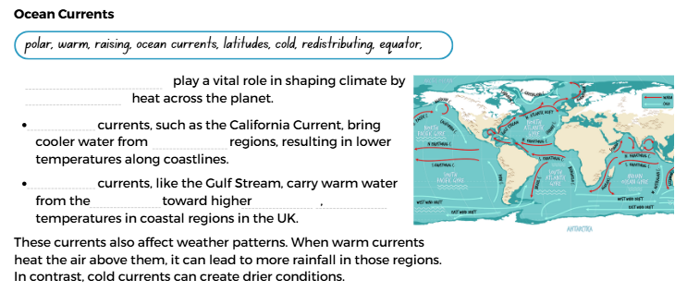
FT Q C53
Factors Influencing Climate
TASK:
On your worksheet, complete the information on ocean currents by filling in the blanks

Slide 17
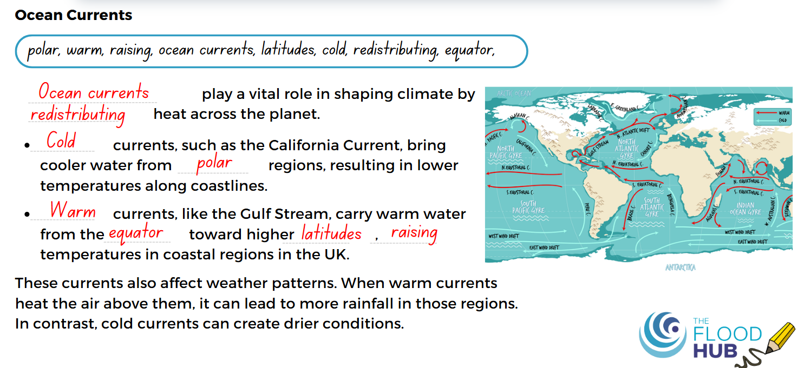
FT Q C53
Factors Influencing Climate
TASK:

Slide 18

FT Q C53
Factors Influencing Climate
Continentality
Continentality refers to how a location's distance from the sea affects its climate. Places that are far from the ocean tend to experience more extreme temperatures compared to coastal areas.
  Inland areas heat up quickly in the summer and cool down rapidly in the winter, leading to hotter summers and colder winters.
  Coastal areas are influenced by the ocean, which absorbs and releases heat more slowly, leading to milder temperatures throughout the year.
This effect is stronger in big continents, where places far inland have more extreme temperatures because they are further away from the sea, which helps keep temperatures more balanced.

Slide 19
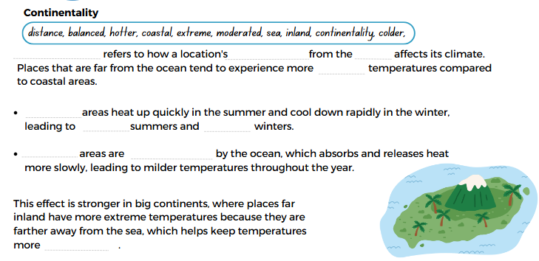
FT Q C53
Factors Influencing Climate
TASK:
On your worksheet, complete the information on continentality by filling in the blanks

Slide 20
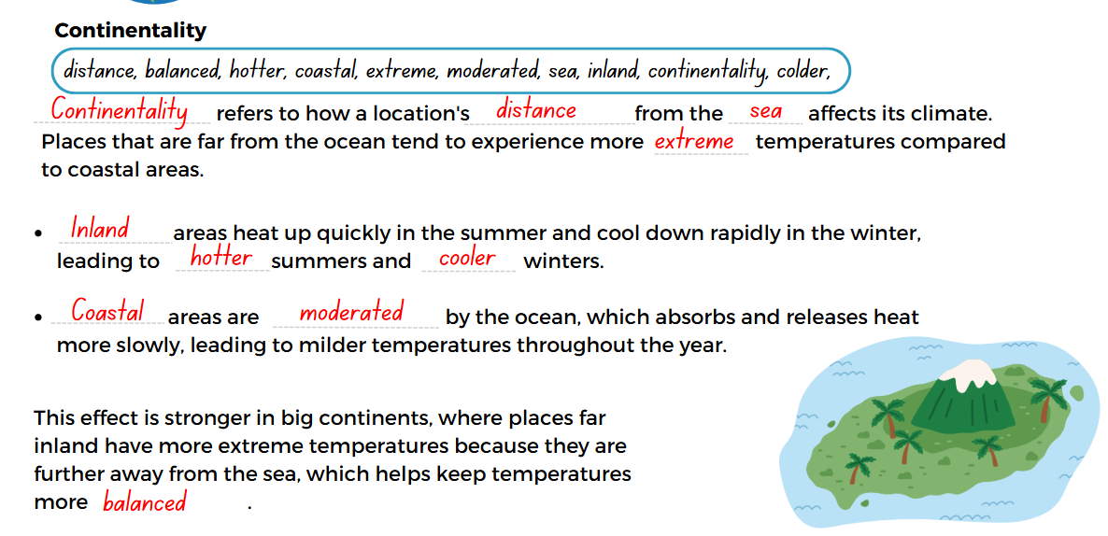
FT Q C53
Factors Influencing Climate
TASK:

