Slide 1




FT Q C54
Climate Change
Learning Objectives:
  To define climate change and explain the natural and human causes.
  Explain the greenhouse effect and its role in global warming, including how key greenhouse gases contribute to climate change.
  Understand the impact of the Industrial Revolution in driving climate change.
  Evaluate evidence for climate change.

Slide 2

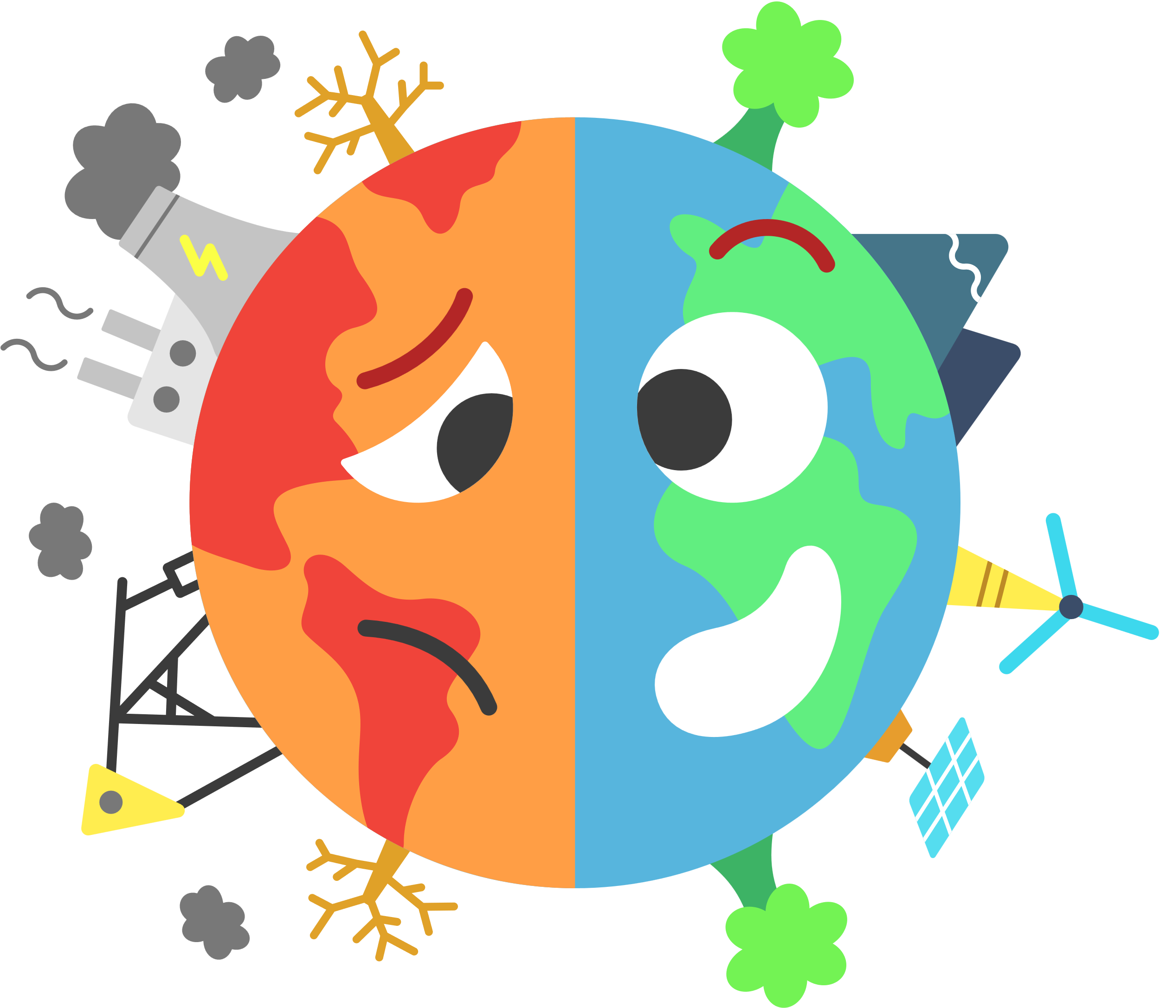
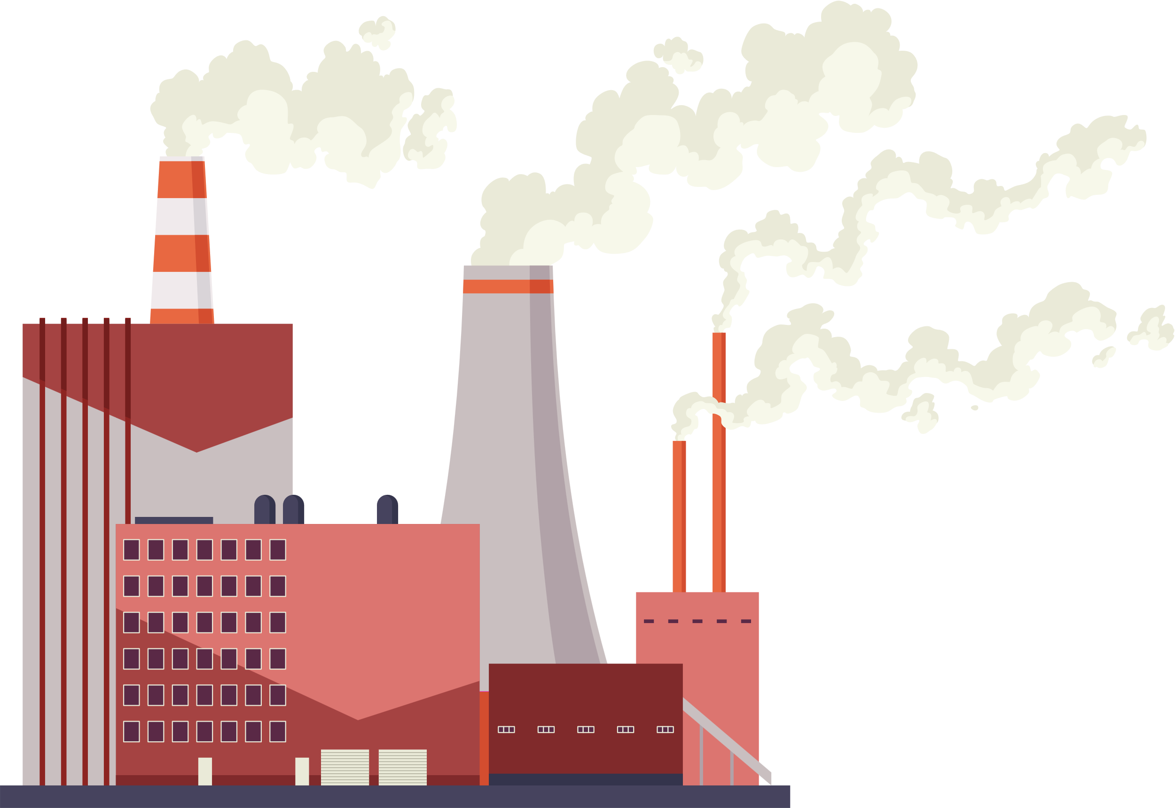


FT Q C54
Climate Change
Introduction to Climate
Starter:
On whiteboards, create a mind map of words that come to mind when you think of Climate Change

Slide 3


FT Q C54
Climate Change
Introduction to Climate
Share with the class what words that come to mind when you think of Climate Change
CLIMATE CHANGE

Slide 4


FT Q C54
Climate Change
Introduction to Climate
Climate Change
Definition:
Climate change refers to long-term changes in global or regional climate patterns, often linked to an increase in average global temperatures.
Global temperatures are 1°C higher than 100 years ago

Slide 5

FT Q C54
Climate Change
Introduction to Climate
Climate Change
Definition:
Climate change refers to long-term changes in global or regional climate patterns, often linked to an increase in average global temperatures.
Global temperatures are 1°C higher than 100 years ago
Task:
Write down the definition on your worksheets

Slide 6


FT Q C54
Climate Change
Introduction to Climate
Climate Change
Climate change refers to long-term changes in global or regional climate patterns, often linked to an increase in average global temperatures.
Natural Causes
Human Causes
It occurs naturally through events like volcanic eruptions, changes in the Earth’s orbit, and variations in the Sun’s energy.
In recent years, global temperatures have increased more rapidly due to human activities like burning fossil fuels.

Slide 7
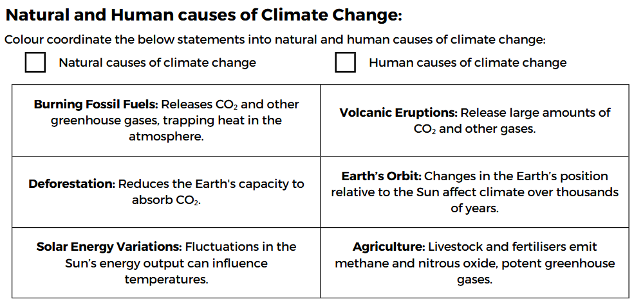
FT Q C54
Climate Change
Introduction to Climate
Task:
On your worksheet colour coordinate the statements into human causes and natural causes of climate change

Slide 8
FT Q C54
Climate Change
Introduction to Climate
Natural Causes
Human Causes
  Volcanic Eruptions: Release large amounts of CO₂ and other gases.
  Earth’s Orbit: Changes in the Earth’s position relative to the Sun affect climate over thousands of years.
  Solar Energy Variations: Fluctuations in the Sun’s energy output can influence temperatures.
  Burning Fossil Fuels: Releases CO₂ and other greenhouse gases, trapping heat in the atmosphere.
  Deforestation: Reduces the Earth's capacity to absorb CO₂.
  Agriculture: Livestock and fertilisers emit methane and nitrous oxide, potent greenhouse gases.

Slide 9
FT Q C54
Climate Change
Introduction to Climate
The Industrial Revolution
The climate and global temperature has always varied slightly over time. However, since the Industrial Revolution, there has been a sharp increase in temperature.
The Industrial Revolution, which began in the late 18th century (around 1750) and continued through the 19th century, marked the starting point for a significant spike in global warming.
Deforestation: Forests were cleared for agriculture and urban
development, reducing the Earth's capacity to absorb CO₂.
Burning Fossil Fuels: Coal, oil, and later natural gas were used extensively for energy, releasing large amounts of carbon dioxide (CO₂) into the atmosphere.

Slide 10

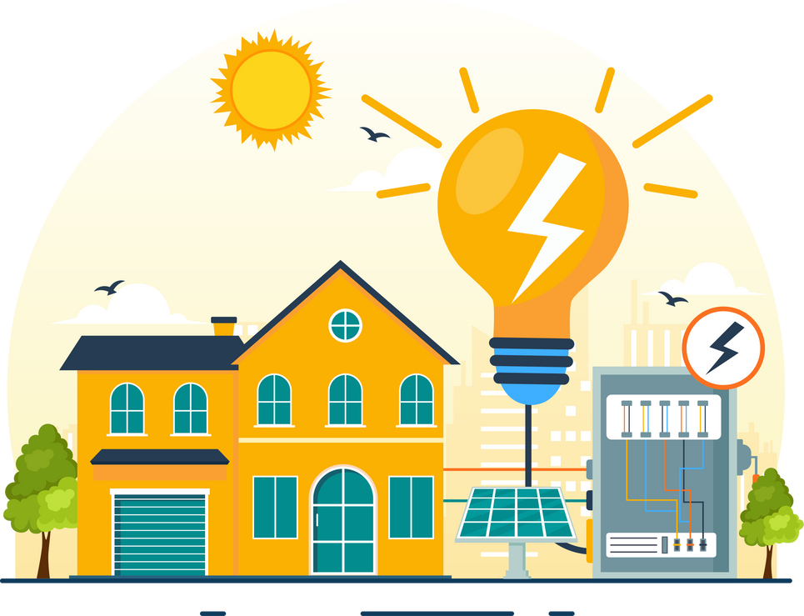

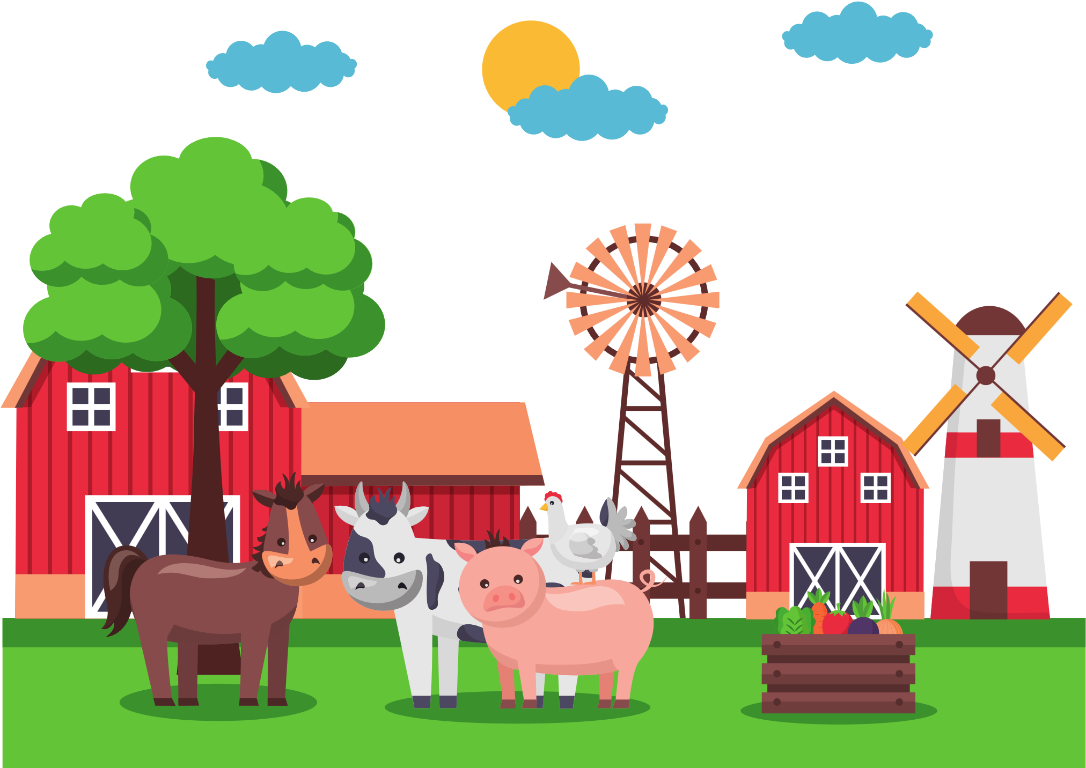
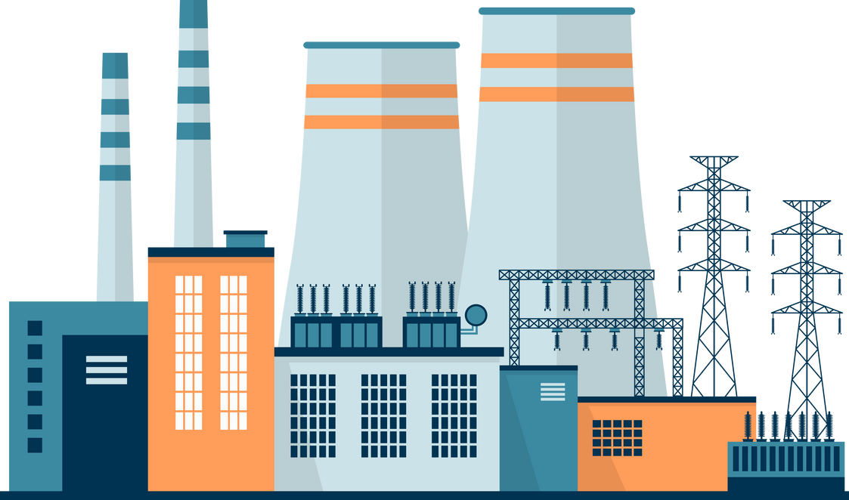

FT Q C54
Climate Change
The Problem
Human activities have increased greenhouse gas levels, trapping too much heat and causing global warming.

Slide 11
FT Q C54
Climate Change
Task:
On your worksheet, write down any ways which your lifestyle produces greenhouse gasses

Slide 12







FT Q C54
Climate Change
Greenhouse Gasses
Greenhouse Gasses are gases in the atmosphere that trap heat, keeping the Earth warm enough to support life.
Carbon Dioxide (CO₂): Released by burning fossil fuels (coal, oil, gas), deforestation and industrial processes.
Water Vapour (H₂O): The most abundant greenhouse gas, intensifies the greenhouse effect as temperatures rise.
Methane (CH₄): Produced livestock (e.g. sheep and cows), waste in landfills and fossil fuel extraction.
Nitrous Oxide (N₂O): Emitted by fertilisers, industrial processes, and burning fossil fuels.
Fluorinated Gases (e.g., HFCs, PFCs): Synthetic greenhouse gases used in industrial processes, refrigeration and air conditioning.

Slide 13
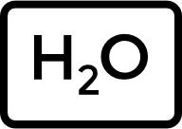


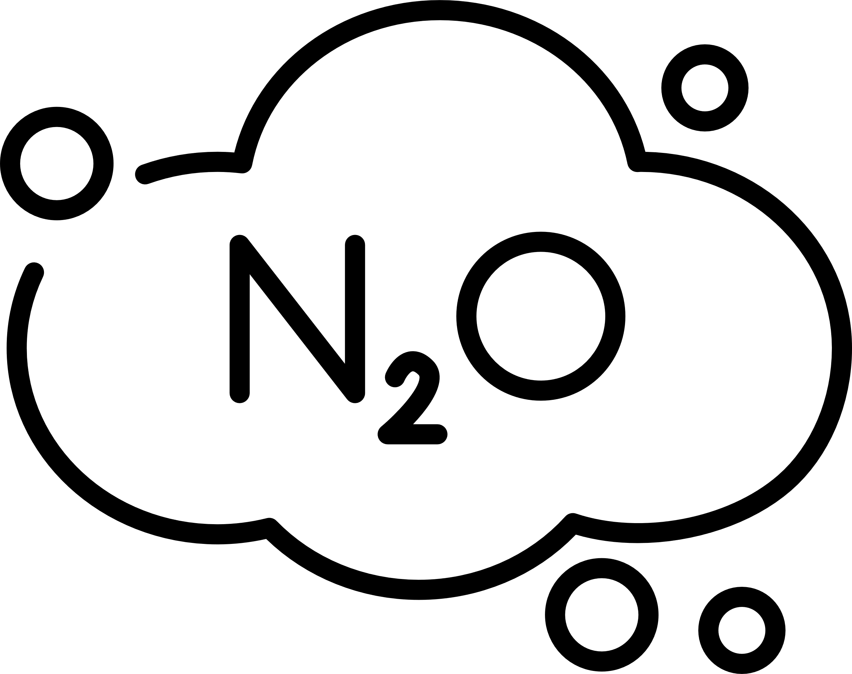
FT Q C54
Climate Change
Greenhouse Gasses
TASK:
On your worksheet, match the name of the greenhouse gas to its chemical symbol and its description:
Carbon Dioxide
Produced by livestock (e.g. sheep and cows), waste in landfills and fossil fuel extraction.
Water Vapour
Synthetic greenhouse gases used in industrial processes, refrigeration and air conditioning.
Methane
The most abundant greenhouse gas, intensifies the greenhouse effect as temperatures rise.
HFCs, PFCs
Nitrous Oxide
Emitted by fertilisers, industrial processes, and burning fossil fuels.
Fluorinated Gases
Released by burning fossil fuels (coal, oil, gas), deforestation and industrial processes.

Slide 14
FT Q C54
Climate Change
Greenhouse Gasses
Carbon Dioxide
Produced livestock (e.g. sheep and cows), waste in landfills and fossil fuel extraction.
Water Vapour
Synthetic greenhouse gases used in industrial processes, refrigeration and air conditioning.
Methane
The most abundant greenhouse gas, intensifies the greenhouse effect as temperatures rise.
HFCs, PFCs
Nitrous Oxide
Emitted by fertilisers, industrial processes, and burning fossil fuels.
Fluorinated Gases
Released by burning fossil fuels (coal, oil, gas), deforestation and industrial processes.

Slide 15


FT Q C54
Climate Change
Greenhouse Effect
The greenhouse effect is a natural process where certain gases in the Earth's atmosphere trap heat from the Sun, keeping the planet warm enough to support life. Without the greenhouse effect, Earth would be too cold to support life (average temperature would be around -18°C instead of +15°C).
How It Works
  Step 1: The Sun’s energy reaches Earth as light and heat.
  Step 2: Some of this energy is absorbed by the Earth’s surface, warming it.
  Step 3: The Earth releases heat back toward space as infrared radiation.
  Step 4: Greenhouse gases like carbon dioxide (CO₂), methane (CH₄), and water vapour trap some of this heat, keeping it in the atmosphere and causing the Earth's surface to heat up further, a process known
as global warming.
Greenhouse Gasses
Step 1
Step 2
Step 3
Step 4

Slide 16
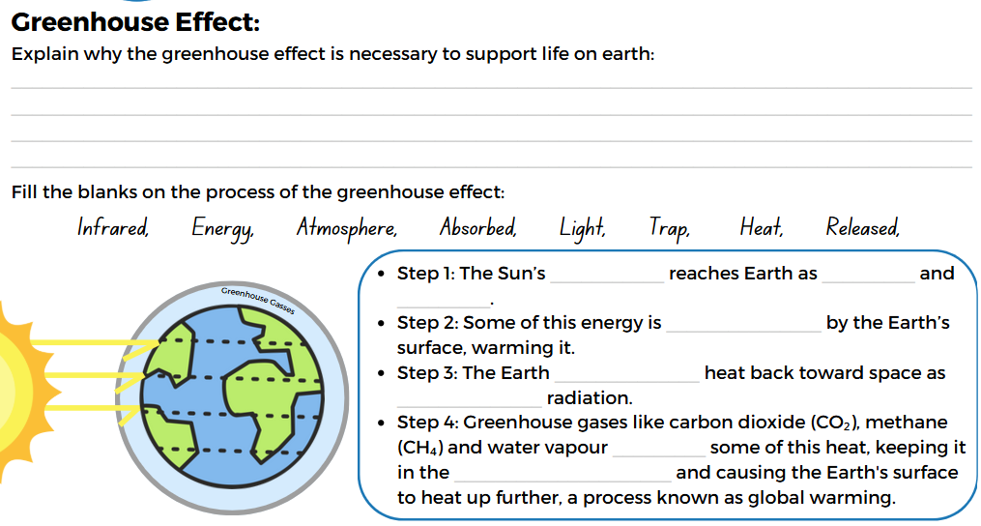
FT Q C54
Climate Change
Greenhouse Effect
TASK:
On your worksheet, explain why the greenhouse effect is necessary to support life on earth and fill the blanks on the process of the greenhouse effect:

Slide 17
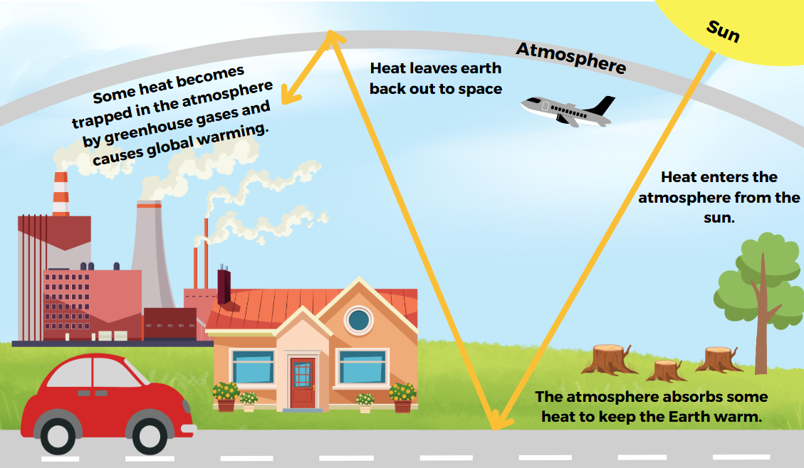
FT Q C54
Climate Change

Slide 18
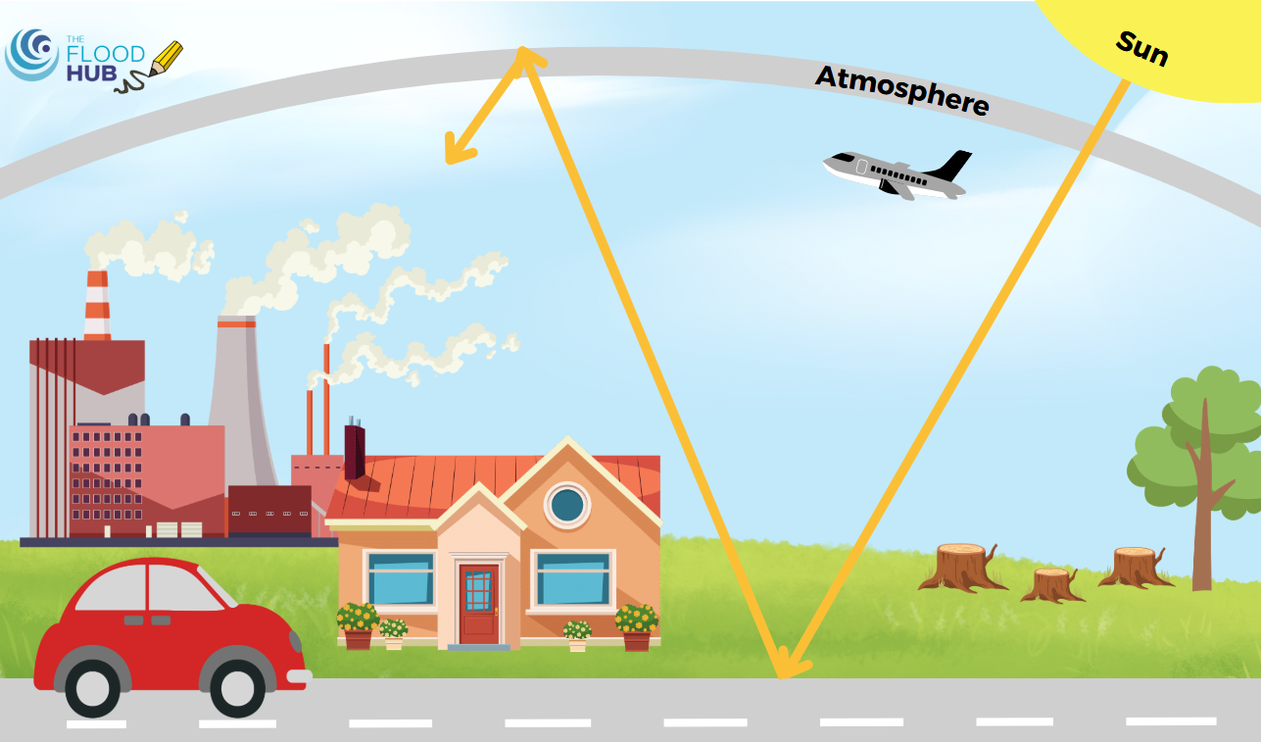
FT Q C54
Climate Change
TASK:
Write the label on the correct place on the diagram to explain the greenhouse effect

Slide 19
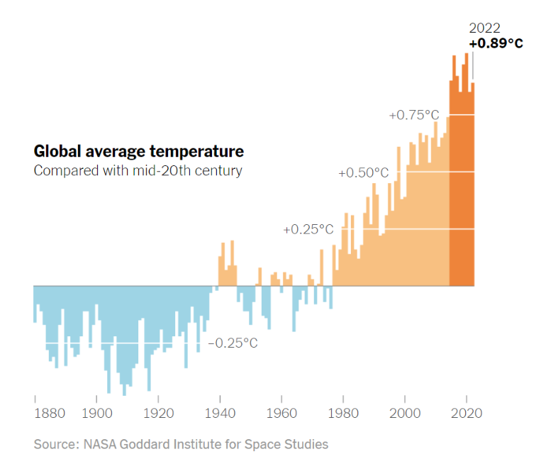
FT Q C54
Climate Change
Evidence for Climate Change
Temperature Records
Scientists use different types of evidence to study past and present climate patterns. These help us understand how Earth’s climate is changing over time.
What trend do you observe in the graph ?

Slide 20
FT Q C54
Climate Change
Evidence for Climate Change
Temperature Records
Scientists have been recording global temperatures since 1850.
While early records are less complete, temperature data from the past 50 years is highly accurate and reliable.
What Do Temperature Records Show?
A steady increase in global average temperatures over the past century.
The last few decades have seen some of the hottest years on record, with global temperatures now around 1°C higher than pre-industrial levels.
Why Are They Important?
  Long-Term Trends: Even though records only go back 170 years, they show a clear trend of warming.
  Human Impact: The rapid rise in temperature aligns with increased greenhouse gas emissions from human activities.
  Real-Time Data: Unlike other evidence (e.g., ice cores or tree rings), temperature records provide ongoing, up-to-date information about current climate changes.

Slide 21

FT Q C54
Climate Change
Evidence for Climate Change
Temperature Records
TASK:
On your worksheet, explain what temperature records show and why they are important

Slide 22
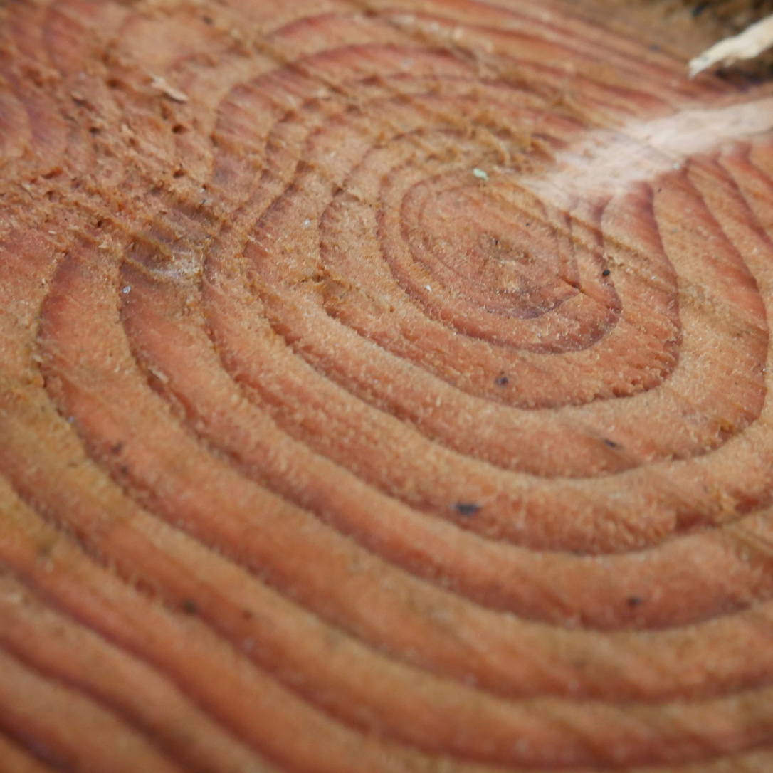
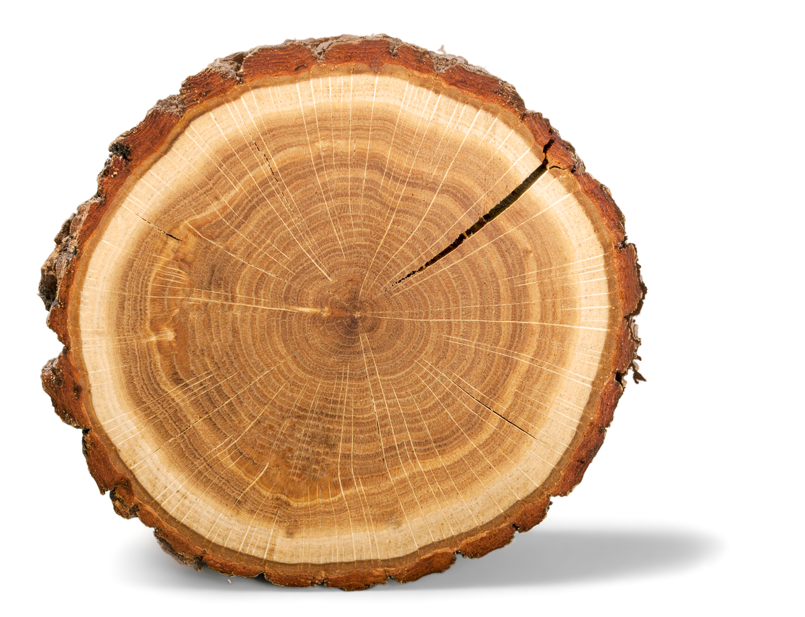
FT Q C54
Climate Change
Evidence for Climate Change
Tree Rings
Trees grow a new ring each year, and their thickness reveals past climate conditions.
What Can Tree Rings Tell Us?
By studying tree rings, scientists can:
  Determine the age of a tree by counting its rings.
  Analyse the climate conditions during each year of the tree's life.
  Track climate data for up to 10,000 years, providing insights into long-term climate patterns.
Thinner Rings: Indicate harsher conditions, such as drought or cold weather.
Thicker Rings: Indicate favourable conditions for growth, such as a warm, wet climate.
Tree Ring by Billion Photos
Tree Rings by Gabriella Aguilar from Getty Images

Slide 23
FT Q C54
Climate Change
Evidence for Climate Change
Tree Rings
Why Is This Useful?
  Tree rings are a natural record of past climates, even before modern weather instruments existed.
  Older trees (e.g., ancient bristlecone pines) can reveal information about climate changes that happened thousands of years ago.
  They help identify climate cycles and compare past natural changes to the rapid warming caused by human activity today.
Tree Rings by Gabriella Aguilar from Getty Images

Slide 24
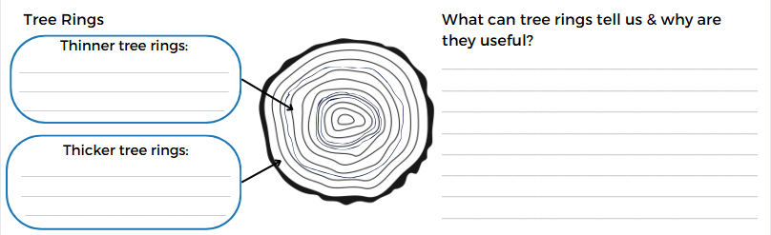
FT Q C54
Climate Change
Evidence for Climate Change
Temperature Records
TASK:
On your worksheet, explain what thinner and thicker tree rings mean and note down what tree rings can tell us and why they're helpful.
Tree Ring by Billion Photos

Slide 25


FT Q C54
Climate Change
Evidence for Climate Change
Ice Cores
Ice cores are cylinders of ice drilled from ice sheets or glaciers.
Tiny air bubbles trapped in the ice contain gases from the atmosphere at the time the ice formed.
What Do Ice Cores Show Us?
  Each year, a new layer of ice forms, preserving a record of climate conditions.
  Scientists analyse the trapped gases (like CO₂ and methane) to determine:
    Atmospheric composition during different periods.
    Temperatures hundreds of thousands of years ago.
  Some ice cores also contain fossils or sediments, offering additional clues about the environment.
Ice-drill by Balakleypb from Getty Images

Slide 26
FT Q C54
Climate Change
Evidence for Climate Change
Ice Cores
Ice-drill by Balakleypb from Getty Images
Why Are Ice Cores Important?
  Ice cores from Antarctica provide data going back 800,000 years, giving us a detailed record of past climates.
  They reveal natural cycles of warming and cooling, as well as the sharp rise in greenhouse gases caused by human activity since the Industrial Revolution.
Did you know...
The deepest ice core ever drilled is over 3 kilometres long, containing 420,000 years of climate history!

Slide 27

FT Q C54
Climate Change
Evidence for Climate Change
Pollen Analysis
Plant pollen can be preserved in sediment layers for thousands of years. By examining pollen in these layers, scientists can identify the types of plants that grew in the area during different time periods.
How does it show Climate Change?
  Different plants thrive in different climates.
  Comparing ancient pollen with modern pollen reveals how plant life—and by extension, climate—has changed over time.
    Warm periods may show pollen from tropical plants.
    Cold periods may show pollen from tundra or boreal species.
Pollen allergy by fotojog from Getty Images

Slide 28
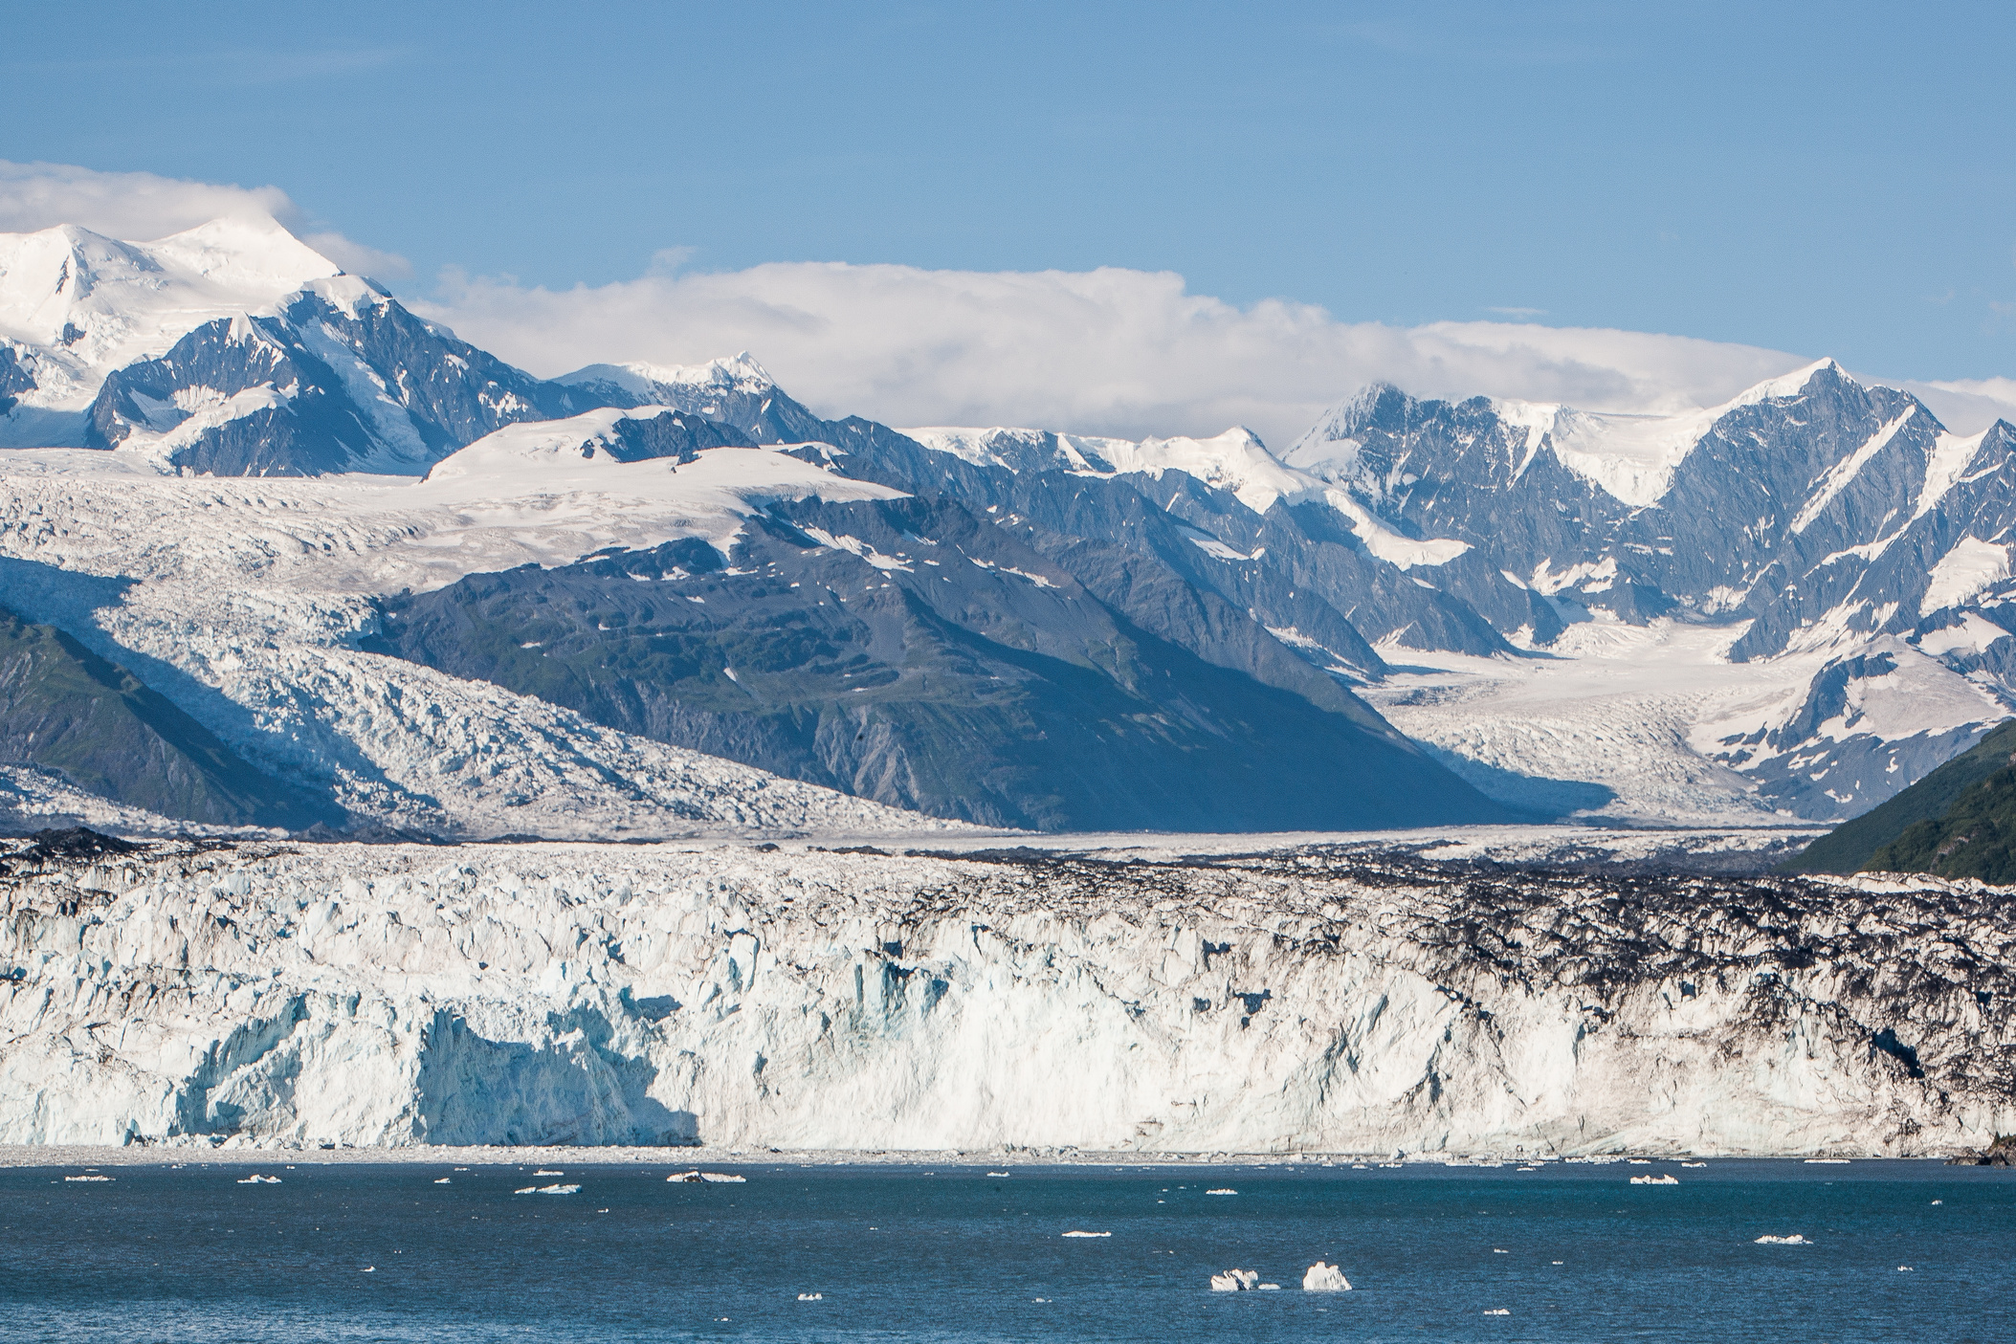
FT Q C54
Climate Change
Evidence for Climate Change
Ice Cover
Ice cover refers to the ice sheets, glaciers, and sea ice found in regions like the Arctic, Antarctica, and high-altitude mountains. These icy areas expand during colder periods and shrink as temperatures rise.
Less ice means less sunlight is reflected back into space, which accelerates global warming (known as the albedo effect).
  Ice cover is a clear and measurable indicator of rising global temperatures.
  Changes in ice size and thickness provide a visual record of the Earth’s warming climate.
Ice Covered Land by AvatarKnowmad from Getty Images

Slide 29

FT Q C54
Climate Change
Recap:
Discuss with your neighbour...
How do you think climate change might affect your life or the world around you?

Slide 30
FT Q C54
Climate Change
Homework Task:
Demonstrate your understanding of the evidence for climate change by creatively presenting your knowledge in one of the following formats.
Create a Poster:
  Design a poster showcasing the key evidence of climate change.
  Include examples such as tree rings, ice cores, temperature records, ice cover, and pollen analysis.
  Use visuals like diagrams, graphs, or illustrations to make the poster engaging.
Write an Article or Report:
  Write a 1-2 page article aimed at convincing someone who is sceptical about climate change.
  Include an introduction, the evidence (with explanations), and a conclusion.
  Use real-world examples and data to support your points.
Make an Infographic:
  Create a digital or hand-drawn infographic summarising the key evidence of climate change.
  Use concise text and visuals to explain each piece of evidence.

