Slide 1




FT Q C56
Managing Climate Change
Learning Objectives:
  Understand the difference between mitigation and adaptation to manage climate change.
  Explore real-world strategies used in the UK.

Slide 2


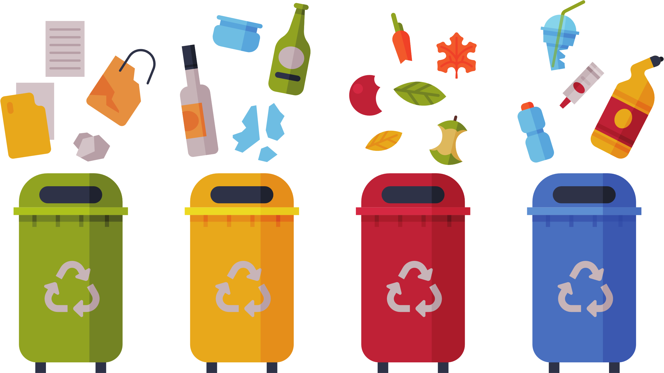
FT Q C56
Managing Climate Change
Introduction to Climate
Starter:
On your whiteboards, write down:
What do you do in your own life to reduce the impacts of climate change?

Slide 3
FT Q C56
Managing Climate Change
Introduction to Climate
Climate change has serious consequences, but we can manage it using two main approaches:
Mitigation
Taking action to reduce or prevent the release of greenhouse gases into the atmosphere. This helps slow down global warming and its effects.
Adaptation
Making changes to cope with the effects of climate change and reduce the damage it can cause.

Slide 4

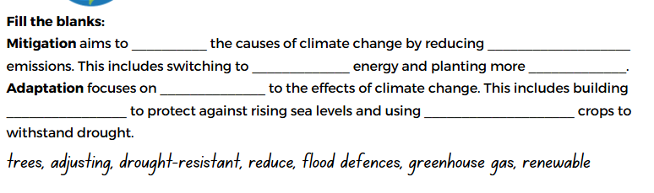
FT Q C56
Managing Climate Change
Introduction to Climate
TASK:
Fill in the blanks on your worksheet to complete the definitions of adaptation and mitigation.

Slide 5
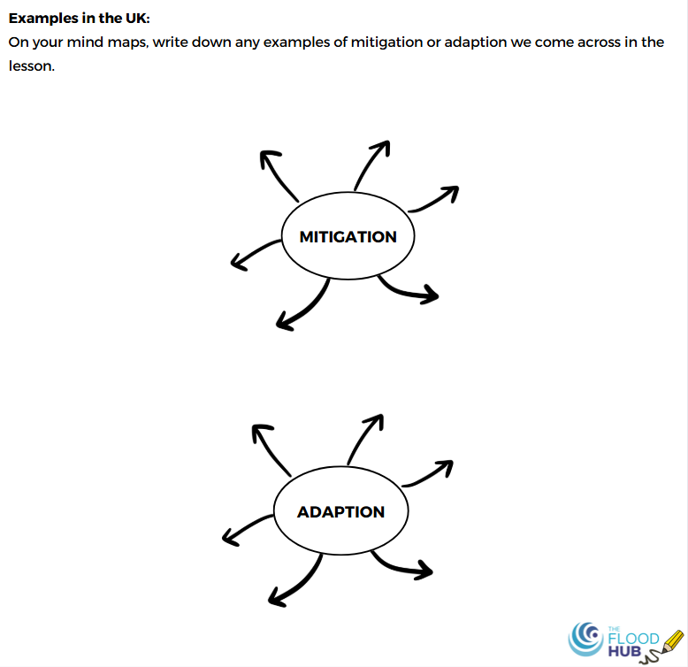
FT Q C56
Managing Climate Change
Introduction to Climate
TASK:
As we go through the PowerPoint, if any examples or case studies of mitigation or adaptation are mentioned, write them down on the mind map section of your worksheet.
Make sure to include both types of strategies and their locations or details.

Slide 6
FT Q C56
Managing Climate Change
Introduction to Climate
Mitigation
Taking action to reduce or prevent the release of greenhouse gases into the atmosphere. This helps slow down global warming and its effects.

Slide 7
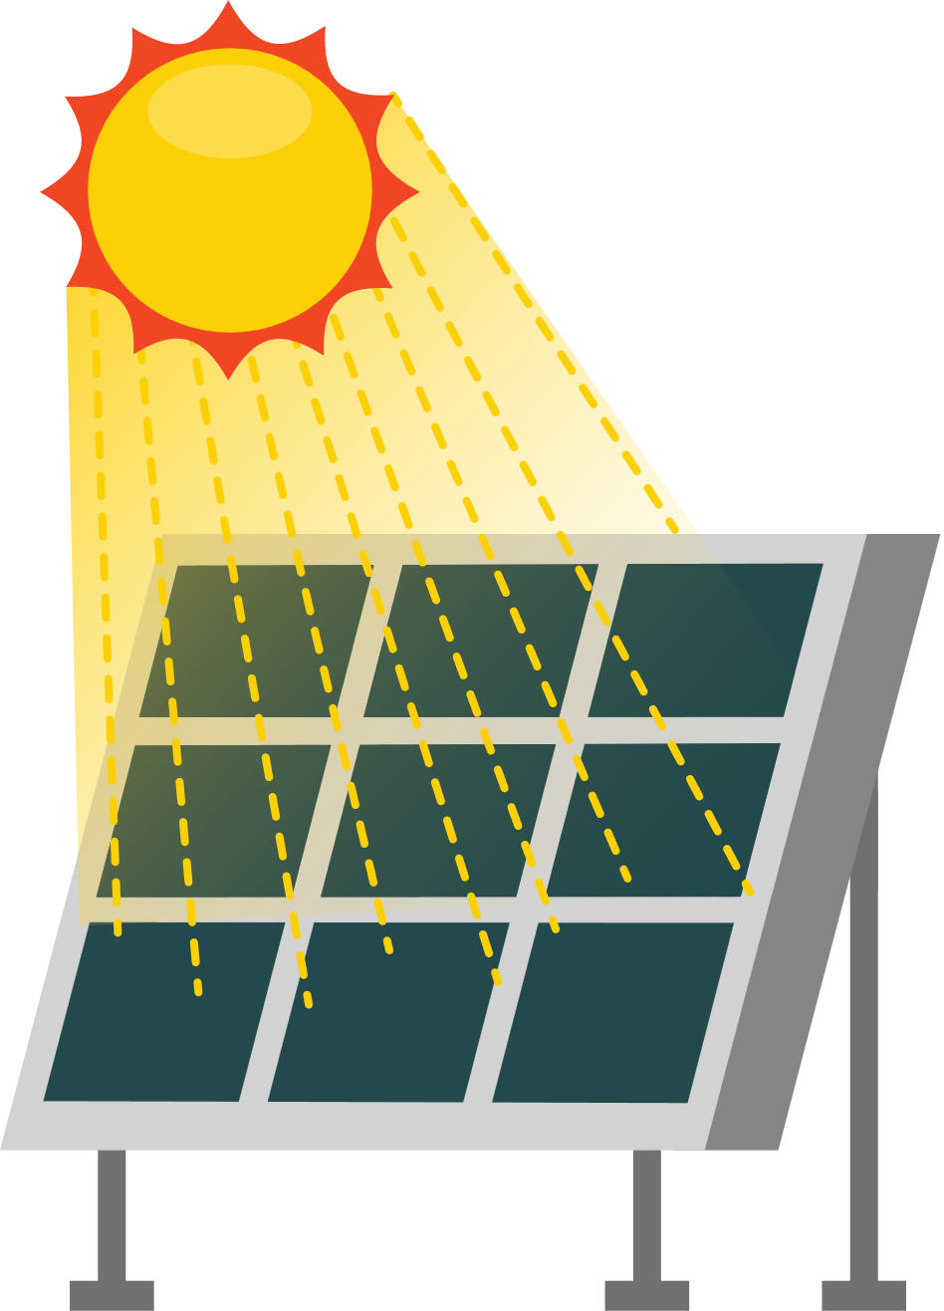

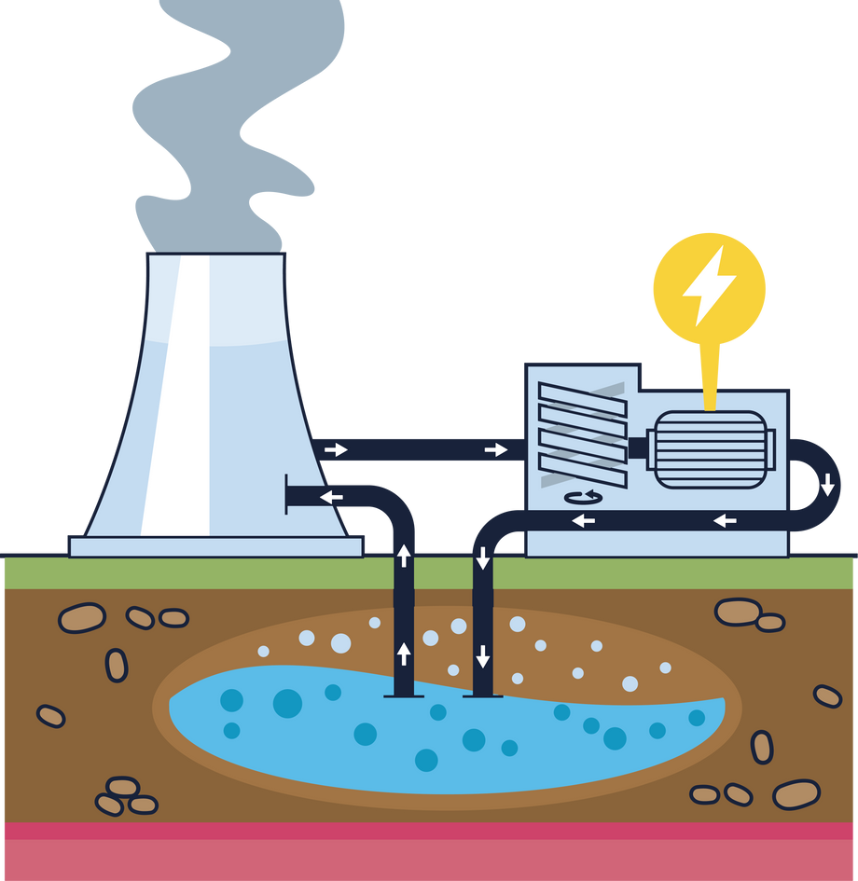
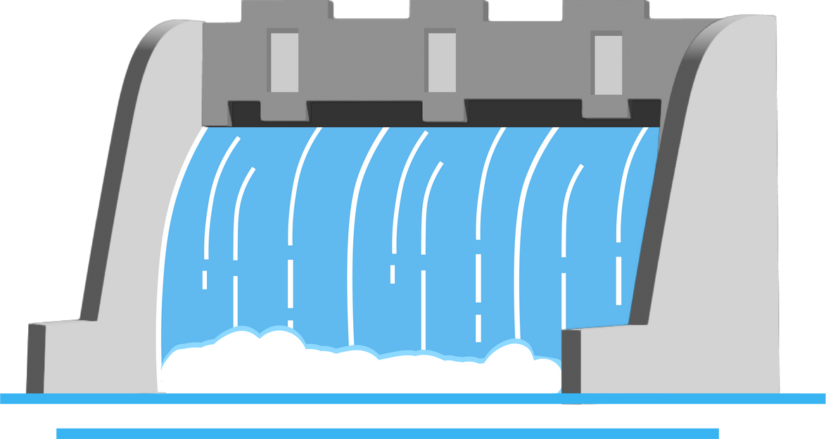
FT Q C56
Managing Climate Change
Introduction to Climate
Mitigation Strategies
Renewable Energy
Renewable energy is energy that comes from natural sources, which are renewed naturally and won't run out.
These include:
Solar energy (from the sun)
Wind energy (from wind turbines)
Geothermal energy (from heat inside the Earth)
Hydroelectric power (from moving water)

Slide 8
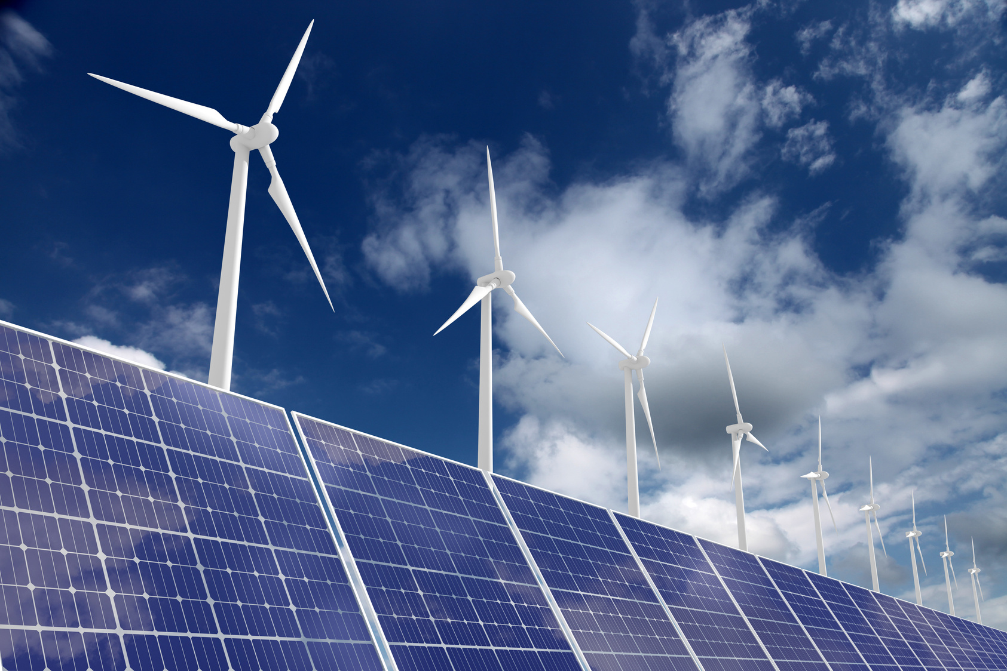
FT Q C56
Managing Climate Change
Introduction to Climate
Mitigation Strategies
Renewable Energy
Why is it important?
  Reduces greenhouse gas emissions: Unlike fossil fuels (coal, oil, gas), renewable energy doesn’t release harmful gases like carbon dioxide.
  Fossil fuels will run out : Fossil fuels are finite (they will run out eventually), whereas renewable energy sources are sustainable and can be used over and over.
  Cleaner and sustainable: Helps prevent air pollution and is eco-friendly.
  Helps fight climate change: By switching to renewable energy, we can reduce our reliance on fossil fuels and lower global temperatures.
Wind turbine solar panel renewable energy by alexsl from Getty Images Signature

Slide 9
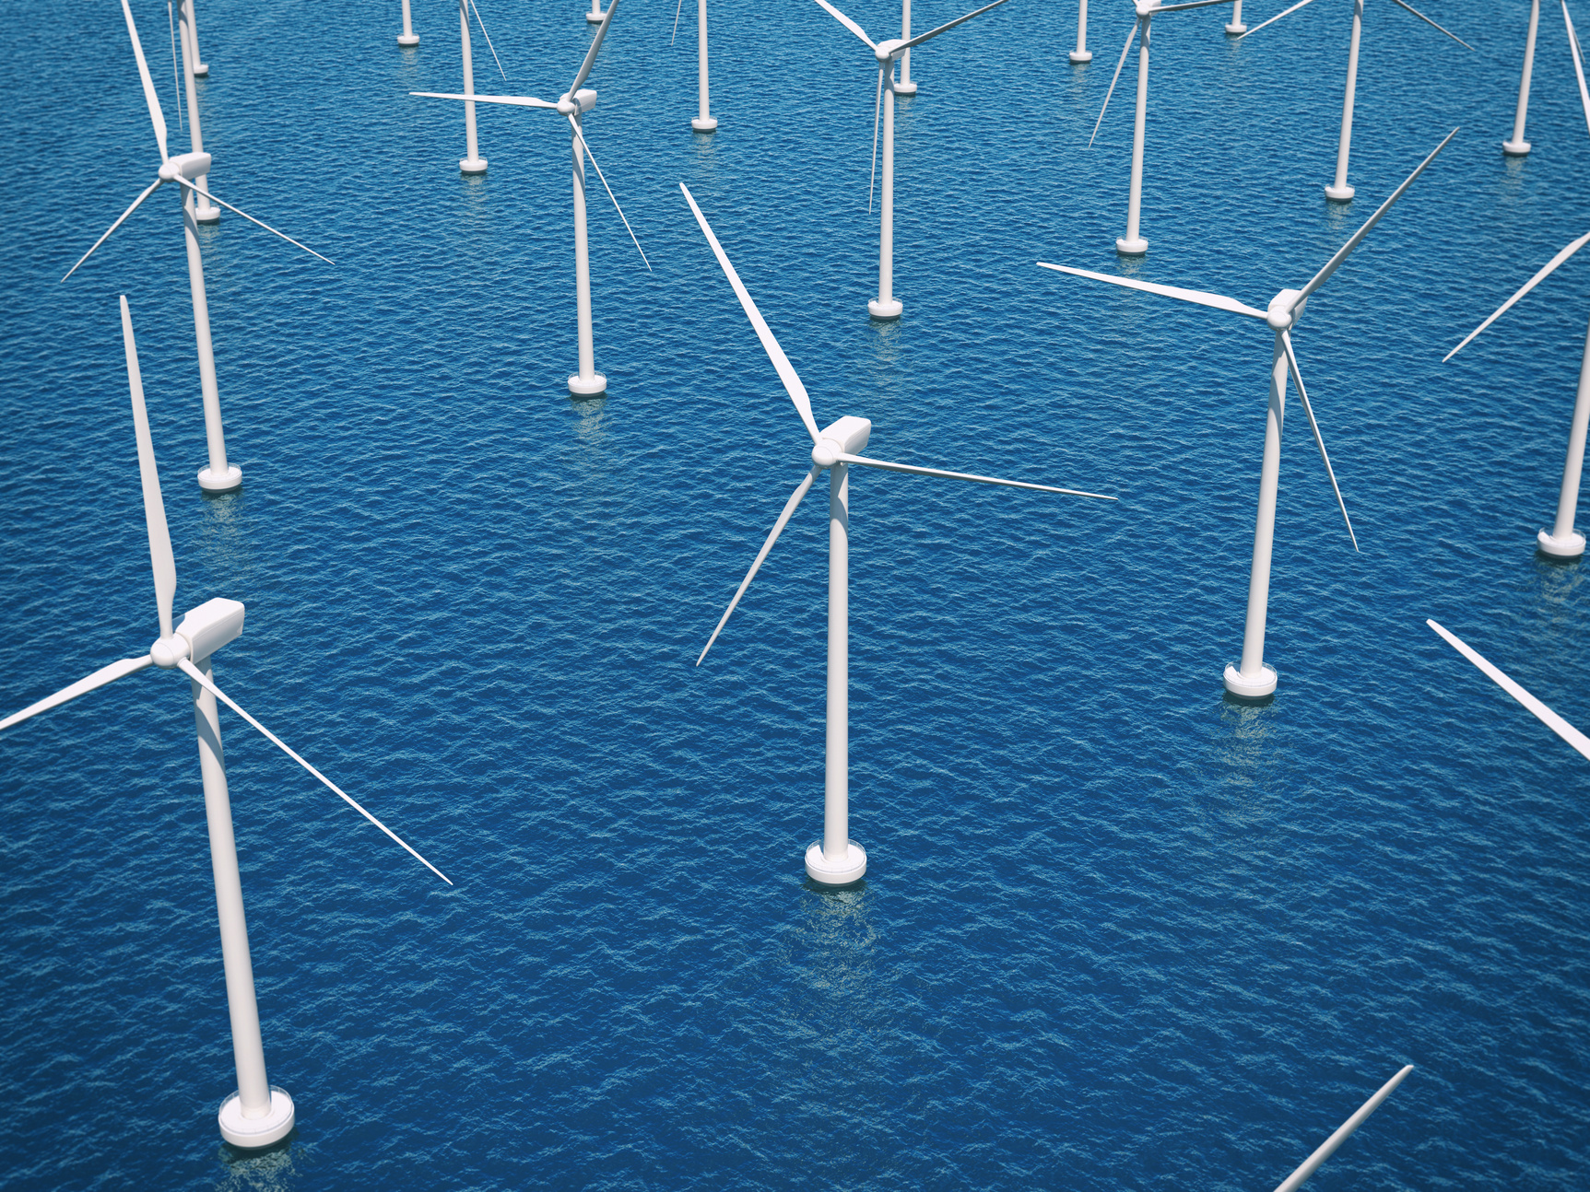
FT Q C56
Introduction to Climate
Mitigation Stratergies
Hornsea One
  The UK’s largest offshore wind farm is Hornsea One, located off the coast of Yorkshire in the North Sea.
  It has a total capacity of 1.2 gigawatts (GW), which is enough to power over 1 million homes.
  The wind farm consists of 174 turbines and is part of the UK's push to expand renewable energy sources and reduce carbon emissions.
Offshore Wind Turbines by imaginima from Getty Images Signature

Slide 10

FT Q C56
Managing Climate Change
Introduction to Climate
Mitigation Strategies
Carbon Capture and Storage (CCS)
Carbon Capture and Storage (CCS) is a process designed to reduce carbon dioxide (CO2) emissions by capturing CO2 from industrial activities and power generation, transporting it, and storing it deep underground to prevent it from entering the atmosphere.
It involves three main steps:
  Capturing the CO2 produced during industrial processes (e.g., steel or cement production) or the burning of fossil fuels for energy.
  Transporting the captured CO2 via pipelines, ships, or trucks to a storage site.
  Storing the CO2 in deep underground geological formations, such as saline aquifers or depleted oil and gas reservoirs, ensuring it remains safely stored for thousands of years.

Slide 11
FT Q C56
Managing Climate Change
Introduction to Climate
Mitigation Strategies
Carbon Capture and Storage (CCS)
Why is it important?
  Reduces CO2 emissions: CCS can help prevent large amounts of CO2 from being released into the air, where it would contribute to global warming and climate change.
  Supports industries: It allows industries that produce a lot of CO2, like cement or steel factories, to continue working while still reducing their environmental impact.
  Helps meet climate targets: CCS is seen as a key solution for achieving net-zero emissions, as it can capture CO2 that’s difficult to remove by other means.

Slide 12
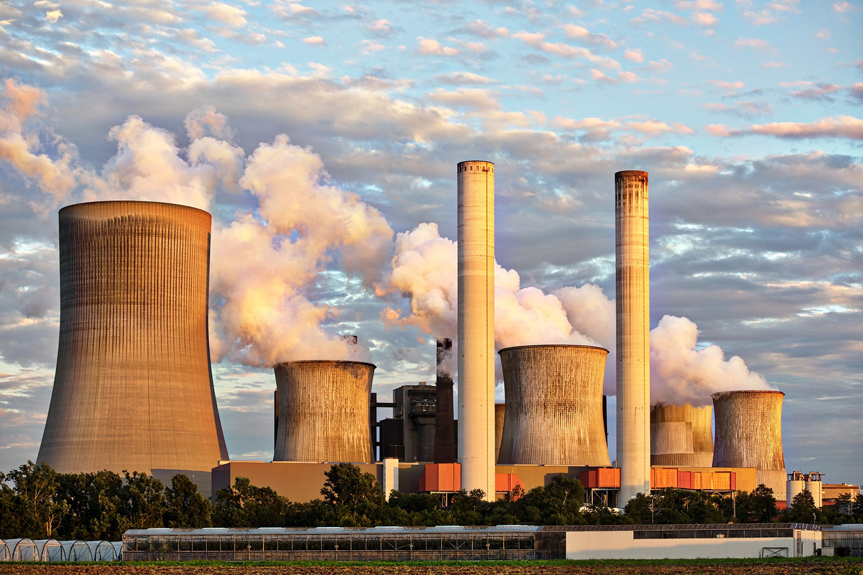
FT Q C56
Managing Climate Change
Introduction to Climate
Mitigation Stratergies
Zero Carbon Humber project
  In the UK, one project working on carbon capture and storage is called the Zero Carbon Humber project.
  This project captures carbon emissions from factories and power plants in the Humber region, then stores them deep underground in a place called the Endurance aquifer, located about 90 km off the coast in the North Sea. The carbon is stored 1 mile below the seabed, helping to reduce harmful gases in the atmosphere and fight climate change.
Power Plant Factory by Benita5 from pixabay

Slide 13
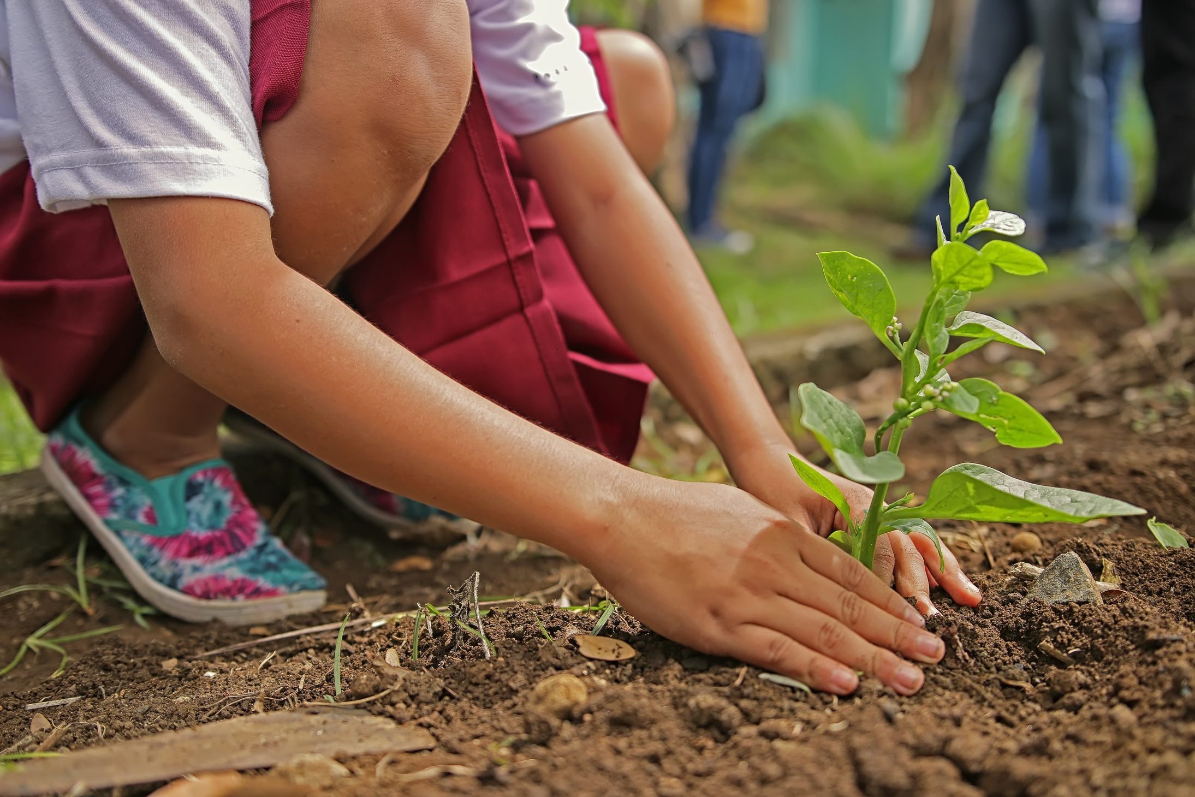
FT Q C56
Managing Climate Change
Introduction to Climate
Mitigation Strategies
Reforestation and Afforestation
Reforestation is planting trees in areas where forests have been destroyed, while afforestation is planting trees in areas that have not previously been forested.
Why is it important?
Trees absorb carbon dioxide (CO₂), a harmful greenhouse gas, from the air.
  By planting more trees, we can help reduce the amount of CO₂ in the atmosphere, helping slow down climate change.
  Trees also help prevent soil erosion, improve biodiversity, and provide homes for wildlife.
Person Planting Tree by artisano from pixabay

Slide 14
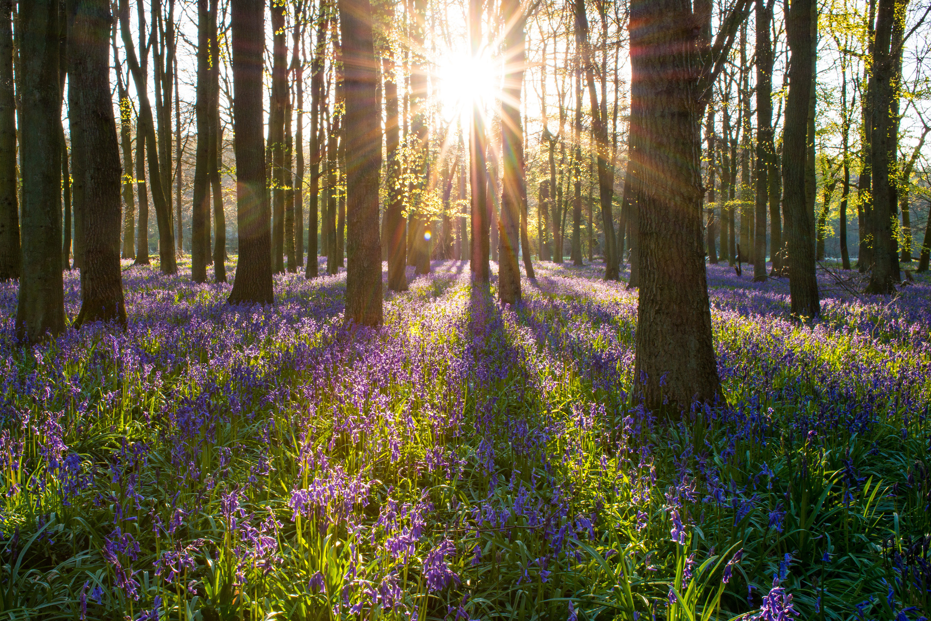
FT Q C56
Managing Climate Change
Introduction to Climate
Mitigation Stratergies
The Northern Forest Reforestation Project
  The Northern Forest project, located from Liverpool to Hull, aims to plant 50 million trees by 2050.
  This reforestation initiative helps tackle climate change by absorbing carbon dioxide and reducing flooding through improved water drainage.
  It also promotes biodiversity by creating habitats for wildlife and enhances local communities' quality of life, contributing to long-term environmental resilience in the North of England.
Forest with Bluebell Flowersby kretktz from pixabay

Slide 15
FT Q C56
Managing Climate Change
Introduction to Climate
Adaptation
Making changes to cope with the effects of climate change and reduce the damage it can cause.

Slide 16
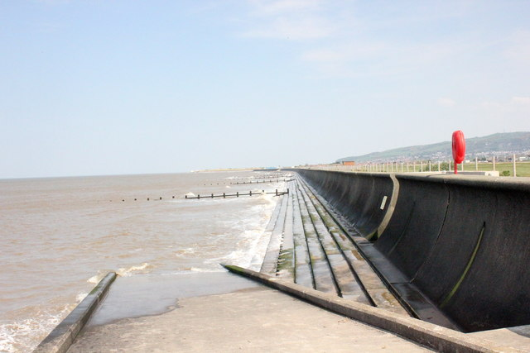
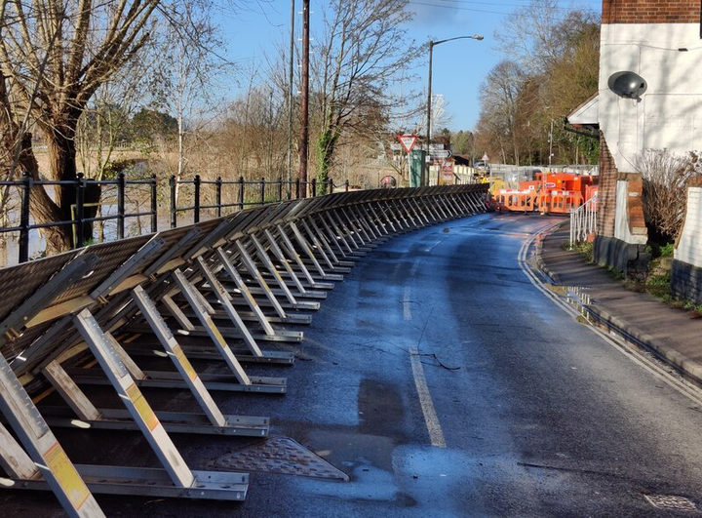
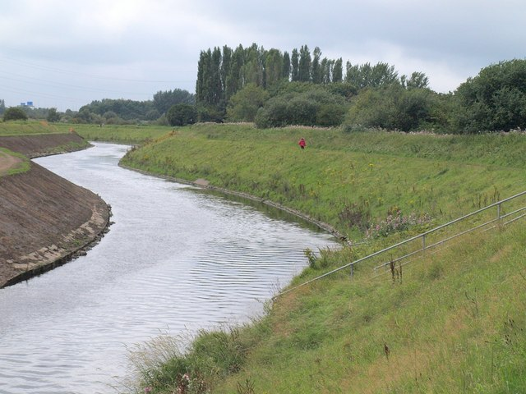
FT Q C56
Managing Climate Change
Introduction to Climate
Adaption Strategies
Flood Defences
Flood defences are structures built to protect areas from flooding caused by heavy rain, storms or rising sea levels. They can include:
Sea walls to stop the sea from flooding land.
Flood barriers to block floodwaters.
Levees and dikes to stop rivers from overflowing.
Slipway and Sea Wall at Rhyl cc-by-sa/2.0 - © Jeff Buck - geograph.org.uk/p/4960969
Flood barriers on Stourport Road, Bewdle. cc-by-sa/2.0 - © Mat Fascione - geograph.org.uk/p/6717908
River Mersey cc-by-sa/2.0 - © Derek Harper - geograph.org.uk/p/2031321

Slide 17
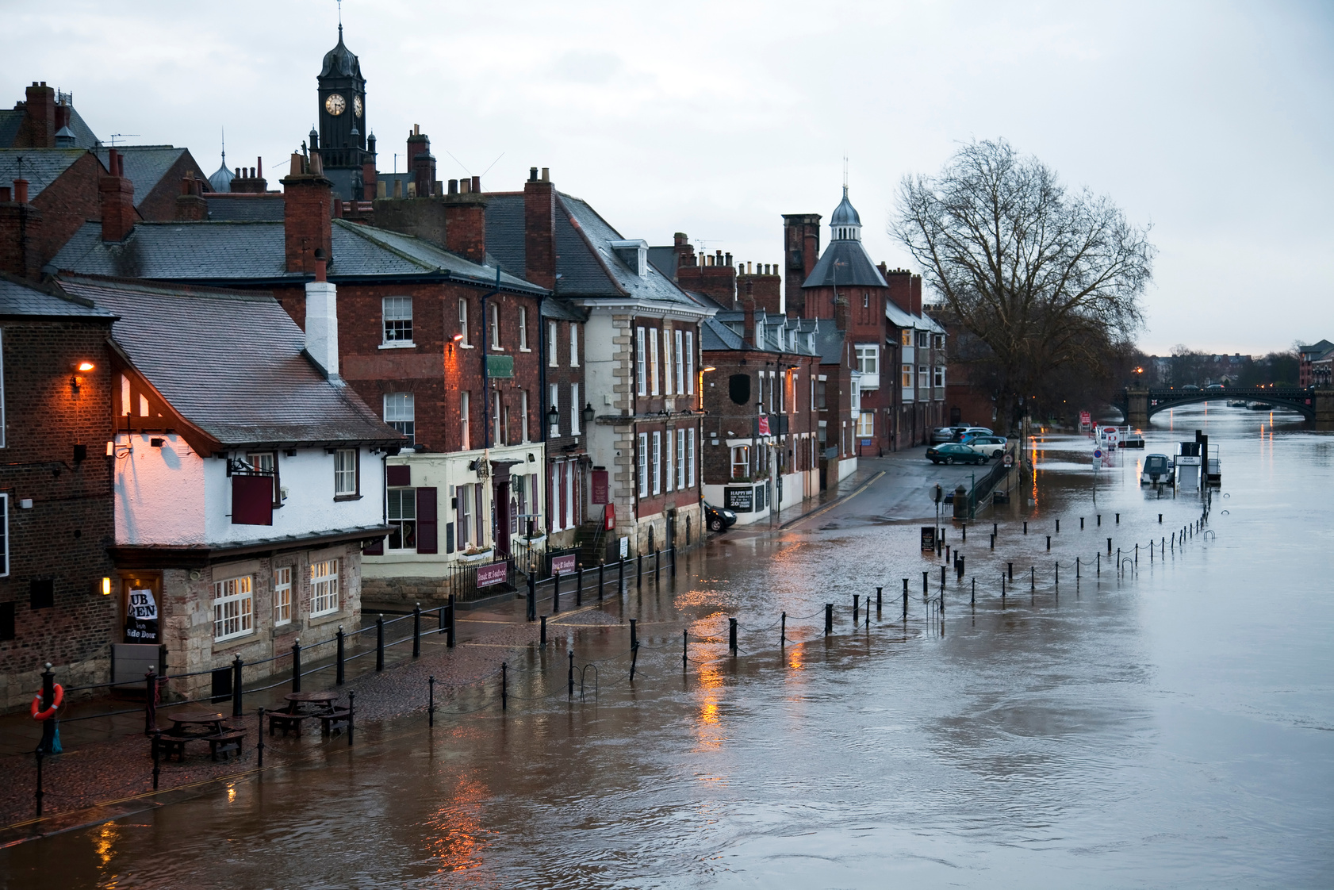
FT Q C56
Managing Climate Change
Introduction to Climate
Adaption Strategies
Why Are Flood Defences Important in Climate Change Adaptation?
  Flood defences help protect communities, homes, and businesses from rising sea levels, intense storms, and heavy rainfall.
  As climate change causes more frequent and severe flooding, defences like sea walls, barriers and drainage systems become essential.
  They reduce damage from floods, protect farmland and ensure people can continue to live and work in flood-prone areas.
  Flood defences also reduce long-term costs and help communities stay resilient to climate change impacts.
Floods by onfilm from Getty Images Signature

Slide 18
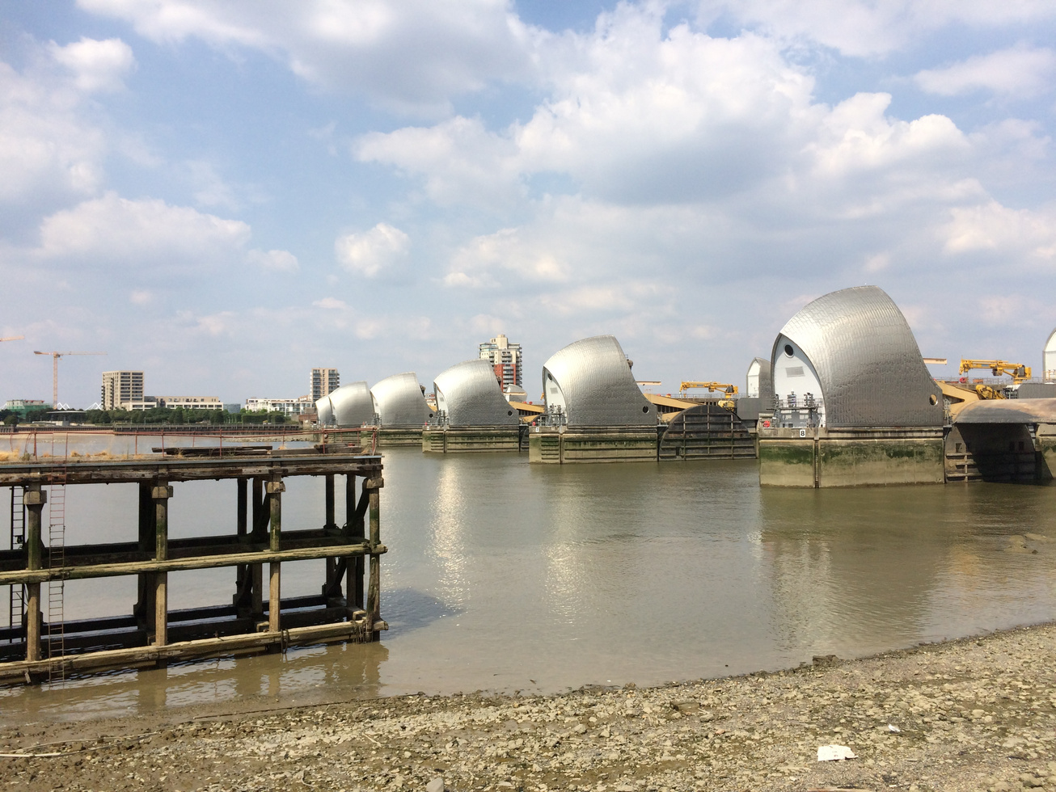
FT Q C56
Managing Climate Change
Introduction to Climate
Adaption Strategies
Flood Defences in the UK
  Thames Barrier (London): Protects the city from storm surges and rising sea levels.
  Hull Tidal Surge Barrier: Helps prevent coastal flooding in a vulnerable area.
  Managed retreat (Essex, Medmerry in Sussex): Instead of building walls, land is allowed to flood naturally.
Thames barrier by ChrisSteer from Getty Images Signature

Slide 19
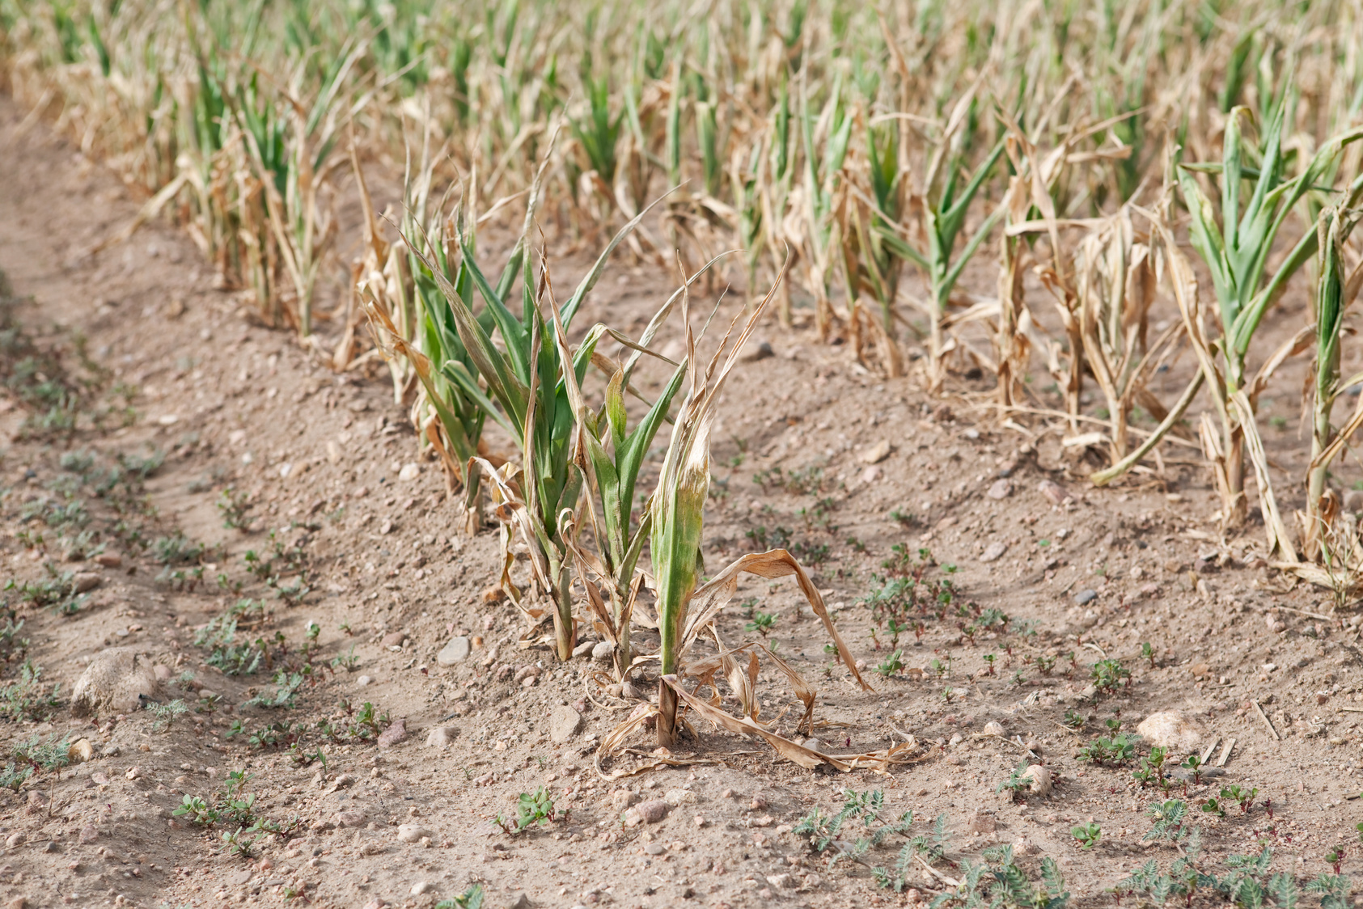
FT Q C56
Managing Climate Change
Introduction to Climate
Adaption Strategies
Drought-Resistant Crops
These are crops designed to survive with less water, making them better suited to hotter, drier climates caused by climate change.
They can be genetically modified (GM) or naturally bred to use water more efficiently and withstand heat.
Why Are They Important?
  Help maintain food production in areas facing drought and water shortages.
  Reduce the need for irrigation, saving finite water resources.
  Support farmers in dry regions by improving crop survival and yields.
Corn Crop Drought by BanksPhotos from Getty Images Signature

Slide 20
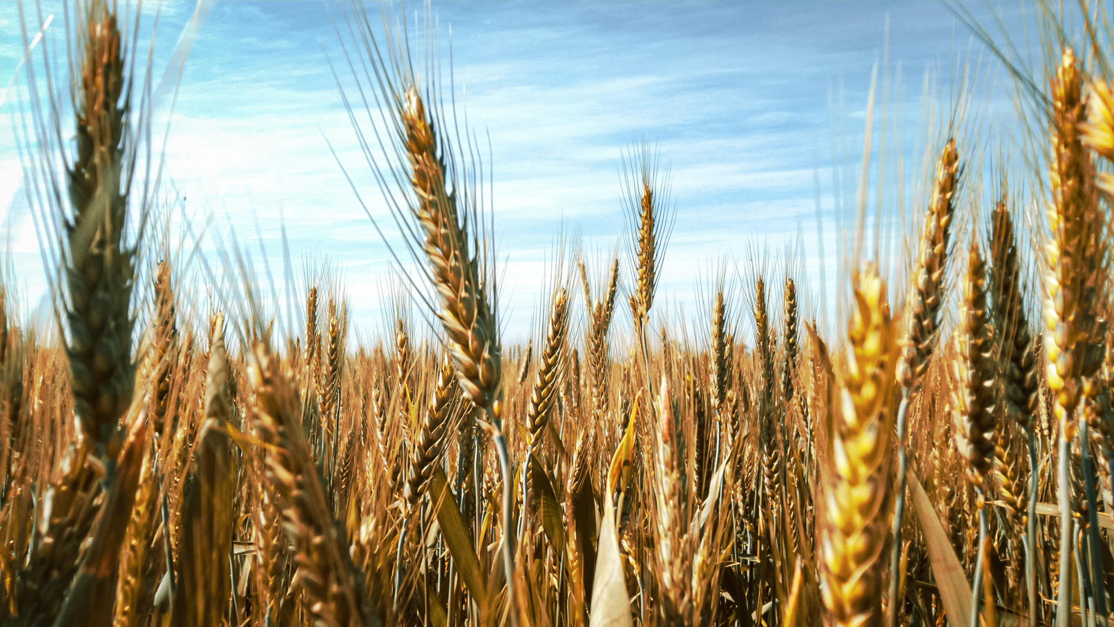
FT Q C56
Managing Climate Change
Introduction to Climate
Adaption Strategies
Drought-Resistant Crops
In East Anglia, farmers are starting to grow drought-resistant crops to help deal with hotter, drier summers caused by climate change.
  East Anglia is one of the UK’s main farming areas, but it gets less rainfall than other regions.
  By using drought-resistant crops, farmers can still grow food even when there is less water available.
Brown Wheat Field by Abhishek Koundle from Pexels

Slide 21
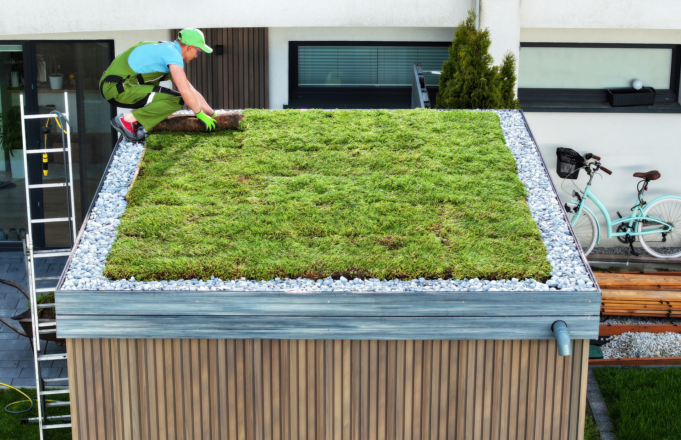
FT Q C56
Managing Climate Change
Introduction to Climate
Adaption Strategies
Sustainable Drainage Systems (SuDS)
Sustainable Drainage Systems (SuDS) are designed to manage rainwater in a way that reduces flood risk and helps the environment. Instead of quickly sending rainwater into drains and rivers, SuDS slow down, store and filter water naturally.
Examples of SuDS in the UK
  Green roofs – absorb rainwater and reduce runoff
  Rain gardens – planted areas that slow and filter rainwater
  Permeable pavements – allow rain to soak through instead of pooling
  Wetlands and ponds – store excess water and create wildlife habitats
Professional Landscap er Finishing Sedum Green Roof Installationby welcomia

Slide 22
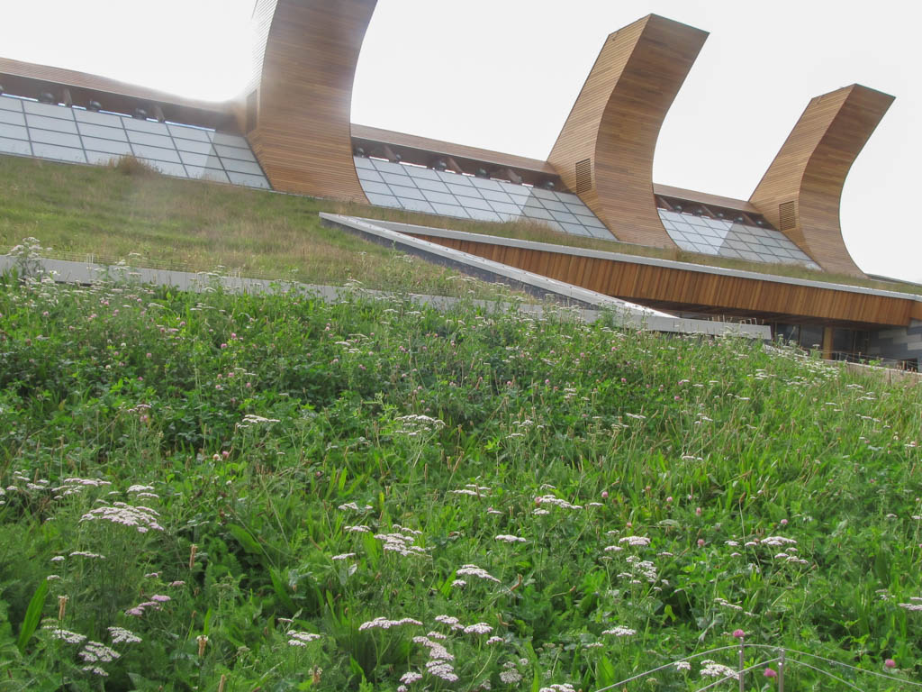
FT Q C56
Managing Climate Change
Introduction to Climate
Adaption Strategies
Manchester Sponge City Approach
The Manchester Sponge City approach uses green infrastructure and SuDS to manage heavy rainfall and reduce flooding. It focuses on allowing rainwater to be absorbed into the ground naturally and creating green spaces for better urban resilience to climate change.
Key Features:
  SuDS: Permeable pavements, green roofs, rain gardens
  Green Infrastructure: Parks, trees, green walls
  Water Storage: Underground tanks and ponds
Green Roofs at Laboratory for Sustainable Chemistry, Jubilee Campus. cc-by-sa/2.0 - © SK53 - geograph.org.uk/p/5151779

Slide 23
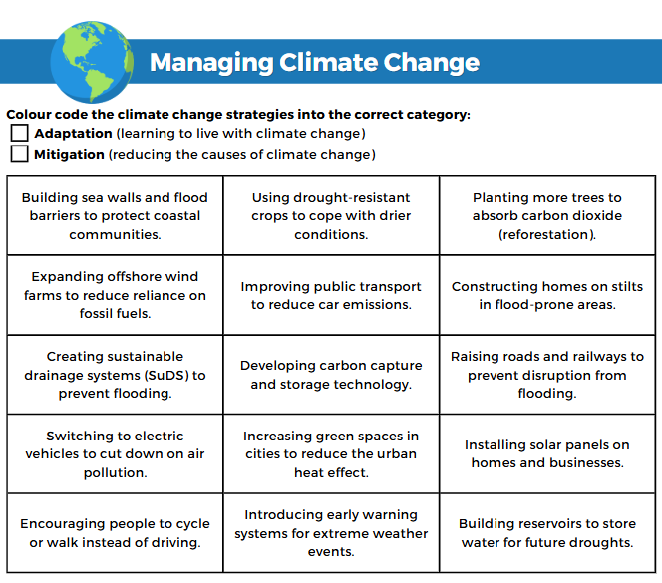
FT Q C56
Managing Climate Change
Introduction to Climate
TASK:
Get two different colours, use one colour to highlight all mitigation strategies and the other colour for adaptation strategies on your worksheet.
Don't forget to colour in the key at the top of your worksheet so it's clear which colour represents each type of strategy.

Slide 24
FT Q C56
Managing Climate Change
Introduction to Climate
Debate: Should the UK invest more in adaptation or mitigation?
Not all strategies work equally well everywhere.
Consider cost, feasibility, and long-term impact.

Slide 25
FT Q C56
Managing Climate Change
Introduction to Climate
Homework task:
Should the UK invest more in adaptation or mitigation to tackle climate change?
Write a paragraph on your worksheet explaining your answer. Use examples from today’s lesson to support your response. You should consider:
  What each approach (adaptation and mitigation) involves.
  Specific examples like flood defences, reforestation, renewable energy, or drought-resistant crops.
  Why you think one approach is more important for the UK than the other.
Make sure to clearly explain your reasoning and link it to real-world examples.

