Slide 1



FT Q C33 R3
GCSE Case Study:
Storm Babet
Learning Objectives:
Explore the causes of Storm Babet.
Analyse the social, economic and environmental impacts of Storm Babet on the UK.
Understand the strategies used to reduce the risks and impacts of Storm Babet.
Use the Storm Babet case study to examine whether UK weather is becoming more extreme.

Slide 2

FT Q C33 R3
GCSE Case Study: Storm Babet
Storm Babet, an extratropical cyclone, hit the UK on 18th October 2023. It was one of the most severe storms in recent years, causing widespread flooding and damage. The storm claimed the lives of seven people and was the second Met Office named storm of the 2023-24 season.

Slide 3

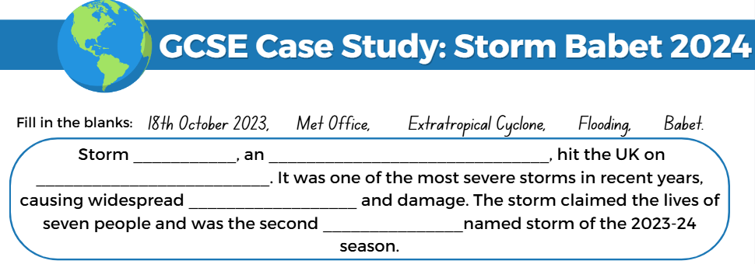
FT Q C33 R3
GCSE Case Study: Storm Babet
TASK:
Fill the blanks on your worksheet with the correct answers about Storm Babet.

Slide 4
FT Q C33 R3
GCSE Case Study: Storm Babet
Storm Babet, an extratropical cyclone, hit the UK on 18th October 2023. It was one of the most severe storms in recent years, causing widespread flooding and damage. The storm claimed the lives of seven people and was the second Met Office named storm of the 2023-24 season.

Slide 5
FT Q C33 R3
GCSE Case Study: Storm Babet
RAIN:
Storm Babet brought 150-200mm of rain to the wettest areas of eastern Scotland, leading to two Met Office red warnings for rain.
In Angus, Scotland, 19th October 2023 was the wettest day on record since 1891.
This period was the third-wettest independent 3-day stretch for England and Wales on record.
WIND:
Babet also brought strong winds, gusting over 58 mph across northeast England and much of Scotland.
Gusts reached 121 mph at Kincardineshire, Scotland.
TASK: Fill in the rainfall and gust figures on your worksheet.

Slide 6



FT Q C33 R3
GCSE Case Study: Storm Babet
Causes:
Strong Jet Stream: A powerful jet stream steered the storm towards the UK.
The jet stream is a core of strong winds around 5 to 7 miles above the Earth’s surface, blowing from west to east.
Notes:
https://www.metoffice.gov.uk/weather/learn-about/weather/types-of-weather/wind/what-is-the-jet-stream

Slide 7
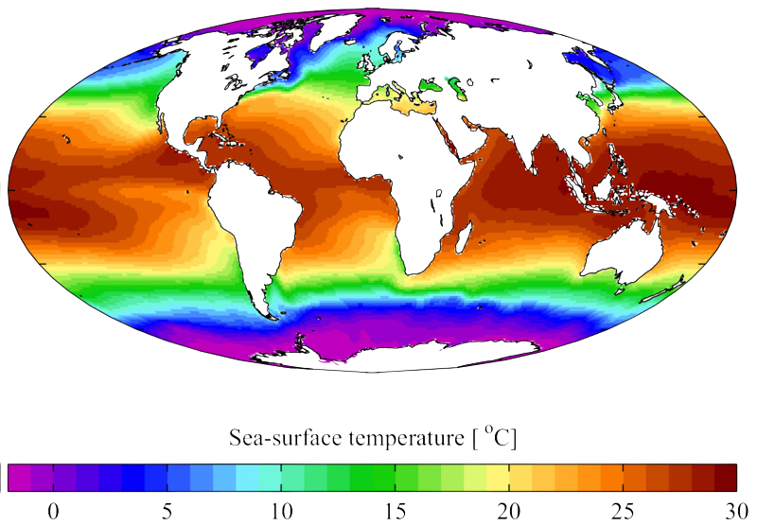
FT Q C33 R3
GCSE Case Study: Storm Babet
Causes:
Warm Sea Surface Temperatures: Elevated temperatures in the North Atlantic provided additional energy to the storm.
Annual mean sea surface temperature from the [http://www.nodc.noaa.gov/OC5/WOA01/ World Ocean Atlas 2001]. Temperature here is in degrees Celsius. It is plotted here using a Mollweide projection (using MATLAB and the https://commons.wikimedia.org/wiki/File:Sea_surface_temperature_2001.png

Slide 8
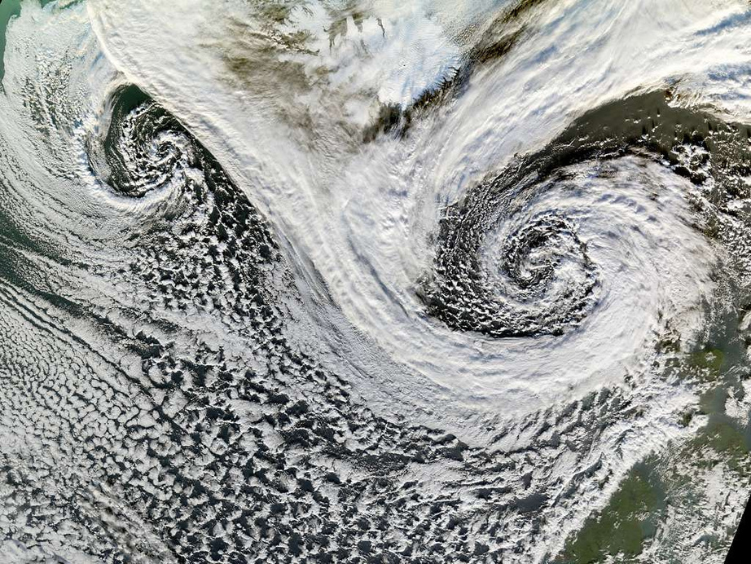
FT Q C33 R3
GCSE Case Study: Storm Babet
Causes:
Low Pressure Area: A significant low-pressure system over the UK helped draw the storm in.
Blocking High Pressure: A high-pressure area over Scandinavia prevented the storm from moving eastwards, prolonging its impact over the UK.
https://jenikirbyhistory.getarchive.net/media/a-cyclone-is-a-low-pressure-area-of-winds-that-spiral-4ee9b0

Slide 9
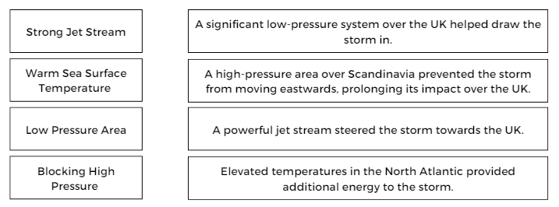
FT Q C33 R3
GCSE Case Study: Storm Babet
Causes:
TASK:
Match the causes of Stom Babet to the description

Slide 10
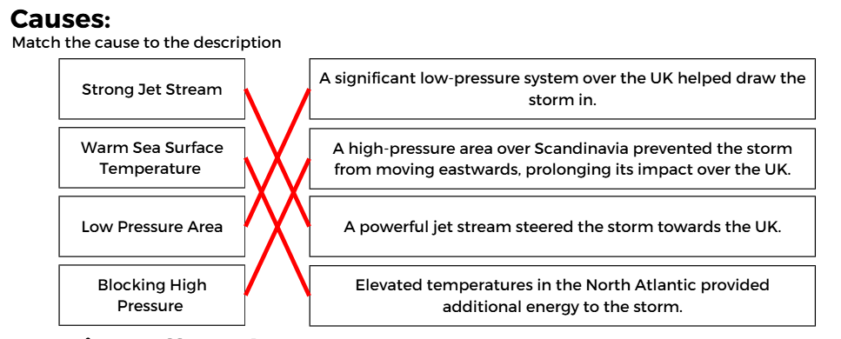
FT Q C33 R3
GCSE Case Study: Storm Babet
Causes:
TASK:
Match the cause’s of Stom Babet to the description

Slide 11
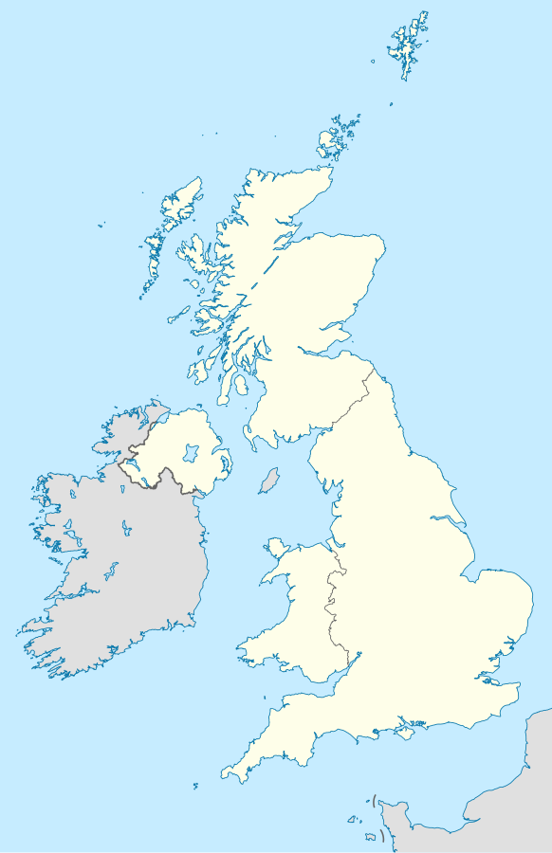

FT Q C33 R3
GCSE Case Study: Storm Babet
Locations Affected:
Scotland:
Brechin, Angus: Became accessible only by boat at one point due to severe flooding.
Aberdeen: Major roads were closed as flood defences were overtopped by the river South Esk.
Northern Ireland:
Derry: Experienced extensive damage due to flooding.
Midlands:
Derby and Nottingham: Rivers exceeded record levels, causing significant flooding.
Retford, Nottinghamshire: Evacuation orders were issued for parts of the town.
Northern England:
Leeds, Sheffield, and York: Roads and railways were shut down due to flooding.

Slide 12
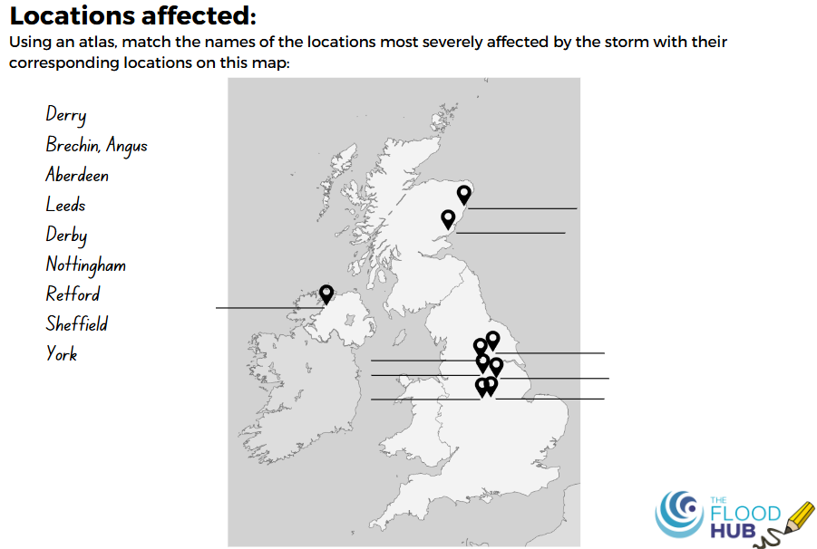
FT Q C33 R3
GCSE Case Study: Storm Babet
Locations Affected:
TASK:
Using an atlas, match the names of the locations most severely affected by the storm with their corresponding locations on the map on your worksheet

Slide 13
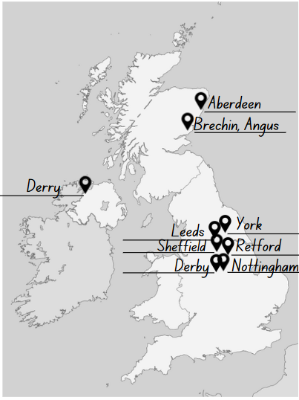
FT Q C33 R3
GCSE Case Study: Storm Babet
Locations Affected:
Scotland:
Brechin, Angus: Became accessible only by boat at one point due to severe flooding.
Aberdeen: Major roads were closed as flood defences were overtopped by the river South Esk.
Northern Ireland:
Derry: Experienced extensive damage due to flooding.
Midlands:
Derby and Nottingham: Rivers exceeded record levels, causing significant flooding.
Retford, Nottinghamshire: Evacuation orders were issued for parts of the town.
Northern England:
Leeds, Sheffield, and York: Roads and railways were shut down due to flooding.

Slide 14
FT Q C33 R3
GCSE Case Study: Storm Babet
IMPACTS:
Social impacts refer to the effects of an event on the lives, health and wellbeing of people in a community. This includes disruptions to daily life, displacement, casualties, public health issues and changes in community dynamics.
Economic impacts refer to the financial effects of an event on individuals, businesses and the overall economy. This includes property damage, business disruption, costs of repairs and rebuilding, and impacts on industries such as agriculture and tourism.
Environmental impacts involve changes to the natural environment due to an event. This includes effects on wildlife, ecosystems, natural resources, and pollution levels.
Some of these impacts overlap because they are connected and affect each other in various ways.

Slide 15
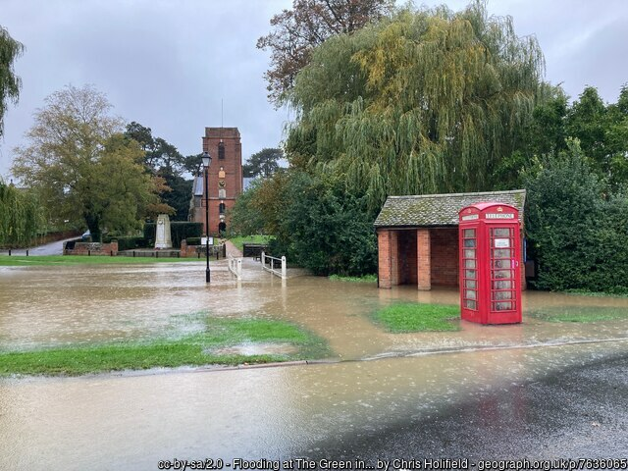
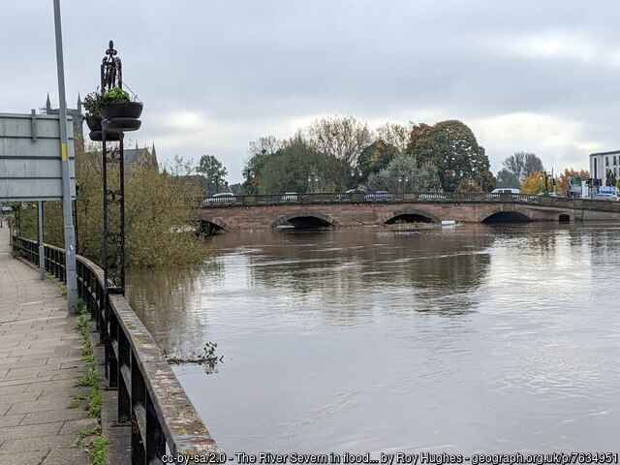
FT Q C33 R3
GCSE Case Study: Storm Babet
IMPACTS:
Flooding at The Green in Grundisburgh. Suffolk
The River Severn in flood at Worcester Bridge

Slide 16
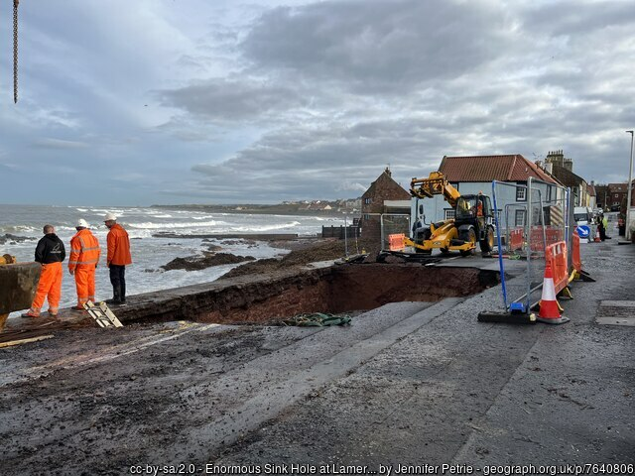
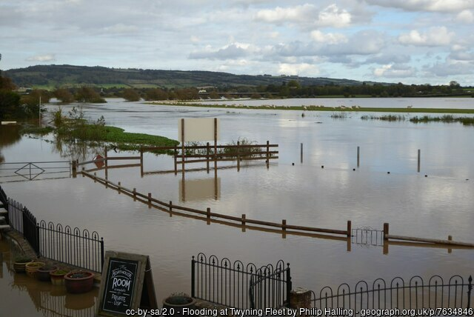
FT Q C33 R3
GCSE Case Study: Storm Babet
IMPACTS:
Sink hole in Dunbar, Scotland
Flooding at Twynin, Tewkesbury

Slide 17
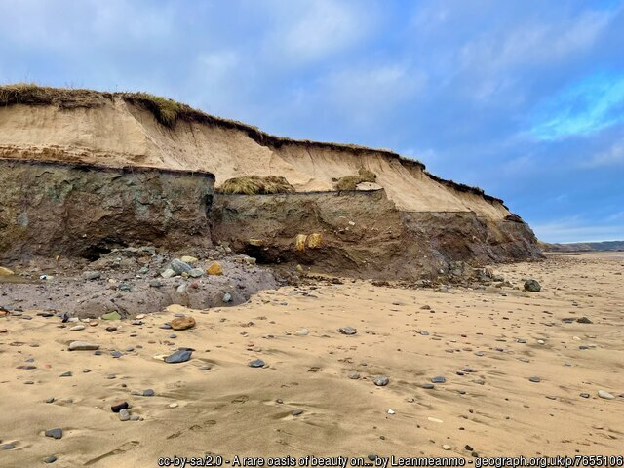
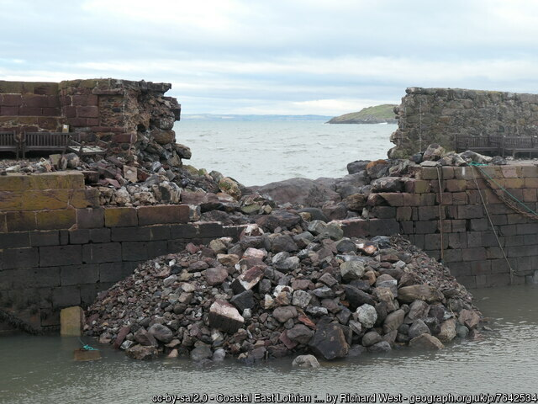
FT Q C33 R3
GCSE Case Study: Storm Babet
IMPACTS:
Cliff erosion at Lynemouth cliffs, Scotland
Breached harbour wall, East Lothian, Scotland

Slide 18

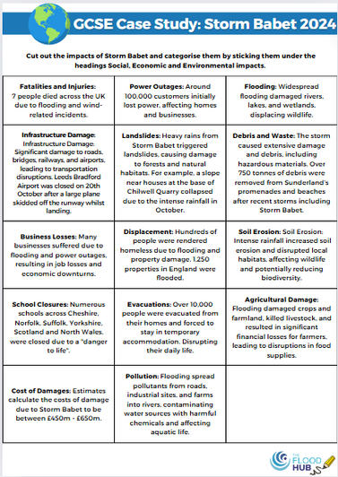

FT Q C33 R3
GCSE Case Study: Storm Babet
IMPACTS:
TASK:
Cut out the impacts of Storm Babet and categorise them by sticking them under the headings Social, Economic and Environmental impacts.

Slide 19
FT Q C33 R3
GCSE Case Study: Storm Babet
SOCIAL IMPACTS:
Fatalities and Injuries: 7 people died across the UK due to flooding and wind-related incidents.
Displacement: Hundreds of people were rendered homeless due to flooding and property damage. 1,250 properties in England were flooded.
School Closures: Numerous schools across Cheshire, Norfolk, Suffolk, Yorkshire, Scotland and North Wales, were closed due to a "danger to life".
Evacuations: Over 10,000 people were evacuated from their homes and forced to stay in temporary accommodation. Disrupting their daily life.

Slide 20
FT Q C33 R3
GCSE Case Study: Storm Babet
ECONOMIC IMPACTS:
Business Losses: Many businesses suffered due to flooding and power outages, resulting in job losses and economic downturns.
Infrastructure Damage: Significant damage to roads, bridges, railways, and airports, leading to transportation disruptions. Leeds Bradford Airport was closed on 20th October after a large plane skidded off the runway whilst landing.
Agricultural Damage:
Flooding damaged crops and farmland, killed livestock, and resulted in significant financial losses for farmers, leading to disruptions in food supplies.
Power Outages: Around 100,000 customers initially lost power, affecting homes and businesses.
Cost of Damages: Estimates calculate the costs of damage due to Storm Babet to be between £450m - £650m.

Slide 21
FT Q C33 R3
GCSE Case Study: Storm Babet
ENVIRONMENTAL IMPACTS:
Landslides: Heavy rains from Storm Babet triggered landslides, causing damage to forests and natural habitats. For example, a slope near houses at the base of Chilwell Quarry collapsed due to the intense rainfall in October.
Debris and Waste: The storm caused extensive damage and debris, including hazardous materials. Over 750 tonnes of debris were removed from Sunderland’s promenades and beaches after recent storms including Storm Babet.
Flooding: Widespread flooding damaged rivers, lakes, and wetlands, displacing wildlife.
Pollution: Flooding spread pollutants from roads, industrial sites, and farms into rivers, contaminating water sources with harmful chemicals and affecting aquatic life.
Soil Erosion:
Intense rainfall increased soil erosion and disrupted local habitats, affecting wildlife and potentially reducing biodiversity.

Slide 22
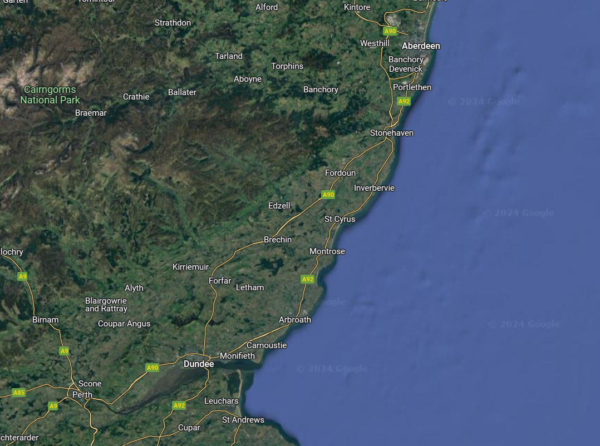



FT Q C33 R3
GCSE Case Study: Storm Babet
REDUCING THE RISK:
Several management strategies were implemented to minimise the risks posed by Storm Babet:
Early Warnings: The Met Office issued two red warnings for heavy rain in eastern Scotland from October 19th to 21st, with amber warnings across Scotland, Northern Ireland, Wales and northern England.
Heavy Rain
Valid 1800 Thurs - 1200 Fri
100-250mm of rain expected

Slide 23
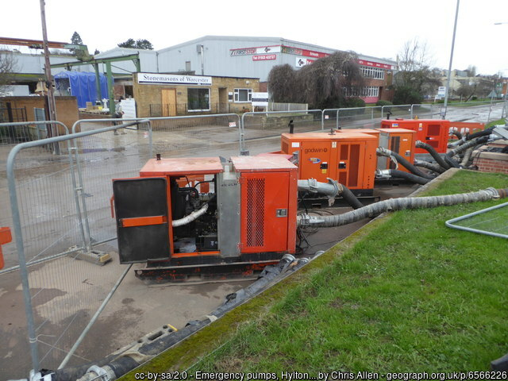

FT Q C33 R3
GCSE Case Study: Storm Babet
REDUCING THE RISK:
Flood Protection: The Environment Agency (EA) issued flood alerts, deployed sandbags and sent over 300,000 warnings. They protected 96,000 properties and deployed 25 pumps.

Slide 24


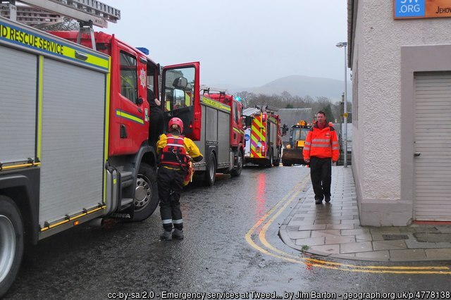
FT Q C33 R3
GCSE Case Study: Storm Babet
REDUCING THE RISK:
Evacuations and Rescues: Emergency services facilitated evacuations and rescue operations, including airlifting workers from a North Sea drilling platform.
Emergency Response: Local authorities and emergency services implemented response plans to manage the storm's effects.

Slide 25
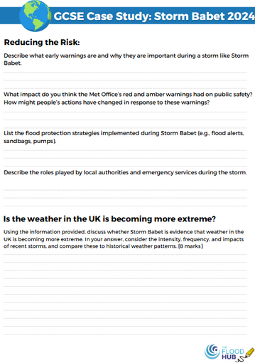
FT Q C33 R3
GCSE Case Study: Storm Babet
REDUCING THE RISK:
TASK:
Answer the questions on you worksheet about reducing the risk of Storm Babet.

Slide 26
FT Q C33 R3
GCSE Case Study: Storm Babet
DOES STORM BABET SHOW THAT THE WEATHER IN THE UK IS BECOMING MORE EXTREME?
Intensity of the Storm: Storm Babet brought intense rainfall and high winds, leading to widespread flooding, landslides, and significant damage across the UK. The severity of the storm, including the issuance of rare red weather warnings and the 7 lives lost, highlights the increasing intensity of storm events in the region.
Frequency of Severe Weather Events: Storm Babet is part of a pattern of recent severe storms in the UK, such as Storm Ciara and Storm Dennis in 2020. The frequency of such extreme weather events suggests a trend towards more volatile weather conditions, which many experts link to climate change.
Widespread Impacts: The extensive damage caused by Storm Babet, including flooding of homes, disruption to transportation, and economic losses, underscores the growing risk and impact of extreme weather in the UK. The scale of the storm’s effects reflects the increasing vulnerability of infrastructure and communities to such events.
Historical Comparisons: When compared to historical records, the frequency and severity of storms like Babet have increased. This aligns with broader climate trends that show more extreme weather patterns over time, influenced by global temperature rises and changes in atmospheric conditions.

Slide 27
FT Q C33 R3
GCSE Case Study: Storm Babet
DOES STORM BABET SHOW THAT THE WEATHER IN THE UK IS BECOMING MORE EXTREME?
TASK:
Answer the question on your worksheet:
‘Using evidence from the case study, explain the social and economic impacts of Storm Babet and what they show about extreme weather in the UK’

