Slide 1




FT Q C07 R3
Weather vs Climate
Lesson aim:
To be able to describe the difference between weather and climate.
Lesson objectives:
To be able to describe the difference between climate and weather and know what type of climate we have in the UK.
To name at least three types of climate.
To name at least one country in each climate zone.

Slide 2

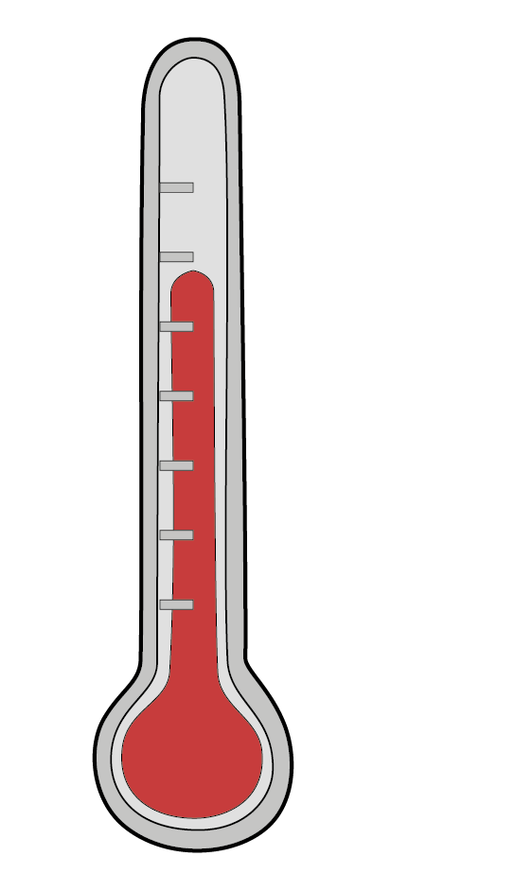
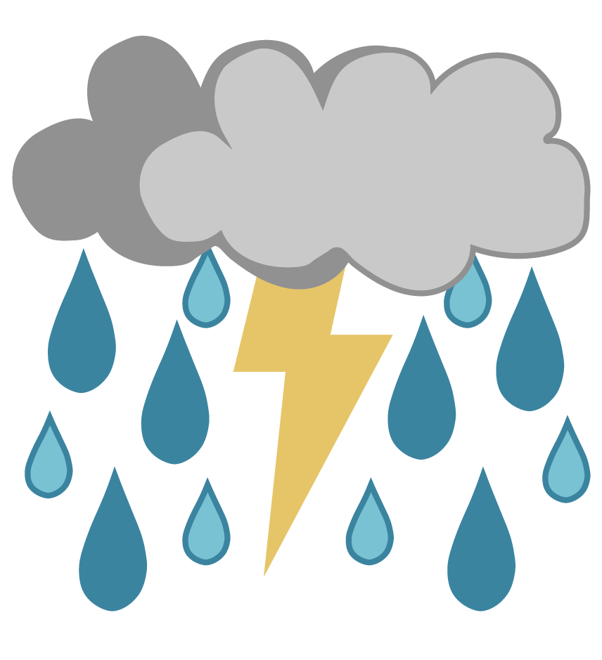
FT Q C07 R3
Weather vs Climate…What’s the Difference?
Can anybody tell me what weather and climate are and the difference between them?

Slide 3
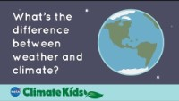
FT Q C07 R3
Weather vs Climate…What’s the Difference?
NASA Climate Change YouTube video

Slide 4

FT Q C07 R3
Weather vs Climate…What’s the Difference?
Weather -
Sunshine, rain, thunderstorms, wind and snow are all examples of weather. The weather is described as what is happening outside right now. It is temporary and only lasts a few days and weeks.
Climate -
Climate is a description of the weather conditions in an area over the last 30 years.

Slide 5
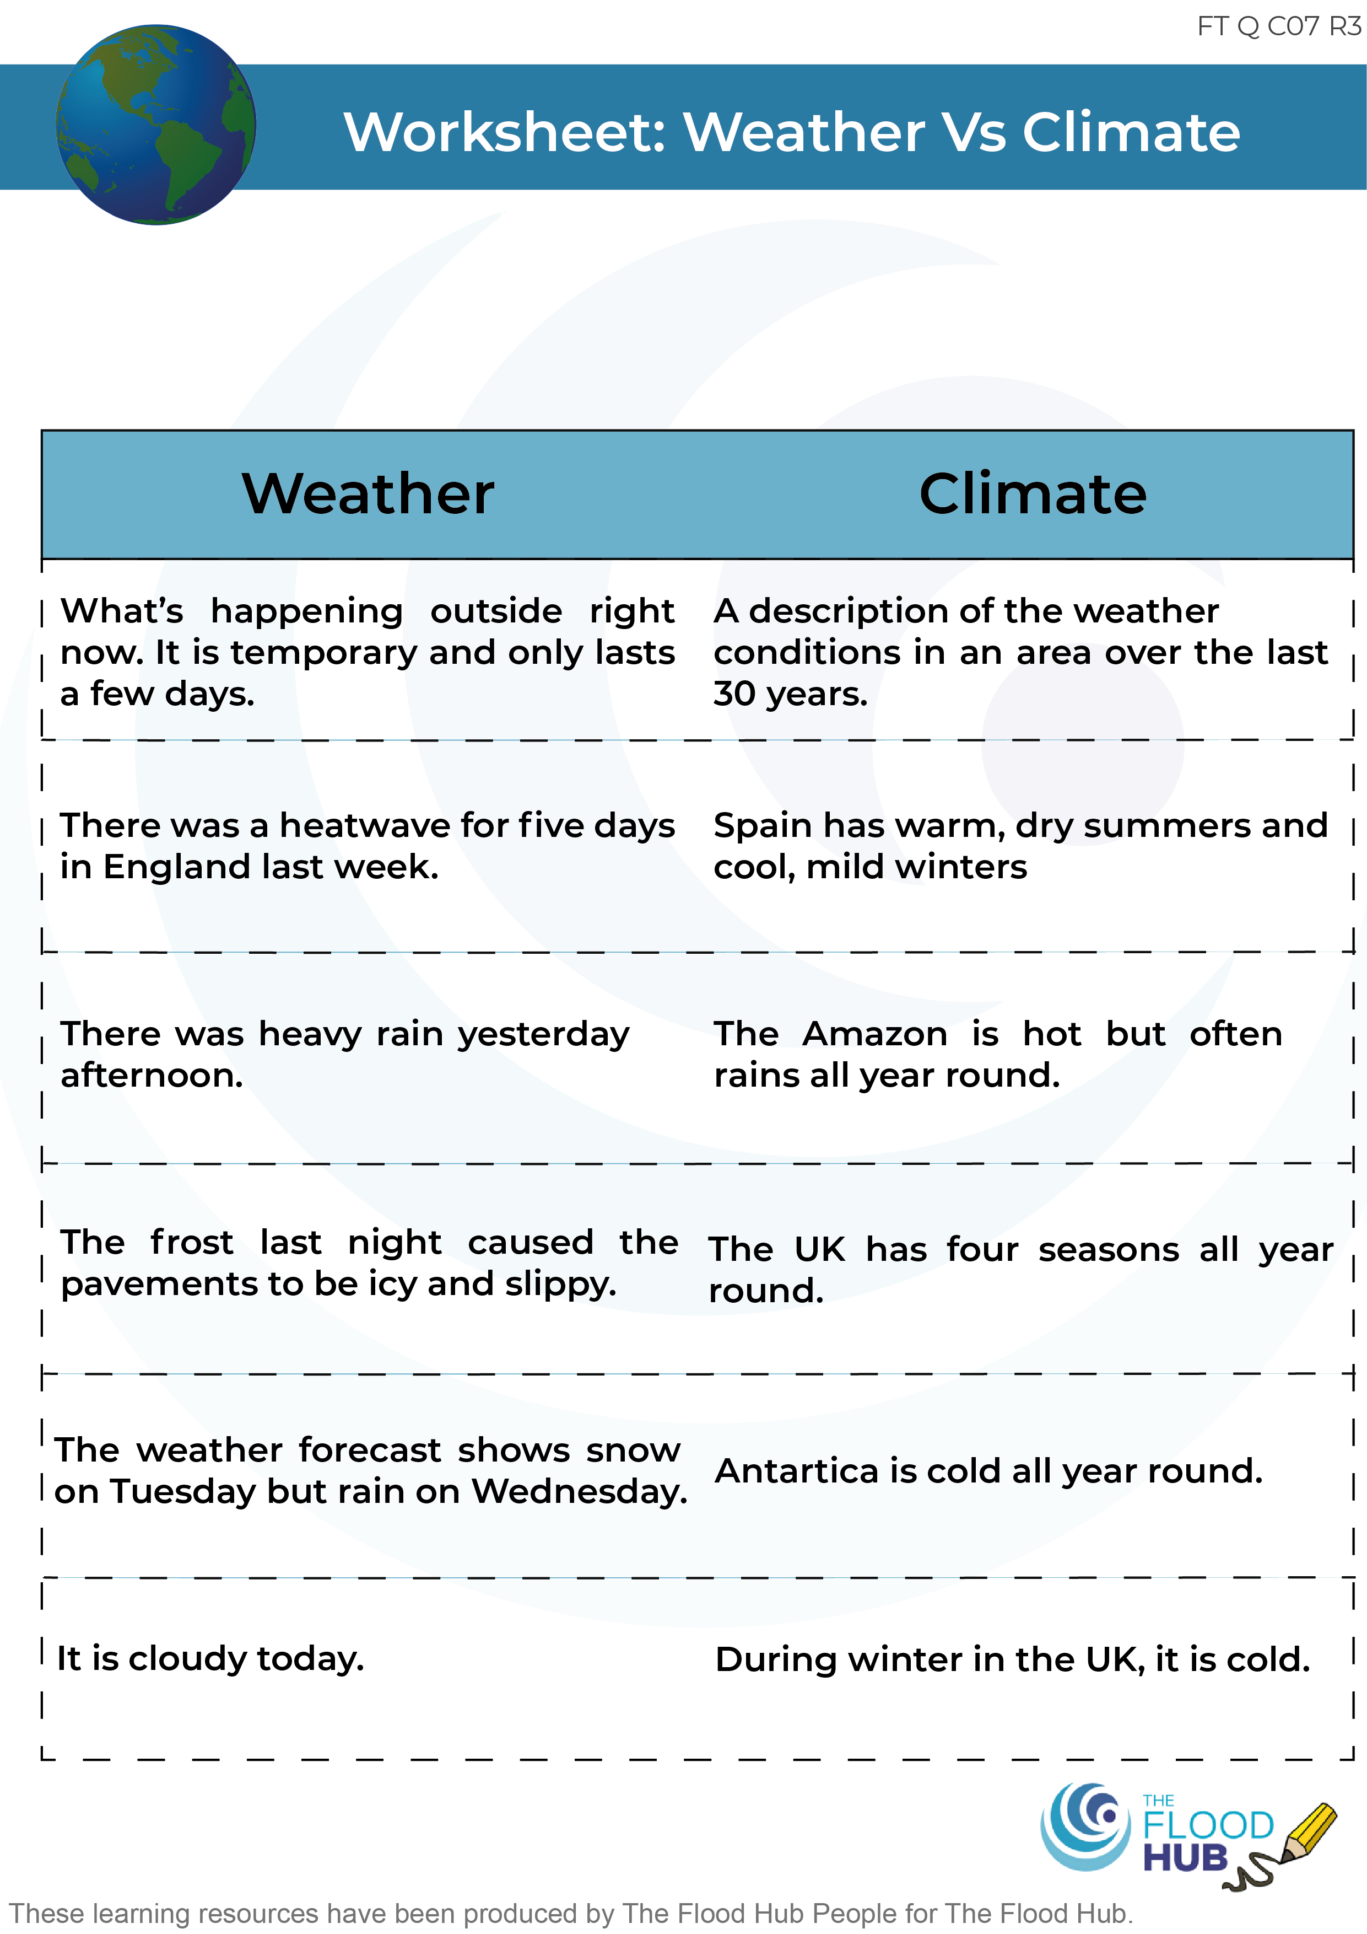
FT Q C07 R3
Weather vs Climate…What’s the Difference?
Cut out the cards and spread them out on the table. Firstly, find two cards, one which defines weather and the other, climate. Then, pick up and read the remaining cards and decide whether they are statements which better describe the weather or climate. Once the cards are in the correct columns, stick them on the worksheet and put into your workbook.

Slide 6
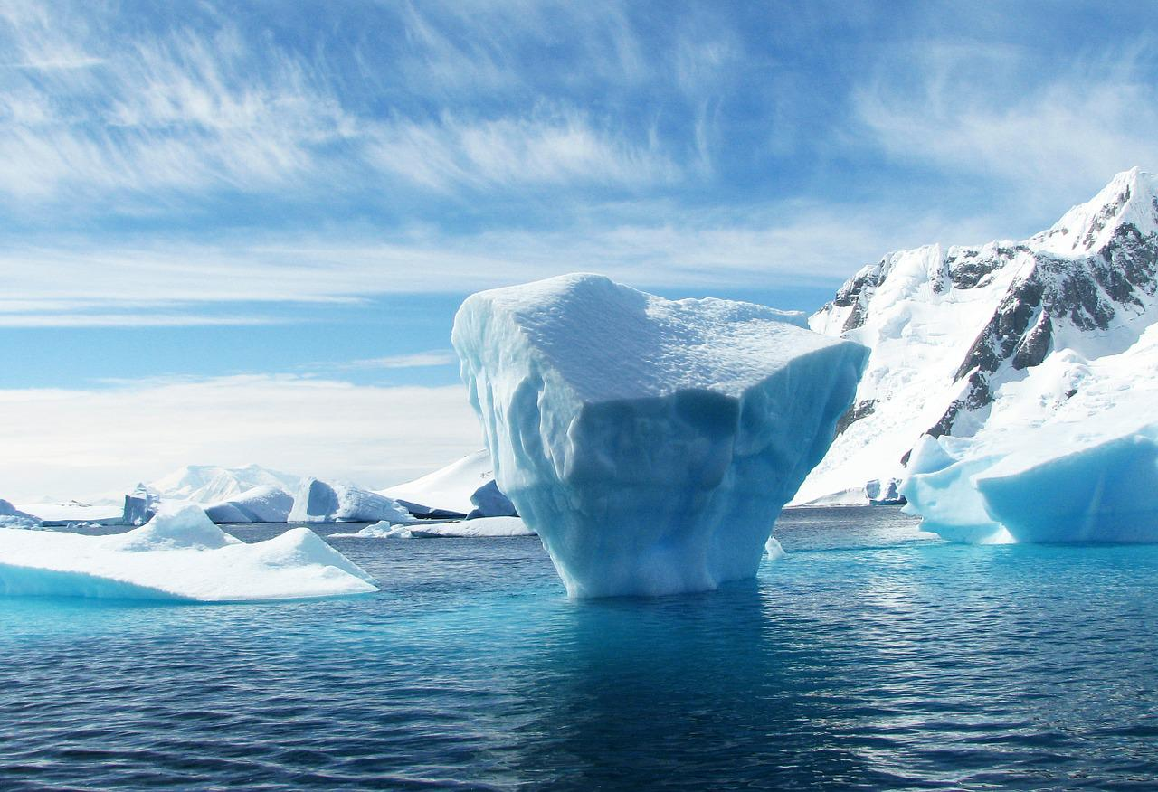

FT Q C07 R3
Types of Climate
Polar
Cold all year round with lots of snow and ice.
Areas with a polar climate include Antarctica and the Arctic.
Image: 358611 from Pixabay

Slide 7
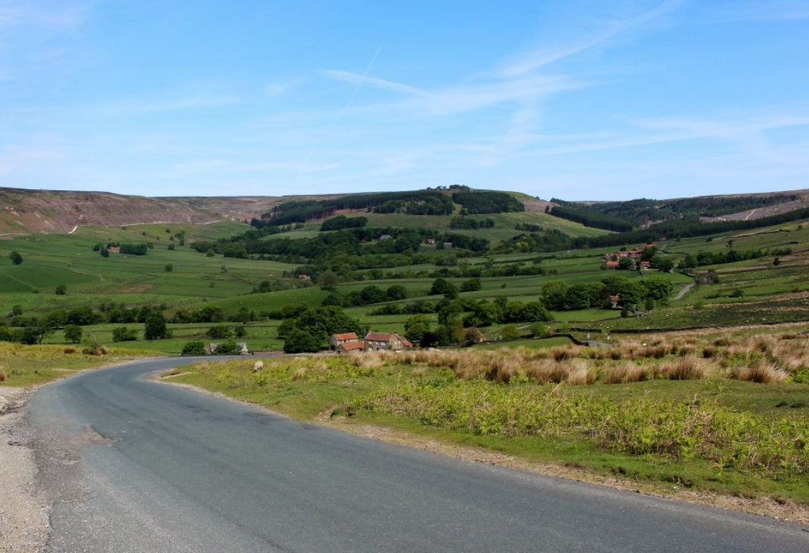
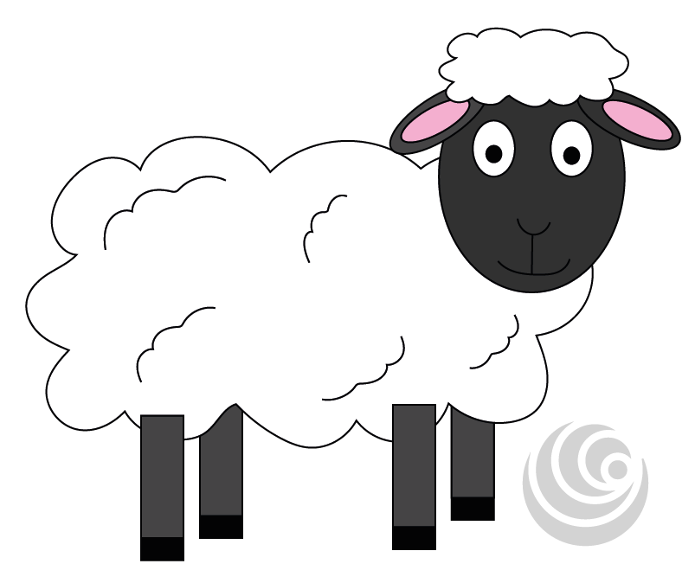
FT Q C07 R3
Types of Climate
Temperate
Temperate climates have four main seasons – spring, summer, autumn and winter.
We have a temperate climate in the UK.

Slide 8
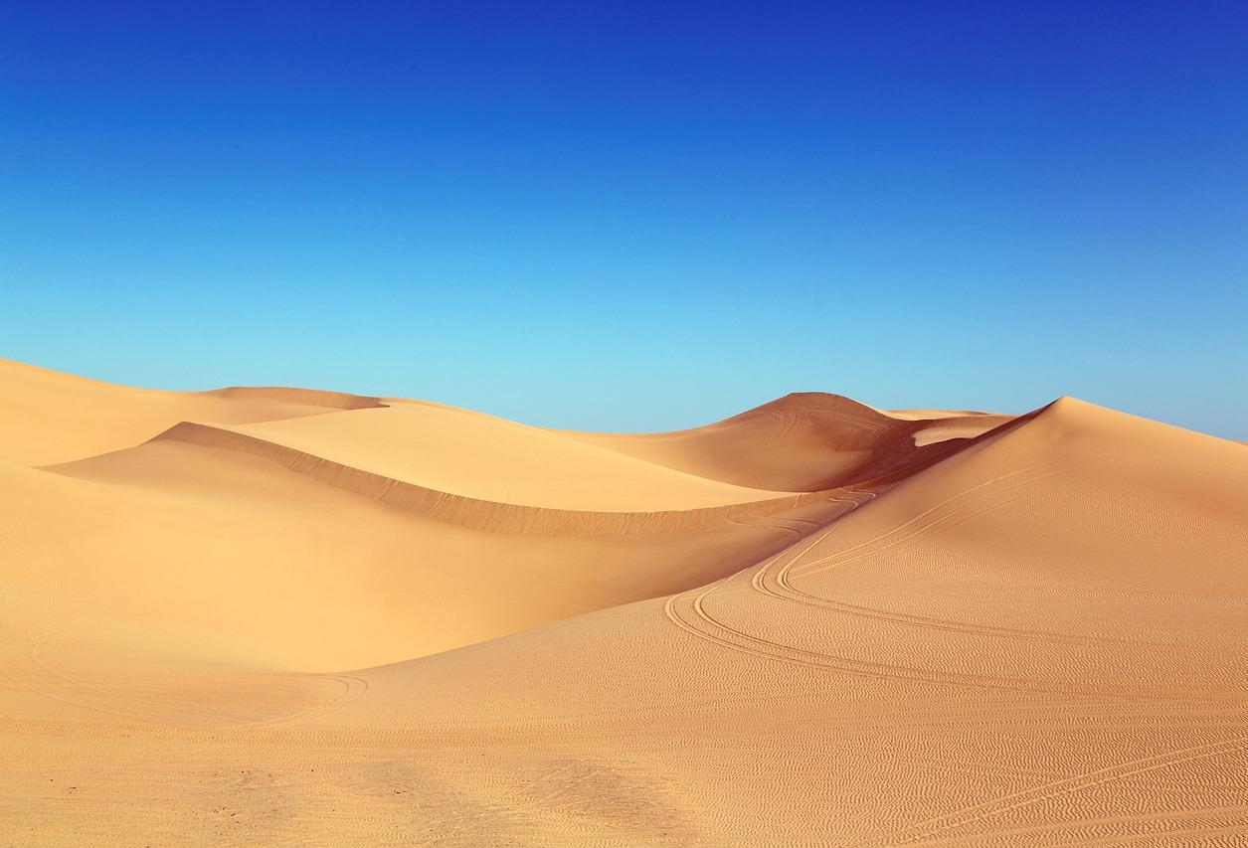

FT Q C07 R3
Types of Climate
Desert/Arid
A desert/arid climate is very, very hot as it rarely rains.
There are lots of hot desert climates across North Africa, e.g the Sahara Desert.
Image by Falkenpost on Pixabay

Slide 9


FT Q C07 R3
Types of Climate
Tropical
Tropical climates are hot all year round but very wet as it rains a lot.
The Amazon rainforest in Central America is an example of an area with a tropical climate.
Photo by Pexels from Pixabay

Slide 10
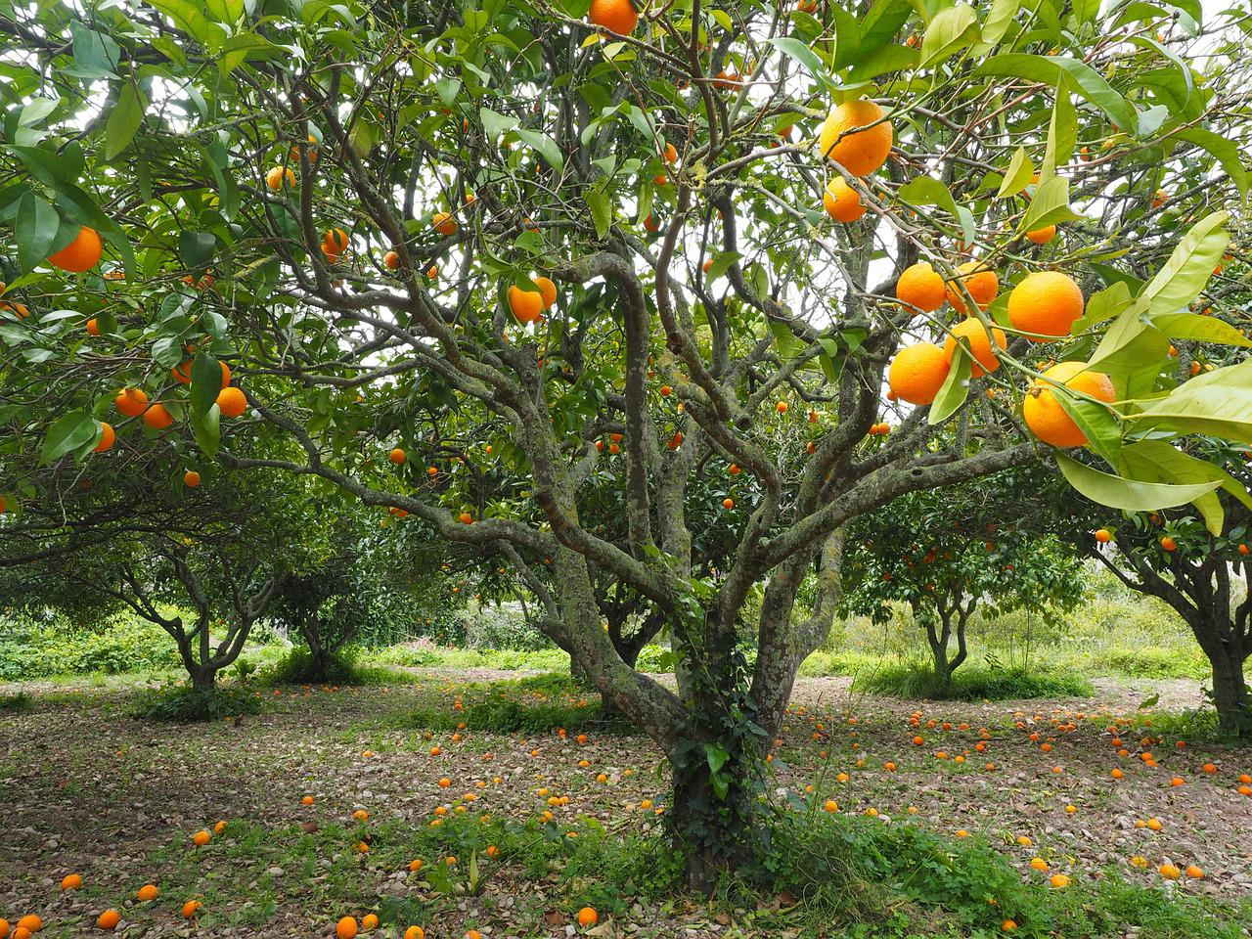
FT Q C07 R3
Types of Climate
Mediterranean
Mediterranean climates have warm, dry summers and cool, mild winters.
An example of an area with a Mediterranean climate is Southern Spain.
Photo by Hans from Pixabay

Slide 11
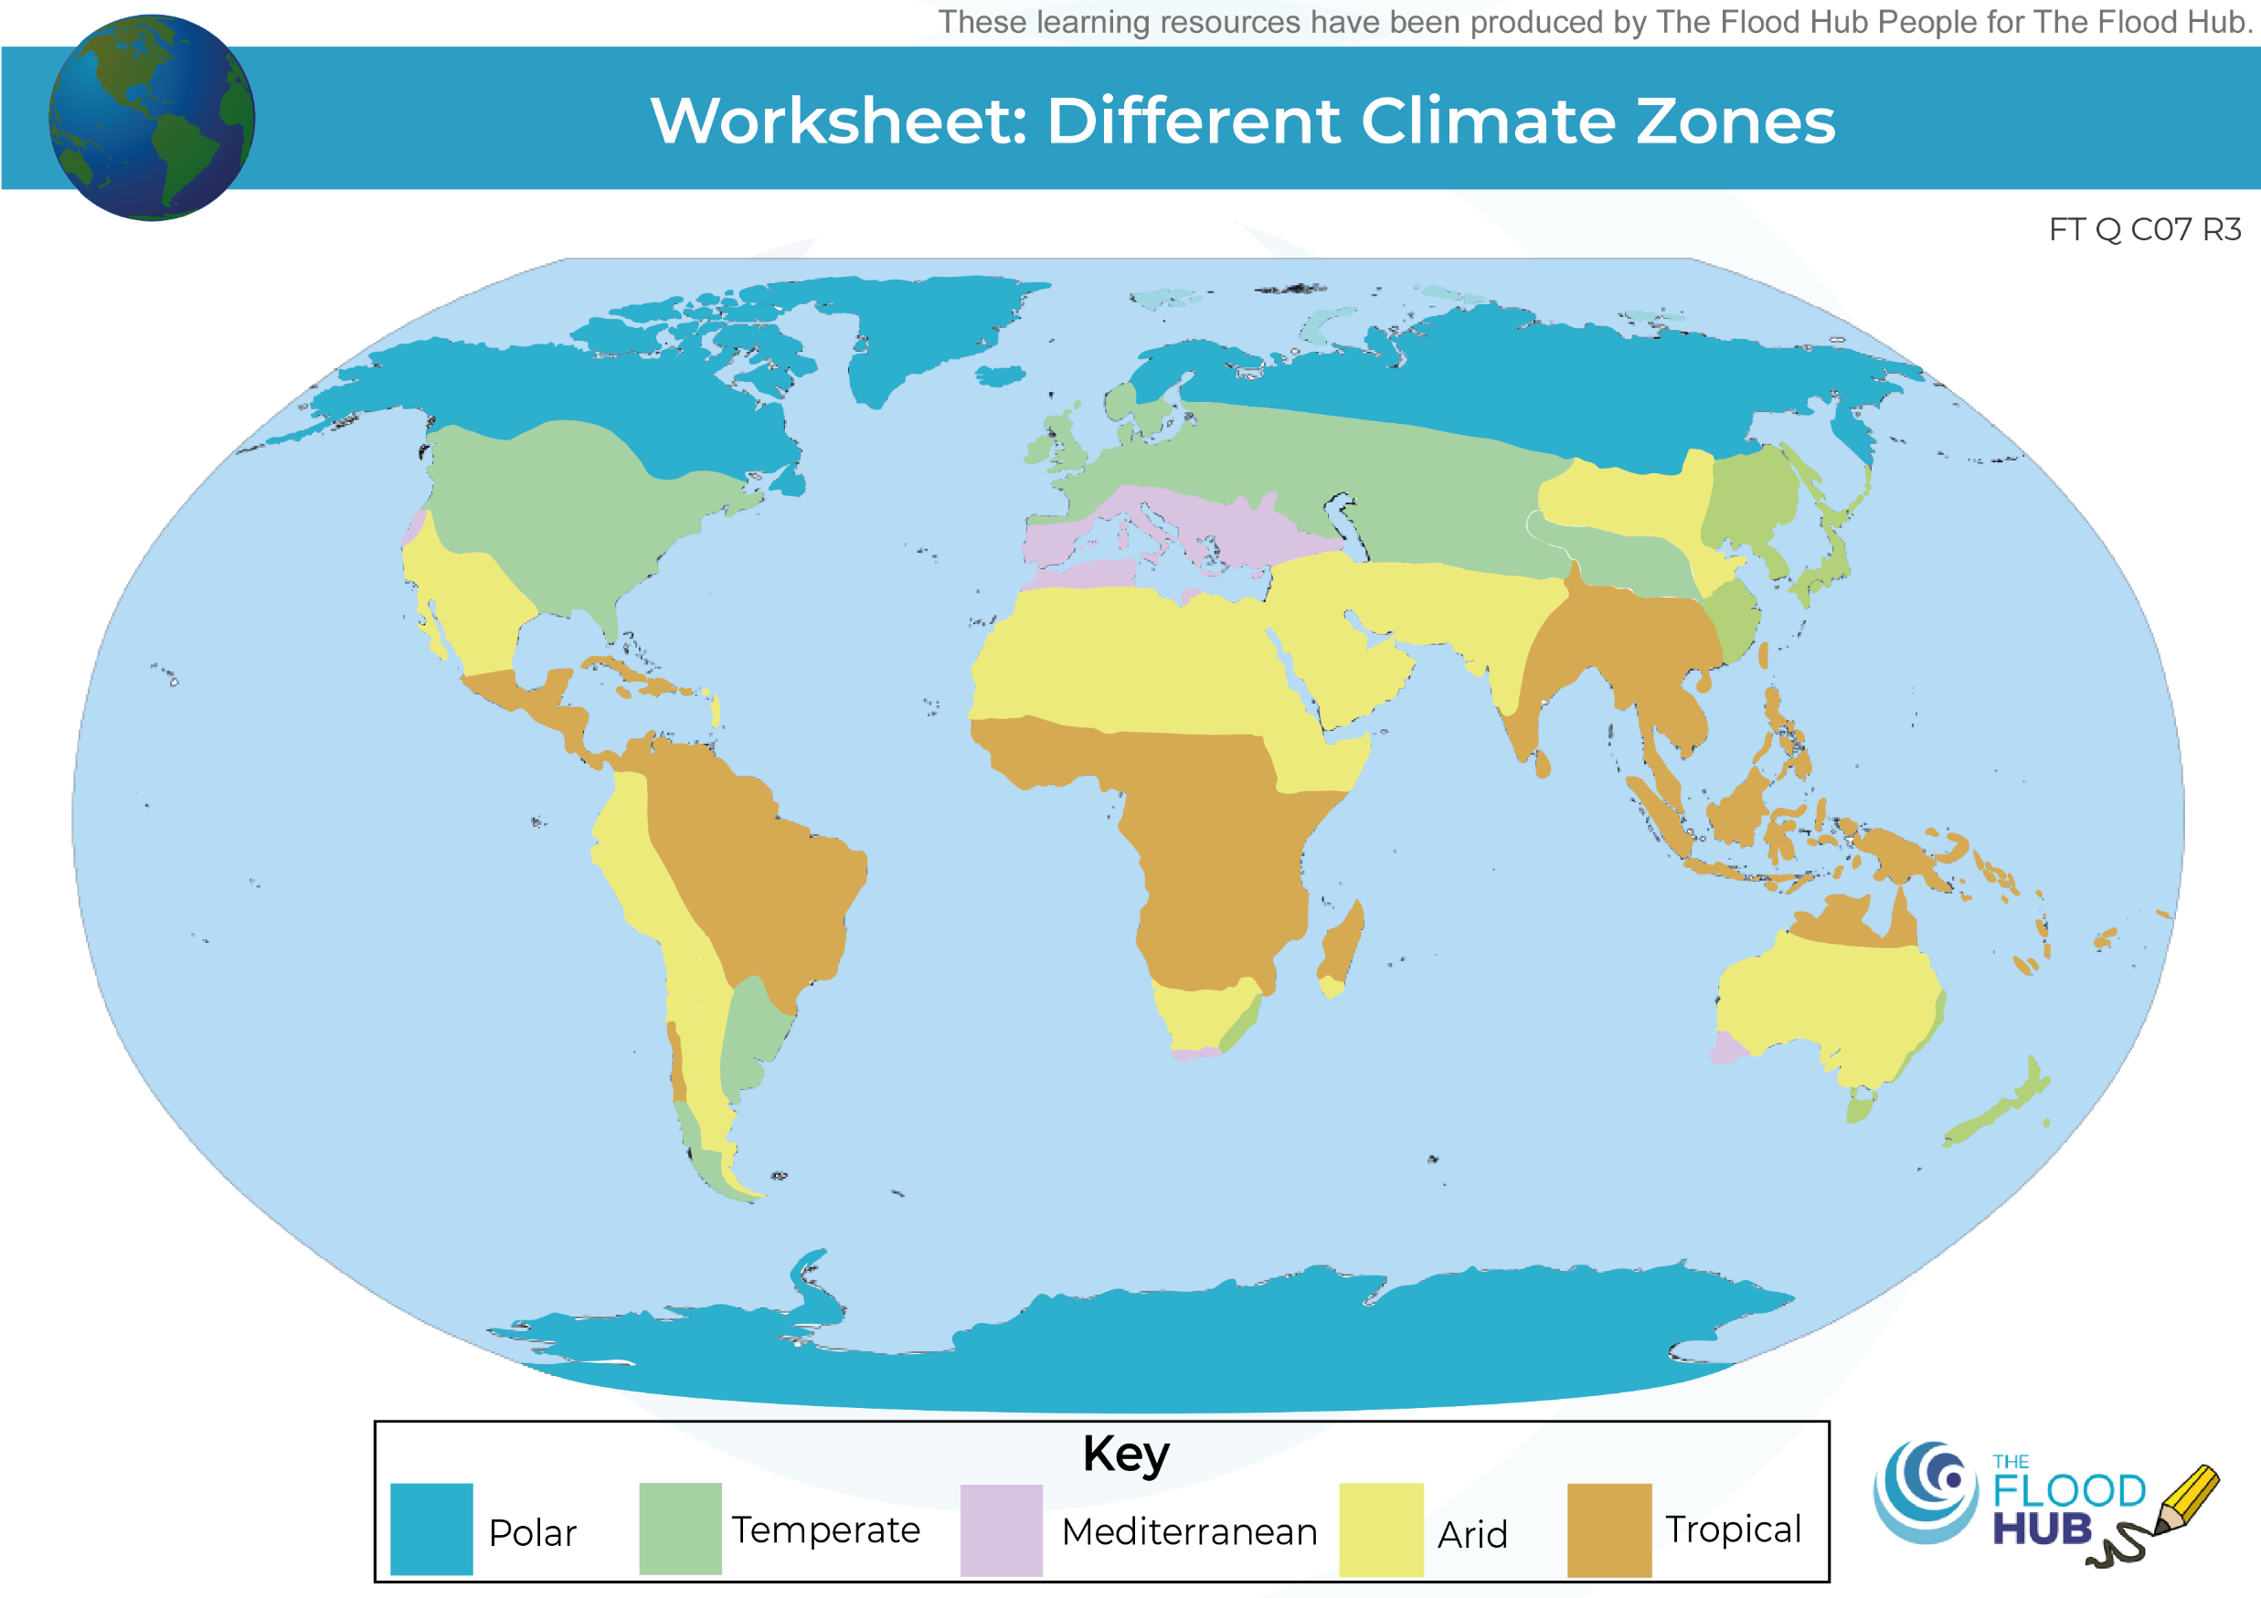
FT Q C07 R3
Climate Zones across Earth

Slide 12
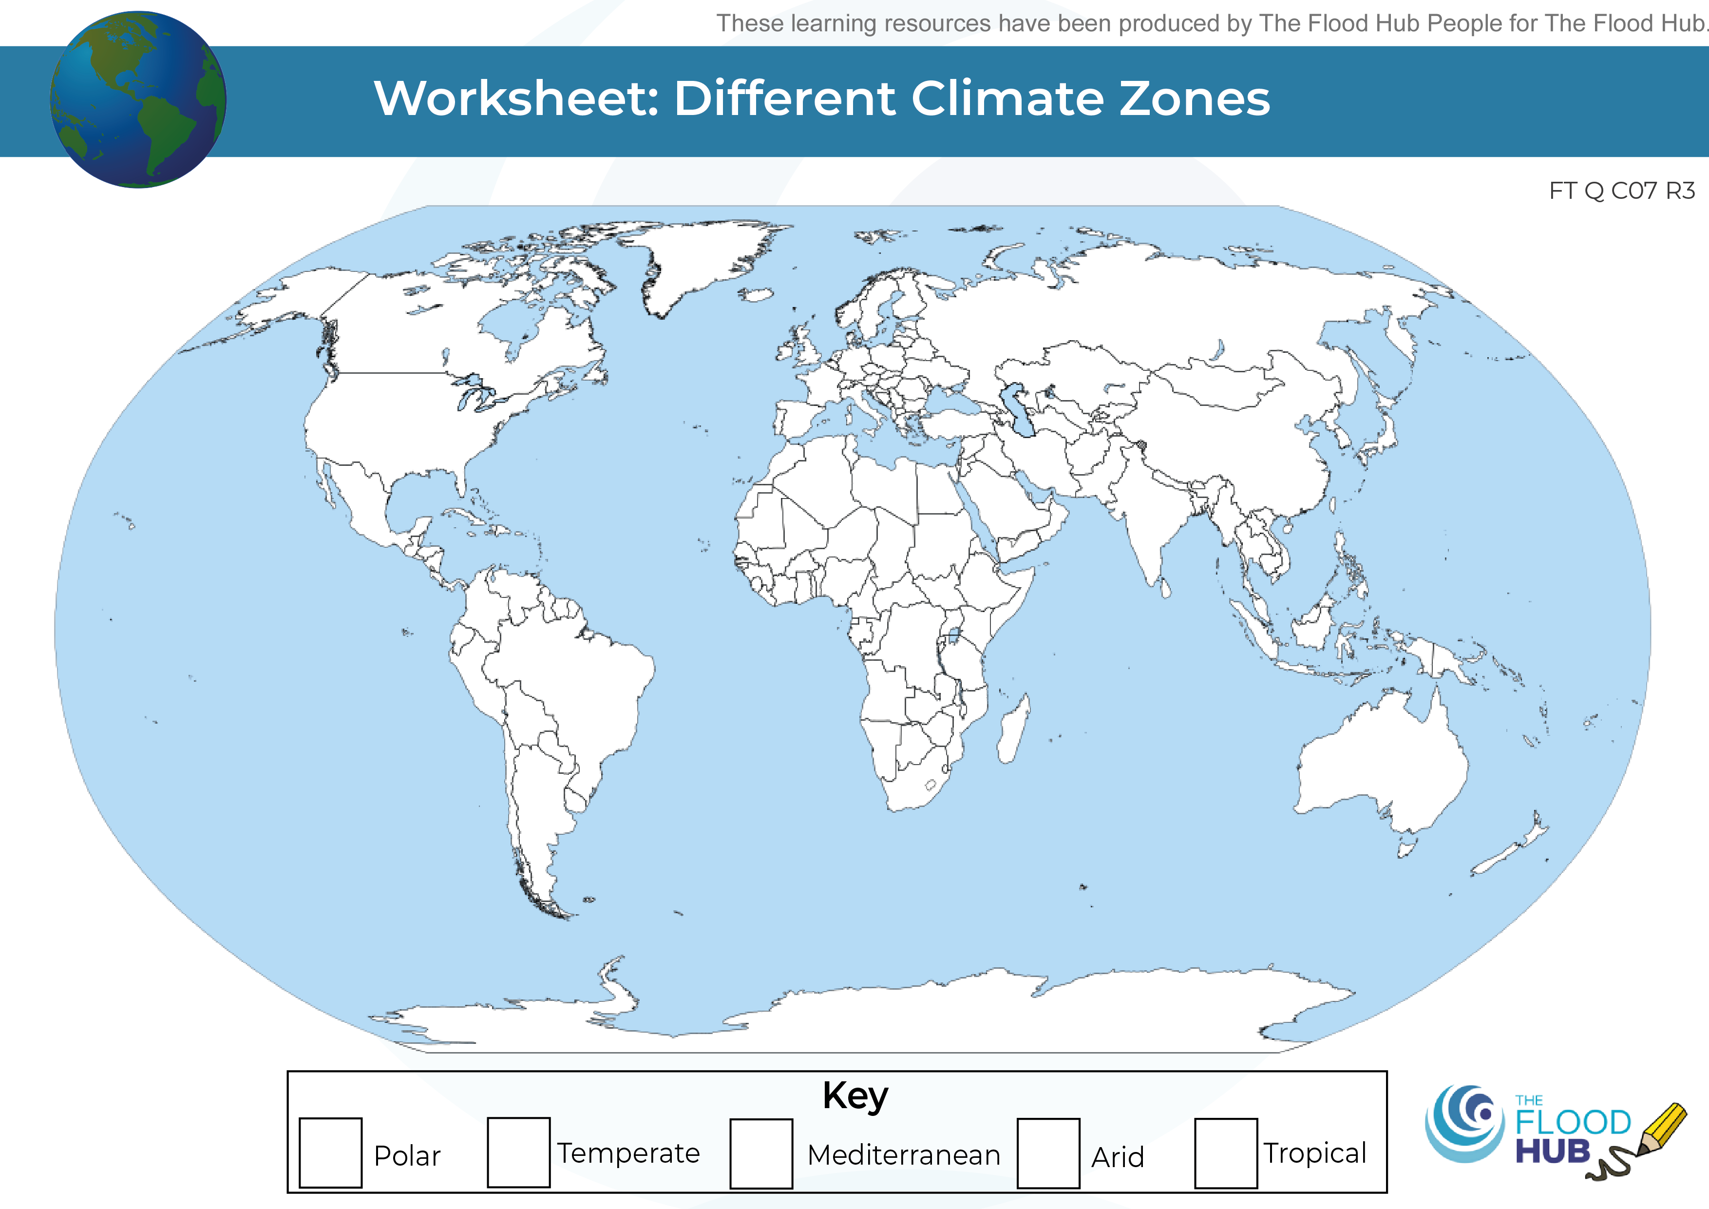
FT Q C07 R3
Climate Zones across Earth
Colour in the climate zone map and label each climate zone.

Slide 13
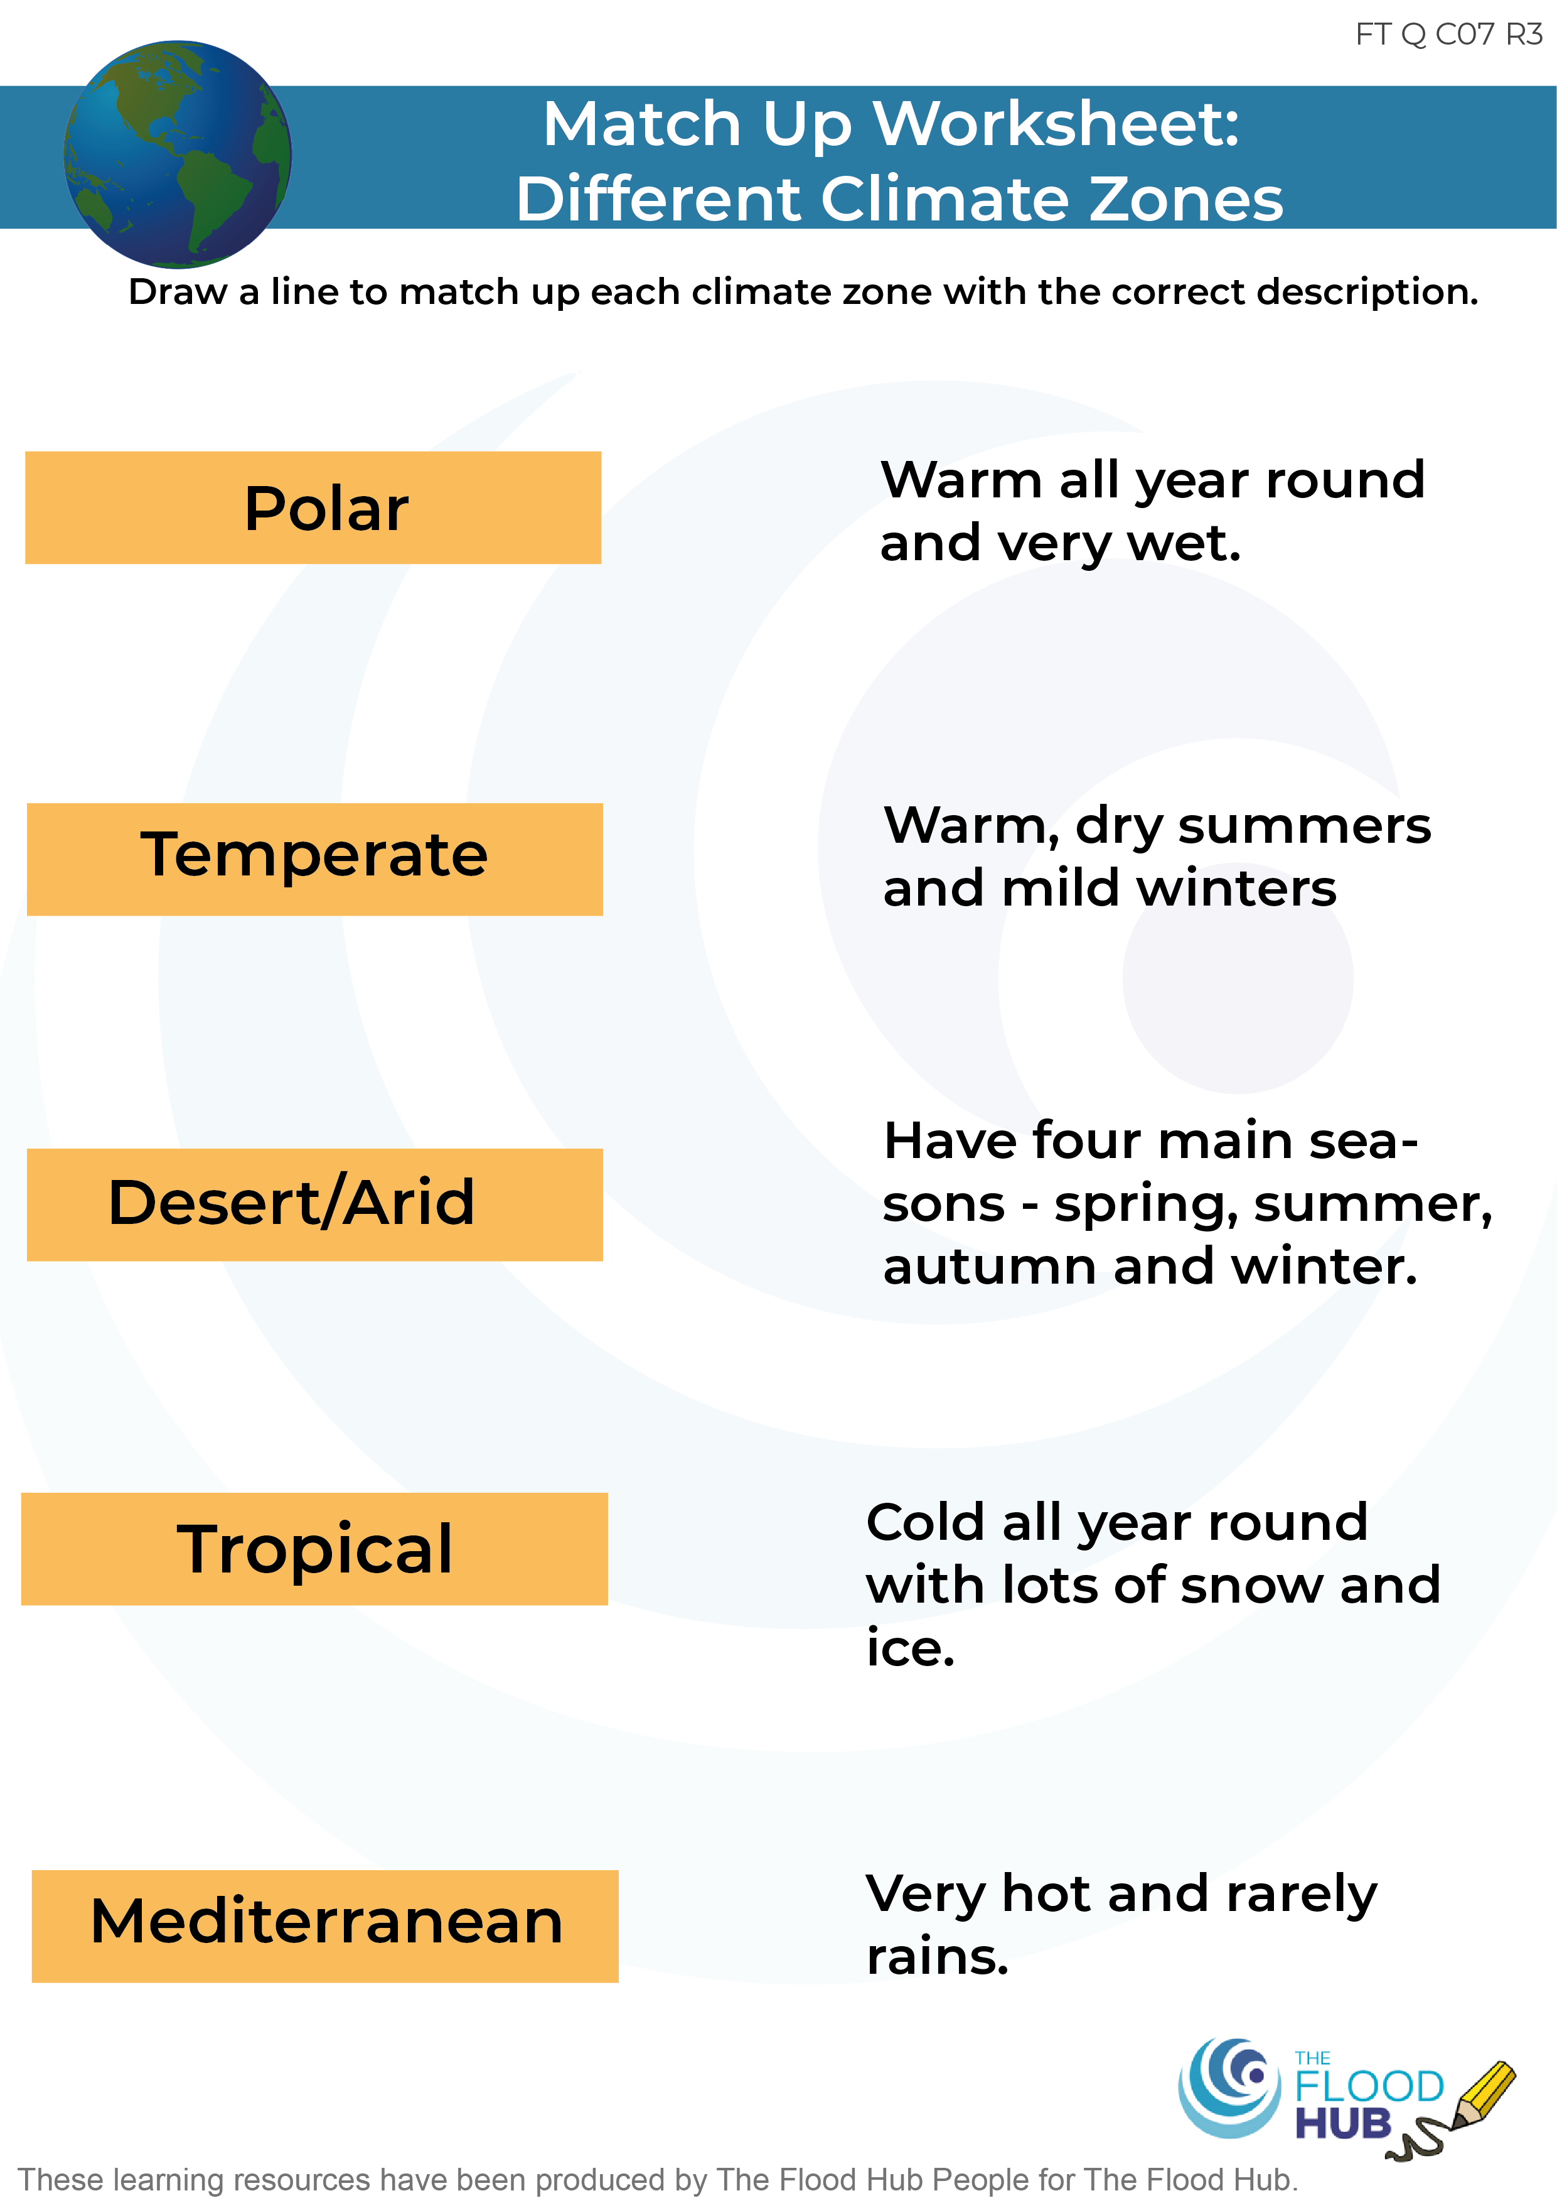
FT Q C07 R3
Climate Match Up Exercise

Slide 14
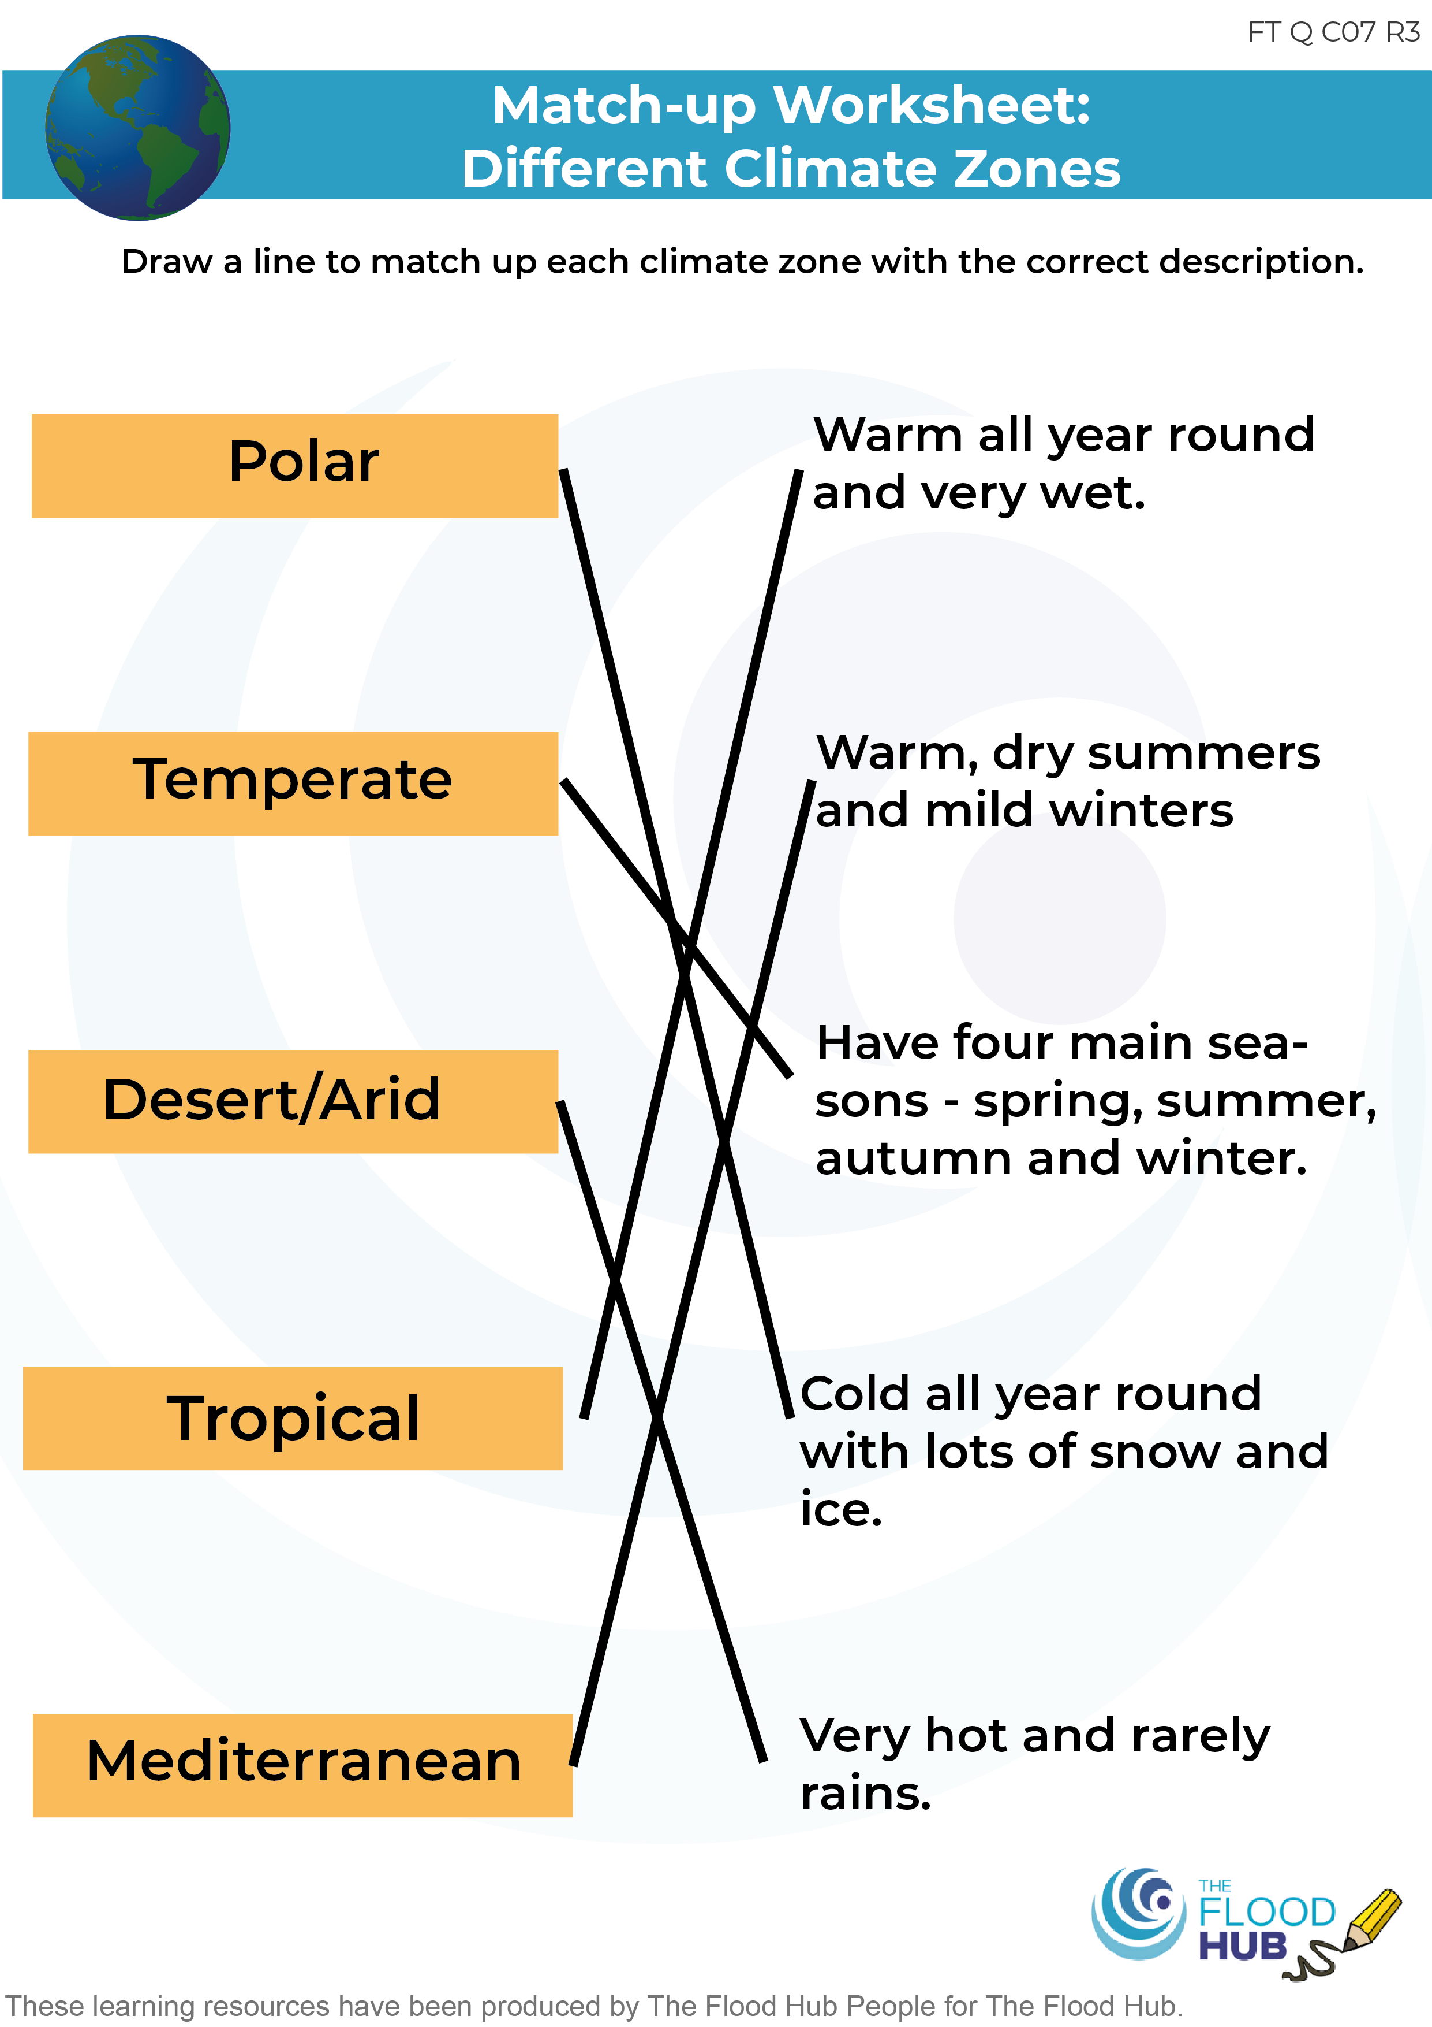
FT Q C07 R3
Climate Match Up Exercise

Slide 15
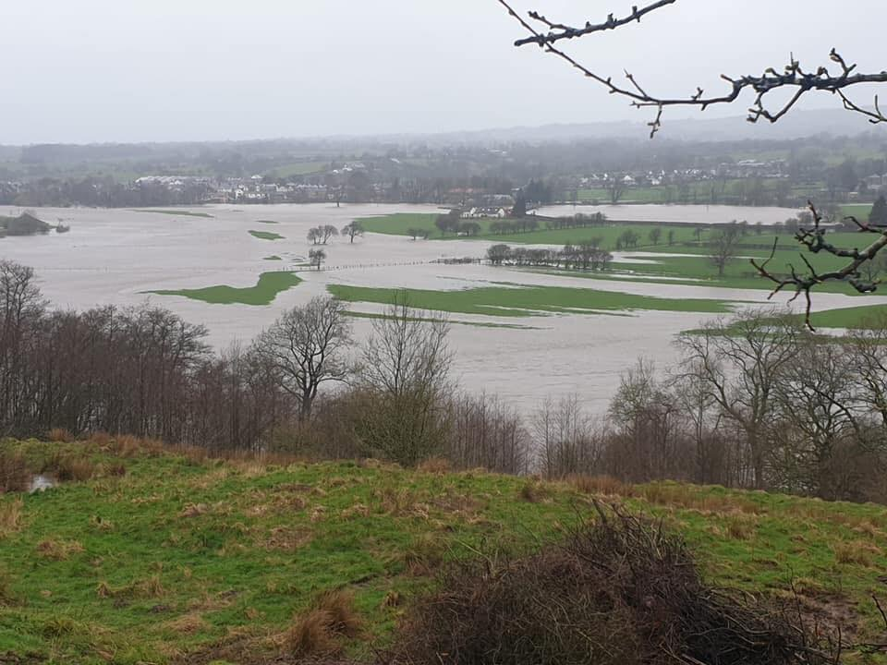
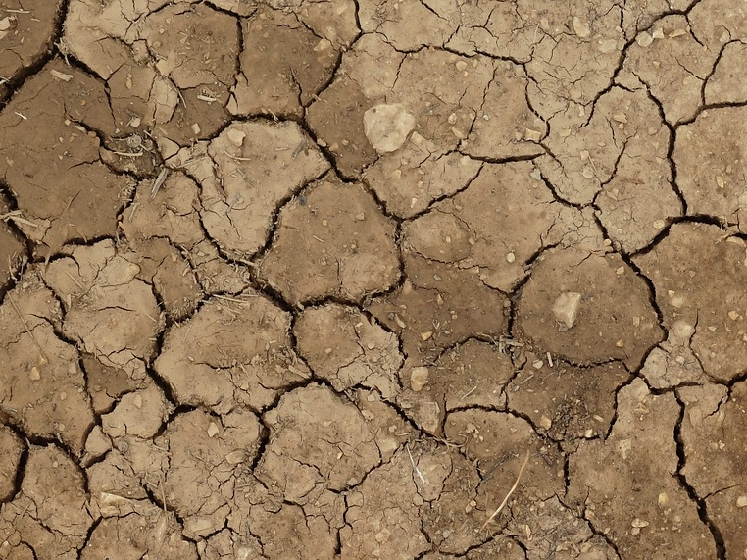
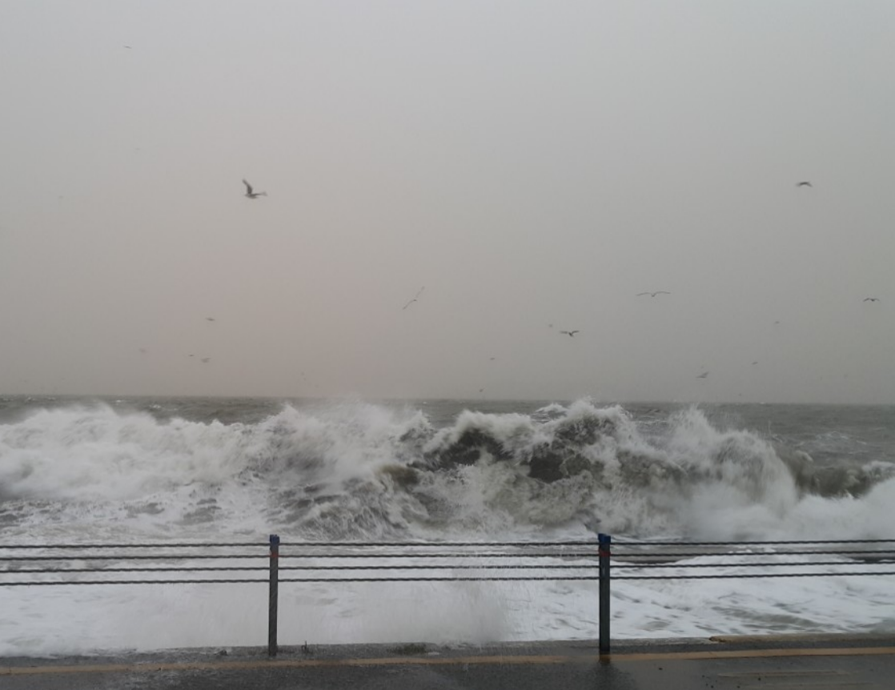
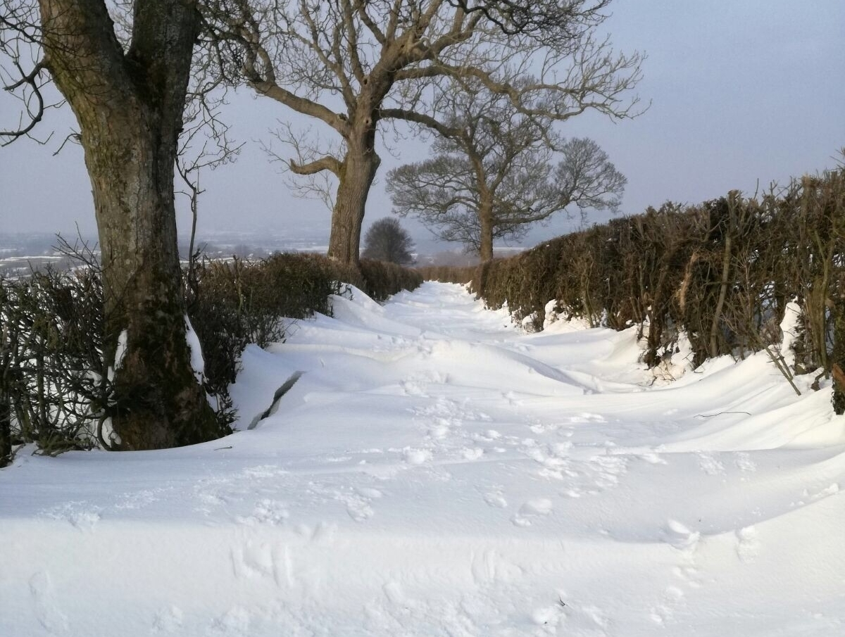
FT Q C07 R3
The Effects of Climate Change
Extreme Weather
Extreme weather is when the weather is very different from normal. Examples of extreme weather events in the UK are:
Image: The Flood Hub
Storm surge
cc-by-sa/2.0 - © David Baird - geograph.org.uk/p/3833138
Image: The Flood Hub
Heavy rain and flooding
Heatwaves and droughts
Strong winds and storms
Heavy snowfall & blizzards
These are becoming more common with climate change.

Slide 16
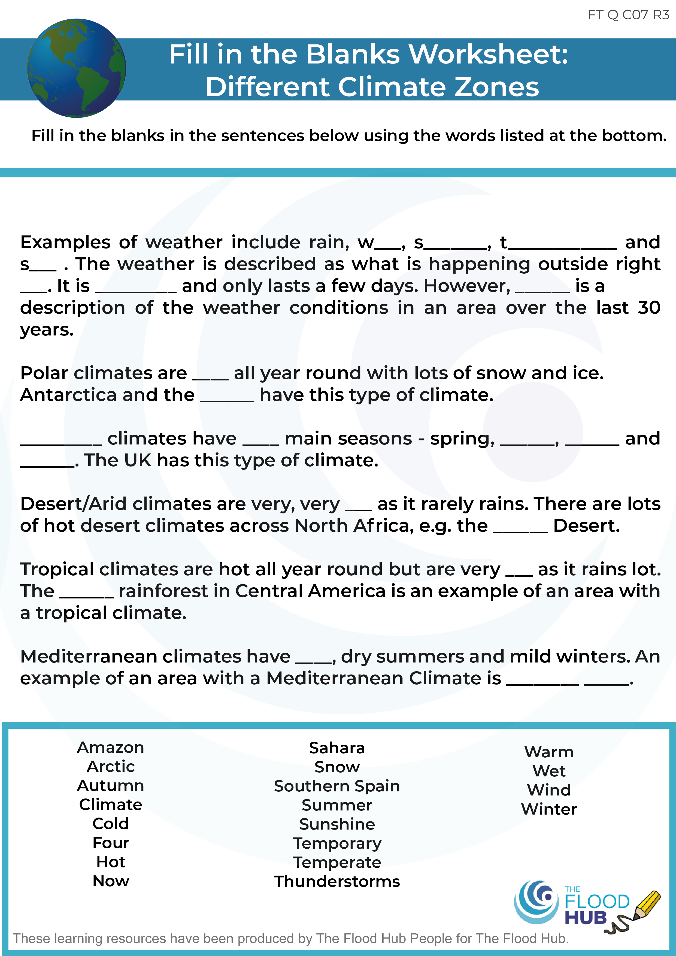
FT Q C07 R3
Homework
Complete the ‘fill in the blanks’ worksheet all about what we have learnt in class today.
Name three animals that you will find in each climate zone on the back of the worksheet.

Slide 17

FT Q C07 R3
These lessons have been produced by
The Flood Hub People for The Flood Hub.
Scan the QR code to access our ‘Learning’ section. Or visit here: https://thefloodhub.co.uk/learning/

