Slide 1




FT Q C010 R2
How can we Reduce the Effects of Climate Change?
Lesson aim:
To be able to name some of the steps that we can all take to reduce the effect of climate change.
Lesson objectives:
To name some steps that we can do to reduce the effect of climate change and why.
To recognise what can be done at school to reduce climate change.
To spread awareness of climate change to a wider audience (Adults at home and the wider school).

Slide 2

FT Q C010 R2
Lesson Recap
Can you name any impacts of climate change?
Extreme weather
Temperature rise
Sea-level rise
Ecosystems
Impacts on human health
Impacts to transport links and buildings
Food
Air quality

Slide 3
FT Q C010 R2
How can we Reduce the Effects of Climate Change?
Use public transport
Lots of people and households have cars, which can be bad for the environment as they contribute to global warming and cause air pollution.
Many run off petrol and diesel (which come from fossil fuels) and they emit a lot of carbon dioxide (CO2)
Other than by car,
What other ways could you travel?

Slide 4
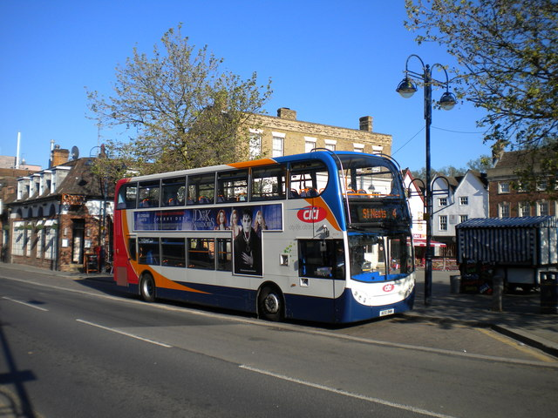
FT Q C010 R2
How can we Reduce the Effects of Climate Change?
Instead, we can travel by…
Bus
Bus on High Street, St Neots
cc-by-sa/2.0 - © Richard Vince - geograph.org.uk/p/3091353

Slide 5
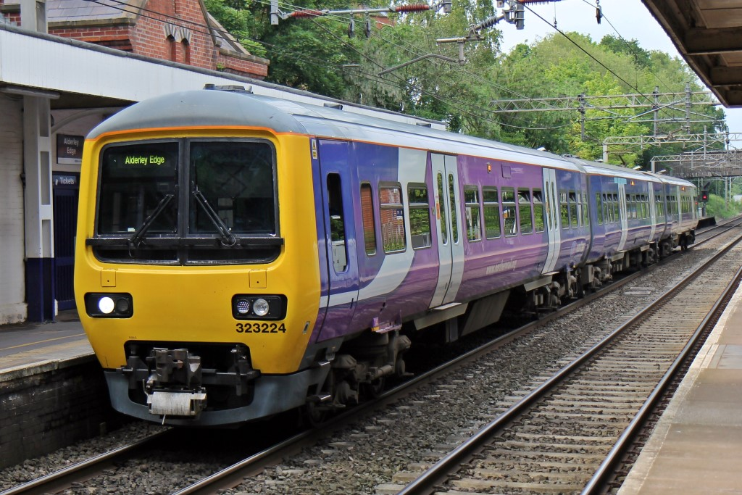
FT Q C010 R2
How can we Reduce the Effects of Climate Change?
Instead, we can travel by…
Train
Northern Rail Class 323, 323224, Alderley Edge railway station
cc-by-sa/2.0 - © El Pollock - geograph.org.uk/p/4524576

Slide 6
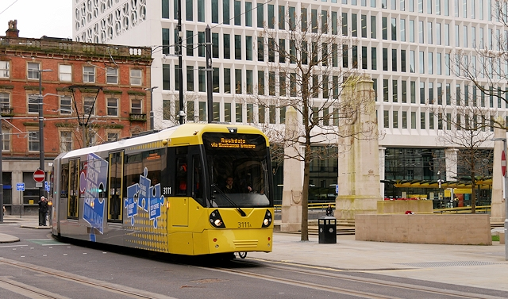
FT Q C010 R2
How can we Reduce the Effects of Climate Change?
Instead, we can travel by…
Tram
Metrolink Second City Crossing, Manchester Cenotaph
cc-by-sa/2.0 - © David Dixon - geograph.org.uk/p/5301785

Slide 7
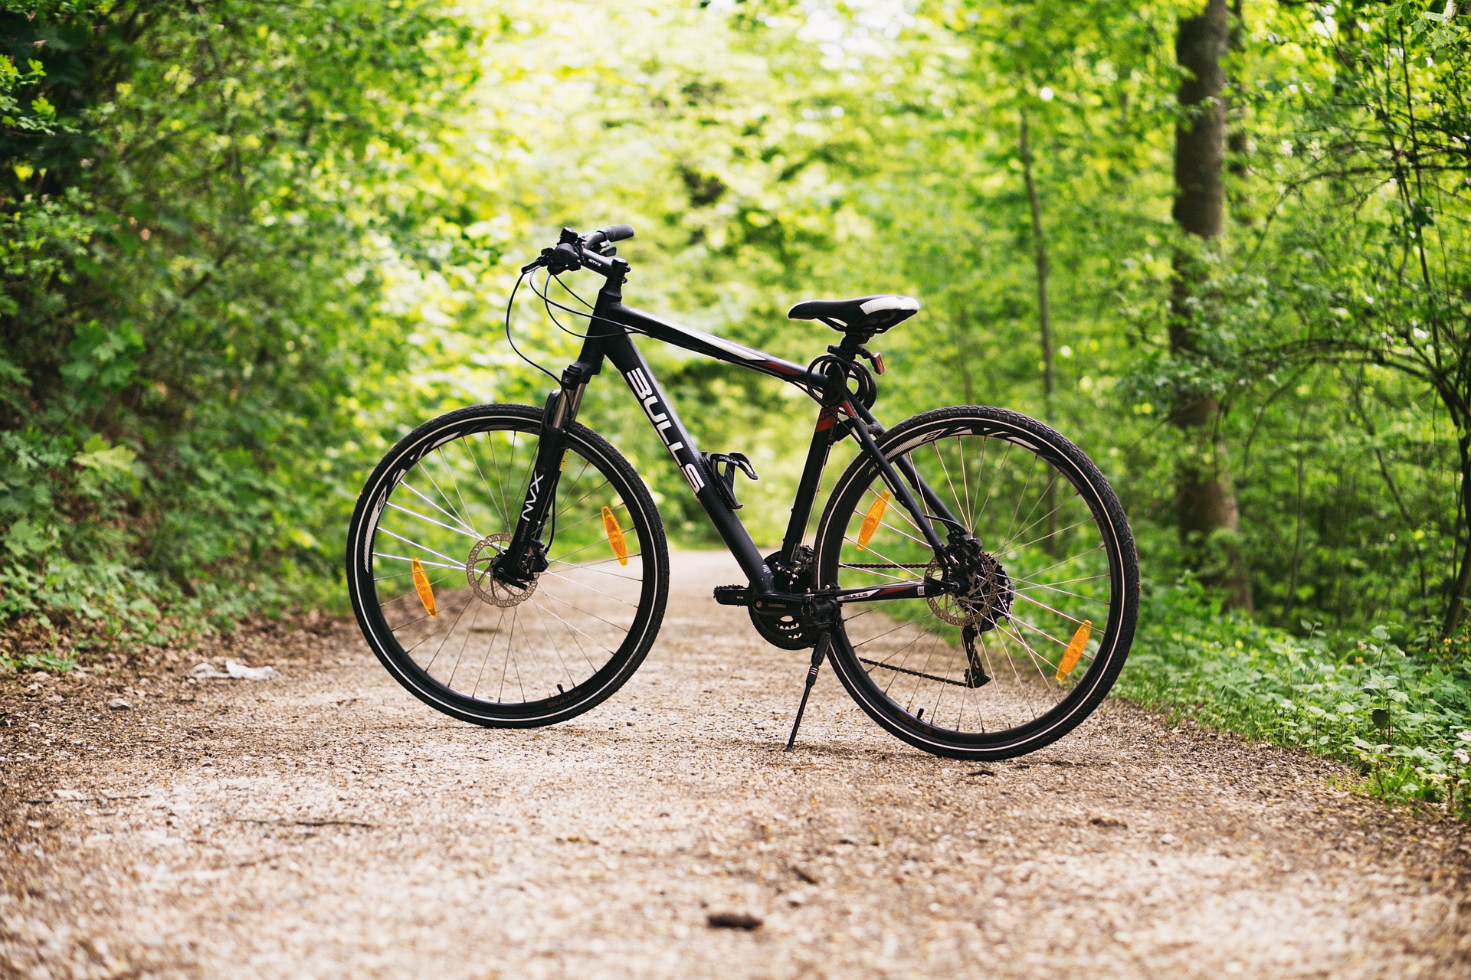
FT Q C010 R2
How can we Reduce the Effects of Climate Change?
Instead, we can travel by…
Bike
Image by Pexels on Pixabay

Slide 8

FT Q C010 R2
How can we Reduce the Effects of Climate Change?
Instead, we can travel by…
Walk

Slide 9
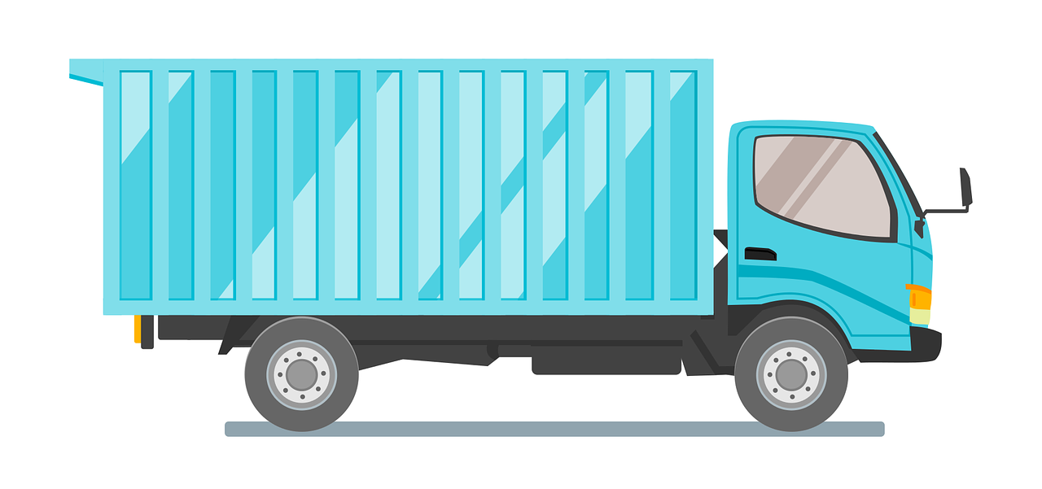
FT Q C010 R2
How can we Reduce the Effects of Climate Change?
Eat locally grown and seasonal food
Supporting UK farmers and buying food which is grown and produced in the UK can reduce the impact of the food industry on the environment as it reduces food miles.
Food miles = the distance food must travel in order to be on your plate.
Image of 200 Degrees on Pixabay
Sometimes, we eat foods that have been produced in different countries and transported to us on planes, boats and lorries which release greenhouse gases into the atmosphere.

Slide 10
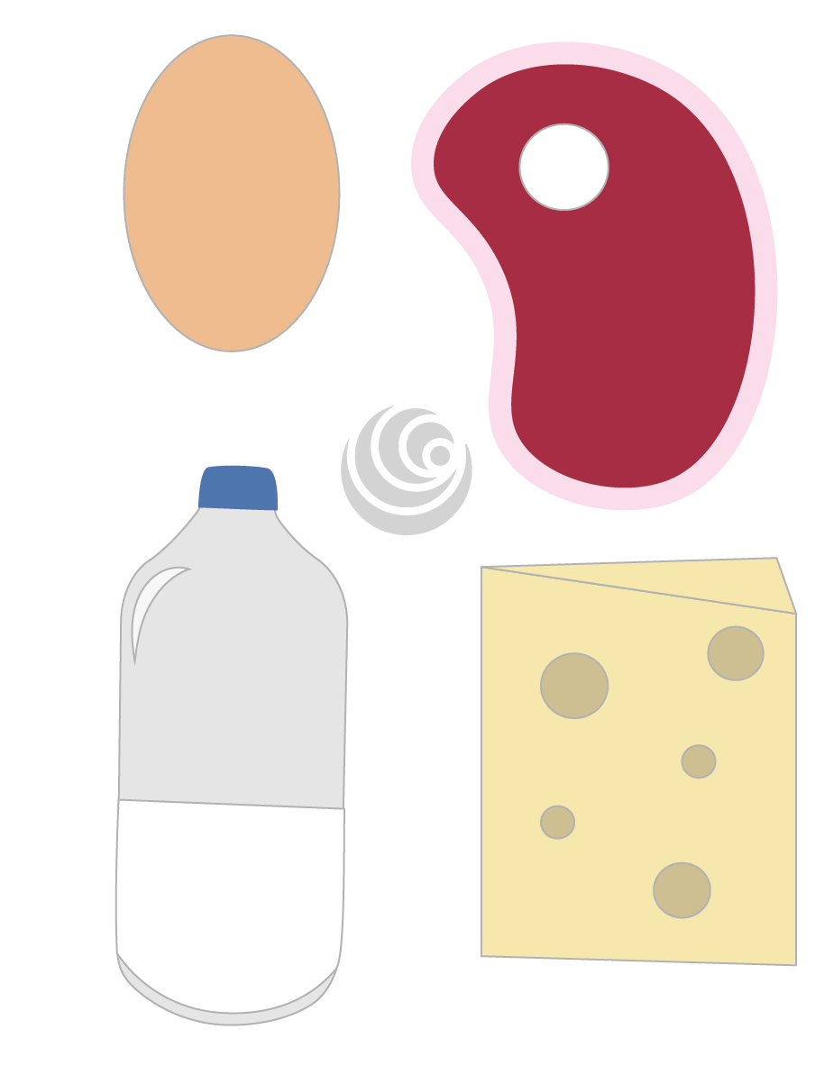
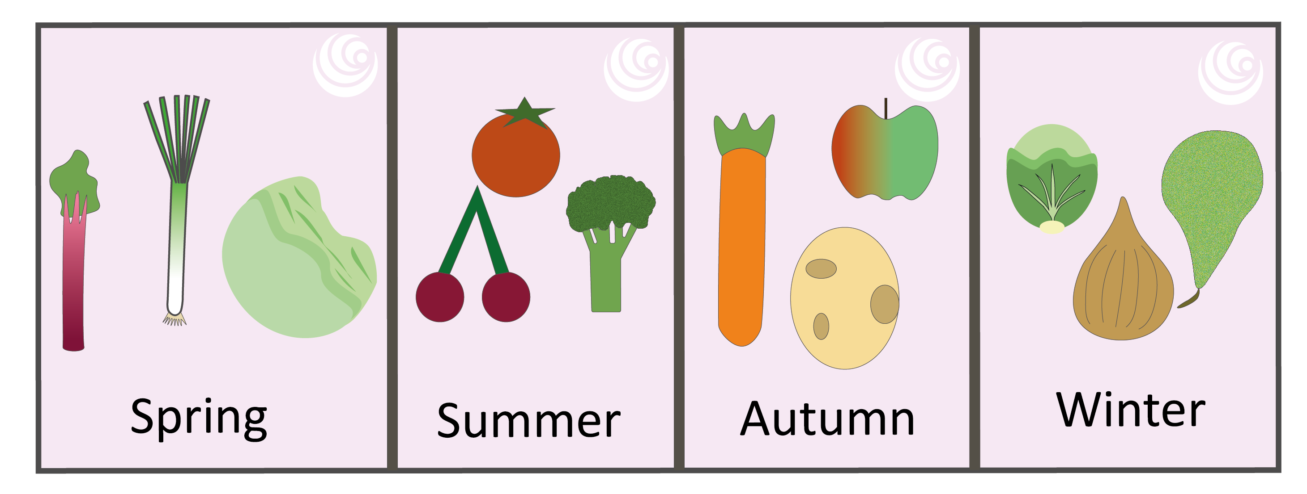
FT Q C010 R2
How can we Reduce the Effects of Climate Change?
Even though some fruits and vegetables are imported into the UK, lots can be grown and consumed seasonally in the UK. The UK also has ideal conditions to grow grass, therefore meat and other dairy products can be produced sustainably.

Slide 11
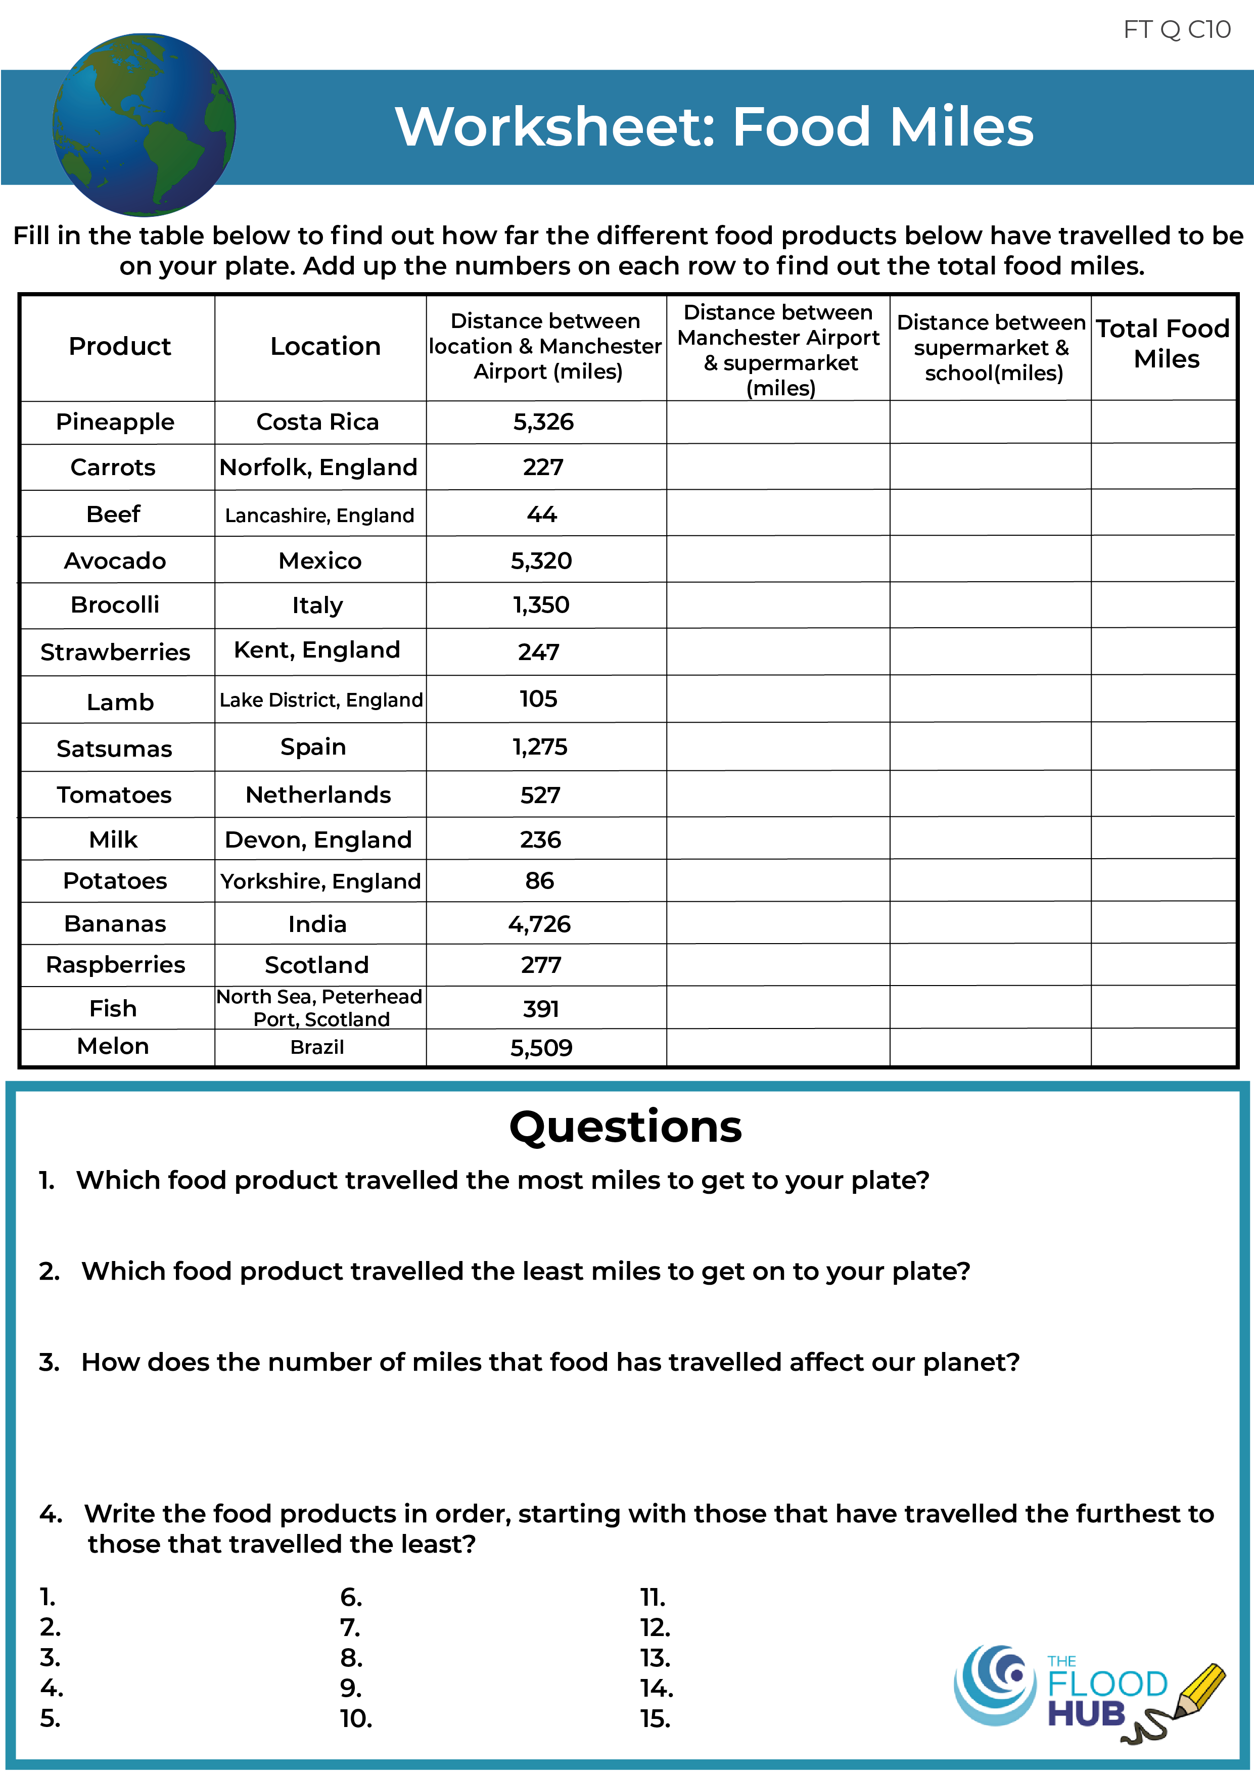
FT Q C010 R2
How can we Reduce the Effects of Climate Change?
Fill in the table and complete the worksheet to find out how many miles the products have travelled to arrive on your plate at school.

Slide 12
FT Q C010 R2
How can we Reduce the Effects of Climate Change?
Eat locally grown and seasonal food
In conclusion, we should:
Eat foods that have been grown and produced in the UK.
Eat seasonal food – certain foods in the UK are fresher, taste better and ready to eat at different times of year. For example, brussel sprouts grow best when the temperature is lower in winter, that’s why we see them at Christmas time.
Eating seasonally reduces food miles as we don’t import food from other countries and only eat different foods at certain times of year.

Slide 13

FT Q C010 R2
How can we Reduce the Effects of Climate Change?
Reduce, Reuse and Recycle Waste
Reduces the use of natural resources – By recycling waste and products, there is less reliance on the need for natural resources. For example, recycling products made from wood helps save trees and forests by stopping them being cut down.

Slide 14
FT Q C010 R2
How can we Reduce the Effects of Climate Change?
Reduce, Reuse and Recycle Waste
Saves energy – Reusing old products and/or making products from recycled materials uses less energy than making brand new ones from natural, raw materials.
  For example, the amount of energy saved from recycling one glass bottle could power an old 100-watt light bulb for 4 hours and a new low-energy LED equivalent for a lot longer.

Slide 15
FT Q C010 R2
How can we Reduce the Effects of Climate Change?
Reduce, Reuse and Recycle Waste
Reduces greenhouse gas emissions – with less waste being sent to landfill, there will be less methane released from waste.
  Also, less energy is used when recycling products compared to creating new ones, so there are less carbon emissions and other greenhouse gases released into the atmosphere.

Slide 16

FT Q C010 R2
How can we Reduce the Effects of Climate Change?
Plant more trees
Trees absorb carbon dioxide from the atmosphere and store it in their leaves and trunks.
Therefore, they can help to fight climate change because they absorb the extra carbon dioxide produced by fossil fuels.
Not only that, but trees also provide us with oxygen to breathe.

Slide 17
FT Q C010 R2
How can we Reduce the Effects of Climate Change?
Plant more trees
Check out this video by the
Woodland Trust here

Slide 18
FT Q C010 R2
How can we Reduce the Effects of Climate Change?
Reduce our energy usage
A lot of the electricity we use in our homes comes from fossil fuels – coal, oil and natural gas. Fossil fuels are natural resources that will eventually run out.
They are harmful for the environment as they release greenhouse gases into the atmosphere when they burn.
Electricity is created by generators which are often powered by fossil fuels.
Natural gas is used to heat our homes and for cooking.
List as many things as you can in your home that use
electricity.

Slide 19

FT Q C010 R2
How can we Reduce the Effects of Climate Change?
Reduce our energy usage
To reduce the amount of gas and electricity used in our homes, here are some examples of what we can do:
Turn off lights when we are not in the room.
Switch to LED light bulbs.
Unplug any electrical devices that we are not using.
Wear a thick jumper and socks instead of turning the heating on.
Put less water in the kettle when making a cup of tea or coffee.
Hang clothes out to dry instead of using a tumble dryer.
Have showers instead of baths.

Slide 20



FT Q C010 R2
How can we Reduce the Effects of Climate Change?
Renewable Energy
A natural source of energy that can be used to create electricity.
Water (hydropower), sun (solar) and wind are examples of renewable energy sources.
They are different to fossil fuels in that they will not run out and are cleaner as they do not produce harmful greenhouse gases.

Slide 21
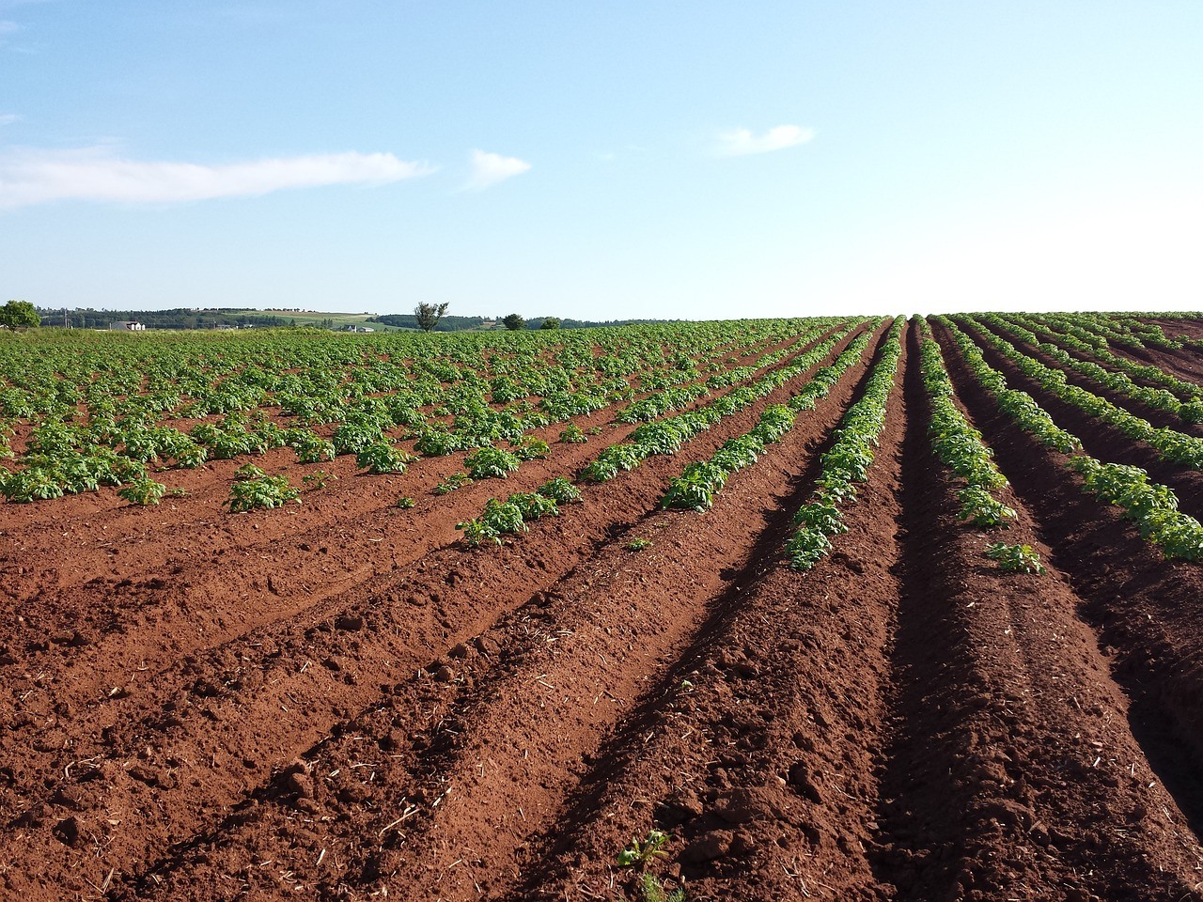
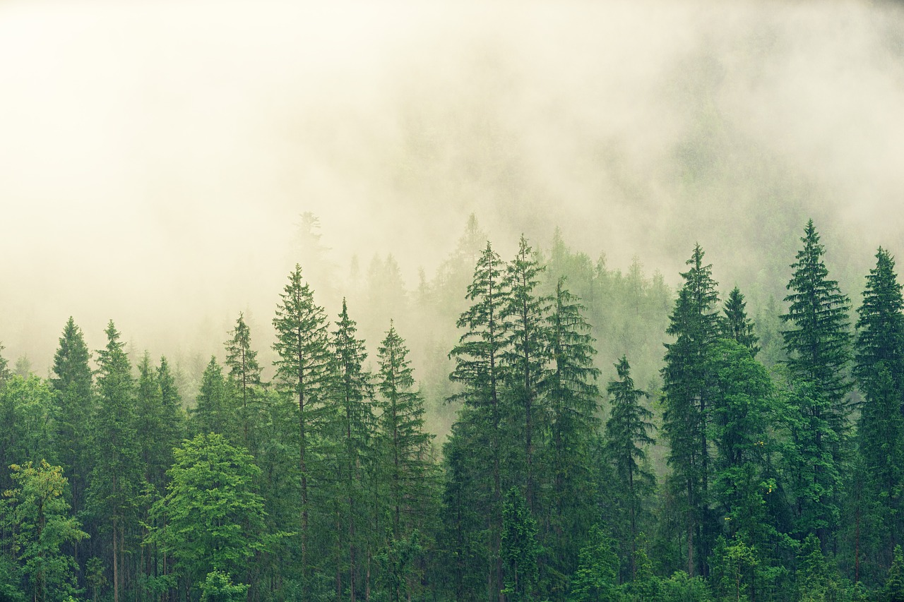
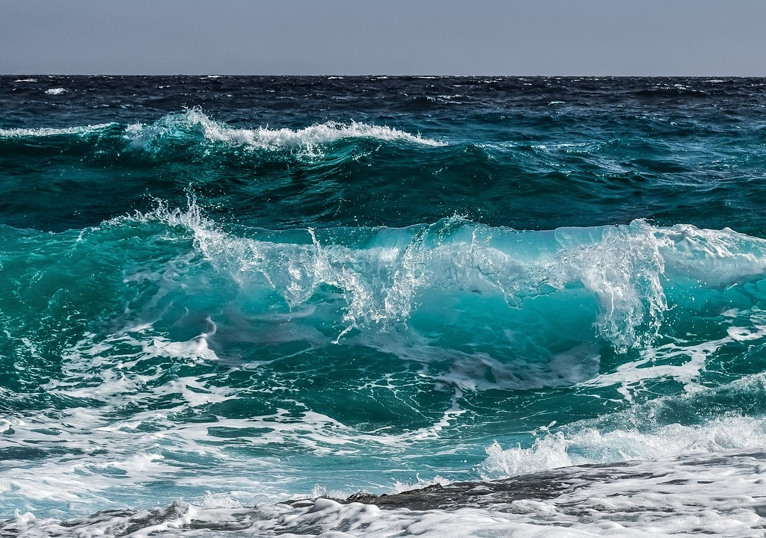
FT Q C010 R2
How can we Reduce the Effects of Climate Change?
Have you heard of the term ‘carbon neutral?’
“Carbon neutral = having a balance between emitting carbon and absorbing carbon from the atmosphere and storing it in carbon sinks.”
“A carbon sink is any system that absorbs more carbon than it emits. The main natural carbon sinks are soil, forests and oceans.”
European Parliament News
Image by meganelford0 from Pixabay
Image by Joe from Pixabay
Image by Dimitris Vetsikas from Pixabay

Slide 22
FT Q C010 R2
How can we Reduce the Effects of Climate Change?
Net Zero Emissions
In order to help tackle climate change, we need to be carbon neutral and have net zero emissions, which is a balance between the greenhouse gases put into the atmosphere and those taken out.
Check out this YouTube video by National Grid here for more information!
The UK government was the first major economy to set a legally binding target of net zero emissions by 2050.

Slide 23
FT Q C010 R2
Activity
Write down a few ideas of what we could do at school to help reduce the effects of climate change.
Choose one idea and create a poster that can be put up around school.

Slide 24

FT Q C010 R2
Activity
Write a diary entry that your future self will read in 2100. Write about what is currently causing climate change and the effects that it is having on the planet. Write about how it makes you feel and what people can do to reduce the effects of climate change.

Slide 25
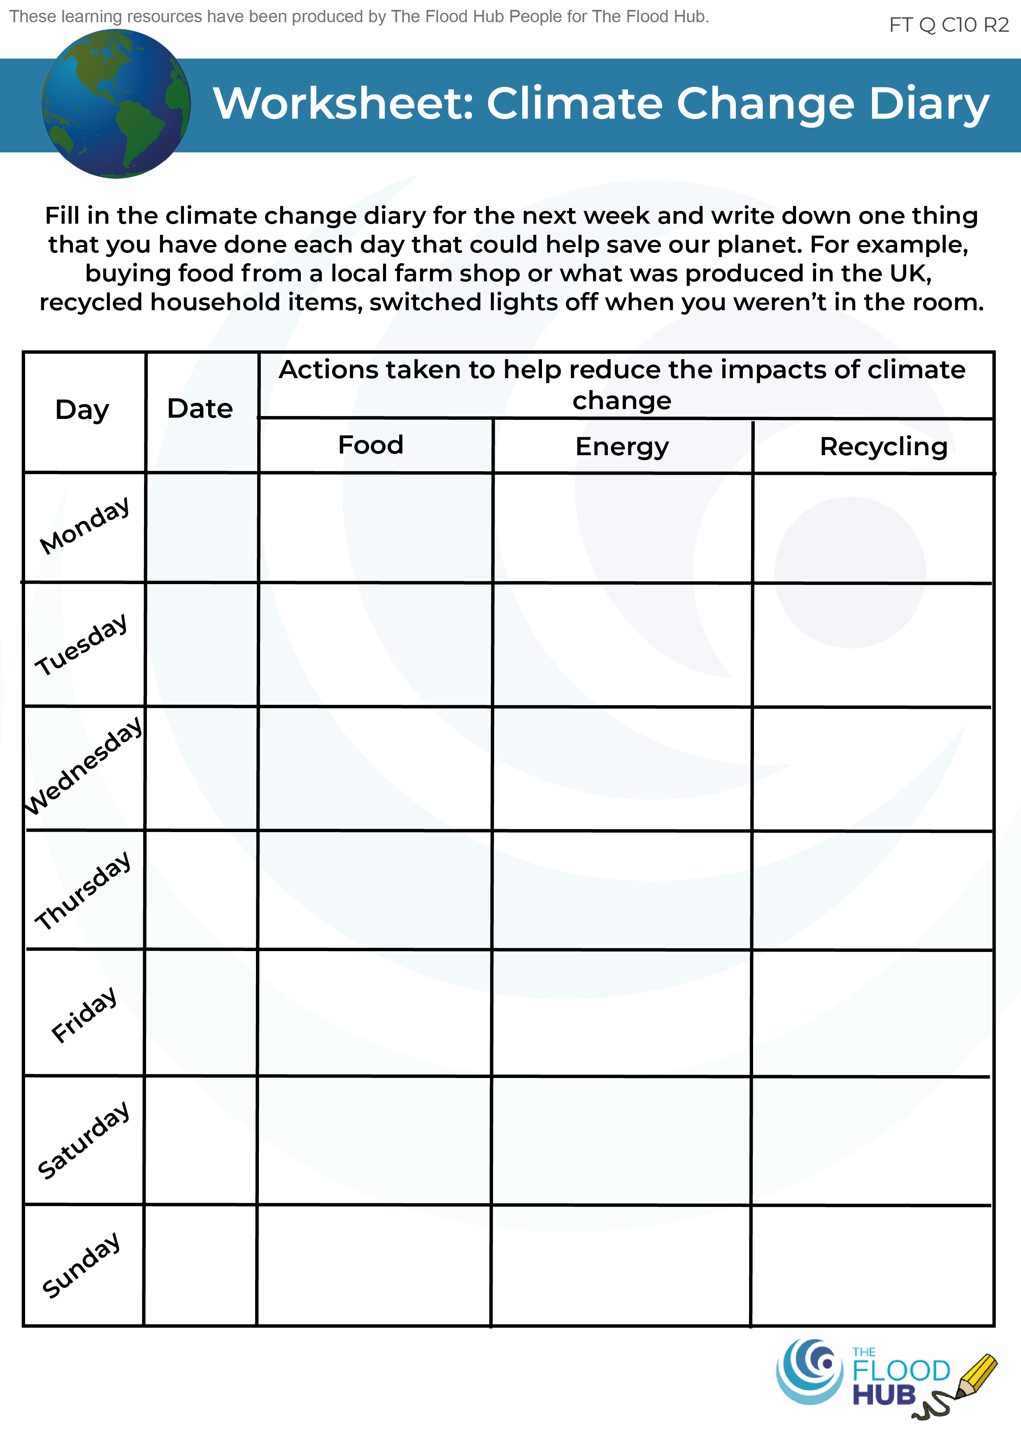
FT Q C010 R2
Homework
With a parent or guardian, using the ‘Climate Change Diary’ worksheet handed out in class, make a note of at least one thing you have done each day to help tackle climate change.

Slide 26
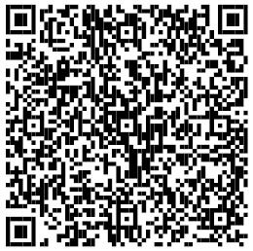
FT Q C010 R2
These lessons have been produced by
The Flood Hub People for The Flood Hub.
Scan the QR code to access our ‘Learning’ section. Or visit here: https://thefloodhub.co.uk/learning/

