Slide 1




Why We Live Around Rivers
Lesson aim:
To understand why we live around rivers.
Lesson objectives:
To understand why people live around rivers and have settled next to rivers in the past.
To learn the various reasons why humans use rivers.
FT Q C39 R2

Slide 2
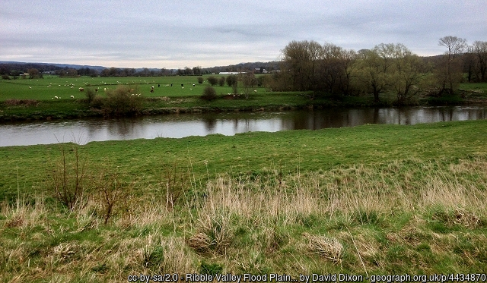
Why We Live Around Rivers
Throughout history people have settled around rivers.
Can you think of some reasons why?
FT Q C39 R2

Slide 3
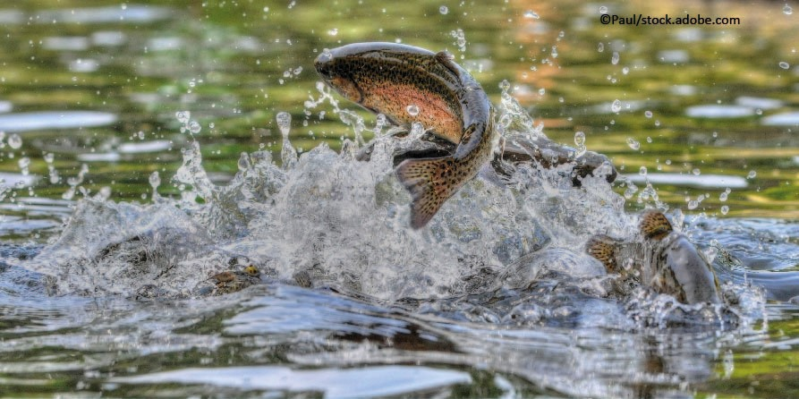
Why We Live Around Rivers
Villages began to develop along rivers because they provide lots of resources for people to use.
Water to drink, cook and clean.
Animals living in and around rivers provided people with food.
FT Q C39 R2

Slide 4
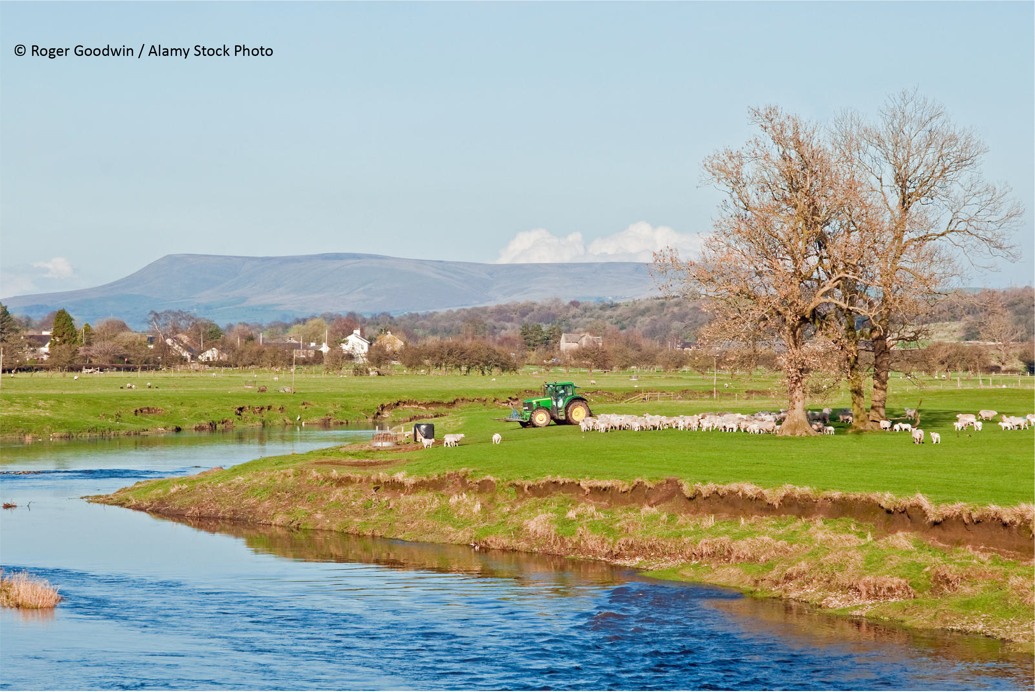
People started to use the river in other ways
Agriculture and Farming
When the river floods, water travels across the land and sediment and nutrients are spread over the floodplain. This provides fertile land to grow crops and feed animals.
FT Q C39 R2

Slide 5
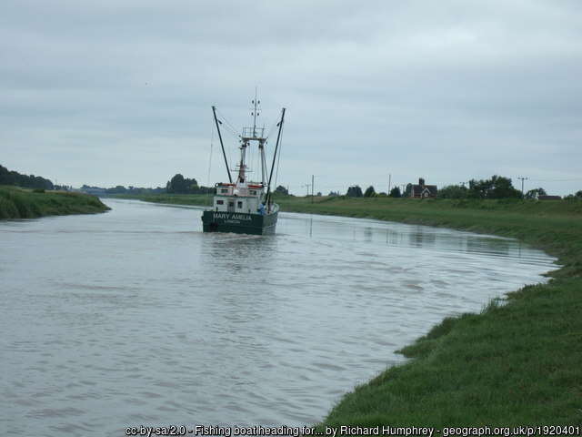
People started to use the river in other ways
Transport
People, goods, animals and food could be transported in boats along the river in times when there were no proper roads.
Image: avlxyz 3447605736 via Flickr
FT Q C39 R2

Slide 6
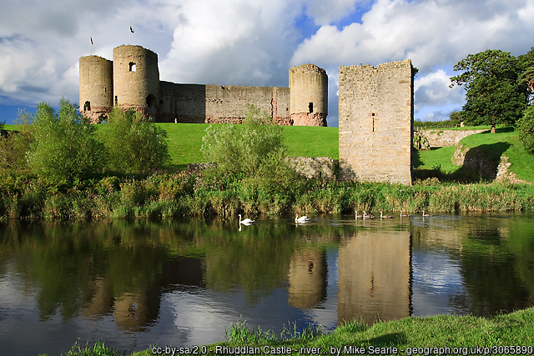
People started to use the river in other ways
Defending against attack
Castles could be built next to rivers or surrounded by deep ditches filled with water, or ‘moats’ from a nearby river to protect against invading armies.
FT Q C39 R2

Slide 7
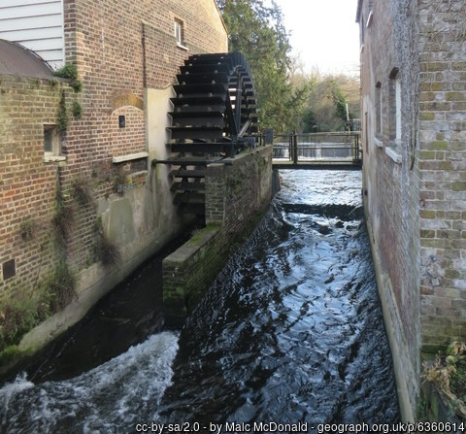
People started to use the river in other ways
Power
People started to use the force of water flowing in rivers to turn water wheels. This could then turn machinery to grind wheat to make flour or cut wood faster than had been possible before.
FT Q C39 R2

Slide 8
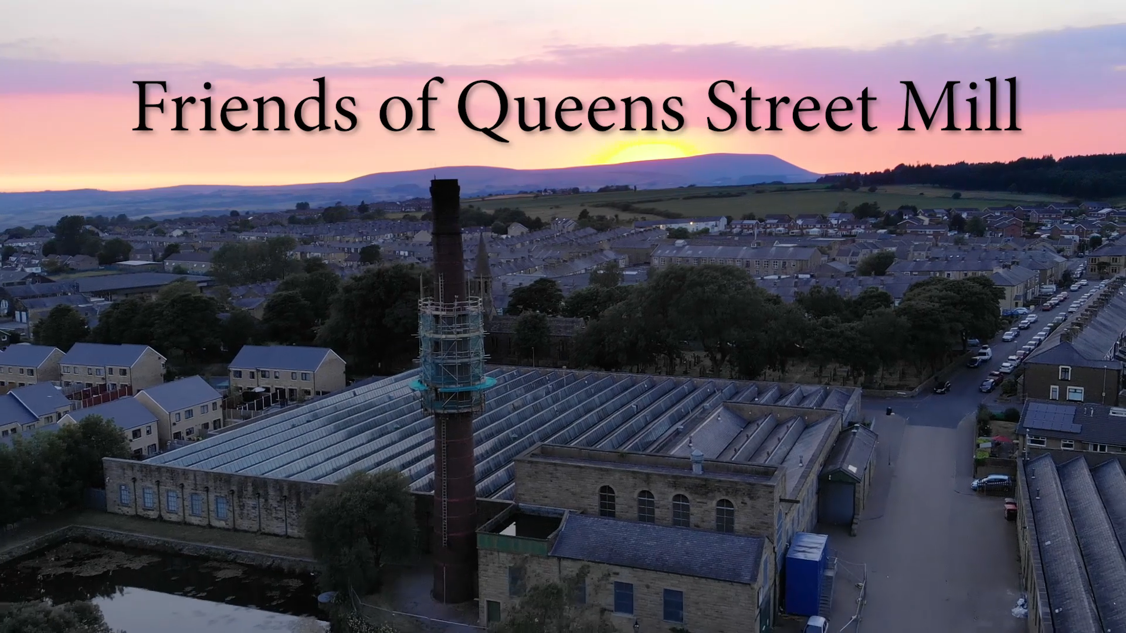
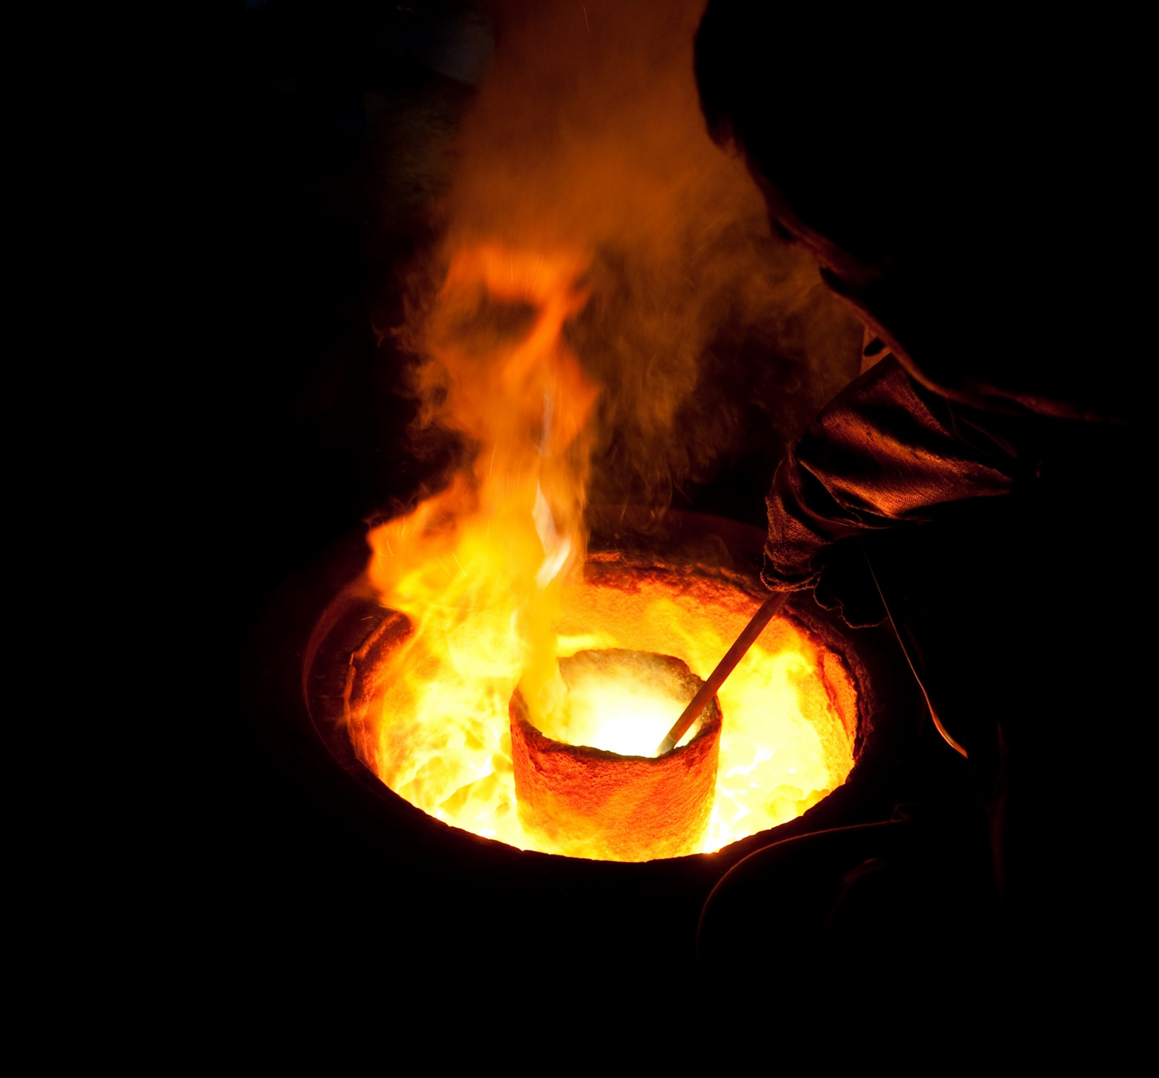
FT Q C39 R2
People started to use the river in other ways
Industry
Factories and machinery which were built during the Industrial Revolution needed water to power them and cools things down.
Image: Jean Beaufort CC BY 2., Via public domain pictures
Heating up water to create steam to power machinery. (Video from Queen St Mill Facebook account).
Water is used for cooling during steel making.

Slide 9
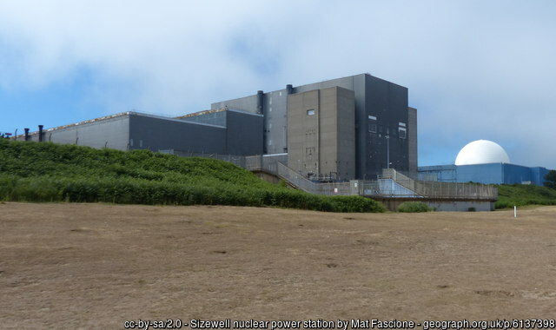
Rivers provide suitable locations for…
Generating electricity
Nuclear Power Stations
Nuclear power stations heat water to spin large turbines which generate electricity.
FT Q C39 R2

Slide 10
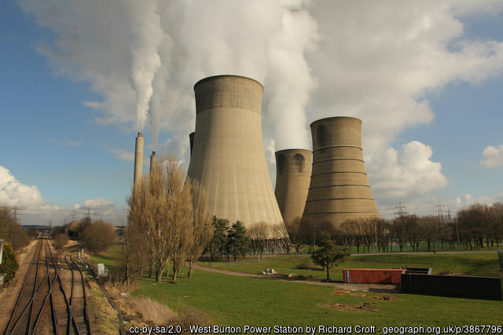
Rivers provide suitable locations for…
Generating electricity
Coal Fired Powered Stations
These power stations generate electricity by burning coal to heat water and create steam to spin turbines.
FT Q C39 R2

Slide 11
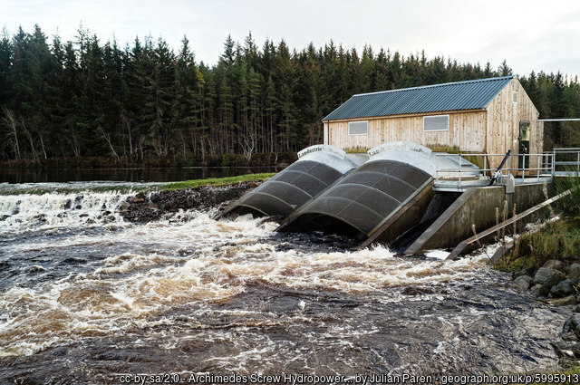
Rivers provide suitable locations for…
Generating electricity
Hydro Electricity
These power stations block off the river with a dam which creates a lake behind them. Gates in the dam can open to allow large amounts of water through to push the turbines round and generate electricity.
FT Q C39 R2

Slide 12
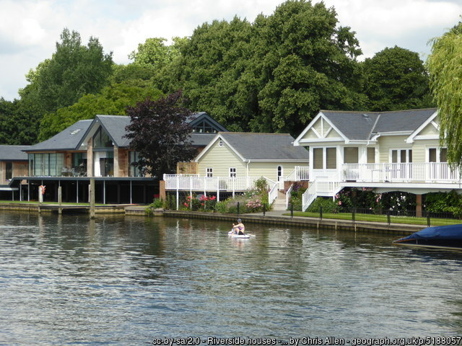
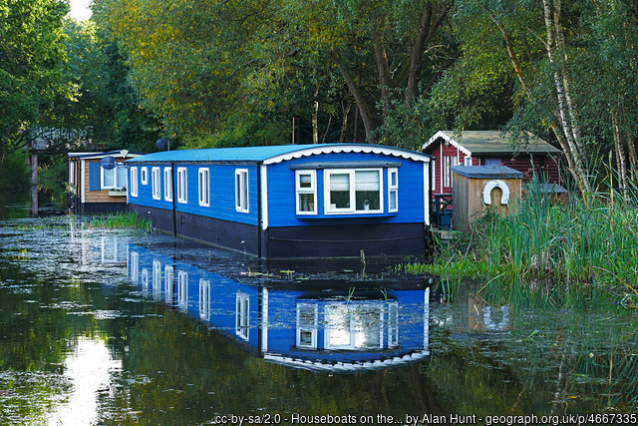
An attractive place to live and visit
There are many reasons why people choose to live near rivers and water.
Living next to a river
Living on a houseboat on a river
Living on boats has become a more affordable way to live for many people in expensive parts of the country, like London.
People like to live near water, so homes next to or near rivers become more desirable.
FT Q C39 R2

Slide 13
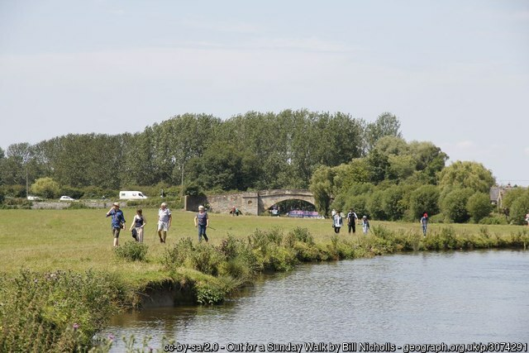
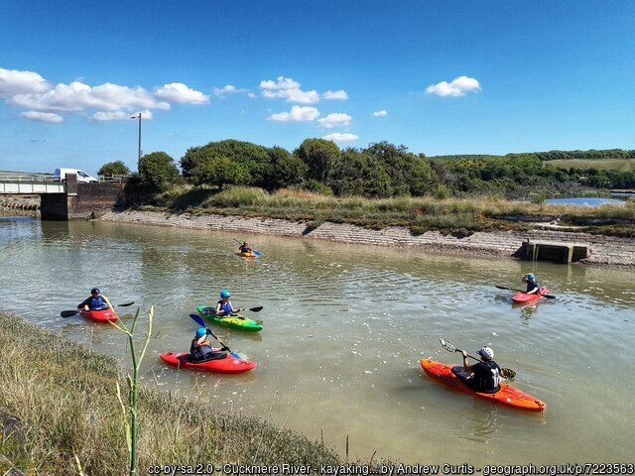
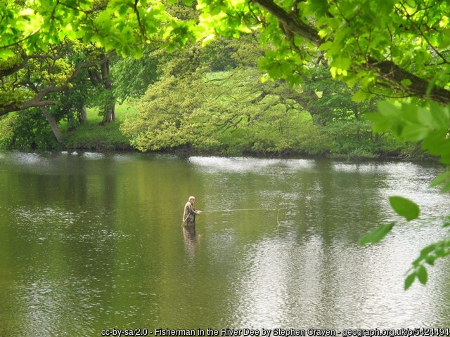
An attractive place to live and visit
There are many reasons why people choose to live near rivers and water.
Work & business
Fun & sports
Fishing
People visit rivers to take part in water sports or have hobbies like fishing or boating. Businesses become needed near rivers to service the people who go there.
FT Q C39 R2

Slide 14
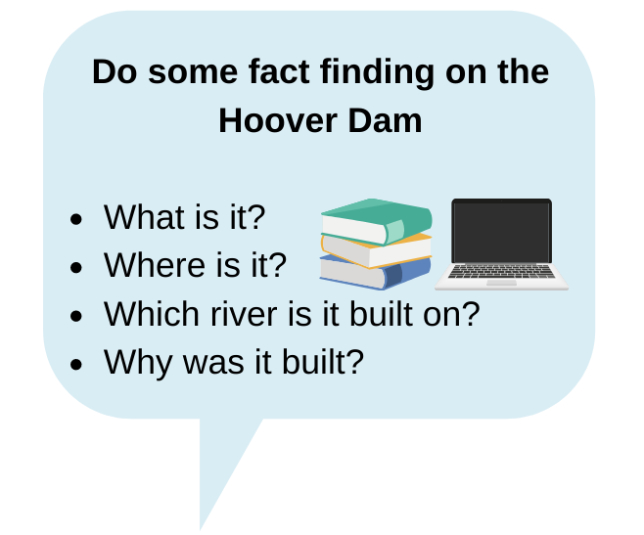
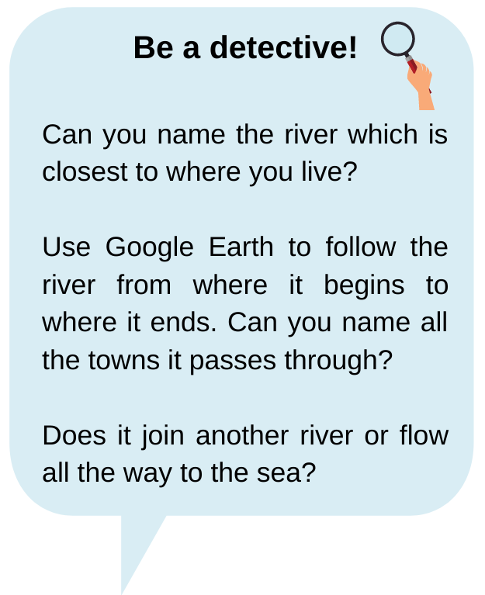
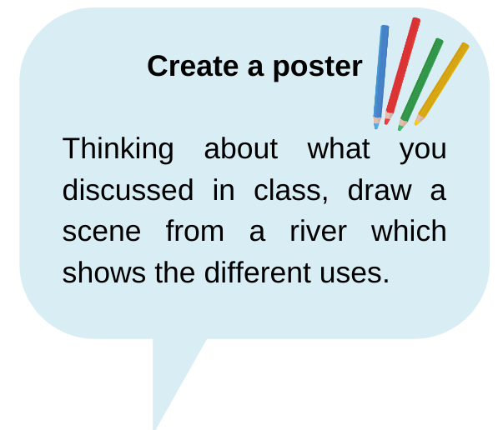
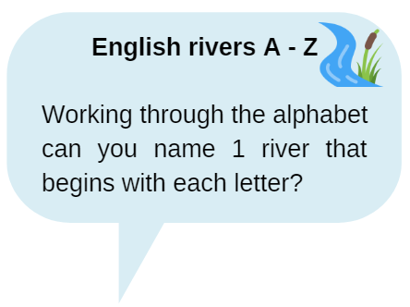
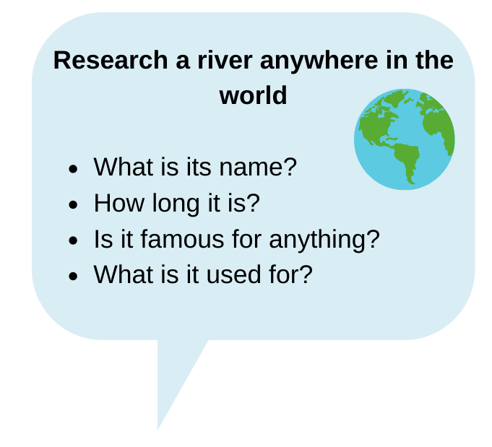

FT Q C39 R2
Homework – Choose two tasks from the homework sheet

Slide 15

These lessons have been produced by
The Flood Hub People for The Flood Hub.
Scan the QR code to access our ‘Learning’ section. Or visit here: https://thefloodhub.co.uk/learning/
FT Q C39 R2

