Slide 1




A River from Source to Sea
Lesson aim:
To understand how rivers and the surrounding land changes from source to sea.
Lesson objectives:
To learn the processes that shape the land and create landforms.
To learn how the land changes from source to sea.
To learn the different river landforms.
To understand what affects the flow of a river.
FT Q C40 R2

Slide 2
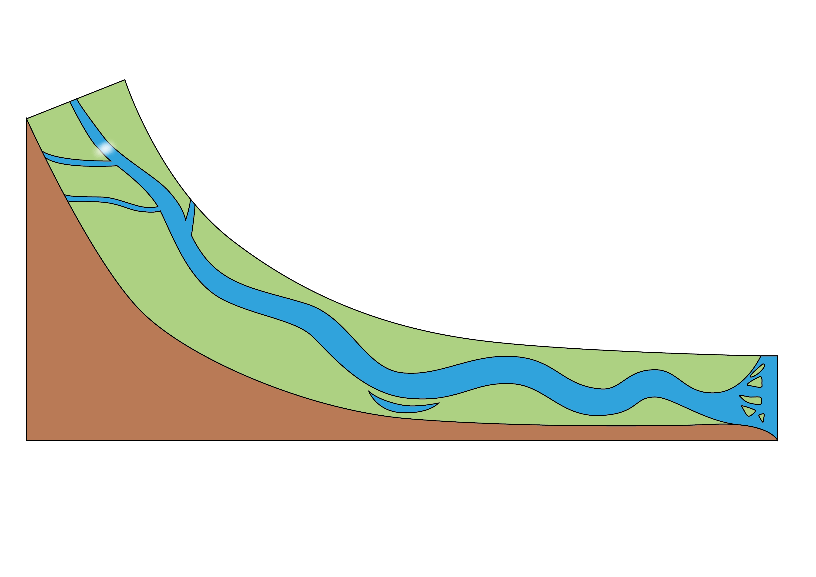
Source to mouth
Where a river starts is called the source, this is in hilly, upland or mountainous areas. Where a river ends is called the mouth, this is at the sea or a lake.
Source
Mouth
This video follows the route of a river from source to mouth: https://www.bbc.co.uk/bitesize/topics/z849q6f/articles/z7w8pg8
FT Q C40 R2

Slide 3
Why do rivers change over time?
Rivers can change naturally or the changes can be man-made.
Rivers never stay the same, they change all the time. These are some of the processes which can shape the landscape, the river’s channel and create landforms.
Weathering
is the breaking down or wearing away of rocks where they are. It does not happen because they move or crash into each other.
is when materials such as rock, soil and sand are broken down and worn away by rain, rivers, wind or waves, and are then moved away.
is when the eroded materials are left behind because the river, wave or wind slows down.
Erosion
Deposition
FT Q C40 R2

Slide 4
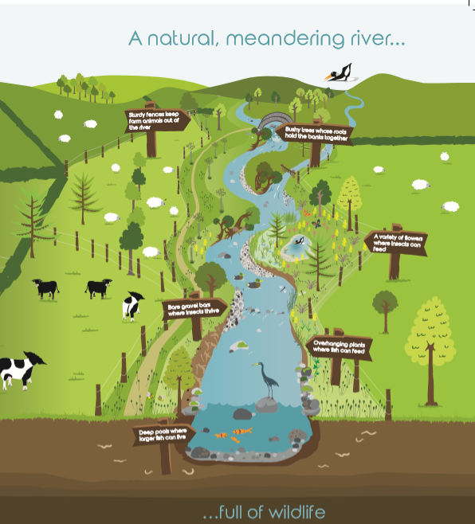
FT Q C40 R2
A natural river
Water flows slower through an unchanged, natural river channel
This is due to the curved shape of the channel which slows the flow of water.
Image taken from West Cumbria Rivers Trust Natural rivers for life A short guide to restoring natural rivers in Cumbria - Design & illustration by Custard Graphic Design

Slide 5
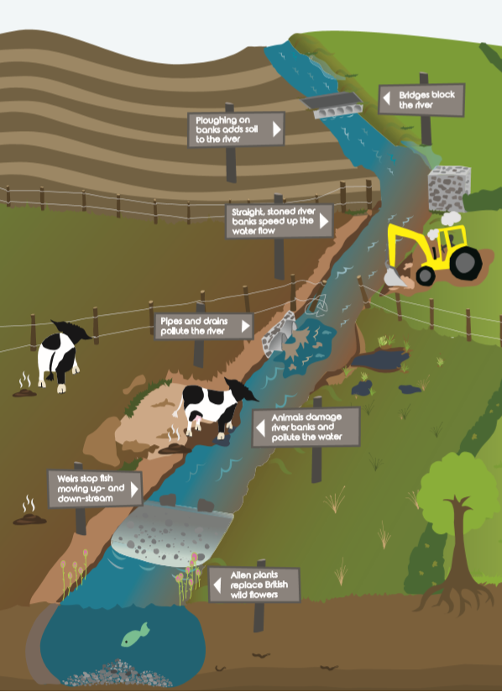
FT Q C40 R2
A straightened river
Water flows much quicker through a straightened river channel as water can easily flow through.
Image taken from West Cumbria Rivers Trust Natural rivers for life A short guide to restoring natural rivers in Cumbria - Design & illustration by Custard Graphic Design

Slide 6
Changes in the land around a river and the channel
A river can be split into three sections:
Upper course
Middle course
Lower course
The first third of a river.
The second third of a river.
The last third of a river.
Begins in hills and mountains (the source)
Steep slopes
Narrow valley sides
Narrow, shallow river channel with a rocky bed
Gentler slopes
Wider, deeper channel
Ends at the sea or a lake (mouth)
Low lying, flat land
Gentle, wide valleys
Wide channel and fastest flow
FT Q C40 R2

Slide 7
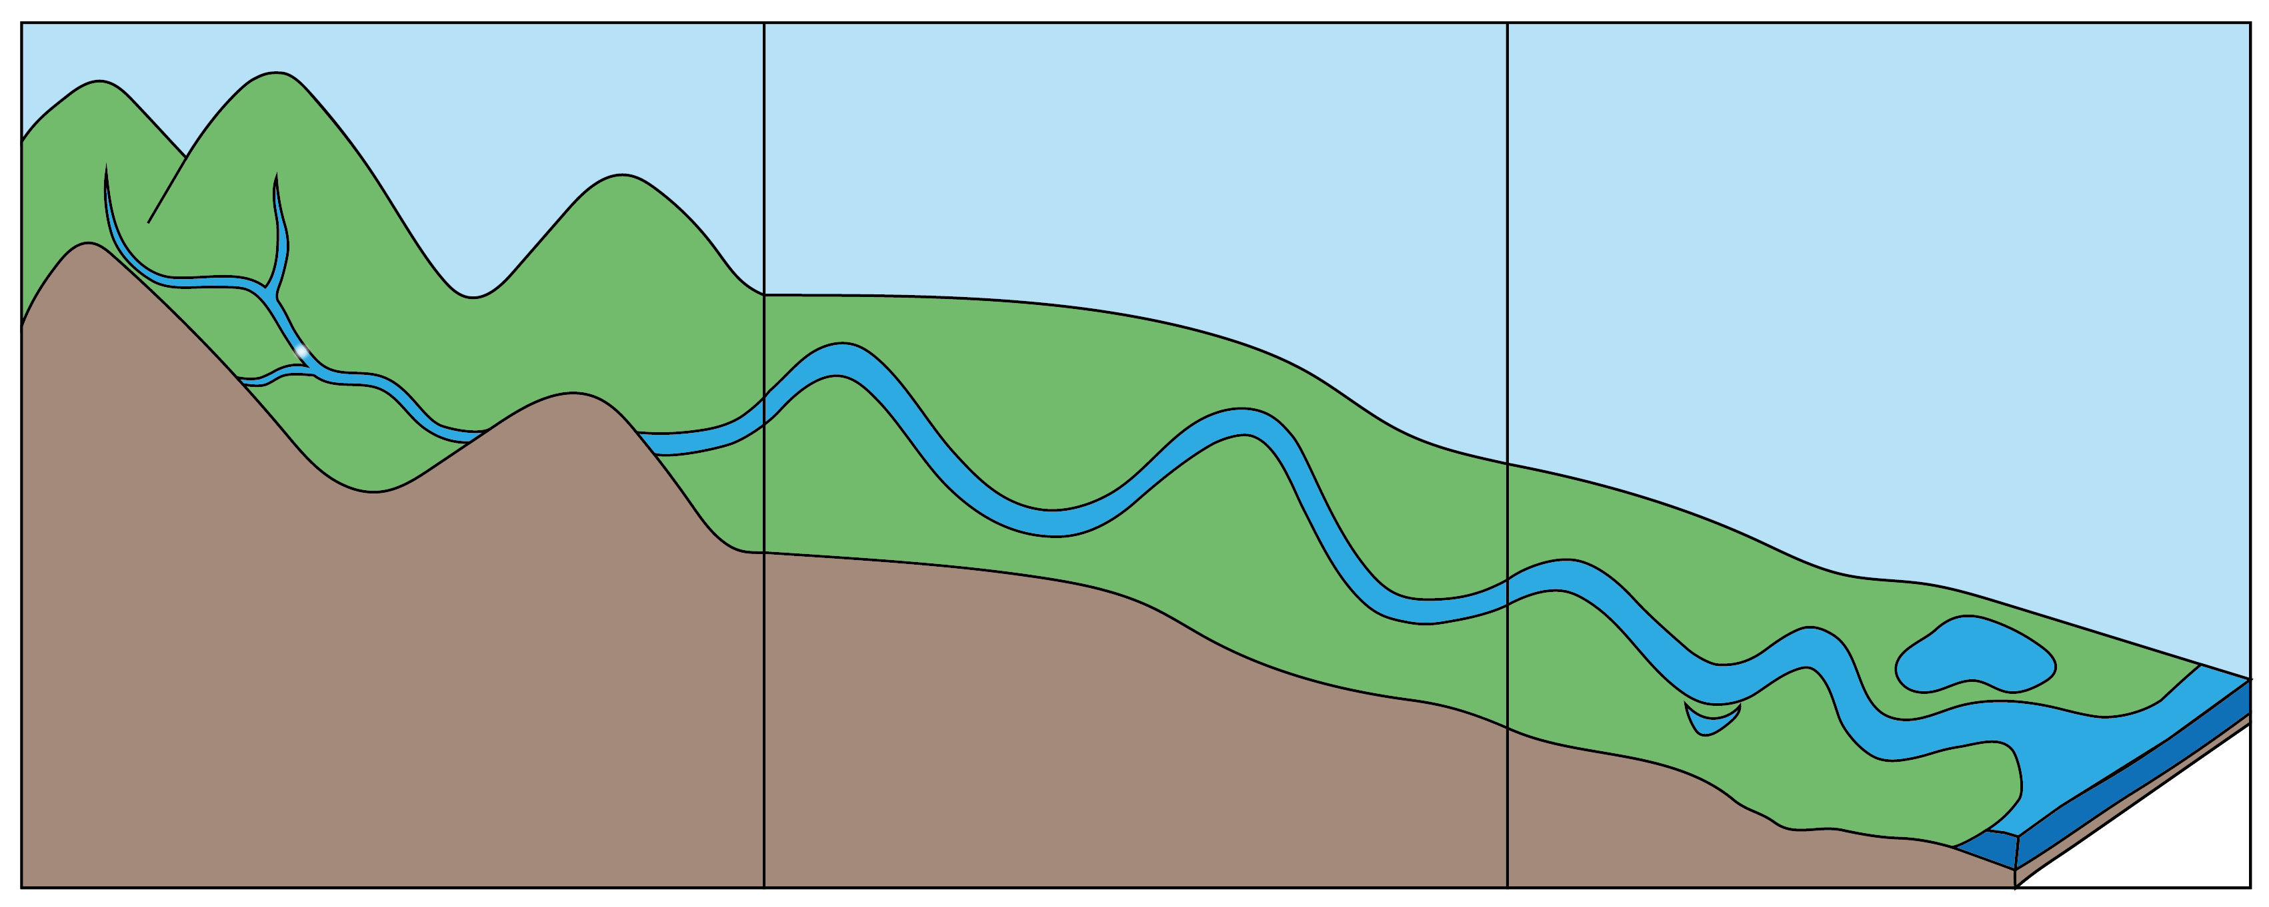
River landforms
Source
Upper course
Middle course
Lower course
Waterfall
River channel
Meander
Tributary
Estuary
Sea or lake
Floodplain
Oxbow lake
Mouth
Image: The Flood Hub
A river landform is a natural feature created by a river on the Earth’s surface.
FT Q C40 R2

Slide 8
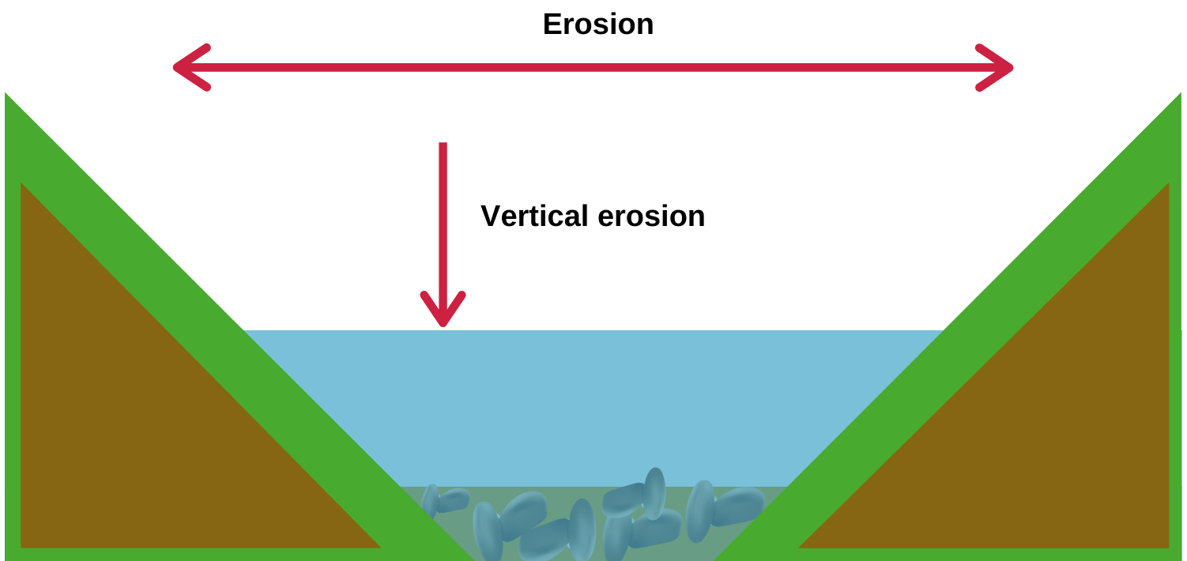
River landforms – Upper course
V-shaped valley
A v-shaped valley is created when a river erodes both vertically and horizontally.
FT Q C40 R2
Image: The Flood Hub

Slide 9
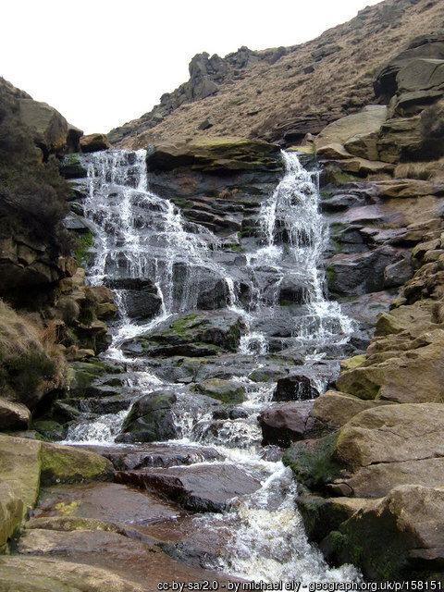
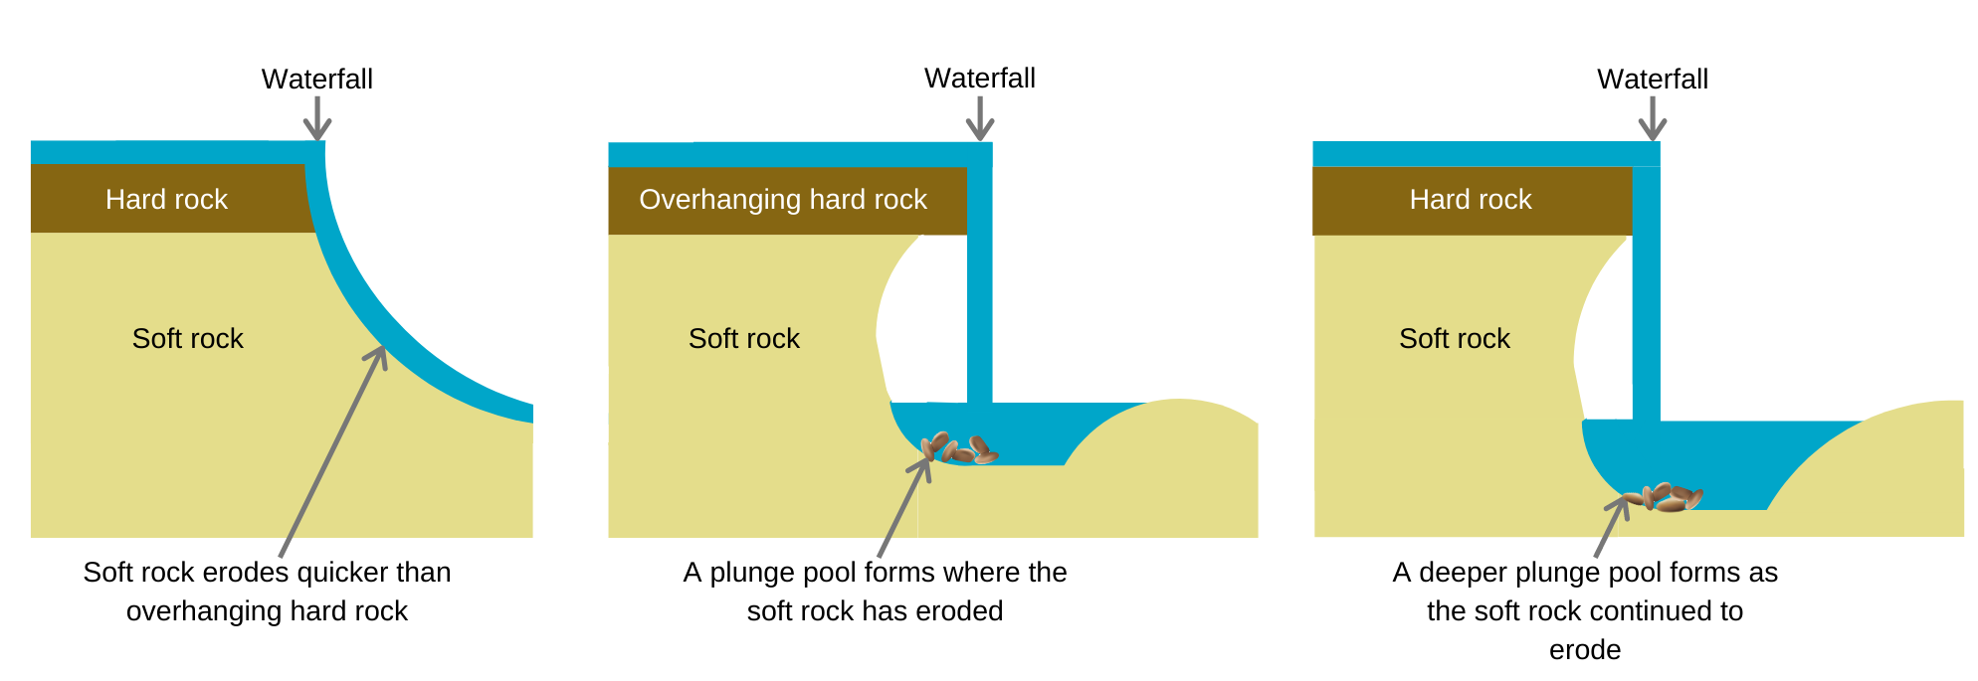
FT Q C40 R2
River landforms – Upper course
Waterfall
A waterfall is a steep drop in the course of a river. They form when water flows over hard rock that overlies softer rock.
Video: https://www.bbc.co.uk/bitesize/guides/zyt9q6f/revision/4
Image: The Flood Hub

Slide 10
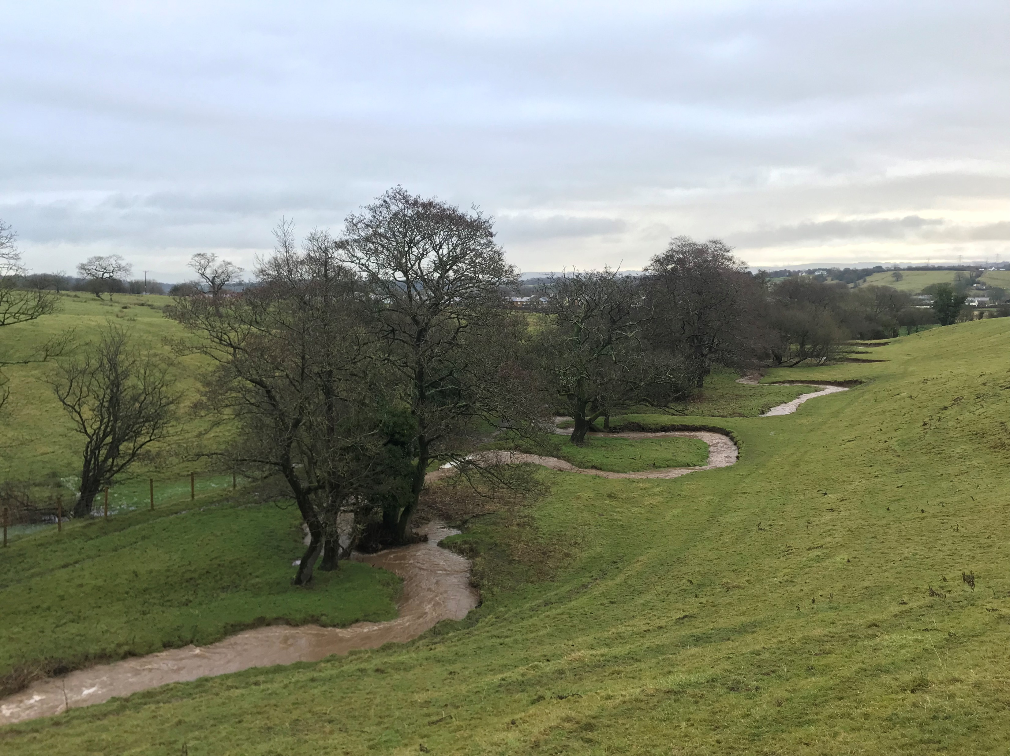
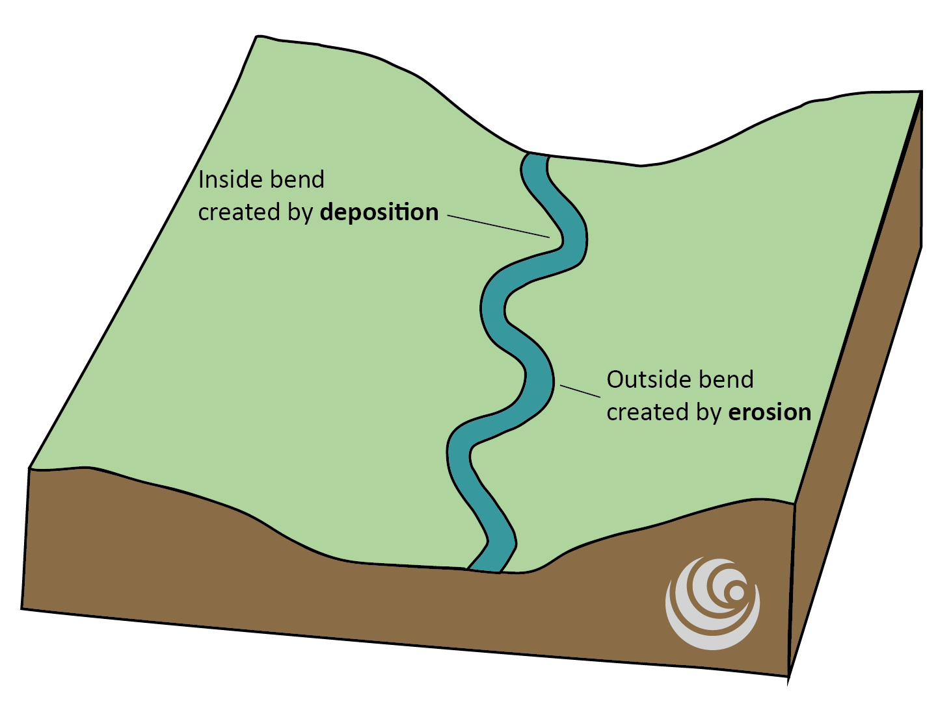
River landforms – Middle and Lower course
Meander
Meanders are a bend in the river channel created by the speed of the water, erosion and deposition.
Image: The Flood Hub
FT Q C40 R2

Slide 11
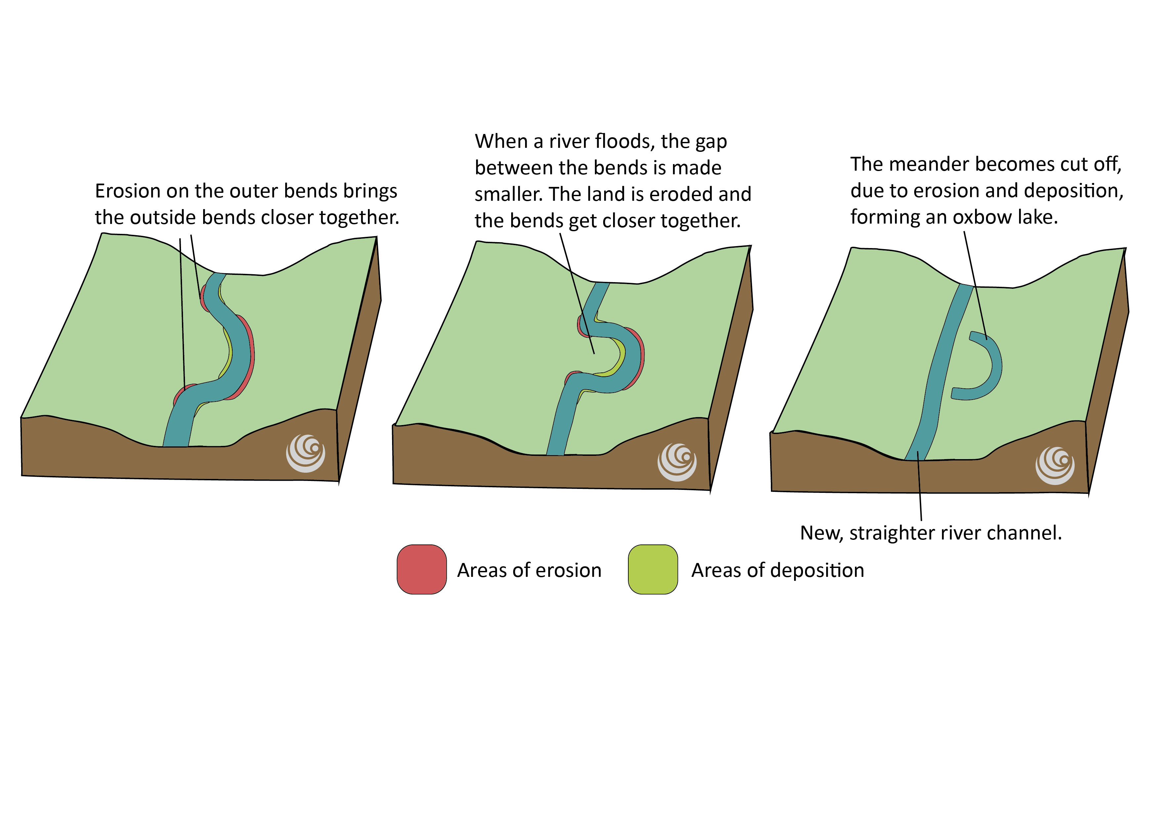
River landforms – Middle and Lower course
Oxbow lake
An oxbow lake is a curved lake created when the gap between a meander bend gets smaller and the river takes the straighter, quicker route through the land instead of flowing around the meander.
Video: https://www.bbc.co.uk/bitesize/guides/z6jx382/revision/4
FT Q C40 R2

Slide 12
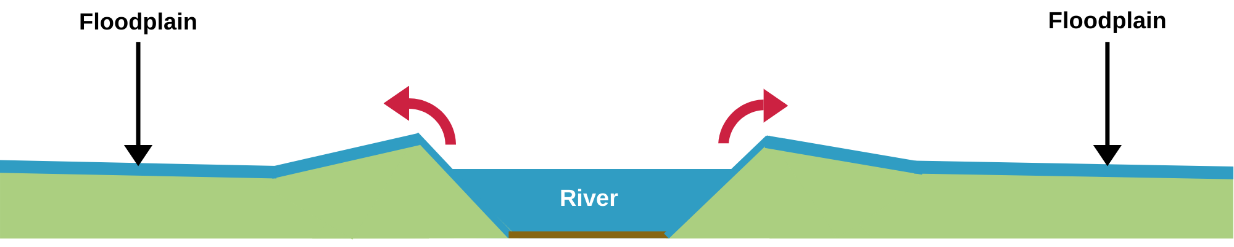
River landforms – Middle and Lower course
Floodplain
A floodplain is the flat land next to a river where water flows when a river overtops during a flood.
Image: The Flood Hub
FT Q C40 R2

Slide 13

River landforms – Lower course
Levee
A levee can form naturally or be built alongside the river on the floodplain. They are a raised bank of a river that protects against flooding.
Levees
River channel
Image: The Flood Hub
FT Q C40 R2

Slide 14
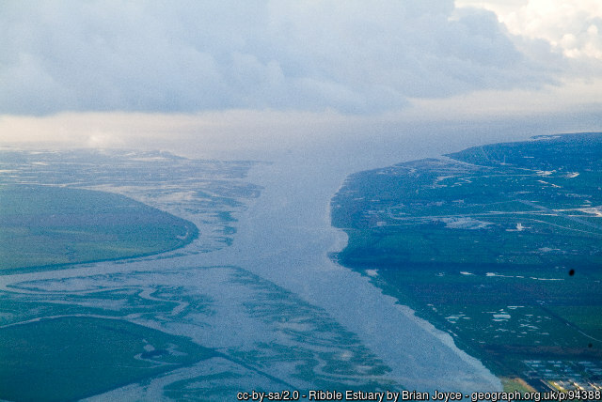
River landforms – Lower course
Estuary
Sea
An estuary is the point where a river meets the sea. At this point, freshwater from the river mixes with the saltwater from the sea.
River
FT Q C40 R2

Slide 15
Recap
Source
Upper course
Middle course
Lower course
Waterfall
River channel
Meander
Tributary
Estuary
Sea or lake
Floodplain
Image: The Flood Hub
Oxbow lake
Mouth
FT Q C40 R2

Slide 16
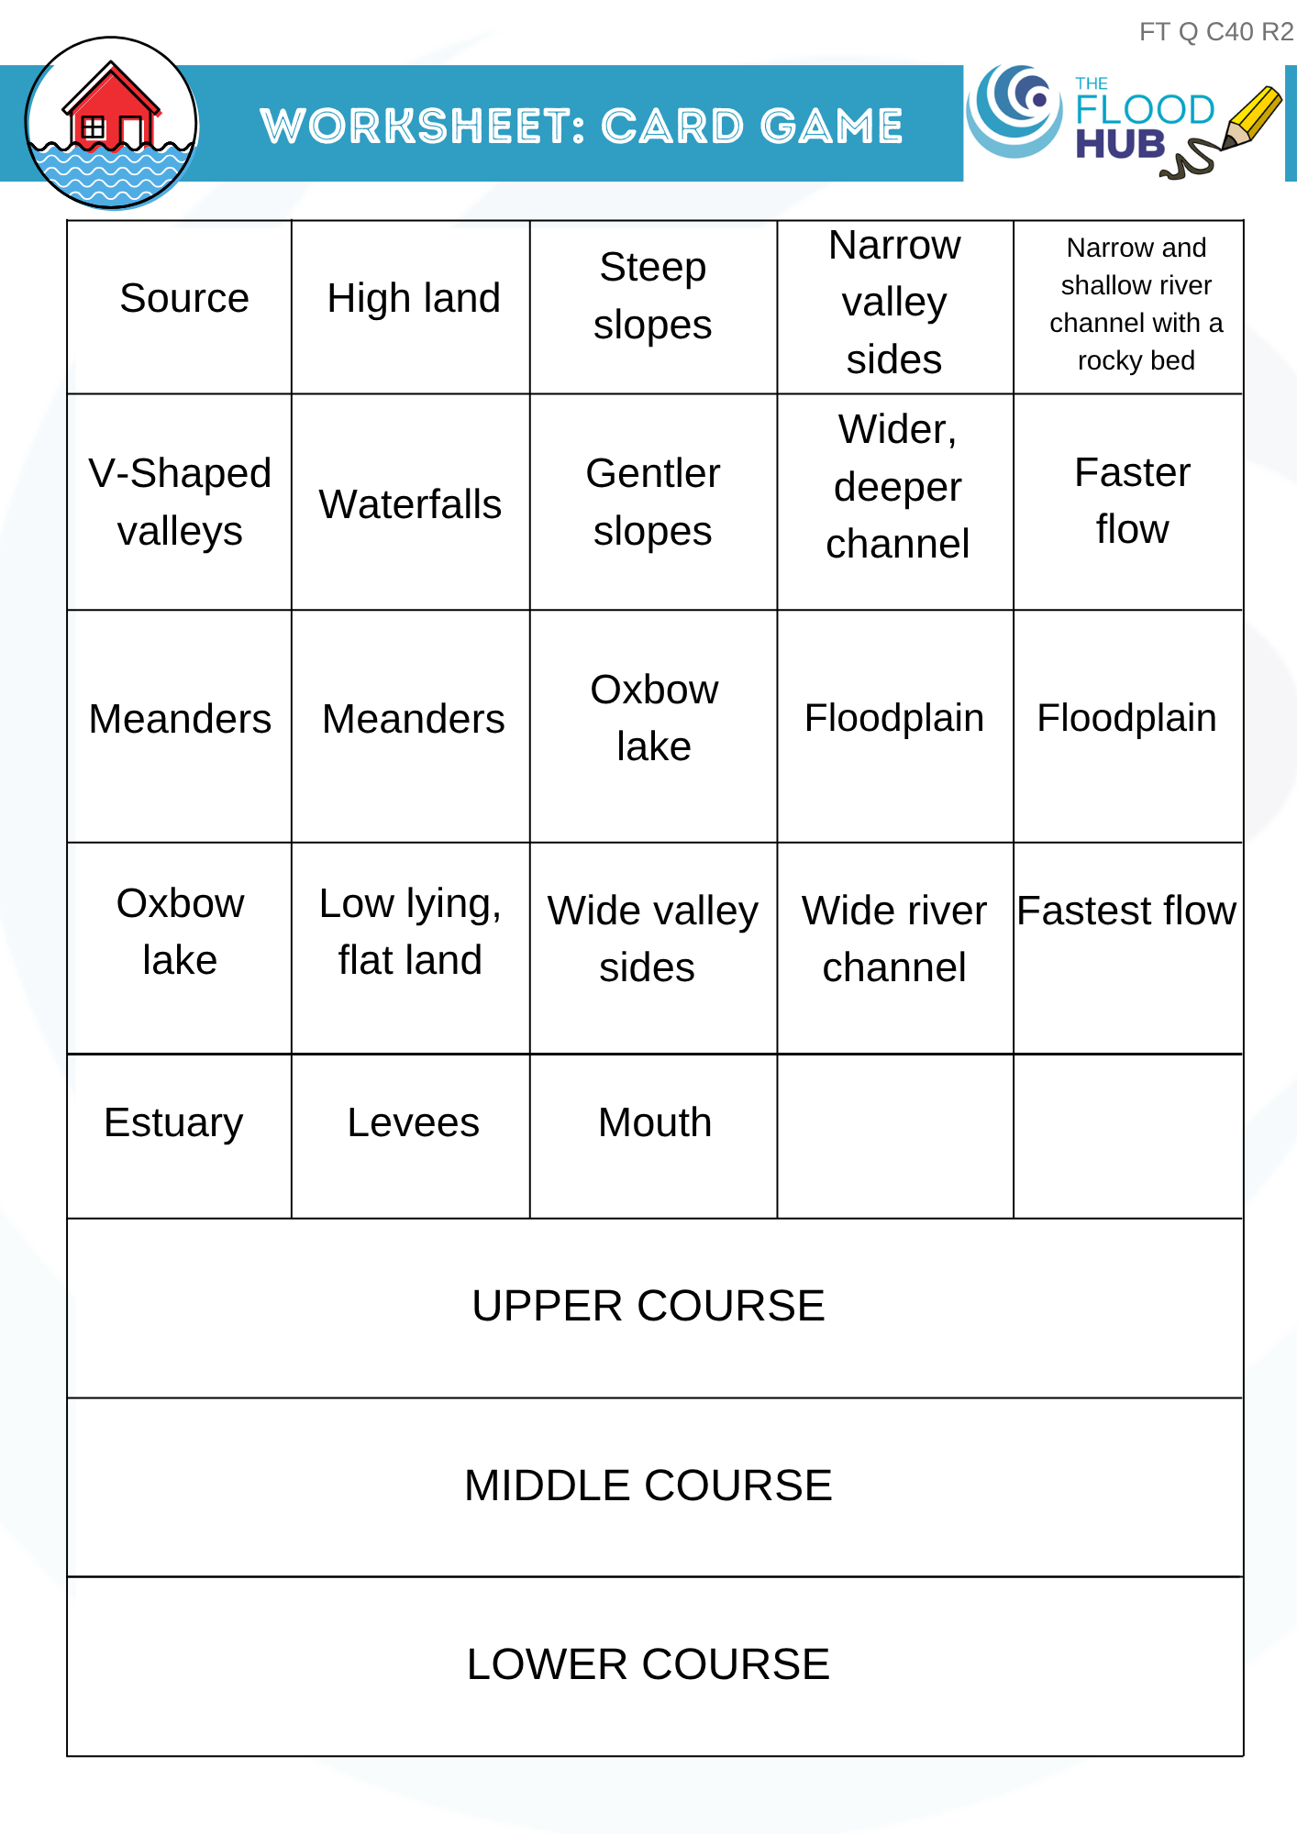
Card game
Let’s play a card game!
Match the small cards to the course of the river that they are found in.
Some cards are the same because they are found in more than one section of the river.
FT Q C40 R2

Slide 17



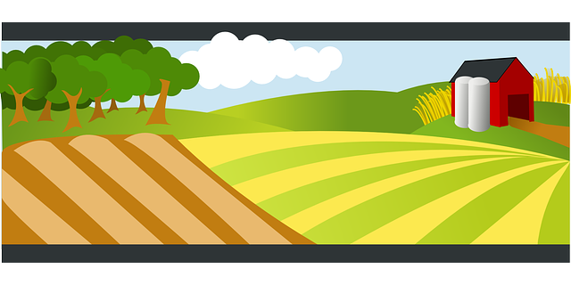
What affects the flow of a river?
Man-made effects
Urban areas
Deforestation
The water cannot soak into the ground and enters the river quicker which increases flow.
When trees are chopped down, water isn’t soaked up by the trees and leaves. Water enters the channel quicker and increases flow.
https://www.kindpng.com/picc/m/228-2288709_transparent-cityscape-png-cartoon-building-clipart-png-png.png
Flood walls
Drainage of farmland
Flood walls can change the flow of water by keeping more water in the channel, stopping it flowing naturally onto the floodplain.
Farm machinery compacts soil and water cannot soak into the ground. The water runs off and enters the river quicker, increasing flow.
FT Q C40 R2

Slide 18

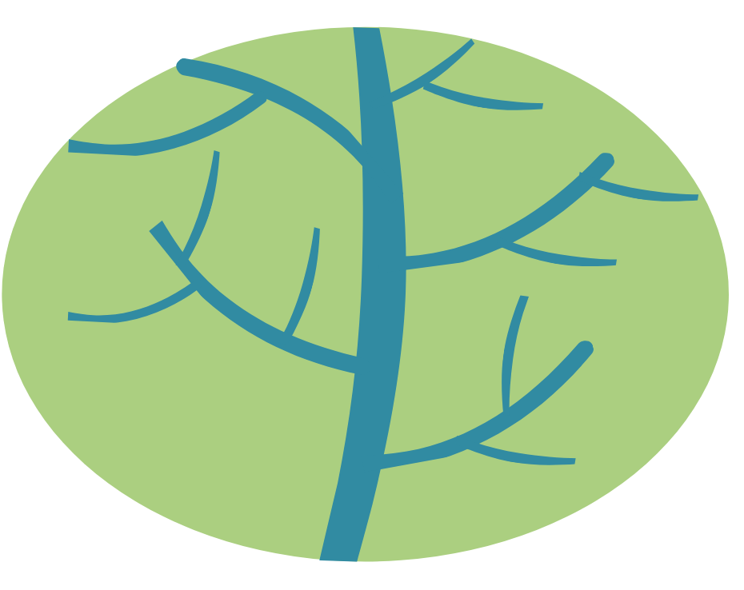
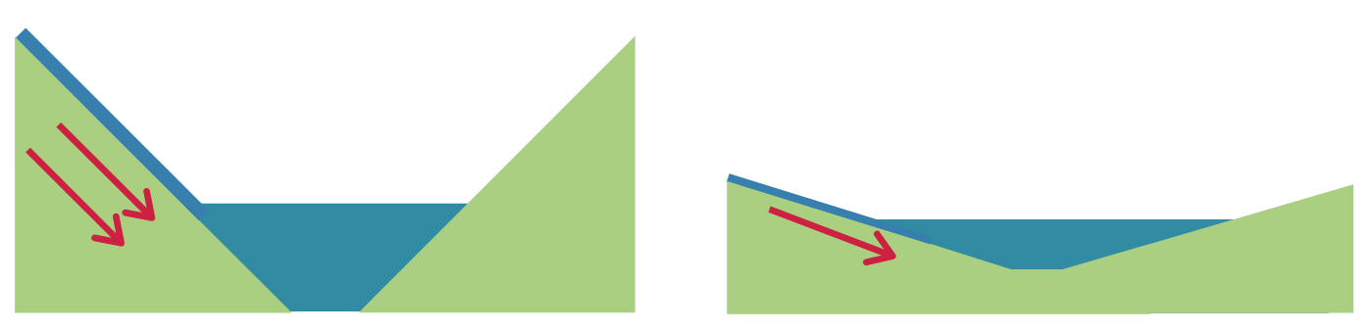

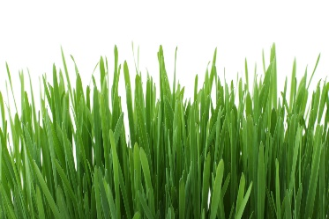
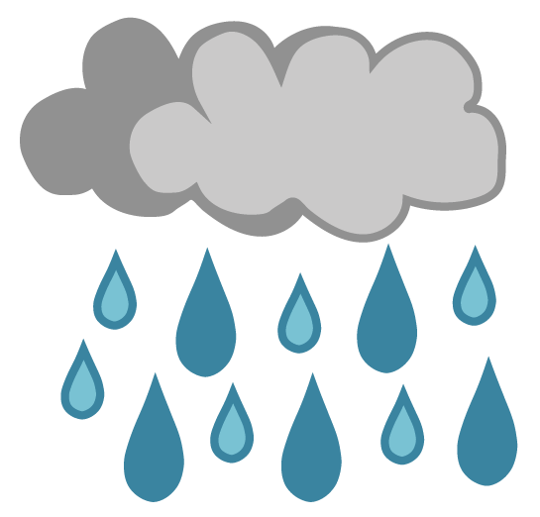
What affects the flow of a river?
Natural effects
The steepness of the catchment
The size and shape of the catchment
Water reaches the river channel quicker when the slopes of the catchment are steeper.
Water reaches the river channel quicker in smaller, narrow catchments, compared to large, round ones.
Image: The Flood Hub
Image: The Flood Hub
A catchment is an area of land that leads each drop of rain that falls within it towards the same river.
Vegetation cover
Weather and climate
Areas with grass instead of concrete allow water to soak into the ground, which slows down and decreases the flow.
Areas that have more rainfall throughout the year will have rivers with bigger flows.
Image: Petr Kratochvil via Public domain pictures.net
FT Q C40 R2

Slide 19
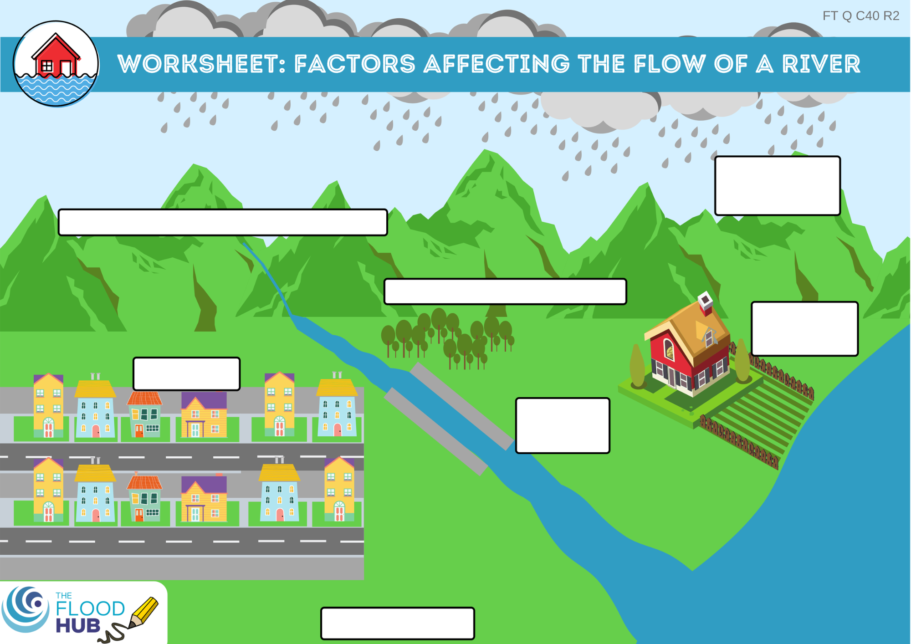
What affects the flow of a river?
Don’t forget….
A natural, meandering channel slows the flow of a river.
A straightened channel speeds up the flow of water.
Weather and climate
Size and shape of the river catchment
Tree cover - deforestation
Drainage of farmland
Urban areas
Flood walls
Vegetation cover
FT Q C40 R2

Slide 20
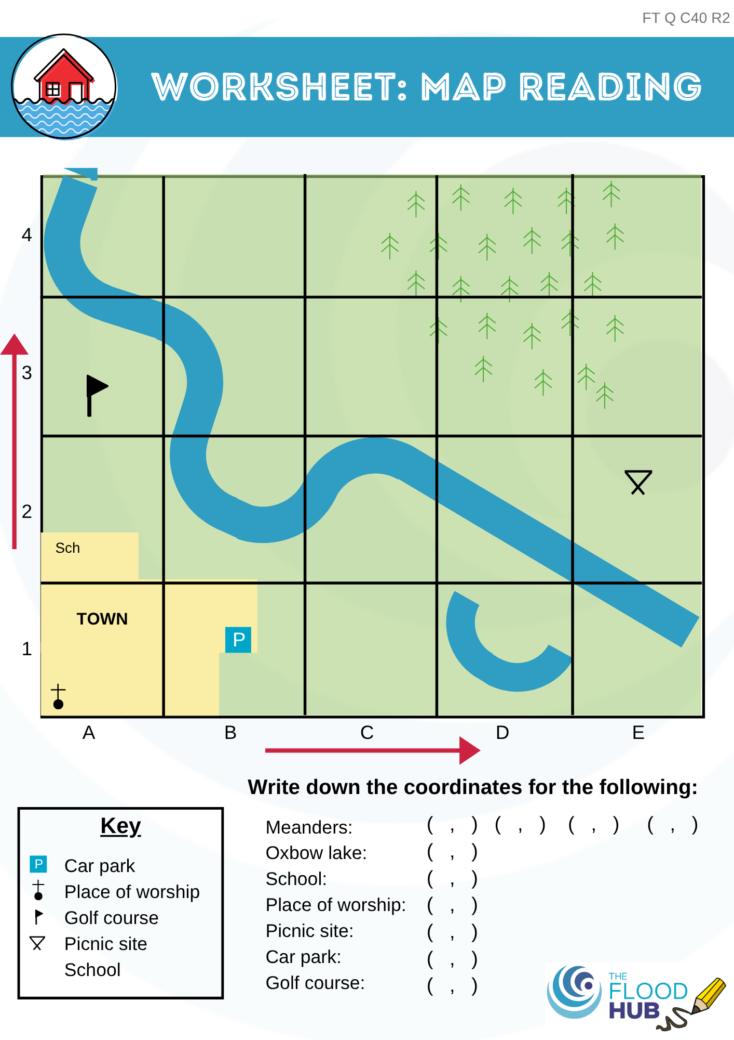
Map Reading
Note down the grid references of the river landforms and places listed on the worksheet.
FT Q C40 R2

Slide 21
Recap of lesson
Rivers and landscapes change over time due to three processes…
Rivers can be split into three sections…
A natural river channel…
A straightened river channel…
weathering, erosion and deposition.
the upper, middle and lower course.
slows the flow of water in a river.
speeds up the flow of water in a river.
FT Q C40 R2

Slide 22
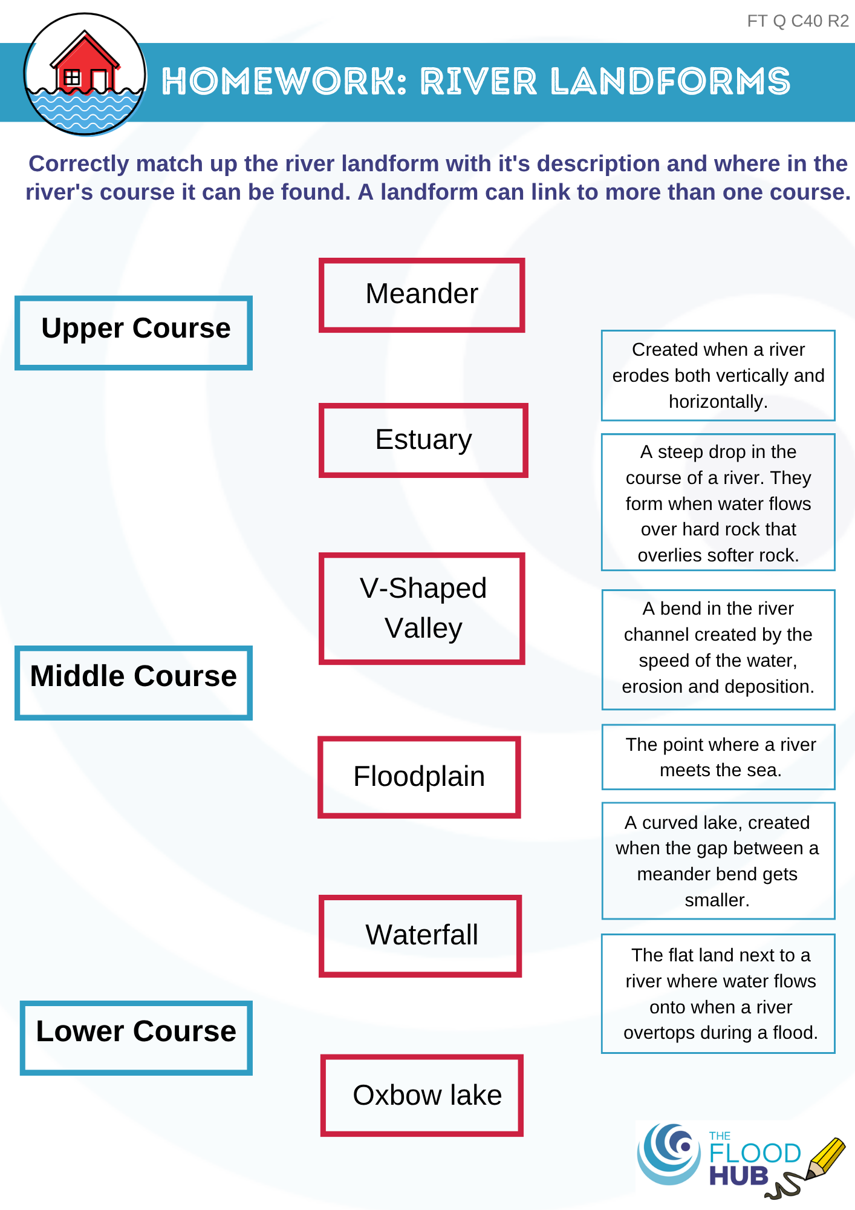

Homework
Complete the river landforms homework sheet by matching up each type of landform with which course it is in and the description of it.
FT Q C40 R2

Slide 23

These lessons have been produced by
The Flood Hub People for The Flood Hub.
Scan the QR code to access our ‘Learning’ section. Or visit here: https://thefloodhub.co.uk/learning/
FT Q C40 R2

