Slide 1




Flooding
Lesson aim:
To introduce the topic of floods and understand why they happen.
Lesson objectives:
To understand what a flood is and how floods are caused.
To learn what factors can affect flood risk and whether these are natural or man-made factors.
FT Q C41 R2

Slide 2
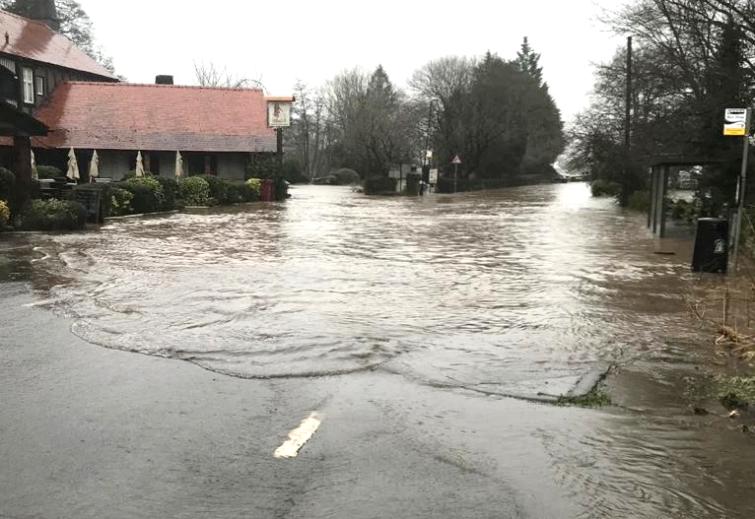
What is a flood?
A flood is a large amount of water covering an area of land that is usually dry.
Floods can happen anywhere in the world.
Image: The Flood Hub
FT Q C41 R2

Slide 3
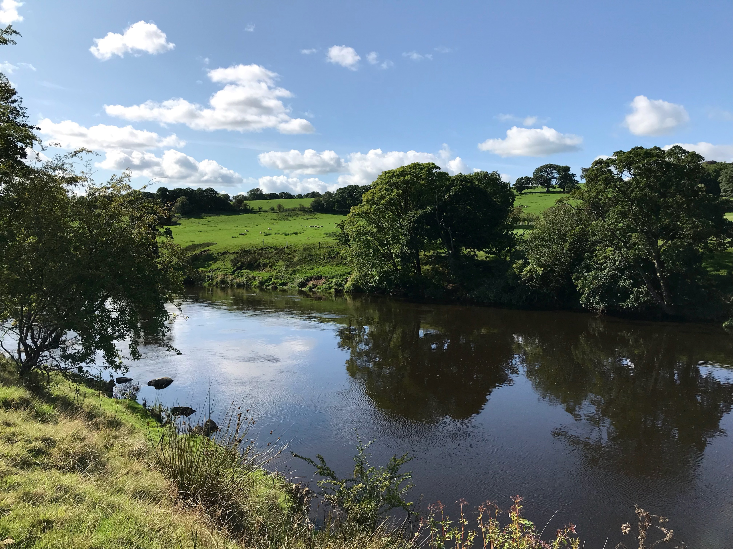
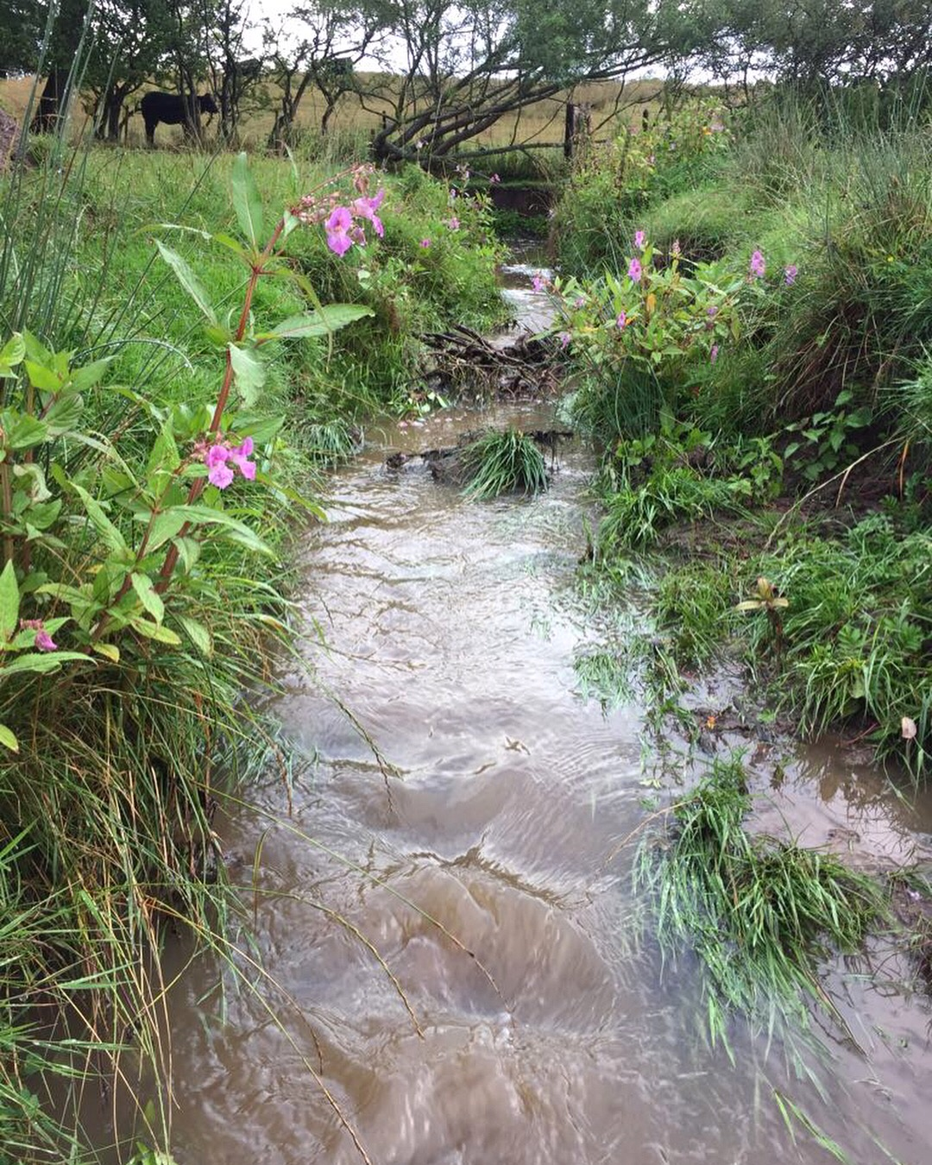
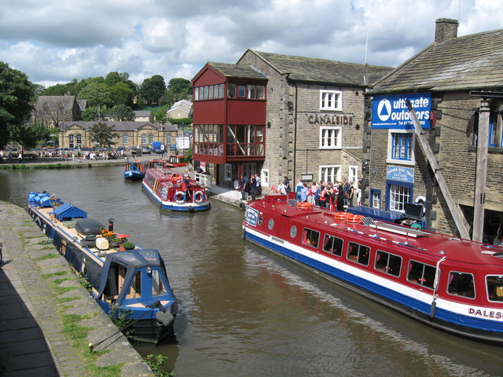
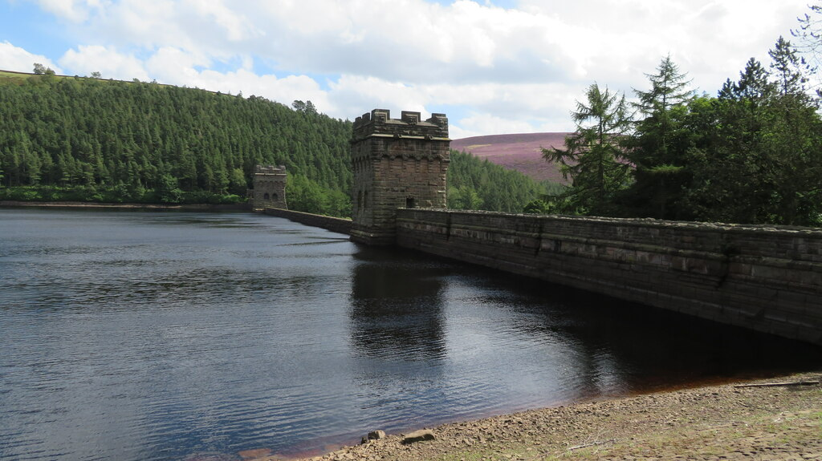
Flooding
What are these watercourses?
Image: The Flood Hub
Image: The Flood Hub
Canal Basin, Skipton - cc-by-sa/2.0 - © Paul Anderson - geograph.org.uk/p/517923
Howden Reservoir Dam, Upper Derwent Valley
cc-by-sa/2.0 - © Colin Park - geograph.org.uk/p/6677241
River
Stream
Canal
Reservoir
FT Q C41 R2

Slide 4
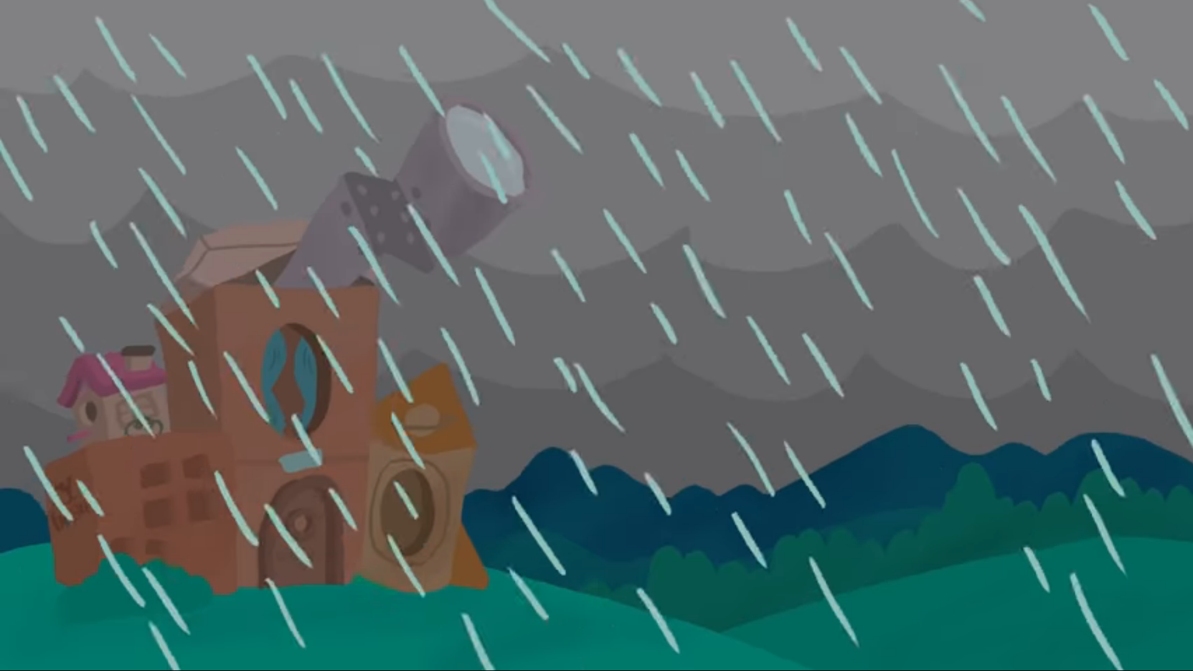
Why do floods happen?
https://www.youtube.com/watch?v=Qe350nm_odA
FT Q C41 R2

Slide 5
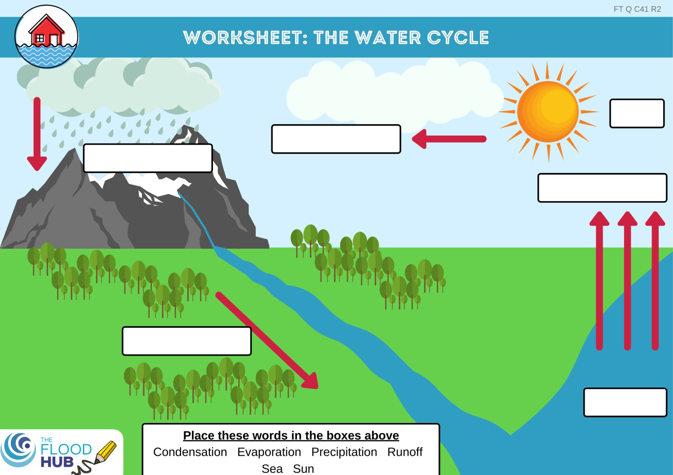
FT Q C41 R2
Recap - The Water Cycle
Sun
Flooding is caused by rain which is a part of the water cycle.
Can you name the different steps of the water cycle?
Condensation
Precipitation
Evaporation
Runoff
Sea

Slide 6
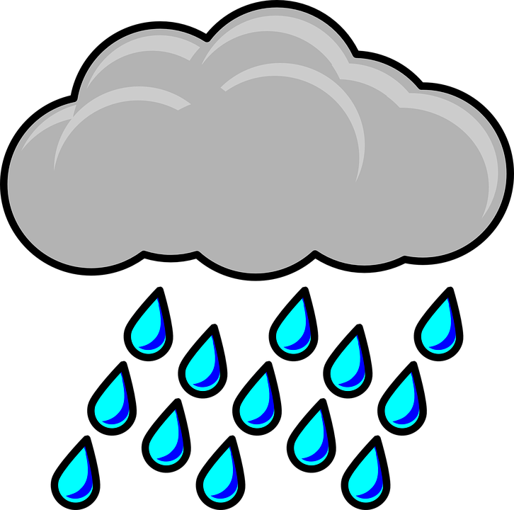





What can make flooding worse?
Storms & heavy rain
Deforestation
Buildings & hard surfaces
More rain means more water entering rivers
Less water is soaked up through tree roots and leaves
Water cannot soak into the ground
Steep hills
Very wet ground
Hard dry ground
Water runs off steep hills quickly into rivers
This can’t soak up any more water
This can’t let any water soak in
FT Q C41 R2

Slide 7
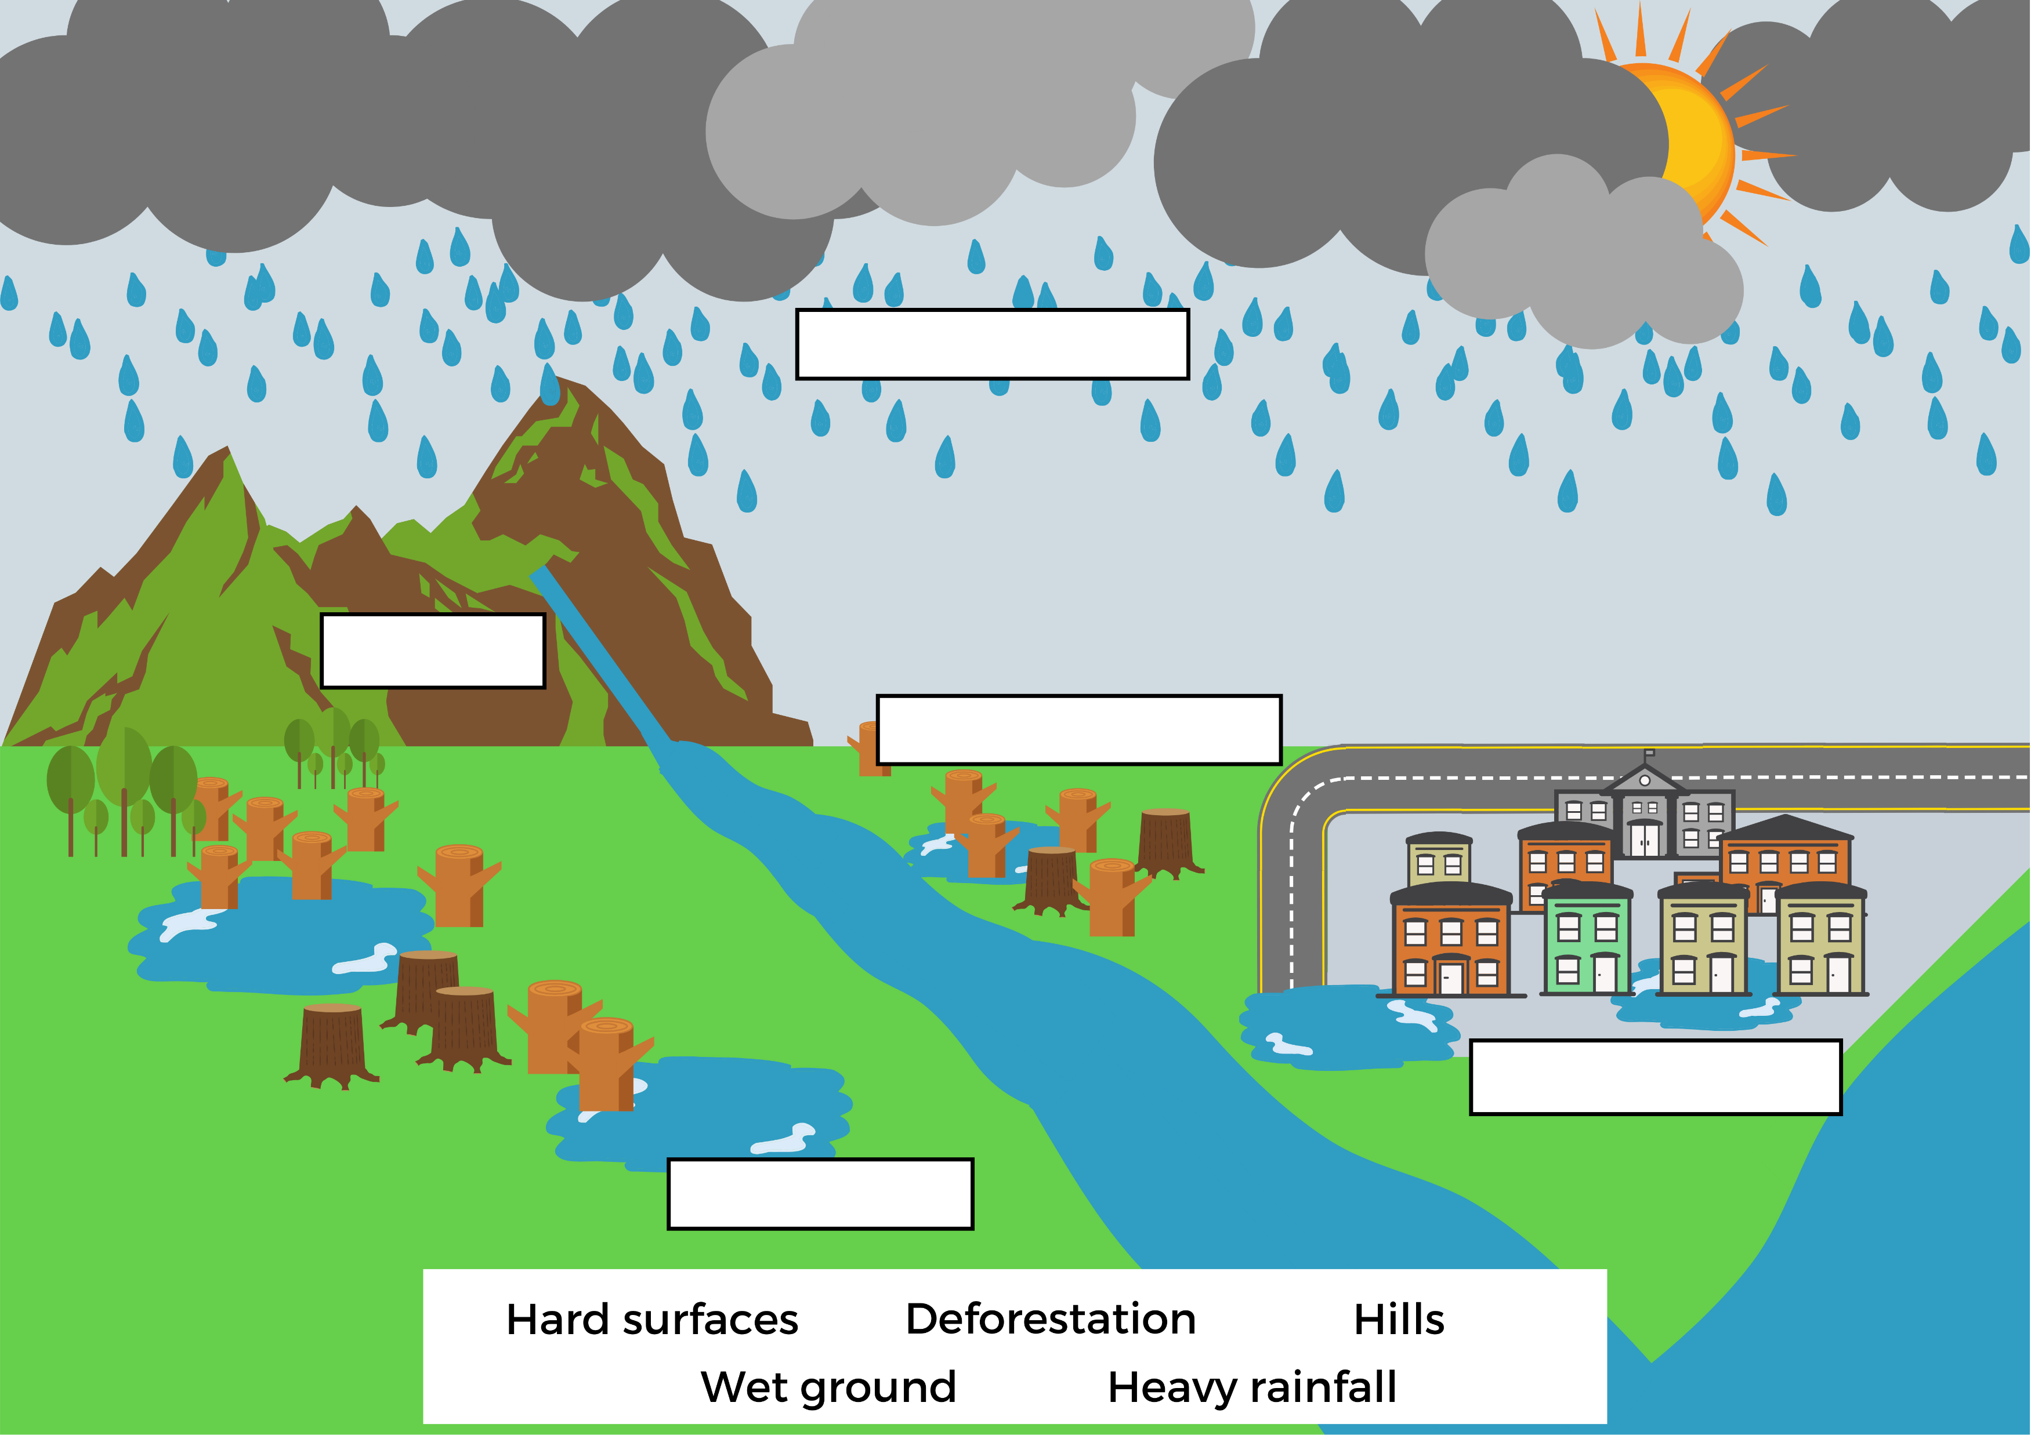
FT Q C41 R2
What can make flooding worse?
FT Q C41 R2
Can you match the words to the blank labels to identify what can make flooding worse?
Which are natural and which are man made?
Heavy rainfall
Natural
Hills
Natural
Deforestation
Man made
Hard surfaces
Man made
Wet ground
Natural

Slide 8


Experiment time!
Optional: Experiments to show the different influences of flooding.
FT Q C41 R2

Slide 9
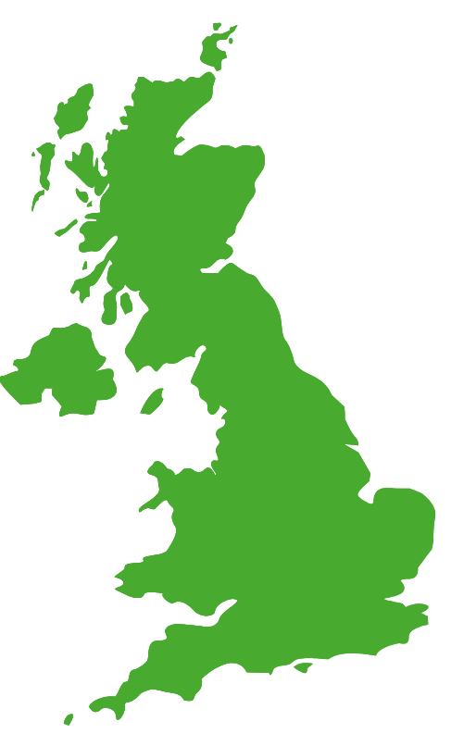
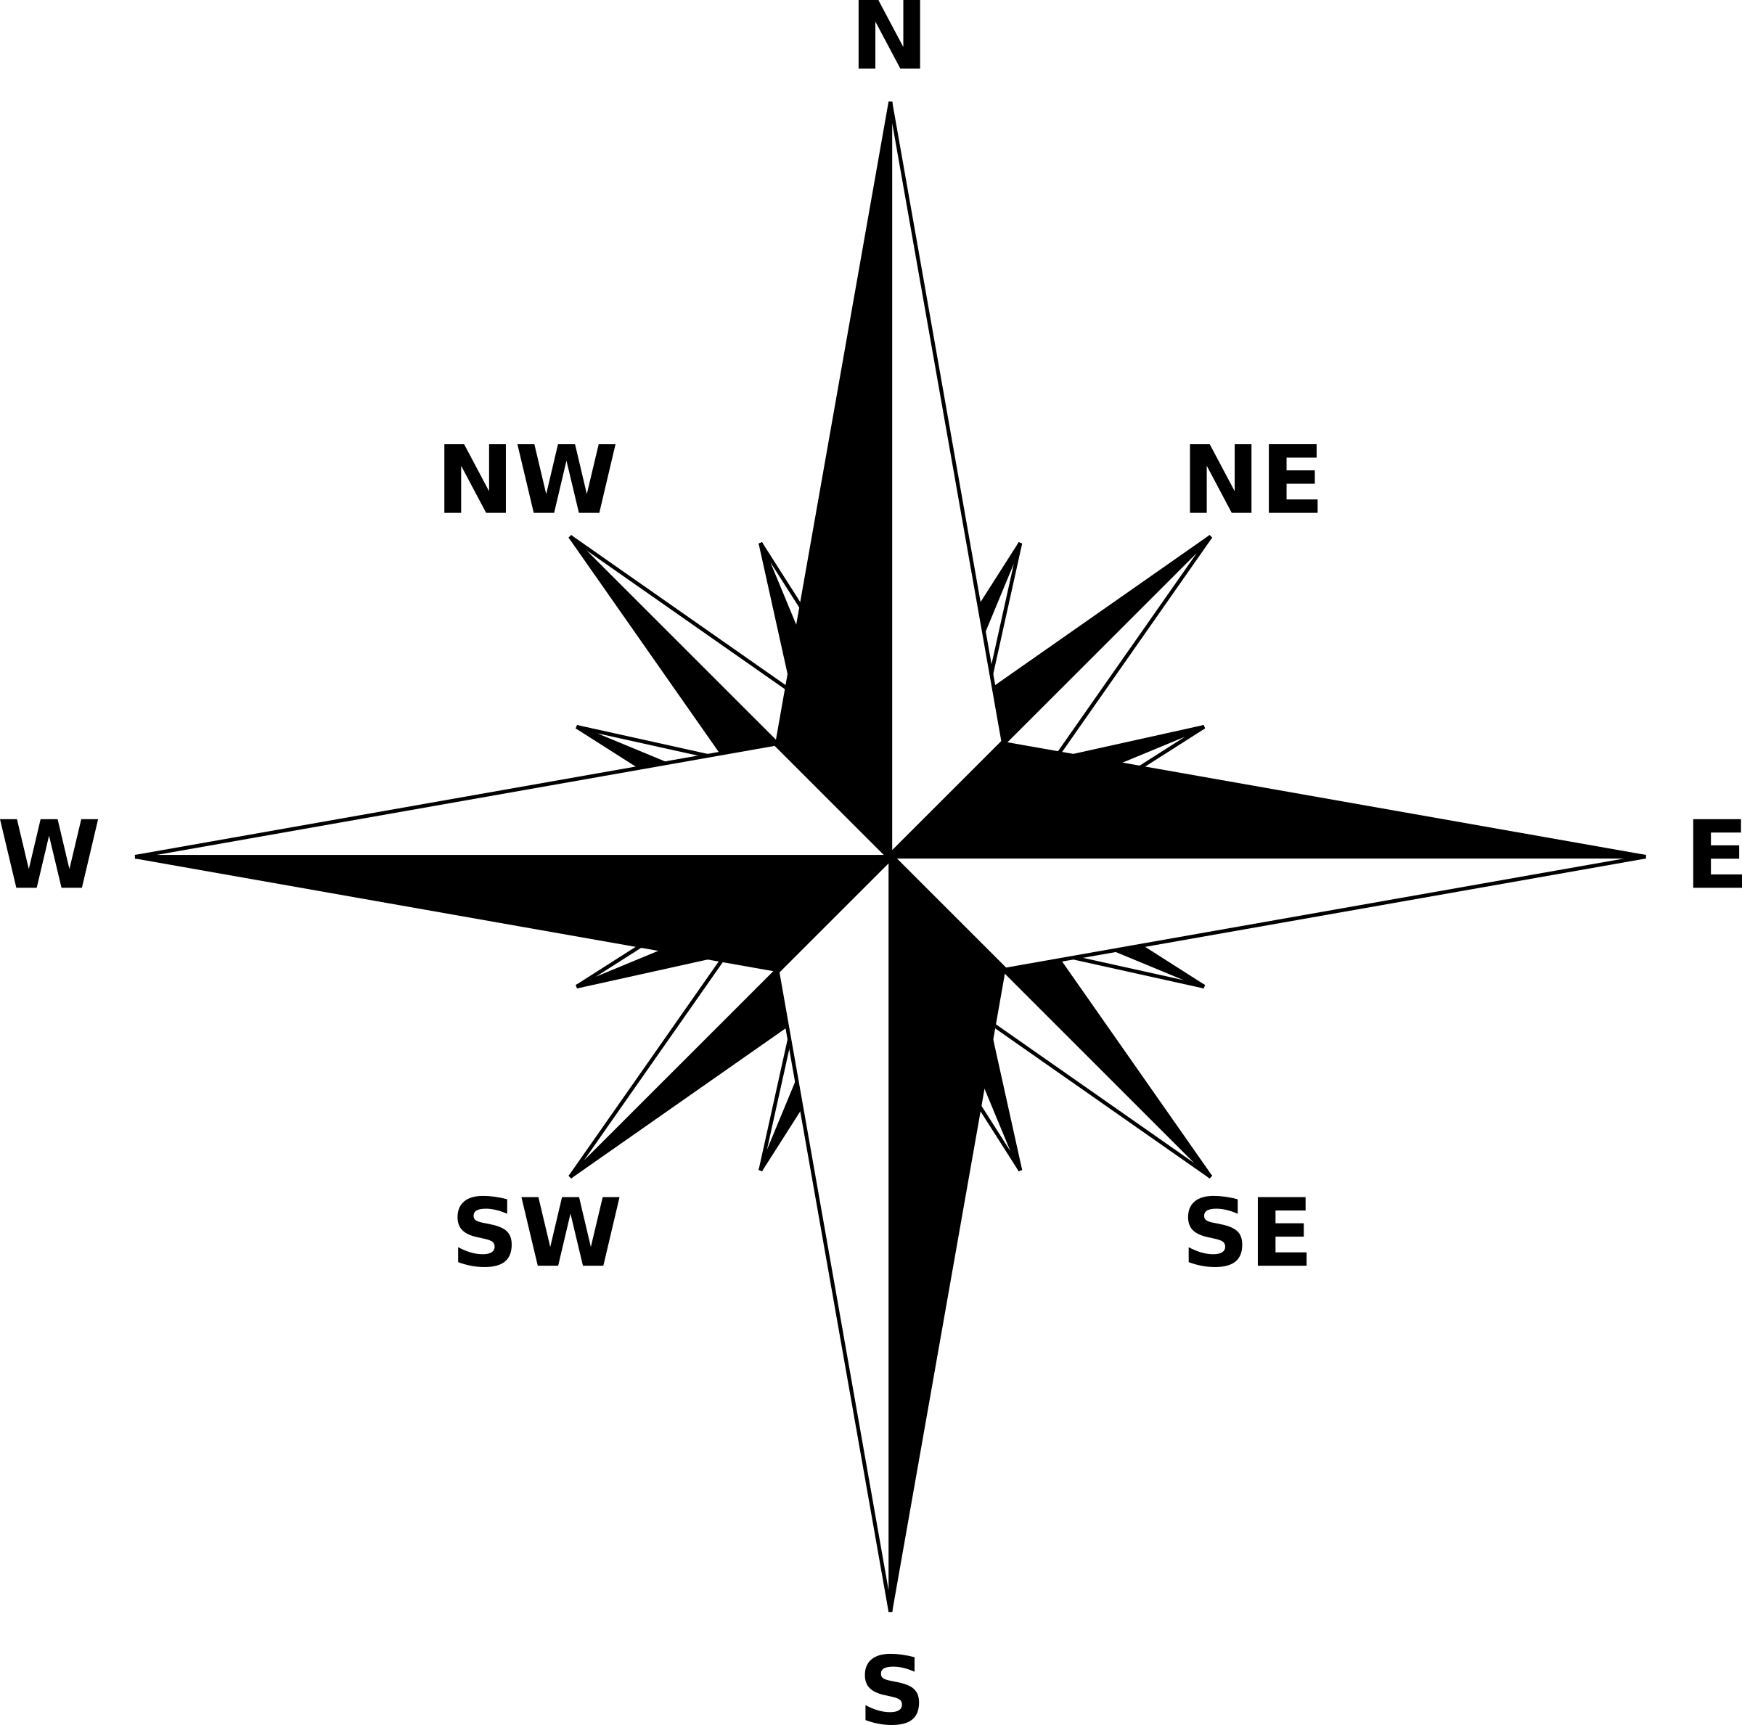
Quiz
Where do you think it rains the most in the UK?
The correct answers are…….
FT Q C41 R2

Slide 10
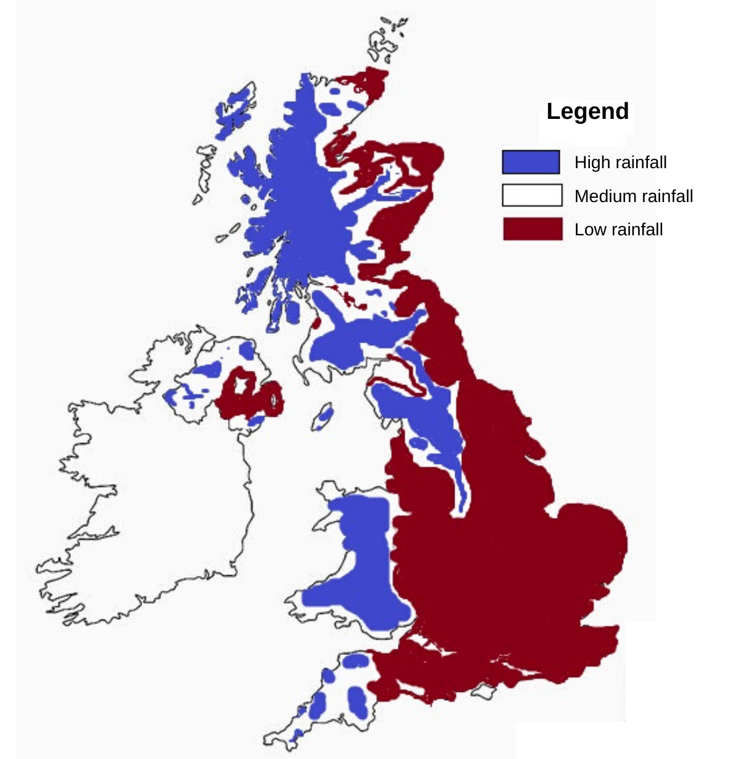
Quiz
THE NORTH AND WEST OF THE UK!
However, heavy rainfall and extreme weather will become more common across all of the UK due to climate change!
FT Q C41 R2

Slide 11
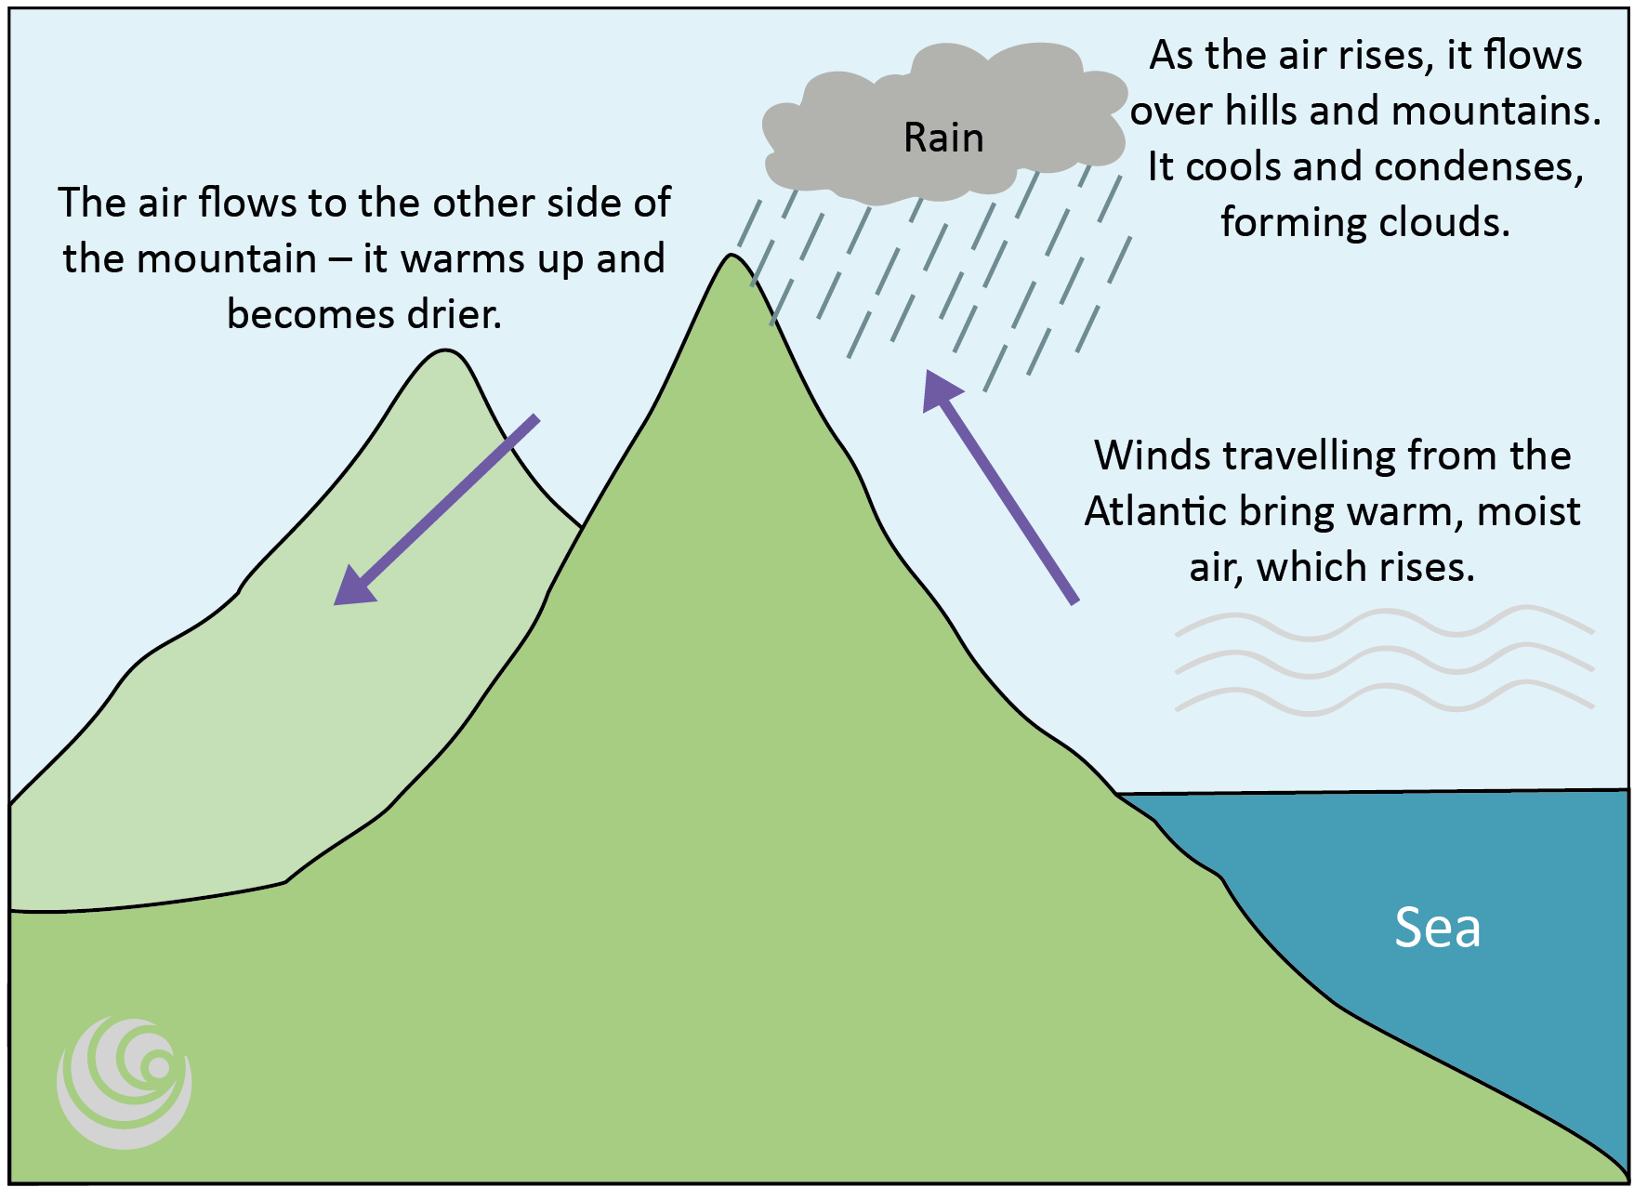
Why does it rain more in the North and West?
There are lots of hills and mountains in the west.
Winds travelling from the Atlantic bring, warm, moist air to the west of Britain.
The air flows over the hills and mountains.
The air cools and condenses forming clouds.
It begins to rain.
The air flows to the other side of the mountain – it warms up and becomes drier.
FT Q C41 R2

Slide 12
Quiz
Scotland
Name the four countries represented by the
England
Northern Ireland
Wales
FT Q C41 R2

Slide 13
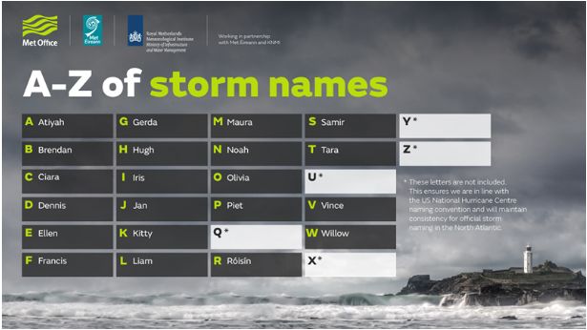
Storms
Storms may become more frequent due to climate change. They are named to raise awareness of extremely bad weather. This enables the public to keep themselves, their homes and businesses safe. Storms are named in this country by the Met Office.
Come up with your own list of storm names in alphabetical order!
Image: Met Office
FT Q C41 R2

Slide 14
Recap of lesson
A flood is…
Flooding is caused by…
Flooding can be made worse by…
A large amount of water covering an area of land that is usually dry.
Heavy rain running off the ground into rivers which get too full.
Both natural and man made things like hard surfaces, storms and climate change.
FT Q C41 R2

Slide 15

Homework
Research a flood in the UK. Find out…
Where did it happen?
What year did it happen?
What caused it?
What were the impacts?
  How many houses were flooded?
  Did it cause other damage to the town/village?
FT Q C41 R2

Slide 16

These lessons have been produced by
The Flood Hub People for The Flood Hub.
Scan the QR code to access our ‘Learning’ section. Or visit here: https://thefloodhub.co.uk/learning/
FT Q C41 R2

