Slide 1




Coastal Flooding and Erosion
Lesson aim:
To understand how our coastline is changing and how this affects the risk of flooding (coastal flooding and erosion).
Lesson objectives:
To understand what a coast is and that the shape is constantly changing.
To understand how a coastline changes.
To understand the impacts of a changing coastline and how this can affect flood risk.
To understand how climate change and rising sea levels can cause an increase in coastal flooding and erosion.
FT Q C43 R2

Slide 2
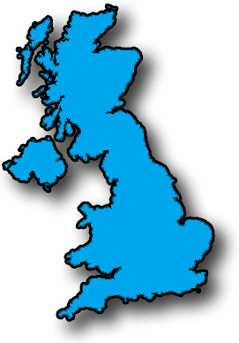
What is a coastline?
Do you know any other
names for coastline?
A coastline describes a point where the land meets the sea or a place near to it.
Sea shore
Seaside
Waterfront
Beach
FT Q C43 R2

Slide 3
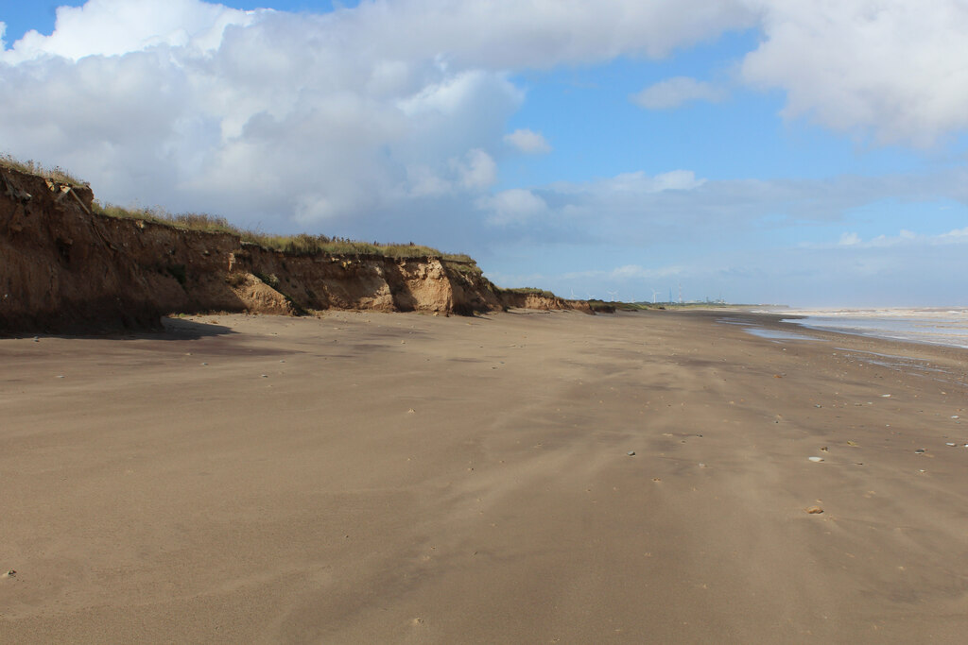
Types of Coastline
Our coastline is changing all the time because the sea is ‘wearing away’ the land. Here are some different types of coastline.
Sandy Beaches
The constant movement of the water can wear away the beach by carrying the sand and pebbles away.
Not all the coastline looks like the beach in the slide, so what do other parts of the coastline look like?
Sandy Beach North of Kilnsea cc-by-sa/2.0 - © Chris Heaton - geograph.org.uk/p/7288257
FT Q C43 R2

Slide 4
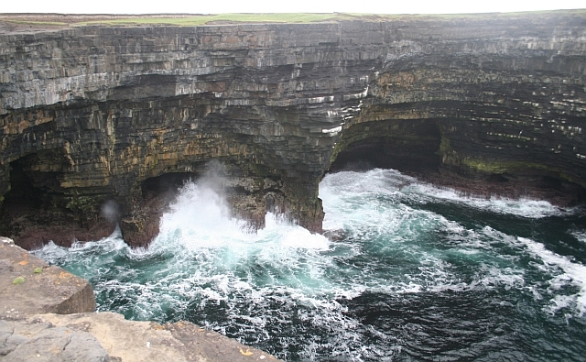
Types of Coastline
Rocky Cliffs
Some parts of the coastline may be made up of rocky cliffs, but even these can wear away over a long period of time.
Wave Erosion, Downpatrick Head cc-by-sa/2.0 - © Bob Embleton - geograph.org.uk/p/369272
FT Q C43 R2

Slide 5
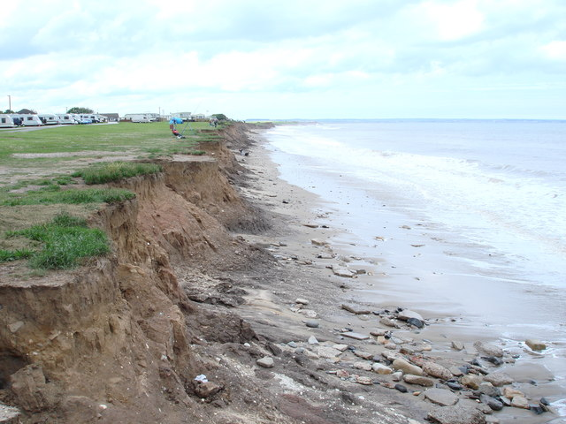
Types of Coastline
Soft Soils and Clay
Some parts of the coast are made of softer material such as clay and can wear away very quickly, particularly during storms.
Coastal erosion at Ulrome, East Yorks cc-by-sa/2.0 - © phillip andrew carl taylor - geograph.org.uk/p/1515059
FT Q C43 R2

Slide 6
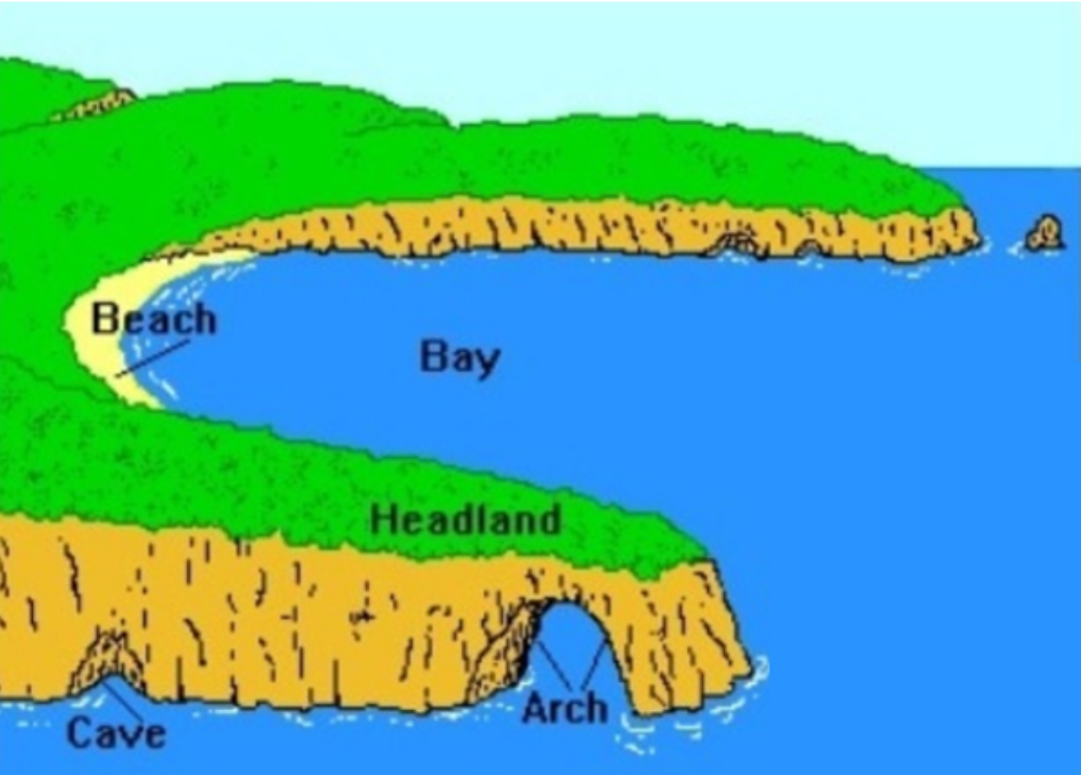
Coastal Features
As the tide goes in and out over thousands of years the sea changes the coastline and different features appear.
Take a look at this video about costal erosion and landforms:
https://www.bbc.co.uk/programmes/p00xr65v
Beach
Bay
Headland
Cave
Arch
FT Q C43 R2

Slide 7
The Changing Coastline
Recap
Beach material such as sand, pebbles and rocks are moved around and washed away by waves.
Softer ground made up of clay and soil is easily washed away by storms and big waves.
Even hard rocks and cliffs can be worn away by the force of the sea over time.
These processes are known as coastal erosion.
Let’s watch this video about how coastal erosion happens: https://www.bbc.co.uk/bitesize/clips/z7fr87h
FT Q C43 R2

Slide 8
Fill in the blanks
Thinking back to what you have just seen, can you fill the boxes in the picture with the correct word below?
Arch
Cave
Beach
Headland
Bay
FT Q C43 R2

Slide 9
FT Q C43 R2
Word search
S | Z | U | C | A | Y | R | I | R | E | H | A
Q | R | S | E | N | D | U | U | I | N | H | R
U | H | E | A | D | L | A | N | D | G | E | C
K | H | G | T | S | M | R | R | P | S | A | H
R | T | E | R | B | P | V | M | H | I | R | Y
T | B | R | G | G | V | U | A | T | O | L | S
A | E | O | C | K | T | W | W | B | N | A | E
R | A | S | S | S | N | A | E | A | D | R | A
C | C | I | I | B | C | C | T | Y | D | T | S
L | H | O | R | E | M | R | A | I | E | O | I
T | R | N | E | E | B | K | R | V | C | A | D
C | O | A | S | T | C | K | O | C | E | S | E
Can you find the hidden words in this coastal word search?
Arch
Bay
Beach
Cave
Coast
Erosion
Headland
Seaside

Slide 10
FT Q C43 R2
Word search
S | Z | U | C | A | Y | R | I | R | E | H | A
Q | R | S | E | N | D | U | U | I | N | H | R
U | H | E | A | D | L | A | N | D | G | E | C
K | H | G | T | S | M | R | R | P | S | A | H
R | T | E | R | B | P | V | M | H | I | R | Y
T | B | R | G | G | V | U | A | T | O | L | S
A | E | O | C | K | T | W | W | B | N | A | E
R | A | S | S | S | N | A | E | A | D | R | A
C | C | I | I | B | C | C | T | Y | D | T | S
L | H | O | R | E | M | R | A | I | E | O | I
T | R | N | E | E | B | K | R | V | C | A | D
C | O | A | S | T | C | K | O | C | E | S | E
Can you find the hidden words in this coastal word search?
Arch
Bay
Beach
Cave
Coast
Erosion
Headland
Seaside

Slide 11
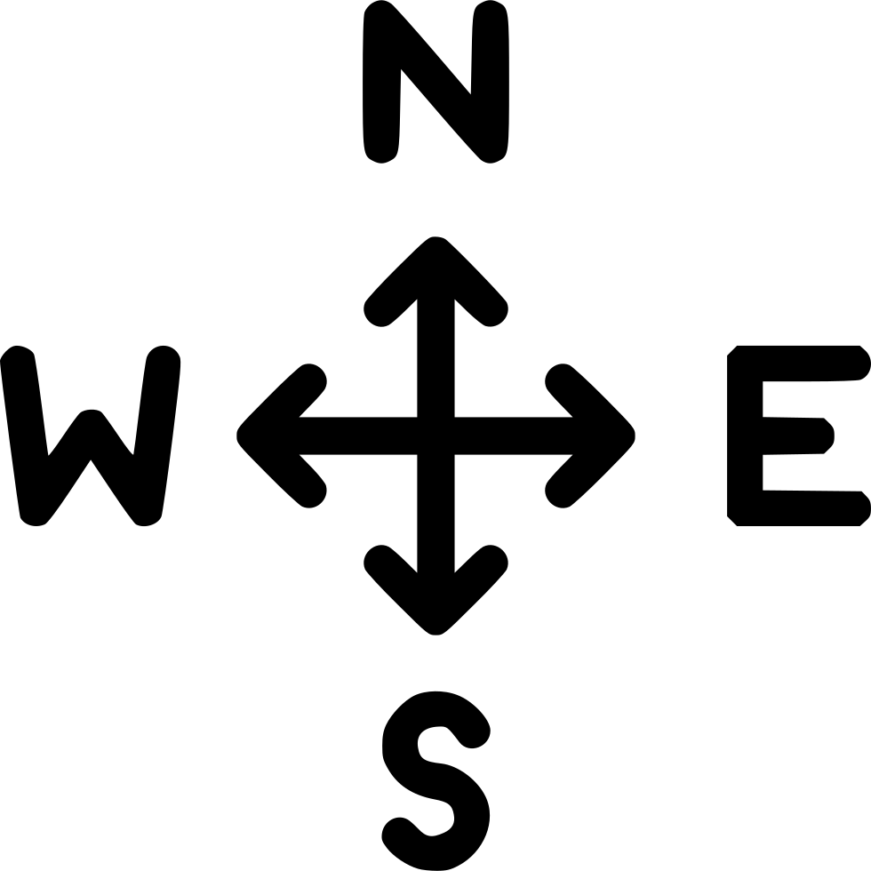
Is coastal erosion a problem for everyone?
If you lived in a house near the coastline would coastal erosion be a problem?
It depends where you live!
At Holderness on the East Coast of England roughly 2 metres of coastline is eroded every year.
Holderness
FT Q C43 R2

Slide 12
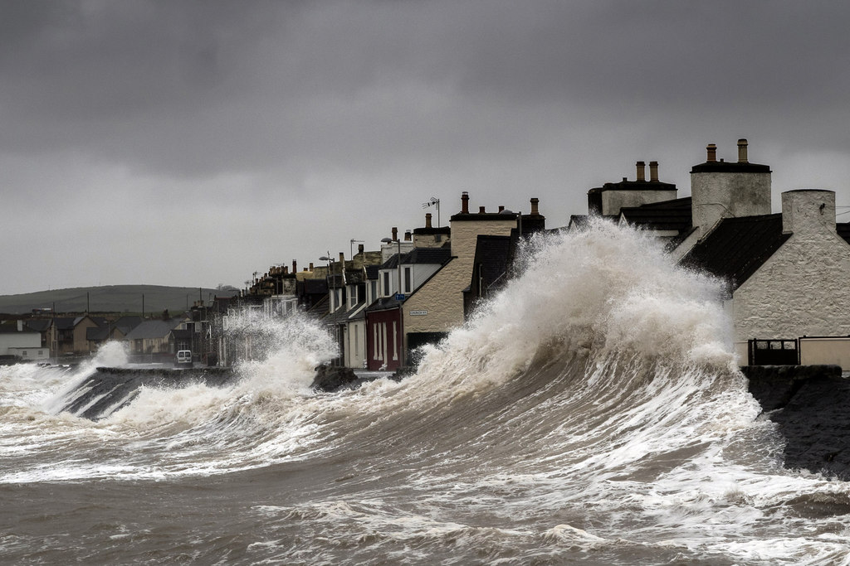
Climate Change, Coastal Erosion and Flooding
Climate change is now also adding to the problem of erosion and flooding in some coastal areas. Higher sea levels, more storms and large waves can speed up erosion and cause flooding.
Storm surge cc-by-sa/2.0 - © David Baird - geograph.org.uk/p/3833138
FT Q C43 R2

Slide 13
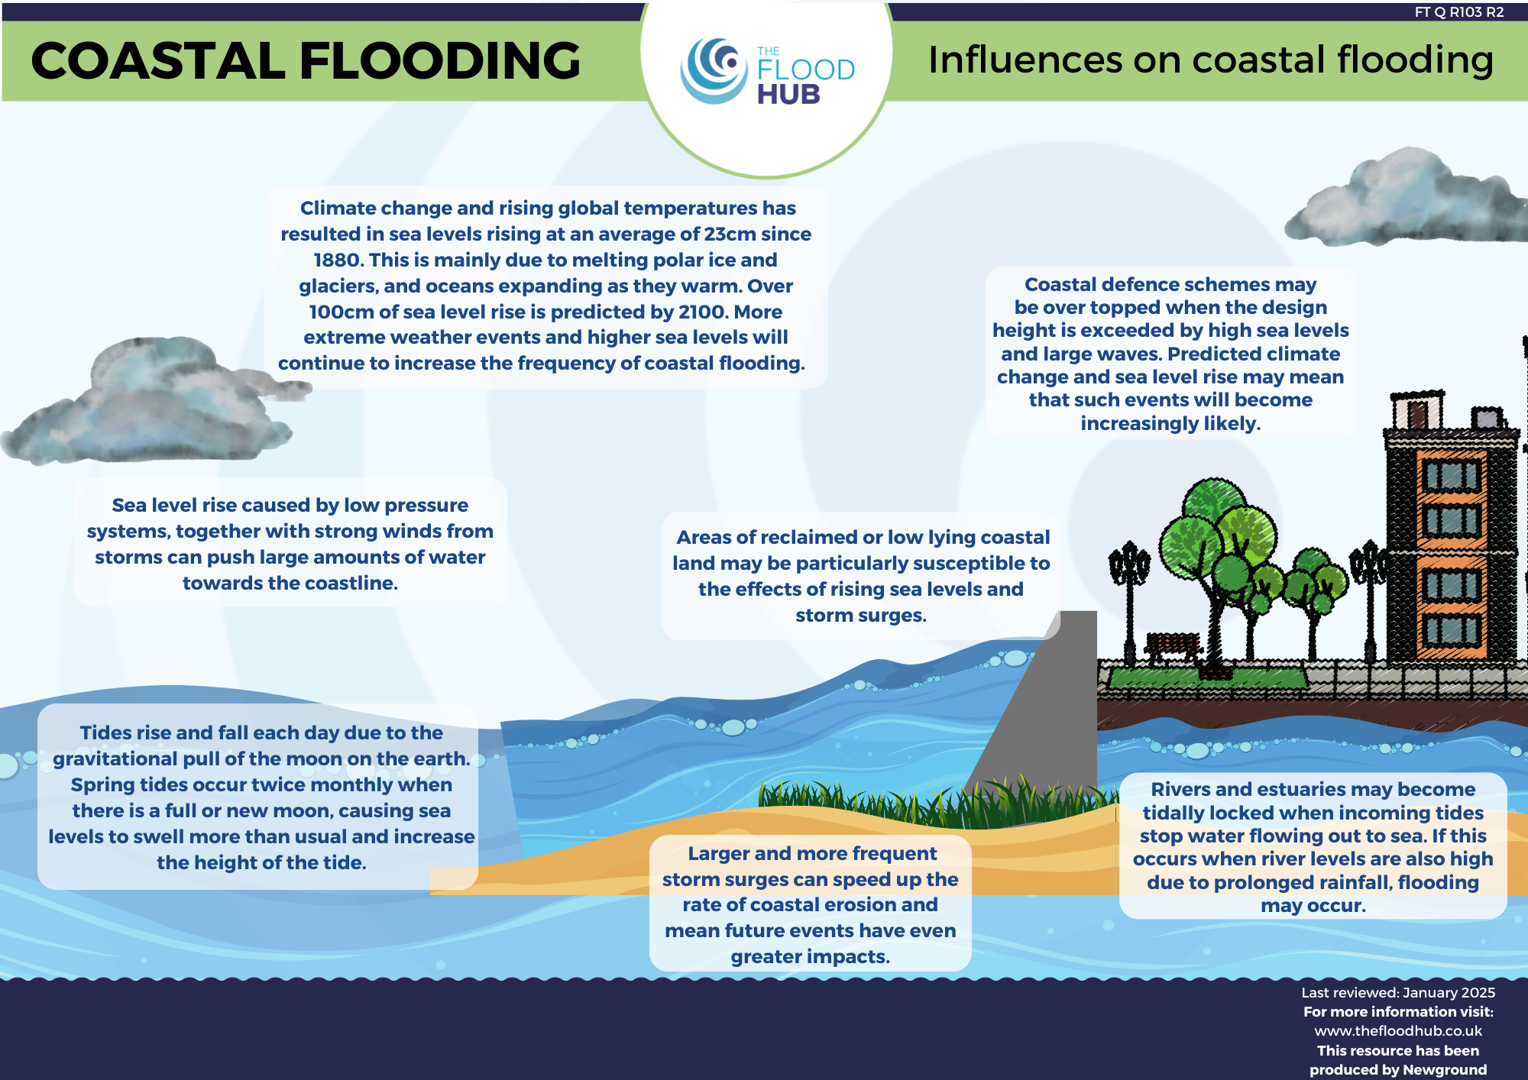
Climate Change, Coastal Erosion and Flooding
As the sea level rises, coastal areas which are flat or low lying become more at risk of flooding from high tides and storms. This is because the higher water level will cause more water to be pushed onto the land.
FT Q C43 R2

Slide 14
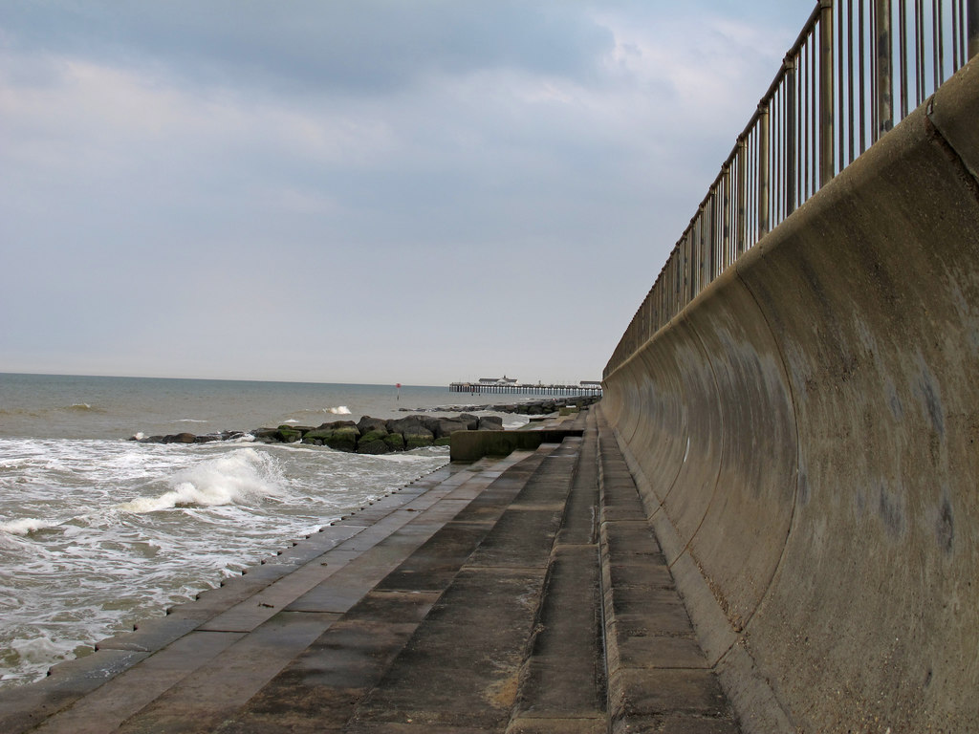
FT Q C43 R2
What can be done?
We can try to slow down the erosion, this is called Coastal Management.
Sea Walls
Concrete walls can be built to stop the sea coming further onto the land or to stop parts of the coast wearing away where people may live, work or visit.
The Sea Wall at Easton Marshes, near Southwold cc-by-sa/2.0 - © Roger Jones - geograph.org.uk/p/5836022

Slide 15
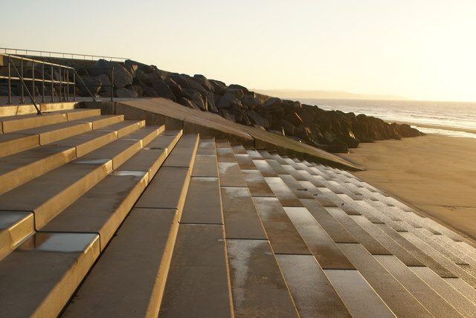
Coastal Management
Revetments
You may have seen these and thought they were just steps!
But these steps and slopes made of wood or concrete are designed to reduce the force of the waves so they do less damage.
View along the stepped revetment on Dymchurch beach #2 cc-by-sa/2.0 - © Robert Lamb - geograph.org.uk/p/5107531
FT Q C43 R2

Slide 16
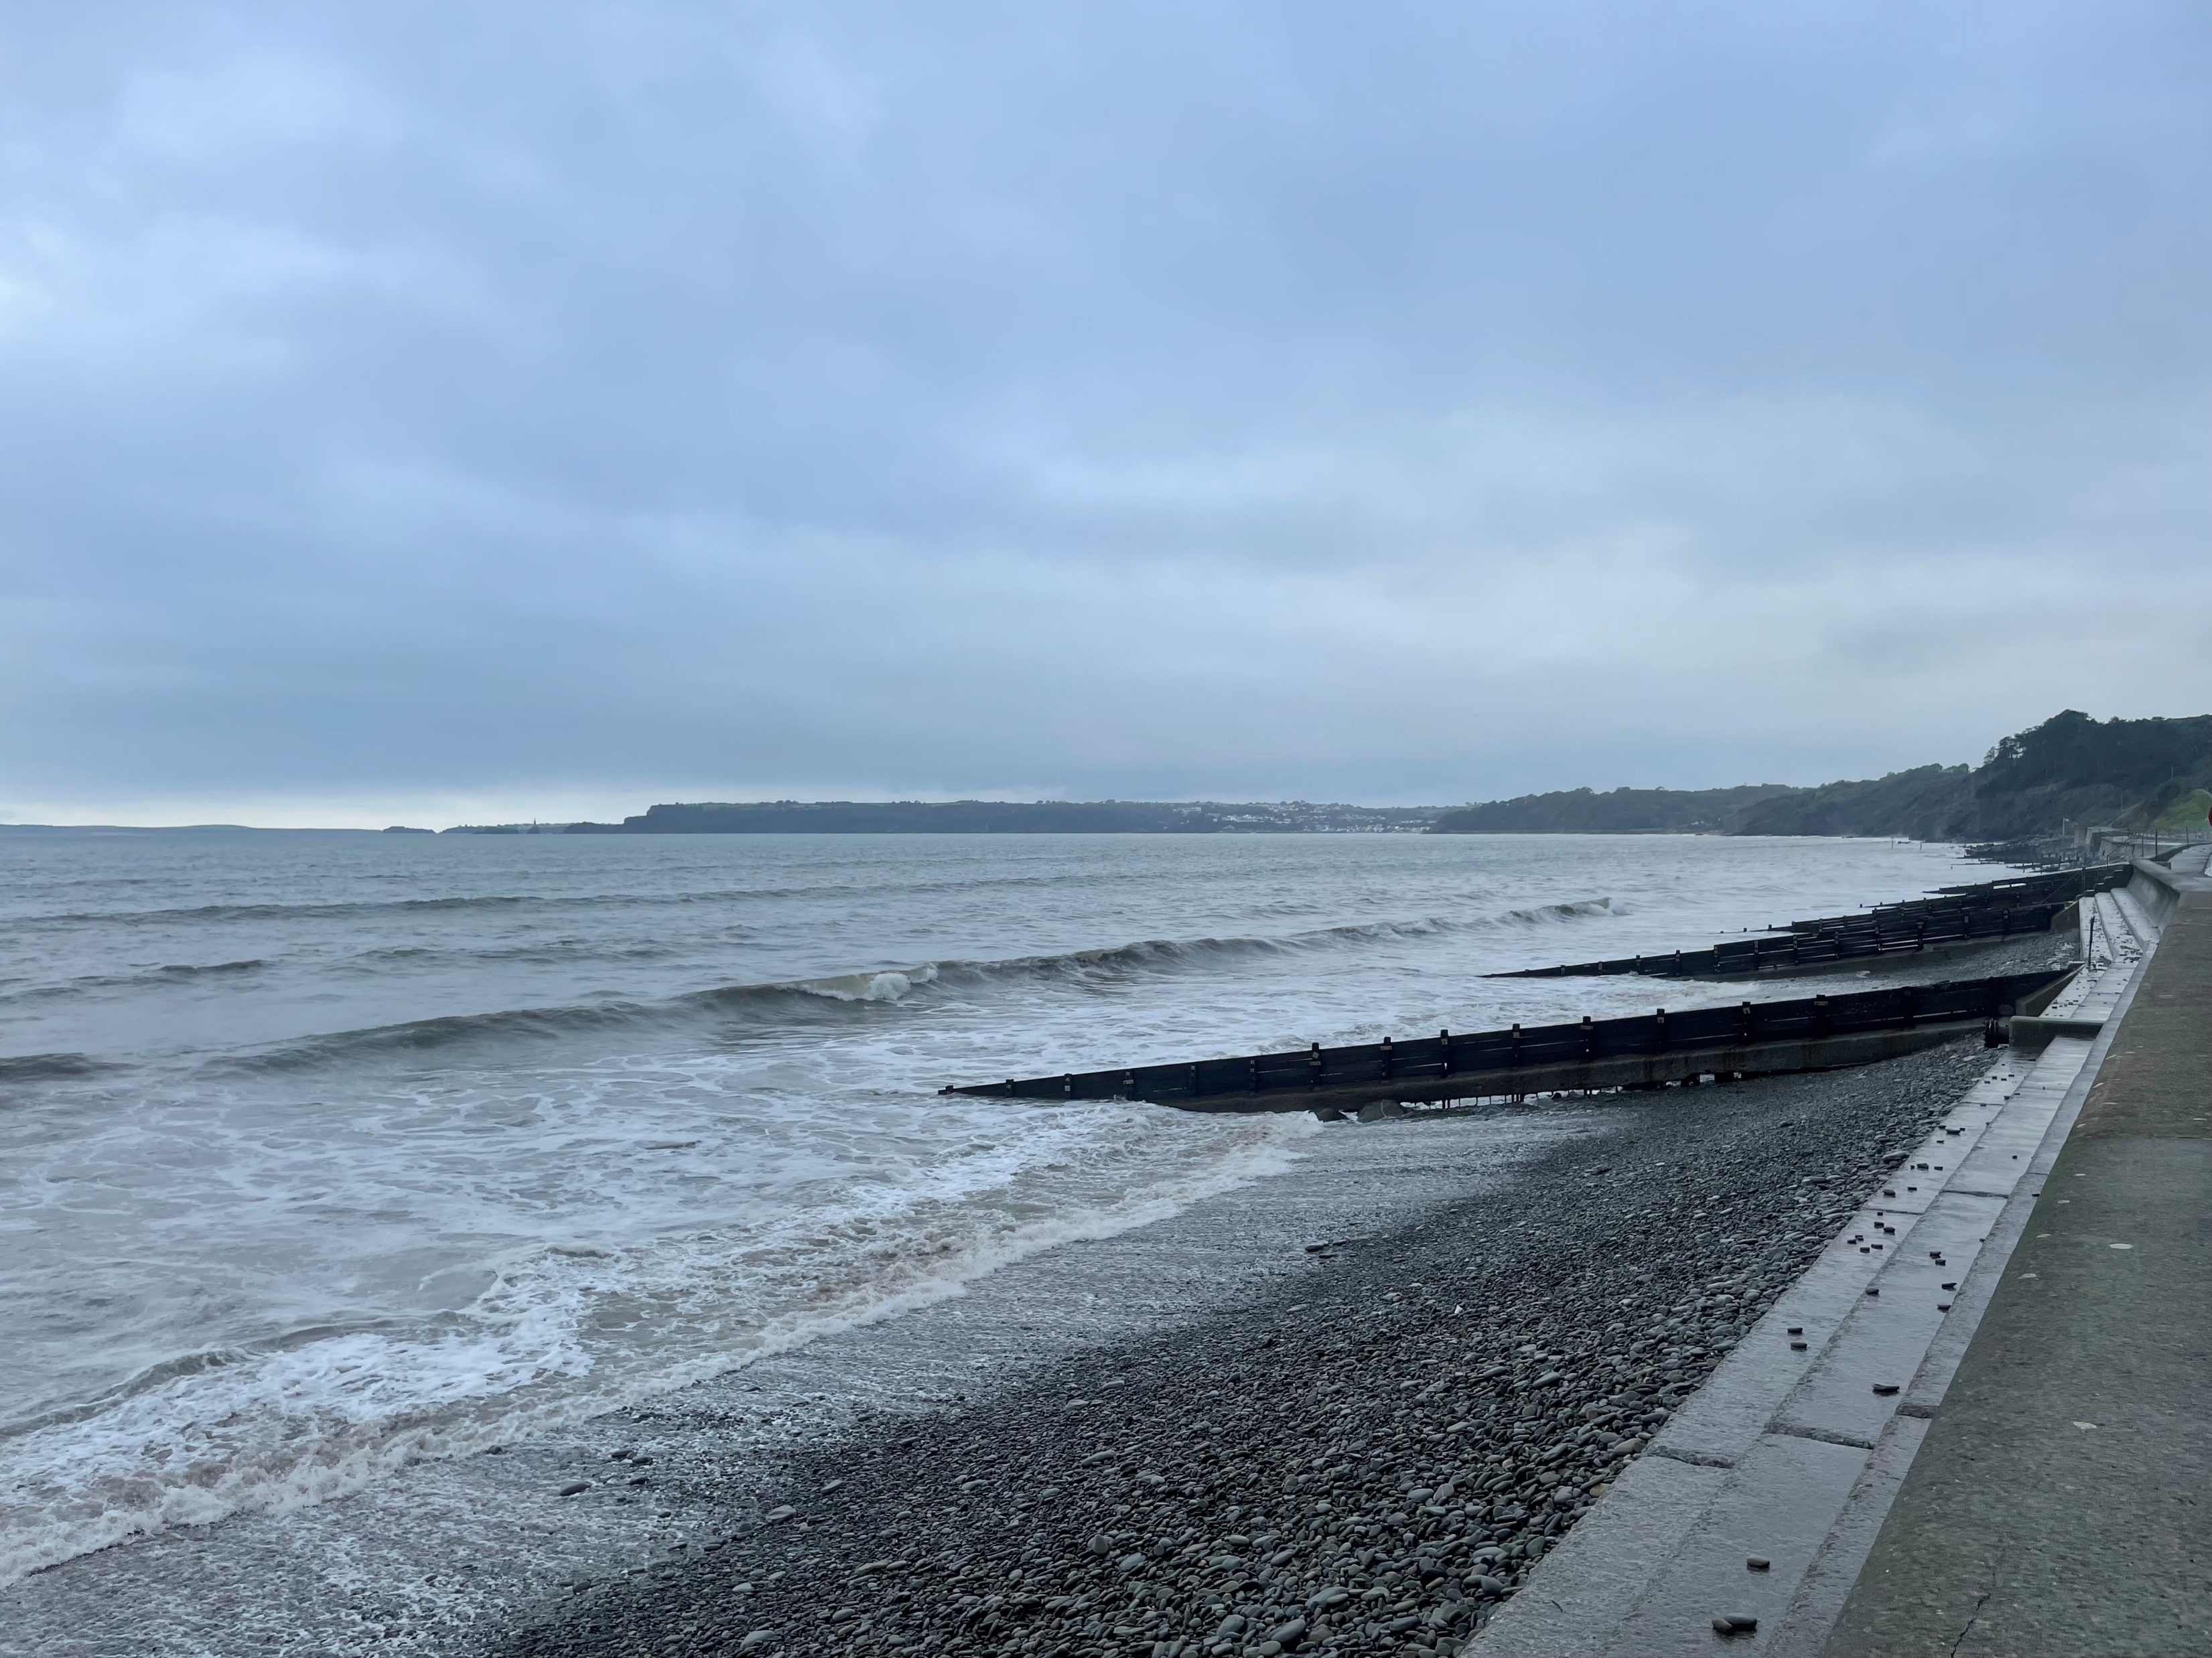
Coastal Management
Groynes
These barriers stretch out from the beach towards the sea and stop the
sand and pebbles moving along the
beach from one area to another.
Image: The Flood Hub
FT Q C43 R2

Slide 17
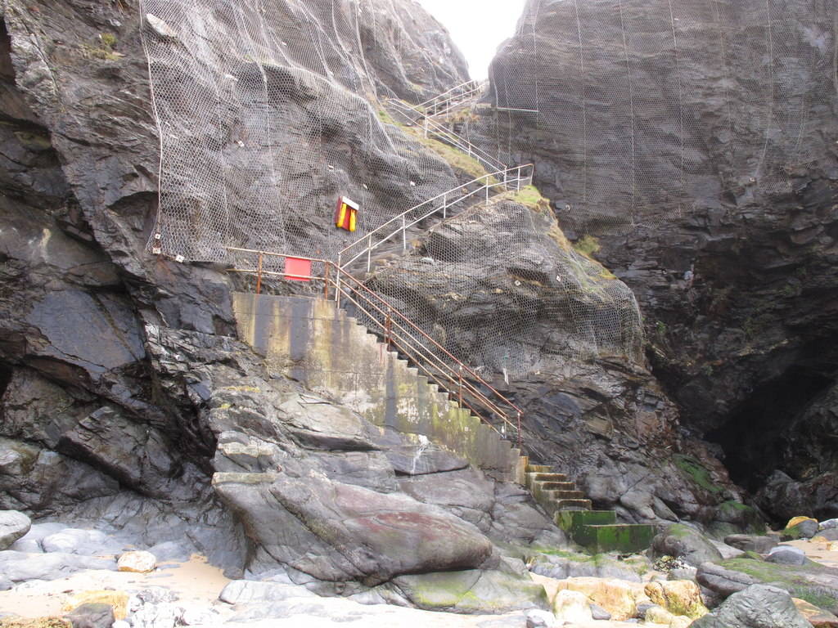
Coastal Management
Cliff Stabilisation
Steel netting can be spread out over the cliff and held in place with large bolts. This holds loose parts of the cliff in place, stopping rocks breaking off and causing further damage.
Rock netting by beach stairs, Bedruthan Steps cc-by-sa/2.0 - © David Hawgood - geograph.org.uk/p/2855121
FT Q C43 R2

Slide 18
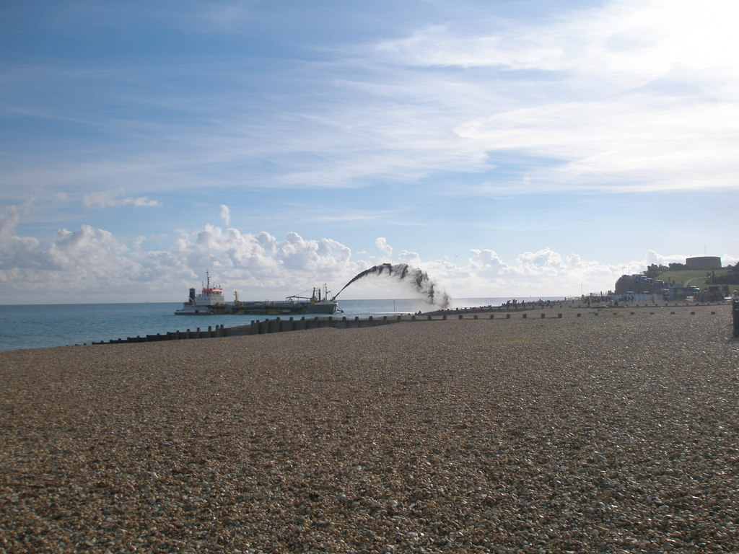
Coastal Management
Beach Nourishment
In this picture we see a large boat, which is sucking up sand and pebbles from the sea floor and pumping them back onto the beach.
This replaces the material that has
been eroded.
Beach replenishment at Eastbourne cc-by-sa/2.0 - © Adrian Diack - geograph.org.uk/p/5164948
FT Q C43 R2

Slide 19
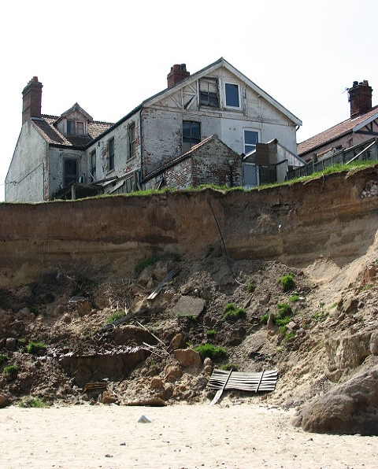
Sometimes we can’t do anything!
Sometimes, as we saw earlier in Holderness,
it is not possible or practical to stop coastal
erosion. People are now losing their homes
to the sea as it gets closer!
This video looks at whether we should protect properties at the coast: https://www.youtube.com/watch?
v=F7xNJiU3ZgE
Falling into the sea cc-by-sa/2.0 - © Evelyn Simak - geograph.org.uk/p/799578
FT Q C43 R2

Slide 20
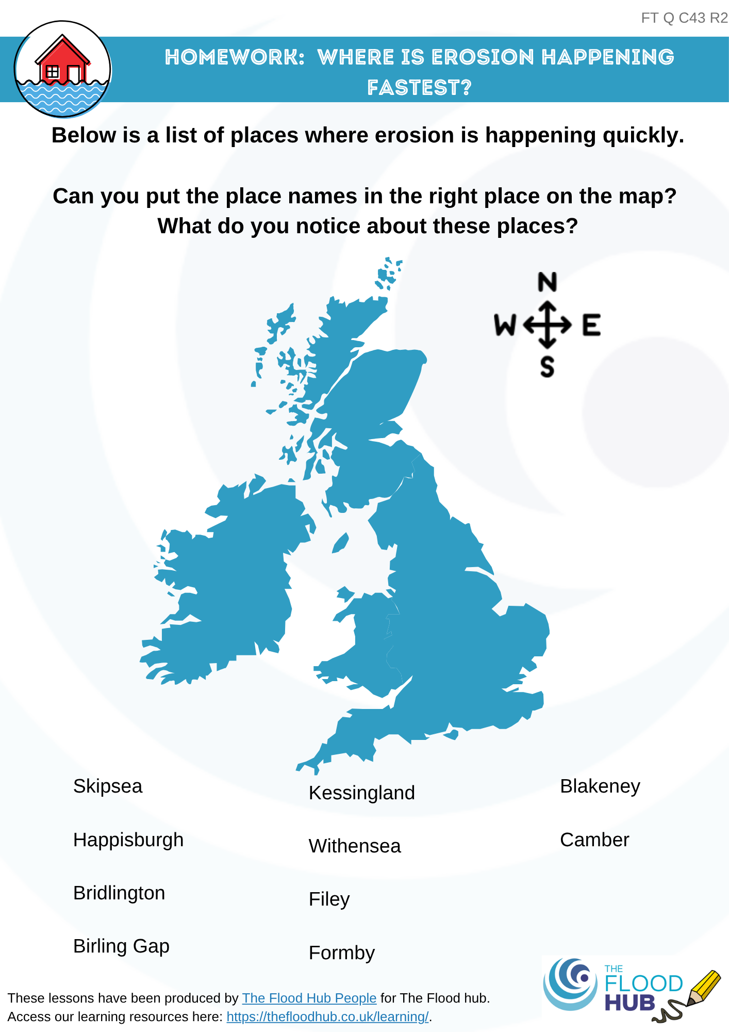

Homework: Where is erosion happening fastest?
Complete the worksheet called ‘Where is erosion happening fastest?’
FT Q C43 R2

Slide 21

These lessons have been produced by
The Flood Hub People for The Flood Hub.
Scan the QR code to access our ‘Learning’ section. Or visit here: https://thefloodhub.co.uk/learning/
FT Q C43 R2

