Slide 1




Planning and Preparing for Flooding
Lesson aim:
To learn how to plan and prepare for a flood.
To learn why it is important to plan and prepare for a flood.
To understand what to do in a flood or other emergency.
Lesson objectives:
To know what you can do to plan and prepare for a flood.
To understand that planning ahead and preparing can reduce the impact of a flood.
To understand what an emergency is and the different types.
FT Q C44 R2

Slide 2

FT Q C44 R2
Planning ahead
Planning ahead and preparing for a flood can reduce the impact it may have on your family, home or community.
It can also reduce the damage that floodwater has on your home and belongings
There are many things you can do to plan and prepare….
Image: The Flood Hub

Slide 3



How can you protect your house?
In some places, there won’t be a flood scheme to protect your house!
What can you do instead?
Find out your flood risk
Sign up to flood warnings
Make a flood plan
Make a flood kit
Buy some property flood resilience (PFR)
FT Q C44 R2

Slide 4
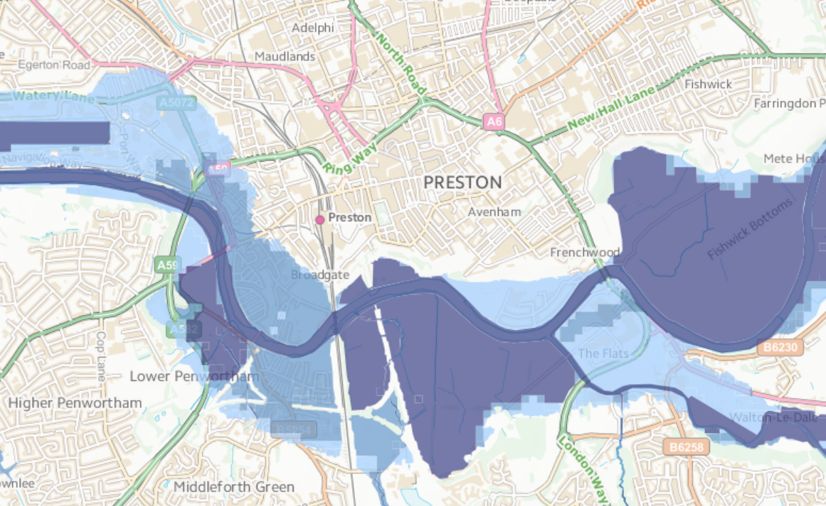
Flood risk
Find out your flood risk!
You can do this by going online and looking at flood risk maps.
Let’s see if we are at flood risk at this school!
Visit this website: https://flood-warning-information.service.gov.uk/long-term-flood-risk/postcode
Put in your post code and select your address
Click ‘View a map of the risk of flooding from surface water’
Select the options from the drop down box to see the risk of flooding from different sources
FT Q C44 R2
Image: The Environment Agency

Slide 5
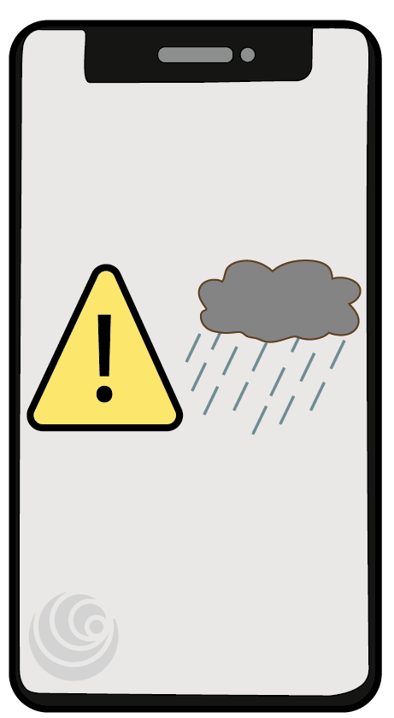
Flood warnings
What do flood warnings do?
Flood warnings send a message to your phone when flooding might happen!
They only work for flooding from rivers and the sea, not for surface water flooding.
They give you a warning so that you can prepare for a flood.
You can sign up to them online.
FT Q C44 R2

Slide 6
FT Q C44 R2
Flood warnings
What do the flood warnings mean?
Flood alert
Flood warning
Severe flood warning
Flooding is possible
Flooding is expected
There is a danger to life from the flooding
Get your flood kit
Check flood warnings
Turn off gas, water and electricity
Move things upstairs
Call 999 if you are in danger
Follow advice from emergency services
Prepare to leave your home
Complete the flood warnings match up exercise and stick it in your workbooks.

Slide 7
Flood warnings
Wait a minute… these flood warnings only tell you about flooding that comes from rivers and the sea! It can also come from places like streams and from lots of rain falling on tarmac!
How else can you be warned about flooding?
Met Office weather warnings (Yellow, Amber & Red warnings)
Alerts from mobile phone apps
“Gauge boards” on rivers & streams are big rulers showing how high it is
Watch local news & listen to local radio stations
FT Q C44 R2

Slide 8
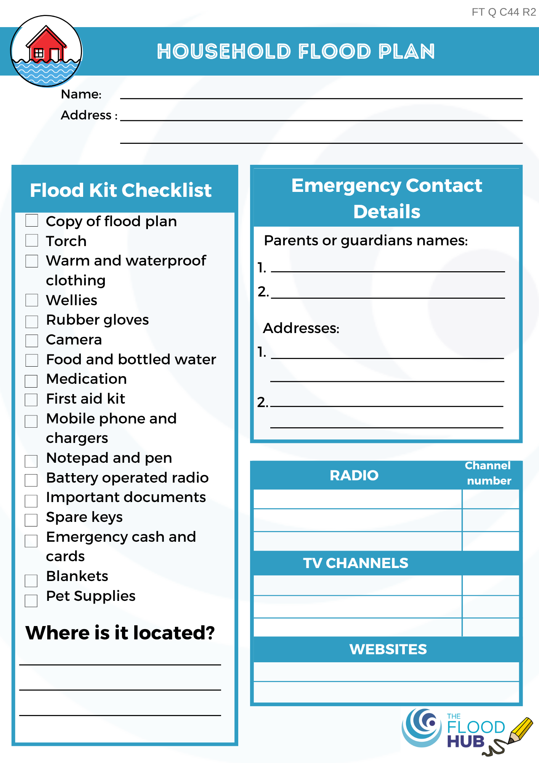
Flood plans
It’s a good idea to have a plan even if your house has never flooded before because they:
Tell you what to do if you receive a flood alert or warning.
Allow you to prepare for a flood, reducing the impact it could have.
FT Q C44 R2

Slide 9

Flood kits
What is a flood kit?
A flood kit or ‘grab bag’ is a bag which contains all the items you would need if you had to leave your house for a few days because of flooding!
You can prepare your flood kit at any time so that if flooding happens you would be ready to grab it and go.
FT Q C44 R2

Slide 10
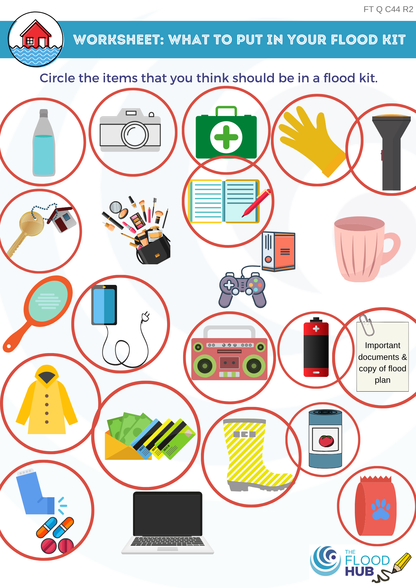
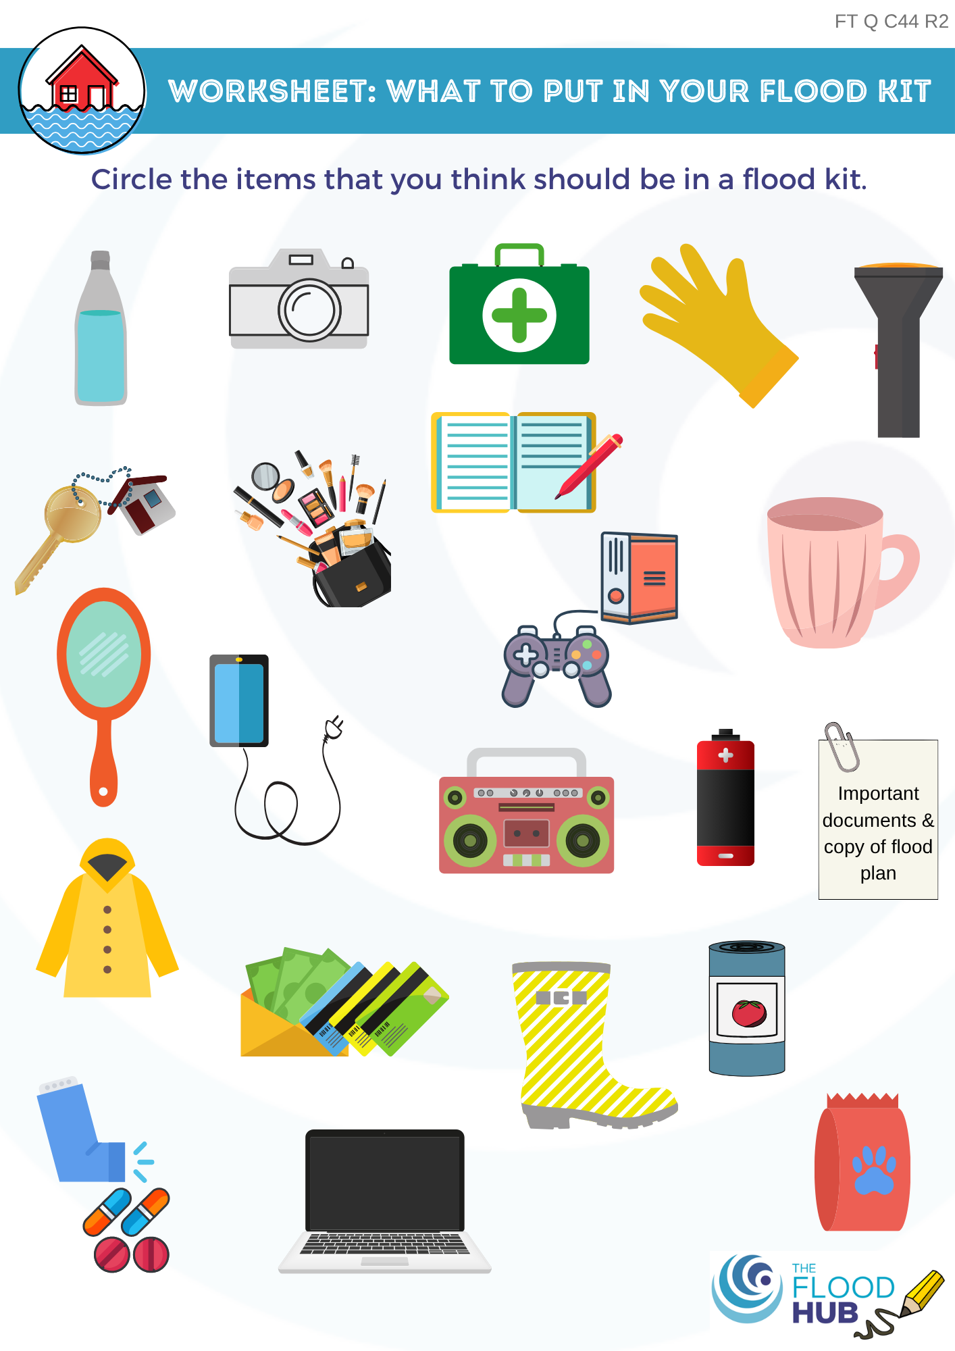
Flood kits
This is a bag which should contain the things you would need in a flood.
Circle what you think should be in your emergency kit.
FT Q C44 R2

Slide 11
Flood kit relay race exercise
In groups, decide which items in front of you would go in a flood kit.
When your time starts, one at a time choose an item and place it in the flood kit.
The first group to finish and who has the correct items in their flood kit wins!
FT Q C44 R2

Slide 12
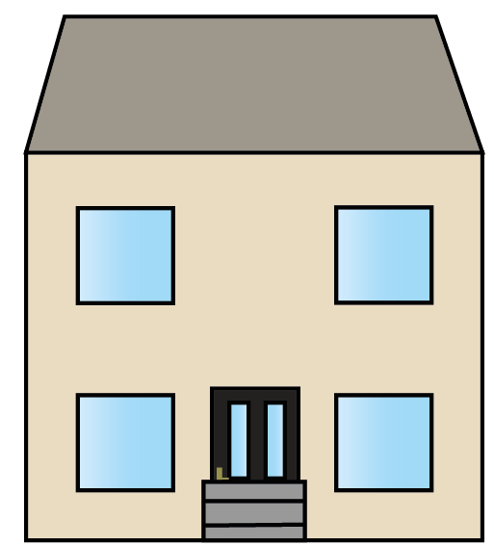






Other ways to prepare for flooding
Put in property flood resilience (PFR) measures to protect your home from damage from floodwater
Write down where your family can go to if you have to leave your home
Write down where your homes utility supplies are so you can switch them off if it floods
Create a list of emergency contacts
Image: The Flood Hub
Image: The Flood Hub
Image: The Flood Hub
Write down where your pets can go to if you have to leave your home
Think about your neighbours who may need extra help in a flood
Keep checking the weather forecasts on the news and radio
?
Image: The Flood Hub
Image: The Flood Hub
FT Q C44 R2

Slide 13
What is an emergency?
An emergency is an unexpected or dangerous situation which happens suddenly and requires quick action to deal with it.
FT Q C44 R2

Slide 14
What is an emergency?
It is an emergency……
If something serious happens and help is needed immediately, for example a serious accident or a crime.
If yours or somebody else’s life is in danger.
If somebody feels very unwell or is badly injured.
If there is a natural disaster such as a large storm, flood event, deep snow, a fire, loss of power etc.
FT Q C44 R2

Slide 15

What number should you call in an emergency?
If there is an immediate threat to life, you should call…
999
FT Q C44 R2

Slide 16
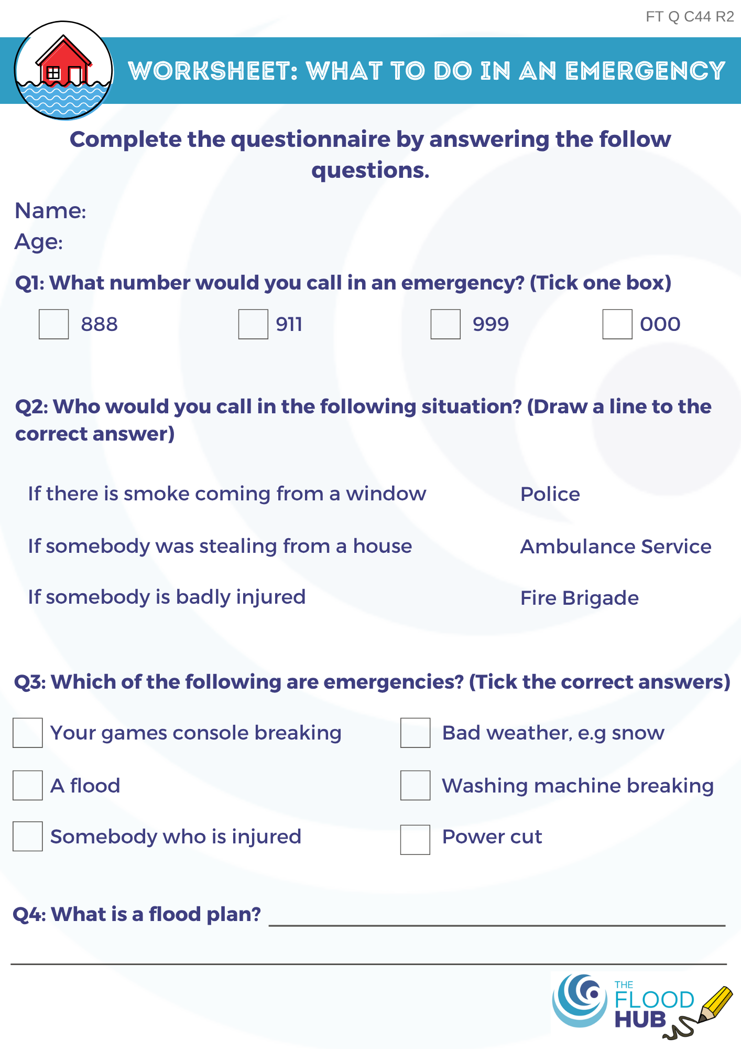
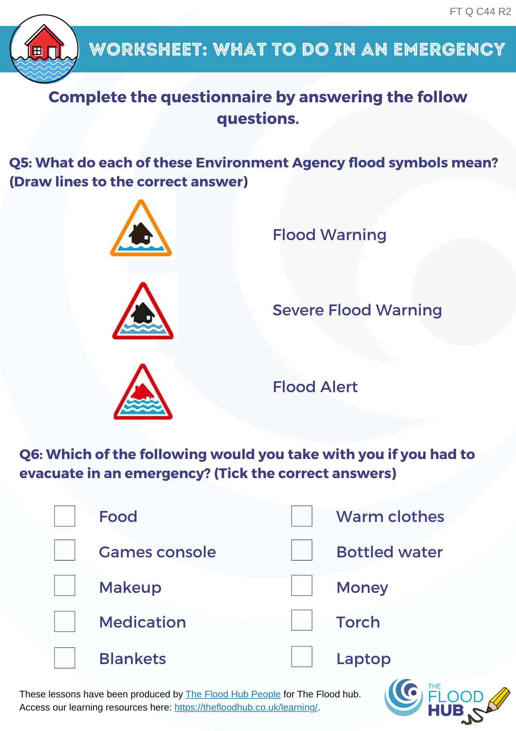
What would you do in an emergency?
FT Q C44 R2

Slide 17
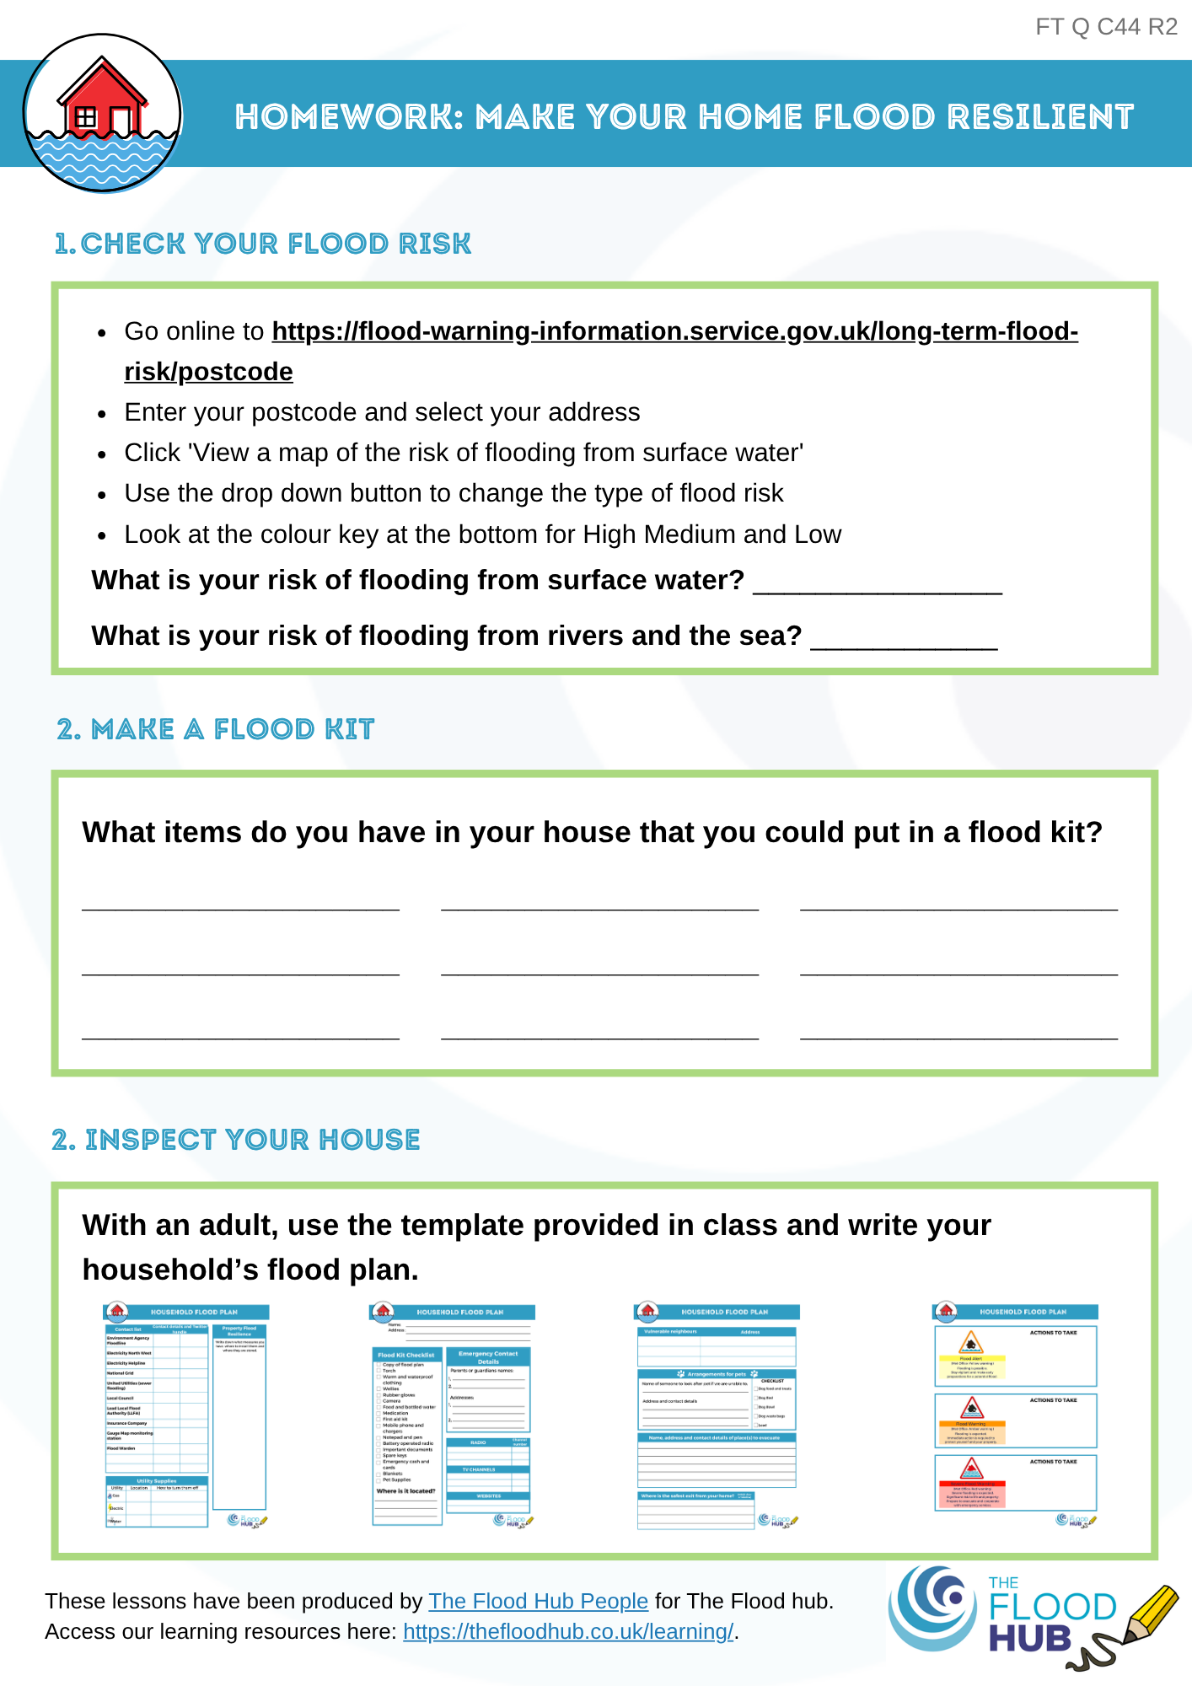

Homework
Prepare your household for a future flood!
With an adult…..
Go online and see if you are at risk of flooding and can sign up to flood warnings – ask parents permission.
See what items you have in your house that could be put in your flood kit.
Use the template provided in class and write your household’s flood plan.
FT Q C44 R2

Slide 18
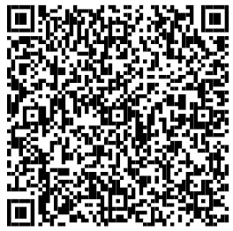
These lessons have been produced by
The Flood Hub People for The Flood Hub.
Scan the QR code to access our ‘Learning’ section. Or visit here: https://thefloodhub.co.uk/learning/
FT Q C44 R2

