Slide 1




Reducing flooding through the catchment (Part 2)
Lesson aim:
To understand how we can reduce flooding using natural flood management and by looking after watercourses
Lesson objectives:
Learn what natural flood management is
Learn the importance of looking after watercourses and drainage
FT Q C48 R2

Slide 2
Recap…
Ways to reduce flooding
PFR =
Property Flood Resilience. This stops water getting into your home and damaging things.
SuDS =
Sustainable Drainage Systems. These catch rainwater, release it slowly and stop it from flowing over roads and into drains.
Flood schemes are built to protect big parts of towns and villages from flooding where the risk of flooding is high for many homes and businesses.
FT Q C48 R2

Slide 3
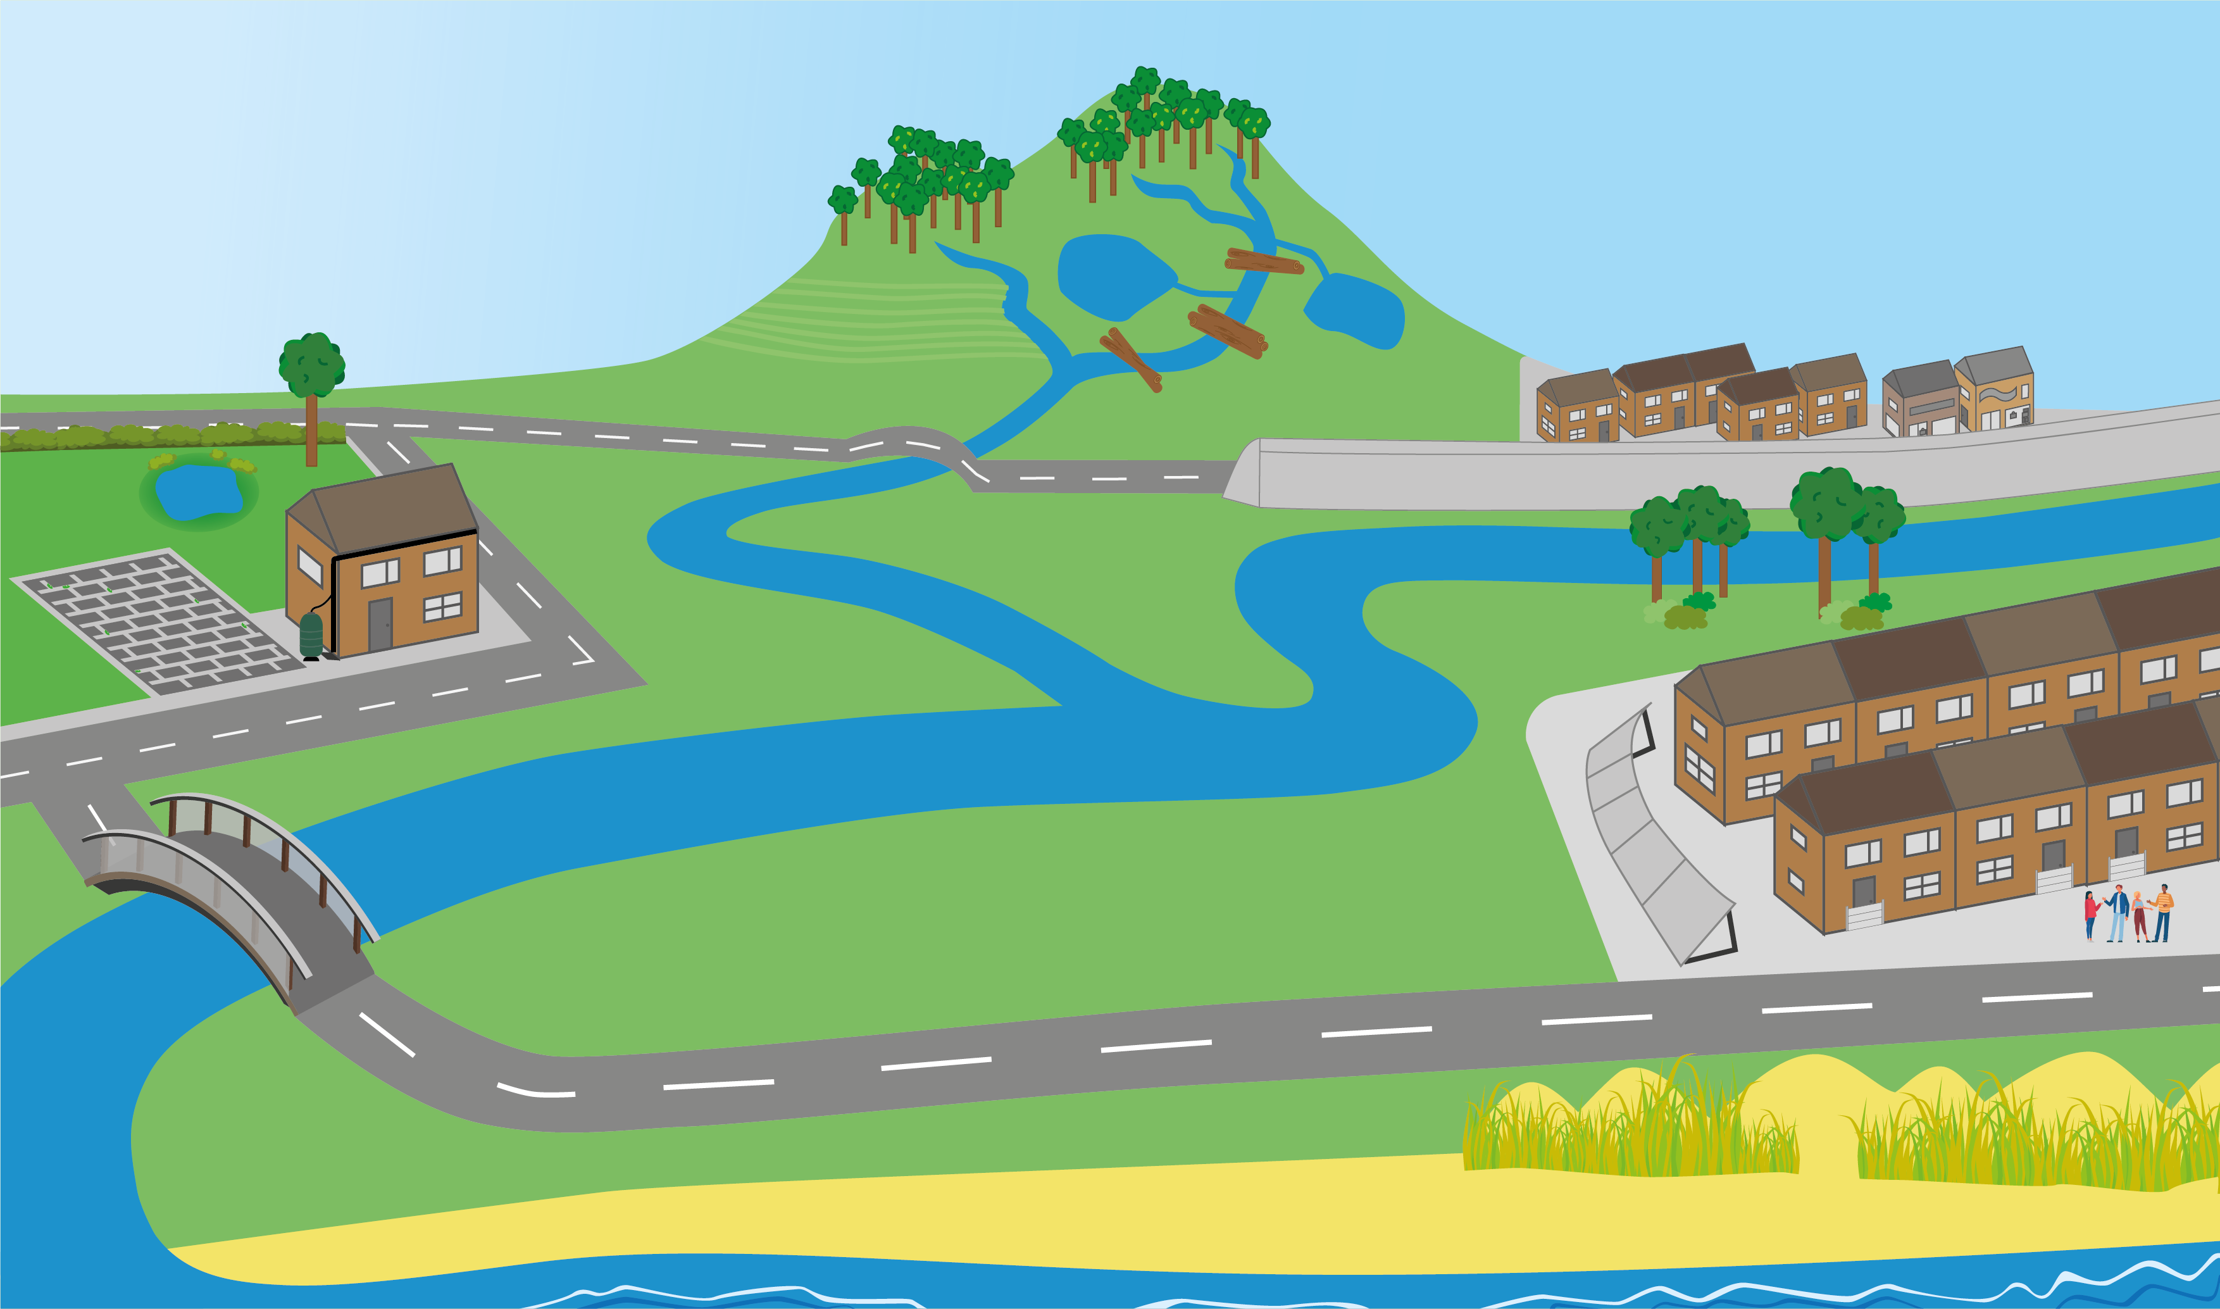
Reducing Flooding
Natural flood management
Already covered…
Flood schemes
What other ways can we reduce flooding?
Only flush the 3 p’s
Sustainable Drainage Systems (SuDS)
Property Flood Resilience (PFR)
Preparing for flooding & creating community groups
FT Q C48 R2

Slide 4
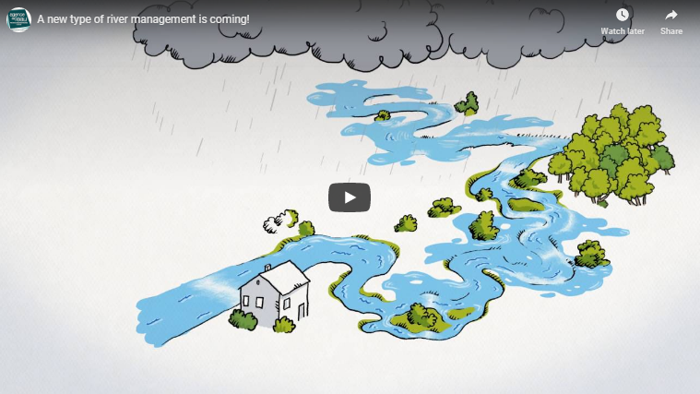
Natural flood management (NFM)
What does it do?
Uses natural materials and processes to help slow the flow of water and reduce the risk of flooding to communities downstream.
https://catchmentbasedapproach.org/learn/what-is-natural-flood-management/
FT Q C48 R2

Slide 5
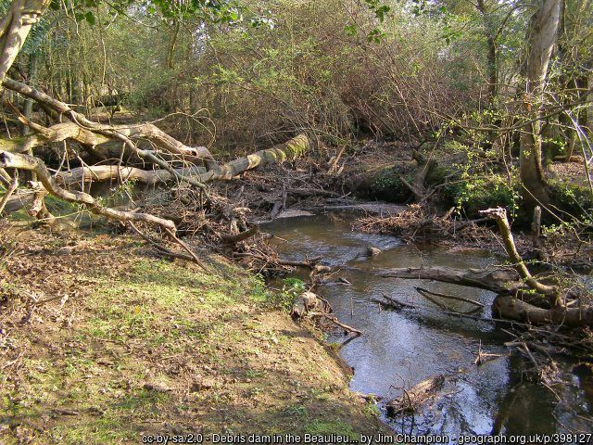
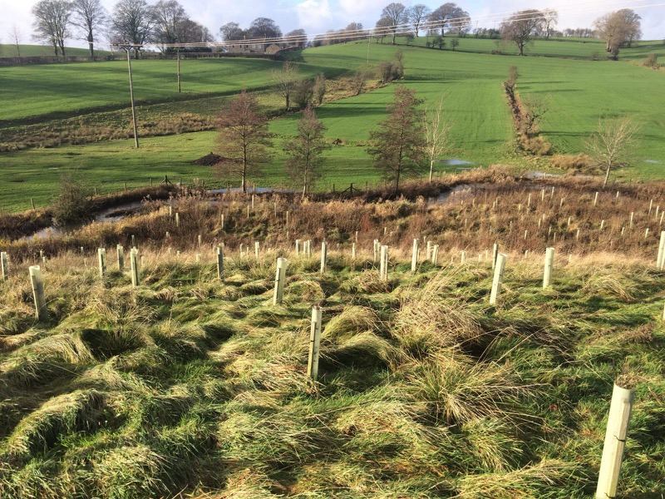
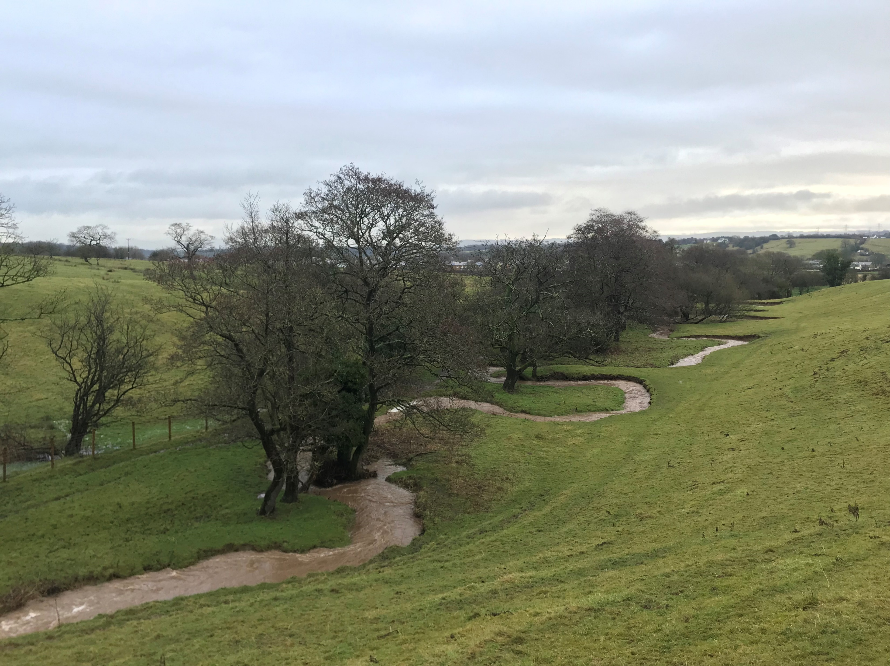
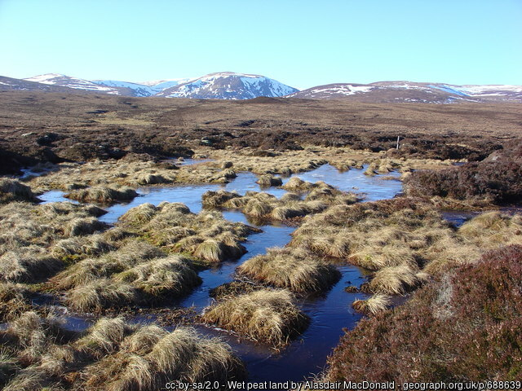
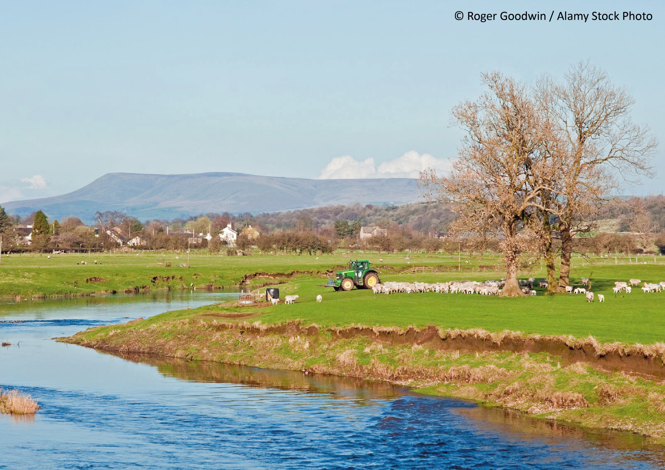
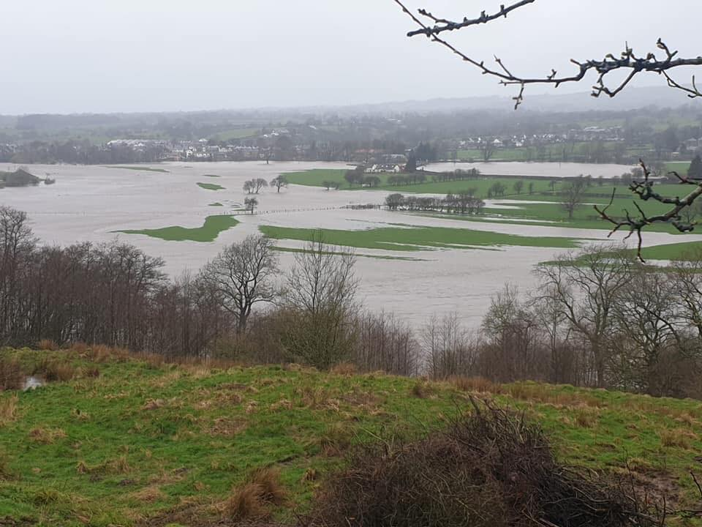
Natural flood management (NFM)
Image: The Flood Hub
Image: The Flood Hub
Leaky woody dams
Tree planting
Meandering rivers
These hold back water but let it through small gaps to slow the flow of the stream
Catches some rain before it reaches the ground, and roots help to soak up water
Bendy streams and rivers slow the flow of water and can connect it to floodplains
Image: The Flood Hub
Moorlands
Farmland management
Floodplains
Healthy peatland soaks up more water before it reaches streams
This will help to stop soil compaction so rain soaks into the ground more easily
Water flows out of a river onto empty land where it is stored
FT Q C48 R2

Slide 6
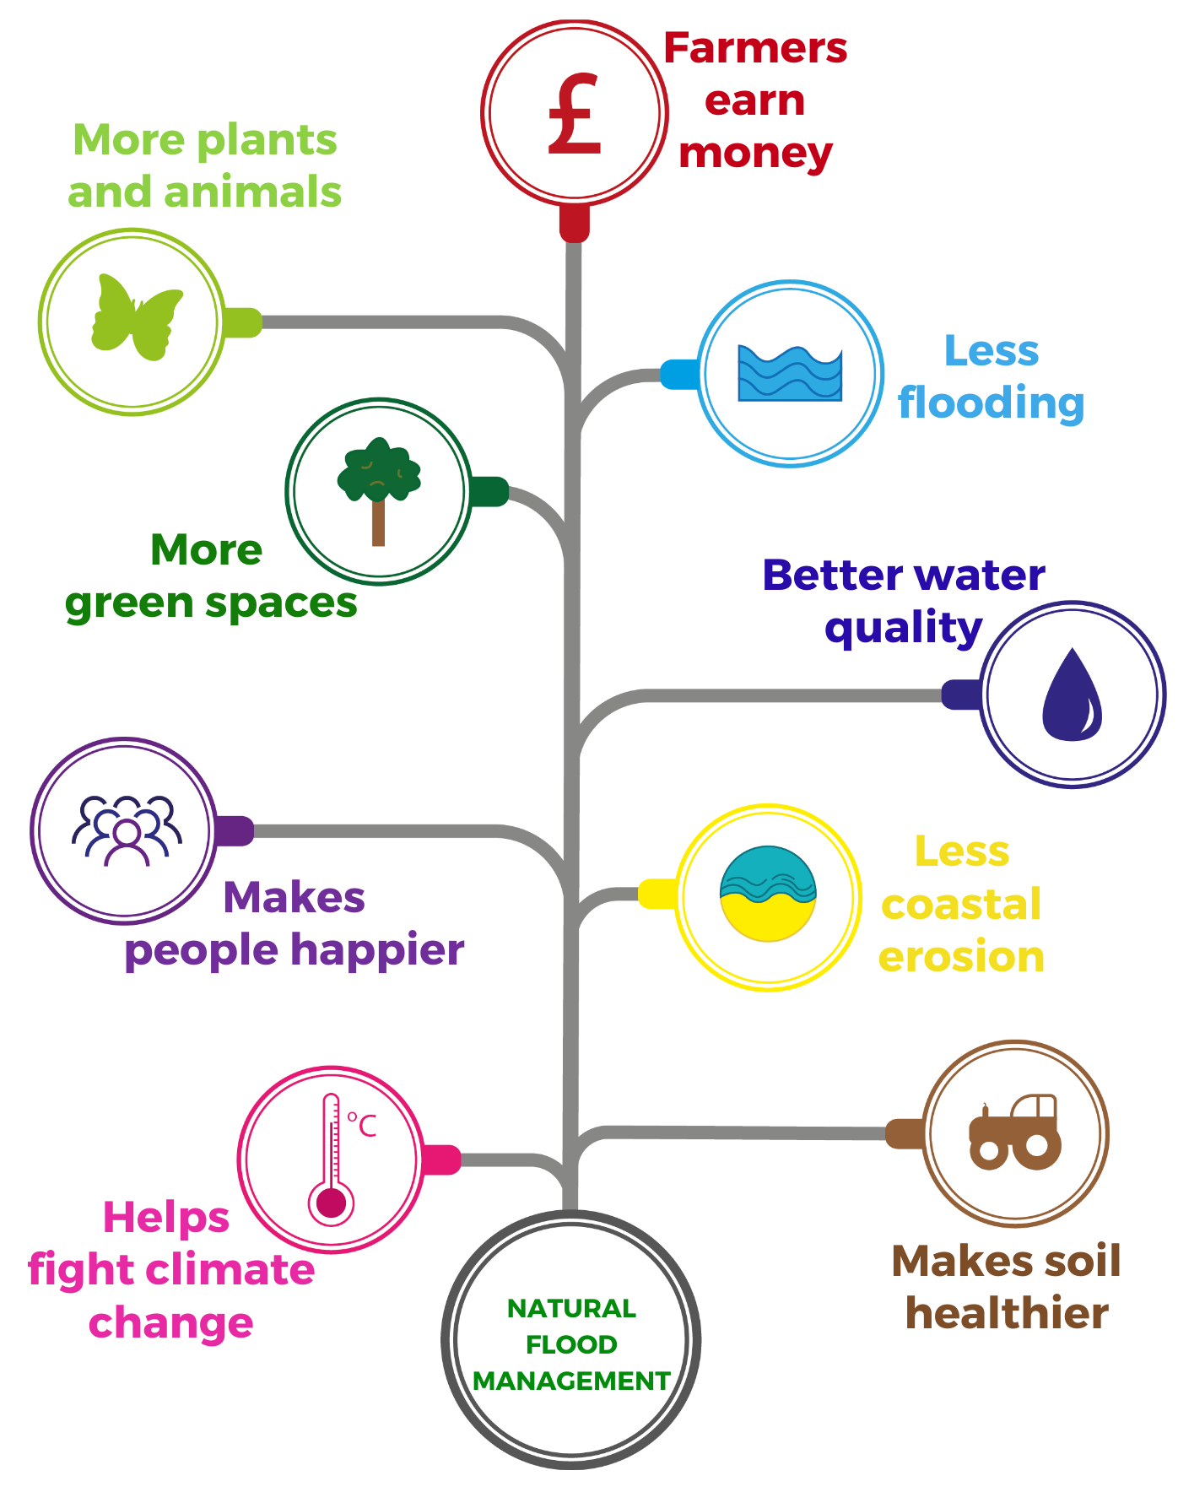
Natural flood management (NFM)
It has lots of benefits!
FT Q C48 R2

Slide 7
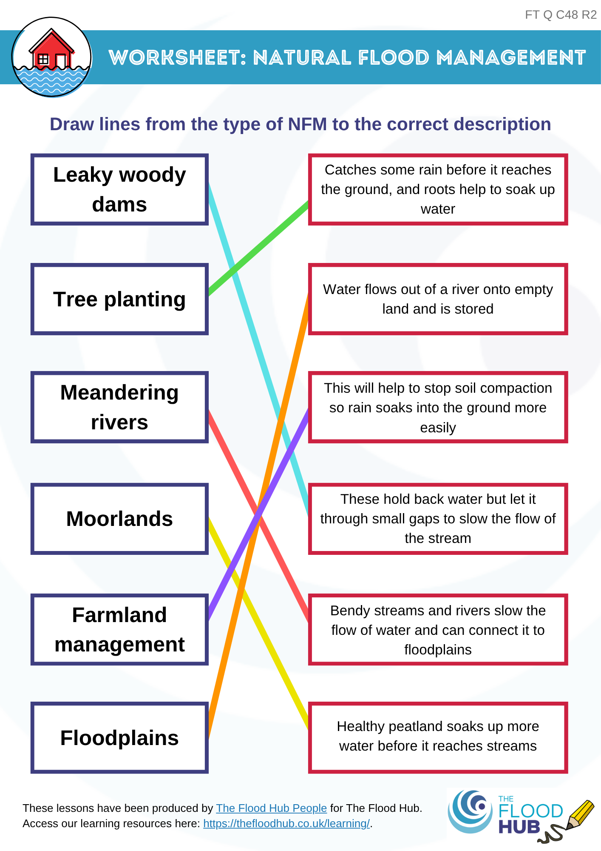
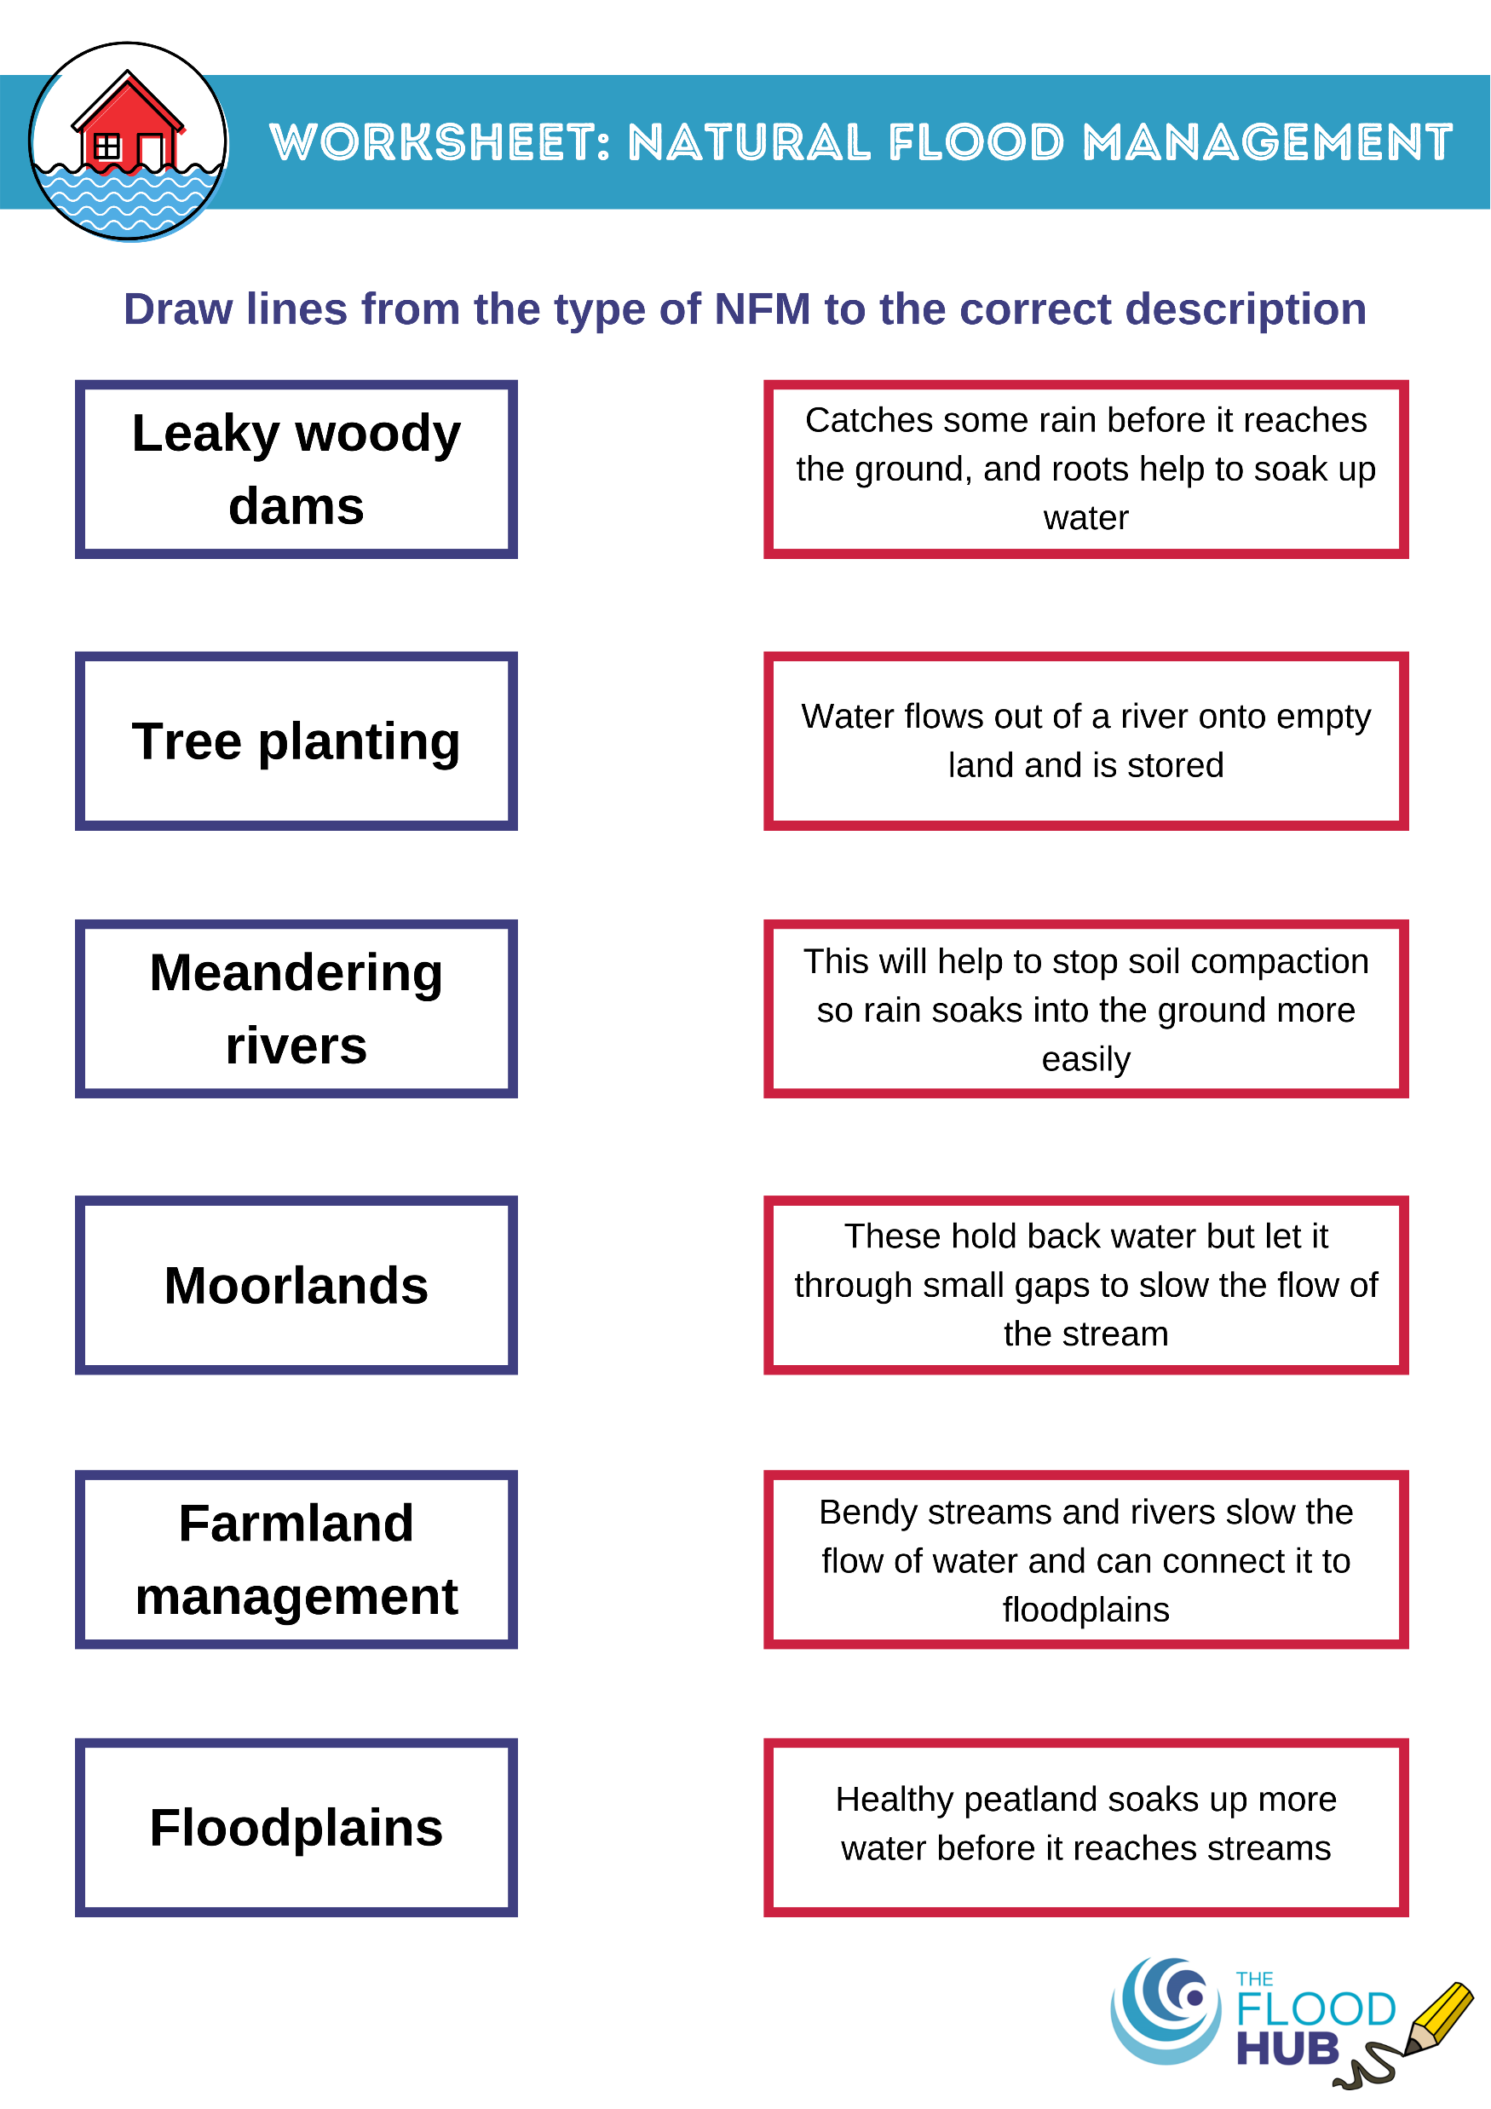
Natural Flood Management (NFM)
Worksheet
Draw lines from the type of NFM to the correct description.
FT Q C48 R2

Slide 8


Experiment time!
Optional: Experiment to show how you can slow the flow of water
FT Q C48 R2

Slide 9
Drains and sewers
Which of these belong down the drain?
The 3 p’s
Paper, pee and poo
Pee
Food scraps
Cotton buds
‘Flushable’ wet wipes
Poo
Wet wipes
Cooking oils
Toilet paper
Nappies
FT Q C48 R2

Slide 10

Drains and sewers
https://www.youtube.com/watch?v=2cR8yNlmqAM
FT Q C48 R2

Slide 11
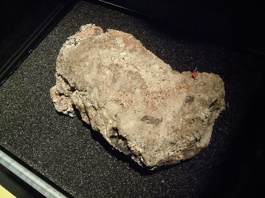
Fatbergs
Blockages cause flooding!
Image: A dried section of a "fatberg" by Lord Belbury is licensed under CC BY-SA 4.0.
Putting the wrong things down the toilet and sink can cause blockages and fatbergs in sewers.
If sewers get blocked up this can cause flooding because the water has nowhere else to go.
The water will burst up out of sewers in the road or in gardens, or will go back up people’s sinks and toilets in houses!
FT Q C48 R2

Slide 12

Fatbergs
Biggest ever fatberg in North West England was found in Liverpool in 2019!
250 metres long – the size of 10 swimming pools or 2.5 football pitches.
400 tonnes – as heavy as 4 blue whales!
Fats, grease, oil, wet wipes, sanitary products and more
FT Q C48 R2

Slide 13

Activity
Write a short newspaper article pretending that the biggest fatberg ever has been found! Include:
Why the fatberg happened
What the fatberg is made up of
What happened because of the fatberg
Add a drawing
FT Q C48 R2

Slide 14
Experiment time!
Optional: Experiment to show how wet wipes don’t break down in sewers
FT Q C48 R2

Slide 15
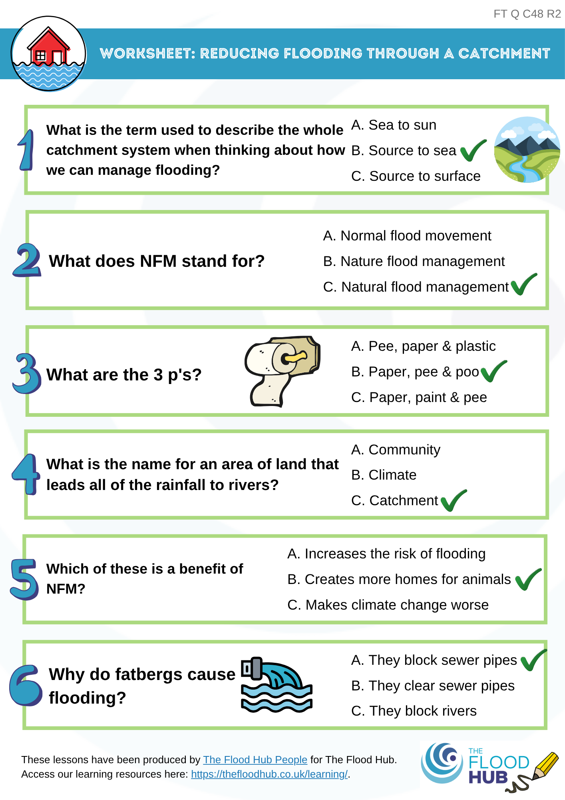
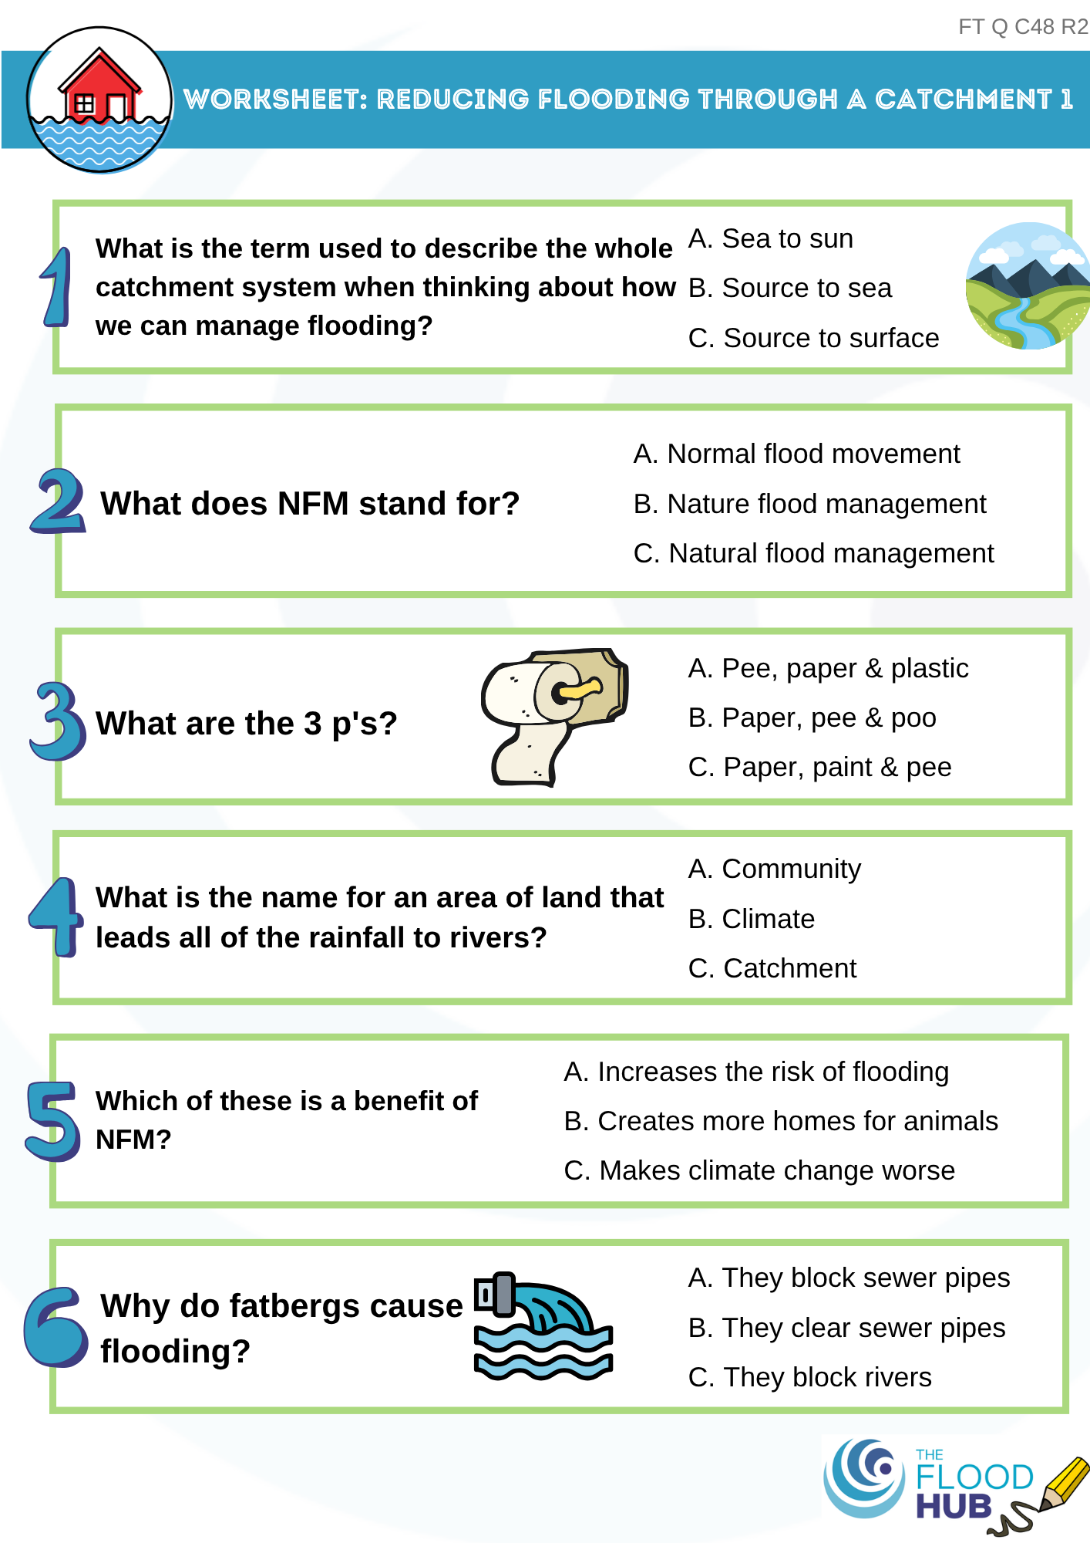

Quick test!
How much have you learnt?
Please complete the 6 test questions now ☺
FT Q C48 R2

Slide 16
Recap of lesson
We need to manage flood risk to…
Natural flood management is…
The only things that should go down the drain are…
Reduce the number of homes and businesses that flood.
Using natural materials and processes to reduce the risk of flooding.
Paper, pee and poo!
FT Q C48 R2

Slide 17
Homework
Create a flood scheme!
Thinking about what you have learnt, and the different ways to try to manage flooding, can you be a flood engineer and create a flood scheme by placing flood protection at the correct place on the catchment image?
Draw a river and town (or use the template)
Draw or cut & stick on at least 4 types of flood protection
Label what the flood defences are
Write down how the flood defences help to stop flooding
FT Q C48 R2

Slide 18

These lessons have been produced by
The Flood Hub People for The Flood Hub.
Scan the QR code to access our ‘Learning’ section. Or visit here: https://thefloodhub.co.uk/learning/
FT Q C48 R2

