Slide 1


FT Q C51 R2
Case Study: Storm Desmond 2015
Learning Objectives:
  Explore the causes of the flooding, and what made Storm Desmond's impacts particularly bad in Cumbria and Lancashire.
  Analyse the social, economic, and environmental impacts of the floods on local communities and infrastructure.
  Evaluate the immediate and long-term responses to the floods.

Slide 2
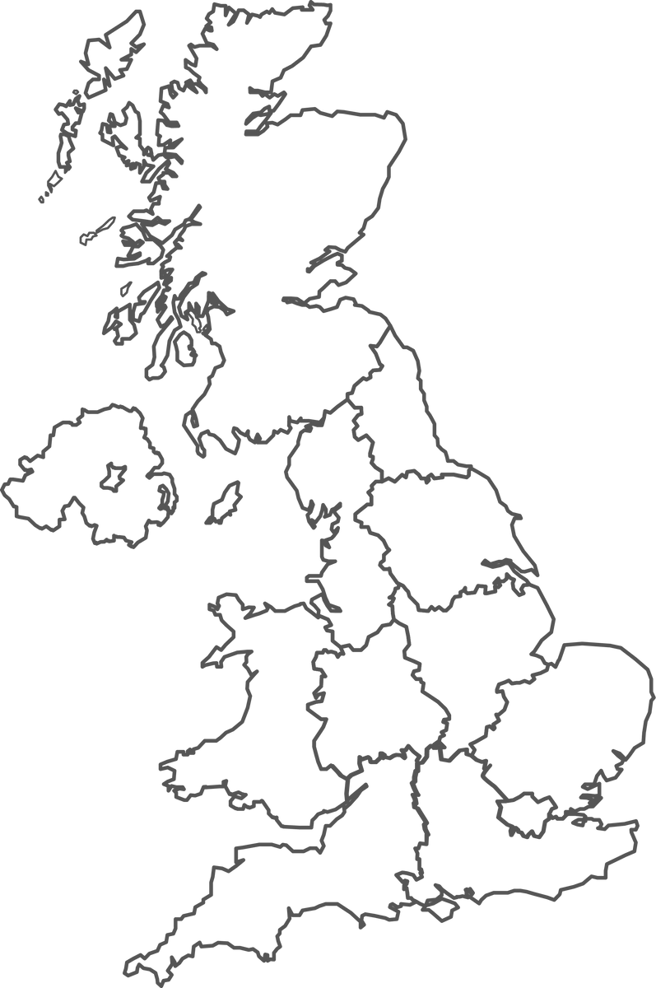


FT Q C51 R2
Case Study: Storm Desmond 2015
Starter:
Using your atlas, locate the counties: Cumbria and Lancashire on this map of Great Britain.
Colour it in on your worksheet to identify it.

Slide 3
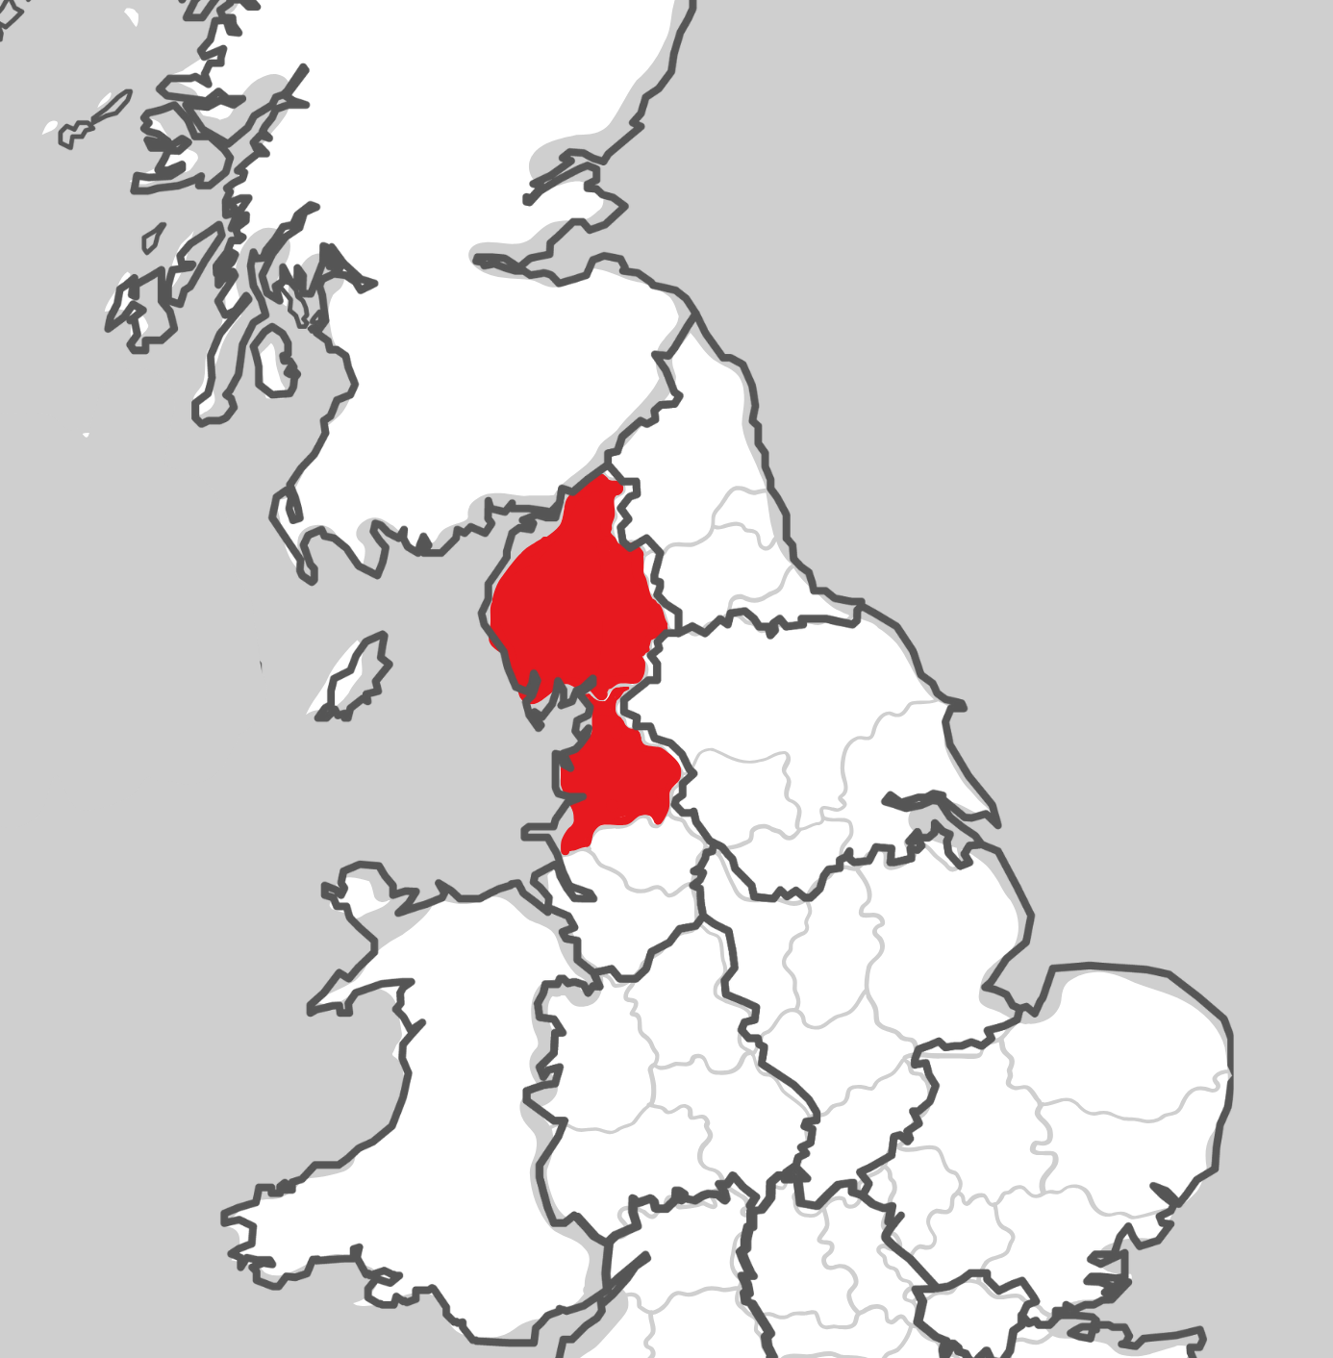
FT Q C51 R2
Case Study: Storm Desmond 2015
Location: Cumbria and Lancashire, located in the Northwest of England.
Many towns across Cumbria and Lancashire were badly affected. The worst hit include:
  Keswick
  Kendal
  Cockermouth
  Carlisle
  Appleby
  Lancaster
  St Michael’s
  Churchtown

Slide 4
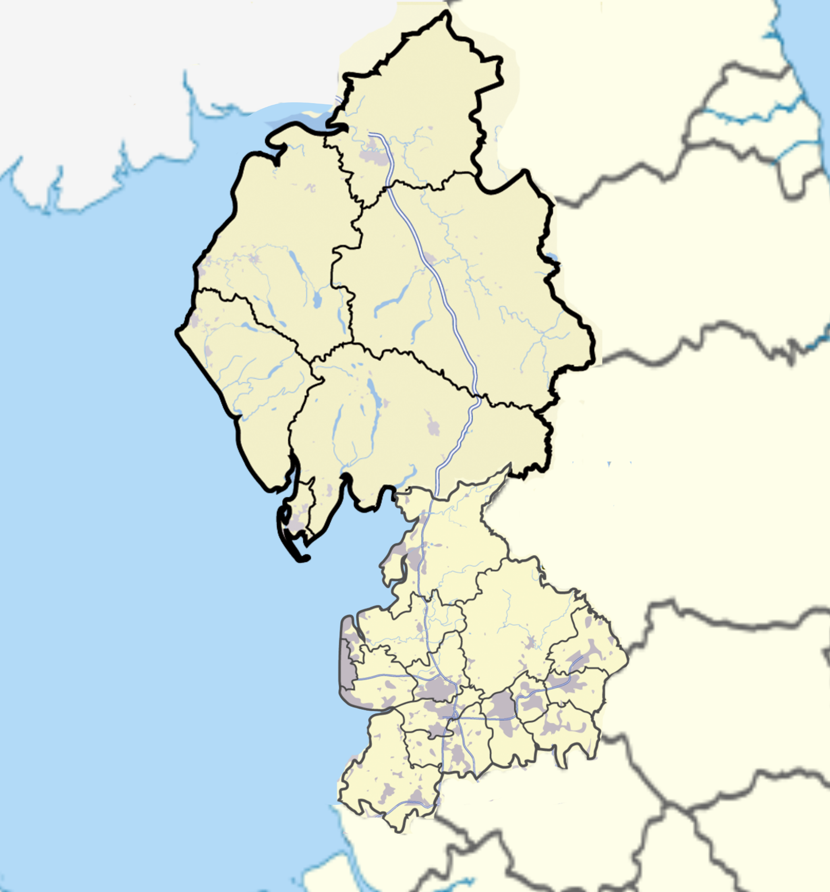
FT Q C51 R2
Case Study: Storm Desmond 2015
TASK:
Using your atlas, mark the worst affected towns and villages onto the clear map provided on your worksheet.
Towns and Villages Worst Hit:
Kendal
Keswick
Cockermouth
Carlisle
Appleby
  Lancaster
  St Michael’s Churchtown
Map of the county of Cumbria and Lancashire , England, United Kingdom by Jhamez84 https://commons.wikimedia.org/ wiki/File:Cumbria_outline_map_with_UK.png

Slide 5
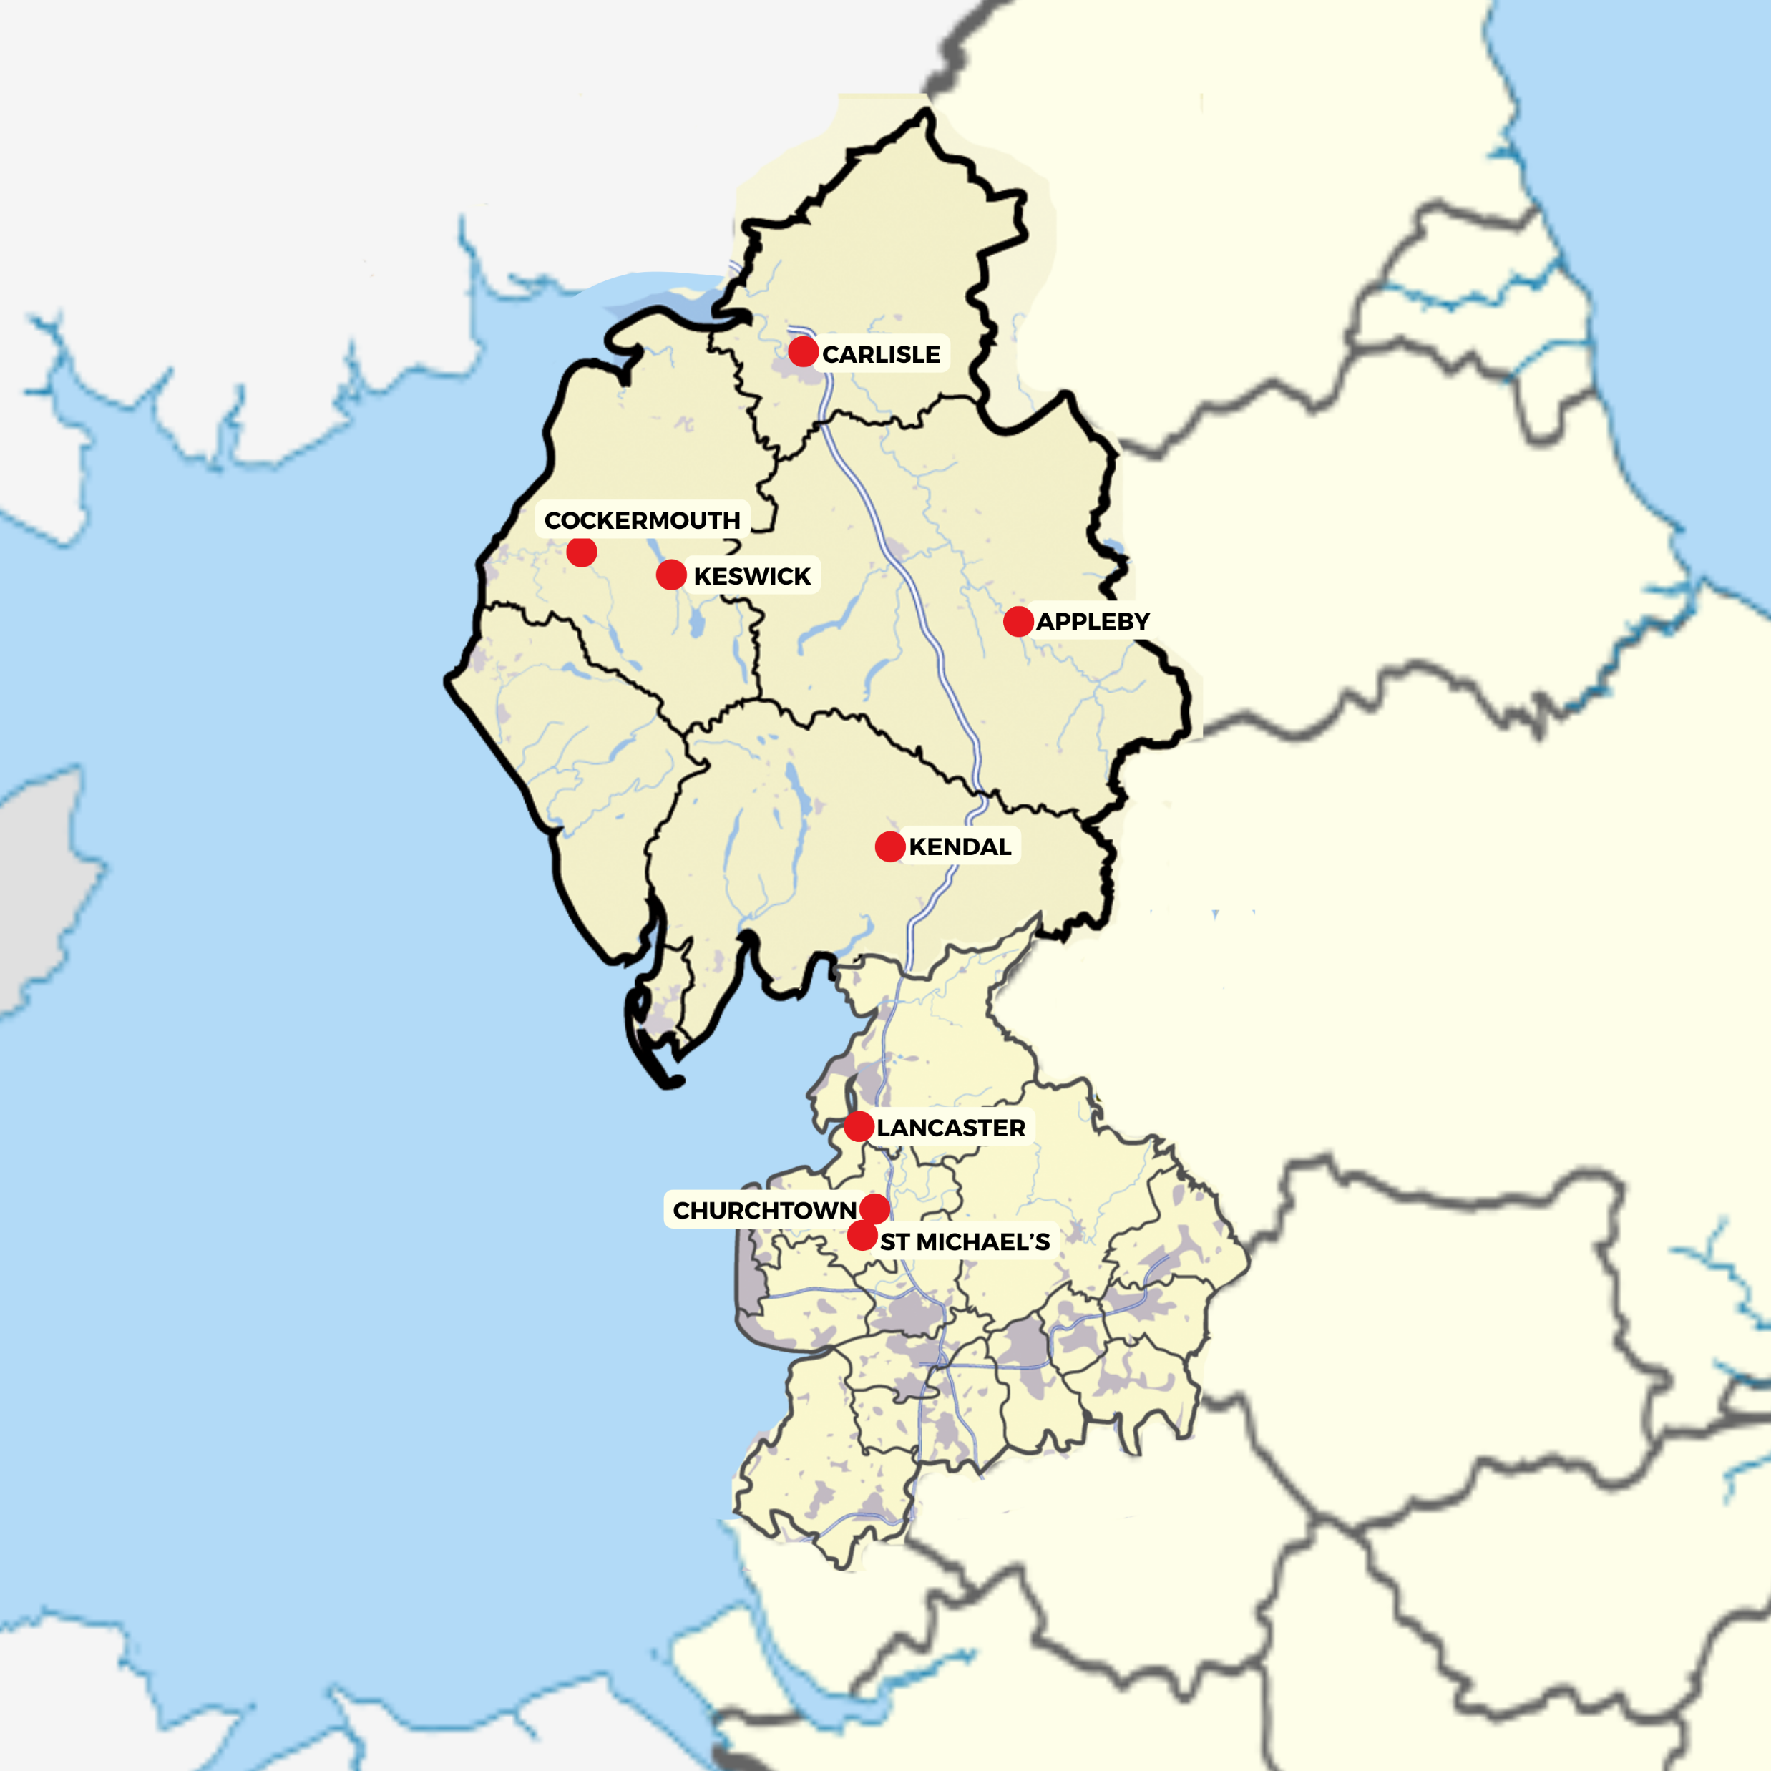
FT Q C51 R2
Case Study: Storm Desmond 2015
TASK:
Using your atlas, mark the worst affected towns and villages onto the clear map provided on your worksheet.
Towns and Villages Worst Hit:
Kendal
Keswick
Cockermouth
Carlisle
Appleby
  Lancaster
  St Michael’s Churchtown
Map of the county of Cumbria and Lancashire , England, United Kingdom by Jhamez84 https://commons.wikimedia.org/ wiki/File:Cumbria_outline_map_with_UK.png

Slide 6
FT Q C51 R2
Case Study: Storm Desmond 2015
Causes:
Storm Desmond affected the UK from the 4th to the 6th of December 2015, bringing heavy rainfall and strong winds due to an area of low pressure from the Atlantic. This led to severe flooding, particularly in Cumbria and Lancashire. Cumbria experienced record-breaking rainfall, with some areas receiving over 300 mm of rain in just 24 hours. The River Lune in Lancashire recorded flows of around 1,750 m³ per second at Caton (just upstream of Lancaster), the highest flow ever recorded on an English river, contributing to widespread flooding.

Slide 7
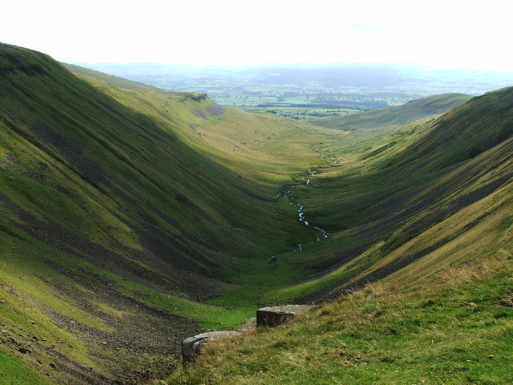
FT Q C51 R2
Case Study: Storm Desmond 2015
Causes:
Topography:
Cumbria is characterised by its hilly terrain, which causes rapid runoff and quick river level rises during heavy rainfall.
Lancashire, with its hilly areas and flat regions near rivers, also faces rapid runoff, making it vulnerable to flooding in heavy rain.
Eden Valley from High Cup Nick cc-by-sa/2.0 - © Tim Leete - geograph.org.uk/p/103396

Slide 8
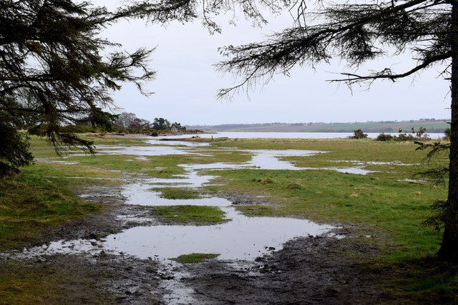
FT Q C51 R2
Case Study: Storm Desmond 2015
Causes:
Soil Saturation: Prior to Storm Desmond, Cumbria and Lancashire had already experienced a wet autumn. Heavy rainfall from Storm Abigail, Barney and Clodagh in the 3 weeks prior to Storm Desmond meant that the ground was saturated, reducing its ability to absorb additional rainfall and increasing surface runoff into rivers.
Saturated landscape near Kiltearn Old Kirk cc-by-sa/2.0 - © Bill Harrison - geograph.org.uk/p/7758388

Slide 9
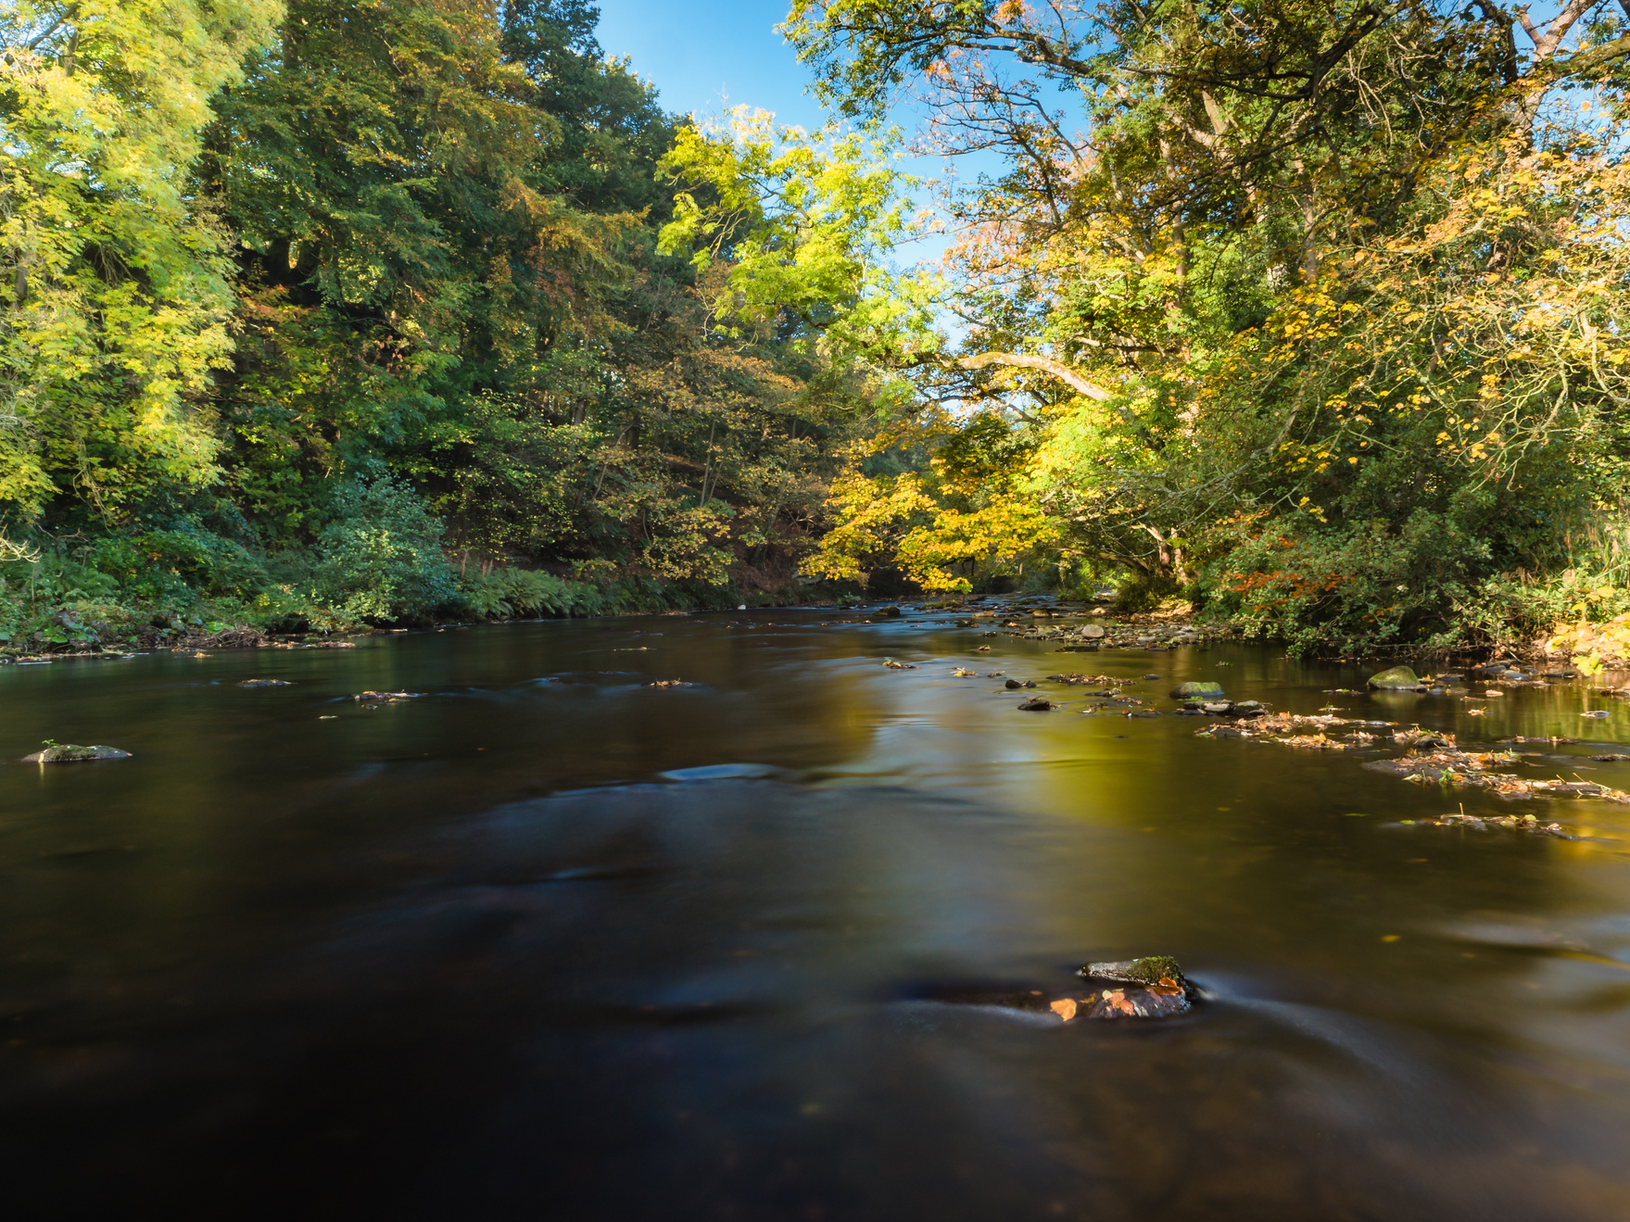
FT Q C51 R2
Case Study: Storm Desmond 2015
Causes:
River Systems: Cumbria and Lancashire have several major rivers, including the Rivers: Eden, Derwent, Kend, Lune, Calder, Wyre and Ribble.
These rivers and their tributaries can quickly swell and overflow during periods of heavy rainfall, leading to widespread flooding.
River Derwent by mikedabell from Getty Images Signature

Slide 10
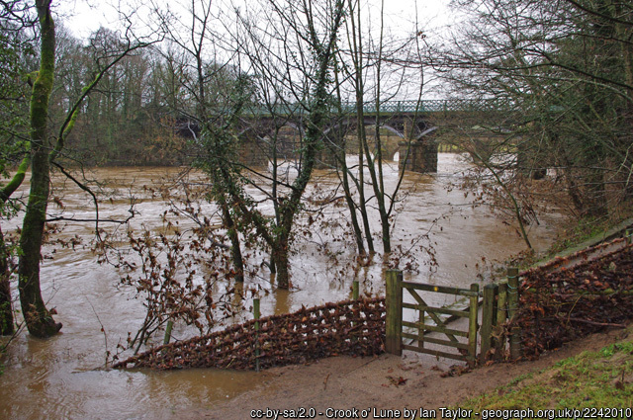
FT Q C51 R2
Case Study: Storm Desmond 2015
The River Lune recorded the highest river flow on record of an English river at 1,750m3 per second at Caton.

Slide 11
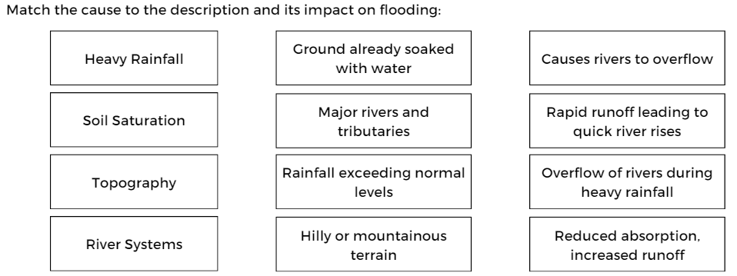
FT Q C51 R2
Case Study: Storm Desmond 2015
Causes:
TASK:
Match the cause to the description and its impact on flooding on your worksheet

Slide 12
FT Q C51 R2
Case Study: Storm Desmond 2015
IMPACTS:
Social impacts refer to the effects of an event on the lives, health and wellbeing of people in a community. This includes disruptions to daily life, displacement, casualties, public health issues and changes in community dynamics.
Economic impacts refer to the financial effects of an event on individuals, businesses and the overall economy. This includes property damage, business disruption, costs of repairs and rebuilding, and impacts on industries such as agriculture and tourism.
Environmental impacts involve changes to the natural environment due to an event. This includes effects on wildlife, ecosystems, natural resources, and pollution levels.
Some of these impacts overlap because they are connected and affect each other in various ways.

Slide 13
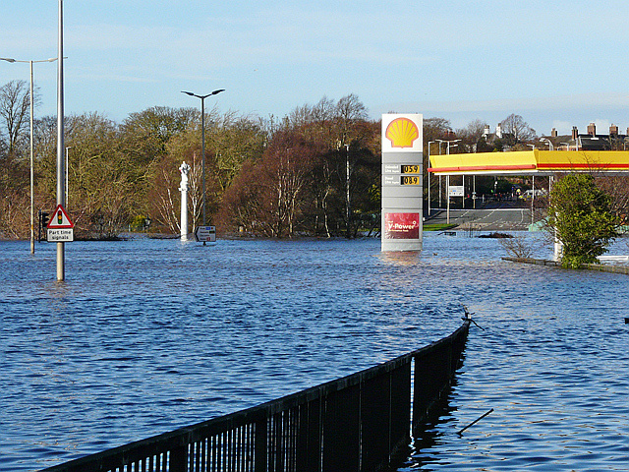
FT Q C51 R2
Case Study: Storm Desmond 2015
IMPACTS:
Fatalities: Storm Desmond led to two confirmed deaths across Cumbria and Lancashire. A man in Cumbria died after being swept away by floodwaters, and another person lost their life in a road accident caused by severe weather conditions
Hardwicke Circus under watercc-by-sa/2.0 - © Rose and Trev Clough - geograph.org.uk/p/4760961

Slide 14
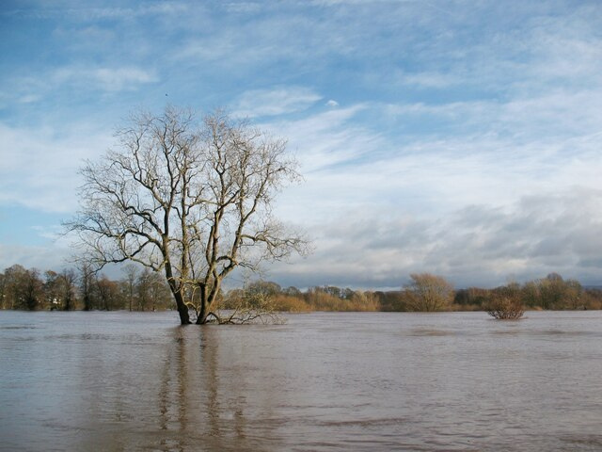
FT Q C51 R2
Case Study: Storm Desmond 2015
IMPACTS:
Homes Flooded: Across Cumbria and Lancashire, over 5,200 homes were flooded, with thousands more left without power, clean water, and essential services.
Rickerby Park after Storm Desmondcc-by-sa/2.0 - © Adrian Taylor - geograph.org.uk/p/7199351

Slide 15
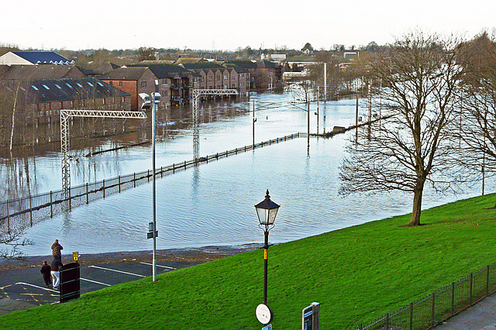
FT Q C51 R2
Case Study: Storm Desmond 2015
IMPACTS:
Flooded Train Lines
The West Coast Main Line in Cumbria is submerged under floodwater from the River Caldew. This disrupts daily travel, stranding passengers and causing major commute issues.
No trains today cc-by-sa/2.0 - © Rose and Trev Clough - geograph.org.uk/p/4761063

Slide 16
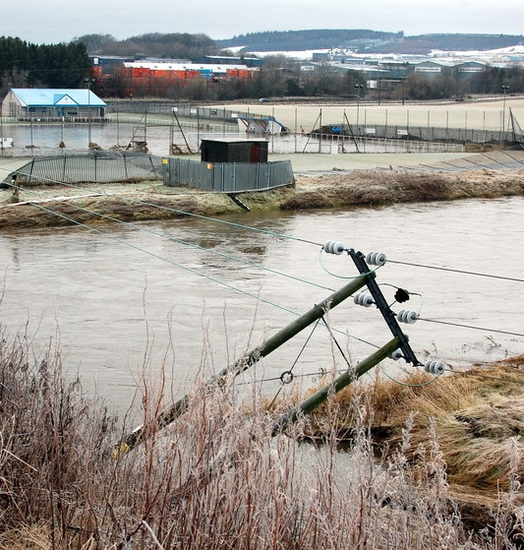
FT Q C51 R2
Case Study: Storm Desmond 2015
IMPACTS:
Lancaster substation on Caton Road flooded: leaving 43,000 properties without power for days, severely impacting homes, businesses, and communication networks.
After the floods III, taken Saturday, 9 January, 2016
cc-by-sa/2.0 - © Bill Harrison - geograph.org.uk/p/4801993

Slide 17
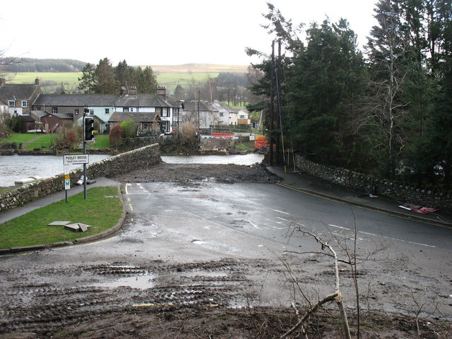
FT Q C51 R2
Case Study: Storm Desmond 2015
IMPACTS:
1600 bridges were closed across Cumbria.
Pooley Bridge was completely destroyed during Storm Desmond due to extreme flooding. The 18th-century stone bridge, which was a vital transport link for the local community, collapsed when the River Eamont's water levels surged.
Pooley No-bridge! cc-by-sa/2.0 - © David Purchase - geograph.org.uk/p/4818184

Slide 18

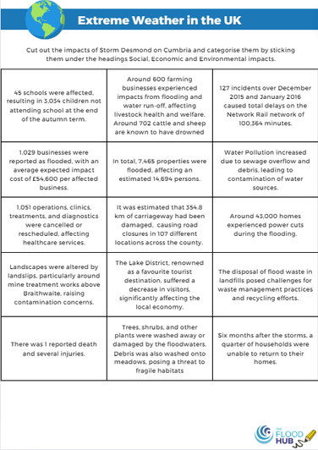

FT Q C51 R2
Case Study: Storm Desmond 2015
IMPACTS:
TASK:
Cut out the impacts of Storm Desmond on Cumbria and Lancashire, and categorise them by sticking them under the headings Social, Economic and Environmental impacts.

Slide 19
FT Q C51 R2
Case Study: Storm Desmond 2015
IMPACTS:
Social impacts refer to the effects of an event on the lives, health and wellbeing of people in a community. This includes disruptions to daily life, displacement, casualties, public health issues and changes in community dynamics.
There was 2 reported deaths and several injuries.
1,051 operations, clinics, treatments, and diagnostics were cancelled or rescheduled.
Around 43,000 homes lost power during the flooding, with the Caton Road substation in Lancaster being flooded, causing widespread outages, including at Royal Lancaster Infirmary
45 schools were affected in Cumbria , resulting in 3,034 children not attending school at the end of the autumn term.
Over 5200 homes across Cumbria and Lancashire were flooded internally.
Six months after the storms, a quarter of households were unable to return to their homes.

Slide 20
FT Q C51 R2
Case Study: Storm Desmond 2015
IMPACTS:
Economic impacts refer to the financial effects of an event on individuals, businesses and the overall economy. This includes property damage, business disruption, costs of repairs and rebuilding, and impacts on industries such as agriculture and tourism.
1,029 businesses were reported as flooded, with an average expected impact cost of £54,600 per affected business.
It was estimated that 354.8 km of carriageway had been damaged, causing road closures in 107 different locations across Cumbria.
127 incidents over December 2015 and January 2016 caused total delays on the Network Rail network of 100,364 minutes (1,673.7 hours or about 69.7 days).
Around 600 farming businesses experienced impacts from flooding and water run-off, affecting livestock health and welfare. Around 702 cattle and sheep are known to have drowned.
The Lake District, renowned as a favourite tourist destination, suffered a decrease in visitors, significantly affecting the local economy.

Slide 21
FT Q C51 R2
Case Study: Storm Desmond 2015
IMPACTS:
Environmental impacts involve changes to the natural environment due to an event. This includes effects on wildlife, ecosystems, natural resources, and pollution levels.
Trees, shrubs, and other plants were washed away or damaged by the floodwaters. Debris was also washed onto meadows, posing a threat to fragile habitats.
Landscapes were altered by landslips, particularly around mine treatment works above Braithwaite, raising contamination concerns.
The disposal of flood waste in landfills posed challenges for waste management practices and recycling efforts.
Water Pollution increased due to sewage overflow and debris, leading to contamination of water sources.

Slide 22
FT Q C51 R2
Case Study: Storm Desmond 2015
RESPONSES:
Immediate Responses | Long Term Responses
Immediate responses are actions taken right before, during, and right after a disaster happens to keep people safe and reduce damage. | Long-term responses are plans and actions taken over a longer period after the initial disaster to help communities recover and to prepare for future events.
Examples include rescue operations, providing emergency aid like food and water and setting up temporary shelters for people who have lost their homes. | These can include rebuilding homes and infrastructure, creating new policies to better manage future disasters, and improving emergency services and response plans.

Slide 23
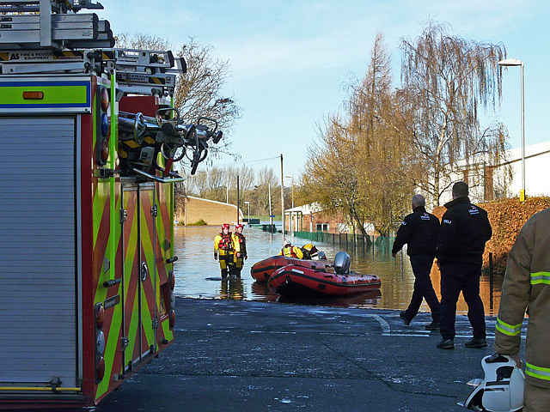
FT Q C51 R2
Case Study: Storm Desmond 2015
RESPONSES:
Rescue Operations: Emergency services and the military conducted numerous rescue operations, evacuating residents from flooded areas and providing immediate medical assistance.
Flood rescue boats in Lismore Place cc-by-sa/2.0 - © Rose and Trev Clough - geograph.org.uk/p/4760952

Slide 24
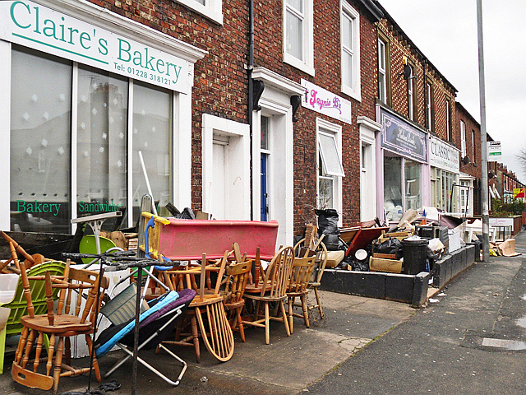
FT Q C51 R2
Case Study: Storm Desmond 2015
RESPONSES:
Government Aid: The UK government provided financial aid, including a £50 million recovery fund for affected communities. Additional grants and loans were made available to help with property repairs and resilience improvements.
Business premises wrecked by flooding cc-by-sa/2.0 - © Rose and Trev Clough - geograph.org.uk/p/4775877

Slide 25
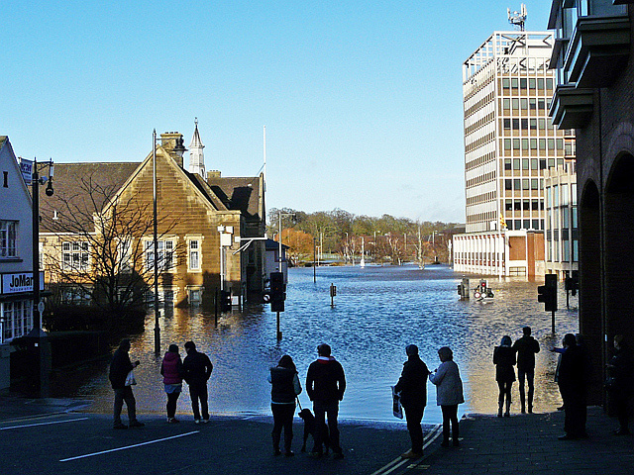
FT Q C51 R2
Case Study: Storm Desmond 2015
RESPONSES:
Emergency Aid: Distribution of emergency supplies, including food, water, and blankets, to affected individuals and families.
On the waterfront, Rickergate, Carlislecc-by-sa/2.0 - © Rose and Trev Clough - geograph.org.uk/p/4760984

Slide 26
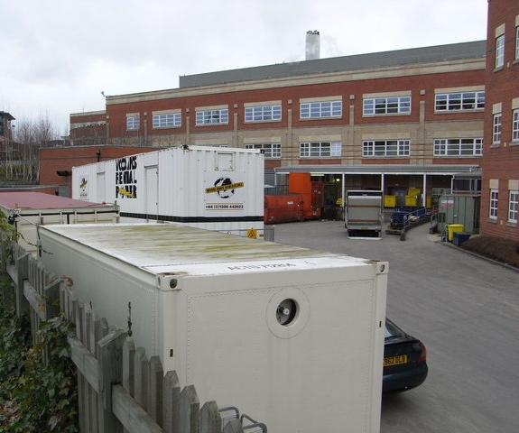
FT Q C51 R2
Case Study: Storm Desmond 2015
RESPONSES:
Backup Generators at Royal Lancaster Infirmary: The activation of backup generators at Royal Lancaster Infirmary ensured that critical healthcare services continued to operate, preventing further disruption to patient care during the flooding.
Worcestershire Royal Hospital service yard, taken Thursday, 25 December, 2008
cc-by-sa/2.0 - © Chris Allen - geograph.org.uk/p/1649784

Slide 27
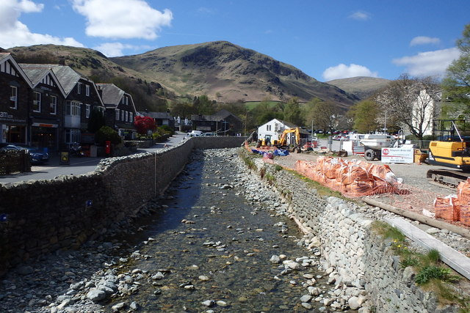
FT Q C51 R2
Case Study: Storm Desmond 2015
RESPONSES:
Flood Defences: Improved flood defences were initiated, reinforcing riverbanks and constructing new barriers. £2.6 billion was invested in flood defence schemes in Cumbria, currently implementing projects in Carlisle, Appleby, and Kendal.
Flood Defences cc-by-sa/2.0 - © Michael Graham - geograph.org.uk/p/5384324

Slide 28
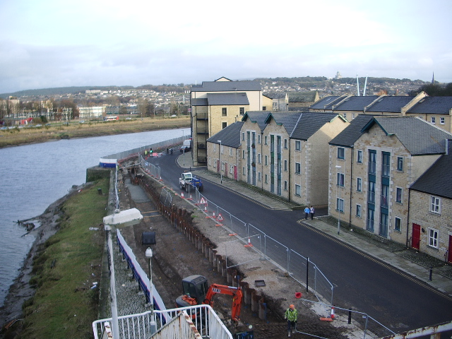
FT Q C51 R2
Case Study: Storm Desmond 2015
RESPONSES:
Flood Defences: The Lancaster Flood Defence Scheme includes £12.1 million spent on defences along Caton Road and Aldrens Lane, a £10.8 million flood wall along the River Lune protecting over 2,000 jobs, and a £5.7 million upgrade to the Caton Road substation to prevent power cuts.
Copyright Alexander P Kapp and licensed for reuse under creativecommons.org/licenses/by-sa/2.0

Slide 29

FT Q C51 R2
Case Study: Storm Desmond 2015
RESPONSES:
Public Awareness and Preparedness: Increased efforts to educate the public about flood risks and preparedness measures, aiming to improve community resilience for future events.

Slide 30
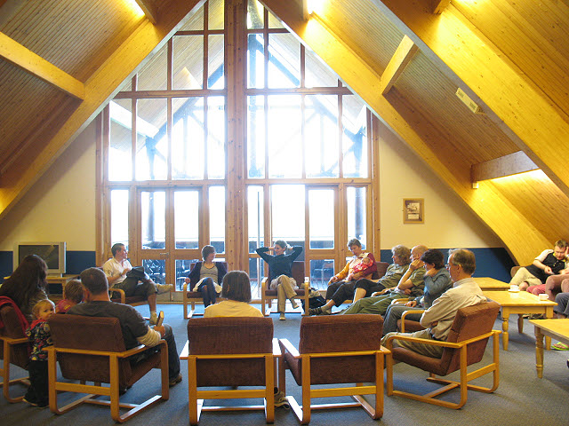
FT Q C51 R2
Case Study: Storm Desmond 2015
RESPONSES:
Formation of Community Food Groups: St Michael's Flood Action Group formed after Storm Desmond, advocating for better flood defences and flood risk management in the area, working with local authorities to protect the community from future floods.
Lee Valley youth hostel - meeting room
cc-by-sa/2.0 - © Stephen Craven - geograph.org.uk/p/1328524

Slide 31
FT Q C51 R2
Case Study: Storm Desmond 2015
RESPONSES:
TASK:
Colour code the responses on your worksheet and sort them into immediate and long-term responses.

Slide 32
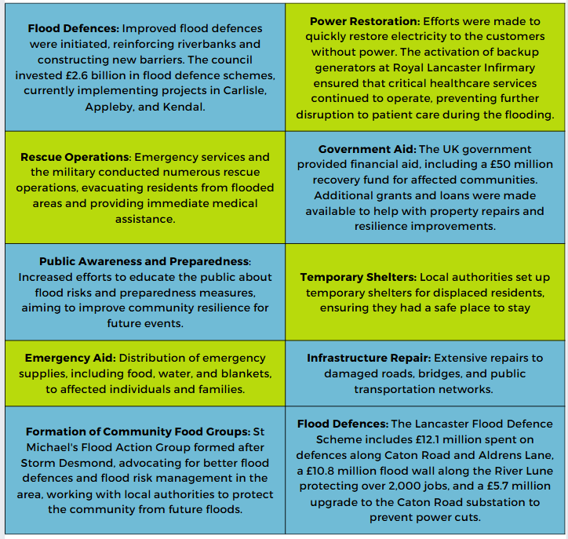
"Emergency Aid: Distribution of emergency supplies, including food, water, and blankets, to affected individuals and families."
FT Q C51 R2
Case Study: Storm Desmond 2015
RESPONSES:
Immediate Responses
Long-Term Responses

Slide 33
FT Q C51 R2
Case Study: Storm Desmond 2015
PLENARY:
Before next lesson, have a think about...
What is the difference between weather and climate?

Slide 34
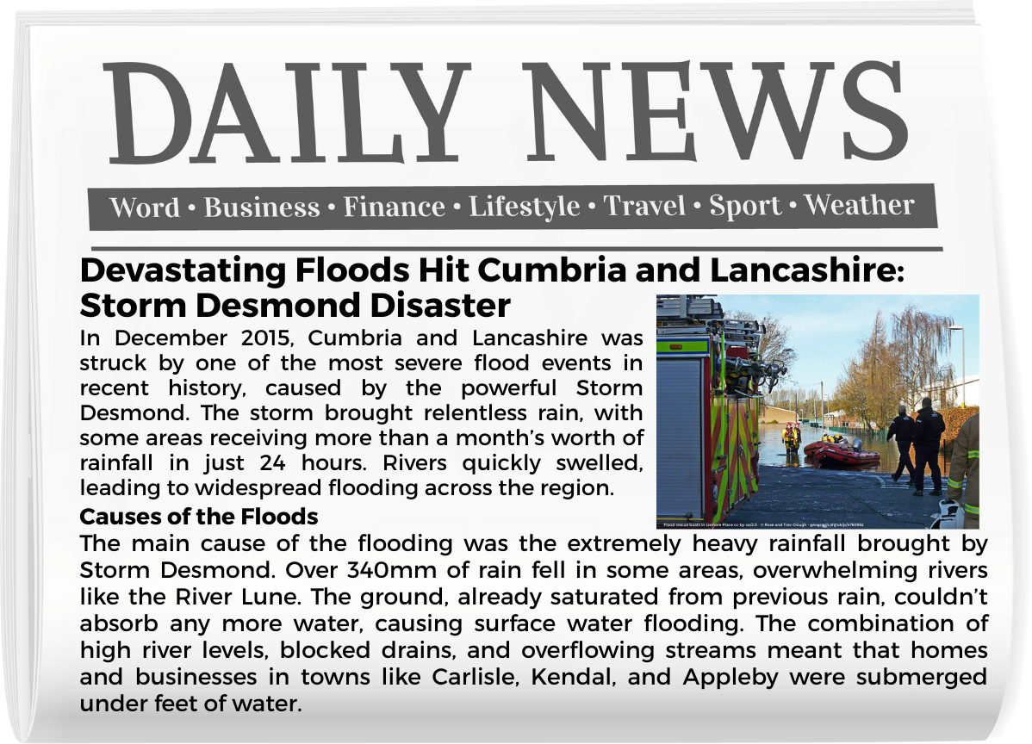
FT Q C51 R2
Case Study: Storm Desmond 2015
Homework Task :
Write a newspaper article about the 2015 Cumbria floods.
Include information on the causes of the floods.
Explain the effects on people, communities, and the environment.
Use the knowledge from today's lesson to support your article.

Slide 35

FT Q C51 R2
Case Study: Storm Desmond 2015
These lessons have been produced by The Flood Hub People for The Flood Hub.
Scan the QR code to access our Learning section. Or visit here: https://thefloodhub.co.uk/learning/

