Slide 1


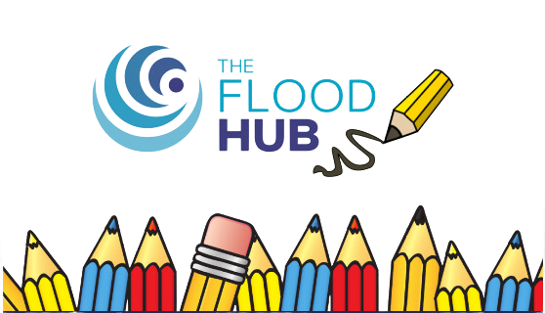
FT Q C55 R2
Impacts of Climate Change
Learning Objectives:
  Explain how climate change could shift the location of the Earth’s climate belts.
  Understand the impacts of flooding due to climate change.
  Evaluate how climate change can lead to the spread of tropical diseases.
  Identify the environmental, social and economic impacts of climate change on both a global and local scale.

Slide 2

FT Q C55 R2
Impacts of Climate Change
Introduction to Climate
Starter:
On whiteboards, list the main causes of climate change

Slide 3
FT Q C55 R2
Impacts of Climate Change
Introduction to Climate
What do you already know about the impacts of climate change? List any ideas in the mind map below:
IMPACTS OF CLIMATE CHANGE

Slide 4
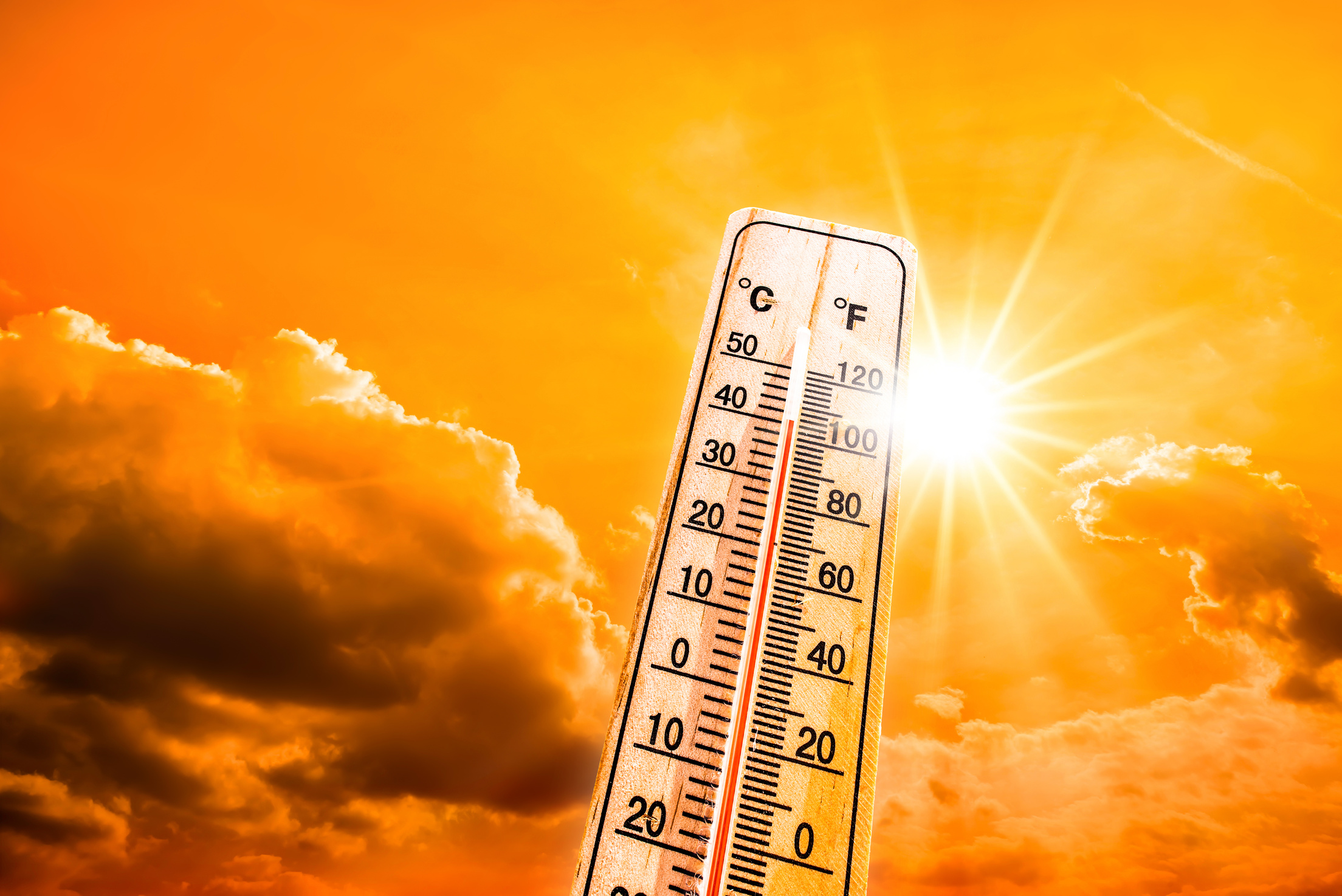
FT Q C55 R2
Impacts of Climate Change
Introduction to Climate
Global average temperatures are 1°C higher than 100 years ago
Rising Temperatures
  Global average temperatures are increasing due to the accumulation of greenhouse gases in the atmosphere.
  Heatwaves are becoming longer and more severe, causing health problems (e.g., heatstroke, respiratory issues) and affecting food and water supplies.
  Rising temperatures also lead to the melting of glaciers and ice caps, contributing to sea level rise.
HeatwaveView more by Xurzon from Getty Images

Slide 5
FT Q C55 R2
Impacts of Climate Change
2018 UK Heatwave Fact File
The 2018 UK heatwave was one of the hottest summers on record.
Average temperatures were 1.5°C higher than usual, peaking at 35.3°C in Faversham, Kent.
Linked to climate change as extreme heat events are becoming more frequent and intense.
Social impacts:
  Health: NHS saw a 15% increase in heat-related illnesses like dehydration and heatstroke.
  Water restrictions: Hosepipe bans were introduced in some areas to manage shortages.
  Disruption: Train delays and road closures due to melting tarmac and buckling tracks.
Economic impacts:
  Agriculture losses: Farmers reported up to 50% reductions in yields of key crops like wheat and potatoes.
  Infrastructure damage: Repairs to heat-damaged roads and railways cost millions.
  Energy costs: Increased use of fans and cooling systems raised electricity demand, straining the National Grid.
Environmental impacts:
  Drought: River flows in parts of England dropped to 40% below average.
  Wildfires: Saddleworth Moor fire burned for weeks, damaging over 7 square miles of moorland.
  Biodiversity loss: Heat stressed plants and wildlife, with fish dying in rivers due to low oxygen levels.

Slide 6
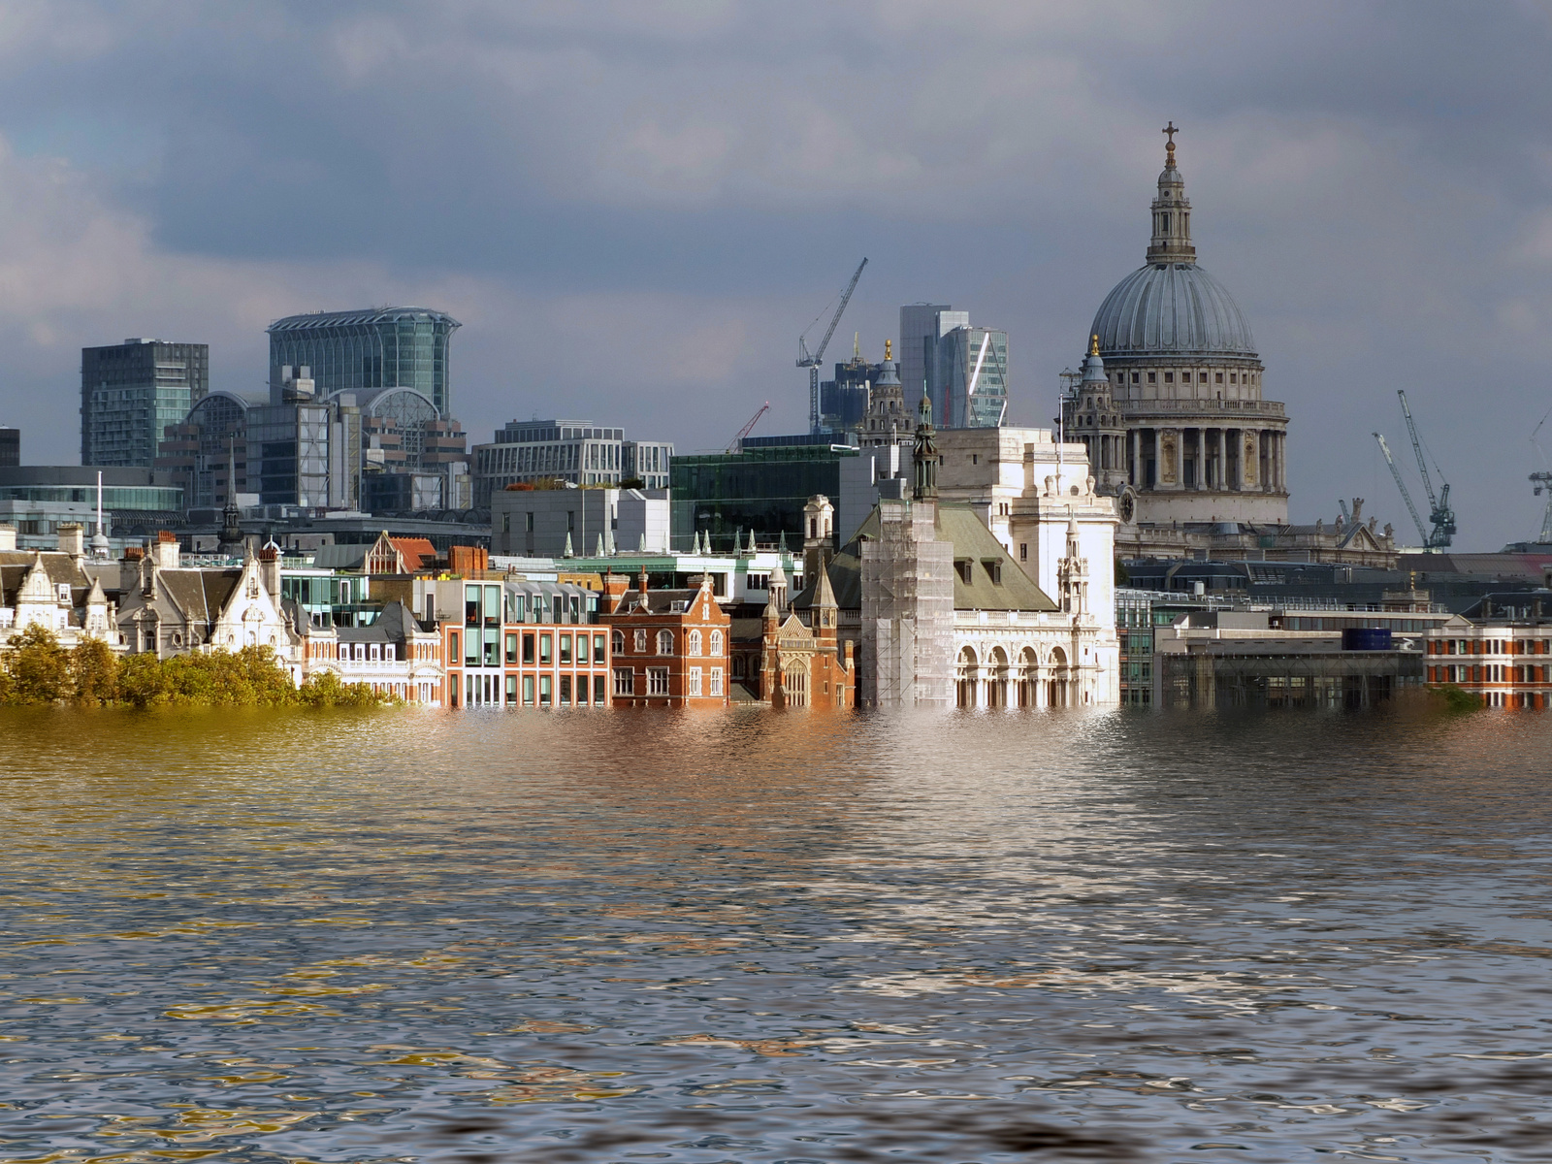
FT Q C55 R2
Impacts of Climate Change
Introduction to Climate
Sea levels are rising by about 3.3 mm per year, and could increase by up to 1 metre by 2100
Sea Level Rise and Erosion
  Rising sea levels are a result of melting ice and the expansion of seawater as it warms.
  This threatens coastal communities with flooding, erosion, and loss of land.
  Erosion can also harm beaches, infrastructure, and ecosystems.
Example: Islands in the Pacific and low-lying areas like Venice face existential threats from sea-level rise.
manipulated conceptual image of the city of london flooded due to global warming and rising sea levelsby Philip Openshaw from Getty Images

Slide 7
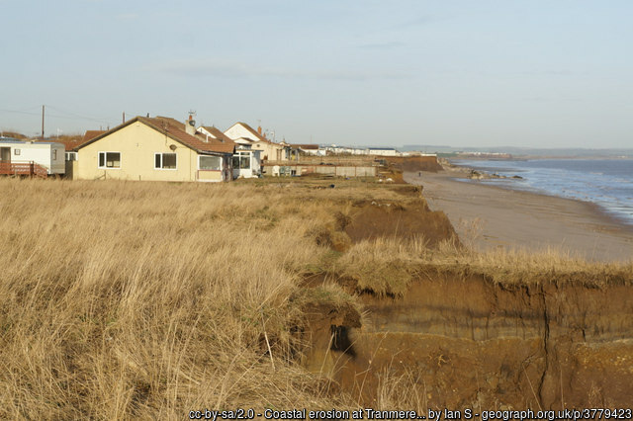
FT Q C55 R2
Impacts of Climate Change
Sea Level Rise and Erosion
LOCAL IMPACTS
  Rising sea levels and coastal erosion are threatening Happisburgh in Norfolk, where up to 250 metres of land has been lost since the 1600s. Homes are being abandoned as the coastline retreats at a rate of up to 4 metres per year.
  By 2100, sea levels around the UK are projected to rise by up to 1 metre, putting areas like East Yorkshire at risk.
Coastal erosion at Tranmere Cliff, Holderness, taken Saturday, 14 December, 2013 cc-by-sa/2.0 - © Ian S - geograph.org.uk/p/3779423

Slide 8
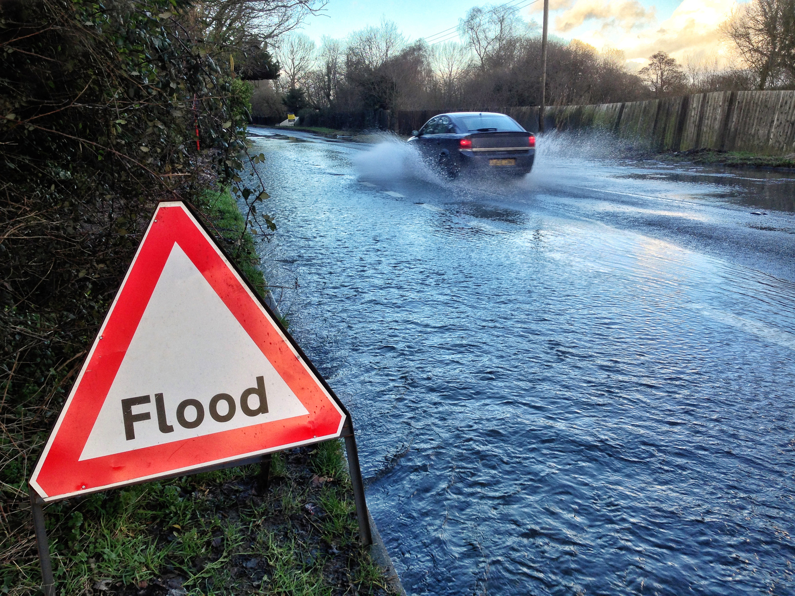
FT Q C55 R2
Impacts of Climate Change
Introduction to Climate
Flooding
  Flooding is one of the most direct consequences of climate change due to rising sea levels and extreme weather events (e.g., storms, hurricanes).
  Coastal and low-lying areas are at higher risk, including cities like New York, Miami and Jakarta.
  Social Impact: People may need to relocate, and communities may be lost. (climate migrants or climate refugees.)
  Economic Impact: Damage to infrastructure, agriculture and tourism.
Flood Warning Sign by Nicholas Free from Getty Images Signature

Slide 9
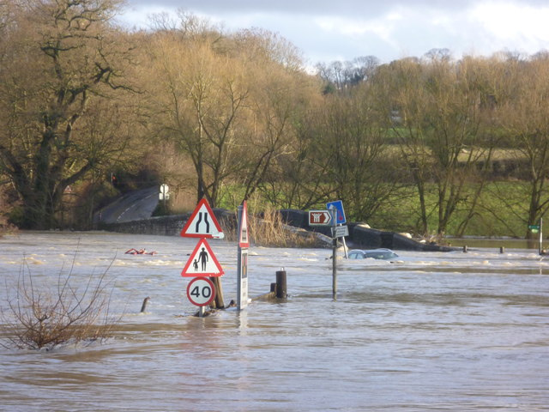
FT Q C55 R2
Impacts of Climate Change
Flooding in the UK
LOCAL IMPACTS
  6.3 million properties in England are at risk of flooding from one or a combination of rivers, the sea and surface water.
  Severe flooding events like the 2015 Cumbria floods caused £500 million in damages.
  Urban areas like London and Manchester are particularly prone to flash floods due to impermeable surfaces like roads and pavements.
Flooding and submerged car at Teston Bridge on Christmas Day, taken Wednesday, 25 December, 2013
cc-by-sa/2.0 - © Marathon - geograph.org.uk/p/3789774

Slide 10
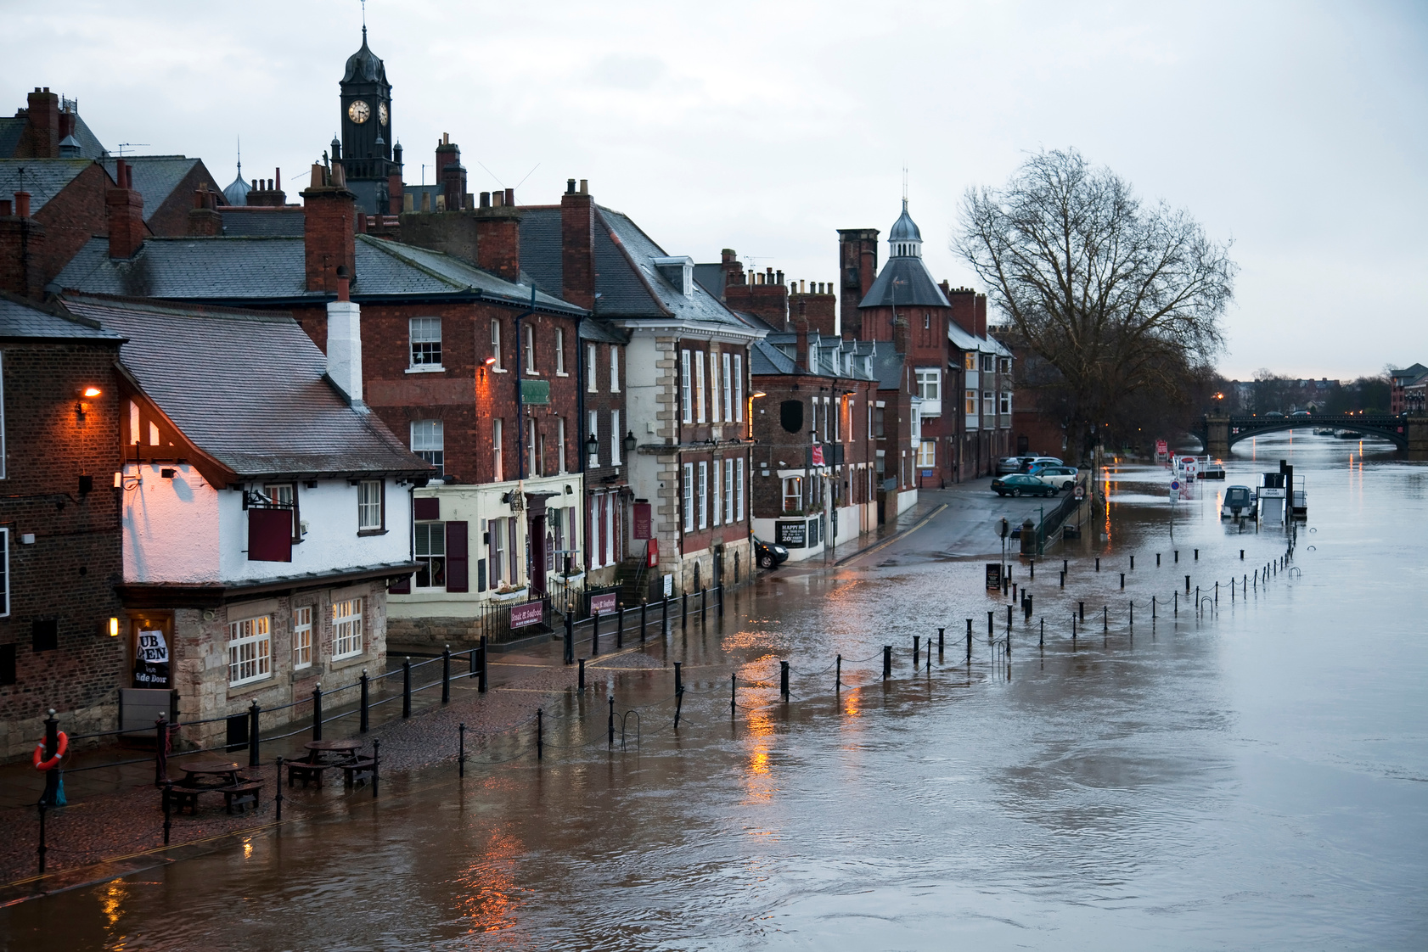
FT Q C55 R2
Impacts of Climate Change
Flooding in the UK
Why Does Climate Change Cause More Flooding?
  Increased Rainfall: Warmer temperatures lead to more evaporation, resulting in heavier and more prolonged rain.
  Rising Sea Levels: Melting ice caps and glaciers, along with the expansion of warmer ocean water, cause sea levels to rise, increasing the risk of coastal flooding.
  Storm Surges: More intense storms caused by climate change can lead to powerful surges along the coast.
Floods View more by onfilm from Getty Images Signature

Slide 11
FT Q C55 R2
Impacts of Climate Change
Impacts of Flooding in the UK
Social impacts :
  Displacement of people: Thousands may lose their homes due to floods, becoming climate refugees.
  Health risks: Damp conditions increase respiratory illnesses.
  Travel disruption: Flooding can damage roads, bridges, and infrastructure, isolating communities and cutting off essential services.
Economic impacts:
  Property damage: Homes, businesses, and infrastructure suffer costly damage, requiring expensive repairs.
  Agricultural losses: Crops and livestock are destroyed, affecting food supply and livelihoods.
Environmental impacts:
  Ecosystem damage: Flooding can destroy habitats, disrupt wildlife, and lead to water pollution as chemicals and waste are washed into rivers and seas.
  Soil erosion: Heavy rainfall and floods wash away fertile topsoil, reducing land productivity.
  Loss of biodiversity: Prolonged flooding can kill plants and animals that are not adapted to such conditions.

Slide 12
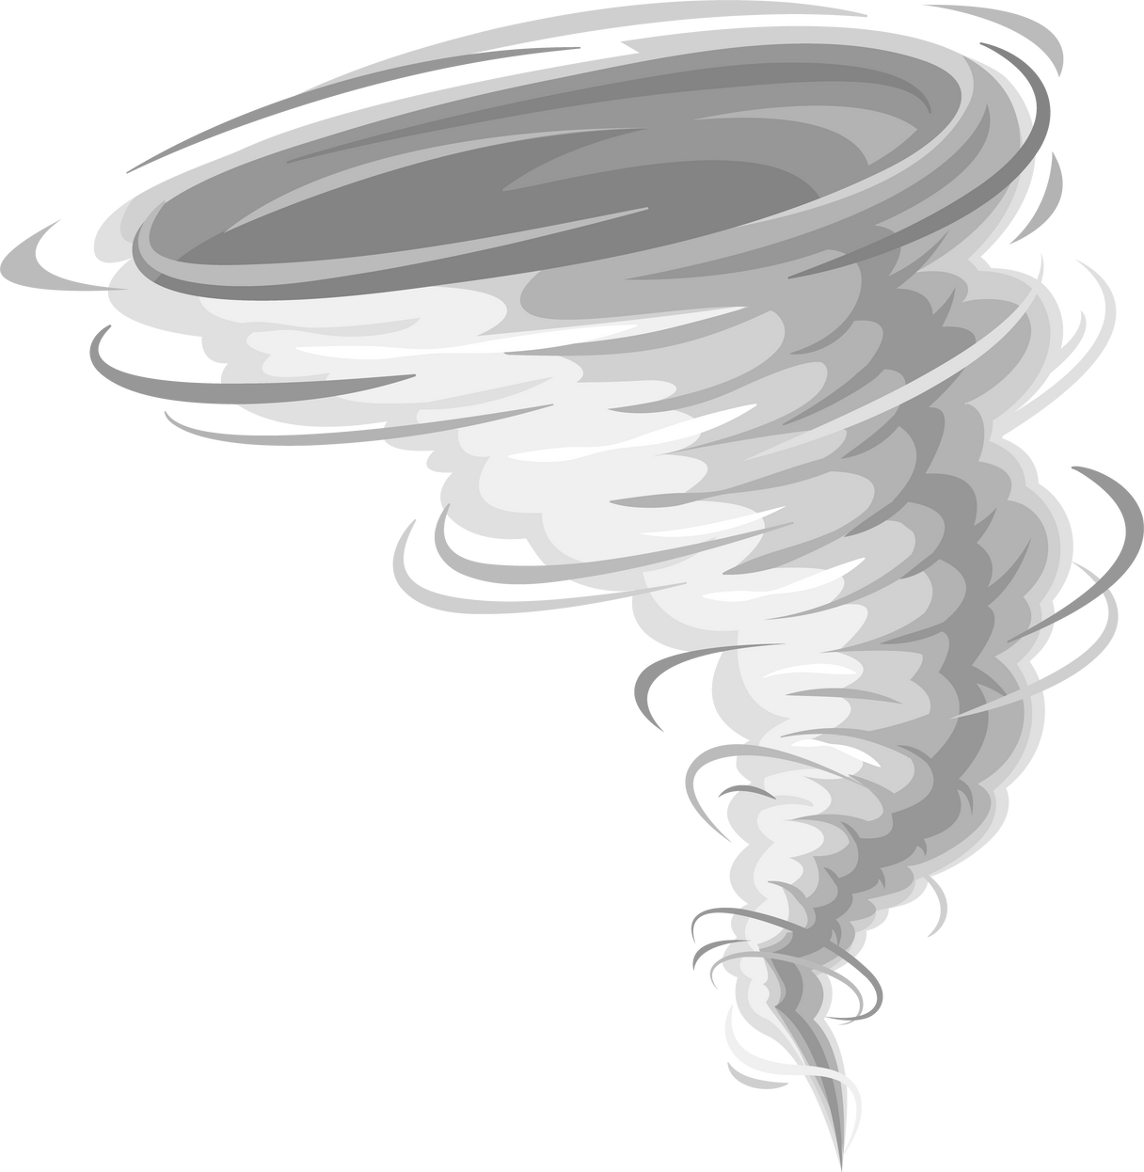
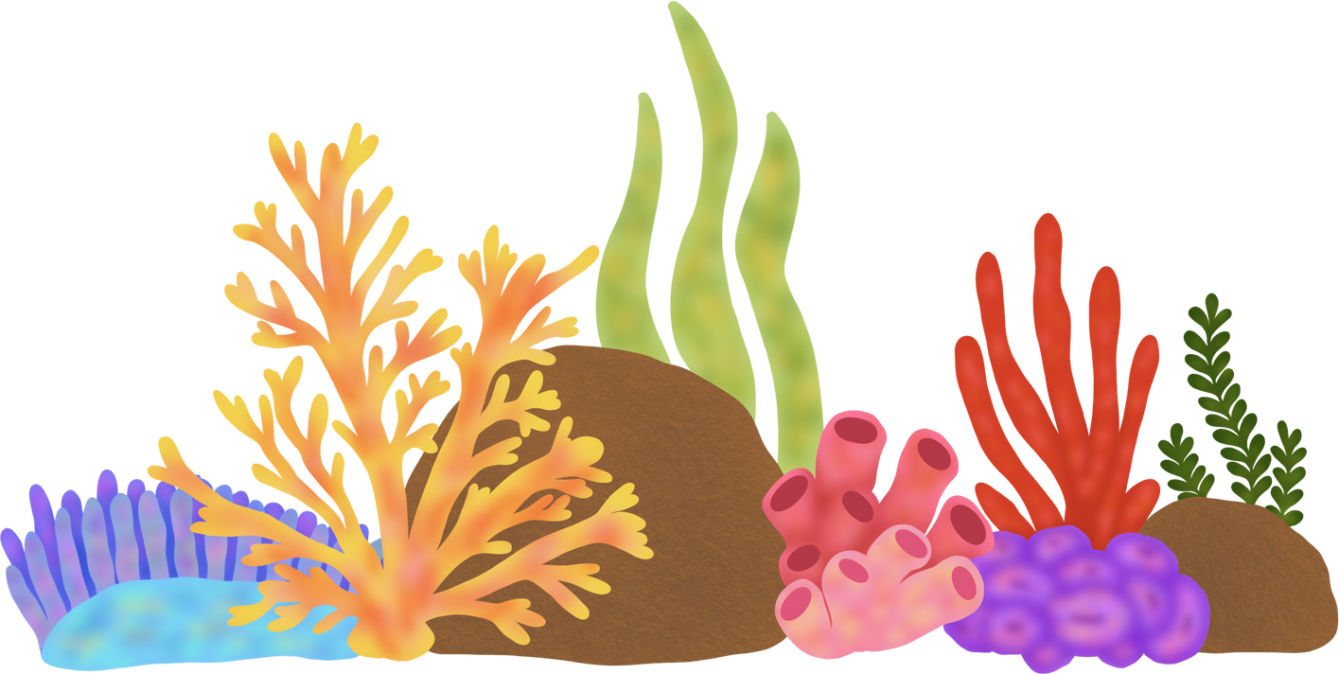
FT Q C55 R2
Impacts of Climate Change
Introduction to Climate
Sea Surface Temperature Increase
Rising Sea Surface Temperatures (SST) are a significant consequence of global warming, and they have multiple impacts on both marine ecosystems and human communities.
Coral Bleaching: Warmer waters stress coral reefs, leading to coral bleaching. This occurs when corals expel the algae living within them, which can eventually cause the corals to die.
Increased Hurricane Frequency and Severity: Higher sea surface temperatures provide more energy for storms, leading to more frequent and severe tropical cyclones and hurricanes.

Slide 13
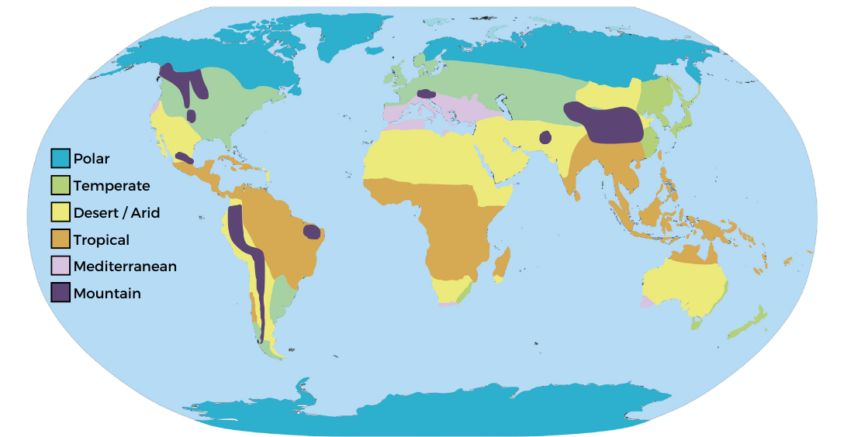
FT Q C55 R2
Impacts of Climate Change
Introduction to Climate
Shifting Climate Belts
  Climate belts are regions that have consistent temperature and precipitation patterns.
  Climate change can shift these belts as rising global temperatures disrupt established weather patterns and systems.
  This changes where crops can grow and making it harder for some countries to produce food.
Example: Regions near the equator may become too hot or dry for agriculture, while other areas could become more temperate.

Slide 14
FT Q C55 R2
Impacts of Climate Change
Introduction to Climate
How might this change in climate belts impact local economies that depend on farming?
Think about the social economic and environmental impacts.

Slide 15
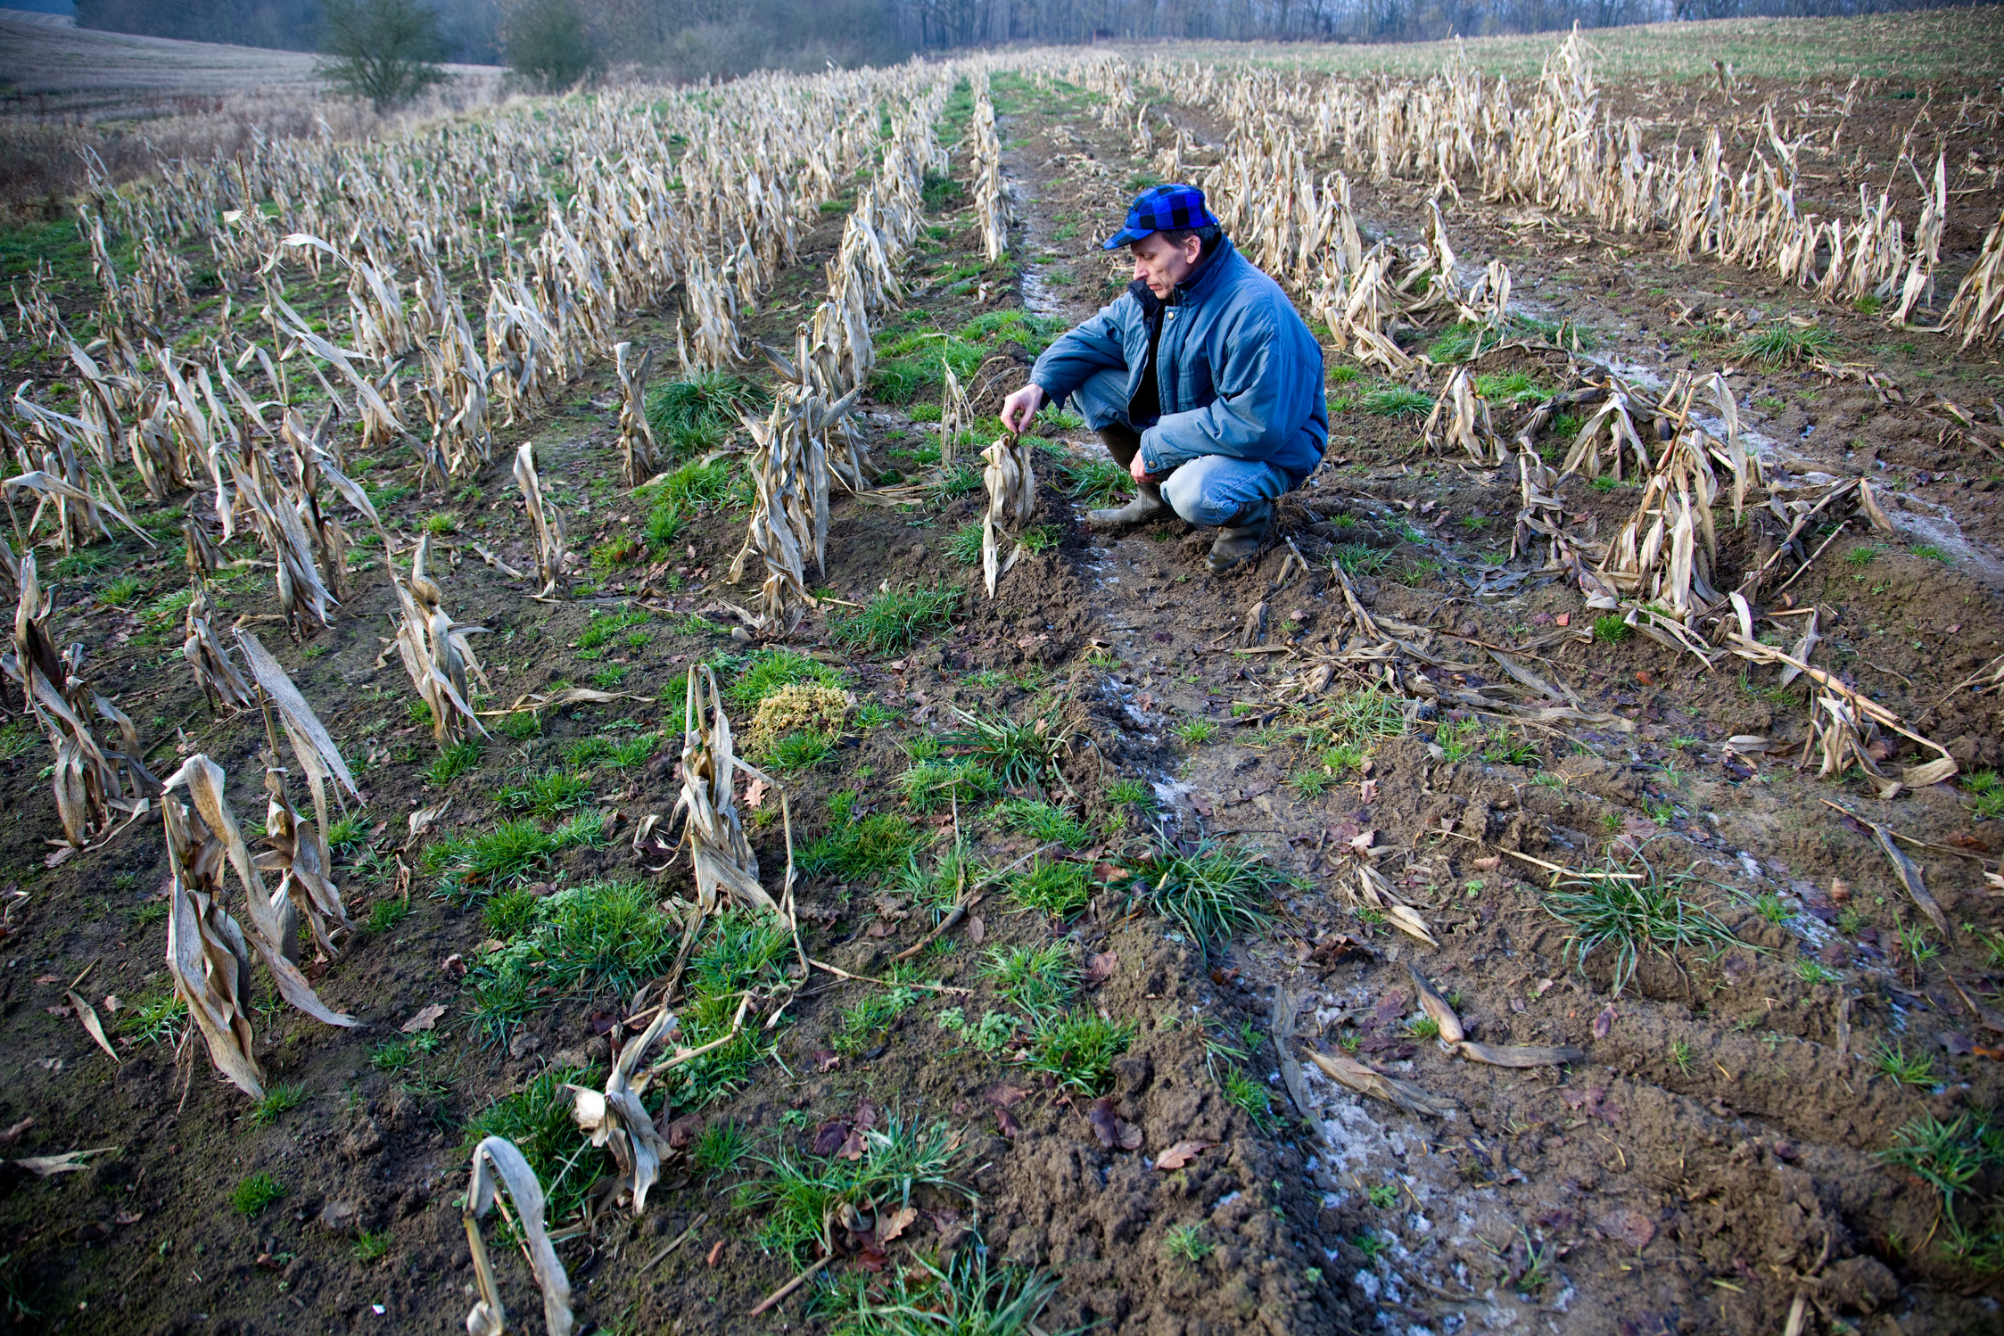
FT Q C55 R2
Impacts of Climate Change
Impact on Food Production
  Climate change is disrupting agricultural production due to shifting climate zones, extreme weather and water scarcity.
  Droughts and heatwaves can reduce crop yields, especially in tropical and subtropical regions.
Water Scarcity: not enough clean, safe water available to meet the needs of people, animals and the environment.
  Example: Rice production in parts of Asia is being threatened by rising temperatures and water shortages.
  Social Impact: This could lead to higher food prices and food insecurity, especially in poorer regions.
Failed crop PeterAustin from Getty Images Signature

Slide 16
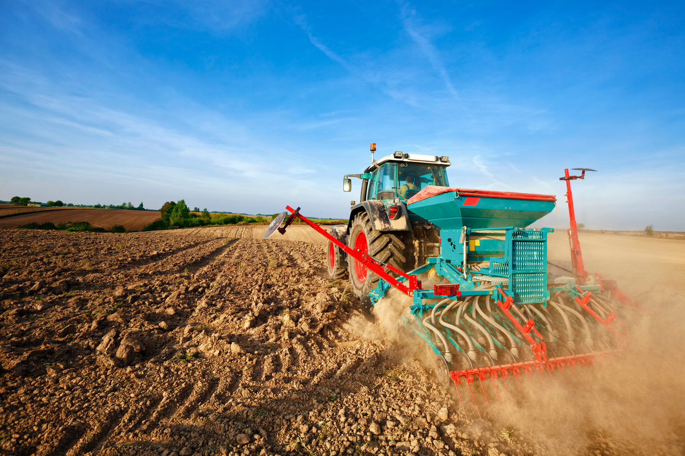
FT Q C55 R2
Impacts of Climate Change
Impact on Food Production
LOCAL IMPACTS
  Crops like wheat, which accounts for 40% of UK arable land, are at risk from unpredictable rainfall and heat stress.
  Farmers in East Anglia, a key agricultural region, are already adapting to reduced water availability by trialling drought-resistant crops.
Blue tractor sowing wheatView more by Avalon_Studio from Getty Images Signature

Slide 17
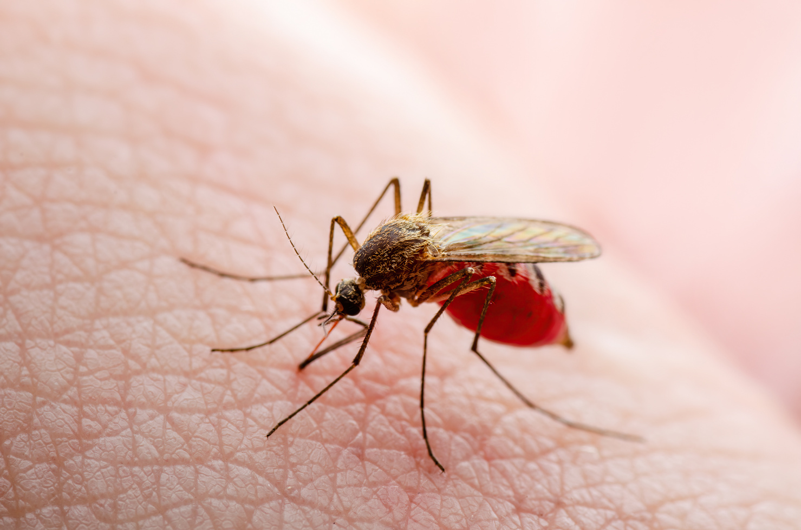

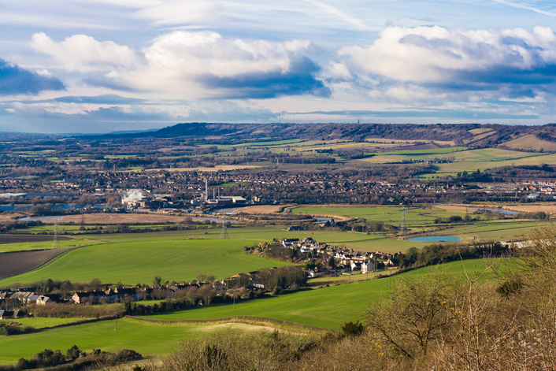
FT Q C55 R2
Impacts of Climate Change
Introduction to Climate
The Spread of Tropical Diseases
Dangerous Zika Infected Mosquito Skin Bite Macro. by nechaev-kon from Getty Images
  Warmer temperatures allow diseases like malaria, dengue, and Zika virus to spread to new areas.
  Tropical diseases are moving to regions that were previously too cool for the mosquitoes and pathogens that carry them.
  Example: Malaria is spreading to parts of Europe and North America due to higher temperatures.
Malaria in Kent: Climate Change Brings Tropical Disease to UK Shores
Malaria is not native to the UK and is not spread from person to person. However, malaria cases in the UK are associated with travel from tropical or subtropical areas. Mosquitoes carrying malara .The Anopheles atroparvus mosquito was once native to the UK and could carry malaria. Malaria was common in low-lying areas of Kent, Essex, and Sussex until the early 1900s. Risk of malaria-carrying mosquitoes. Climate change and the movement of people and goods could increase the risk of malaria-carrying mosquitoes reaching the UK. For example, the Asian tiger mosquito has been spotted in southeast England since 2016.

Slide 18
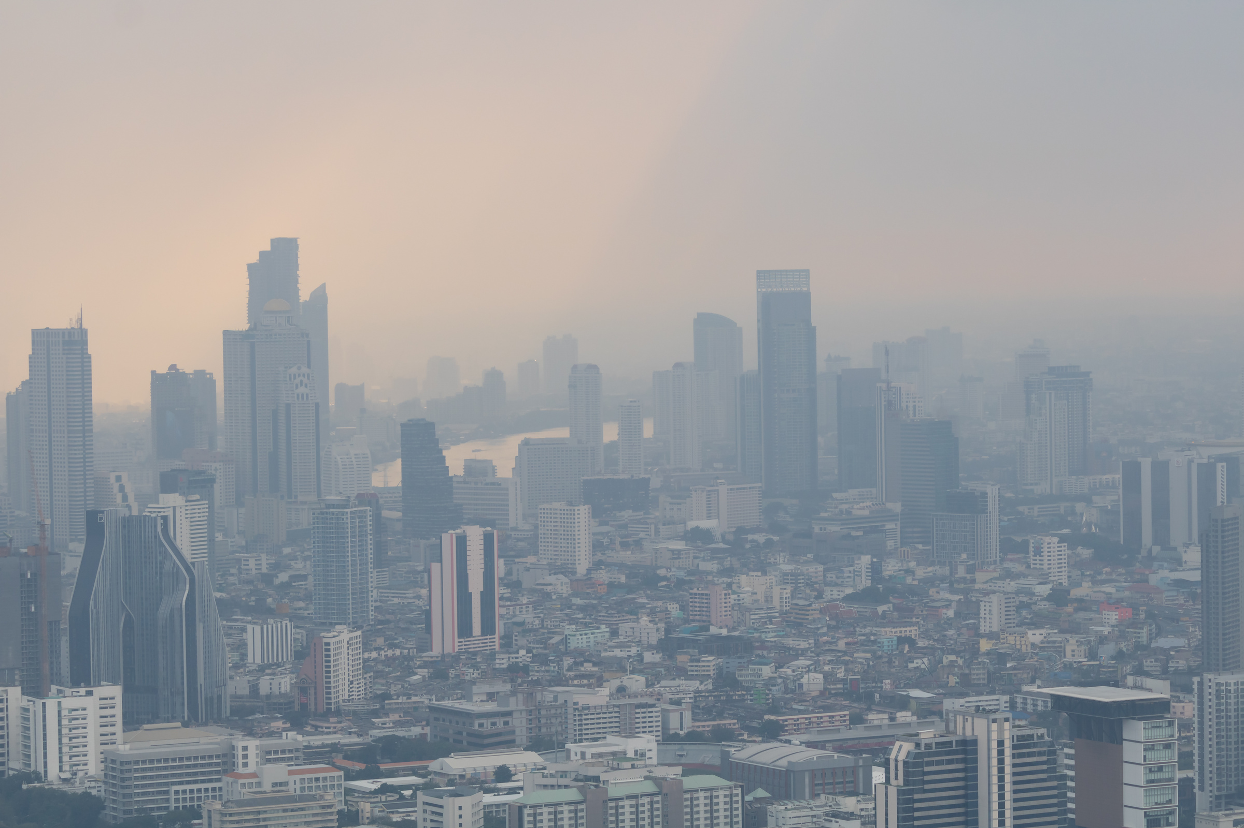
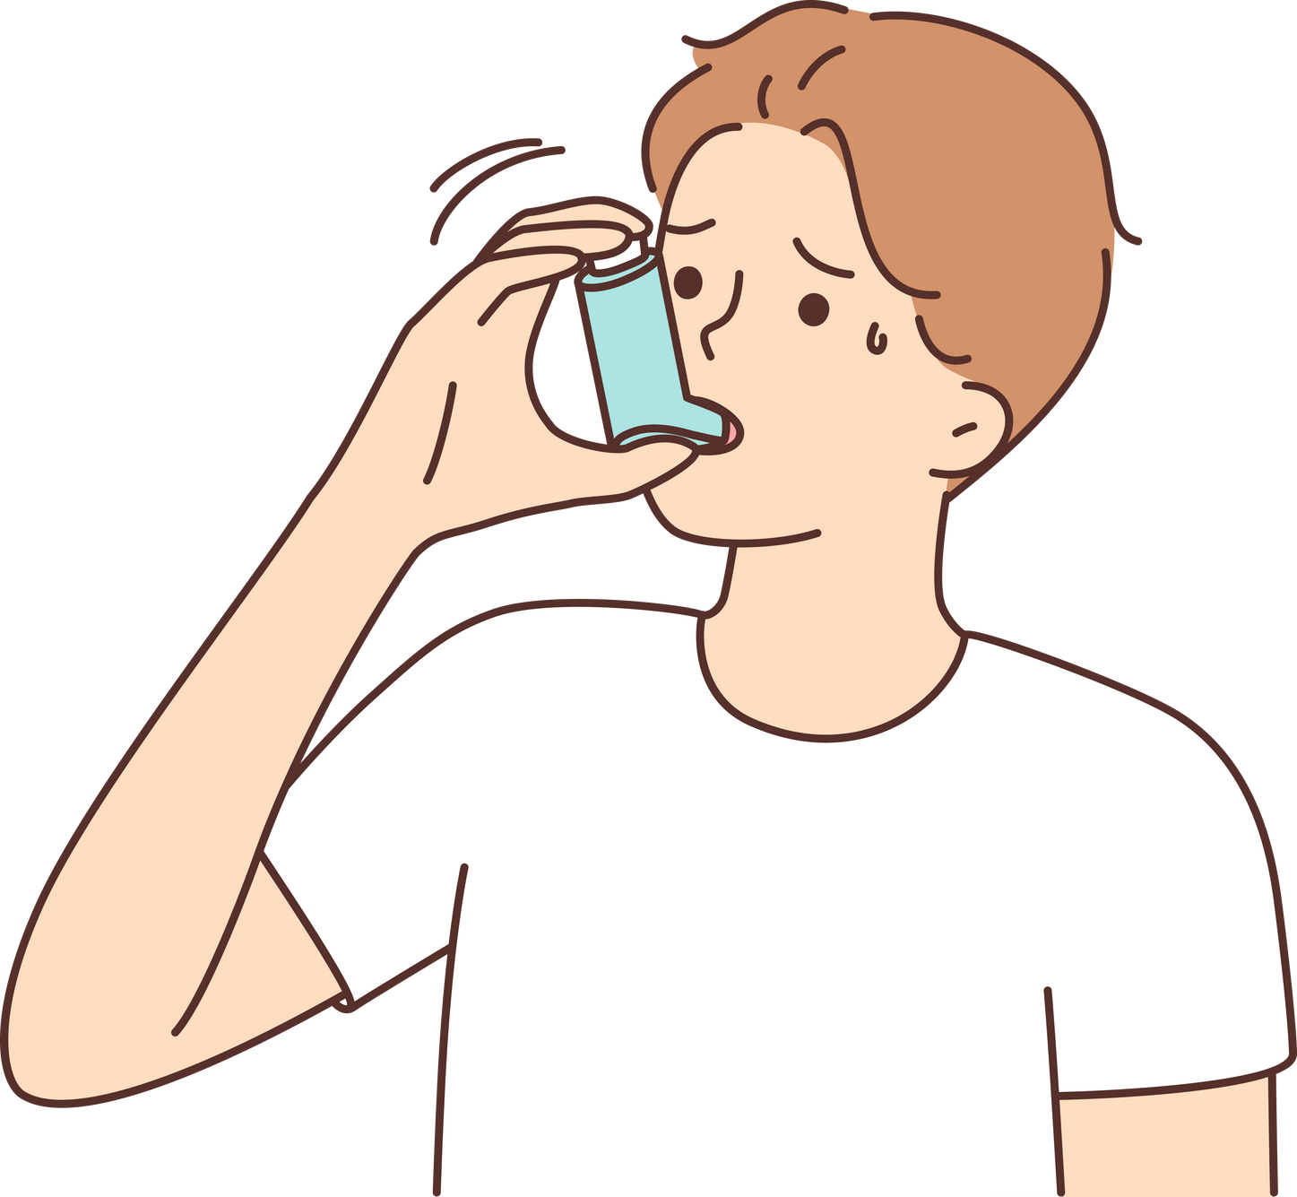
FT Q C55 R2
Impacts of Climate Change
Introduction to Climate
Climate Change and Respiratory Health
PM2.5 Air pollution of Bangkok View more by Mas042 from Getty Images
  Warmer temperatures and increased air pollution are contributing to a rise in asthma cases.
  Higher temperatures can worsen air quality by increasing the concentration of pollutants.
  These pollutants irritate the lungs and trigger asthma attacks, particularly in vulnerable populations e.g. children and the elderly.

Slide 19
FT Q C55 R2
Impacts of Climate Change
Introduction to Climate
Impacts of Climate Change
Social impacts refer to the effects of an event on the lives, health and wellbeing of people in a community. This includes disruptions to daily life, displacement, casualties, public health issues and changes in community dynamics.
Economic impacts refer to the financial effects of an event on individuals, businesses and the overall economy. This includes property damage, business disruption, costs of repairs and rebuilding, and impacts on industries such as agriculture and tourism.
Environmental impacts involve changes to the natural environment due to an event. This includes effects on wildlife, ecosystems, natural resources, and pollution levels.
Some of these impacts overlap because they are connected and affect each other in various ways.

Slide 20

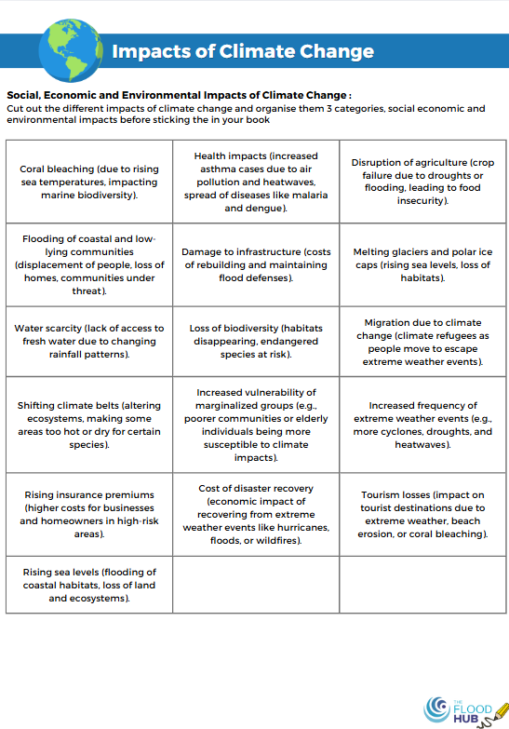
FT Q C55 R2
Impacts of Climate Change
Introduction to Climate
Impacts of Climate Change
Task:
  Cut out the different impacts of climate change from the sheet provided.
  Organise them into three categories:
    Social Impacts (affecting people and communities)
    Economic Impacts (affecting jobs, businesses and costs)
    Environmental Impacts (affecting nature, ecosystems and wildlife)
  Once sorted, stick them into your book under the correct headings.

Slide 21
FT Q C55 R2
Impacts of Climate Change
Introduction to Climate
Social Impacts:
Flooding of coastal and low-lying communities (displacement of people, loss of homes, communities under threat).
Migration due to climate change (climate refugees as people move to escape extreme weather events).
Increased vulnerability of marginalised groups (e.g., poorer communities or elderly individuals being more susceptible to climate impacts).
Health impacts (increased asthma cases due to air pollution and heatwaves, spread of diseases like malaria and dengue).
Water scarcity (lack of access to fresh water due to changing rainfall patterns).

Slide 22

FT Q C55 R2
Impacts of Climate Change
Introduction to Climate
Environmental Impacts
Rising sea levels (flooding of coastal habitats, loss of land and ecosystems).
Coral bleaching (due to rising sea temperatures, impacting marine biodiversity).
Shifting climate belts (altering ecosystems, making some areas too hot or dry for certain species).
Increased frequency of extreme weather events (e.g., more cyclones, droughts, and heatwaves).
Loss of biodiversity (habitats disappearing, endangered species at risk).
Melting glaciers and polar ice caps (rising sea levels, loss of habitats).

Slide 23
FT Q C55 R2
Impacts of Climate Change
Introduction to Climate
Economic Impacts:
Damage to infrastructure (costs of rebuilding and maintaining flood defenses).
Disruption of agriculture (crop failure due to droughts
or flooding, leading to food insecurity).
Cost of disaster recovery (economic impact of recovering from extreme weather events like hurricanes, floods, or wildfires).
Rising insurance premiums (higher costs for businesses and homeowners in high-risk areas).
Tourism losses (impact on tourist destinations due to extreme weather, beach erosion, or coral bleaching).

Slide 24
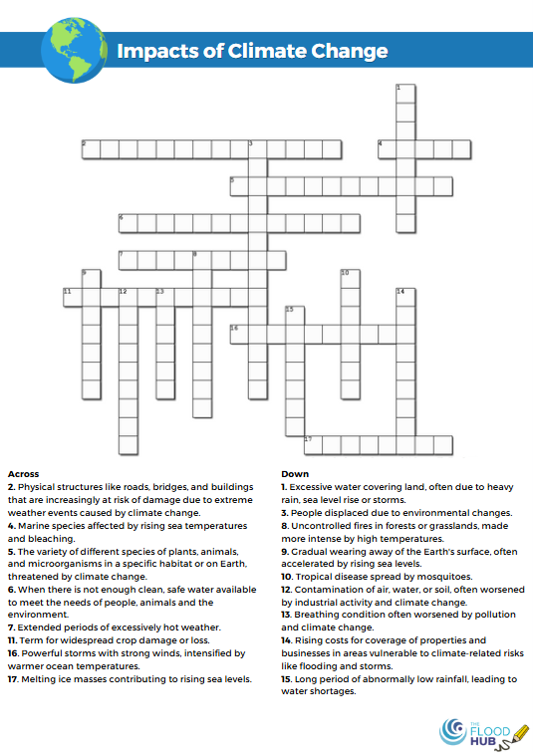
FT Q C55 R2
Impacts of Climate Change
Introduction to Climate
HOMEWORK TASK:
On your worksheet, complete the crossword with the different impacts of climate change

Slide 25
FT Q C55 R2
Impacts of Climate Change
Introduction to Climate
Next steps:
Before next lesson have a think about....
We’ve explored the impacts of climate change, but how can we manage it?

Slide 26

FT Q C55 R2
Impacts of Climate Change
Introduction to Climate
These lessons have been produced by The Flood Hub People for The Flood Hub.
Scan the QR code to access our Learning section. Or visit here: https://thefloodhub.co.uk/learning/

