Slide 1

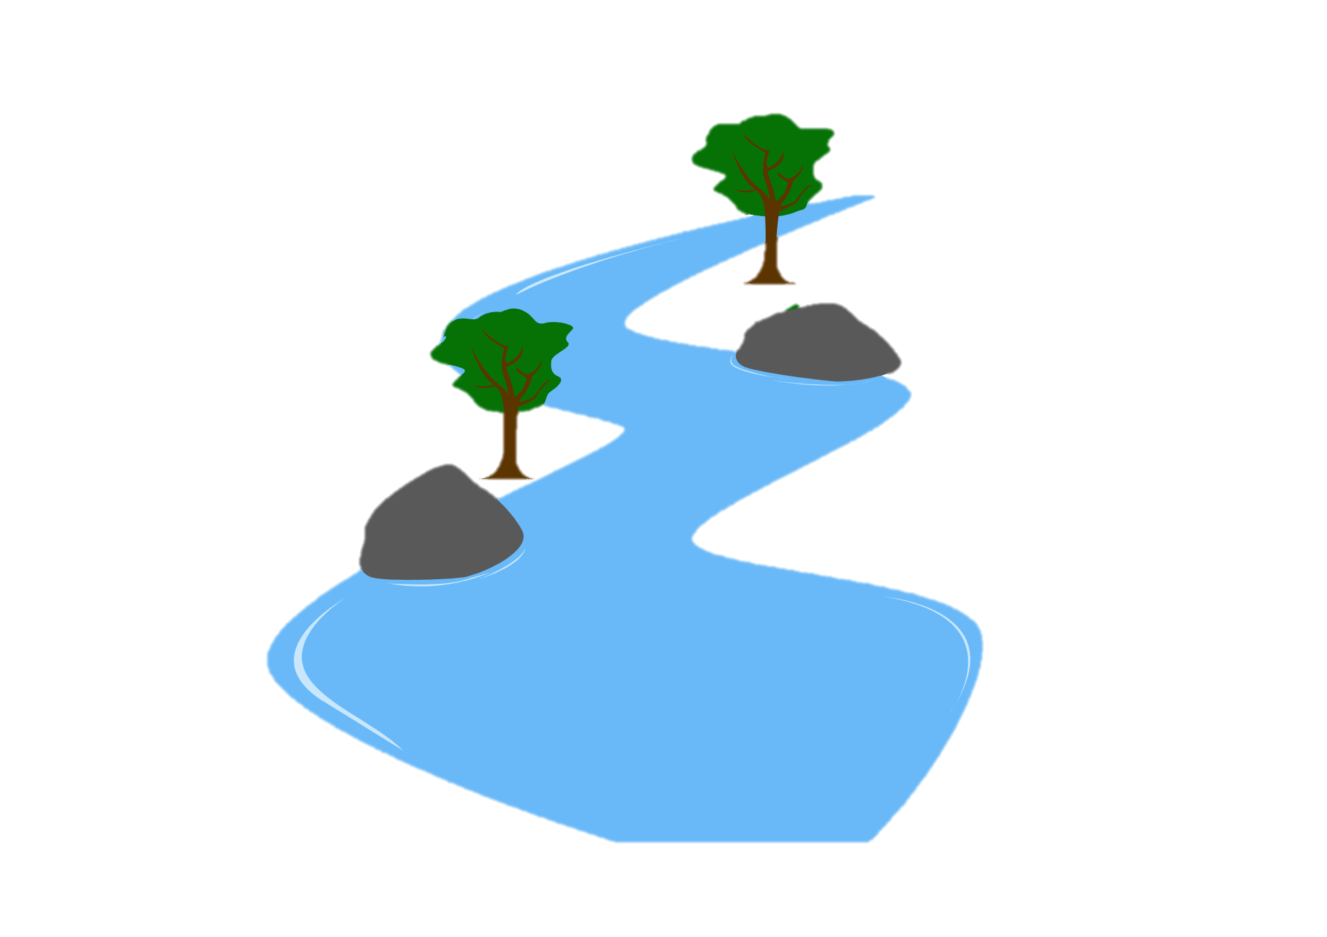
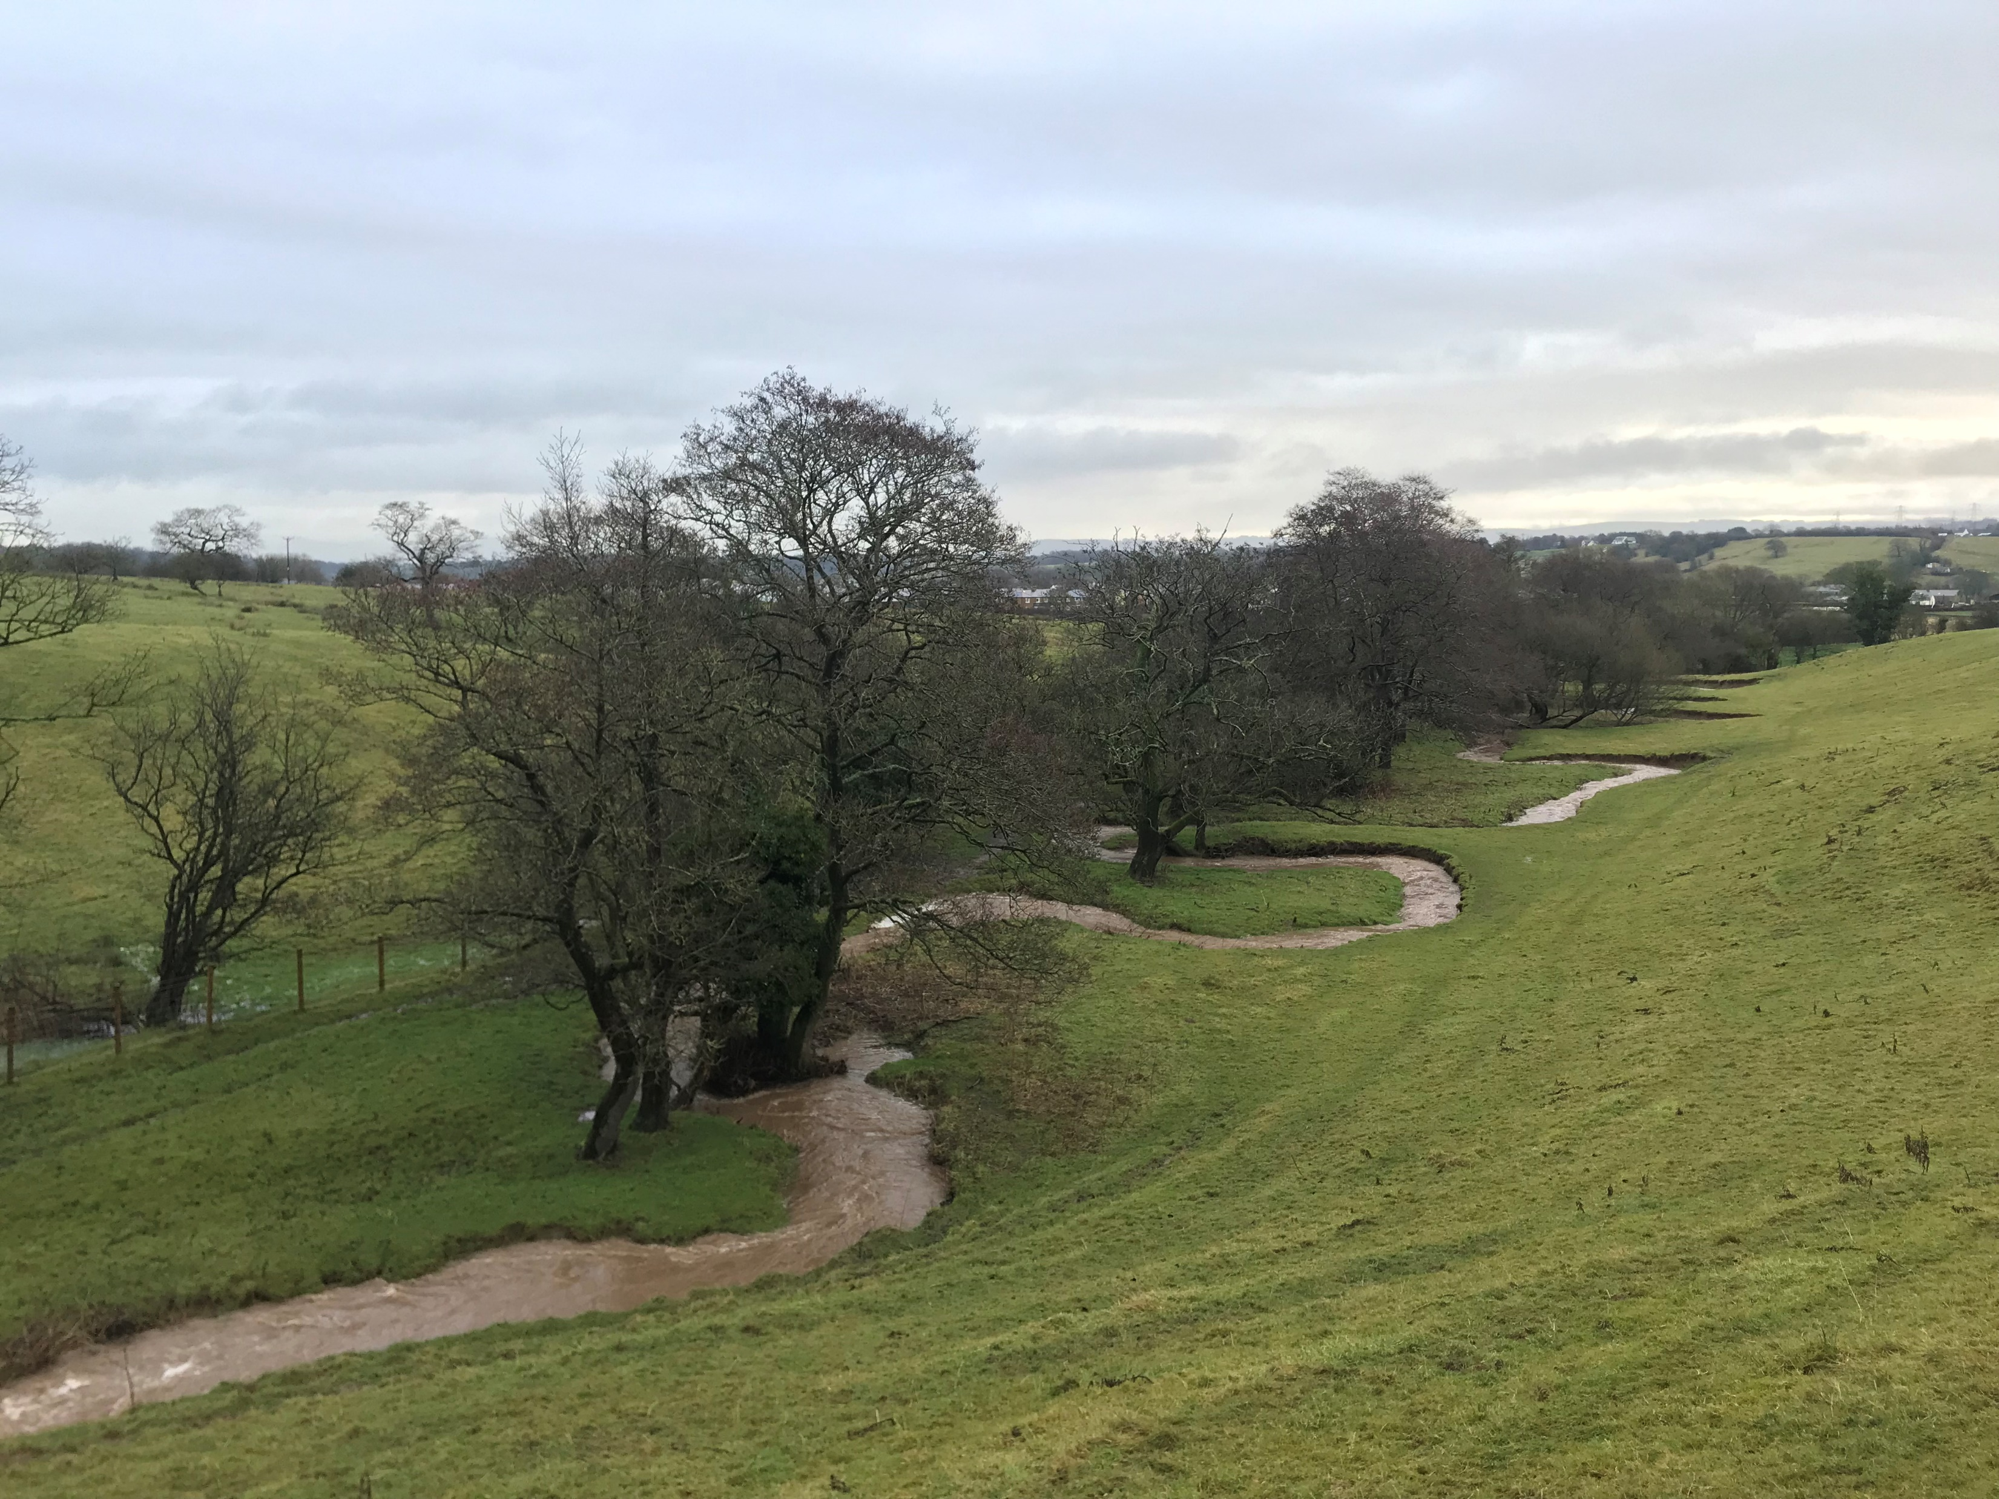
River Landscapes: Processes
FT Q C66
Learning objectives:
Define a river
Explain the different components of a river
Understand and explain the different fluvial (river) processes
Image: The Flood Hub People

Slide 2
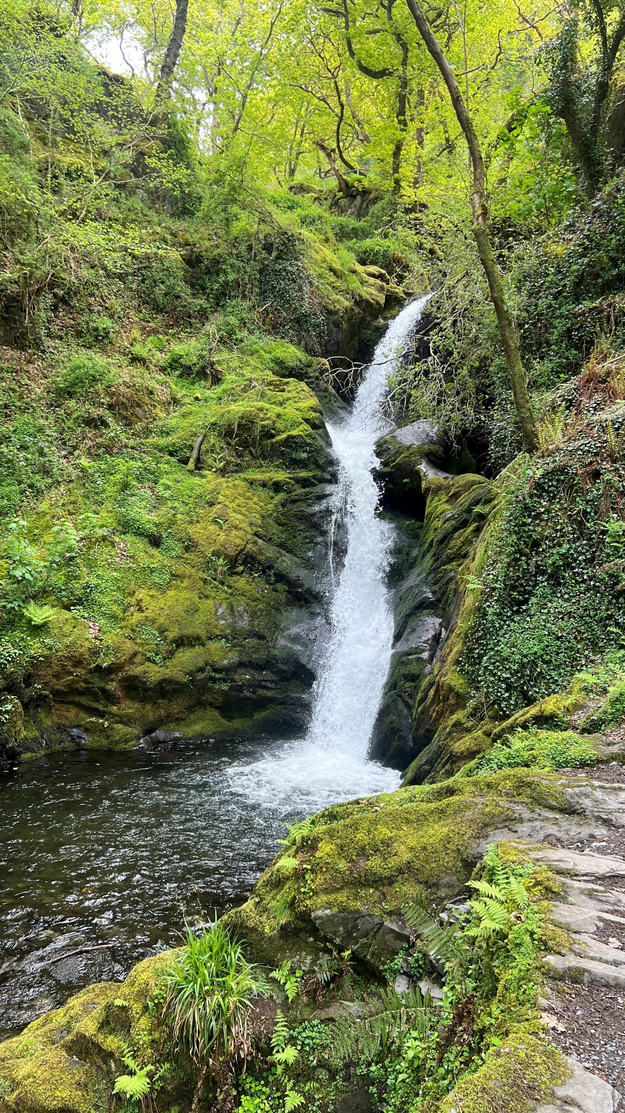
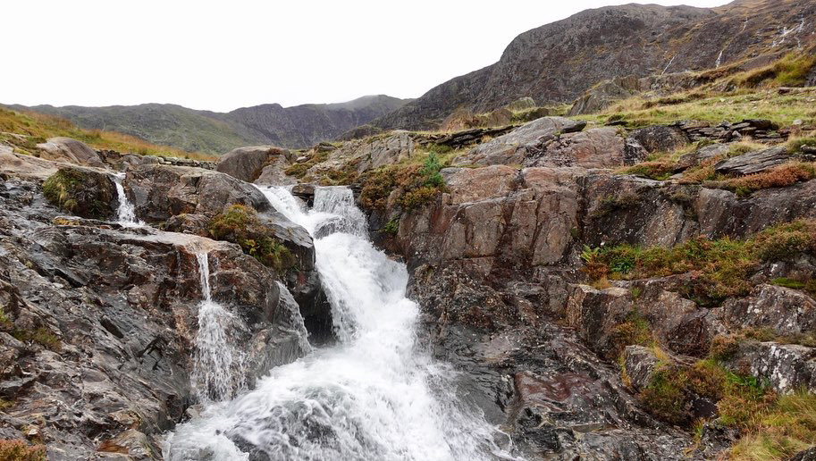
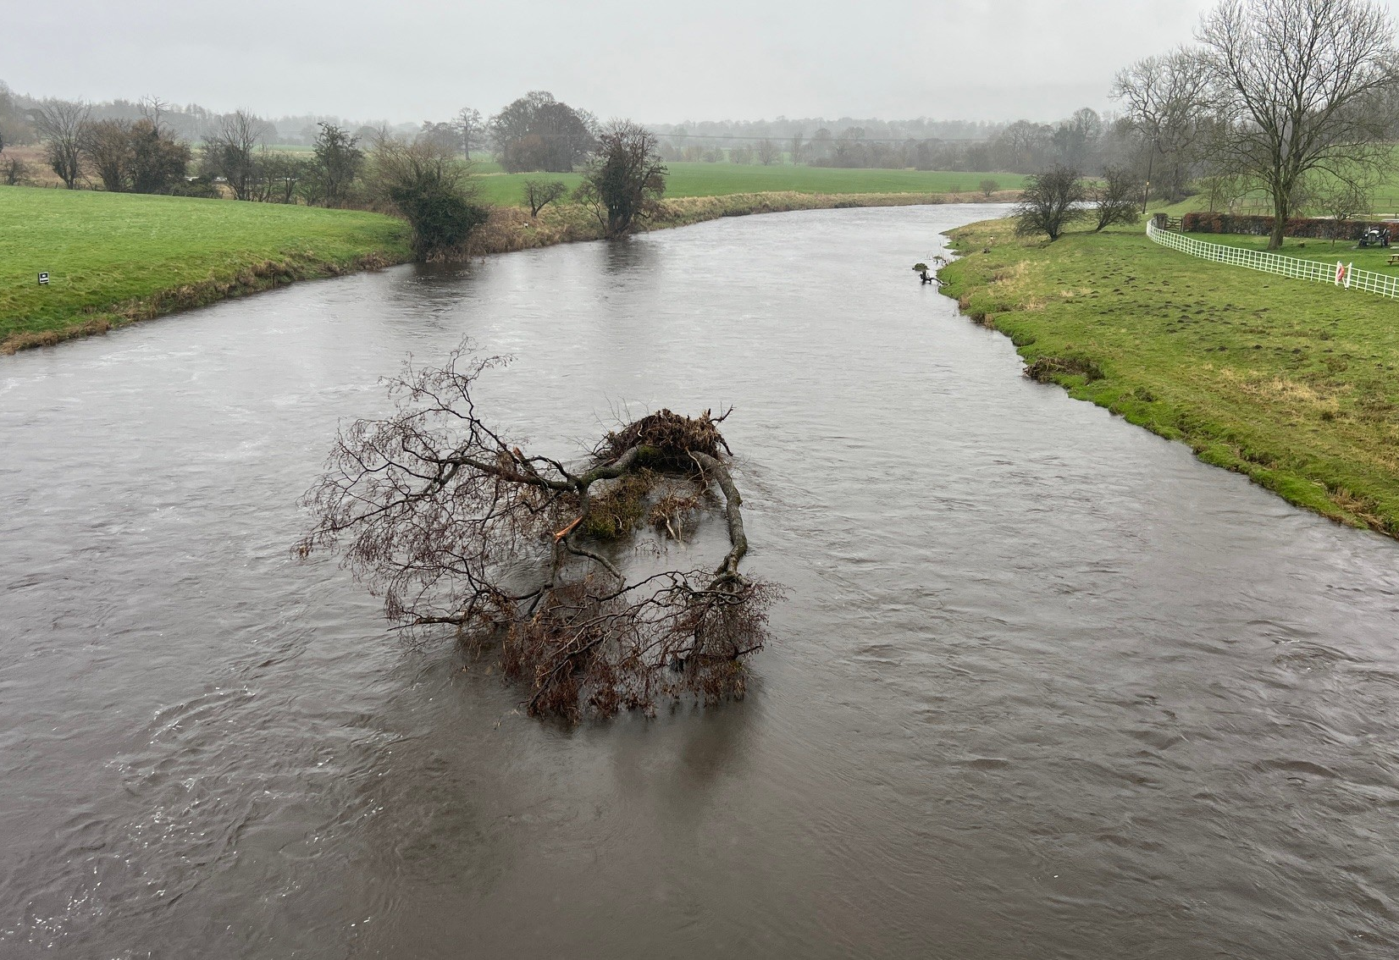
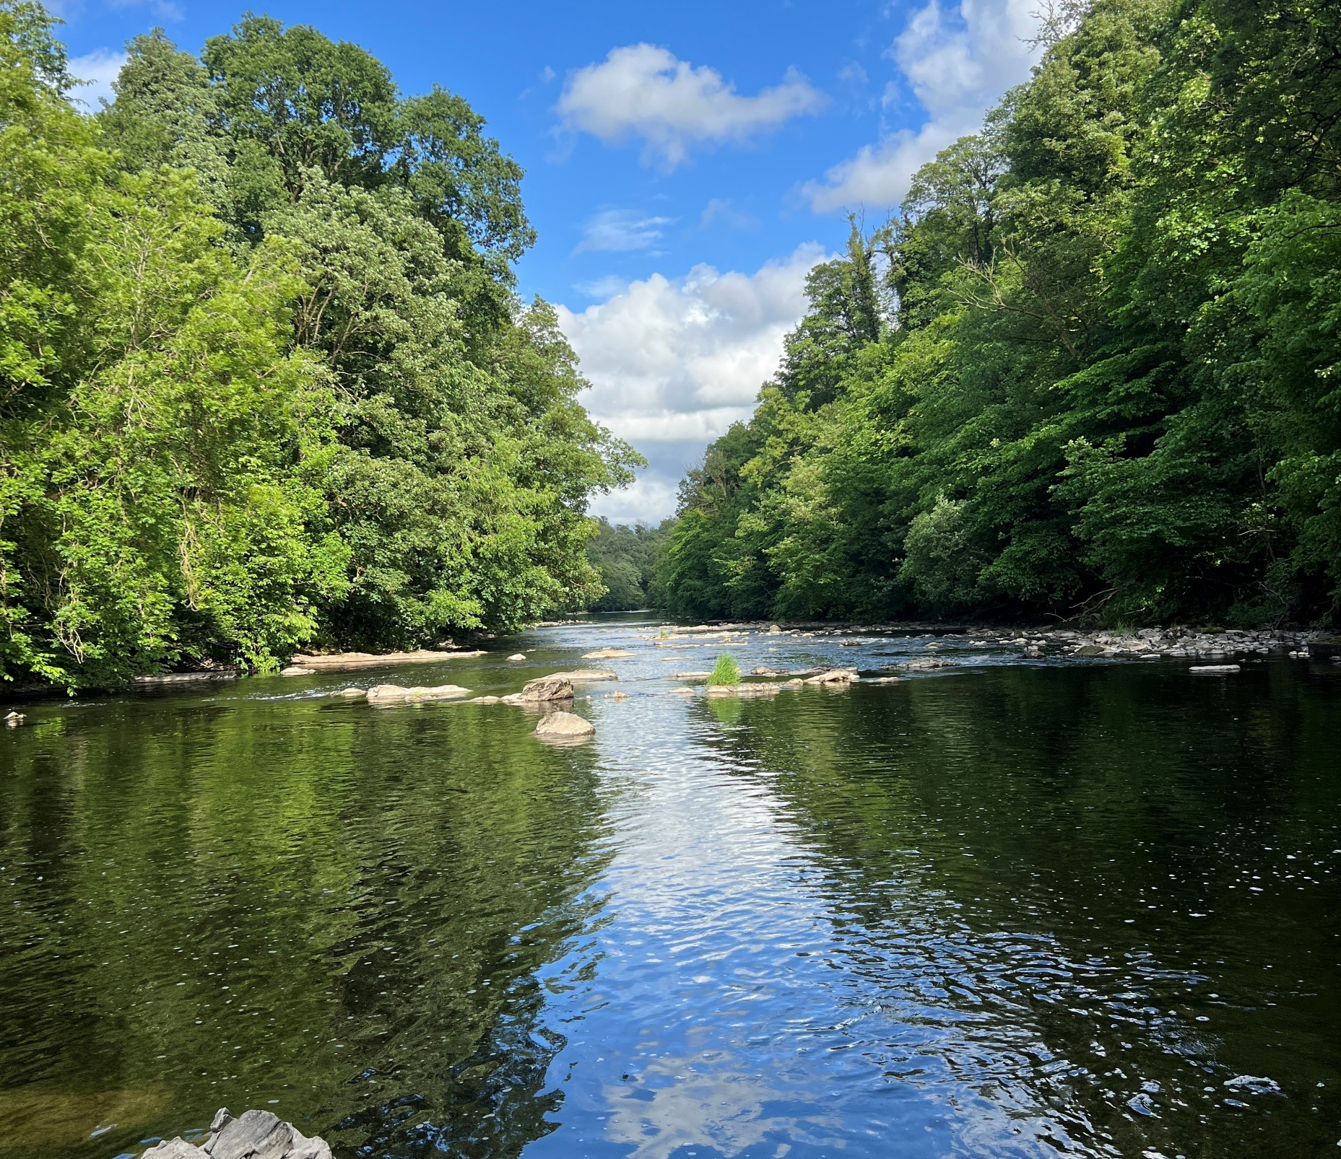
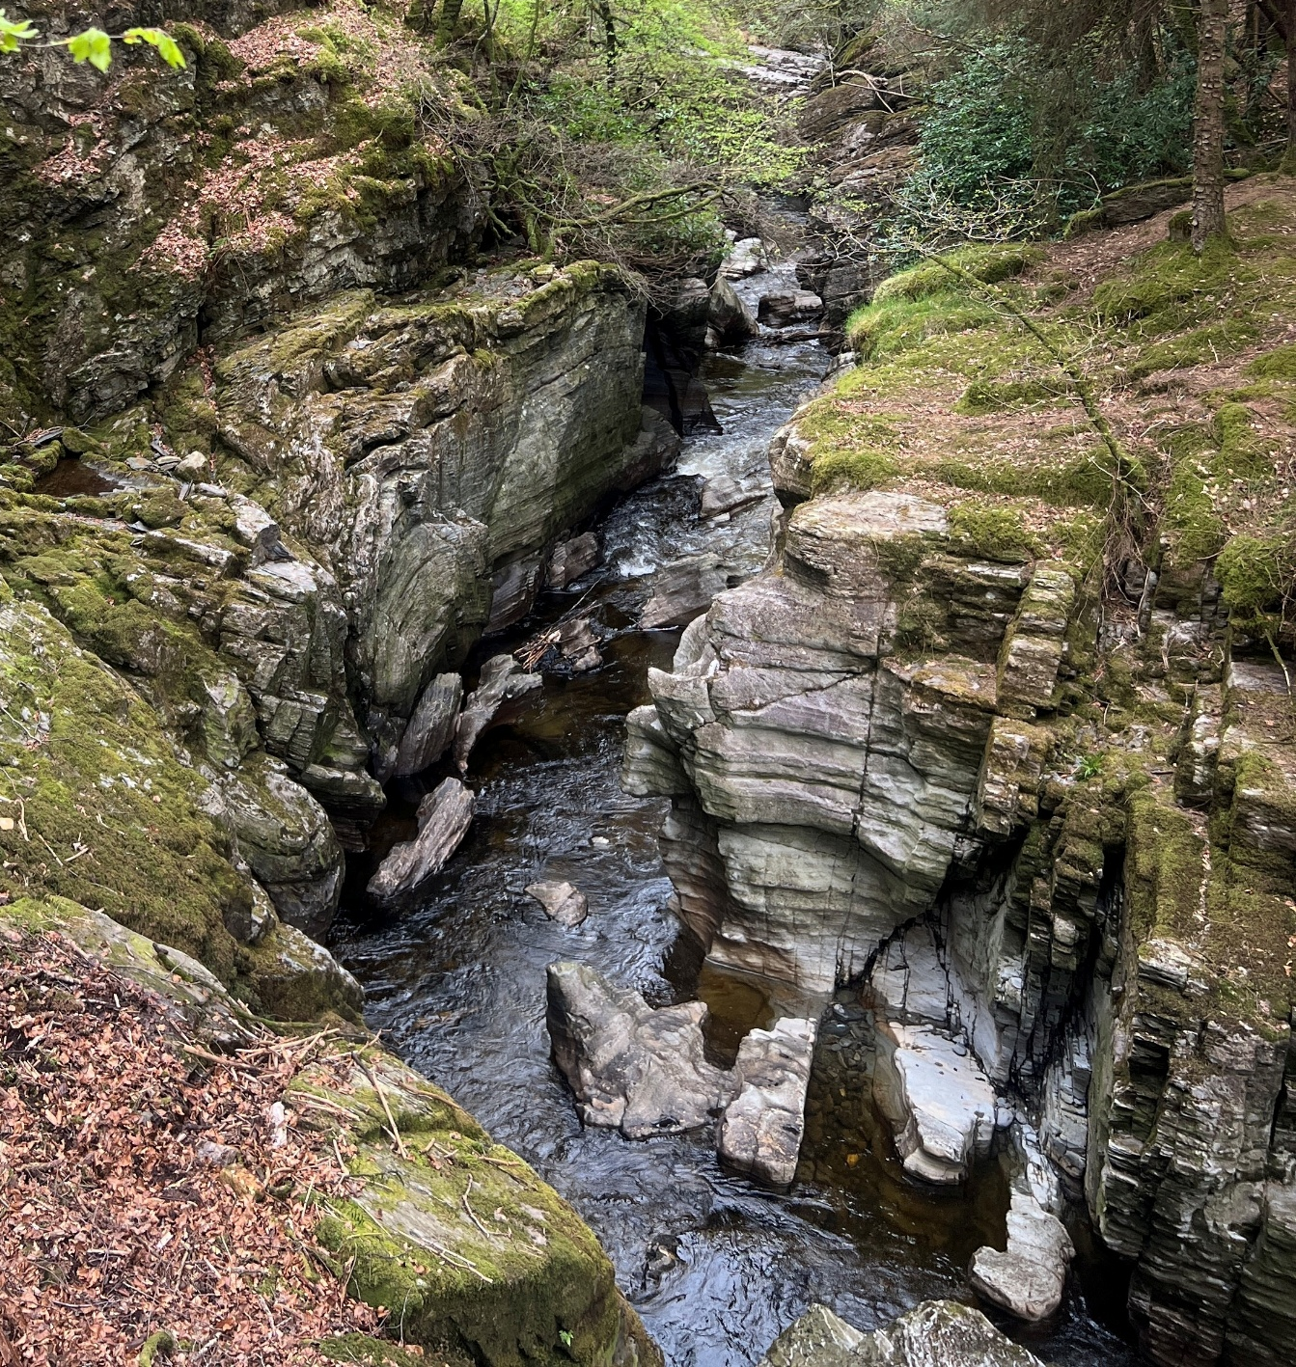
Processes
FT Q C66
What is a river?
A moving body of water that drains the land. A river flows from higher ground, (the source) into another body of water (the sea, lake or another river).
Image: The Flood Hub People
Image: The Flood Hub People
Image: The Flood Hub People
Image: The Flood Hub People
Image: The Flood Hub People

Slide 3
Processes
FT Q C66
River components:
Exercise 1: Can you correctly match the component to its definition.
Source
The area of high land forming the edge of a river basin
Mouth
The point at which two, or more, rivers meet
Tributary
The main path which a river flows along
Confluence
The point where the river meets the sea
Channel
The point where a river begins
Watershed
A smaller watercourse which flows into a larger one

Slide 4
Processes
FT Q C66
River components:
Check your answers.
Source
The area of high land forming the edge of a river basin
Mouth
The point at which two, or more, rivers meet
Tributary
The main path which a river flows along
Confluence
The point where the river meets the sea
Channel
The point where a river begins
Watershed
A smaller watercourse which flows into a larger one

Slide 5
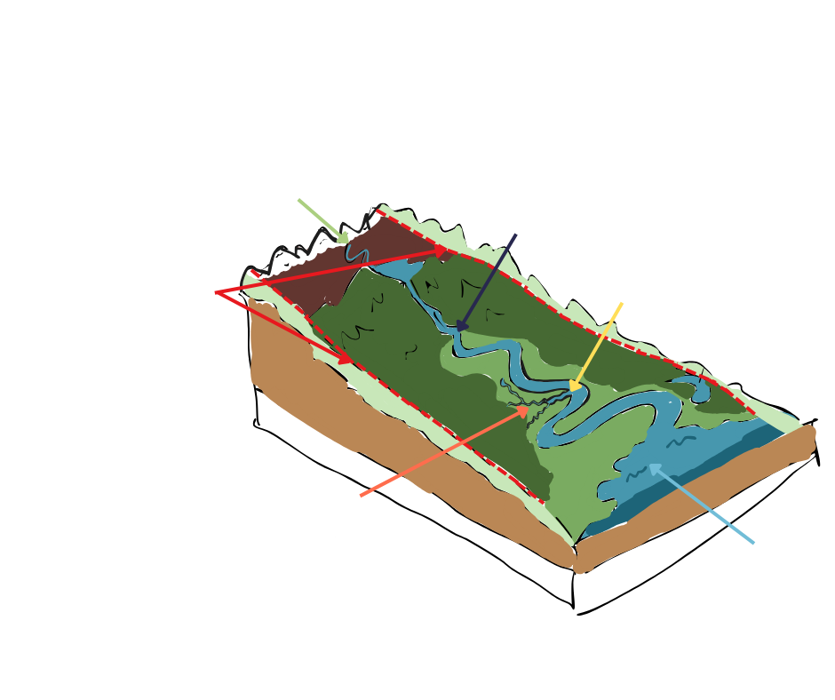
Processes
FT Q C66
River components:
Now we know what these terms mean, can you correctly label each component on the diagram?
Source
Channel
Watershed
Confluence
Tributary
Mouth
Image: The Flood Hub People

Slide 6
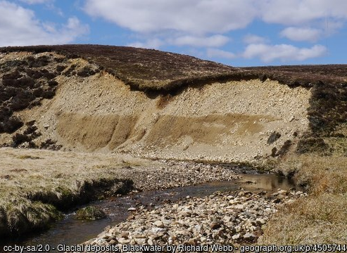
Processes
FT Q C66
River (fluvial) processes:
As rivers flow from source to mouth, several fluvial processes occur which shape the landscape and create distinct fluvial landforms.
These fluvial processes are:
Erosion
Weathering
Mass movement
Transportation
Deposition

Slide 7
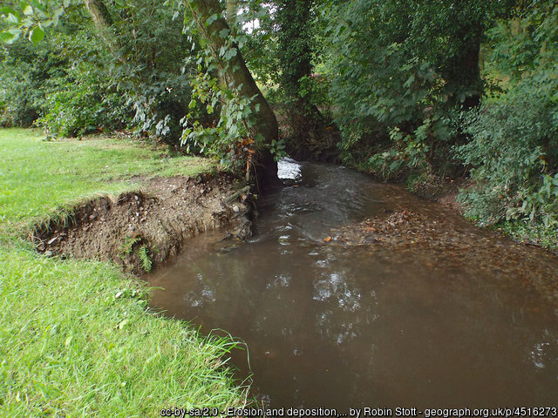
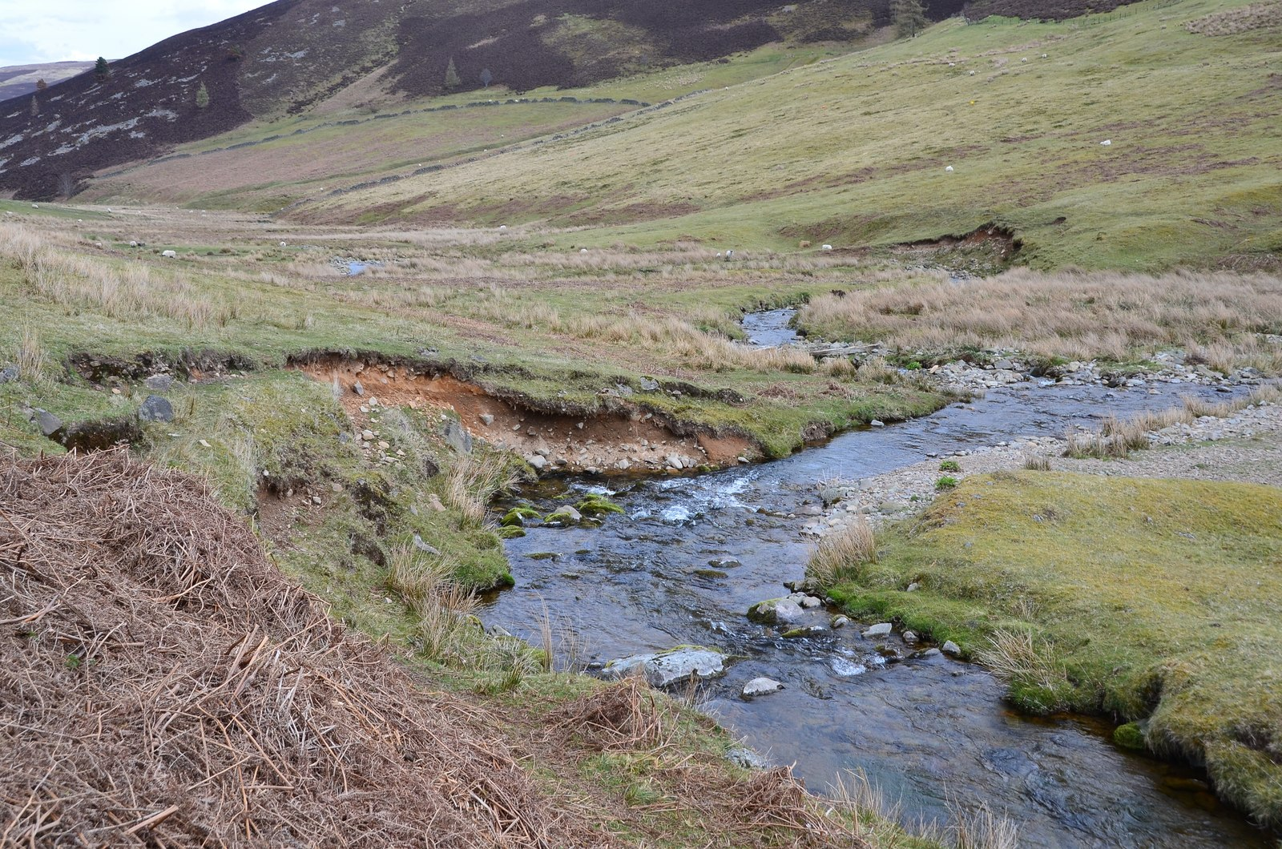
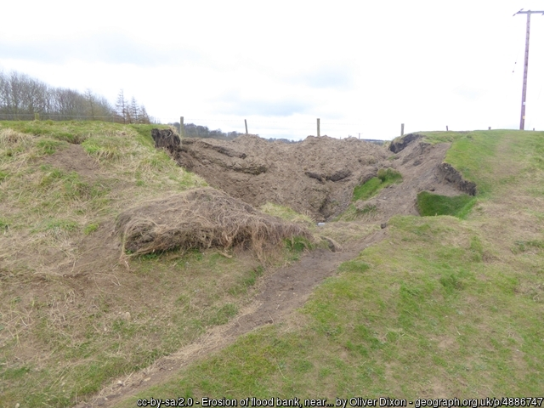
Processes
FT Q C66
Erosion:
The wearing away of the river’s banks and bed, and the breaking of rocks which are carried by the river. Erosion can be vertical which deepens the channel, or lateral which widens the channel.
Image: The Flood Hub People

Slide 8
Processes
FT Q C66
Four types of erosion:
Hydraulic action: The power of the moving water disturbing and weakening the bed and banks.
Abrasion: The load of pebbles and rocks are carried by the flowing water which smash into the bed and banks and wear it away.
Attrition: Load particles crash into each other and become smaller and rounder.
Solution: Dissolved material is carried away. Limestone is most easily dissolvable.

Slide 9
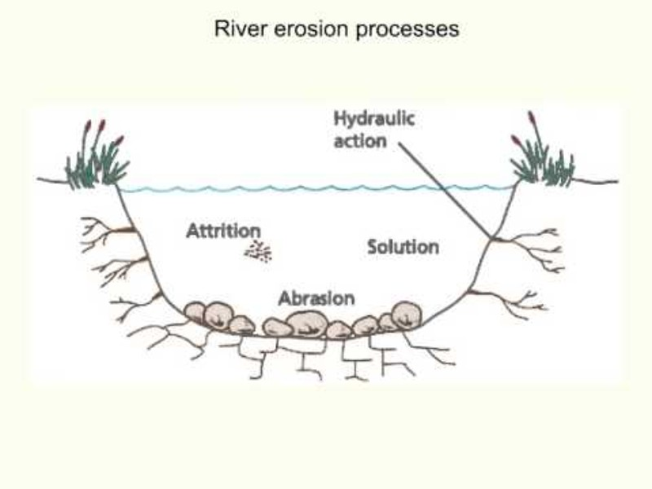
Processes
FT Q C66
Erosion:
Watch this video which explains how the four types of erosion occur.
Write down the key information about each process.

Slide 10
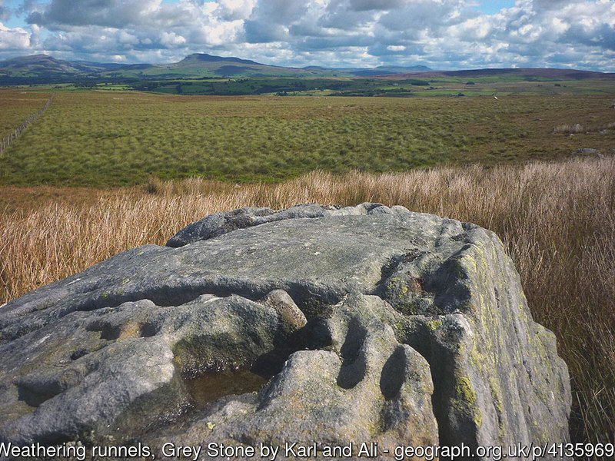
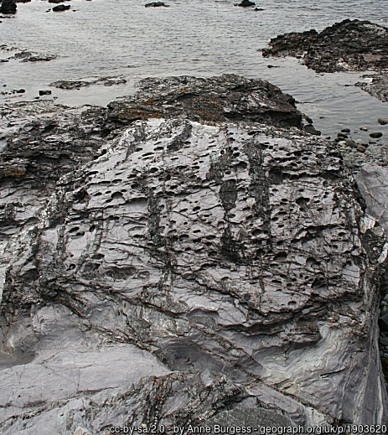
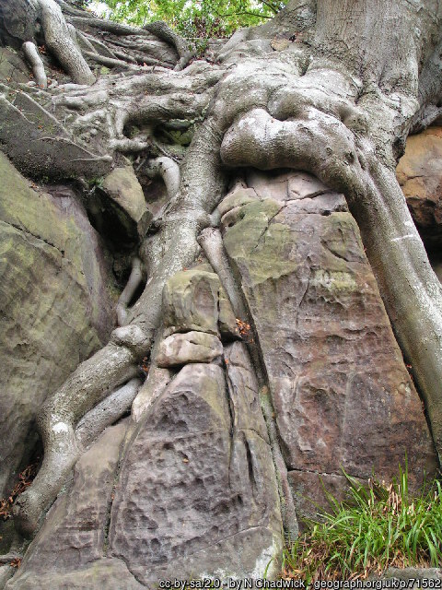
Processes
FT Q C66
Weathering:
The wearing down or breaking of rocks due to the weather, plants, animals or chemical processes.

Slide 11
Processes
FT Q C66
Three types of weathering:
Mechanical: Physical weathering such as freeze thaw, where water seeps into cracks and if it freezes, it expands and splits the rock. In addition, wind can blow sand grains against the rock, gradually wearing it down.
Chemical: Chemicals in rainwater can change and “weather” a rock. Carbon dioxide in the air can make rain slightly acidic, which can slowly degrade and dissolve the minerals in a rock.
Biological: The movement of plants and animals can damage, crack or split rock. Roots can grow into cracks and widen them, or rabbits could burrow through.

Slide 12
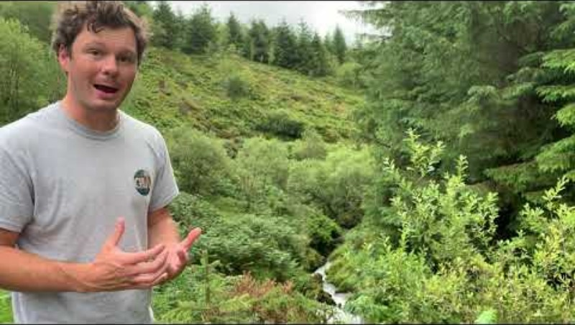
Processes
FT Q C66
Weathering:
Watch this video which explains how the 3 types of weathering occur.
Write down the key information of each process.

Slide 13
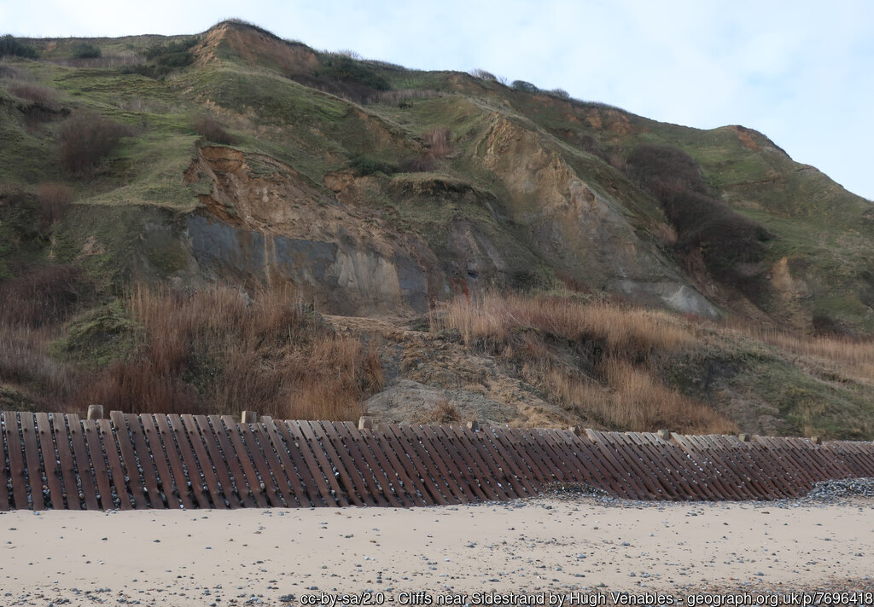
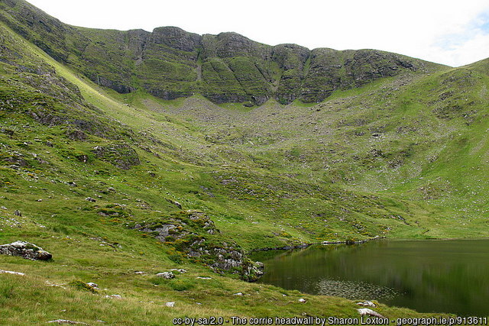
Processes
FT Q C66
Mass movement:
A large-scale downward movement of rocks and material due to gravity.

Slide 14
Processes
FT Q C66
Five types of mass movement:
Rotational slip / slumping: Rather than a smooth, flat slope, saturated soil slumps down a curved slope which causes the soil to rotate.
Landslides: Heavy rain saturates the ground. The increased weight causes it to rapidly slide down.
Mudslides: A fast-moving landslide which is more fluid in consistency due to more water and soil.
Rock falls: The rock at the base is undercut and eroded making it unstable and unable to support the rock above.
Soil creep: A slow movement of earth due to gravity where the land gradually creeps down the valley side.

Slide 15
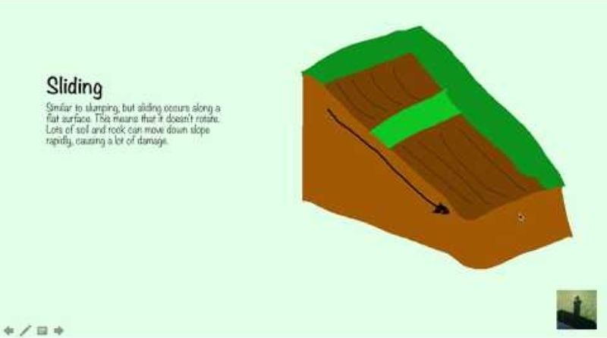
Processes
FT Q C66
Mass movement:
Watch this video
which recaps erosion, weathering and mass movement.
Write down the key information about each process.

Slide 16
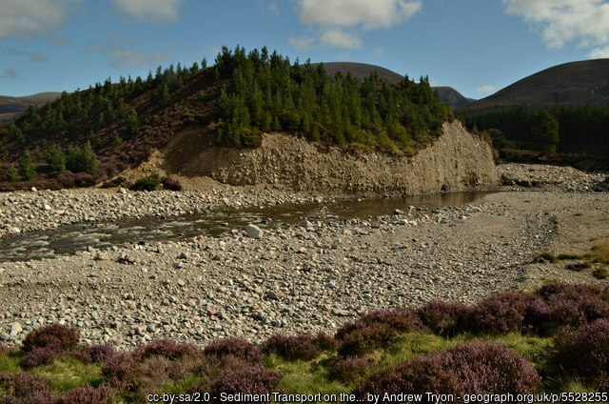
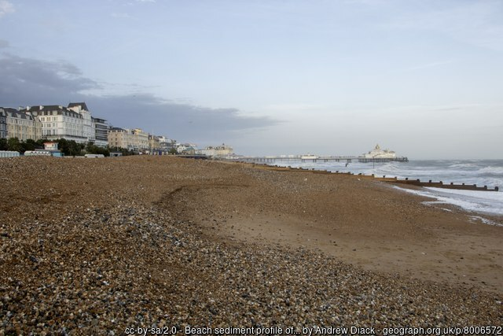
Processes
FT Q C66
Transportation:
The river picks up sediment and material and carries it within the flowing water.

Slide 17
Processes
FT Q C66
Four types of transportation:
Traction: Large, heavy boulders and rocks roll along the riverbed. This is more common in the upper course where the load is larger.
Saltation: Smaller pebbles bounce along the riverbed. Typically occurs upper – middle course where flow is faster.
Suspension: Light, fine sediment is suspended and carried in the water. Occurs at the mouth where the sediment is mostly silt.
Solution: Dissolved material is carried away.

Slide 18
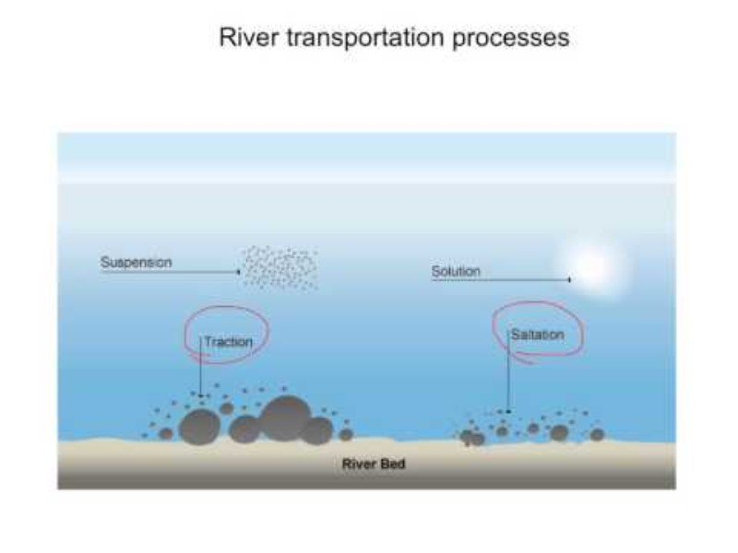
Processes
FT Q C66
Transportation:
Watch this video which explains how the 4 types of transportation occur.
Write down the key information about each process.

Slide 19
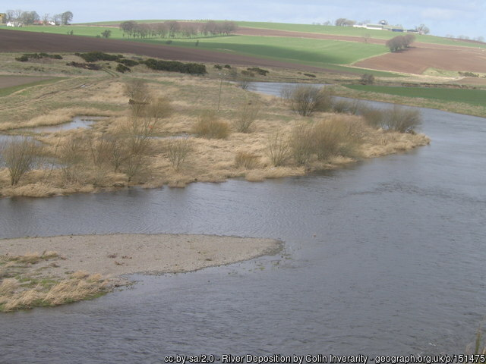
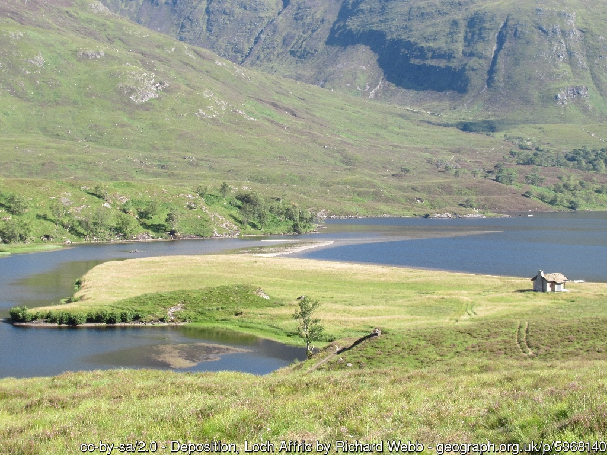
Processes
FT Q C66
Deposition:
When the river loses energy, it slows down and drops the material it has been carrying. This is known as deposition.

Slide 20
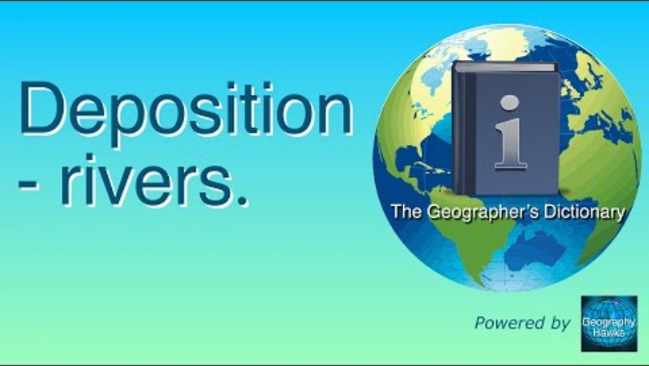
Processes
FT Q C66
Deposition:
Watch this video which explains the process of deposition.
Make notes in your workbooks.

Slide 21
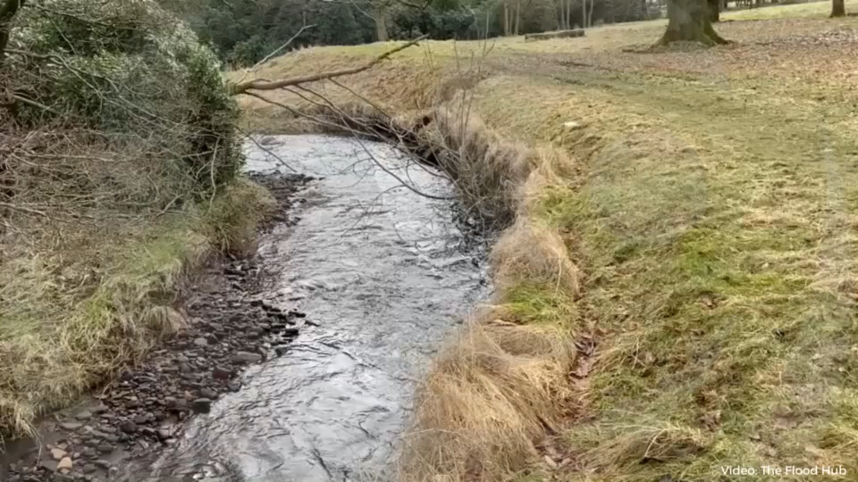
Processes
FT Q C66
River (fluvial) processes:
Play the video to watch these processes in action.
Video: The Flood Hub People

Slide 22
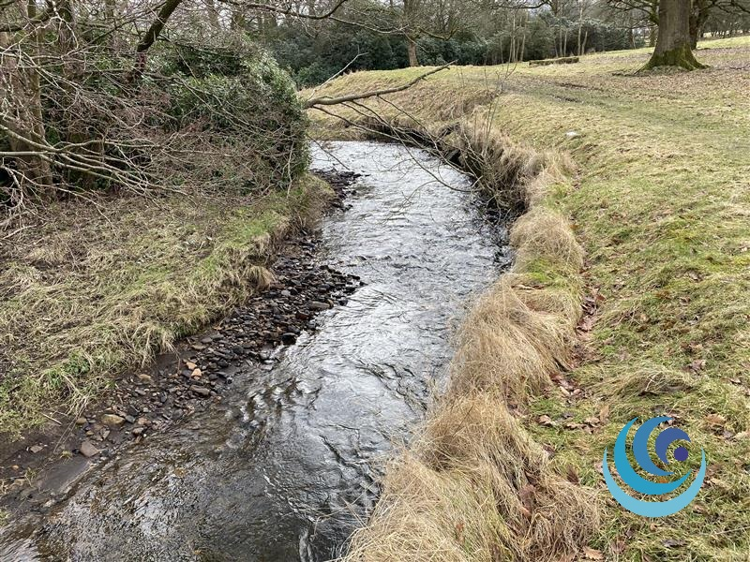
Processes
FT Q C66
Quick question:
What processes are the arrows highlighting?
(1 mark)
Erosion
Deposition
Transportation
Image: The Flood Hub People

Slide 23
Processes
FT Q C66
Practice questions / Homework:
Name the process of transportation which involves small pebbles bouncing along the riverbed. (1 mark)
State one mass movement process. (1 mark)
Explain why deposition occurs in a river channel? (3 mark)
Explain how different types of erosion change a river channel. (4 marks).

Slide 24



FT Q C66
These lessons have been produced by
The Flood Hub People for The Flood Hub.
Scan the QR code to access our learning section.
Or visit here: https://thefloodhub.co.uk/learning/

