Slide 1

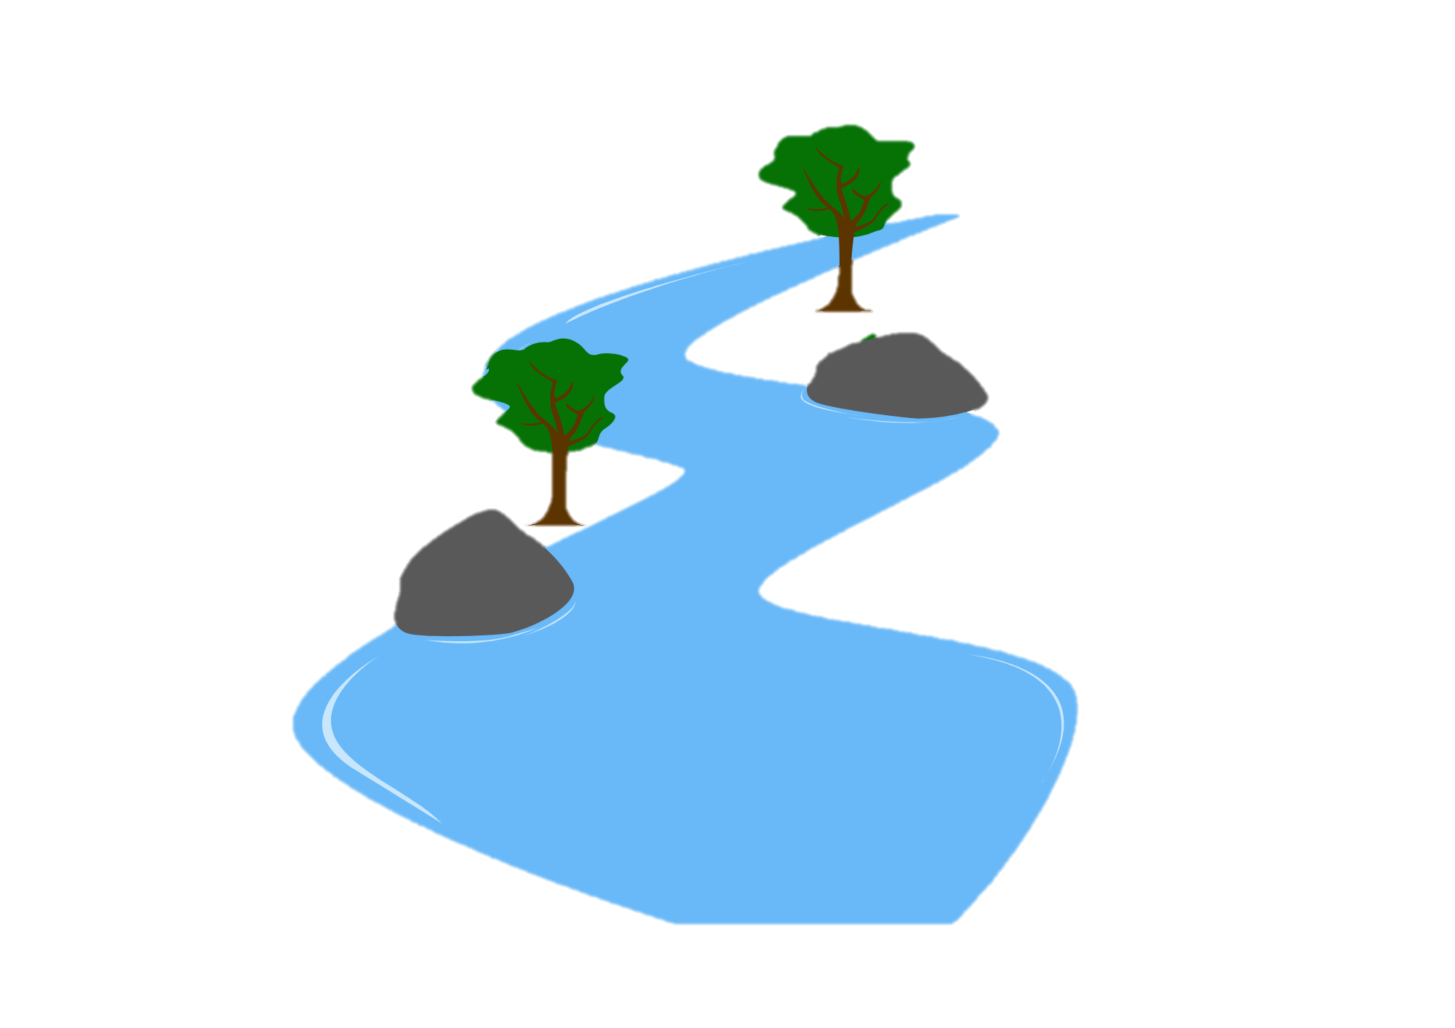
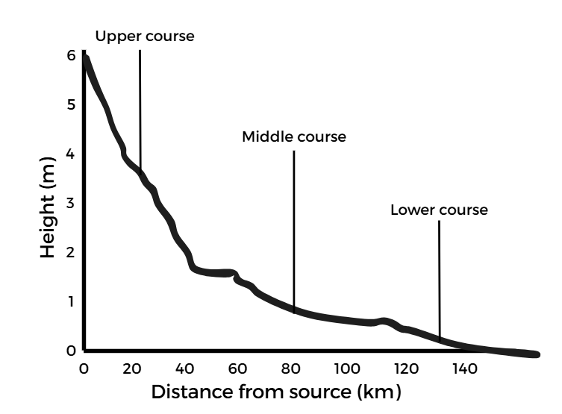
River Landscapes: Long & Cross Profile
FT Q C67
Learning objectives:
Understand what the long and cross profile of a river are
To be able to calculate the cross profile of a river
Understand what can affect river discharge
To be able to calculate river discharge
Image: The Flood Hub People

Slide 2
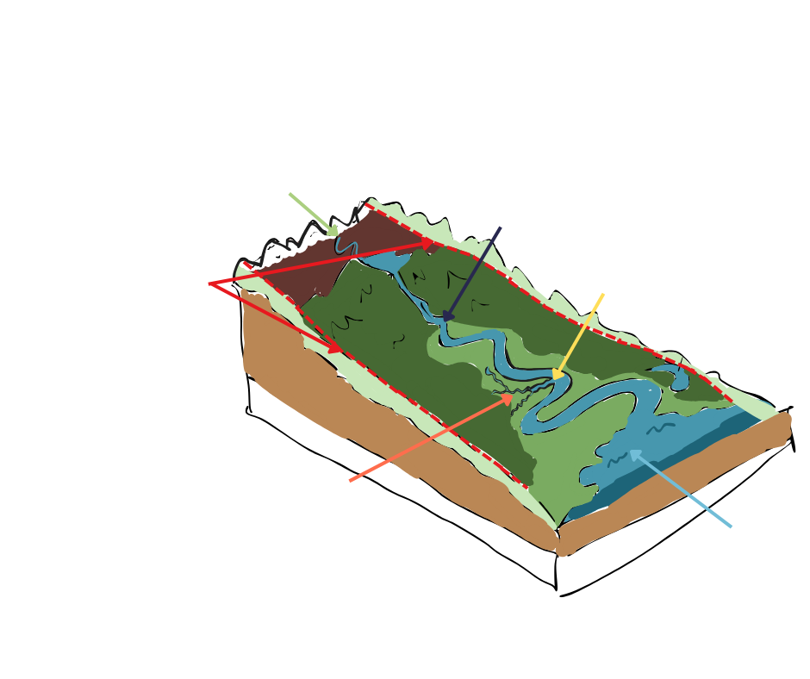
Long & Cross Profiles
FT Q C67
River components recap:
Source
Channel
Watershed
Confluence
Tributary
Mouth
Image: The Flood Hub People

Slide 3
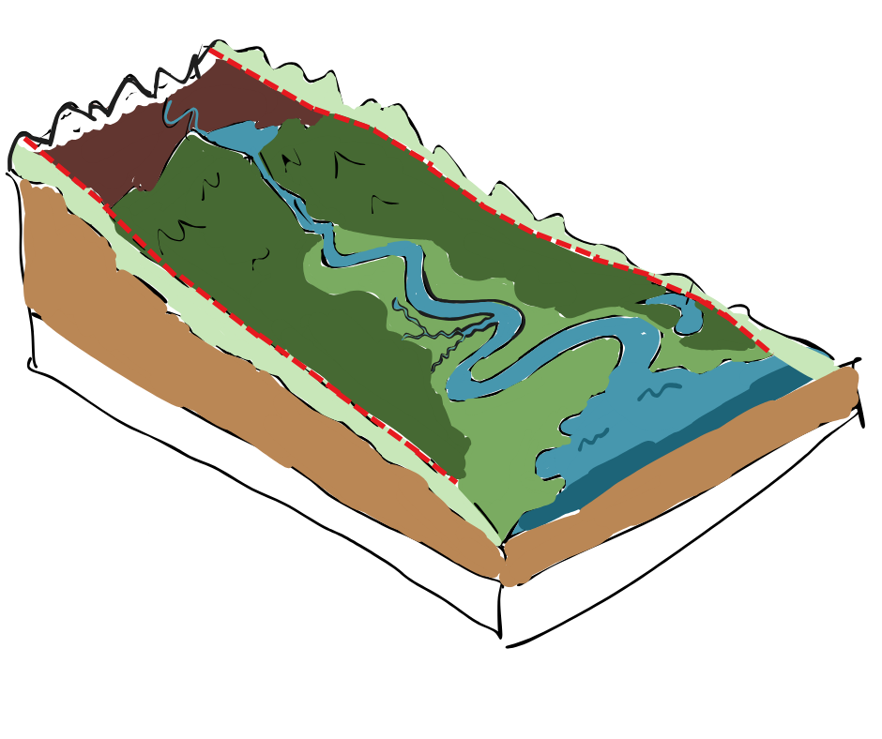
Long & Cross Profiles
FT Q C67
Long profile of a river:
The long profile of a river shows its change in gradient and altitude from source to its mouth. It shows how a river changes throughout its course, from steep at the source, to gentle at the mouth.
Source
Long profile
Mouth
Image: The Flood Hub People

Slide 4
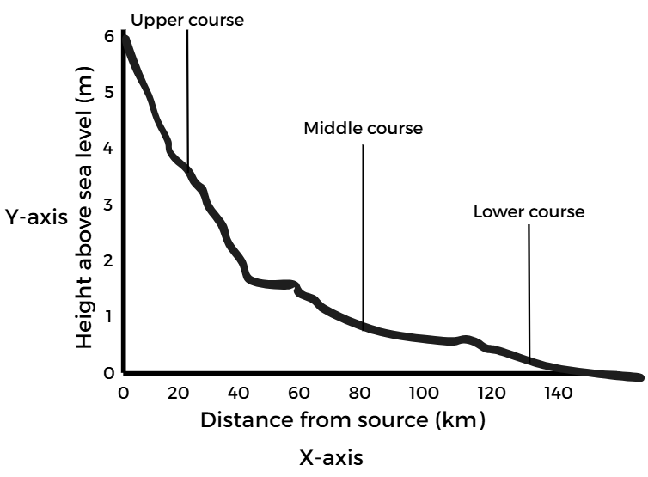
Long & Cross Profiles
FT Q C67
Long profile of a river:
A river’s course can be split into three stages, the upper, middle and lower course. These can be shown on the long profile.
The X axis shows the distance through the course from the source.
The Y axis is metres above sea level.
Image: The Flood Hub People

Slide 5


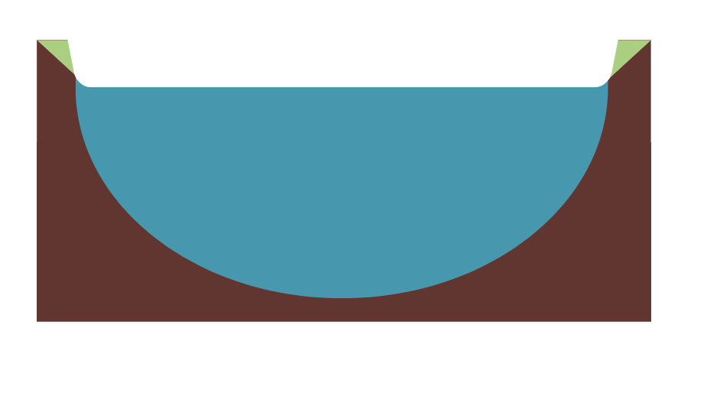
Long & Cross Profiles
FT Q C67
Cross profile of a river:
A cross profile shows a cross-section of a river’s channel and valley at a specific point in its course.
Image: The Flood Hub People
Image: The Flood Hub People
Image: The Flood Hub People
Upper course
Middle course
Lower course

Slide 6
Long & Cross Profiles
FT Q C67
Cross profile of a river:
The cross profile changes shape as it moves from the upper course through to the lower course. It helps us understand how the valley sides and channel change due to erosion and deposition.
Vertical erosion: downward erosion
Lateral erosion: sideways erosion
Deposition: dropping of sediment

Slide 7
Long & Cross Profiles
FT Q C67
Cross profile and long profile:
These two diagrams can be displayed together to show the change in a channel’s shape, gradient, width and depth from source to mouth.
Image: The Flood Hub People

Slide 8
Long & Cross Profiles
FT Q C67
Cross-sectional area:
Cross-sectional area is the surface area of a river from bank to bank if you took a vertical slice through it at any point through its course.
It is measured in square metres (m²).
Formula:
Cross-sectional area (m²) = Width (m) x Mean depth (m)

Slide 9
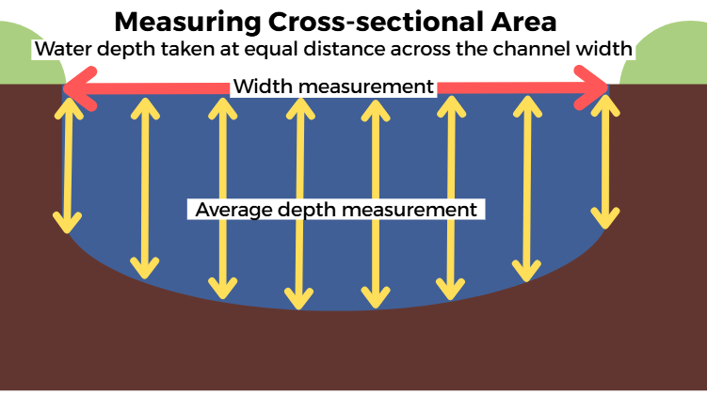
Long & Cross Profiles
FT Q C67
Calculating cross-sectional area (m²):
Equipment:
Tape measure
Metre rule
Method:
Measure the width across the channel from dry bank to dry bank
Chose an appropriate interval across the width. e.g. channel width = 4m, interval = 0.5m / 50cm
Record the height of the water from river floor at each interval
Repeat at all intervals
Then calculate the mean water depth
Image: The Flood Hub People

Slide 10
Long & Cross Profiles
FT Q C67
Calculating cross-sectional area (m²):
Interval | 1 | 2 | 3 | 4 | 5 | 6 | 7 | 8
Depth (m) | 0.10 | 0.40 | 0.90 | 1.30 | 1.20 | 0.80 | 0.50 | 0.30
The table shows the channel depth for each interval across the river width.
4m
1
2
3
4
5
6
7
8
Image: The Flood Hub People

Slide 11
Long & Cross Profiles
FT Q C67
Calculating cross-sectional area (m²):
Interval | 1 | 2 | 3 | 4 | 5 | 6 | 7 | 8
Depth (m) | 0.10 | 0.40 | 0.90 | 1.30 | 1.20 | 0.80 | 0.50 | 0.30
Cross-sectional area (m²) = Width (m) x Mean depth (m)
4m
The width is
Calculate the mean depth =
Calculate the cross-sectional area = =
0.69m
4m x 0.69m
2.76m²

Slide 12
Long & Cross Profiles
FT Q C67
What does cross-sectional area show?
The cross-sectional area increases as the river travels downstream.
In the upper course, the channel is narrow and shallow, but the width and depth of the channel increases towards the lower course.
Image: The Flood Hub People
Image: The Flood Hub People
Image: The Flood Hub People
Upper course
Middle course
Lower course

Slide 13
Long & Cross Profiles
FT Q C67
River discharge:
The discharge of a river is the volume of water flowing through a specific point in the channel, measured in (m³/s) / (cumecs).
Formula:
Discharge (m³/s) = Velocity (m/s) x Cross-sectional area (m²)

Slide 14
Long & Cross Profiles
FT Q C67
What affects river discharge?
The flow of a river can change along its course due to the human and physical factors. This can also affect the discharge of the river.
Physical Factors | Human Factors
Precipitation (amount, intensity)
Deforestation (removal of trees)
Geology: permeable (water soaks through) vs impermeable (water runs over)
Land use (roads, buildings)
Relief (steep vs flat land)
Flood risk management schemes
Temperature (snowmelt or freezing)
Farming (irrigation, drainage)
Vegetation cover (creates friction)
Water extraction for mills, manufacturing etc.
Tributaries
Dams and reservoirs

Slide 15
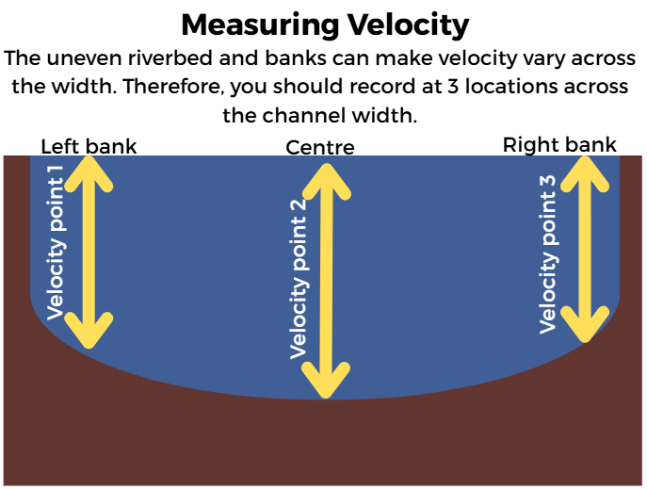
Long & Cross Profiles
FT Q C67
River speed (velocity):
Velocity is the speed which the river flows.
Formula:
Velocity (m/s) = Distance (m) / Time (s)
Image: The Flood Hub People

Slide 16
Long & Cross Profiles
FT Q C67
Calculating velocity:
Velocity can be recorded using the following method.
Equipment:
A float (ball / stick)
Stopwatch
Tape measure
Method:
Record at the left bank, right bank and centre of channel and repeat 3 times to remove anomalies
Mark a start point and measure a set distance (e.g. 10 metres) downstream and mark this as the end point
Place your float at the start line
Record the time it takes for the float to reach the end point
Repeat this 3 times (to remove anomalies) and calculate the mean for all 3 positions
Use the mean from all 3 positions and calculate the overall mean
Use the velocity formula to calculate the velocity

Slide 17
Long & Cross Profiles
FT Q C67
Calculating velocity:
The table shows 3 recordings for each location. Calculate the mean for each one.
Now calculate the mean of all
three banks =
The distance travelled was 10m.
Use the formula to calculate the velocity
 | Left bank | Centre | Right bank
1 | 31 seconds | 24 seconds | 45 seconds
2 | 32 seconds | 19 seconds | 41 seconds
3 | 39 seconds | 26 seconds | 49 seconds
Mean
34 seconds
23 seconds
45 seconds
34 seconds
0.29 m/s
Velocity (m/s) = Distance (m) / Time (s)
=
=
10m/34s

Slide 18
Long & Cross Profiles
FT Q C67
River Discharge(m³/s):
The discharge of a river is calculated rather than measured.
Discharge (m3/s) = Velocity (m/s) x Cross-sectional area (m2)
Velocity = 0.29m/s
x
CSA = 2.76m
=
Discharge = 0.8m³/s

Slide 19
Long & Cross Profiles
FT Q C67
Practice questions / Homework:
Describe the shape of a river’s cross profile in the upper course. (1 mark)
Describe how the long profile changes from source to mouth. (1 mark)

Slide 20
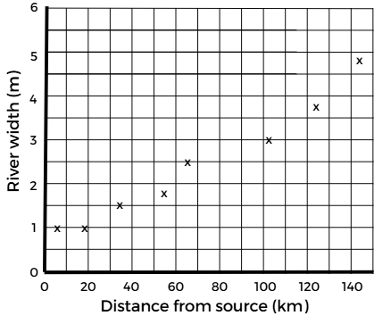
Long & Cross Profiles
FT Q C67
Practice questions / Homework:
At 90km from the source, the channel is 2.8m wide. Plot this on Figure 1. (1 mark)
Compare the shape of a river’s cross profile in the upper course and lower course. (2 marks)
Figure 1
Image: The Flood Hub People

Slide 21
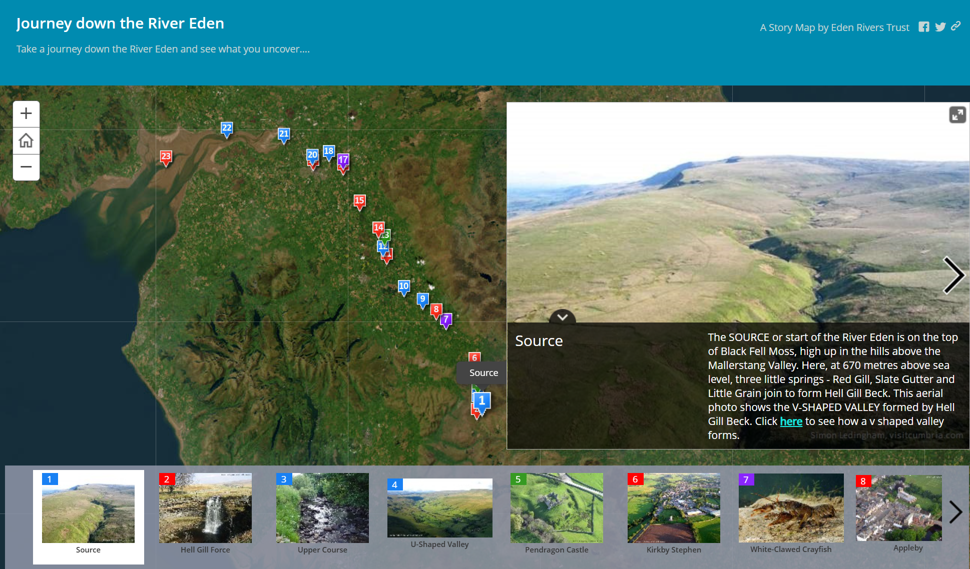
Long & Cross Profiles
FT Q C67
Closing activity: The River Eden, Cumbria
Using Eden Rivers Trust’s ‘Journey down the River Eden Storymap’, explore the River Eden from its source above the Mallerstang Valley through Carlisle to its mouth, Solway Firth.

Slide 22



FT Q C67
These lessons have been produced by
The Flood Hub People for The Flood Hub.
Scan the QR code to access our learning section.
Or visit here: https://thefloodhub.co.uk/learning/

