Slide 1

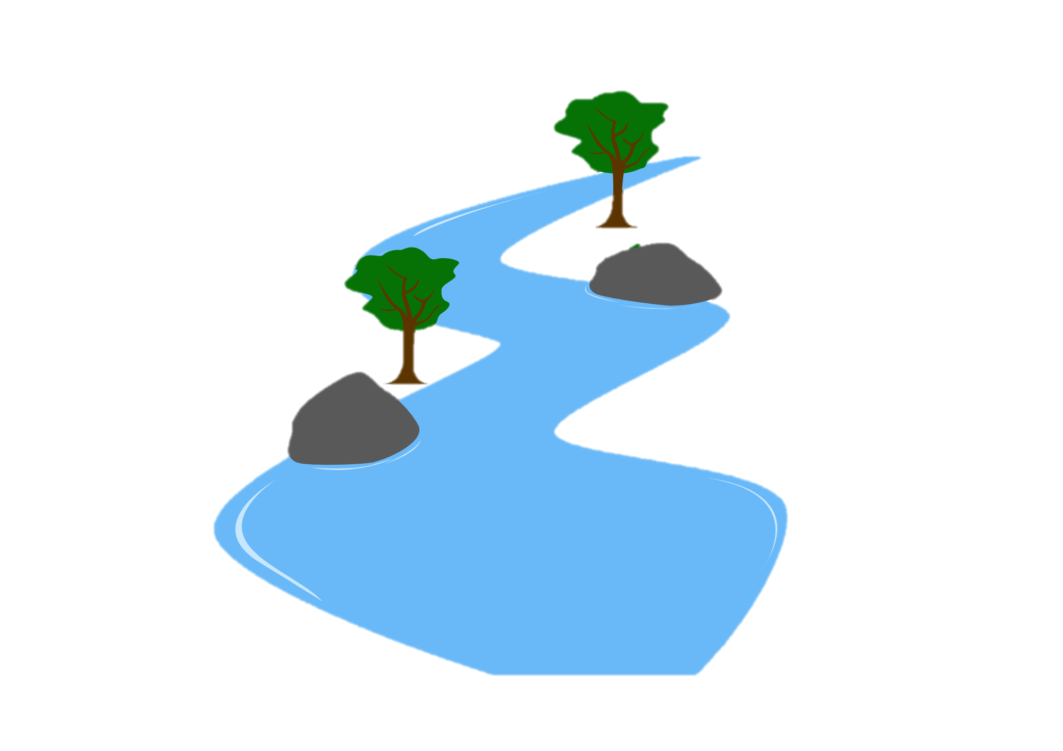
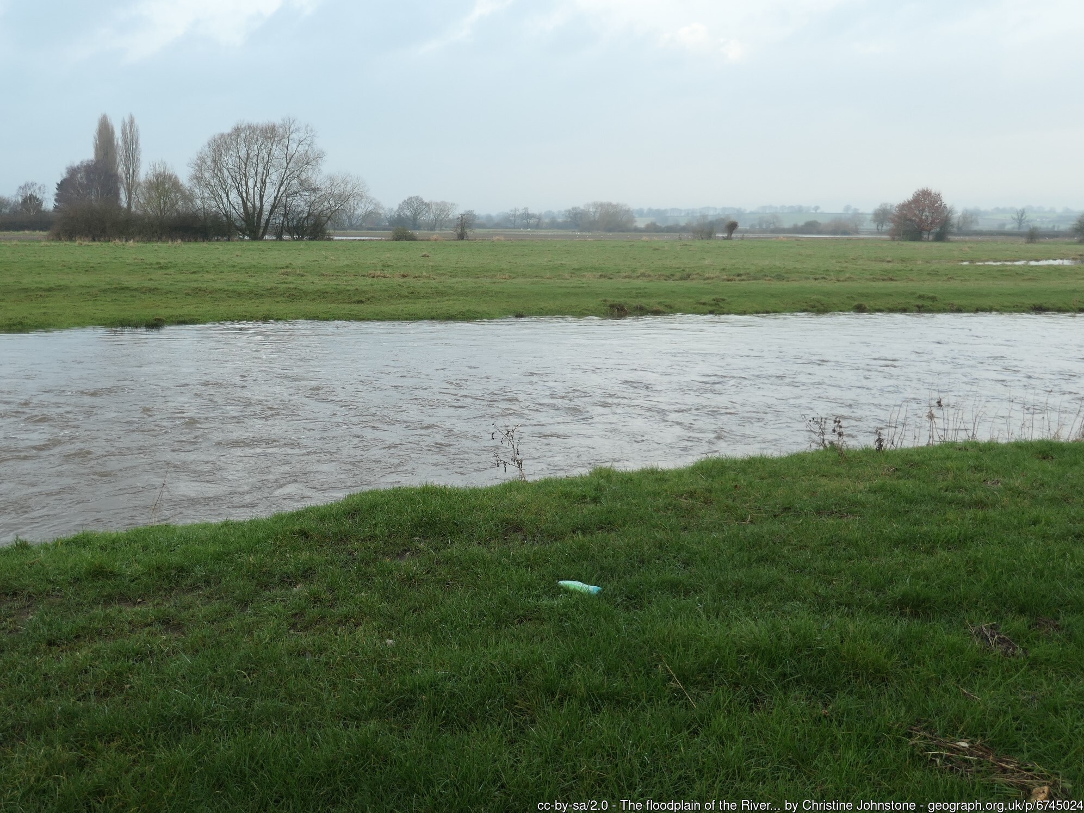
River Landscapes: Upper, Middle and Lower Course Part 2
FT Q C69
Learning objectives:
Describe the fluvial (river) landforms found in the middle and lower course of a river
Explain how fluvial (river) landforms are formed in the middle and lower course

Slide 2
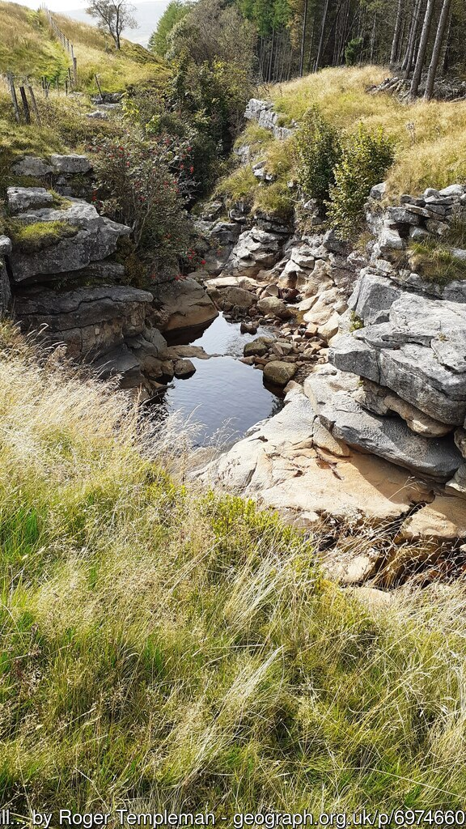
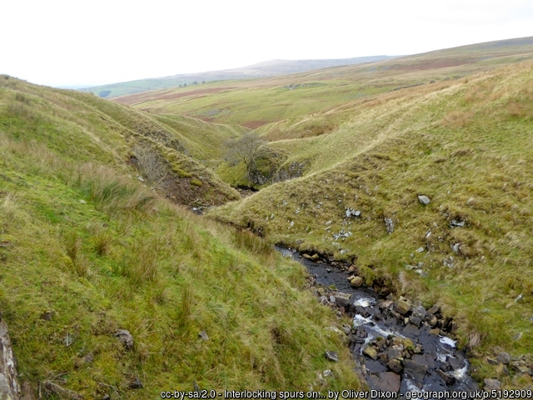
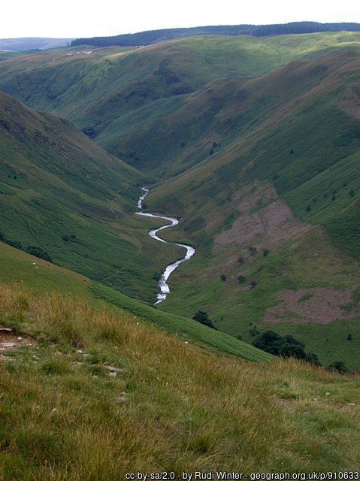
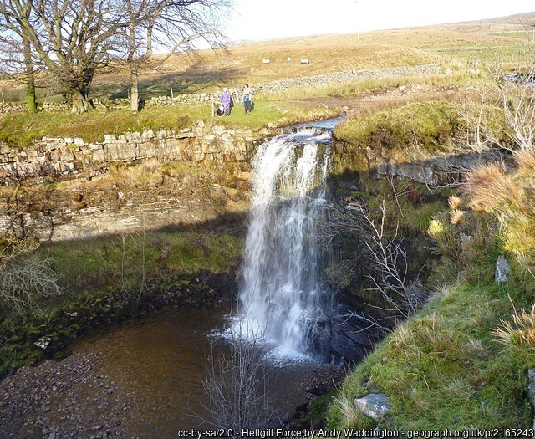
Upper, Middle & Lower Course Part 2
FT Q C69
Recap activity:
Can you correctly name all the landforms which can be found in the upper course of a river?
Interlocking spurs
Gorge
Waterfall
V-shaped valley

Slide 3
Upper, Middle & Lower Course Part 2
FT Q C69
Middle course landforms:
Landforms are created along the course of a river due to erosion and deposition.
Erosion can be lateral or vertical and both can happen at the same time, however one is usually more dominant at certain points.
Vertical erosion creates V-shaped valleys as it deepens the channel. It is dominant in the upper course.
Lateral erosion widens the valley and channel and is more dominant in the middle and lower course.

Slide 4
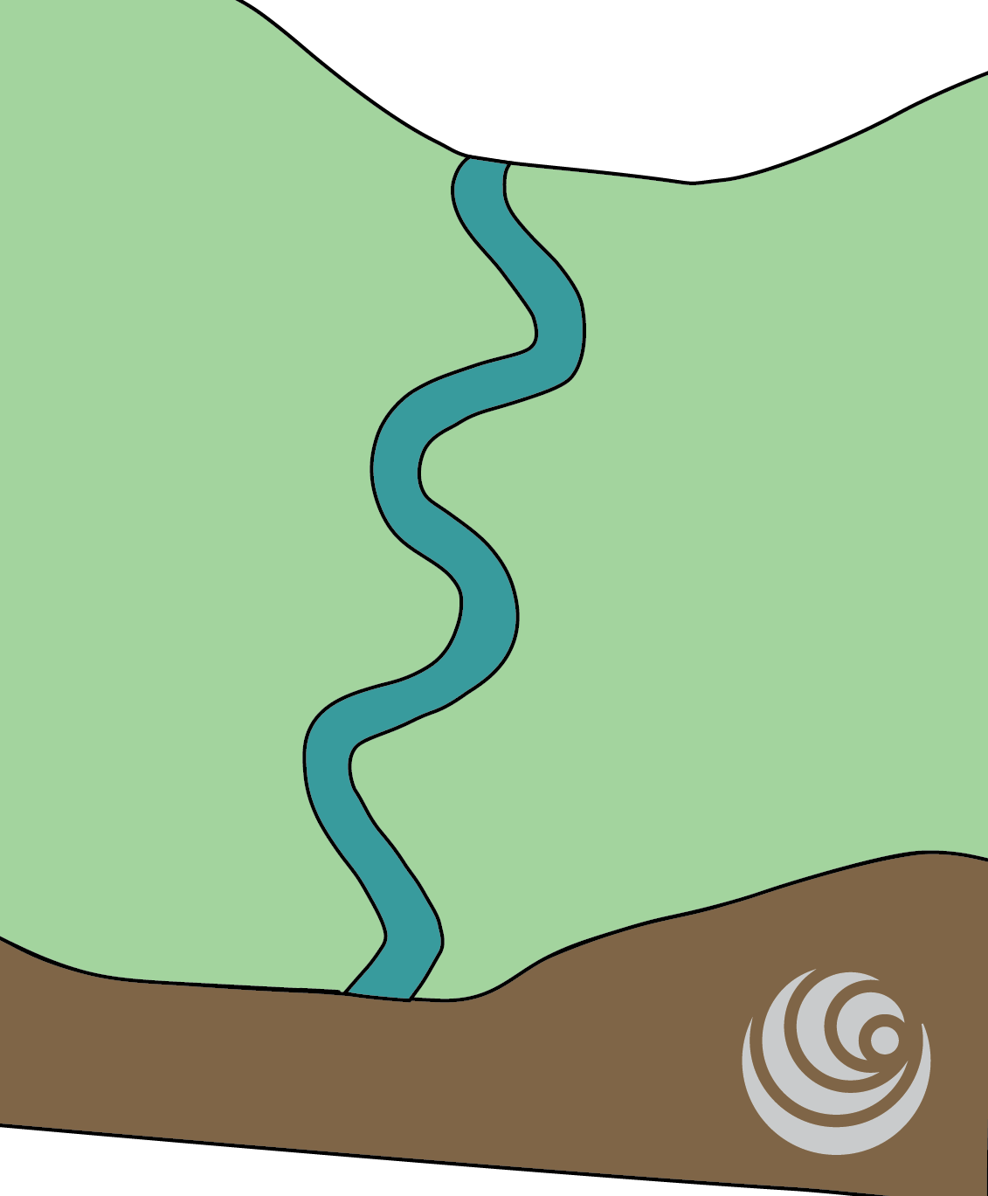

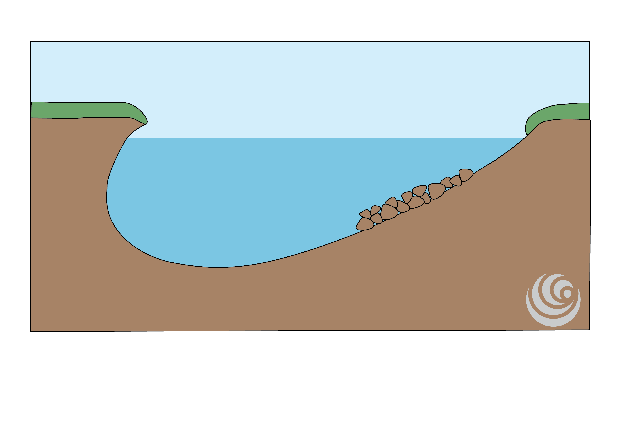
Upper, Middle & Lower Course Part 2
FT Q C69
Middle course landforms: Meander
A meander is a winding bend in a river channel.
The flow on the outside of the meander is faster, so more hydraulic action and abrasion occurs, deepening the channel. The channel is eroded laterally which creates a river cliff.
The flow on the inside of the meander is slower, so the river deposits more sediment, these are called
slip-off slopes.
Fast flow
Slower flow
Erosion
Deposition
River cliff
Slip-off slope
Fast flow
Slower flow
Erosion
Deposition

Slide 5
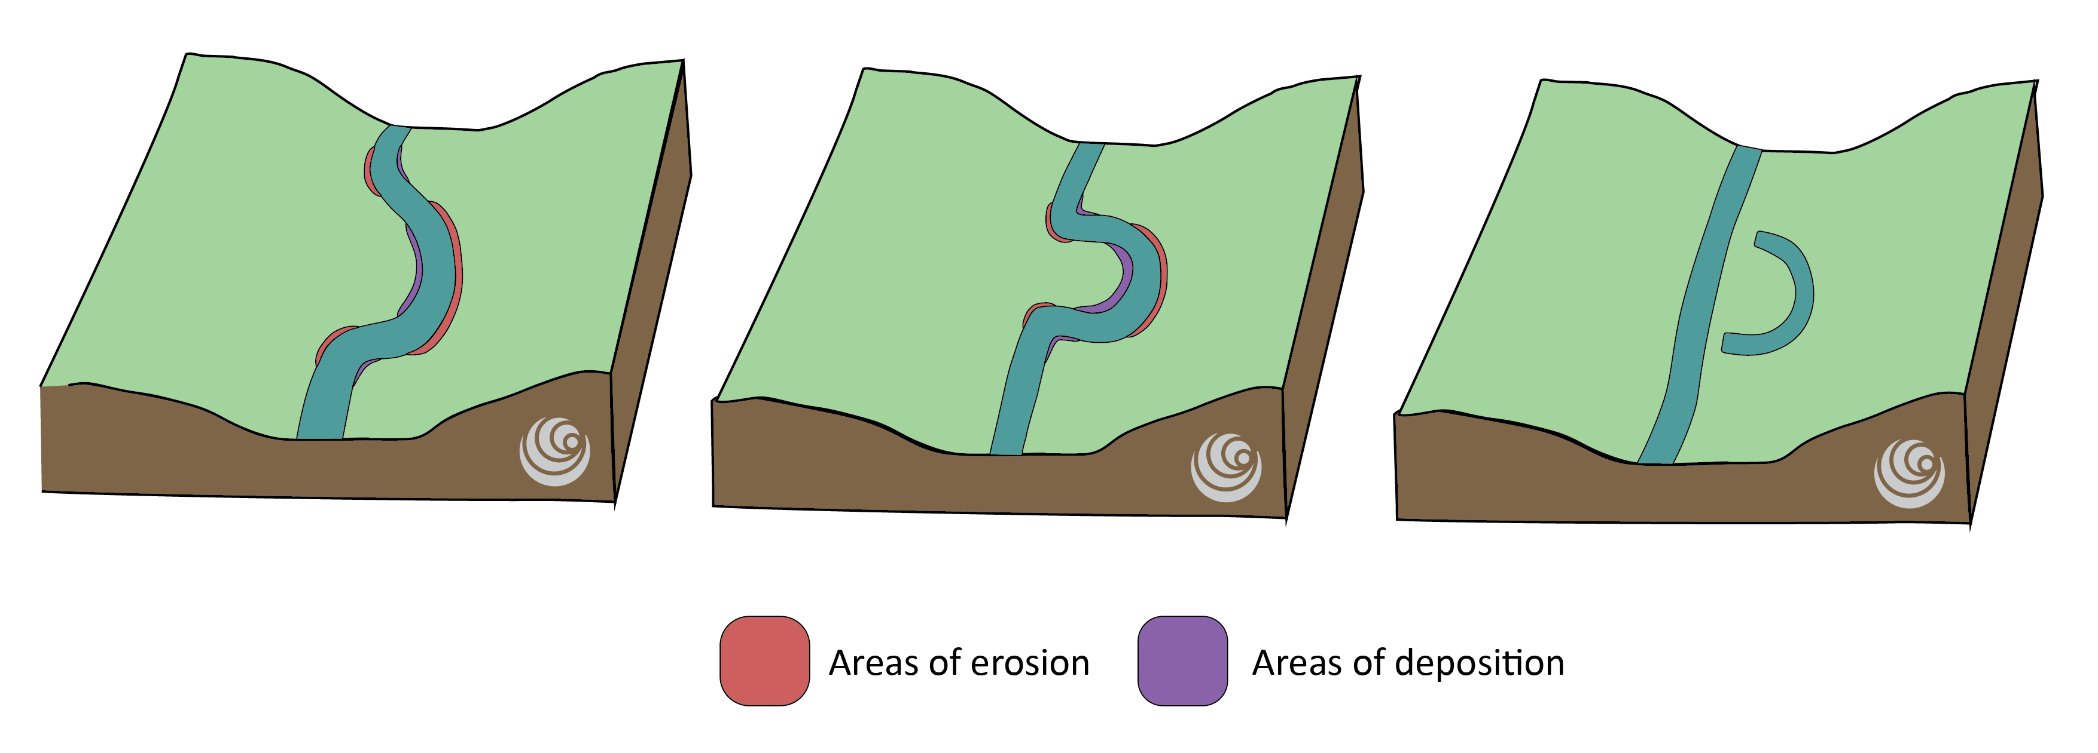
FT Q C69
Upper, Middle & Lower Course Part 2
Middle course landforms: Oxbow lake
As a meander continues to grow and erode laterally, the bends become more exaggerated. The outside bends become closer leaving a slim part of land, known as the neck. As the outside bend of a meander continues to erode, the neck gets narrower.

Slide 6
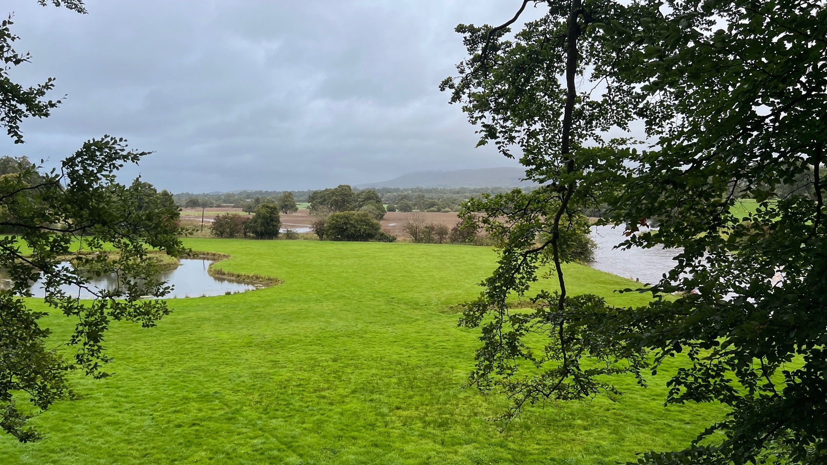
Upper, Middle & Lower Course Part 2
FT Q C69
Middle course landforms: Oxbow lake
During high flow, the river channel breaks through the neck, and the river follows the easiest, straightest and quickest route.
The previous bend is cut off from the main channel due to deposition, and this is known as an oxbow lake.
Image: The Flood Hub People

Slide 7
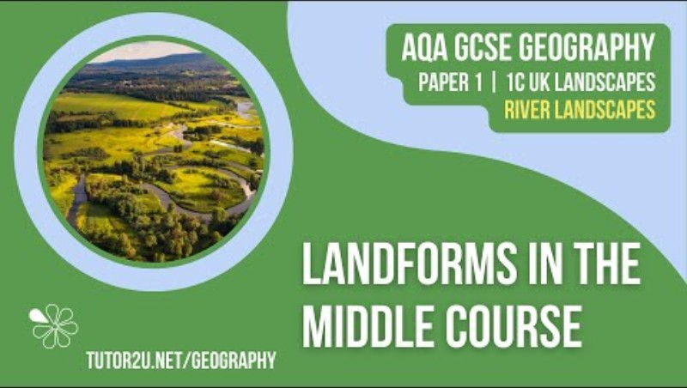
Upper, Middle & Lower Course Part 2
FT Q C69
Middle course landforms:
Watch this video which recaps the landforms found in the middle course.

Slide 8
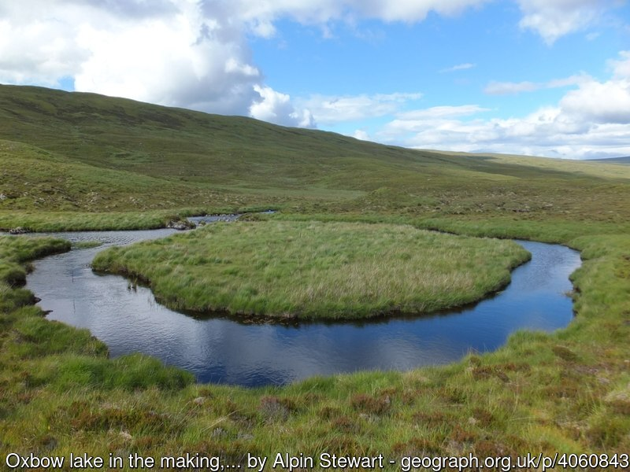
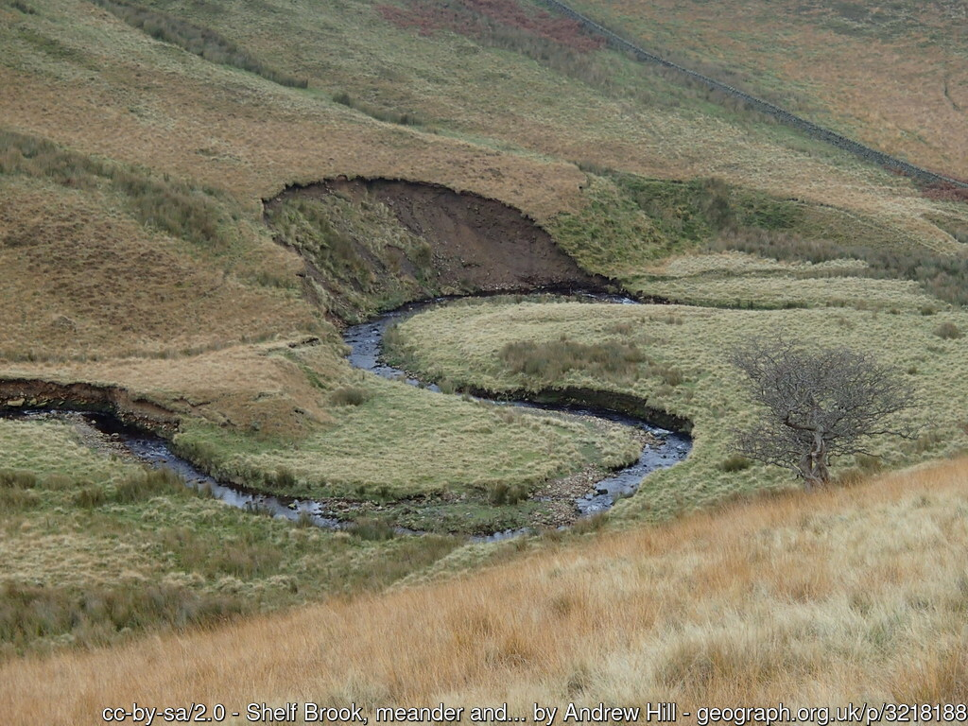
Upper, Middle & Lower Course Part 2
FT Q C69
Middle course landforms:
Can you correctly name all the landforms which can typically be found in the middle course?
Oxbow lake
Meander

Slide 9
Upper, Middle & Lower Course Part 2
FT Q C69
Lower course landforms:
Remember: Landforms are created along the course of a river due to erosion and deposition.
Erosion can be lateral or vertical and both can happen at the same time, however one is usually more dominant at certain points.
Vertical erosion creates V-shaped valleys as it deepens the channel. It is dominant in the upper course.
Lateral erosion widens the valley and channel and is more dominant in the middle and lower course.

Slide 10
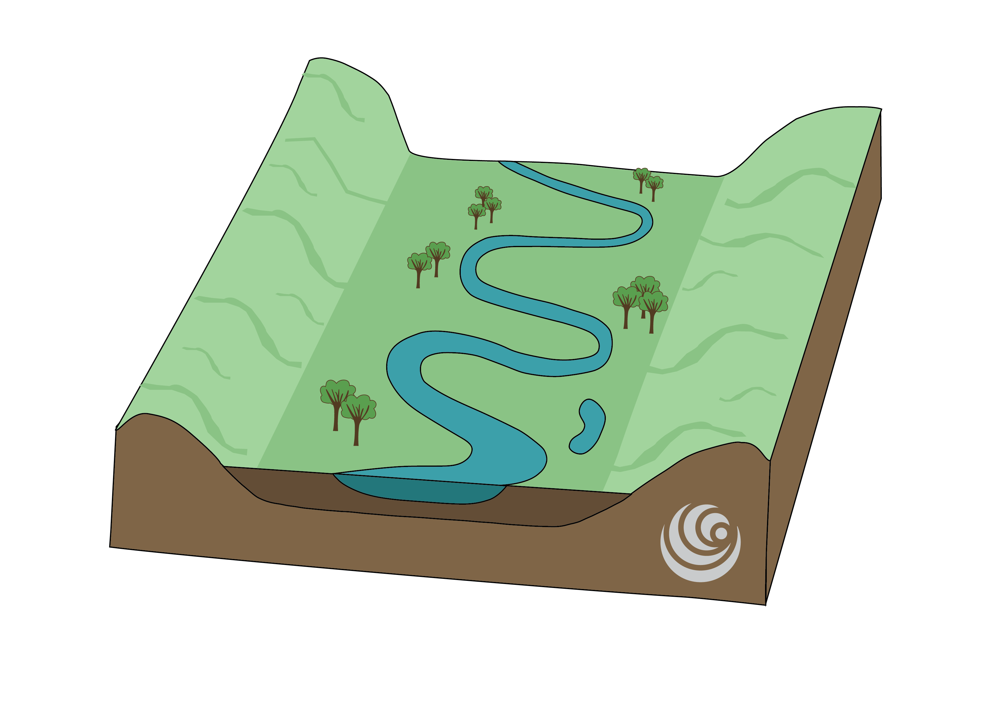
Upper, Middle & Lower Course Part 2
FT Q C69
Lower course landforms: Floodplains
A floodplain is the extensive, flat area of the valley floor on either side of the river.
They are formed during flood conditions where the river overtops its banks onto the land adjacent to the channel.
As the water recedes, the load which was previously carried is deposited, creating a floodplain.

Slide 11
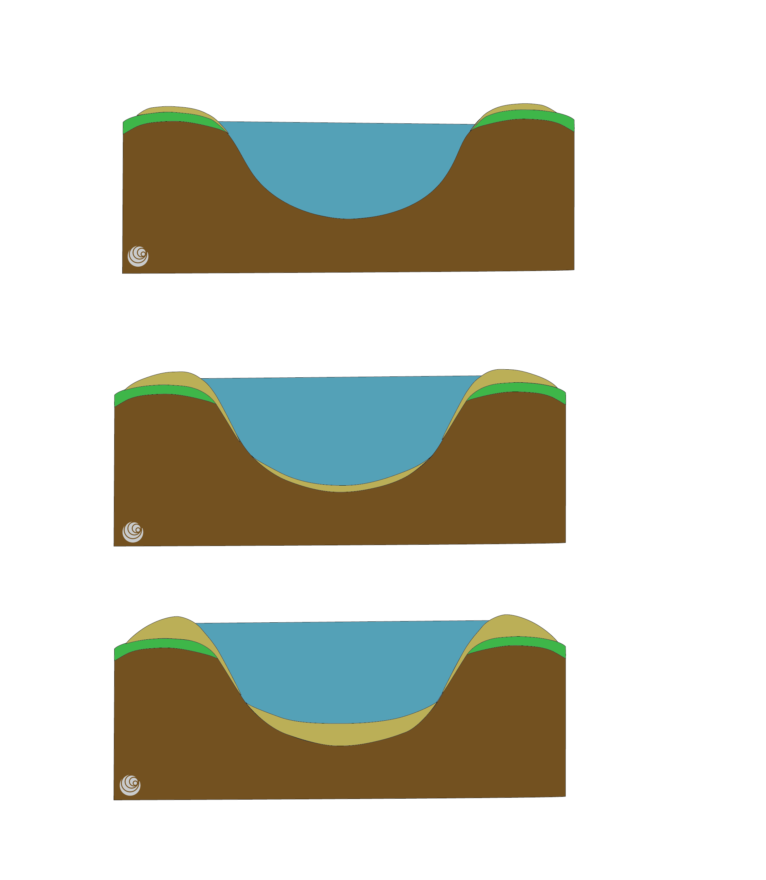
Upper, Middle & Lower Course Part 2
FT Q C69
Lower course landforms: Levees
During flood conditions, the river overtops onto the floodplains.
The velocity decreases on the floodplain due to increased friction and the river starts to deposit its material. The heavier load is deposited first, closest to the channel, whilst the finer load is transported further out into the floodplain.
Over time, the deposited material builds up, creating natural raised embankments between the floodplain and channel.
Deposited load after
flood conditions

Slide 12
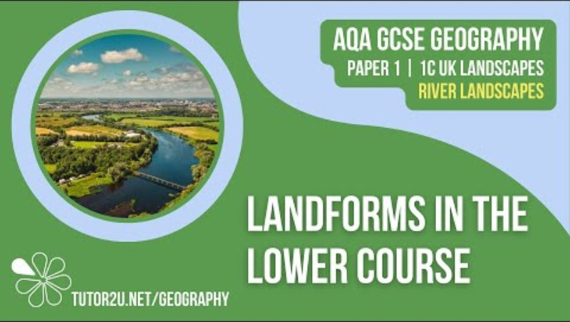
Upper, Middle & Lower Course Part 2
FT Q C69
Lower course landforms:
Watch this video which recaps levees and floodplains.

Slide 13
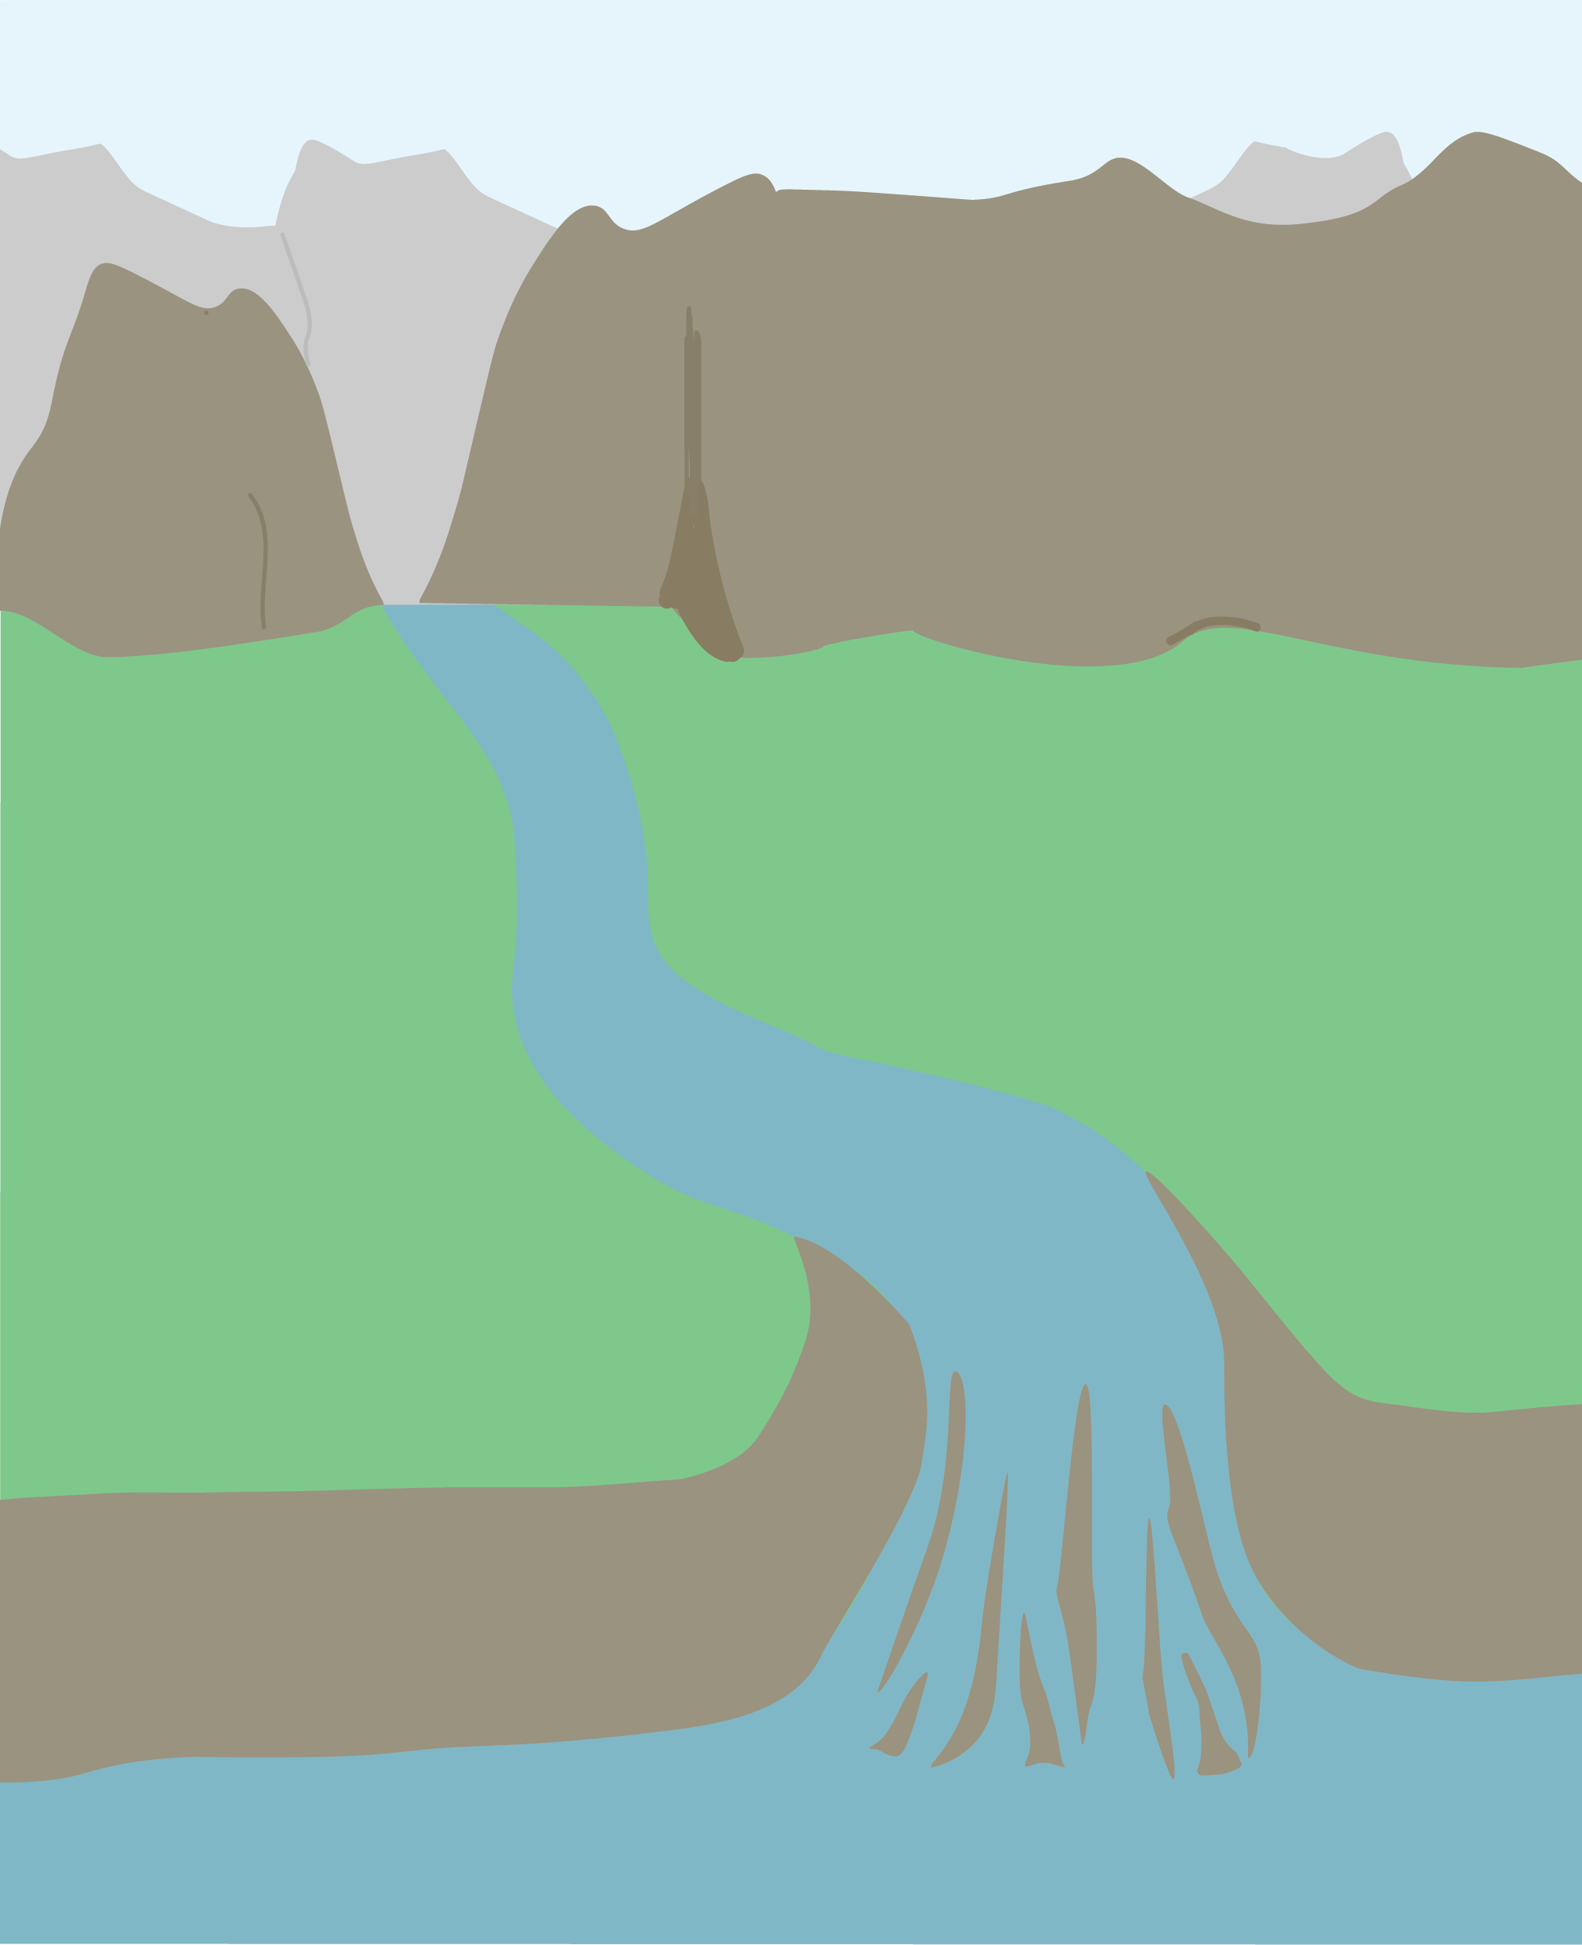
FT Q C69
Upper, Middle & Lower Course Part 2
Lower course landforms: Delta
A delta is a landform created through deposition, where fresh river water meets the sea or lake. When they meet, the energy and velocity is reduced causing the load to be deposited.
The heavier sediment is dropped first, whilst the finer sediment may be carried further into the sea or lake.
Over time, the deposited material creates a triangular
shaped fan of deposited material.
The river splits around the sediment and creates smaller rivers, known as distributaries.
Image: The Flood Hub People

Slide 14
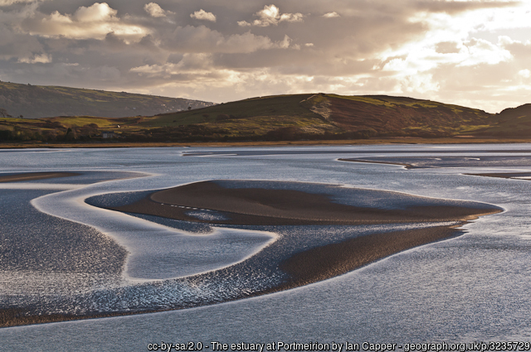
FT Q C69
Upper, Middle & Lower Course Part 2
Lower course landforms: Estuary
An estuary is a partially closed body of water where fresh water and sea water mix. It is formed where the mouth of the river meets the sea. As the river meets the sea, the velocity reduces and its energy decreases.
The river deposits the larger load first.
Low-tide and high-tide cause the deposited material to be re-distributed and the area changes consistently.

Slide 15
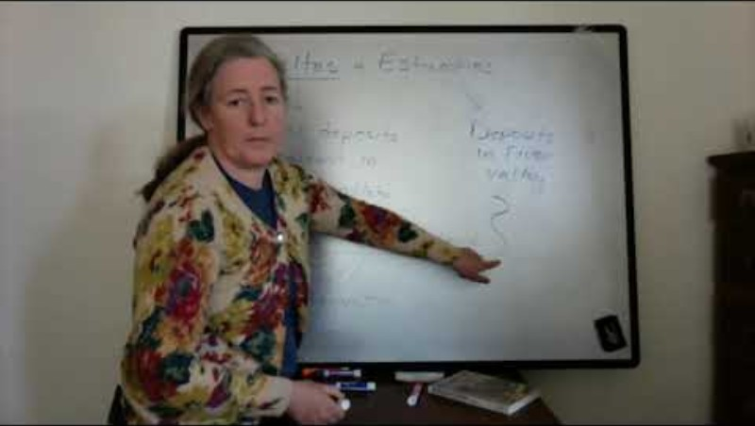
Upper, Middle & Lower Course Part 2
FT Q C69
Lower course landforms:
Watch this video which explains the difference between a delta and an estuary.

Slide 16
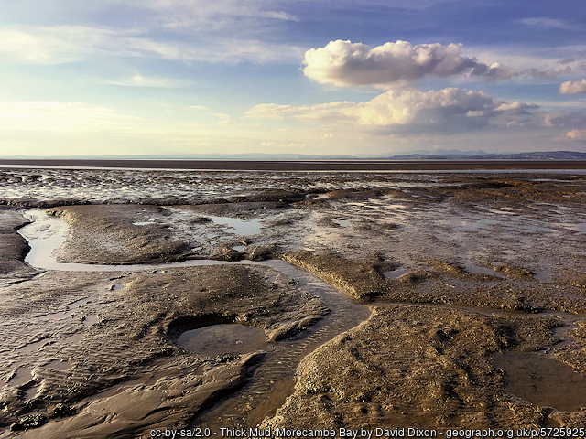
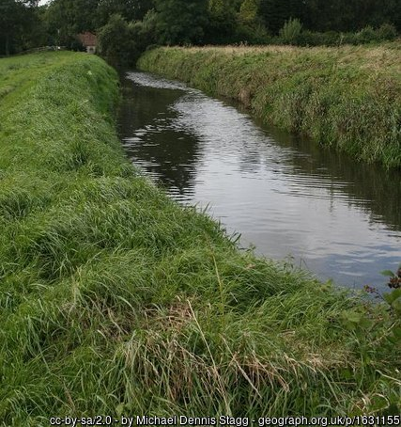
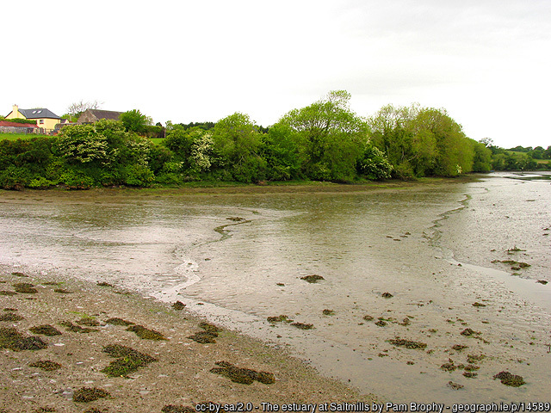
Upper, Middle & Lower Course Part 2
FT Q C69
Lower course landforms:
Can you correctly name all the landforms which can typically be found in the lower course?
Estuary
Delta
Floodplain
Levee

Slide 17
FT Q C69
Upper, Middle & Lower Course Part 2
Practice questions / Homework:
1. Draw a diagram to show the formation of a meander. (2 marks)
2. Explain the formation of a levee. You may use one or more diagrams to support your answer. (4 marks)
3. Using a catchment or river of your choice (the river Eden), explain how fluvial processes contribute to the formation of landforms found along its course. (8/9/12 marks)

Slide 18



FT Q C69
These lessons have been produced by
The Flood Hub People for The Flood Hub.
Scan the QR code to access our learning section.
Or visit here: https://thefloodhub.co.uk/learning/

