Slide 1


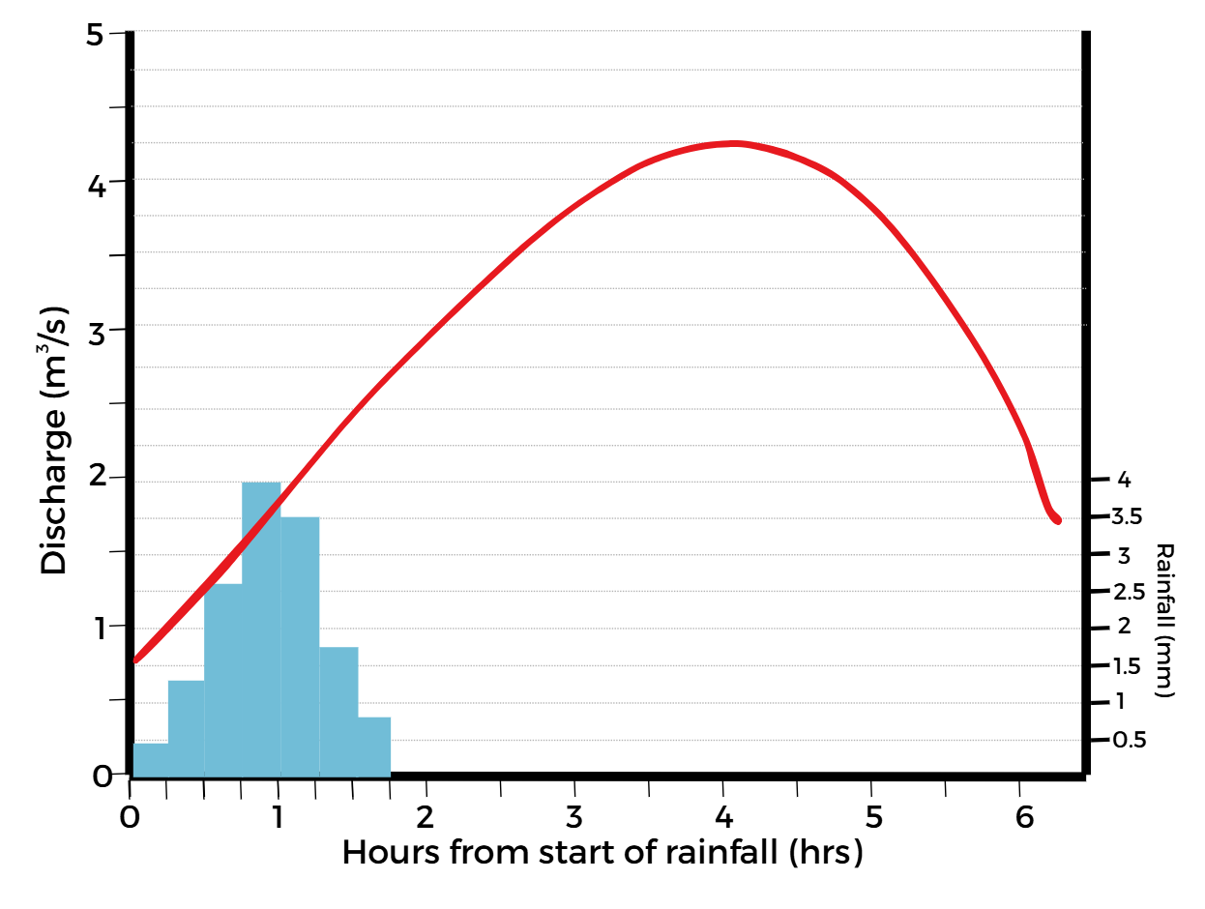
River Landscapes: Hydrographs
FT Q C71
Learning objectives:
To understand what a hydrograph is and how they are used
To be able to interpret a flood hydrograph and understand the components
Image: The Flood Hub People

Slide 2
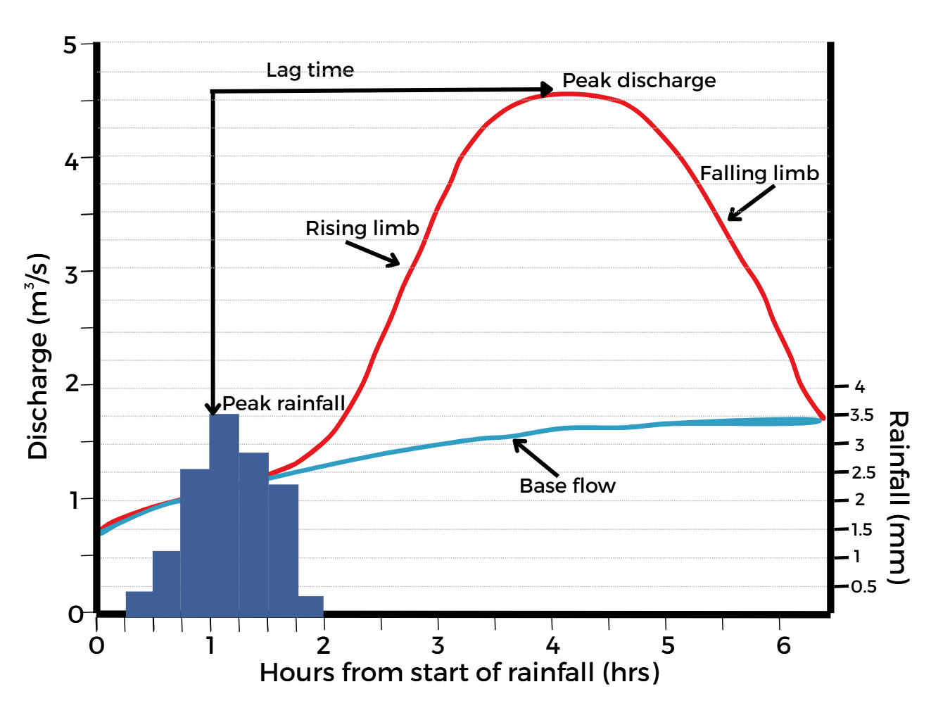
Hydrographs
FT Q C71
What is a hydrograph:
A hydrograph shows how river discharge changes in response to a period of rainfall over time. The shape of a hydrograph varies between river and storm event, and they can be used to predict flooding by showing how rivers react to precipitation.
Image: The Flood Hub People
Discharge = the volume of water flowing through a specific point in a river’s channel. (m³/s)

Slide 3
Hydrographs
FT Q C71
Hydrographs:
The X axis shows the time from the start of the rainfall (hrs)
The Y axis shows river discharge (m3/s)
A second Y axis shows the rainfall levels (mm).
Image: The Flood Hub People

Slide 4

Hydrographs
FT Q C71
Hydrograph features:
Base flow = The typical flow of the river
Image: The Flood Hub People

Slide 5

Hydrographs
FT Q C71
Hydrograph features:
Rising limb = Shows an increase in discharge after rainfall
Image: The Flood Hub People

Slide 6

Hydrographs
FT Q C71
Hydrograph features:
Peak discharge = The highest point represents the maximum discharge
Image: The Flood Hub People

Slide 7
Hydrographs
FT Q C71
Hydrograph features:
The lag time is calculated by subtracting the time which peak discharge is reached from the time when peak rainfall is reached
Lag time = The delay between peak rainfall and peak discharge
Image: The Flood Hub People

Slide 8

Hydrographs
FT Q C71
Hydrograph features:
Falling limb = Shows the decrease in discharge as normal conditions begin to return
Image: The Flood Hub People

Slide 9
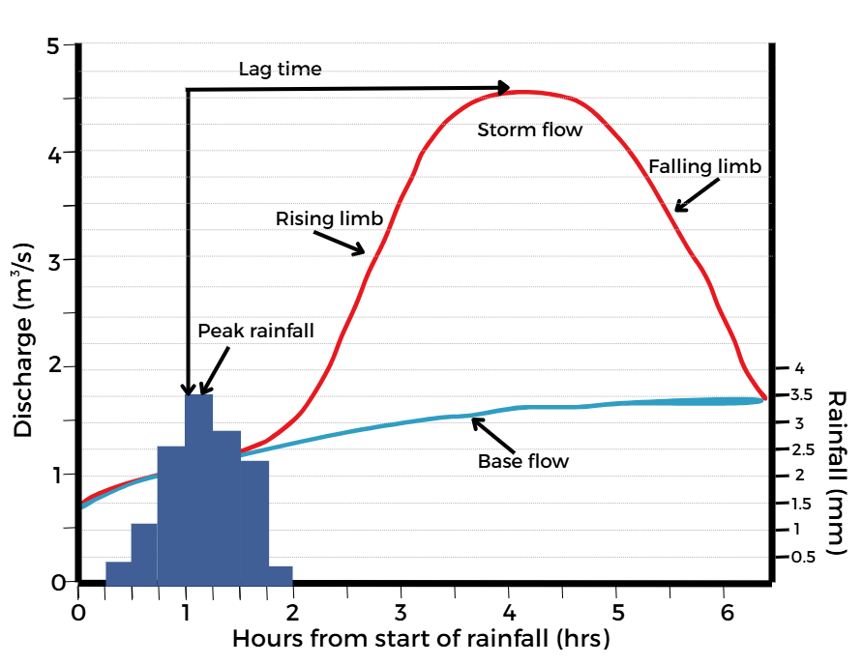
Hydrographs
FT Q C71
Hydrographs:
The shape of a hydrograph can either be
‘gentle’, or ‘flashy’ (flash flooding).
A gentle hydrograph has gentle rising and
falling limbs, a longer lag time and a low risk of flooding.
A flashy hydrograph has steep rising and falling limbs, a reduced lag time and increased risk of flooding.
Image: The Flood Hub People

Slide 10
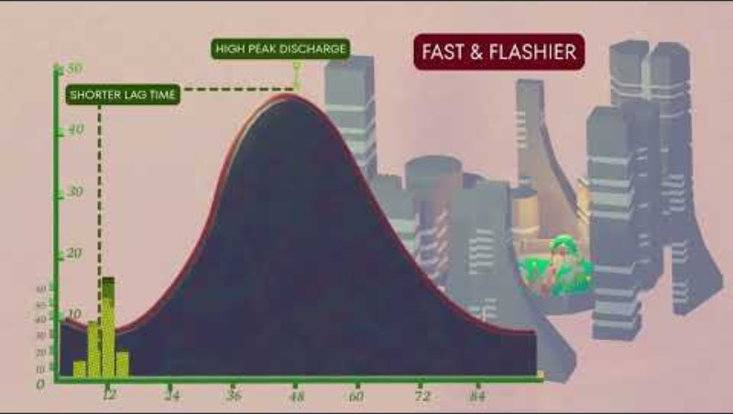
Hydrographs
FT Q C71
Interpret a hydrograph:
Watch this video which explains the features of a hydrograph, what they display and what we can interpret from them.

Slide 11
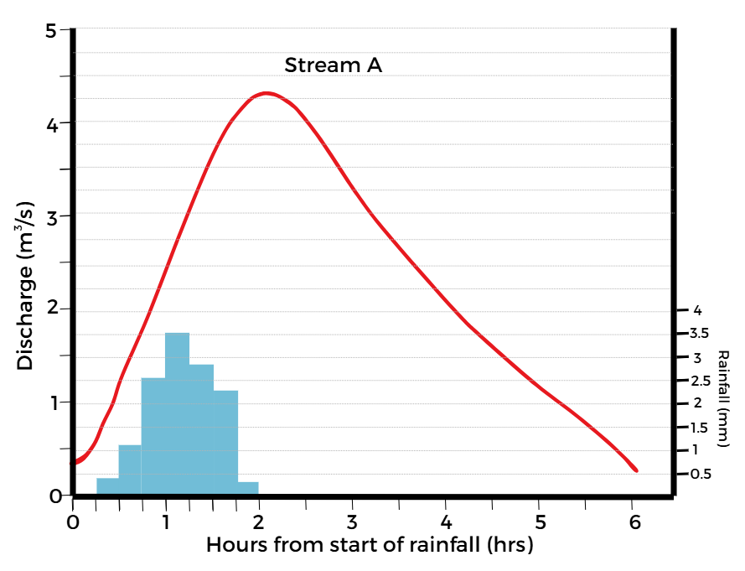
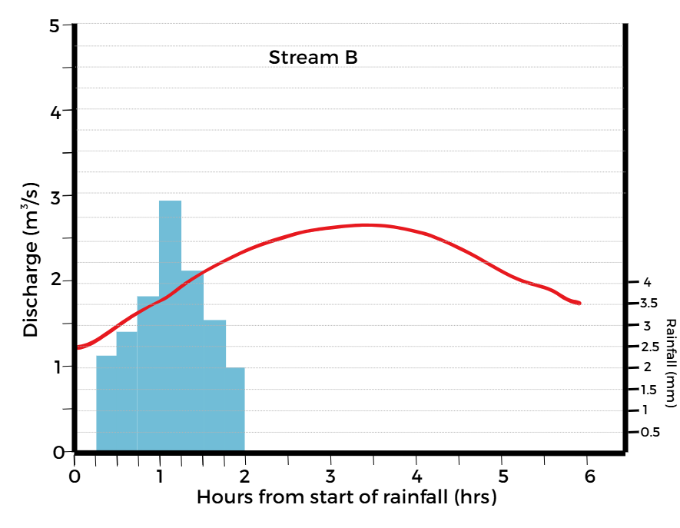
Hydrographs
FT Q C71
Interpret a hydrograph:
Study these two hydrographs from two different rivers during the same storm. What comparisons can you make?
Image: The Flood Hub People
Image: The Flood Hub People

Slide 12
Hydrographs
FT Q C71
Flashy hydrograph (stream A):
Steep rising limb = discharge is increasing rapidly
Small lag time = the rainwater reaches the river fast
Drainage basin = steep sides where water flows faster,
less distance to travel before it reaches the river
Land use = urban area with impermeable surfaces
Antecedent conditions = either dry-baked, saturated
or frozen so cannot absorb further water
Geology / Soil = Impermeable rock or clay soil with greater surface run off
Vegetation = Likely minimal, deforestation could have occurred due to a very short lag time (no interception or infiltration)
4.4cumecs
Lag time – 1hr
0.4cumecs
Image: The Flood Hub People

Slide 13
Hydrographs
FT Q C71
Gentle hydrograph (stream B):
Lag time – 3.5hrs
Shallow rising limb = discharge increasing steadily
Greater lag time = longer for rainfall to reach the
channel
Drainage basin = shallow, larger basin so water has
further to travel at a lower velocity
Land use = rural, farmland, woodlands, or permeable areas
Antecedent Conditions = normal so able to absorb plenty rainwater
Geology / Soil = permeable rocks and sandy soil which allow water to infiltrate
Vegetation = trees, grass and woodlands to intercept and infiltrate
rainwater
2.7cumecs
1.3cumecs
Image: The Flood Hub People

Slide 14
Hydrographs
FT Q C71
Practice questions / Homework:
Calculate the lag time. (1 mark)
What physical factors might influence the lag time. (2 marks)
A new housing estate is being built on a floodplain. Explain how this will change the shape of the hydrograph. (4 marks)
Figure 1
Image: The Flood Hub People

Slide 15



FT Q C71
These lessons have been produced by
The Flood Hub People for The Flood Hub.
Scan the QR code to access our learning section.
Or visit here: https://thefloodhub.co.uk/learning/

