Slide 1

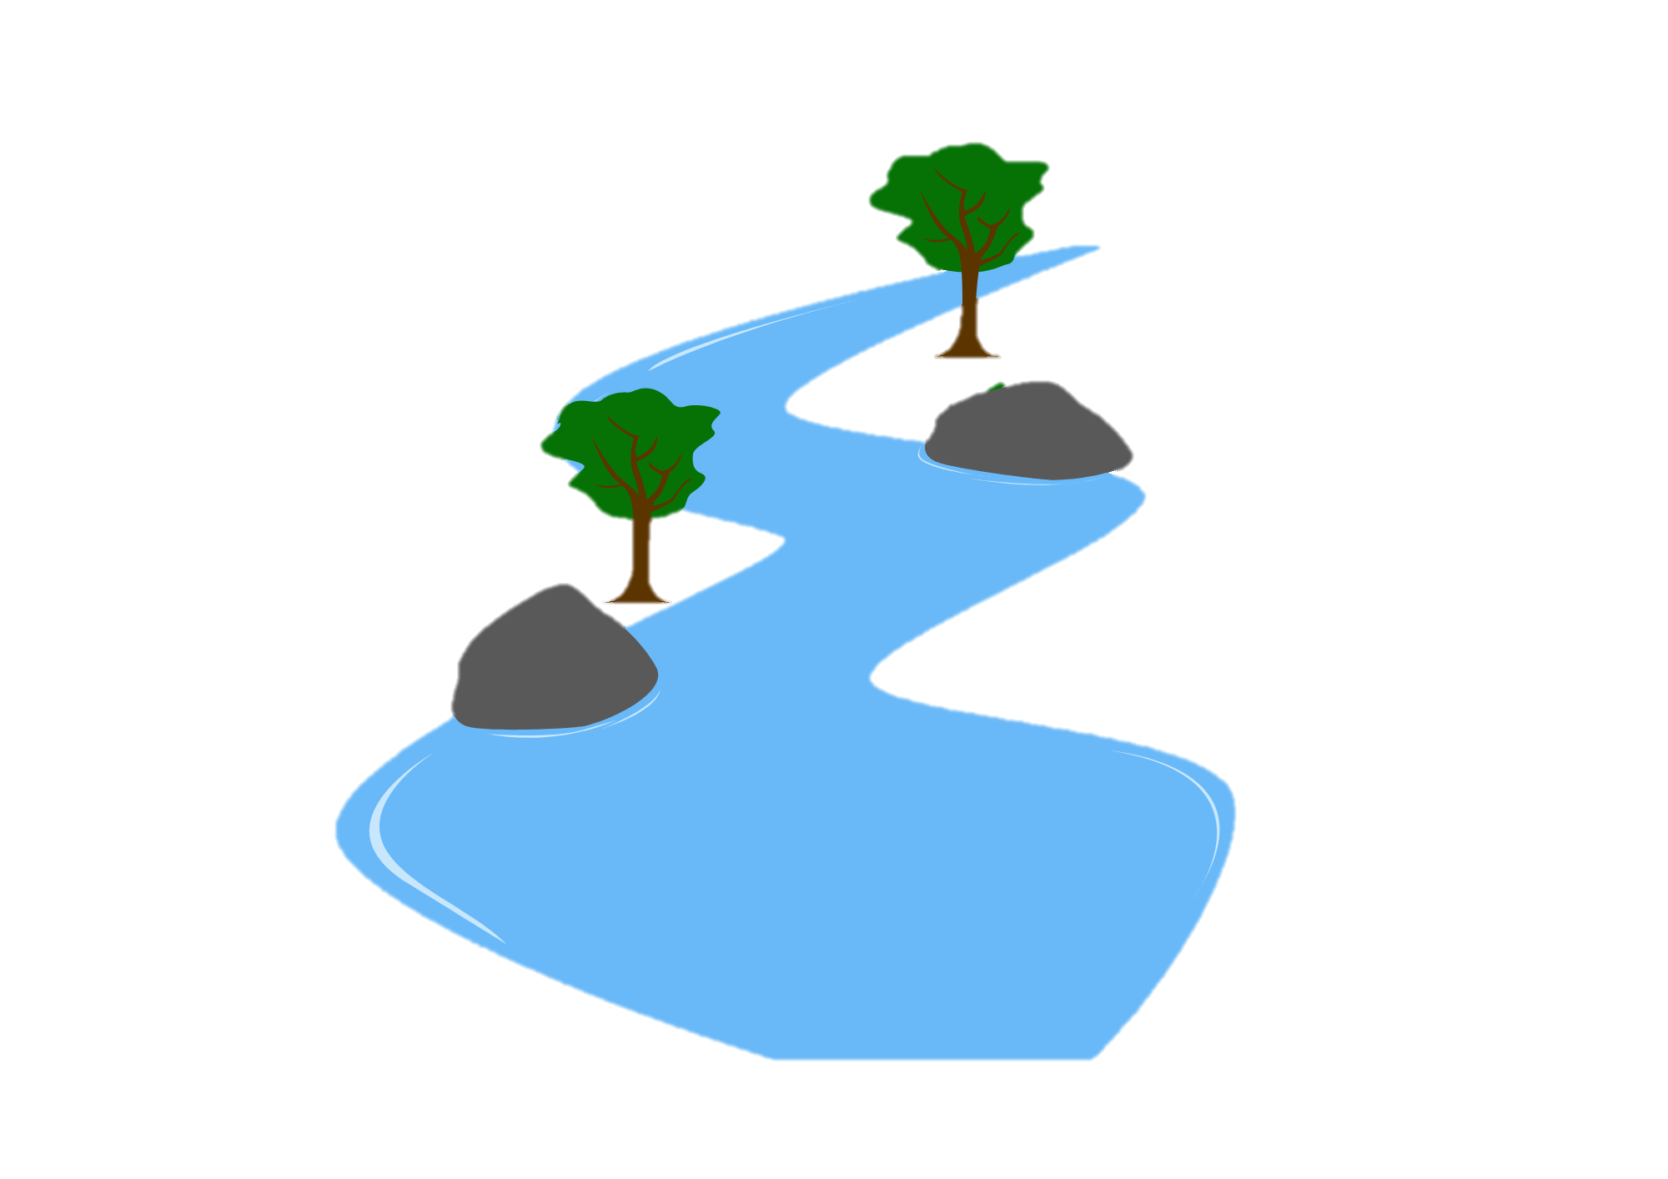
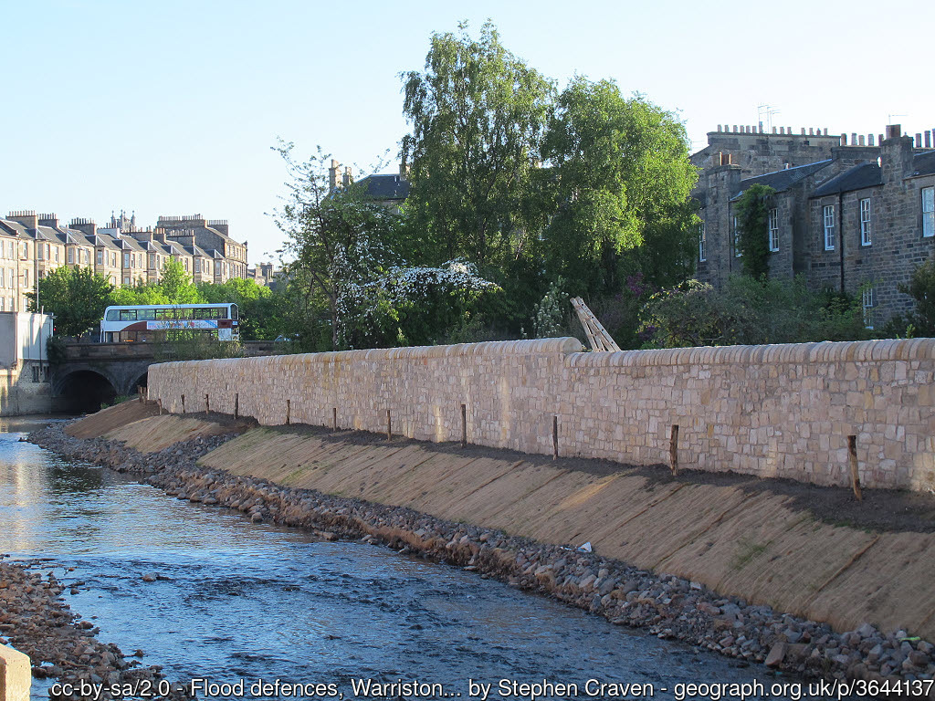
River Landscapes: Flooding Management
FT Q C72
Learning objectives:
Define soft and hard engineering and explain examples of these techniques and strategies
Explain the advantages and disadvantages of each technique and strategy

Slide 2











Flooding Management
FT Q C72
Recap activity:
In partners, identify which factors below can increase or decrease flood risk.
Antecedent conditions
(previous weather / soil moisture)
Urbanisation
Flood schemes
Land use
Vegetation
Afforestation or deforestation
Geology
Relief / slope
Drainage basin
Channel straightening
Precipitation

Slide 3
Flooding Management
FT Q C72
River management:
Floods can be devastating, however there are several management measures which help manage the risk. These are categorised under the following headings:
Hard engineering –
Soft engineering –
man-made, artificial structures built to control the flow or rivers and manage flood risk.
natural, sustainable processes and knowledge of river systems to manage the impacts of flooding.

Slide 4
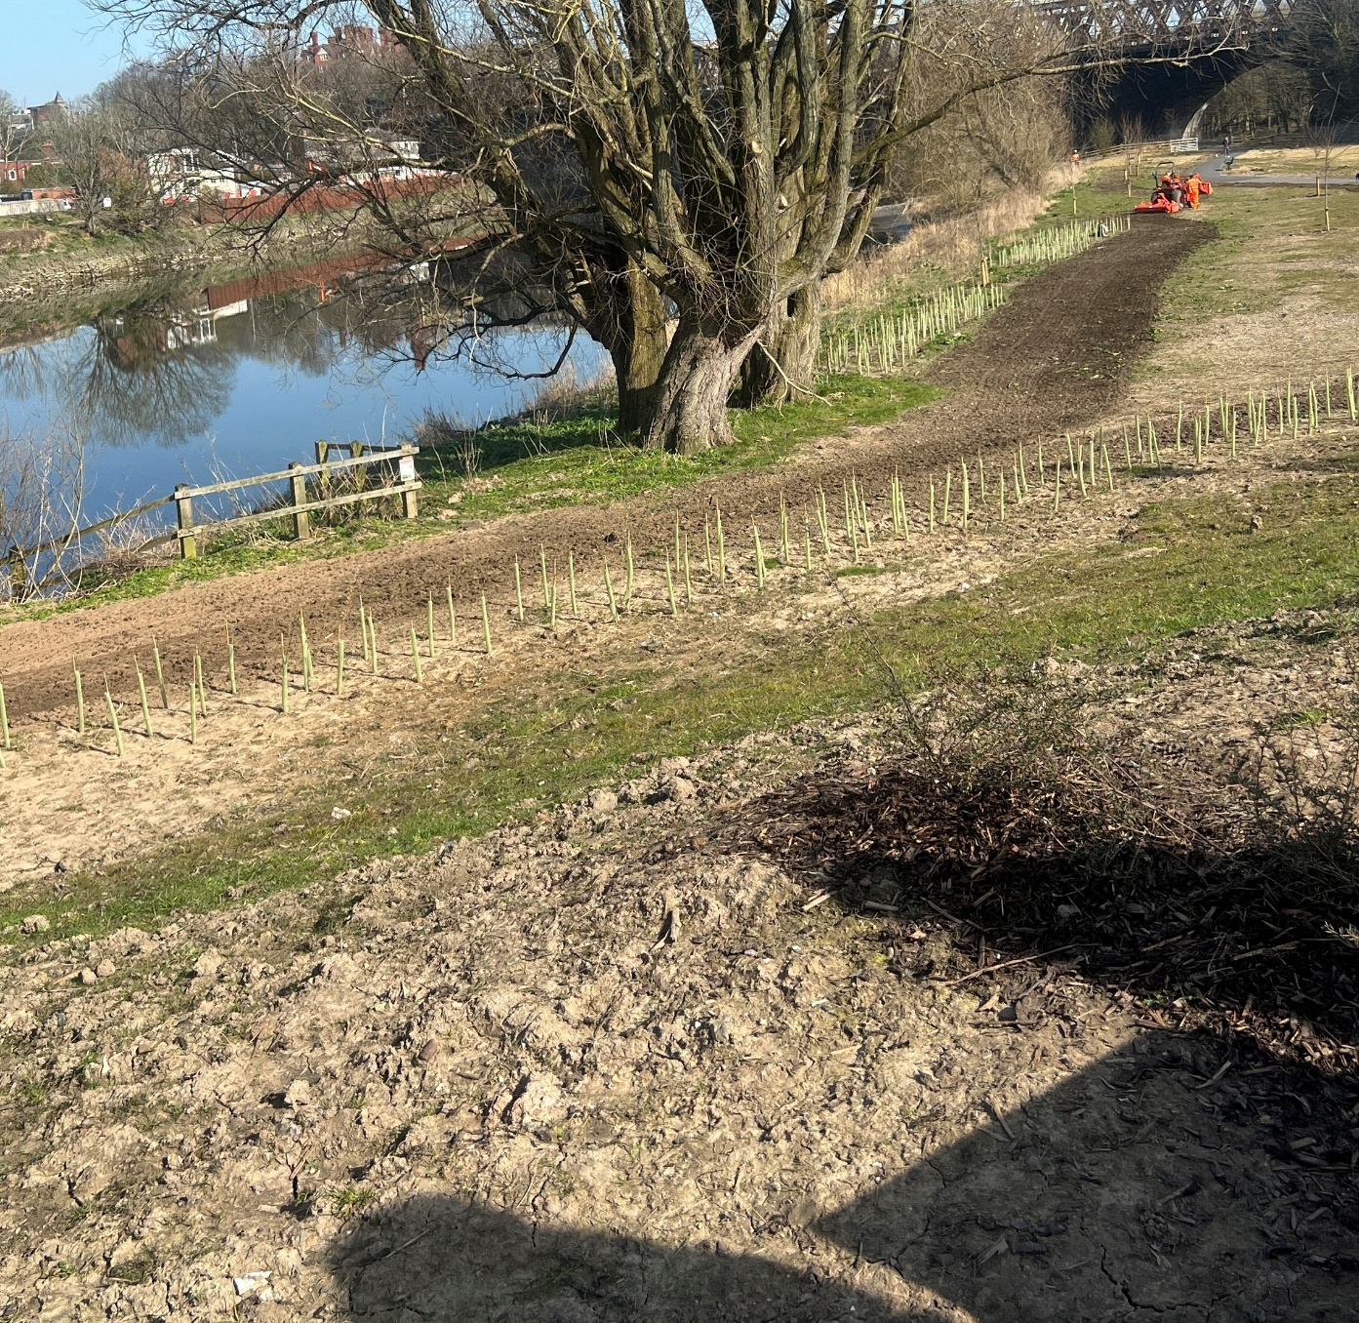

Flooding Management
FT Q C72
River management:
Using the definitions for hard and soft engineering,
can you correctly identify which of these images show hard engineering and which shows soft engineering practices.
Soft engineering
Hard engineering
Tree planting
Flood wall
Image: The Flood Hub People
Image: The Flood Hub

Slide 5
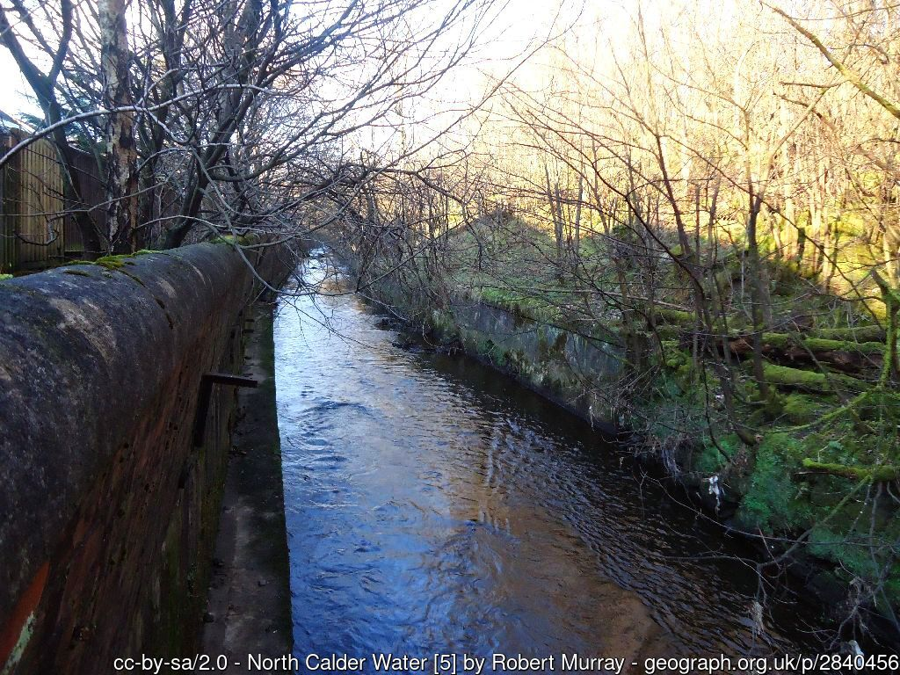
Flooding Management
FT Q C72
Hard engineering:
Hard engineering involves building man-made, artificial structures as a defence against flooding. Examples are:
flood walls which holds back water,
widening or deepening the river channel to increase capacity,
or building embankments to prevent overtopping.
Flood Walls

Slide 6
Flooding Management
FT Q C72
Hard engineering: Advantages & disadvantages
Can you correctly identify which of these are an advantage and which are a disadvantage for hard engineering?
Intrusive on the landscape
Timely to build
Intrusive on the landscape
Timely to build
Dams can be used to generate hydro-electric power
Dams can be used to generate hydro-electric power
Artificial structures
Artificial structures
Visually unattractive
Visually unattractive
Expensive
Expensive
Disruption to people during construction
Disruption to people during construction
Once built, immediate effect
Once built, immediate effect
Protects valuable land
Protects valuable land

Slide 7
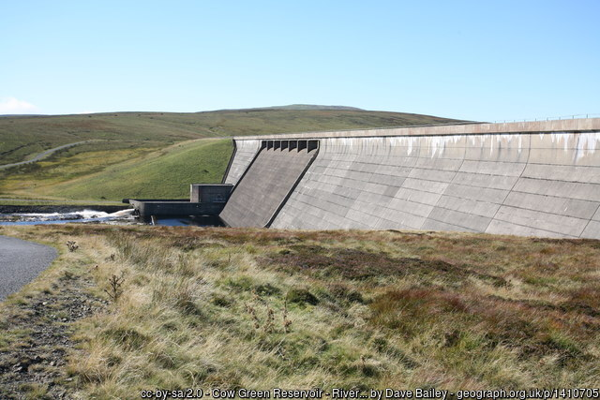
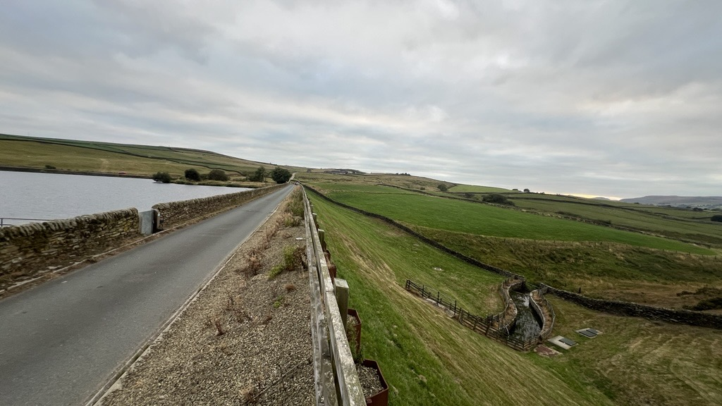
Flooding Management
FT Q C72
Hard engineering: Dams & reservoirs
About | Advantages | Disadvantages
Dams are barriers built across the rivers. Behind the barrier, a reservoir is formed which holds the water | Can generate hydro-electric power Reservoirs create greenspace for the community and tourists Create habitats for wildlife | Very expensive The reservoir could flood nearby communities Displacement of people to build them
Large volume of water held behind the dam
Controlled release of water from reservoir
Image: The Flood Hub People

Slide 8
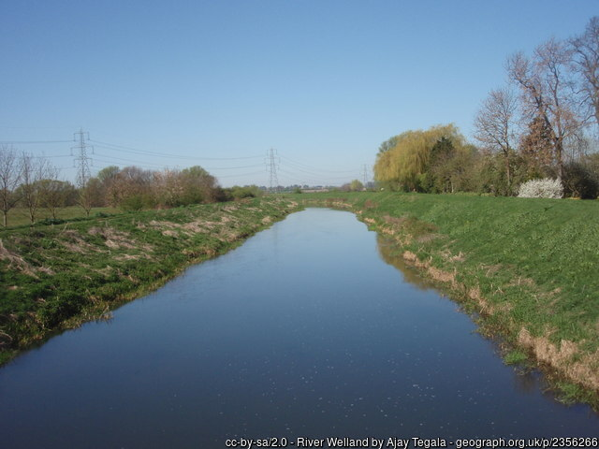
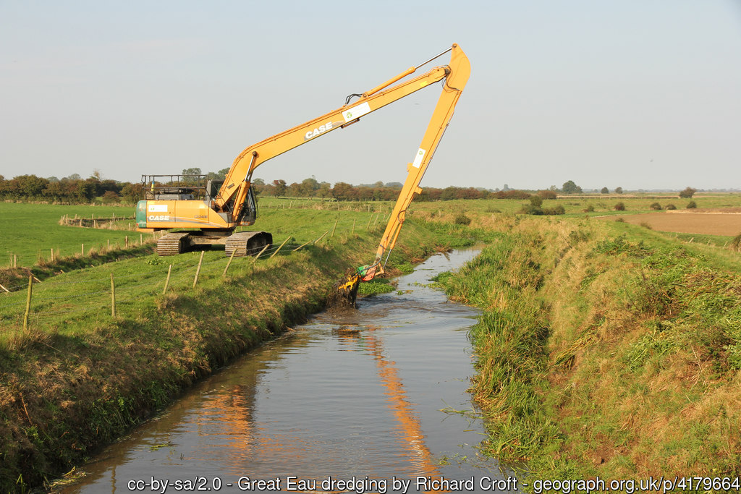
Flooding Management
FT Q C72
Hard engineering: Straightening & dredging
About | Advantages | Disadvantages
Meanders are removed and replaced with artificial straight channels. Dredging involves the removal of sediment on the riverbed and banks. | Increases river capacity Works well in urban areas Water passes through catchment faster | Needs to be repeated frequently Can speed up velocity which increases flood risk and erosion May flood downstream communities They can disturb habitats
Very straight channel with little vegetation (roughness) so water flows through fast.
Riverbanks and bed are scraped of deposited sediment to increase channel capacity

Slide 9
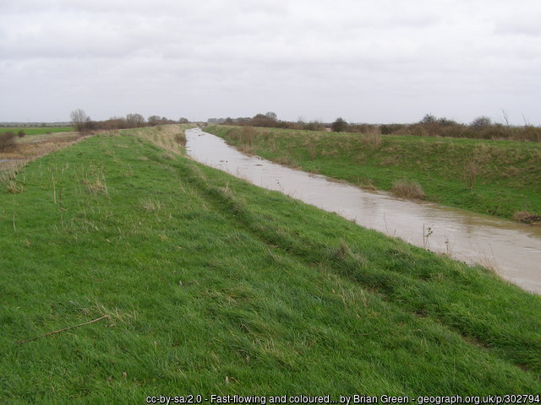
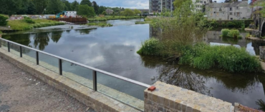
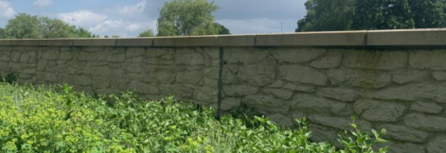
Flooding Management
FT Q C72
Hard engineering: Embankments & flood walls
About | Advantages | Disadvantages
Embankments are earth-filled structures, commonly covered with vegetation. Flood walls are commonly concrete, metal, or timber and can either be on the riverbank, or set back between a channel and urban area. | Keeps water contained within the channel Embankments look natural Flood walls can feature glass panels and artwork printed into concrete | Can speed up velocity which increases flood risk Very expensive and timely to build
Raised embankment increases height of banks so river can hold more water and reduce risk of overtopping
Flood wall made of concrete and glass separates channel from the town
Image: Environment Agency

Slide 10
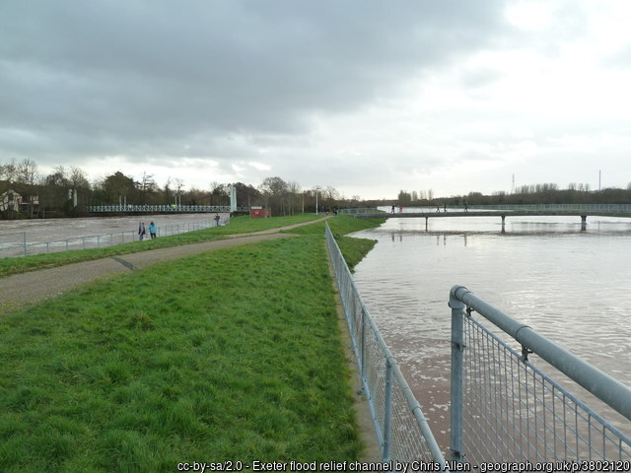
Flooding Management
FT Q C72
Hard engineering: Flood relief channels
About | Advantages | Disadvantages
Floodwater flows into a channel and is taken to an area where it can be stored, infiltrated or diverted further down course. | Removes excess water from the channel Adding gates on the channel can control the release of water | Increased discharge where the relief channel rejoins the river which could cause flooding downstream
River channel at risk of flooding nearby community
Flood relief channel where excess water can be sent to and stored before being released slowly after flood conditions have subsided

Slide 11
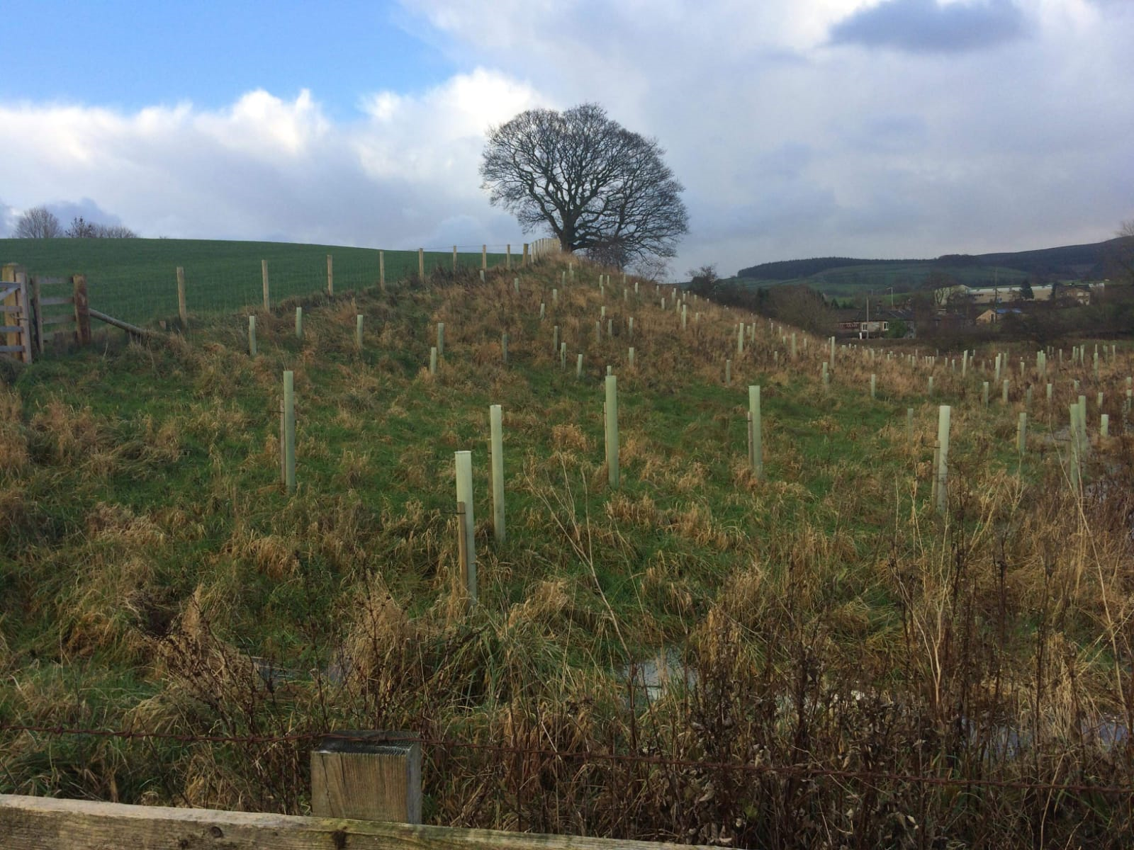
Flooding Management
FT Q C72
Soft engineering:
Soft engineering strategies aim to reduce the effect of flooding using our knowledge of river systems. Examples are:
warning and informing to raise awareness and increase preparedness
tree planting to slow the flow and increase infiltration
river restoration to reconnect the river with its floodplain as it once was
Image: The Flood Hub People

Slide 12
Flooding Management
FT Q C72
Soft engineering: Advantages & disadvantages
Can you correctly identify which of these are an advantage and which are a disadvantage for soft engineering?
Preserves the natural floodplain
Working with the river landscape
Preserves the natural floodplain
Working with the river landscape
Can be slow to take effect
Can be slow to take effect
Restricts the growth of nearby development
Restricts the growth of nearby development
Maintenance can be expensive
Maintenance can be expensive
May not be suitable in urban areas
May not be suitable in urban areas
Creates natural habitats for wildlife
Creates natural habitats for wildlife
Inexpensive to build
Inexpensive to build

Slide 13
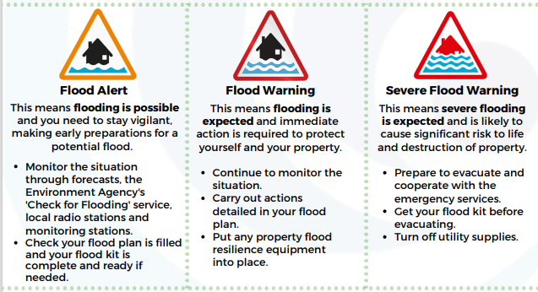
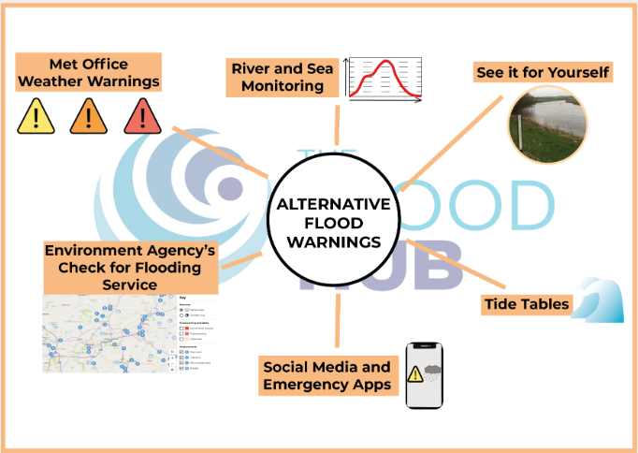
Flooding Management
FT Q C72
Soft engineering strategy: Warning & informing
About | Advantages | Disadvantages
The Environment Agency (EA) sends flood alerts, warnings or severe flood warning when sea or river levels rise above the average. The Met Office Severe Weather Warnings send alerts to mobiles, tv and radio stations before bad weather is forecast | Gives people time to action their flood plan before a flood occurs which may include: Property Flood Resilience measures (PFR) Moving valuables or vehicles Evacuating Collecting flood kit | Warnings can’t stop the flood happening People may not have access to the warning PFR can be expensive to install
Download this resource here: Alternative Flood Warnings
Download this resource here: Flood Warnings

Slide 14
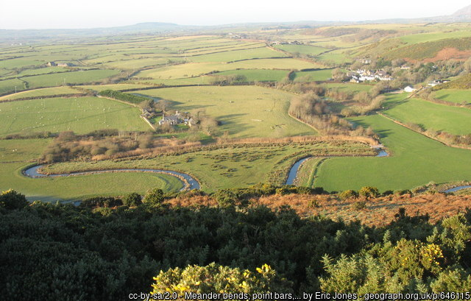
Flooding Management
FT Q C72
Soft engineering strategy: Floodplain zoning
About | Advantages | Disadvantages
A planning strategy that restricts development on land which is most likely to flood according to risk. It involves storing water away from developed areas to reduce flood risk. | Fewer impermeable surfaces so reduced run off and increased infiltration Any impact of flooding is reduced as there is no infrastructure to damage | Expansion of urban area is limited Doesn’t help existing buildings
Minimal development on floodplains surrounding river

Slide 15
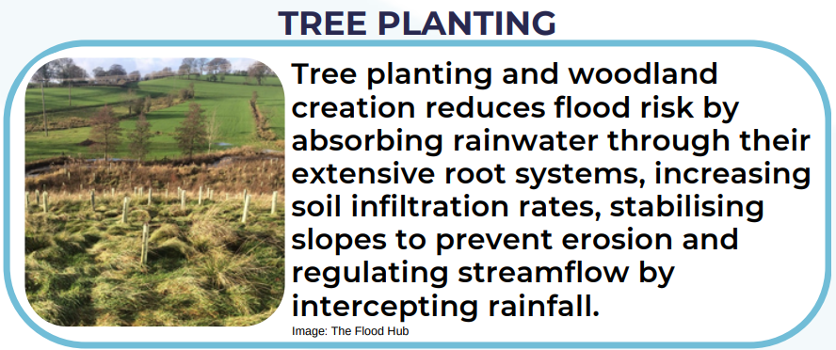
Flooding Management
FT Q C72
Soft engineering: Tree planting
About | Advantages | Disadvantages
Tree planting increases the lag time during flood conditions. Leaves and branches intercept rainwater, roots uptake water and the friction of trees slows the flow. | Absorbs CO2 so air quality is improved Increases biodiversity and natural habitats | Less land available for urban development Can be timely before completed Loss of grazing land for farming
Trees during early growth stage. It can take several years for a planted woodland to become established
Image: The Flood Hub People

Slide 16
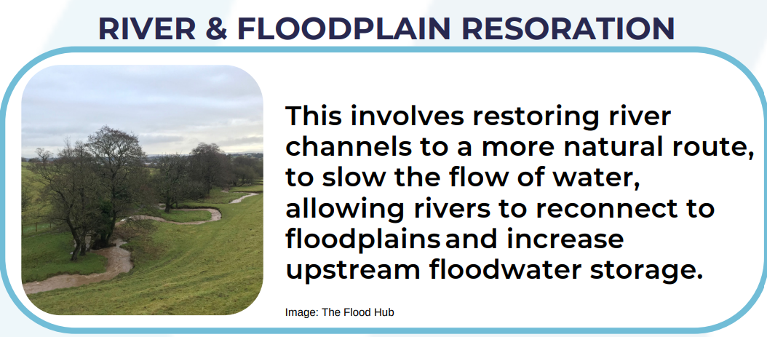
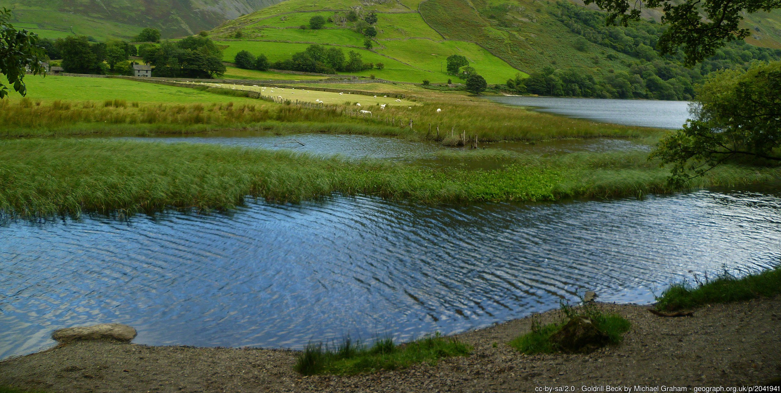
Flooding Management
FT Q C72
Soft engineering: River restoration
About | Advantages | Disadvantages
Removing any artificial or hard engineering structures to return the river to a natural state. Allows the river to reconnect with the floodplain and overtop the banks during flood conditions | Creates new wetland habitats Increased water storage and reduced velocity Visually attractive and creates a green space for the community | Less land available for development Can be timely before full effects are seen Can be expensive to remove old hard engineering structures
A ‘re-wiggled’ river with natural meanders which slow the flow as the water passes through

Slide 17
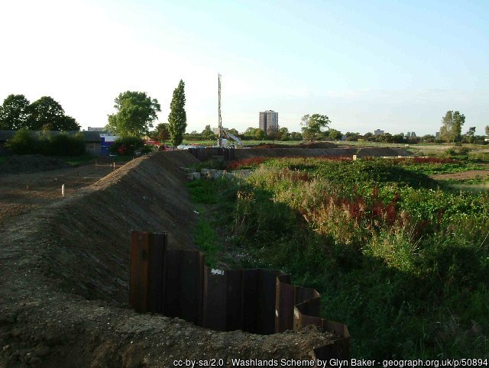
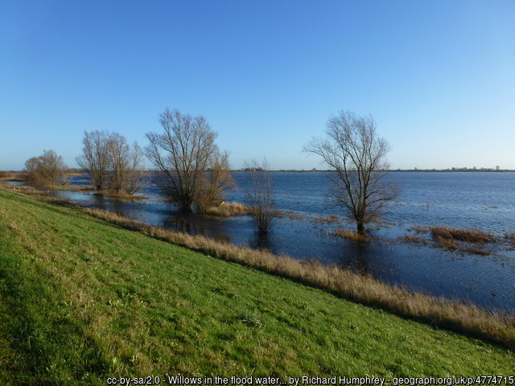
Flooding Management
FT Q C72
Soft engineering: Washlands
About | Advantages | Disadvantages
Leaving some areas deliberately open to flood. They are found in the lower course and often rural land. During normal conditions, the storage area can create a recreational space for the community. | Creates new habitats Increased water storage and reduces discharge Visually attractive and creates a green space for the community | Reduces land available for development or farming Expensive to maintain Less effective at stopping significant flood events
Trees can be flooded temporarily and recover once the floodwater has receded.

Slide 18
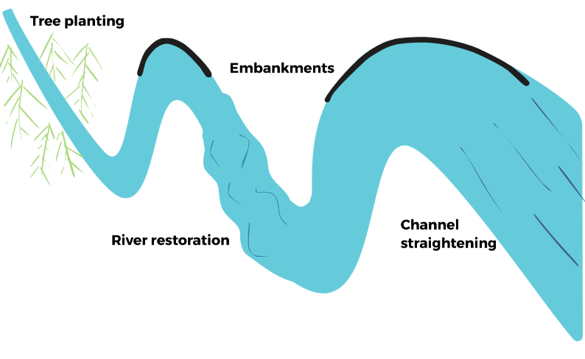
Flooding Management
FT Q C72
Practice questions / Homework:
Using Figure 1, give one advantage of using tree planting to protect a community from flooding. (1 mark)
Explain how river restoration can be used to manage the risk of flooding. (2 marks)
Figure 1

Slide 19
Flooding Management
FT Q C72
Practice questions / Homework:
Using Figure 1, identify and explain one hard engineering strategy and one soft engineering strategy being used to manage flooding. (4 marks)
“Hard engineering strategies, such as channel straightening, are the best way to reduce flood risk”. To what extent do you agree with this statement? (8/9/12 marks)

Slide 20
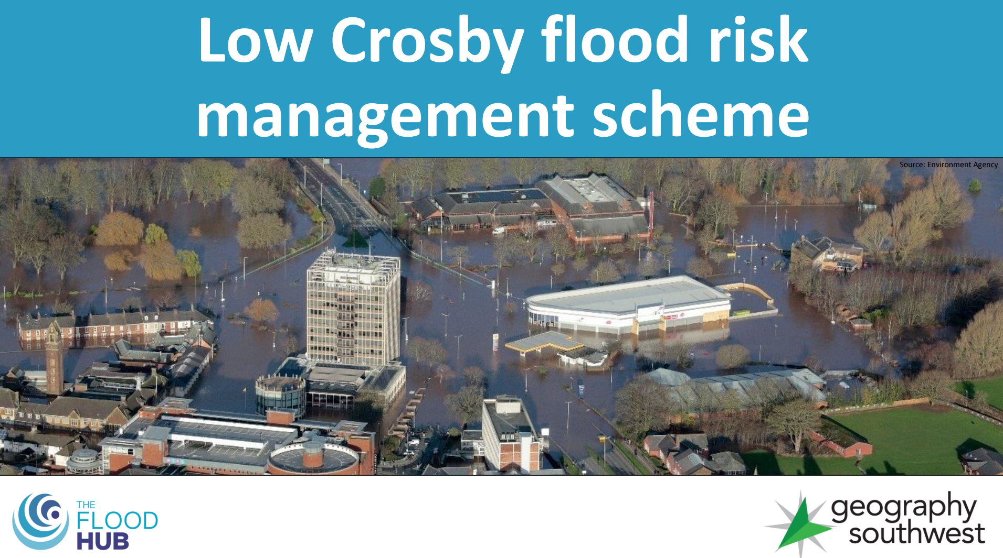
Flooding Management
FT Q C72
Case study: Low Crosby
Open the Low Crosby Flood Risk Management Scheme lesson 4 from the River Flood Management GCSE case study: Low Crosby, Cumbria package on The Flood Hub here: Low Crosby Flood Risk Management Scheme

Slide 21



FT Q C72
These lessons have been produced by
The Flood Hub People for The Flood Hub.
Scan the QR code to access our learning section.
Or visit here: https://thefloodhub.co.uk/learning/

