Slide 1


FT Q C49 R2
Introduction to Weather
Learning Objectives:
Define weather and identify different weather types.
List and describe basic instruments used to measure weather.
Understand the importance and creation of weather forecasts.
Demonstrate how to read a simple weather graph showing temperature and precipitation.

Slide 2
FT Q C49 R2
Introduction to Weather
Starter:
Discuss with your neighbour...
How does it compare to yesterdays weather?
What weather are we experiencing today?

Slide 3
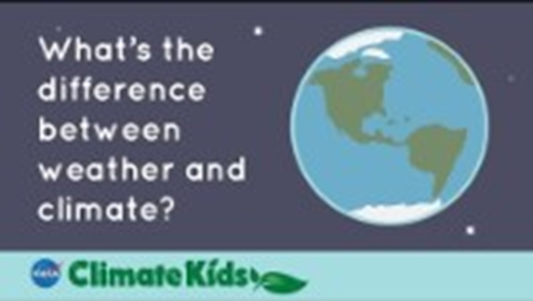
FT Q C49 R2
Introduction to Weather

Slide 4
FT Q C49
Introduction to Weather
WEATHER
Weather refers to the day-to-day changes in the atmosphere. It is a description of what the conditions are like in a particular place, such as hot or cold, wet or dry, windy or calm, or stormy with thunder and lightning.
We can measure atmospheric conditions, such as air pressure and wind direction, to create weather forecasts.

Slide 5

FT Q C49 R2
Introduction to Weather
TEMPERATURE
Temperature is a measure of how hot or cold something is. It tells us how much heat energy is in an object, substance, or environment.
We use units like degrees Celsius (°C) or degrees Fahrenheit (°F) to measure temperature. A thermometer is a tool used to measure temperature.
Temperature records in Britain
Highest: Coningsby, Lincolnshire hit 40.3°C in July 2022.
Lowest: Altnaharra, Scotland reached -27.2°C in December 1995.

Slide 6
FT Q C49
Introduction to Weather
TEMPERATURE
Factors Affecting Temperature:
Sunlight: More sunlight = higher temperatures.
Time of Day: Warmer in the afternoon, cooler in the morning and evening.
Season: Summer is warmer, winter is cooler.
Location: Near the equator is warmer, near the poles is cooler.
Altitude: Higher places are cooler.
Weather: Clouds block sunlight (cooler), clear skies let sunlight in (warmer).
Surroundings: Cities are warmer than the countryside (urban heat island effect).

Slide 7
FT Q C49 R2
Introduction to Weather
PRECIPITATION
Precipitation refers to any form of water (such as rain, snow, sleet, or hail), that falls from the atmosphere to the Earth's surface. Precipitation is measured using instruments such as rain gauges and snow gauges in millimetres (mm) or even metres per hour, day, month or year.
The highest recorded rainfall in a 24-hour period in Britain is 341.4 millimetres (13.44 inches), which occurred at Honister Pass, Cumbria, on 5 December 2015.

Slide 8

FT Q C49 R2
Introduction to Weather
WIND
Wind speed is how fast the air moves past a certain spot. It is measured using an anemometer, which has cups or blades that spin in the wind. The faster they spin, the stronger the wind. Wind speed is measured in miles per hour (mph).
Wind direction is measured using a weather vane, which has compass points and an arrow that aligns with the blowing wind. By observing the arrow's position, we can determine which direction the wind is coming from.
The official highest recorded wind speed in Britain is a gust of 173 mph (278 km/h), measured at Cairn Gorm Summit in Scotland on 20 March 1986.

Slide 9
FT Q C49 R2
Introduction to Weather
AIR PRESSURE
Air pressure is like the weight of the air pressing down on us from above. The device used to measure air pressure in millibars (mb) is called a barometer.
Low pressure means the air is rising, which typically leads to cloudy skies and rainfall.
High pressure means the air is falling. This often brings clear skies and dry weather.

Slide 10

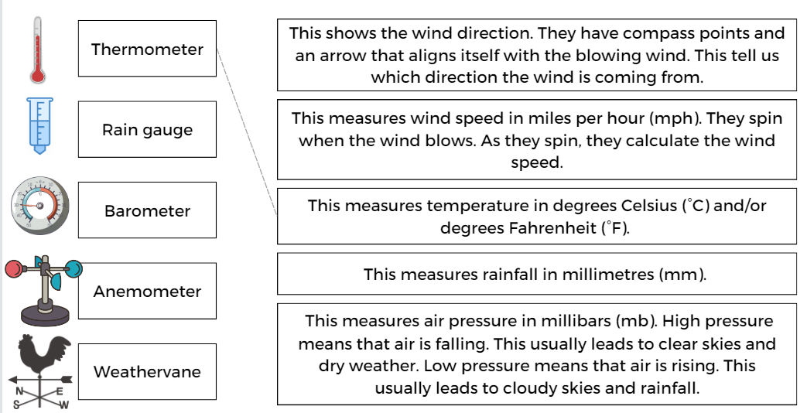
FT Q C49 R2
Introduction to Weather
HOW DO WE MEASURE WEATHER?
TASK:
Using your worksheet. Match up the instruments for measuring weather with their function.

Slide 11
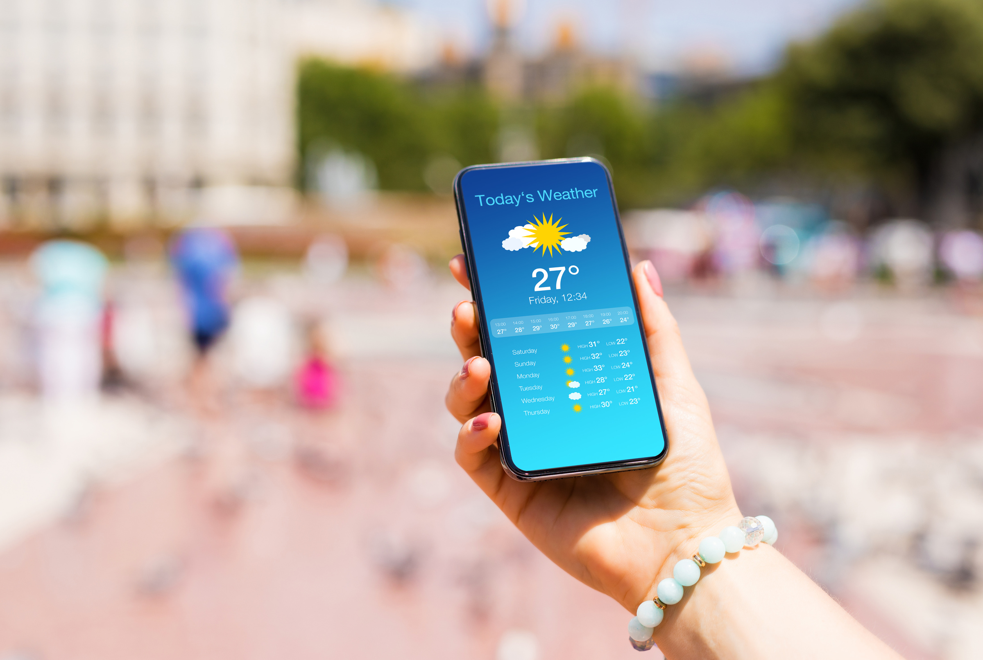
FT Q C49 R2
Introduction to Weather
WEATHER FORECASTING
Weather forecasts are predictions about what the weather is likely to be in the upcoming days and weeks.
THINK...
Why is it important to have weather forecasting?
Woman Checking Weather in Her Smartphone by Kaspars Grinvalds

Slide 12

FT Q C49 R2
Introduction to Weather
WEATHER FORECASTING
It's important we have weather forecasts because they help us plan our daily activities, stay safe during extreme weather and allow various industries to operate efficiently.
TASK:
List some activities and occupations which you would check the weather forecast for...

Slide 13
FT Q C49 R2
Introduction to Weather
HOW ARE WEATHER FORECASTS MADE?
Weather forecasts are made by gathering information from....
Ground Level: Weather stations across the UK collect data on temperature, humidity, wind speed and air pressure.
Aeroplanes: Special instruments on planes measure weather conditions at different altitudes.
Radar: Radar systems track rain, snow, and storms by bouncing radio waves off precipitation.
Satellites: Satellites in space take pictures of clouds and track large weather systems from above.
Weather Buoys: Floating devices in the sea measure water temperature and wave height.
Meteorologists, who are scientists that study weather, analyse this data and use powerful computers to predict what the weather will be like in the future. They look at patterns in the data and use computer models to simulate the atmosphere.
Based on this, they create weather forecasts and keep updating them as new information comes in to make sure the predictions are accurate.

Slide 14
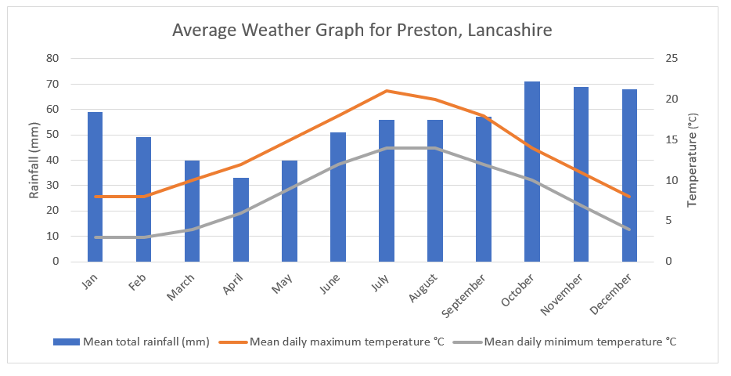
FT Q C49 R2
Introduction to Weather
WEATHER GRAPHS
Meteorologists use weather records to draw graphs showing the average weather for a specific location. These graphs typically display temperature and precipitation over a year.

Slide 15
FT Q C49 R2
Introduction to Weather
TASK:
Take a look at your worksheet. Use it to help you answer the questions about the graph.

Slide 16
FT Q C49 R2
Introduction to Weather
TASK:
Which month had the least amount of precipitation?

Slide 17
FT Q C49 R2
Introduction to Weather
TASK:
Which month had the highest mean temperature?

Slide 18
FT Q C49 R2
Introduction to Weather
TASK:
What was the average rainfall for October?

Slide 19
FT Q C49 R2
Introduction to Weather
WEATHER SYMBOLS
Weather symbols are used to represent different weather conditions on maps and forecasts, helping people quickly understand and anticipate upcoming weather patterns.

Slide 20
FT Q C49 R2
Introduction to Weather
WEATHER SYMBOLS
Weather symbols are used to represent different weather conditions on maps and forecasts, helping people quickly understand and anticipate upcoming weather patterns.

Slide 21
FT Q C49 R2
Introduction to Weather
WEATHER SYMBOLS
Task: Match the weather symbol with the correct type of weather:
1.
2.
3.
4.
5.
6.
7.
8.
9.
10.
A. Heavy rainfall B. Sunshine C. Snow D. Overcast E. Thunderstorms F. Occasional sunshine and light showers G. Sunshine and cloud H. Light cloud cover I. Hail J. Light rainfall

Slide 22
FT Q C49 R2
Introduction to Weather
WEATHER SYMBOLS
1.
2.
3.
4.
5.
B. Sunshine
G. Sunshine and cloud
J. Light rainfall
A. Heavy rainfall
I. Hail
6.
7.
8.
9.
10.
H. Light cloud cover
D. Overcast
F. Occasional sunshine and light showers
C. Snow
E. Thunderstorms

Slide 23
FT Q C49 R2
Introduction to Weather
PLENARY:
Before next lesson, have a think about...
Any extreme weather events you've heard about or experienced in the UK.
How do these events differ from regular weather, and what impact do they have on people and communities?

Slide 24
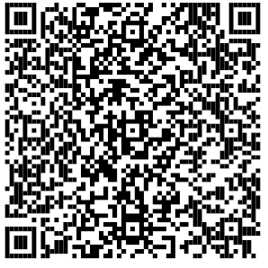
FT Q C49 R2
Introduction to Weather
These lessons have been produced by The Flood Hub People for The Flood Hub.
Scan the QR code to access our Learning section. Or visit here: https://thefloodhub.co.uk/learning/

